Slide 1
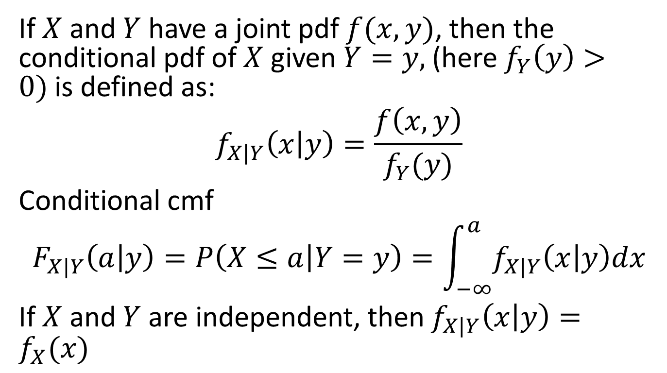
Section 6.5 Conditional distributions Continuous Case
If $X$ and $Y$ have a joint pdf $f(x,y)$, then the conditional pdf of $X$ given $Y=y,$ (here $f_{Y}\left(y\right)>0)$is defined as:
$$f_{X|Y}\left(x | y\right)=\frac{f\left(x,y\right)}{f_{Y}(y)}$$
Conditional cmf
$$F_{X|Y}\left(a | y\right)=P\left(X≤a | Y=y\right)=\int_{−∞}^{a}{f_{X|Y}\left(x | y\right)dx}$$
If $X$ and $Y$ are independent, then $f_{X|Y}\left(x | y\right)=f_{X}(x)$

Slide 2
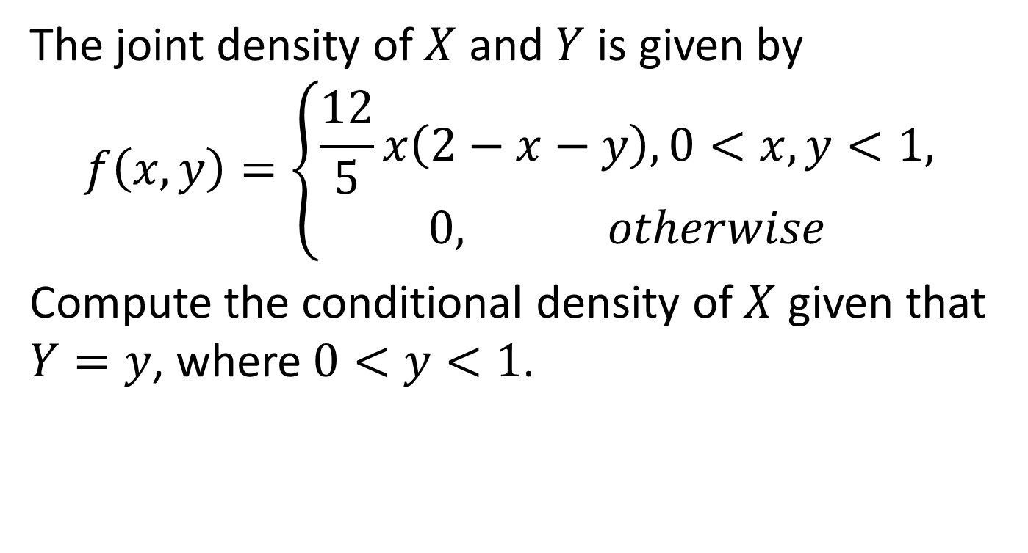
Example 1
The joint density of $X$ and $Y$ is given by
$$f\left(x,y\right)=\left\{\begin{aligned}\frac{12}{5}x\left(2−x−y\right), 0<x,y<1, \\ 0, otherwise \end{aligned}\right.$$
Compute the conditional density of $X$ given that $Y=y$, where $0<y<1$.

Slide 3
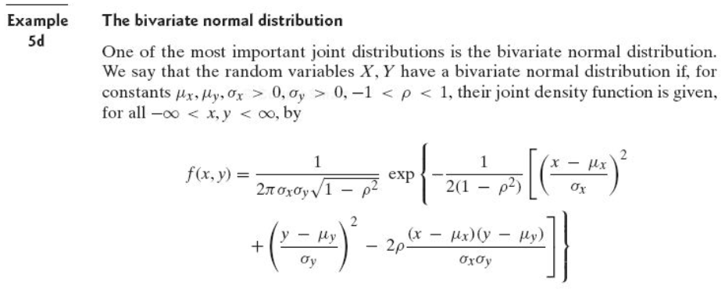

Example 2. the bivariate normal distribution
The density function is given by
Find the conditional density of $X$ given $Y=y$.

Slide 4
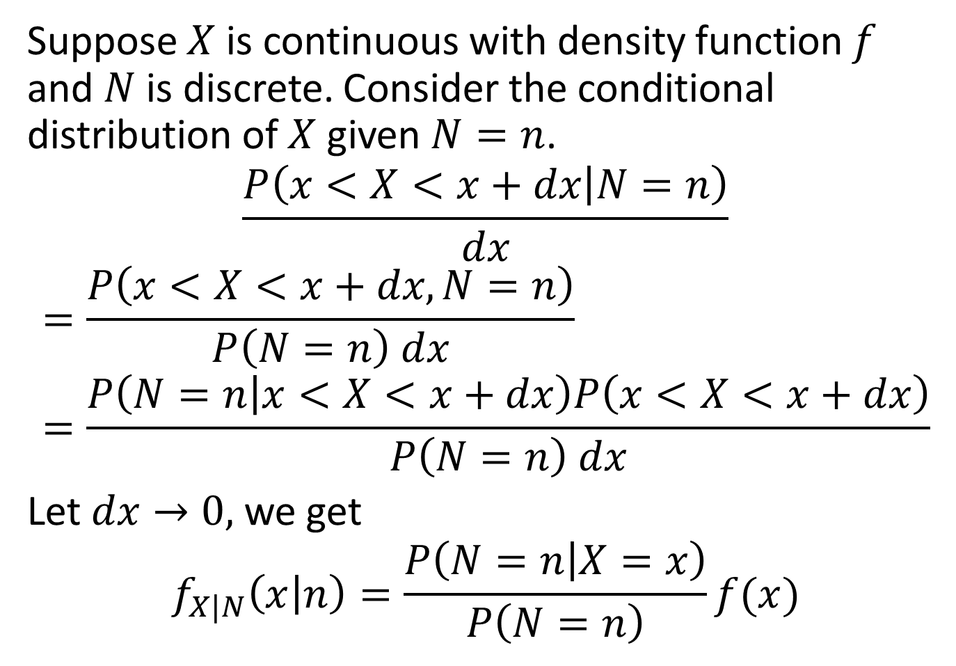
Suppose $X$ is continuous with density function $f$ and $N$ is discrete. Consider the conditional distribution of $X$ given $N=n$.
$$\frac{P\left(x<X<x+dx | N=n\right)}{dx}$$
$$=\frac{P\left(x<X<x+dx,N=n\right)}{P\left(N=n\right) dx}=\frac{P\left(N=n | x<X<x+dx\right)P\left(x<X<x+dx\right)}{P\left(N=n\right) dx}$$
Let $dx→0,$ we get
$$f_{X|N}\left(x | n\right)=\frac{P\left(N=n | X=x\right)}{P\left(N=n\right)}f(x)$$

Slide 5
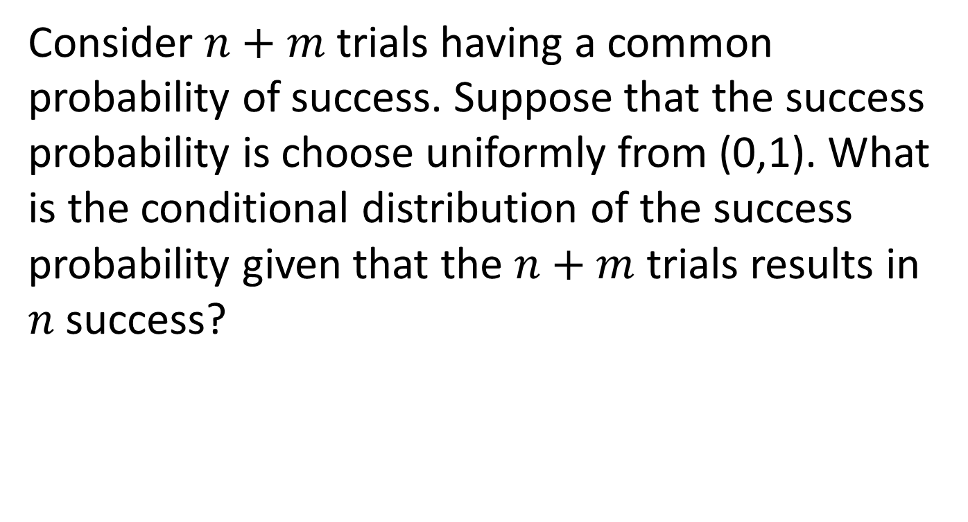
Example 3
Consider $n+m$ trials having a common probability of success. Suppose that the success probability is choose uniformly from (0,1). What is the conditional distribution of the success probability given that the $n+m$ trials results in $n$ success?

Slide 6
Section 6.7 Joint Probability Distribution of Functions of rv’s
Suppose X, Y jointly continuous with joint pdf f(x,y).
Let U=g₁(X,Y), and V=g₂(X,Y) be functions of X,Y
Find joint pdf of U, V.

Slide 7
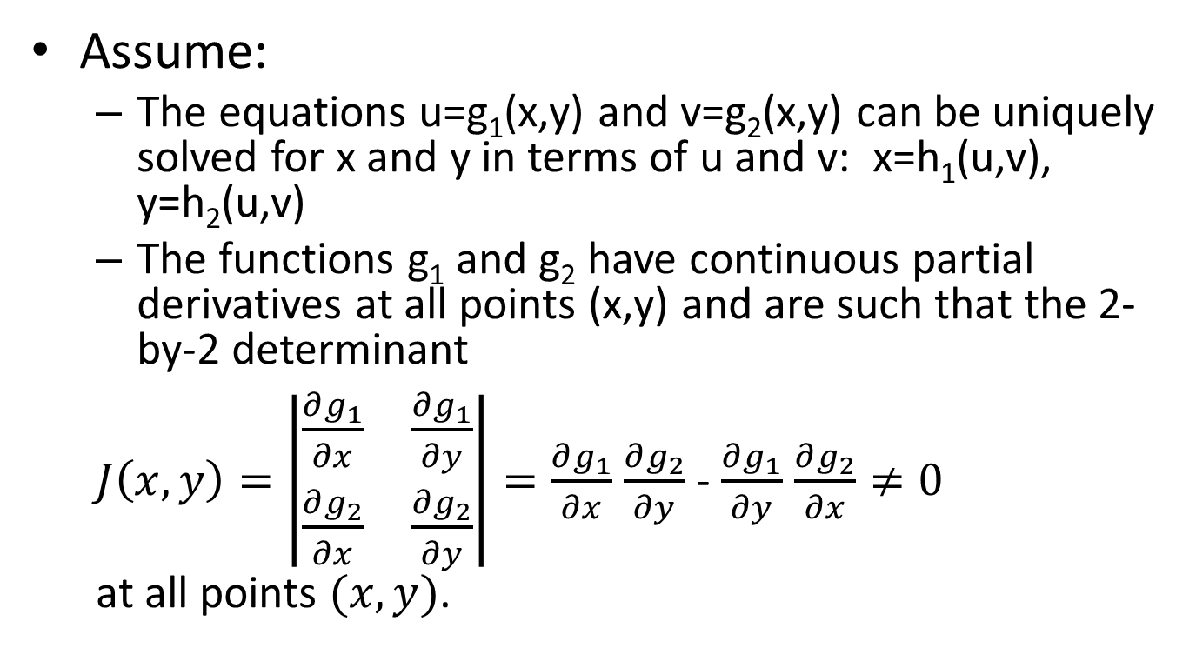
Joint Probability Distribution of Functions of rv’s
[Section 6.7, Ross]
Assume:
The equations u=g₁(x,y) and v=g₂(x,y) can be uniquely solved for x and y in terms of u and v: x=h₁(u,v), y=h₂(u,v)
The functions g₁ and g₂ have continuous partial derivatives at all points (x,y) and are such that the 2-by-2 determinant
$J\left(x,y\right)=\left|\begin{matrix}\frac{∂g_{1}}{∂x} & \frac{∂g_{1}}{∂y} \\ \frac{∂g_{2}}{∂x} & \frac{∂g_{2}}{∂y}\end{matrix}\right|=\frac{∂g_{1}}{∂x}$ $\frac{∂g_{2}}{∂y}$ - $\frac{∂g_{1}}{∂y}$ $\frac{∂g_{2}}{∂x}≠0$
at all points $(x,y)$.

Slide 8

Joint Probability Distribution of Functions of rv’s
[Section 6.7, Ross]
Then, the joint pdf of U and V is given by
$f_{U,V}\left(u,v\right)=\frac{f_{X,Y}(x,y)}{{|J\left(x,y\right)|}^{}}$=$\frac{f_{X,Y}(h_{1}(u,v),h_{2}(u,v))}{{|J\left(h_{1}\left(u,v\right),h_{2}(u,v)\right)|}^{}}$

Slide 9
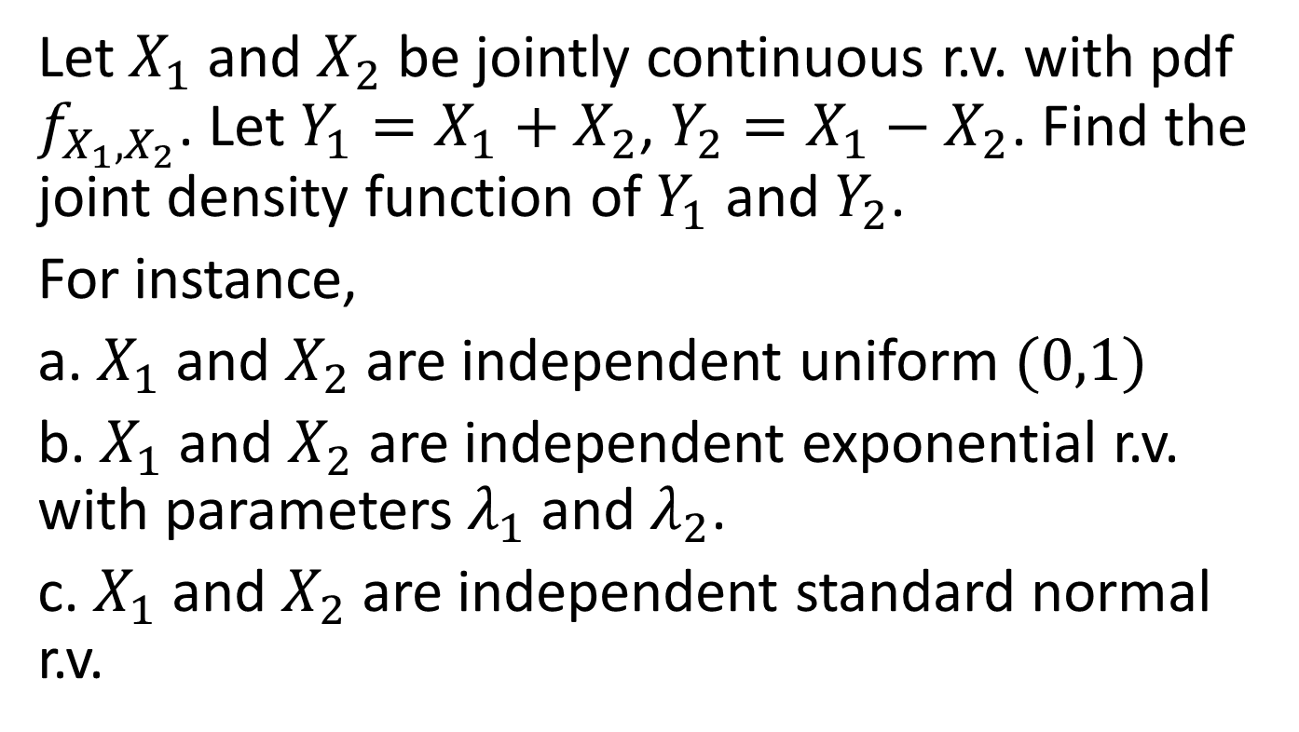
Example 4
Let $X_{1}$ and $X_{2}$ be jointly continuous r.v. with pdf $f_{X_{1},X_{2}}$. Let $Y_{1}=X_{1}+X_{2}$, $Y_{2}=X_{1}−X_{2}$. Find the joint density function of $Y_{1}$ and $Y_{2}$.
For instance,
a. $X_{1}$ and $X_{2}$ are independent uniform $(0,1)$
b. $X_{1}$ and $X_{2}$ are independent exponential r.v. with parameters $λ_{1}$ and $λ_{2}$.
c. $X_{1}$ and $X_{2}$ are independent standard normal r.v.

Slide 10
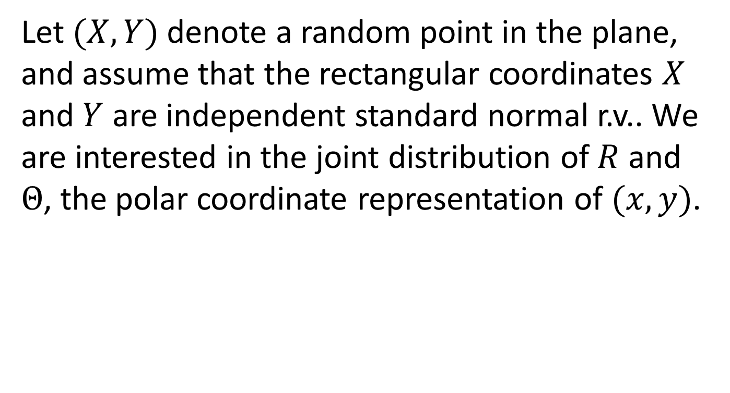
Example 5
Let $(X,Y)$ denote a random point in the plane, and assume that the rectangular coordinates $X$ and $Y$ are independent standard normal r.v.. We are interested in the joint distribution of $R$ and $Θ$, the polar coordinate representation of $(x,y)$.

Slide 11
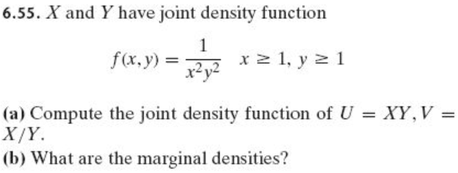

Example6

Slide 12
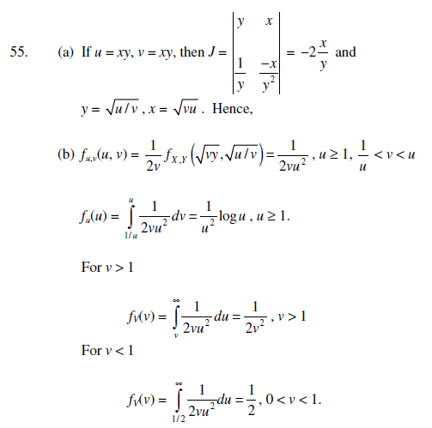
v=x/y

Slide 13
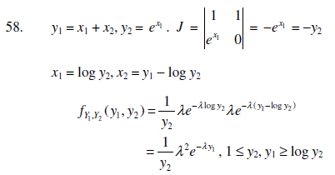

Slide 14
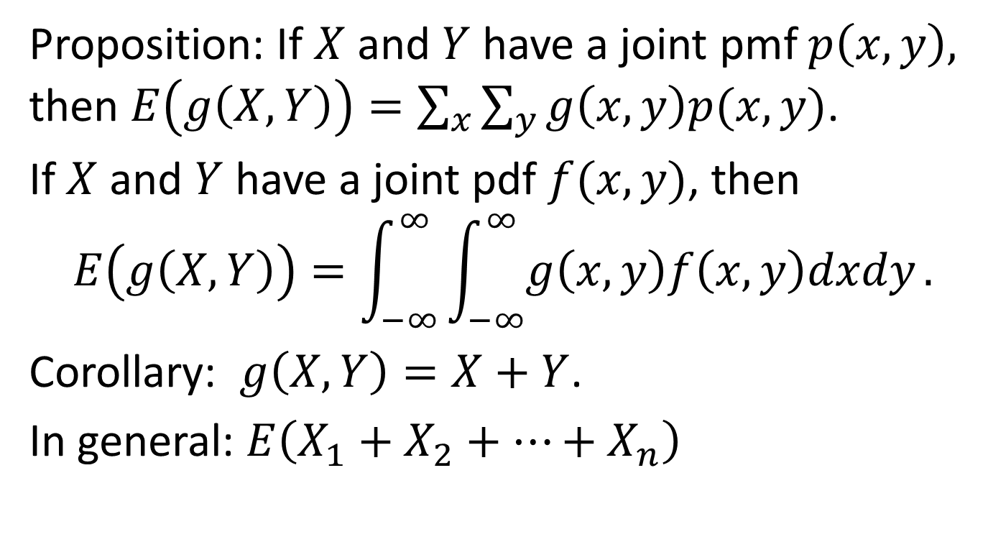
Section 7.2 Expectation of sums of r.v.
Proposition: If $X$ and $Y$ have a joint pmf $p\left(x,y\right),$ then $E\left(g\left(X,Y\right)\right)=\sum_{x}{\sum_{y}{g\left(x,y\right)p(x,y)}}$.
If $X$ and $Y$ have a joint pdf $f(x,y)$, then
$$E\left(g\left(X,Y\right)\right)=\int_{−∞}^{∞ }{\int_{−∞}^{∞}{g\left(x,y\right)f\left(x,y\right)dxdy}.}$$
Corollary: $g\left(X,Y\right)=X+Y$.
In general: $E\left(X_{1}+X_{2}+⋯+X_{n}\right)$

Slide 15
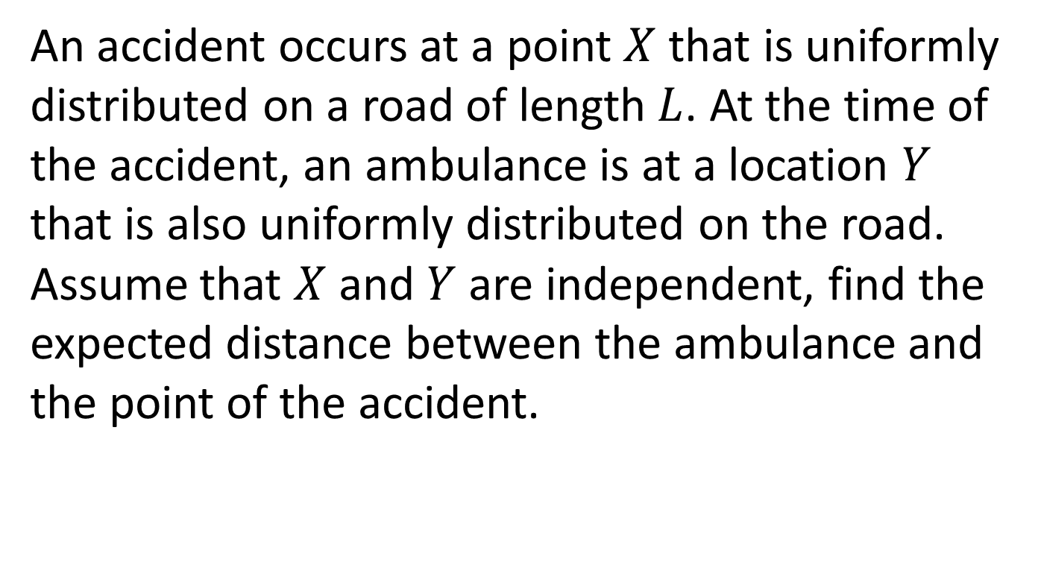
Example 1
An accident occurs at a point $X$ that is uniformly distributed on a road of length $L$. At the time of the accident, an ambulance is at a location $Y$ that is also uniformly distributed on the road. Assume that $X$ and $Y$ are independent, find the expected distance between the ambulance and the point of the accident.

Slide 16

Example 2
Let $X_{1},…,X_{n}$ be independent and identically distributed r.v. having distribution function $F$ and the expected value $μ$. The quantity $X^{′}=\sum_{i=1}^{n}{\frac{X_{i}}{n}}$ is the sample mean. Compute $E\left(X^{′}\right).$

Slide 17

Expectations of common discrete r.v.
Example 3. Boole’s inequality
$$P\left(\bigcup_{i=1}^{n}{A_{i}} \right)≤\sum_{i=1}^{n}{P(A_{i})}$$

Slide 18
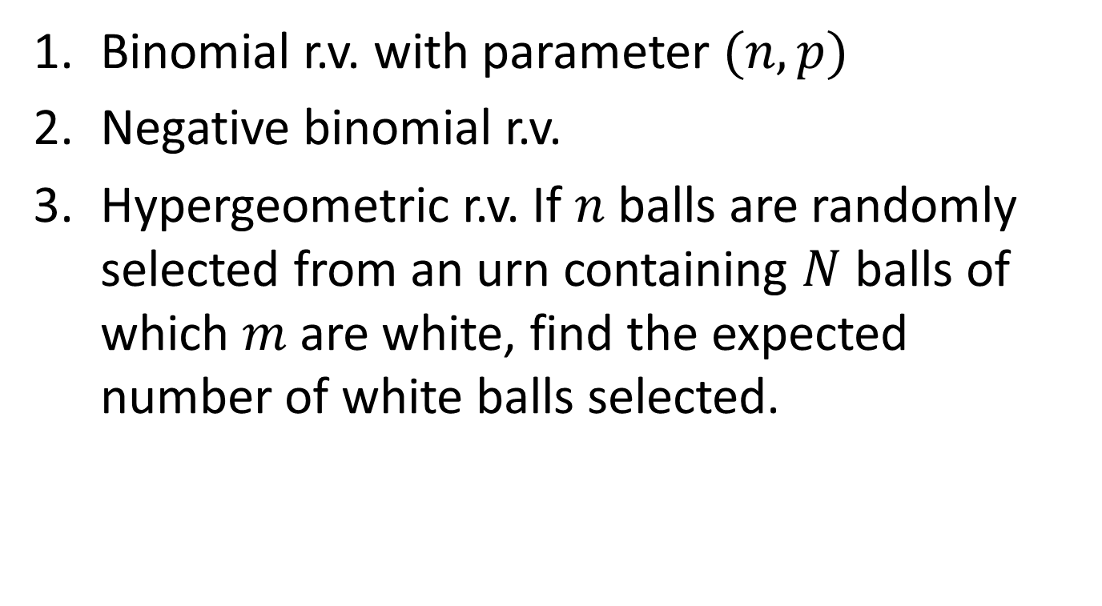
Expectations of common discrete r.v.
Binomial r.v. with parameter $(n,p)$
Negative binomial r.v.
Hypergeometric r.v. If $n$ balls are randomly selected from an urn containing $N$ balls of which $m$ are white, find the expected number of white balls selected.

Slide 19

Example 3. Expected number of matches
Suppose that $N$ people throw their hats into the center of a room. The hats are mixed up and each person randomly selected one. Find the expected number of people who select their own hat.

Slide 20
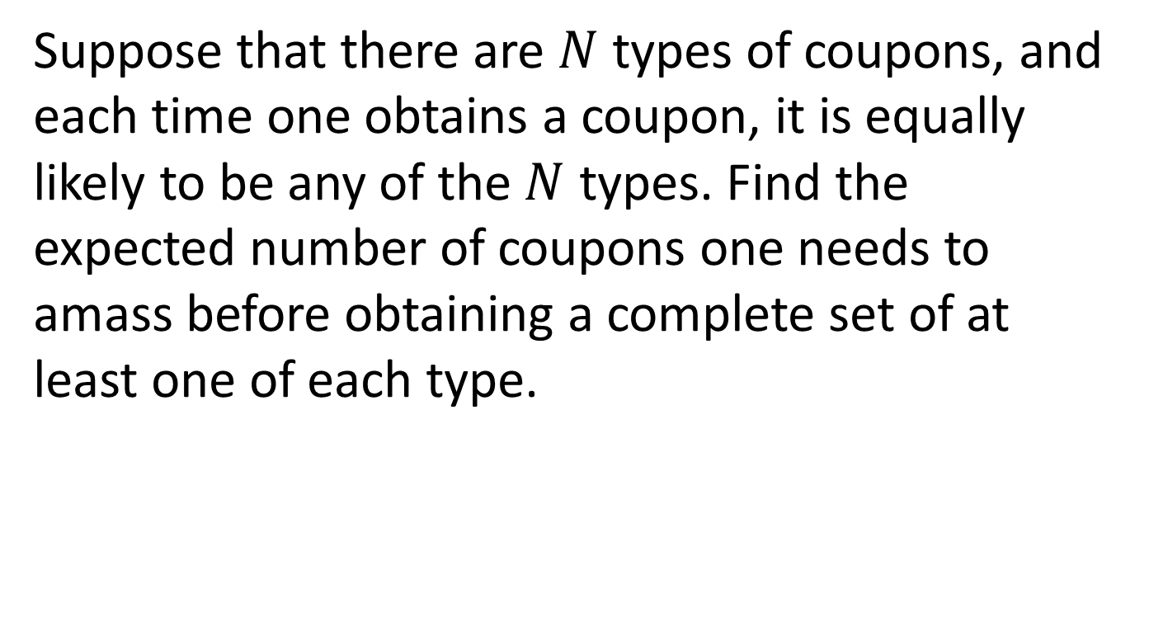
Example 4 Coupon collecting
Suppose that there are $N$ types of coupons, and each time one obtains a coupon, it is equally likely to be any of the $N$ types. Find the expected number of coupons one needs to amass before obtaining a complete set of at least one of each type.

Slide 21
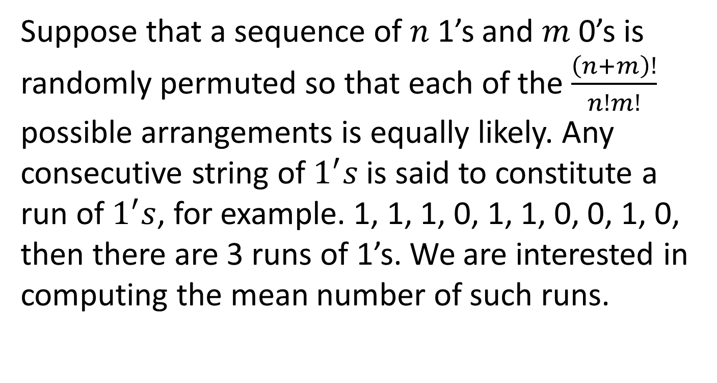
Example 5 Expected number of runs
Suppose that a sequence of $n$ 1’s and $m$ 0’s is randomly permuted so that each of the $\frac{\left(n+m\right)!}{n!m!}$ possible arrangements is equally likely. Any consecutive string of $1^{′}s$is said to constitute a run of $1^{′}s$, for example. 1, 1, 1, 0, 1, 1, 0, 0, 1, 0, then there are 3 runs of 1’s. We are interested in computing the mean number of such runs.

