Slide 1
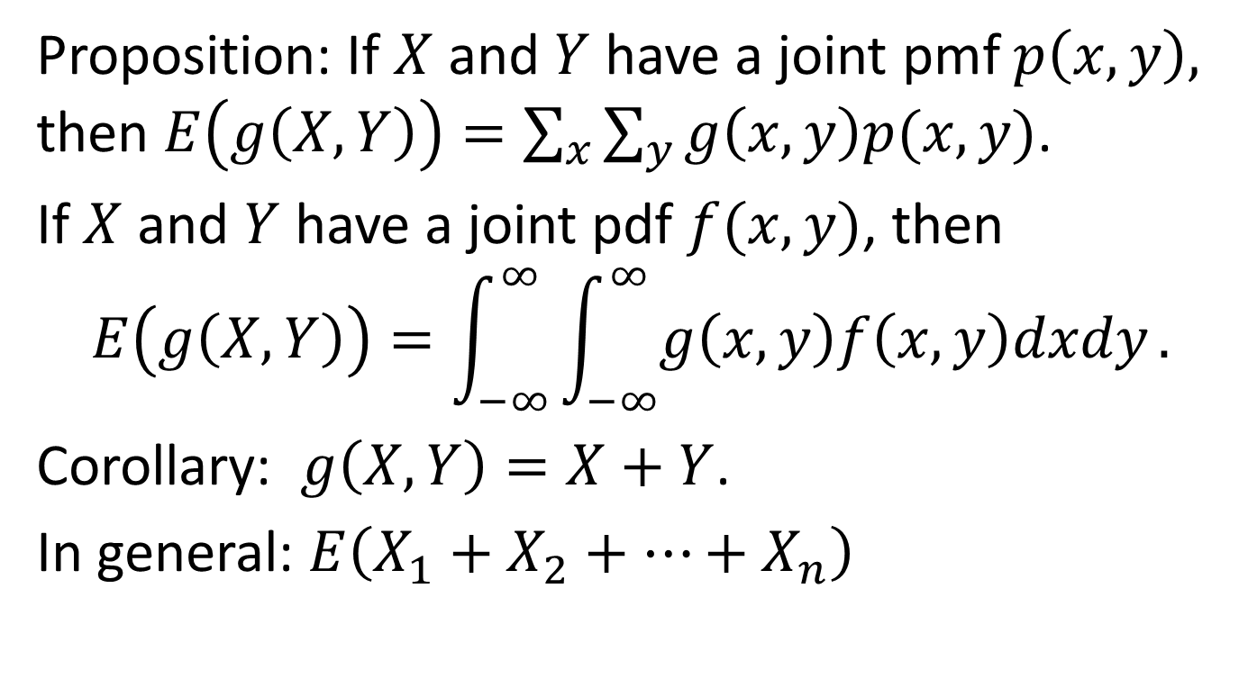
Section 7.2 Expectation of sums of r.v.
Proposition: If $X$ and $Y$ have a joint pmf $p\left(x,y\right),$ then $E\left(g\left(X,Y\right)\right)=\sum_{x}{\sum_{y}{g\left(x,y\right)p(x,y)}}$.
If $X$ and $Y$ have a joint pdf $f(x,y)$, then
$$E\left(g\left(X,Y\right)\right)=\int_{−∞}^{∞ }{\int_{−∞}^{∞}{g\left(x,y\right)f\left(x,y\right)dxdy}.}$$
Corollary: $g\left(X,Y\right)=X+Y$.
In general: $E\left(X_{1}+X_{2}+⋯+X_{n}\right)$

Slide 2
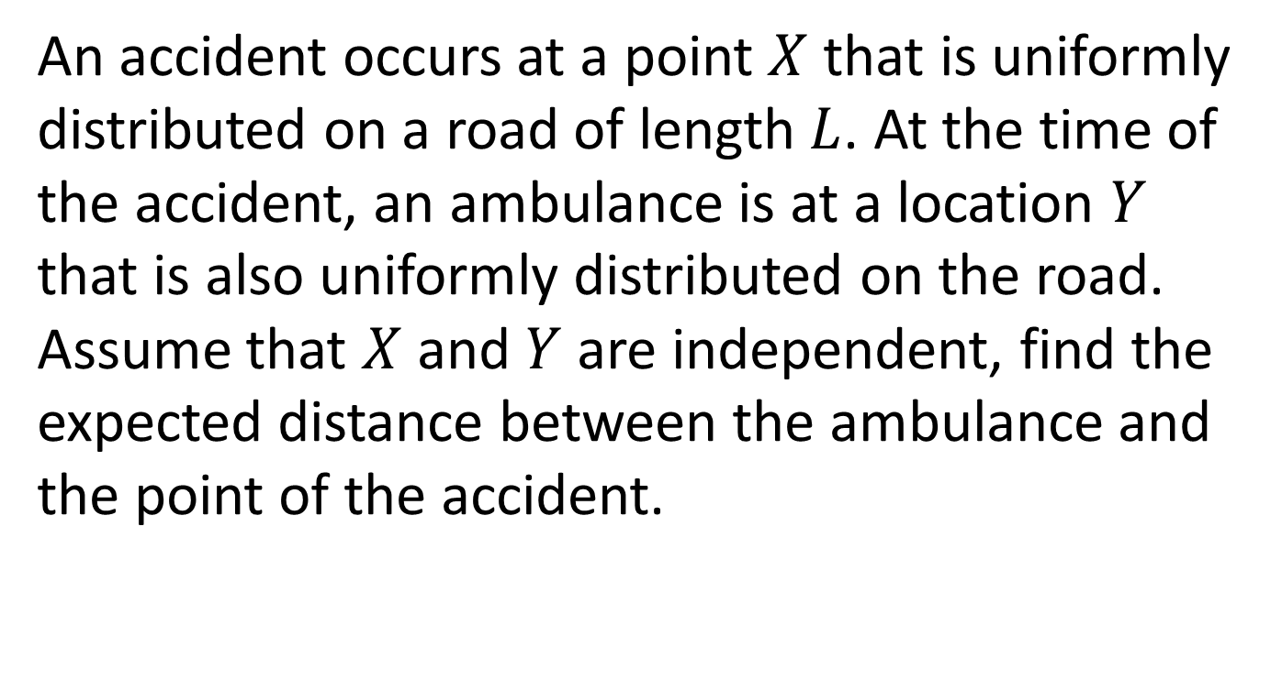
Example 1
An accident occurs at a point $X$ that is uniformly distributed on a road of length $L$. At the time of the accident, an ambulance is at a location $Y$ that is also uniformly distributed on the road. Assume that $X$ and $Y$ are independent, find the expected distance between the ambulance and the point of the accident.

Slide 3

Example 2
Let $X_{1},…,X_{n}$ be independent and identically distributed r.v. having distribution function $F$ and the expected value $μ$. The quantity $X^{′}=\sum_{i=1}^{n}{\frac{X_{i}}{n}}$ is the sample mean. Compute $E\left(X^{′}\right).$

Slide 4

Expectations of common discrete r.v.
Example 3. Boole’s inequality
$$P\left(\bigcup_{i=1}^{n}{A_{i}} \right)≤\sum_{i=1}^{n}{P(A_{i})}$$

Slide 5
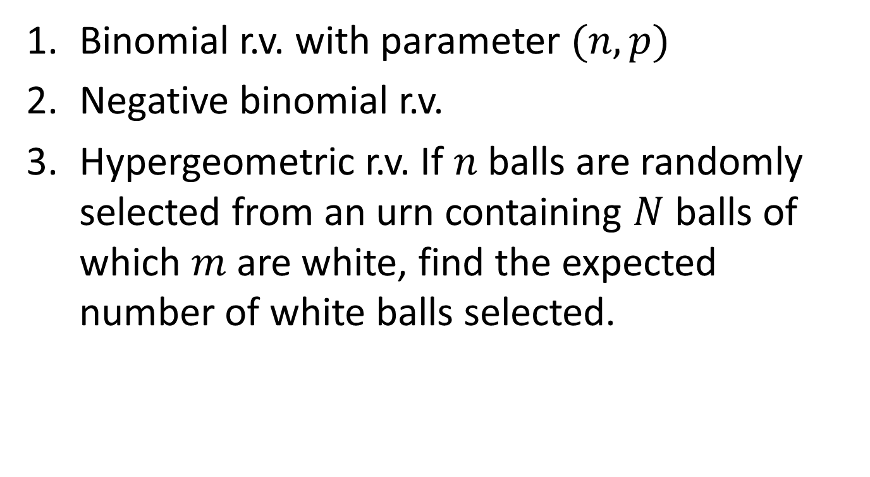
Expectations of common discrete r.v.
Binomial r.v. with parameter $(n,p)$
Negative binomial r.v.
Hypergeometric r.v. If $n$ balls are randomly selected from an urn containing $N$ balls of which $m$ are white, find the expected number of white balls selected.

Slide 6
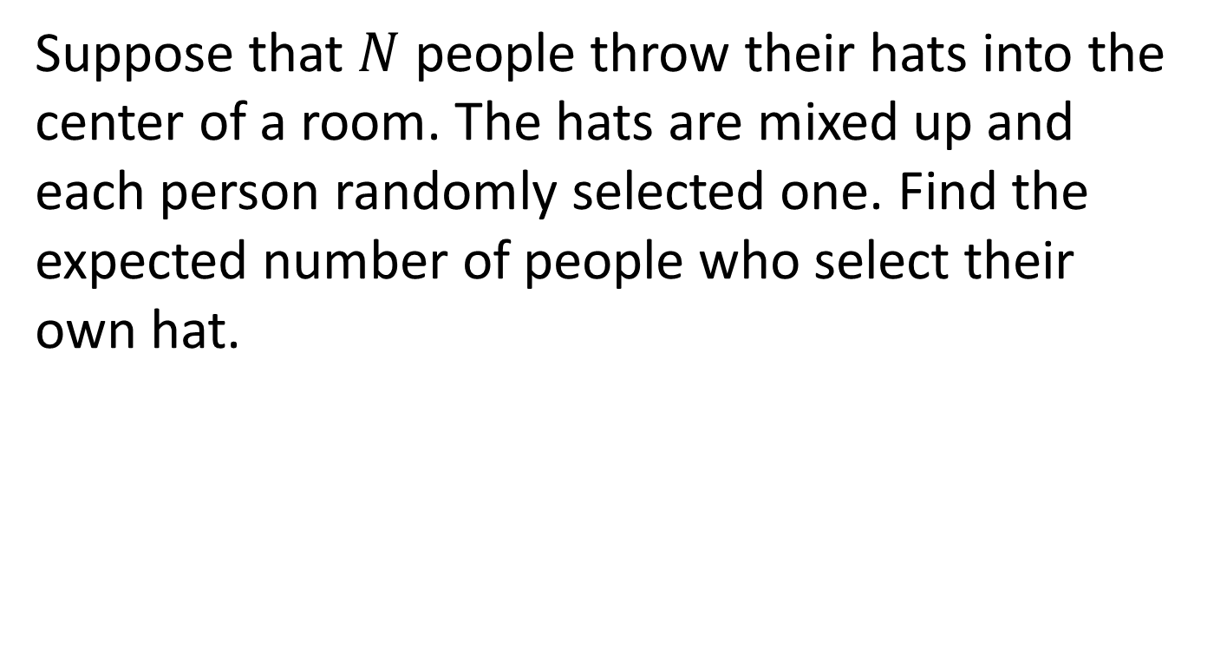
Example 3. Expected number of matches
Suppose that $N$ people throw their hats into the center of a room. The hats are mixed up and each person randomly selected one. Find the expected number of people who select their own hat.

Slide 7
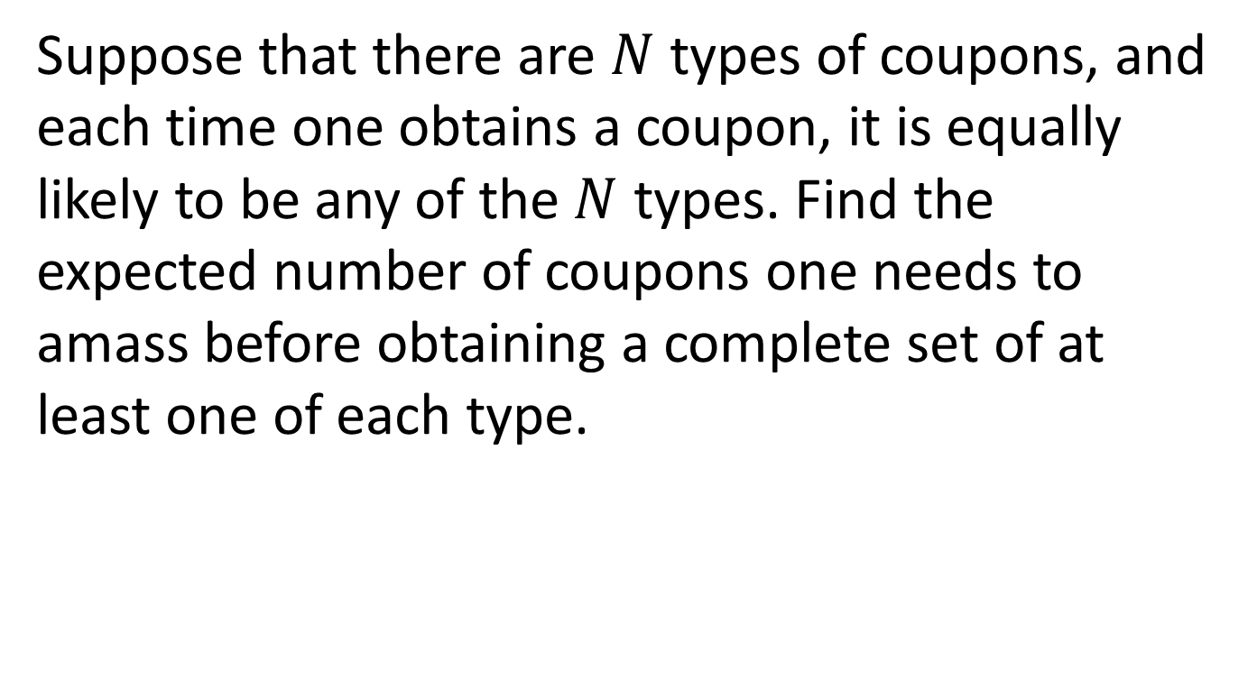
Example 4 Coupon collecting
Suppose that there are $N$ types of coupons, and each time one obtains a coupon, it is equally likely to be any of the $N$ types. Find the expected number of coupons one needs to amass before obtaining a complete set of at least one of each type.

Slide 8
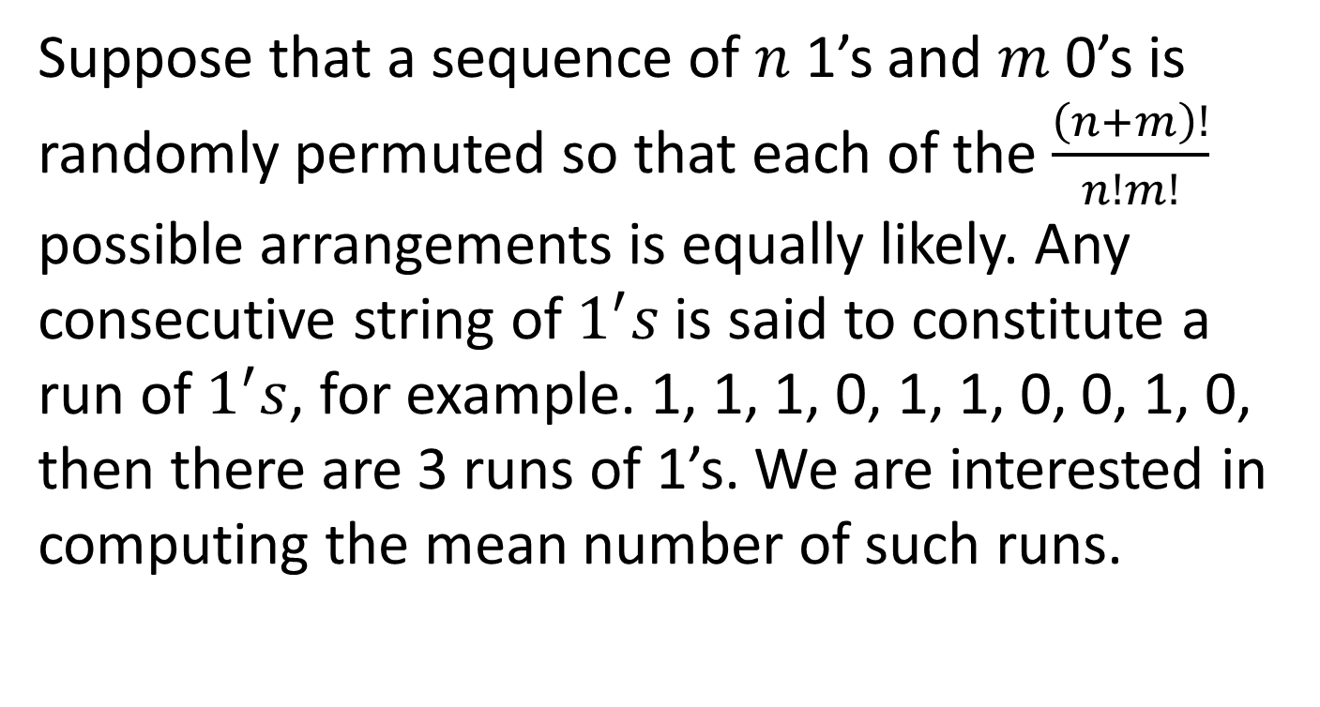
Example 5 Expected number of runs
Suppose that a sequence of $n$ 1’s and $m$ 0’s is randomly permuted so that each of the $\frac{\left(n+m\right)!}{n!m!}$ possible arrangements is equally likely. Any consecutive string of $1^{′}s$is said to constitute a run of $1^{′}s$, for example. 1, 1, 1, 0, 1, 1, 0, 0, 1, 0, then there are 3 runs of 1’s. We are interested in computing the mean number of such runs.

Slide 9
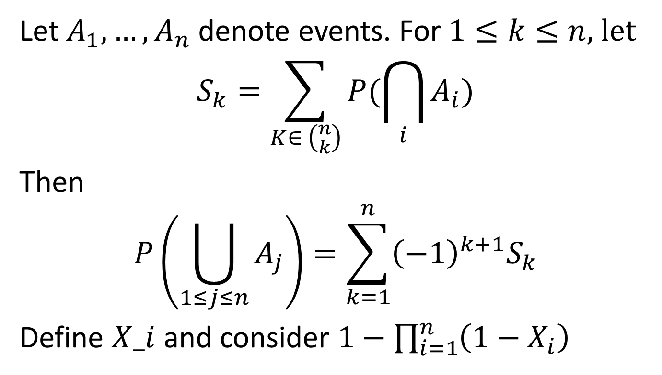
Example 6
Let $A_{1},…,A_{n}$ denote events. For $1≤k≤n,$ let
$$S_{k}=\sum_{K∈ \left({n \atop k}\right)}{P(\bigcap_{i}{A_{i}})}$$
Then
$$P\left(\bigcup_{1≤j≤n}{A_{j}}\right)=\sum_{k=1}^{n}{{\left(−1\right)}^{k+1}S_{k}}$$
Define $X_i$ and consider $1−\prod_{i=1}^{n}{\left(1−X_{i}\right)}$

Slide 10
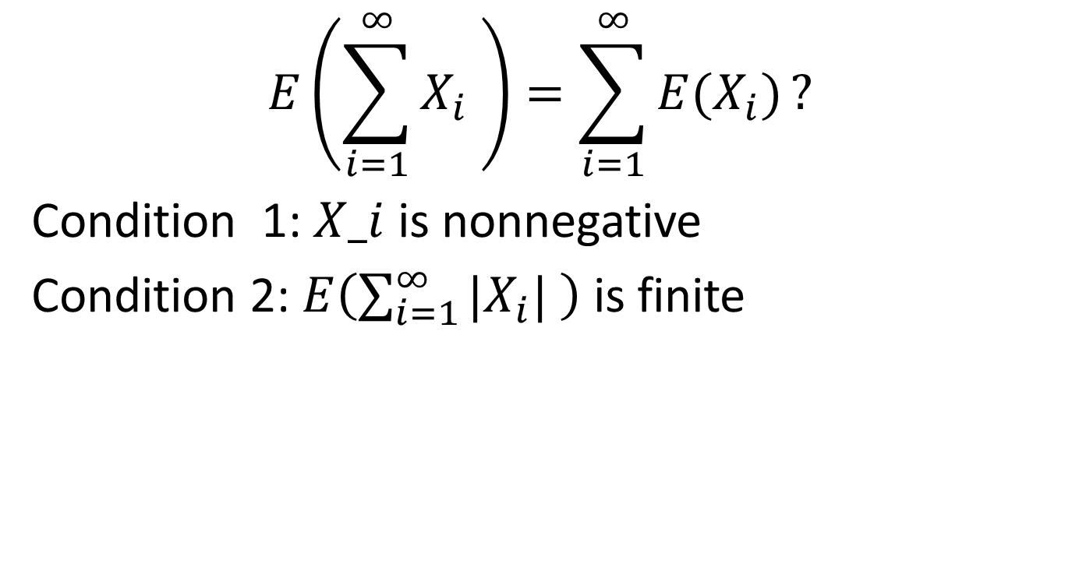
Example 6
$$E\left(\sum_{i=1}^{∞}{X_{i}} \right)=\sum_{i=1}^{∞}{E(X_{i})}?$$
Condition 1: $X_i$ is nonnegative
Condition 2: $E\left(\sum_{i=1}^{∞}{{|X}_{i}|} \right)$ is finite

Slide 11
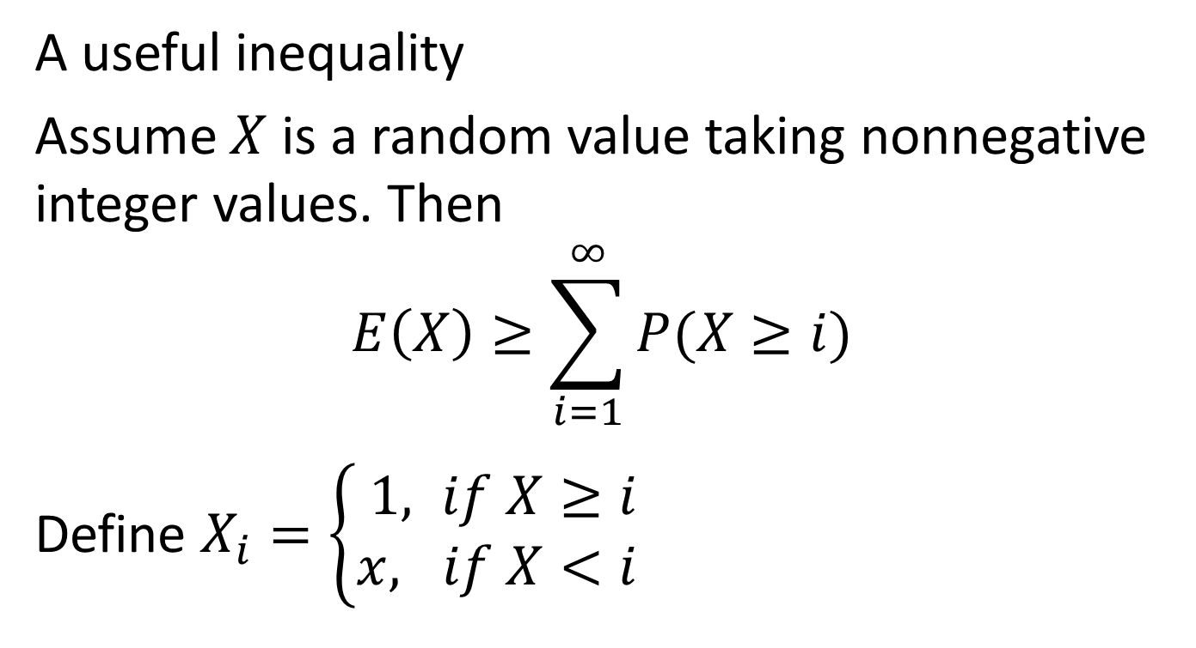
Example 7
A useful inequality
Assume $X$ is a random value taking nonnegative integer values. Then
$$E\left(X\right)≥\sum_{i=1}^{∞}{P(X≥i)}$$
Define $X_{i}=\left\{\begin{aligned}1, if X≥i \\ &x, if X<i \end{aligned}\right.$

Slide 12
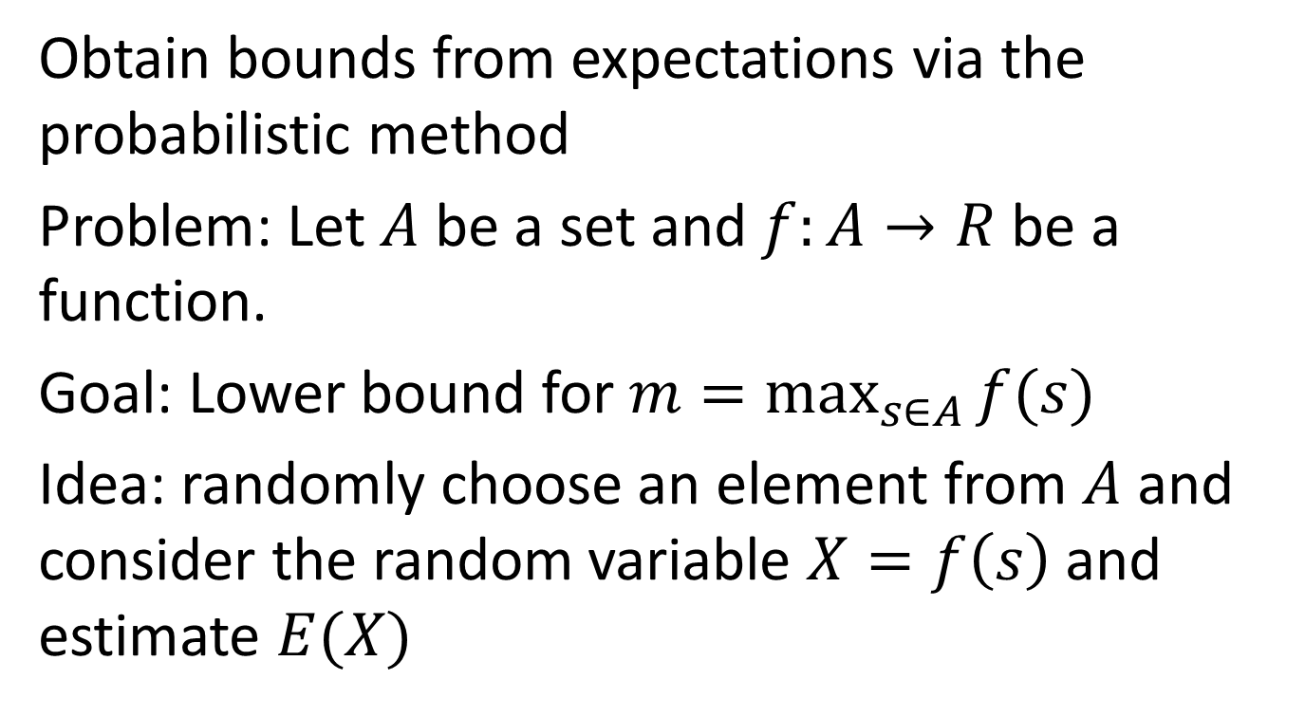
7.2.1
Obtain bounds from expectations via the probabilistic method
Problem: Let $A$ be a set and $f:A→R$ be a function.
Goal: Lower bound for $m=\max_{s∈A}{f(s)}$
Idea: randomly choose an element from $A$ and consider the random variable $X=f\left(s\right)$ and estimate $E(X)$

Slide 13
Example 1
The maximum number of Hamilton paths in a tournament

Slide 14
Example 2
A grove of 52 trees is arranged in a circular fashion. If 15 chipmunks live in these trees, show that there is a group of 7 consecutive trees that together house at lease 3 chipmunks.

Slide 15
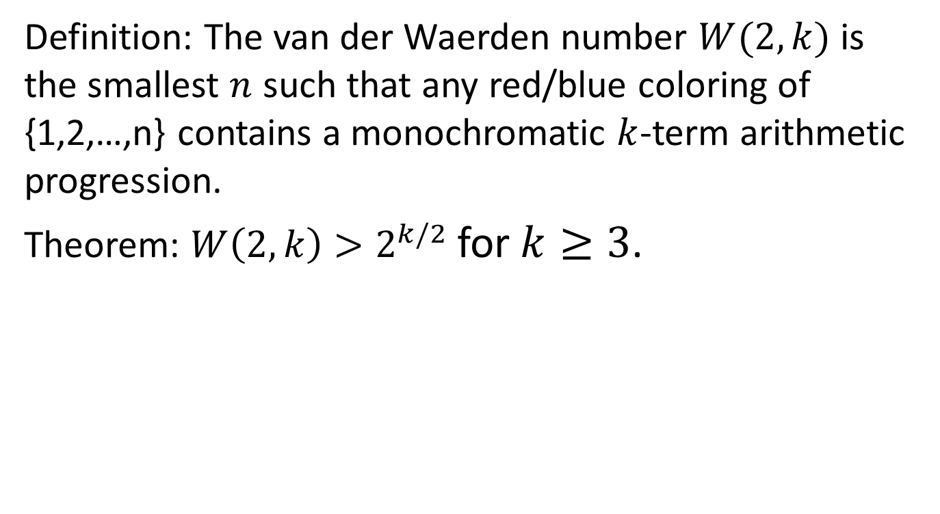
Example 3
Definition: The van der Waerden number $W(2,k)$ is the smallest $n$ such that any red/blue coloring of {1,2,…,n} contains a monochromatic $k$-term arithmetic progression.
Theorem: $W\left(2,k\right)>2^{k/2}$for $k≥3$.

