Slide 1
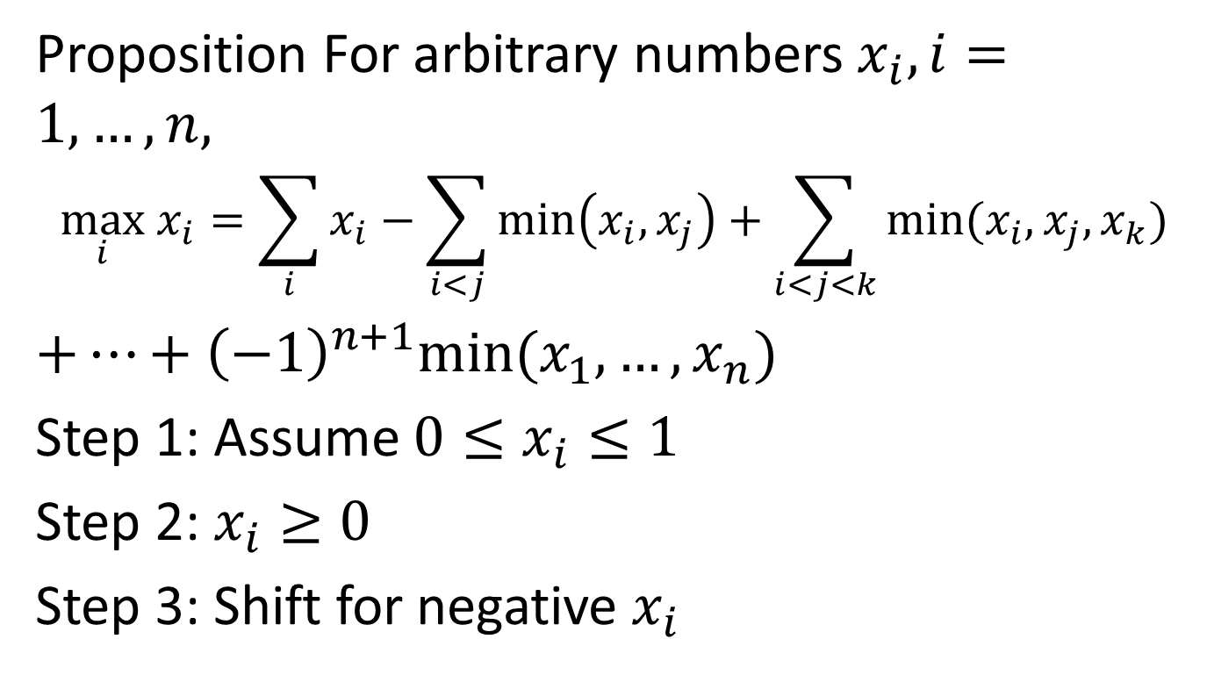
7.2.2 The Maximum-Minimums Idetity
Proposition For arbitrary numbers $x_{i}, i=1,…, n,$
$$\max_{i} x_{i}=\sum_{i}{x_{i}−\sum_{i<j}{\min\left(x_{i},x_{j}\right)}+\sum_{i<j<k}{min⁡(x_{i},x_{j},x_{k})}}$$
$+…+{\left(−1\right)}^{n+1}min⁡(x_{1},…,x_{n})$
Step 1: Assume $0≤x_{i}≤1$
Step 2: $x_{i}≥0$
Step 3: Shift for negative $x_{i}$

Slide 2
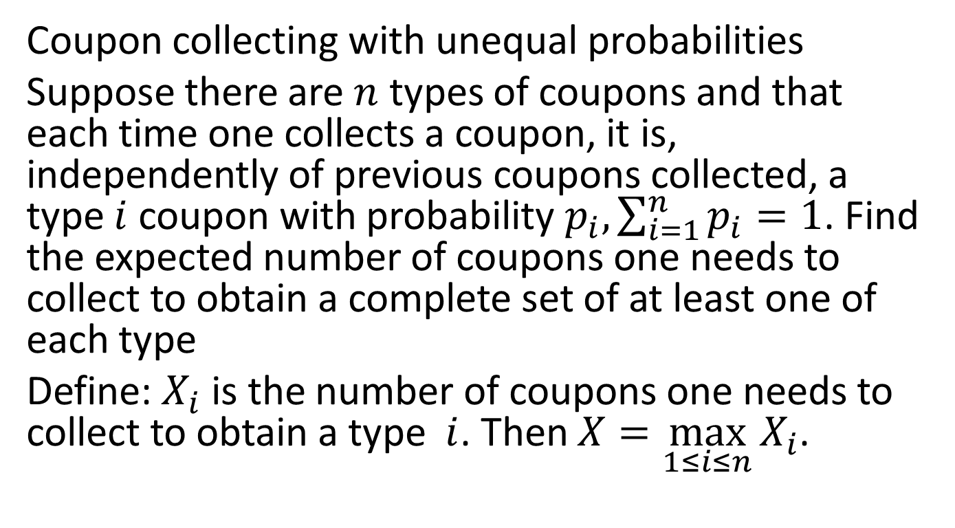
Example 1
Coupon collecting with unequal probabilities
Suppose there are $n$ types of coupons and that each time one collects a coupon, it is, independently of previous coupons collected, a type $i$ coupon with probability $p_{i}, \sum_{i=1}^{n}{p_{i}}=1$. Find the expected number of coupons one needs to collect to obtain a complete set of at least one of each type
Define: $X_{i}$ is the number of coupons one needs to collect to obtain a type $i$. Then $X=\max_{1≤i≤n}{X_{i}}$.

Slide 3
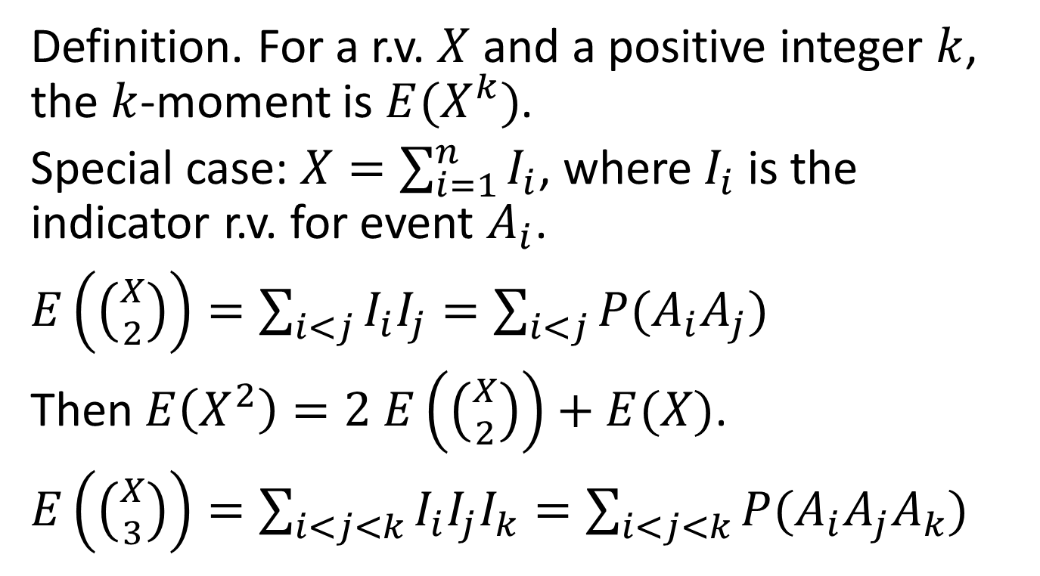
7.3 Moments of a r.v.
Definition. For a r.v. $X$ and a positive integer $k$, the $k$-moment is $E(X^{k})$.
Special case: $X=\sum_{i=1}^{n}{I_{i}}$, where $I_{i}$ is the indicator r.v. for event $A_{i}$.
$E\left(\left({X \atop 2}\right)\right)=\sum_{i<j}{I_{i}I_{j}}=\sum_{i<j}{P(A_{i}A_{j})}$
Then $E\left(X^{2}\right)=2$ $E\left(\left({X \atop 2}\right)\right)+E(X)$.
$E\left(\left({X \atop 3}\right)\right)=\sum_{i<j<k}{I_{i}I_{j}I_{k}}=\sum_{i<j<k}{P(A_{i}A_{j}A_{k})}$

Slide 4
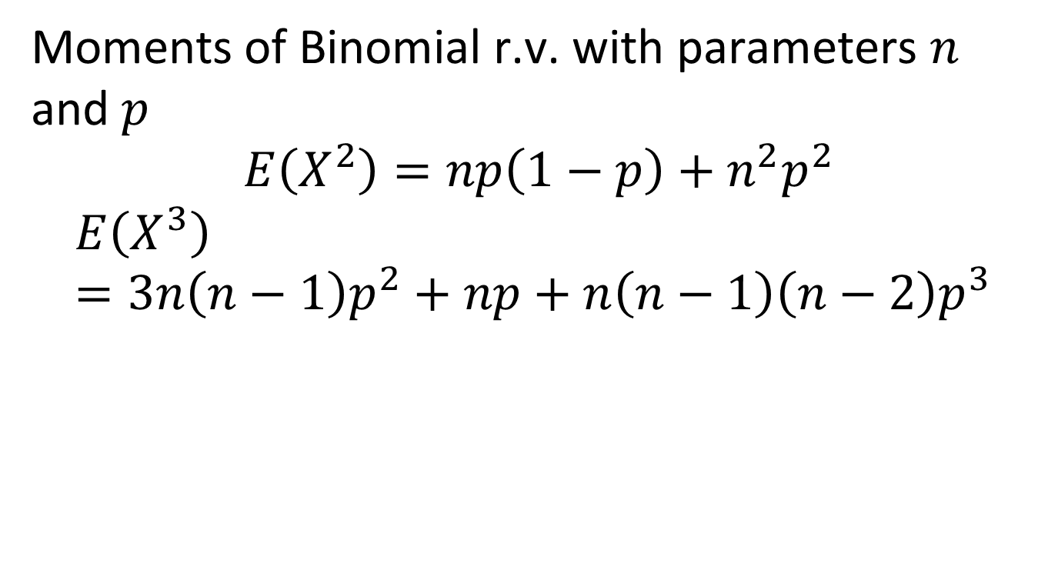
Example 1
Moments of Binomial r.v. with parameters $n$ and $p$
$$E\left(X^{2}\right)=np\left(1−p\right)+n^{2}p^{2}$$
$$E\left(X^{3}\right)=3n\left(n−1\right)p^{2}+np+n\left(n−1\right)\left(n−2\right)p^{3}$$

Slide 5
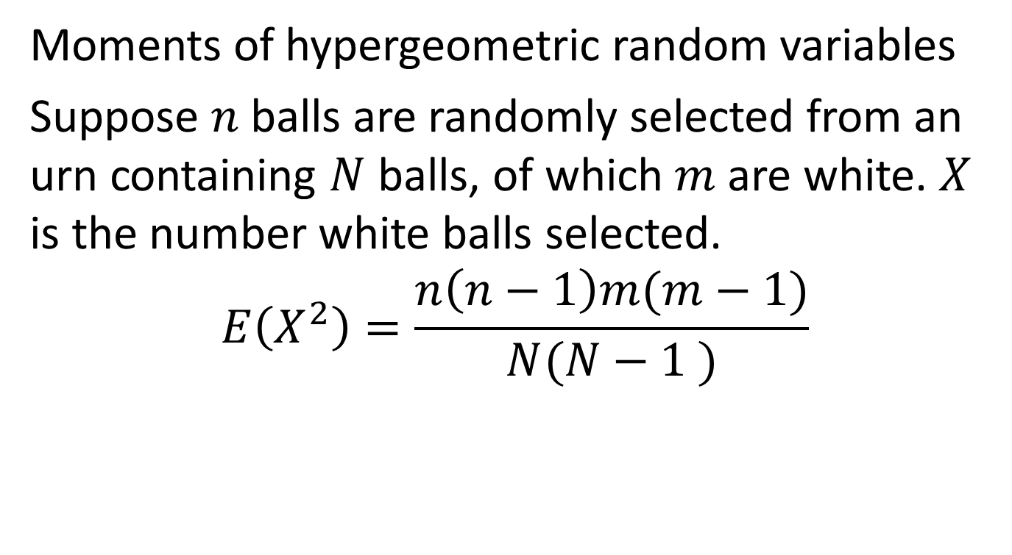
Example 2
Moments of hypergeometric random variables
Suppose $n$ balls are randomly selected from an urn containing $N$ balls, of which $m$ are white. $X$ is the number white balls selected.
$$E\left(X^{2}\right)=\frac{n\left(n−1\right)m(m−1)}{N(N−1 )}$$

Slide 6

Example 3
Moments in the match problem
$X$ is the number of people who selects his own hat.

Slide 7
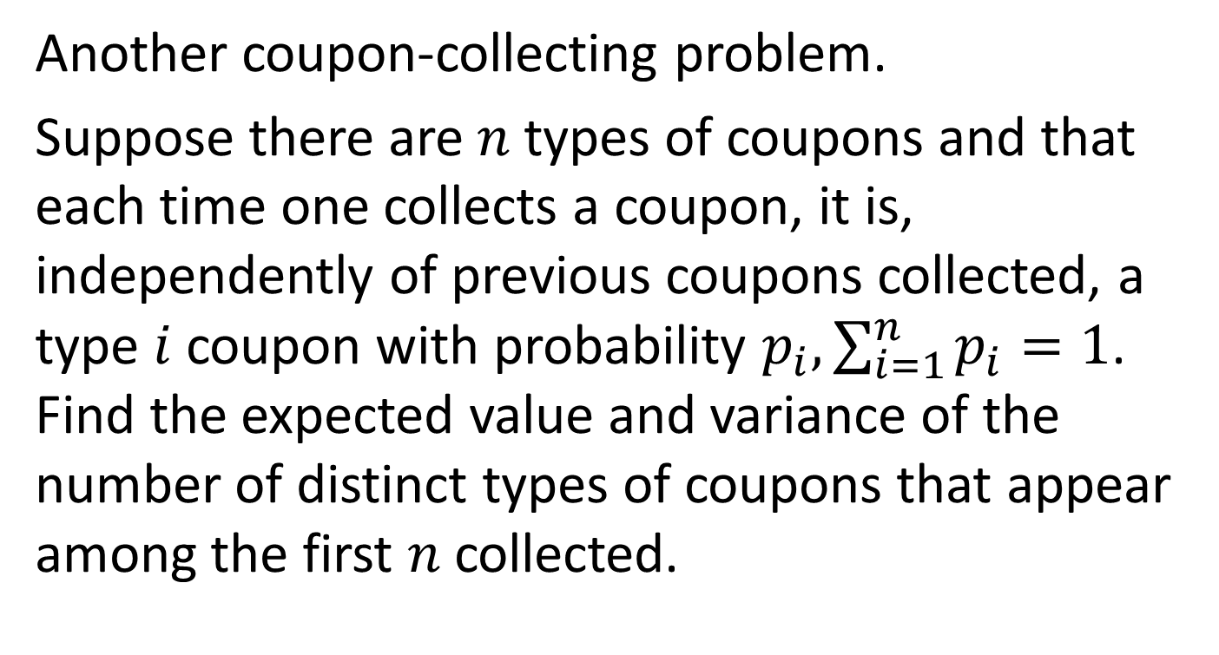
Example 4
Another coupon-collecting problem.
Suppose there are $n$ types of coupons and that each time one collects a coupon, it is, independently of previous coupons collected, a type $i$ coupon with probability $p_{i}, \sum_{i=1}^{n}{p_{i}}=1$. Find the expected value and variance of the number of distinct types of coupons that appear among the first $n$ collected.

Slide 8

7.4 Variance and correlations
Proposition. If $X$ and $Y$ are independent, then for any functions $h$ and $g$,
$$E\left(g\left(X\right)h\left(Y\right)\right)=E\left(g\left(X\right)\right)E(h\left(Y\right))$$

Slide 9
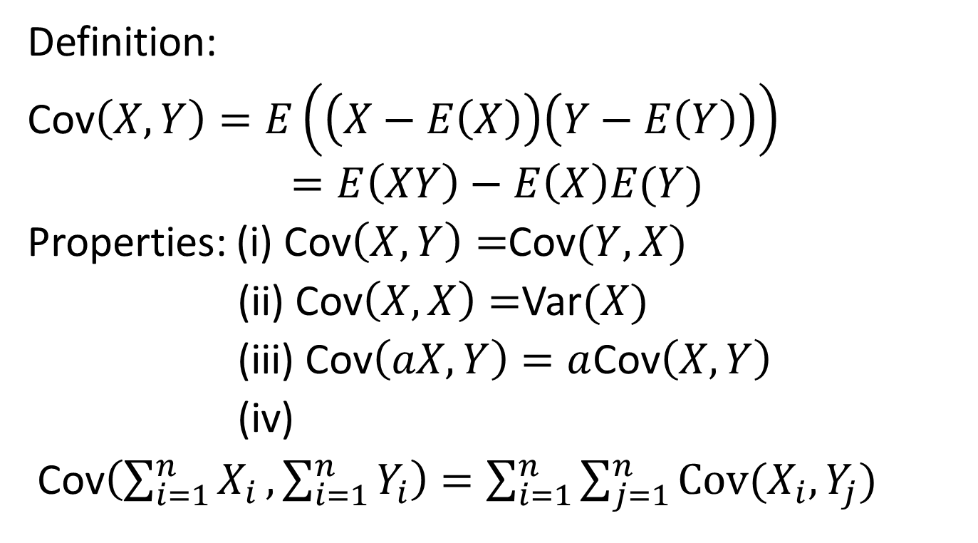
Covariance
Definition:
Cov$\left(X,Y\right)=E\left(\left(X−E\left(X\right)\right)\left(Y−E\left(Y\right)\right)\right)$
$$=E\left(XY\right)−E\left(X\right)E(Y)$$
Properties: (i) Cov$\left(X,Y\right)=$Cov$(Y,X)$
(ii) Cov$\left(X,X\right)=$Var$(X)$
(iii) Cov$\left(aX,Y\right)=a$Cov$\left(X,Y\right)$
(iv)
Cov$\left(\sum_{i=1}^{n}{X_{i}},\sum_{i=1}^{n}{Y_{i}}\right)=\sum_{i=1}^{n}{\sum_{j=1}^{n}{Cov(X_{i}, Y_{j})}}$

Slide 10
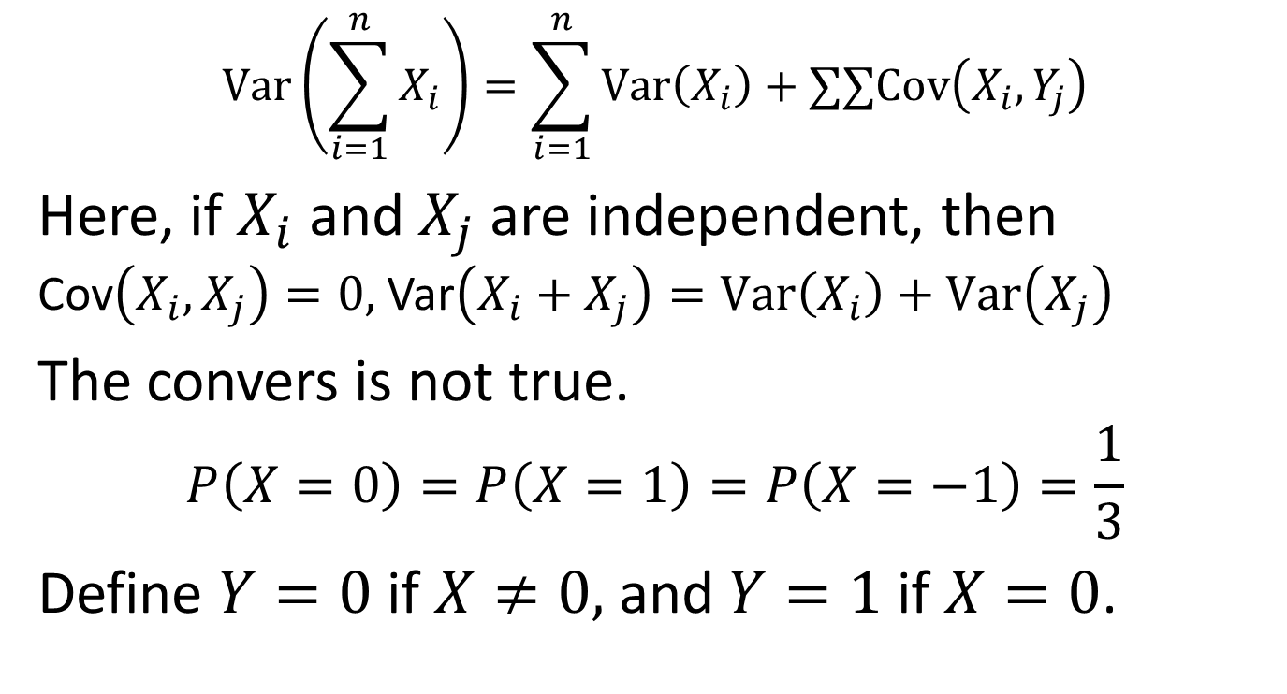
Variance versus covariance
$$Var\left(\sum_{i=1}^{n}{X_{i}}\right)=\sum_{i=1}^{n}{Var\left(X_{i}\right)}+∑∑Cov\left(X_{i},Y_{j}\right)$$
Here, if $X_{i}$ and $X_{j}$ are independent, then Cov$\left(X_{i},X_{j}\right)=0,$Var$\left(X_{i}+X_{j}\right)=Var\left(X_{i}\right)+Var\left(X_{j}\right)$
The convers is not true.
$$P\left(X=0\right)=P\left(X=1\right)=P\left(X=−1\right)=\frac{1}{3}$$
Define $Y=0$ if $X≠0,$ and $Y=1$ if $X=0$.

Slide 11
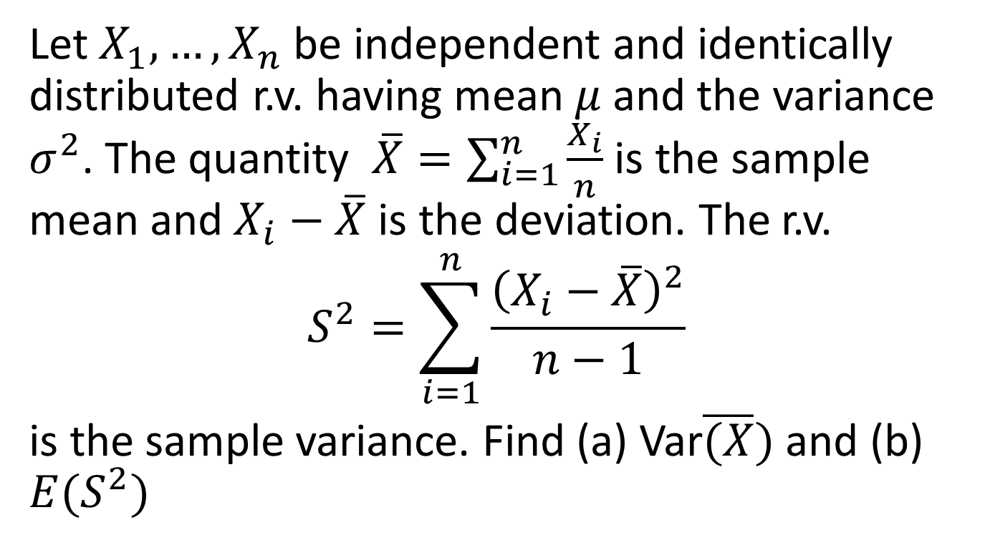
Example 1
Let $X_{1},…,X_{n}$ be independent and identically distributed r.v. having mean $μ$ and the variance $σ^{2}$. The quantity $\overline{X}=\sum_{i=1}^{n}{\frac{X_{i}}{n}}$ is the sample mean and $X_{i}−\overline{X}$ is the deviation. The r.v.
$$S^{2}=\sum_{i=1}^{n}{\frac{{\left(X_{i}−\overline{X}\right)}^{2}}{n−1} }$$
is the sample variance. Find (a) Var$\overline{(X})$ and (b) $E(S^{2})$

Slide 12
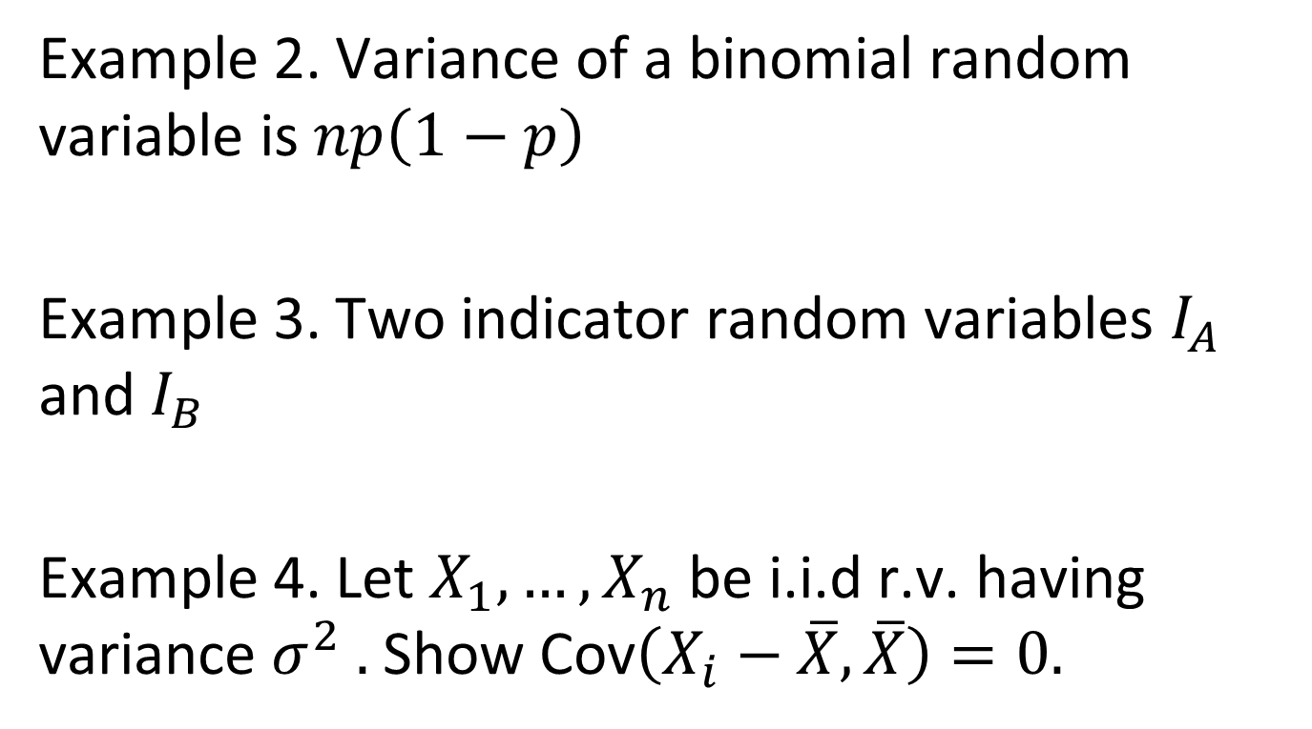
Example 2. Variance of a binomial random variable is $np\left(1−p\right)$
Example 3. Two indicator random variables $I_{A}$ and $I_{B}$
Example 4. Let $X_{1},…,X_{n}$ be i.i.d r.v. having variance $σ^{2} .$ Show Cov$\left(X_{i}−\overline{X},\overline{X}\right)=0.$

Slide 13
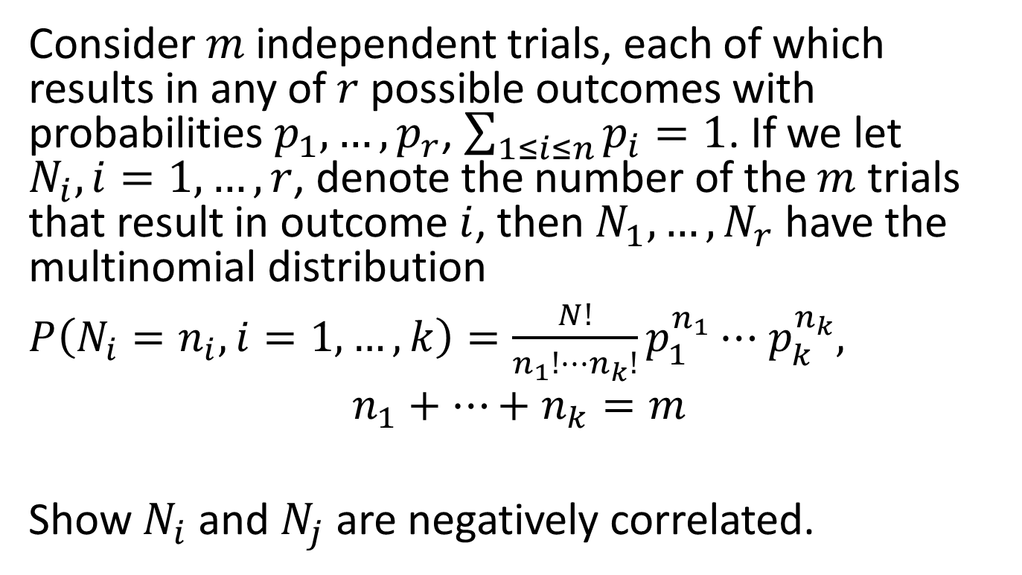
Example 5
Consider $m$ independent trials, each of which results in any of $r$ possible outcomes with probabilities $p_{1},…,p_{r}$, $\sum_{1≤i≤n}{p_{i}}=1$. If we let $N_{i}, i=1,…,r$, denote the number of the $m$ trials that result in outcome $i$, then $N_{1},…,N_{r}$ have the multinomial distribution
$P\left(N_{i}=n_{i}, i=1,…, k\right)=\frac{N!}{n_{1}!⋯n_{k}!}p_{1}^{n_{1}}⋯$ $p_{k}^{n_{k}},$
$$n_{1}+…+n_{k}=m$$
Show $N_{i}$ and $N_{j}$ are negatively correlated.

Slide 14

The correlation
$$ρ\left(X,Y\right)=\frac{Cov\left(X,Y\right)}{\sqrt{Var\left(X\right)Var(Y)}}$$
Property: $−1≤ρ\left(X,Y\right)≤1$

