Slide 1
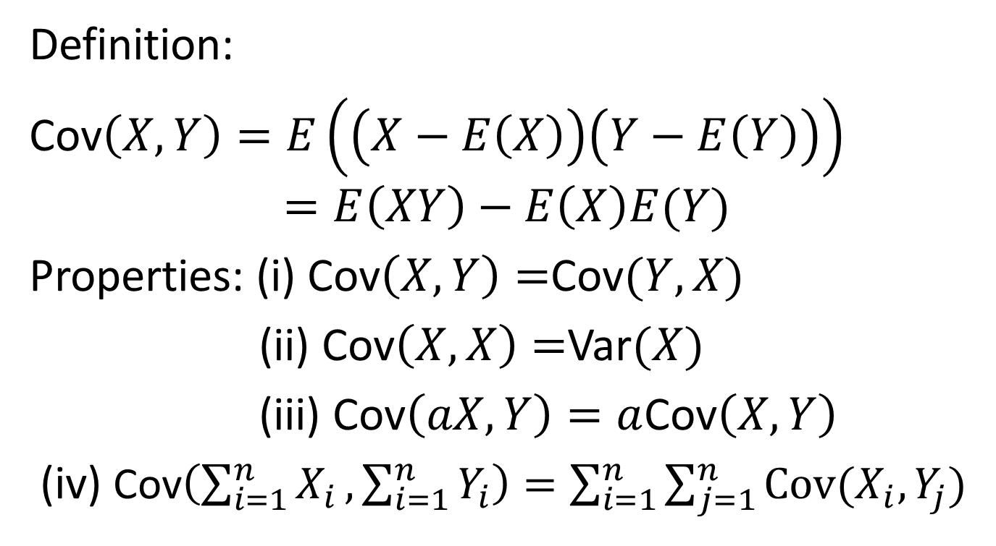
Covariance
Definition:
Cov$\left(X,Y\right)=E\left(\left(X−E\left(X\right)\right)\left(Y−E\left(Y\right)\right)\right)$
$$=E\left(XY\right)−E\left(X\right)E(Y)$$
Properties: (i) Cov$\left(X,Y\right)=$Cov$(Y,X)$
(ii) Cov$\left(X,X\right)=$Var$(X)$
(iii) Cov$\left(aX,Y\right)=a$Cov$\left(X,Y\right)$
(iv) Cov$\left(\sum_{i=1}^{n}{X_{i}},\sum_{i=1}^{n}{Y_{i}}\right)=\sum_{i=1}^{n}{\sum_{j=1}^{n}{Cov(X_{i}, Y_{j})}}$

Slide 2
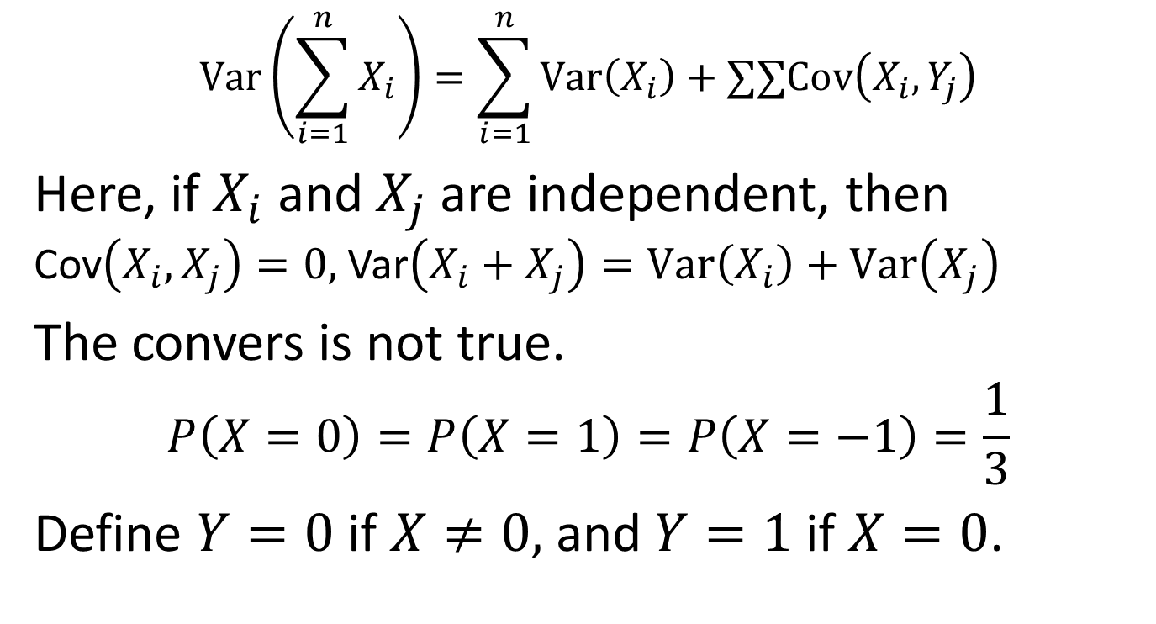
Variance versus covariance
$$Var\left(\sum_{i=1}^{n}{X_{i}}\right)=\sum_{i=1}^{n}{Var\left(X_{i}\right)}+∑∑Cov\left(X_{i},Y_{j}\right)$$
Here, if $X_{i}$ and $X_{j}$ are independent, then Cov$\left(X_{i},X_{j}\right)=0,$Var$\left(X_{i}+X_{j}\right)=Var\left(X_{i}\right)+Var\left(X_{j}\right)$
The convers is not true.
$$P\left(X=0\right)=P\left(X=1\right)=P\left(X=−1\right)=\frac{1}{3}$$
Define $Y=0$ if $X≠0,$ and $Y=1$ if $X=0$.

Slide 3
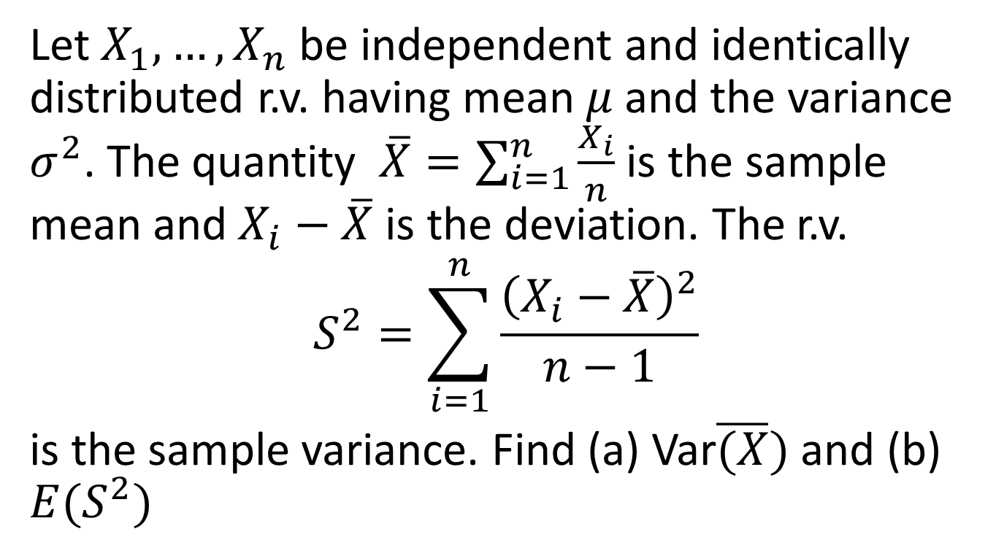
Example 1
Let $X_{1},…,X_{n}$ be independent and identically distributed r.v. having mean $μ$ and the variance $σ^{2}$. The quantity $\overline{X}=\sum_{i=1}^{n}{\frac{X_{i}}{n}}$ is the sample mean and $X_{i}−\overline{X}$ is the deviation. The r.v.
$$S^{2}=\sum_{i=1}^{n}{\frac{{\left(X_{i}−\overline{X}\right)}^{2}}{n−1} }$$
is the sample variance. Find (a) Var$\overline{(X})$ and (b) $E(S^{2})$

Slide 4

The correlation
$$ρ\left(X,Y\right)=\frac{Cov\left(X,Y\right)}{\sqrt{Var\left(X\right)Var(Y)}}$$
Property: $−1≤ρ\left(X,Y\right)≤1$

Slide 5
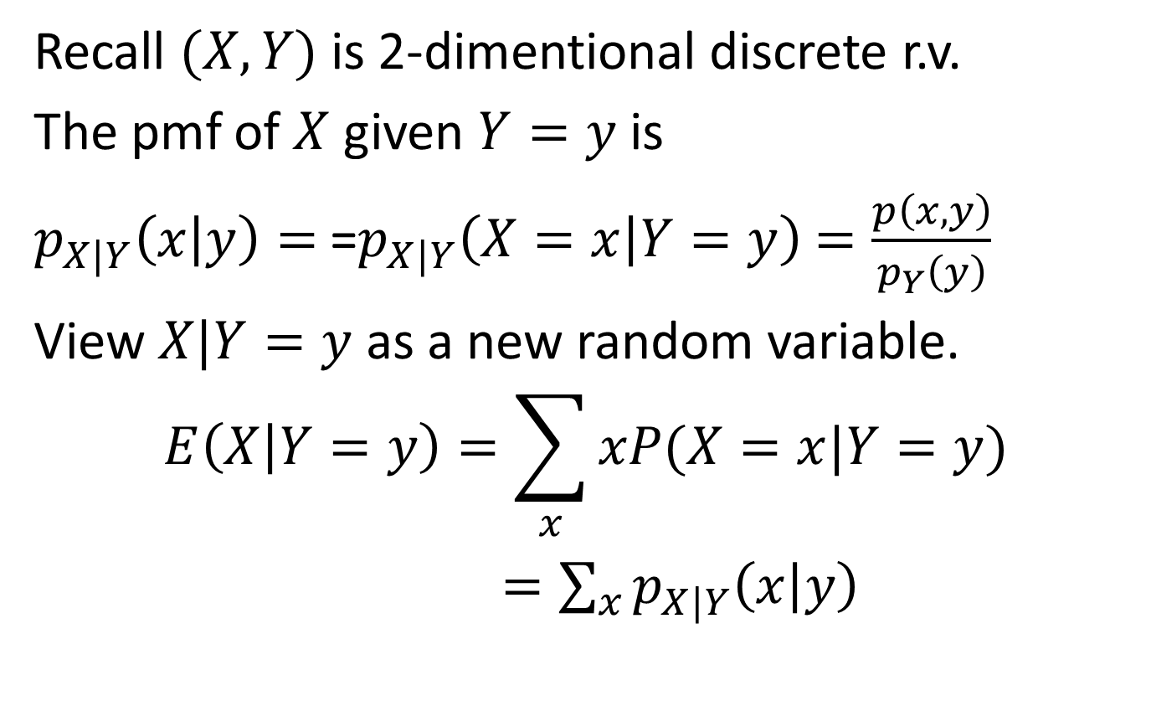
7.5 Conditional Expectation
Recall $(X,Y)$ is 2-dimentional discrete r.v.
The pmf of $X$ given $Y=y$ is
$p_{X|Y}\left(x | y\right)=$=$p_{X|Y}\left(X=x | Y=y\right)$ $=\frac{p\left(x,y\right)}{p_{Y}\left(y\right)}$
View $X|Y=y$ as a new random variable.
$$E\left(X | Y=y\right)=\sum_{x}{xP(X=x|Y=y)}$$
$=\sum_{x}{p_{X|Y}\left(x | y\right)}$

Slide 6

Example 1
If $X$ and $Y$ are independent binomial r.v. with identical parameters $n$ and $p,$ calculate the conditional expected value of $X$ given $X+Y=m$

Slide 7
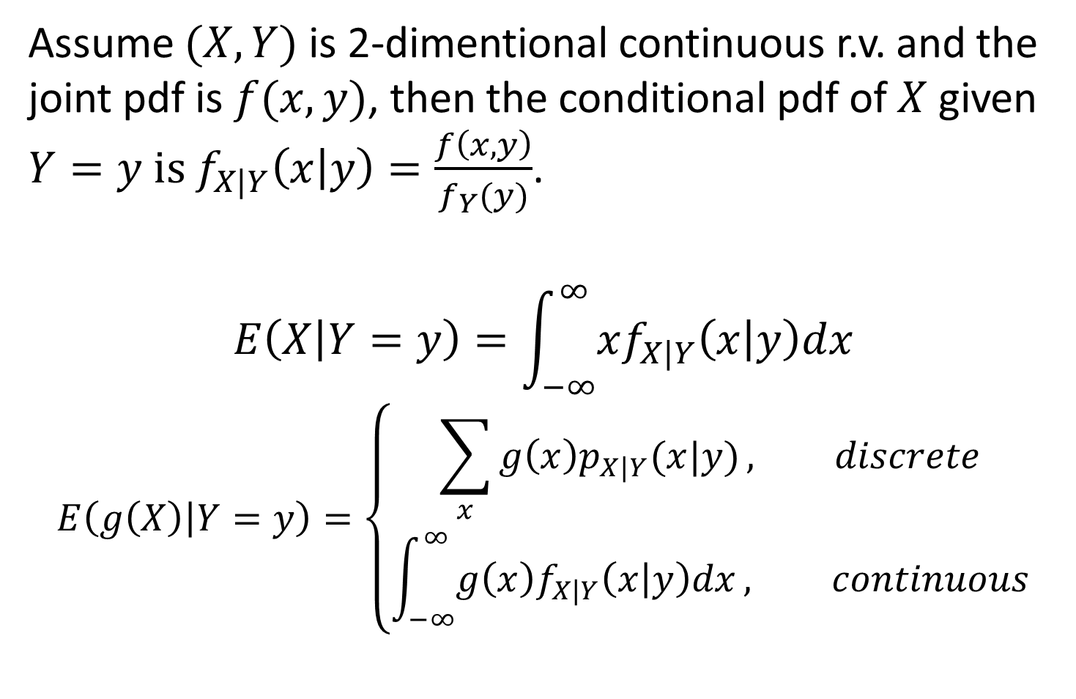
Assume $(X,Y)$ is 2-dimentional continuous r.v. and the joint pdf is $f(x,y)$, then the conditional pdf of $X$ given $Y=y is f_{X|Y}\left(x | y\right)=\frac{f\left(x,y\right)}{f_{Y}(y)}$.
$$E\left(X | Y=y\right)=\int_{−∞}^{∞}{xf_{X|Y}\left(x | y\right)dx}$$
$$E\left(g\left(X\right) | Y=y\right)=\left\{\begin{aligned}\sum_{x}{g\left(x\right)p_{X|Y}(x|y)}, discrete \\ &\int_{−∞}^{∞}{g\left(x\right)f_{X|Y}\left(x | y\right)dx}, continuous\end{aligned}\right.$$

Slide 8
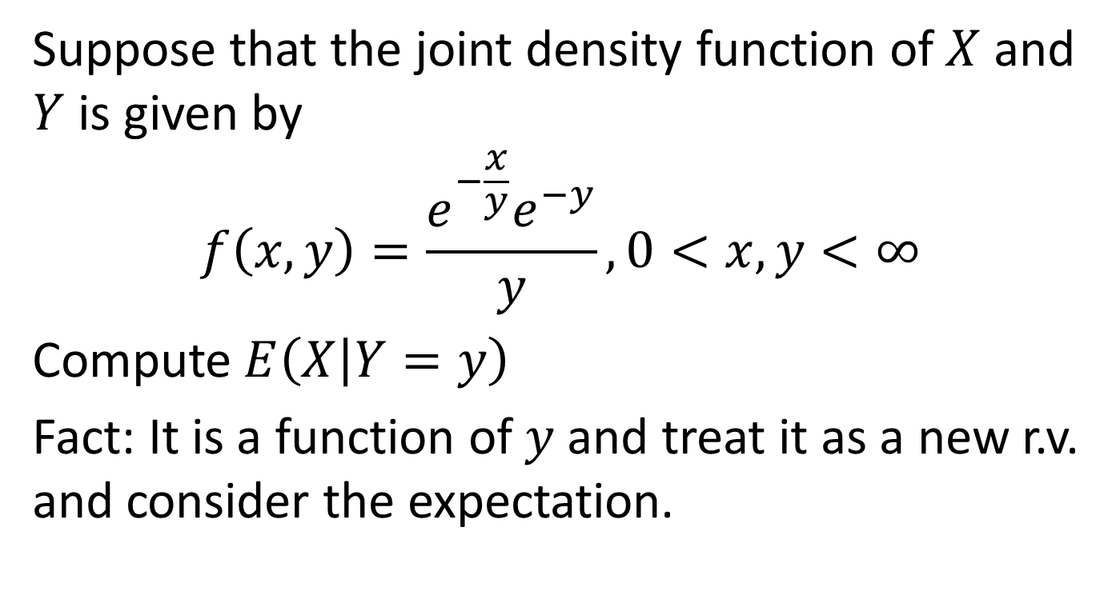
Example 2
Suppose that the joint density function of $X$ and $Y$ is given by
$$f\left(x,y\right)=\frac{e^{−\frac{x}{y}}e^{−y}}{y},0<x,y<∞$$
Compute $E\left(X | Y=y\right)$
Fact: It is a function of $y$ and treat it as a new r.v. and consider the expectation.

Slide 9

Proposition 5.1
The conditional expectation formula
$$E\left(X\right)=E(E(X|Y))$$

Slide 10
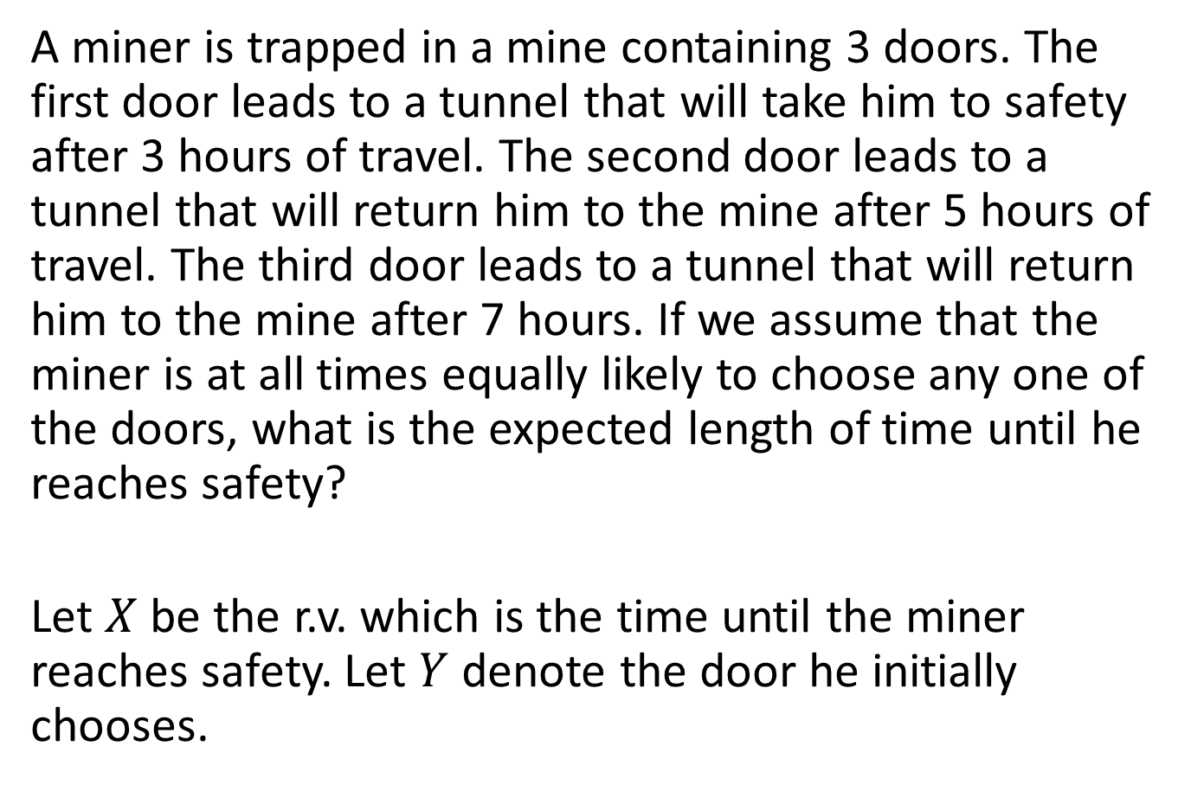
Example 3
A miner is trapped in a mine containing 3 doors. The first door leads to a tunnel that will take him to safety after 3 hours of travel. The second door leads to a tunnel that will return him to the mine after 5 hours of travel. The third door leads to a tunnel that will return him to the mine after 7 hours. If we assume that the miner is at all times equally likely to choose any one of the doors, what is the expected length of time until he reaches safety?
Let $X$ be the r.v. which is the time until the miner reaches safety. Let $Y$ denote the door he initially chooses.

Slide 11
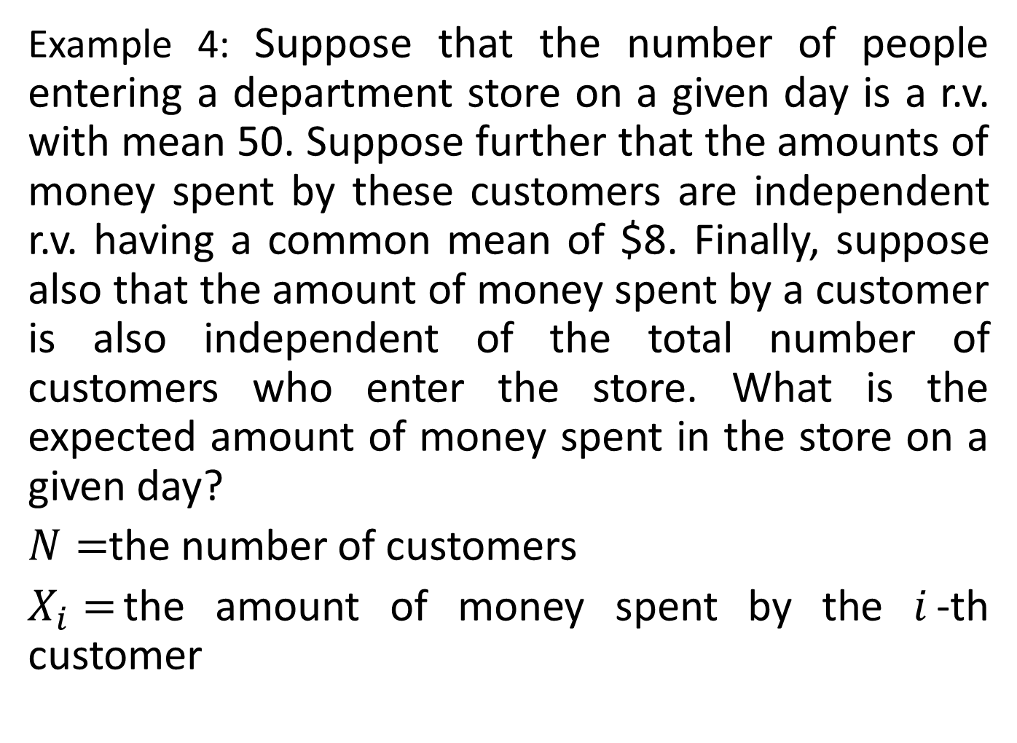
Example 4: Suppose that the number of people entering a department store on a given day is a r.v. with mean 50. Suppose further that the amounts of money spent by these customers are independent r.v. having a common mean of $8. Finally, suppose also that the amount of money spent by a customer is also independent of the total number of customers who enter the store. What is the expected amount of money spent in the store on a given day?
$N=$the number of customers
$X_{i}=$the amount of money spent by the $i$-th customer

Slide 12
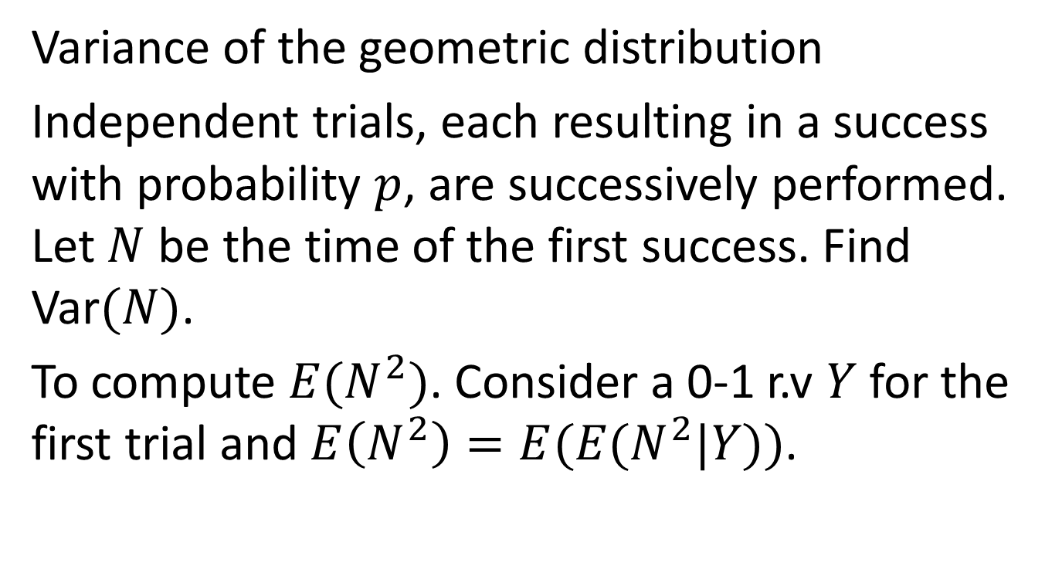
Example 5
Variance of the geometric distribution
Independent trials, each resulting in a success with probability $p$, are successively performed. Let $N$ be the time of the first success. Find Var$(N)$.
To compute $E(N^{2})$. Consider a 0-1 r.v $Y$for the first trial and $E\left(N^{2}\right)=E(E(N^{2}|Y))$.

Slide 13
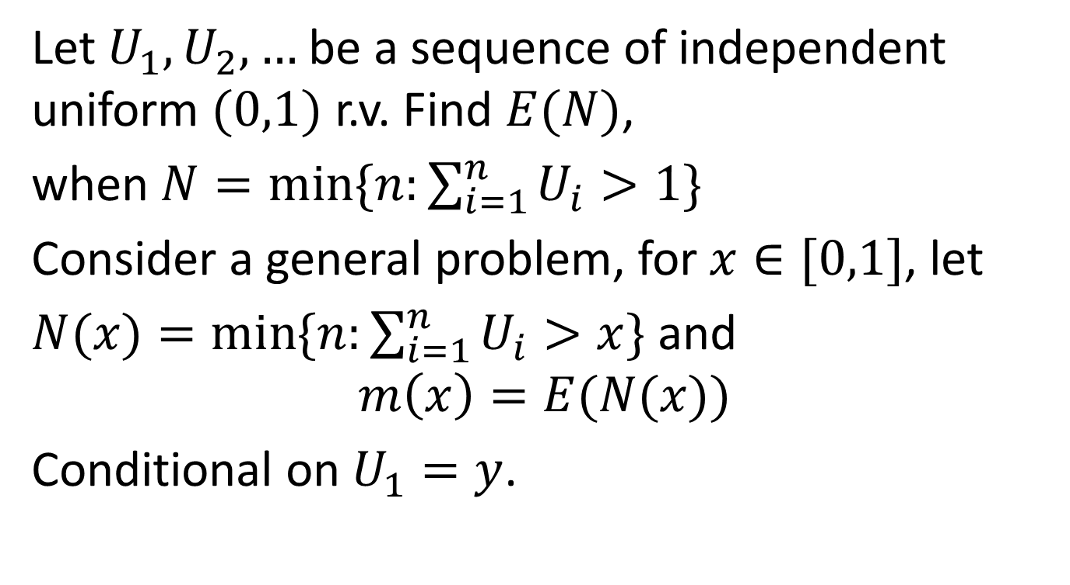
Example 6
Let $U_{1}, U_{2},…$be a sequence of independent uniform $(0,1)$ r.v. Find $E(N)$,
when $N=\min{\{n:\sum_{i=1}^{n}{U_{i}}>1\}}$
Consider a general problem, for $x∈[0,1]$, let
$N(x)=\min{\{n:\sum_{i=1}^{n}{U_{i}}>x\}}$ and
$$m\left(x\right)=E(N(x))$$
Conditional on $U_{1}=y$.

Slide 14
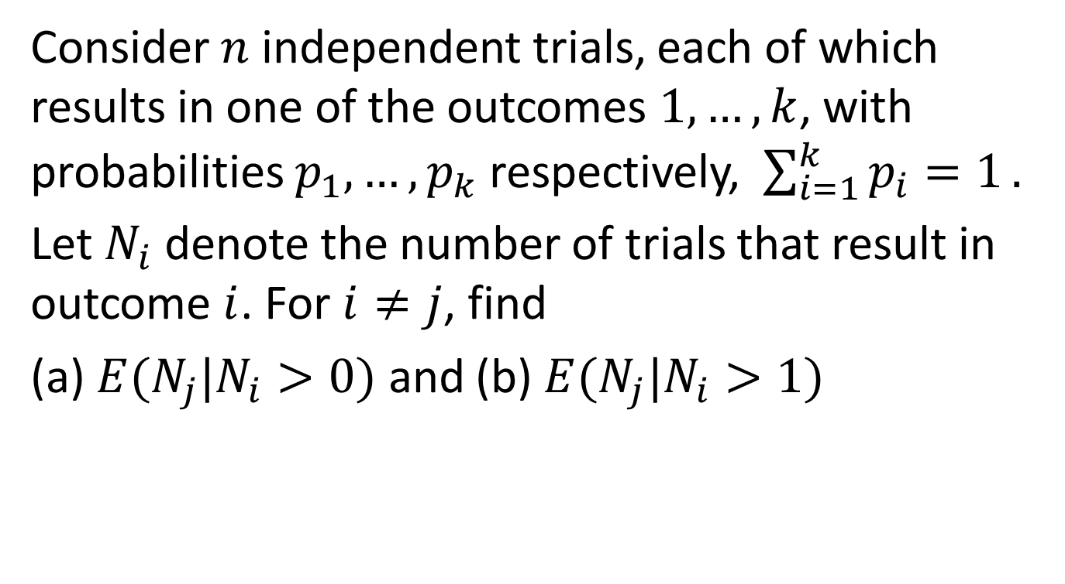
Example 7
Consider $n$ independent trials, each of which results in one of the outcomes $1,…,k$, with probabilities $p_{1},…,p_{k}$ respectively, $\sum_{i=1}^{k}{p_{i}=1}.$
Let $N_{i}$ denote the number of trials that result in outcome $i$. For $i≠j$, find
(a) $E(N_{j}|N_{i}>0)$ and (b) $E(N_{j}|N_{i}>1)$

Slide 15
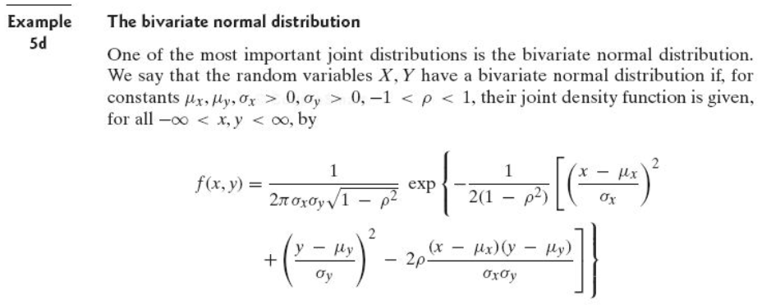

Example 8
Show the correlation of $X$ and $Y$ is $ρ$.
Recall: marginal distribution is normal.
$f_{X|Y}\left(x | y\right)$ is normal with mean $μ_{x}+ρ(y−μ_{y})\frac{σ_{x}}{σ_{y}}$
To compute $E\left(XY\right)=E(XY|Y)$.

