Slide 1
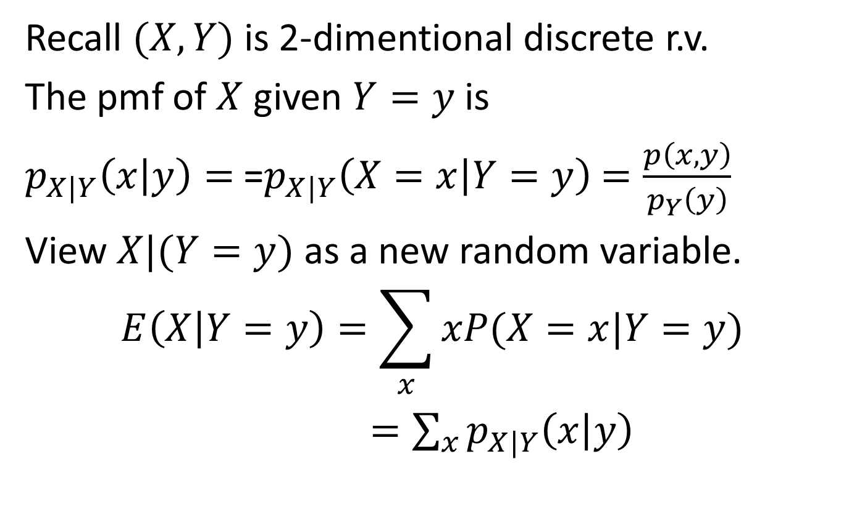
Conditional Expectation: recall
Recall $(X,Y)$ is 2-dimentional discrete r.v.
The pmf of $X$ given $Y=y$ is
$p_{X|Y}\left(x | y\right)=$=$p_{X|Y}\left(X=x | Y=y\right)$ $=\frac{p\left(x,y\right)}{p_{Y}\left(y\right)}$
View $X|(Y=y)$ as a new random variable.
$$E\left(X | Y=y\right)=\sum_{x}{xP(X=x|Y=y)}$$
$=\sum_{x}{p_{X|Y}\left(x | y\right)}$

Slide 2
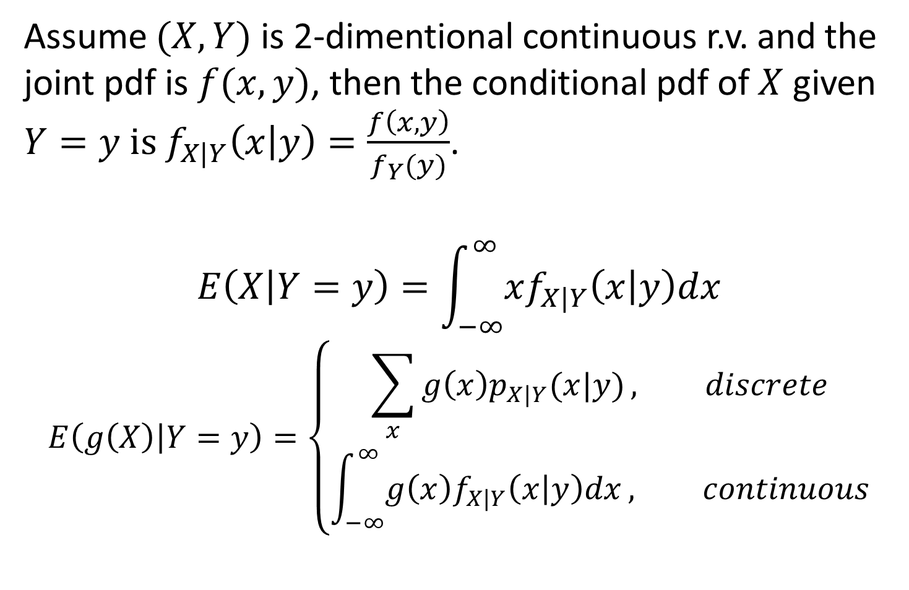
Assume $(X,Y)$ is 2-dimentional continuous r.v. and the joint pdf is $f(x,y)$, then the conditional pdf of $X$ given $Y=y is f_{X|Y}\left(x | y\right)=\frac{f\left(x,y\right)}{f_{Y}(y)}$.
$$E\left(X | Y=y\right)=\int_{−∞}^{∞}{xf_{X|Y}\left(x | y\right)dx}$$
$$E\left(g\left(X\right) | Y=y\right)=\left\{\begin{aligned}\sum_{x}{g\left(x\right)p_{X|Y}(x|y)}, discrete \\ &\int_{−∞}^{∞}{g\left(x\right)f_{X|Y}\left(x | y\right)dx}, continuous\end{aligned}\right.$$

Slide 3
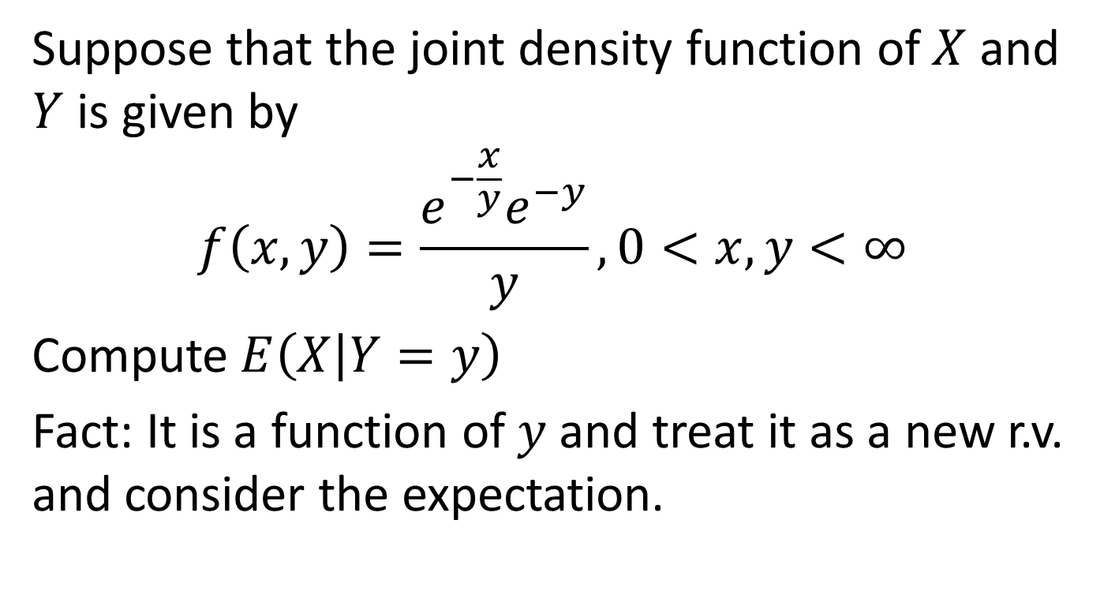
Example 2
Suppose that the joint density function of $X$ and $Y$ is given by
$$f\left(x,y\right)=\frac{e^{−\frac{x}{y}}e^{−y}}{y},0<x,y<∞$$
Compute $E\left(X | Y=y\right)$
Fact: It is a function of $y$ and treat it as a new r.v. and consider the expectation.

Slide 4

Proposition 5.1
The conditional expectation formula
$$E\left(X\right)=E(E(X|Y))$$

Slide 5
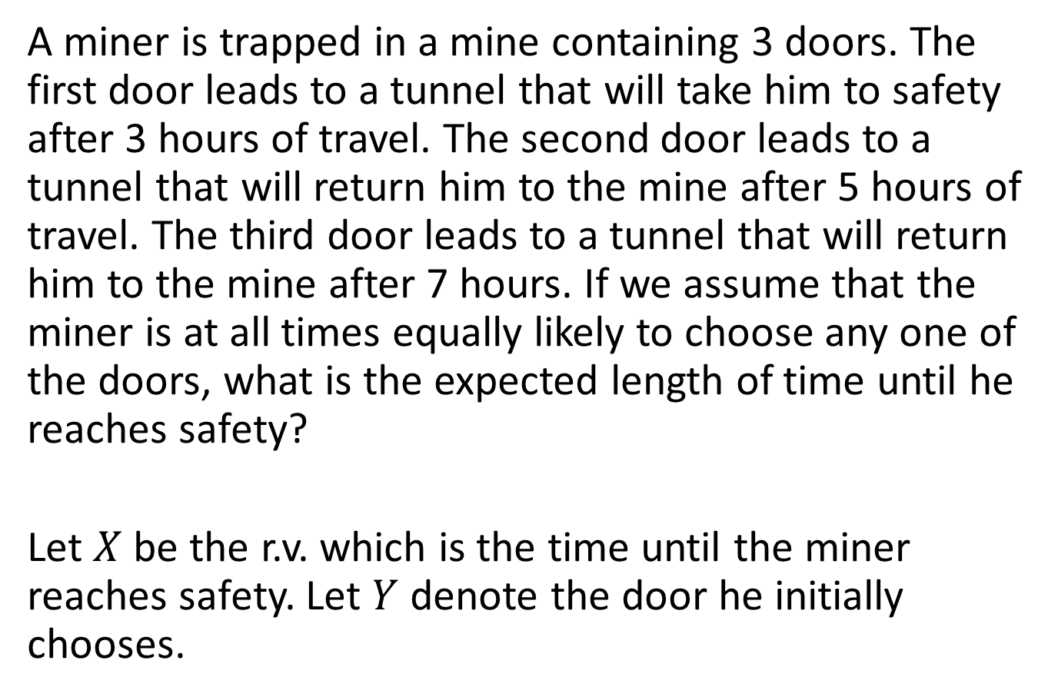
Example 3
A miner is trapped in a mine containing 3 doors. The first door leads to a tunnel that will take him to safety after 3 hours of travel. The second door leads to a tunnel that will return him to the mine after 5 hours of travel. The third door leads to a tunnel that will return him to the mine after 7 hours. If we assume that the miner is at all times equally likely to choose any one of the doors, what is the expected length of time until he reaches safety?
Let $X$ be the r.v. which is the time until the miner reaches safety. Let $Y$ denote the door he initially chooses.

Slide 6
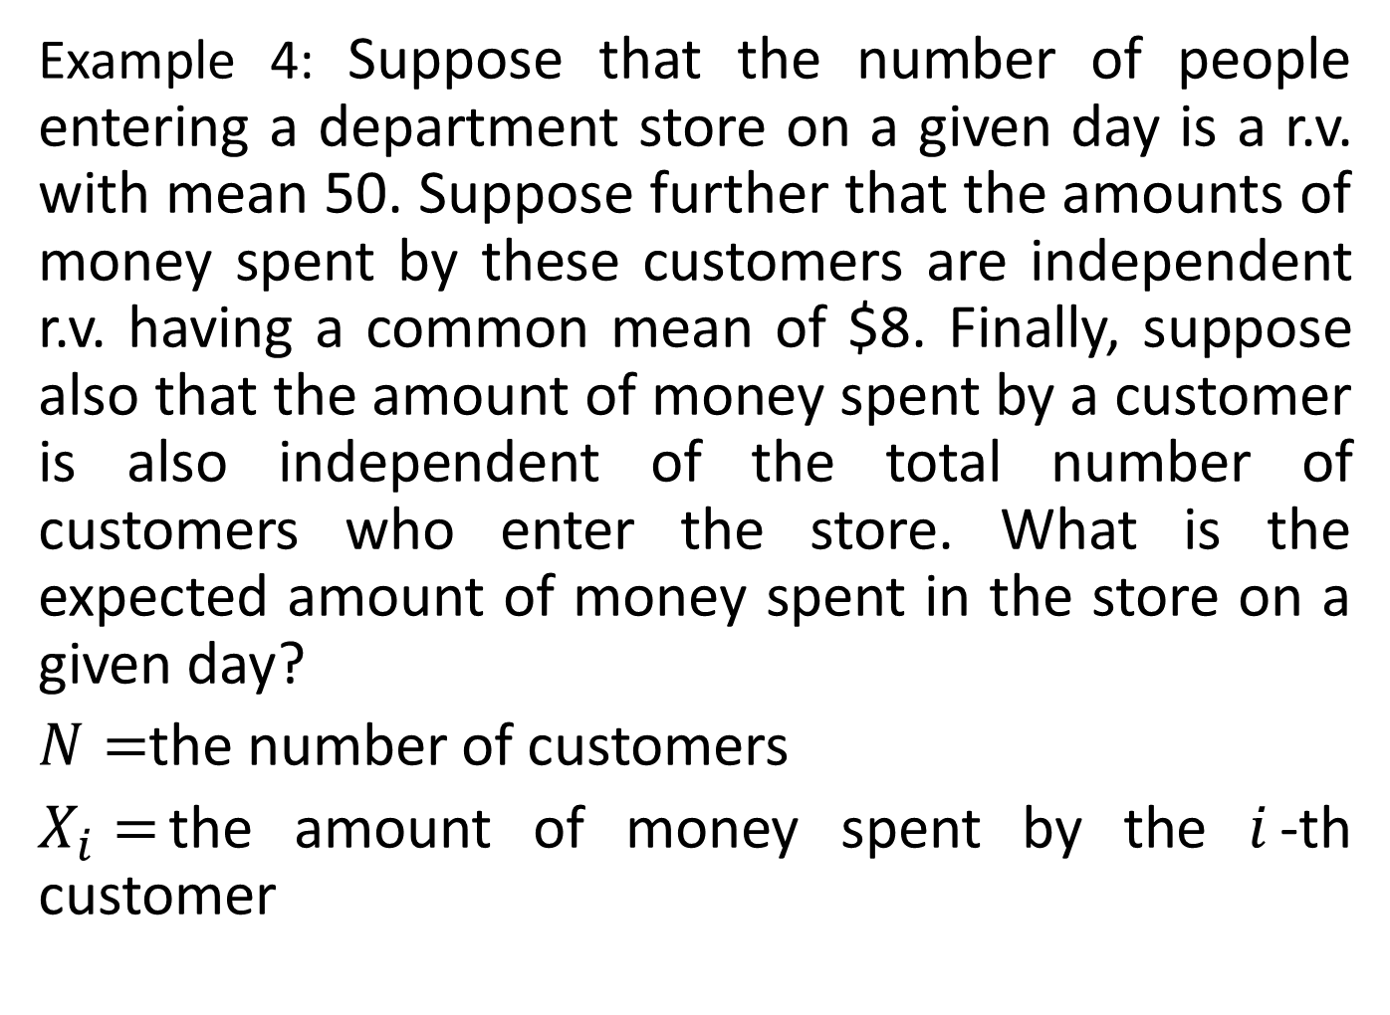
Example 4: Suppose that the number of people entering a department store on a given day is a r.v. with mean 50. Suppose further that the amounts of money spent by these customers are independent r.v. having a common mean of $8. Finally, suppose also that the amount of money spent by a customer is also independent of the total number of customers who enter the store. What is the expected amount of money spent in the store on a given day?
$N=$the number of customers
$X_{i}=$the amount of money spent by the $i$-th customer

Slide 7
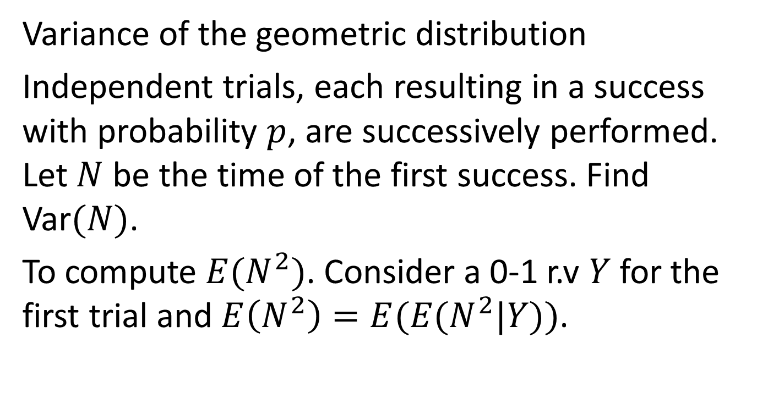
Example 5
Variance of the geometric distribution
Independent trials, each resulting in a success with probability $p$, are successively performed. Let $N$ be the time of the first success. Find Var$(N)$.
To compute $E(N^{2})$. Consider a 0-1 r.v $Y$for the first trial and $E\left(N^{2}\right)=E(E(N^{2}|Y))$.

Slide 8
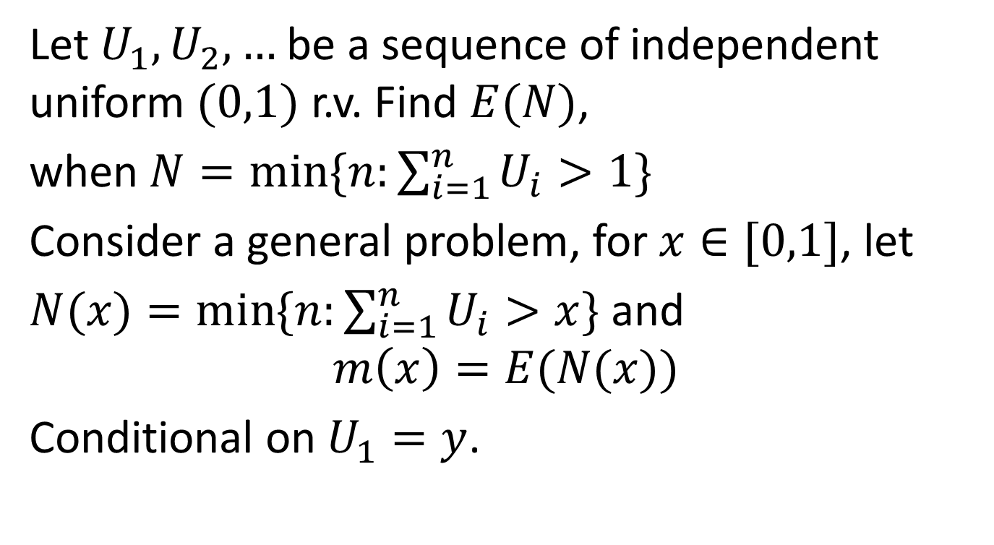
Example 6
Let $U_{1}, U_{2},…$be a sequence of independent uniform $(0,1)$ r.v. Find $E(N)$,
when $N=\min{\{n:\sum_{i=1}^{n}{U_{i}}>1\}}$
Consider a general problem, for $x∈[0,1]$, let
$N(x)=\min{\{n:\sum_{i=1}^{n}{U_{i}}>x\}}$ and
$$m\left(x\right)=E(N(x))$$
Conditional on $U_{1}=y$.

Slide 9
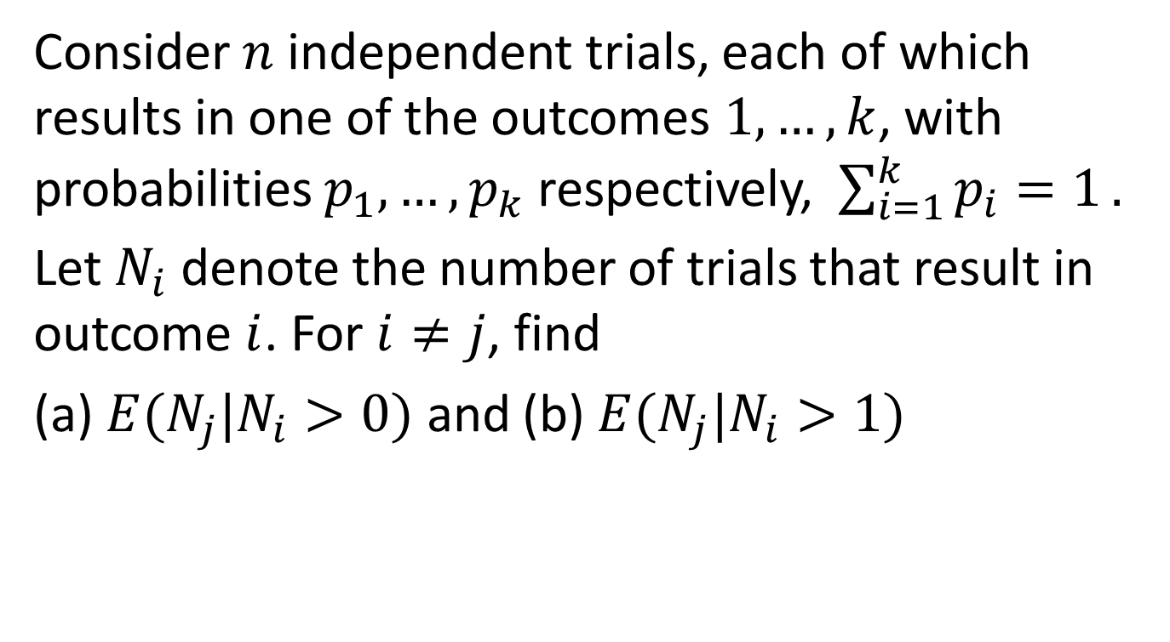
Example 7
Consider $n$ independent trials, each of which results in one of the outcomes $1,…,k$, with probabilities $p_{1},…,p_{k}$ respectively, $\sum_{i=1}^{k}{p_{i}=1}.$
Let $N_{i}$ denote the number of trials that result in outcome $i$. For $i≠j$, find
(a) $E(N_{j}|N_{i}>0)$ and (b) $E(N_{j}|N_{i}>1)$

Slide 10
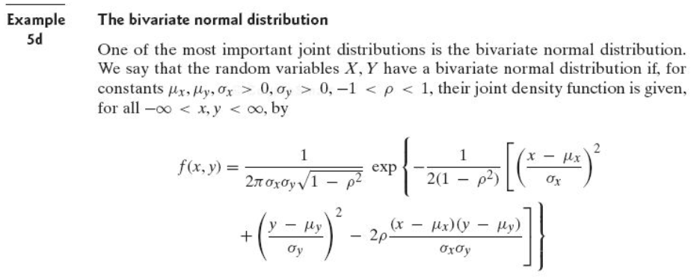

Example 8
Show the correlation of $X$ and $Y$ is $ρ$.
Recall: marginal distribution is normal.
$f_{X|Y}\left(x | y\right)$ is normal with mean $μ_{x}+ρ(y−μ_{y})\frac{σ_{x}}{σ_{y}}$
To compute $E\left(XY\right)=E(XY|Y)$.

Slide 11
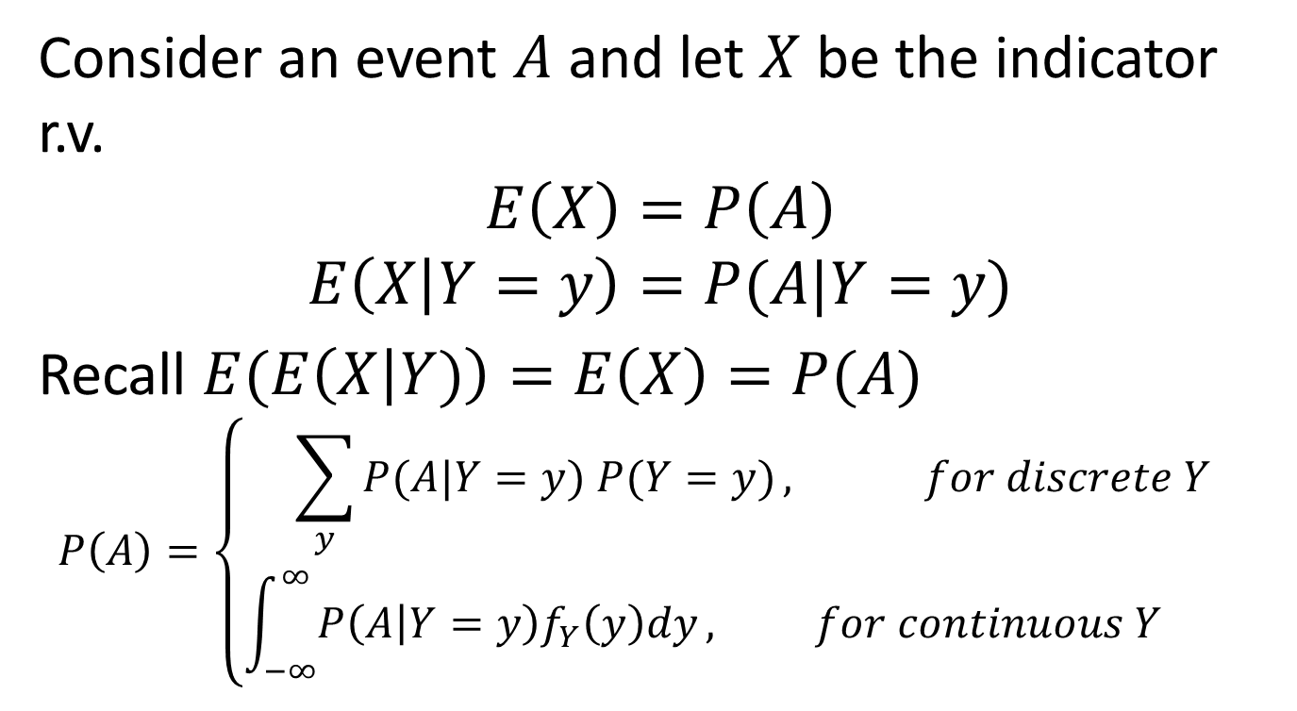
7.5.3 Computing probabilities by conditioning
Consider an event $A$ and let $X$ be the indicator r.v.
$$E\left(X\right)=P\left(A\right)$$
$$E\left(X | Y=y\right)=P(A|Y=y)$$
Recall $E(E\left(X | Y)\right)=E\left(X\right)=P(A)$
$$P\left(A\right)=\left\{\begin{aligned}\sum_{y}{P(A|Y=y) P(Y=y)}, for discrete Y \\ &\int_{−∞}^{∞}{P\left(A | Y=y\right)f_{Y}\left(y\right)dy}, for continuous Y \end{aligned}\right.$$

Slide 12

For discrete $Y$, let $B_{i}=\{Y=y_{i}\}$ be an event.
$$P\left(A\right)=\sum_{i=1}^{n}{P\left(A | B_{i}\right)P(B_{i})}$$
is the law of total probability.

Slide 13

Example 1
Let $U$ be a uniform r.v. on $\left(0,1\right)$, and suppose that the conditional distribution of $X$, given that $U=p$, is the binomial with parameters $n$ and $p$. Find the probability mass function of $X$.

Slide 14
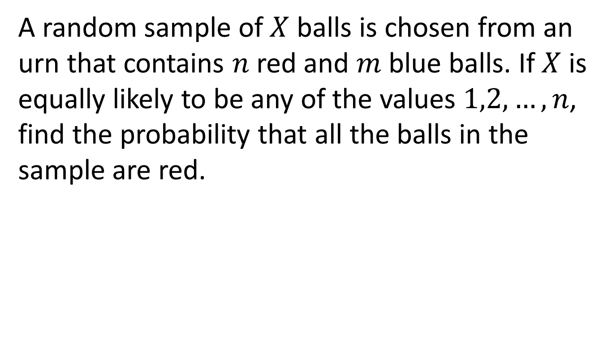
Example 2
A random sample of $X$ balls is chosen from an urn that contains $n$ red and $m$ blue balls. If $X$ is equally likely to be any of the values $1,2,…,n$, find the probability that all the balls in the sample are red.

Slide 15

Example 3
Suppose that $X$ and $Y$ are independent continuous random variables having densities $f_{X}$ and $f_{Y}$, respectively. Compute $P(X<Y)$.

Slide 16
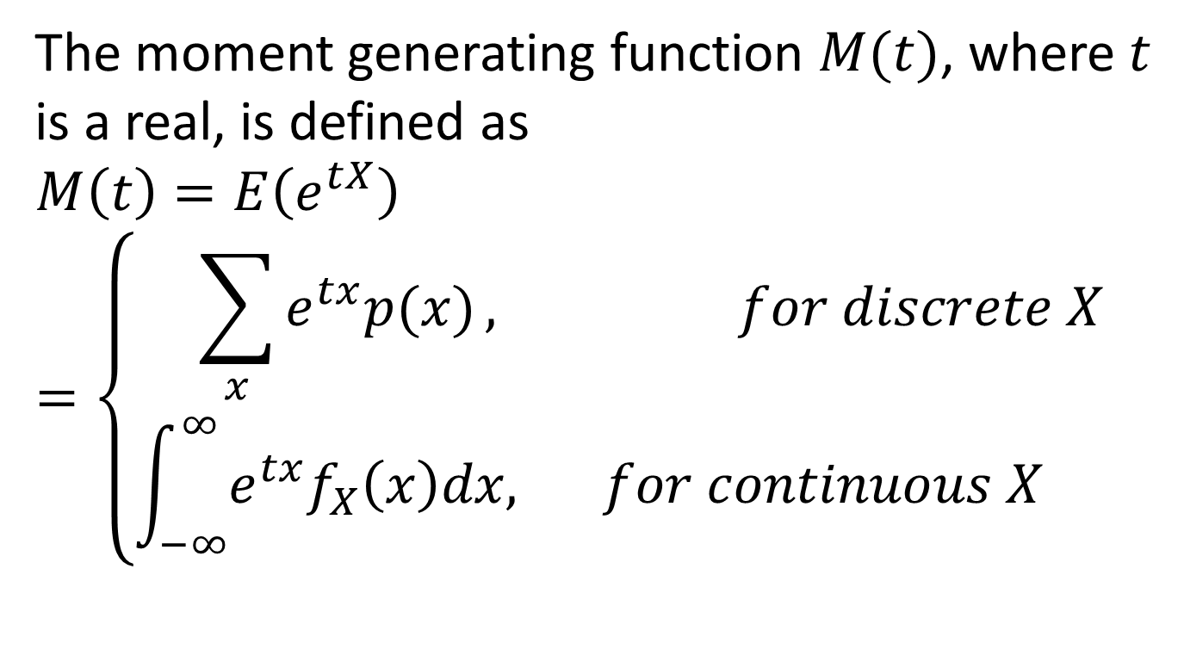
7.7 Moment generating functions
The moment generating function $M(t)$, where $t$ is a real, is defined as
$$M\left(t\right)=E\left(e^{tX}\right)=\left\{\begin{aligned}\sum_{x}{e^{tx}p(x)}, for discrete X \\ &\int_{−∞}^{∞}{e^{tx}f_{X}\left(x\right)dx,} for continuous X \end{aligned}\right.$$

Slide 17
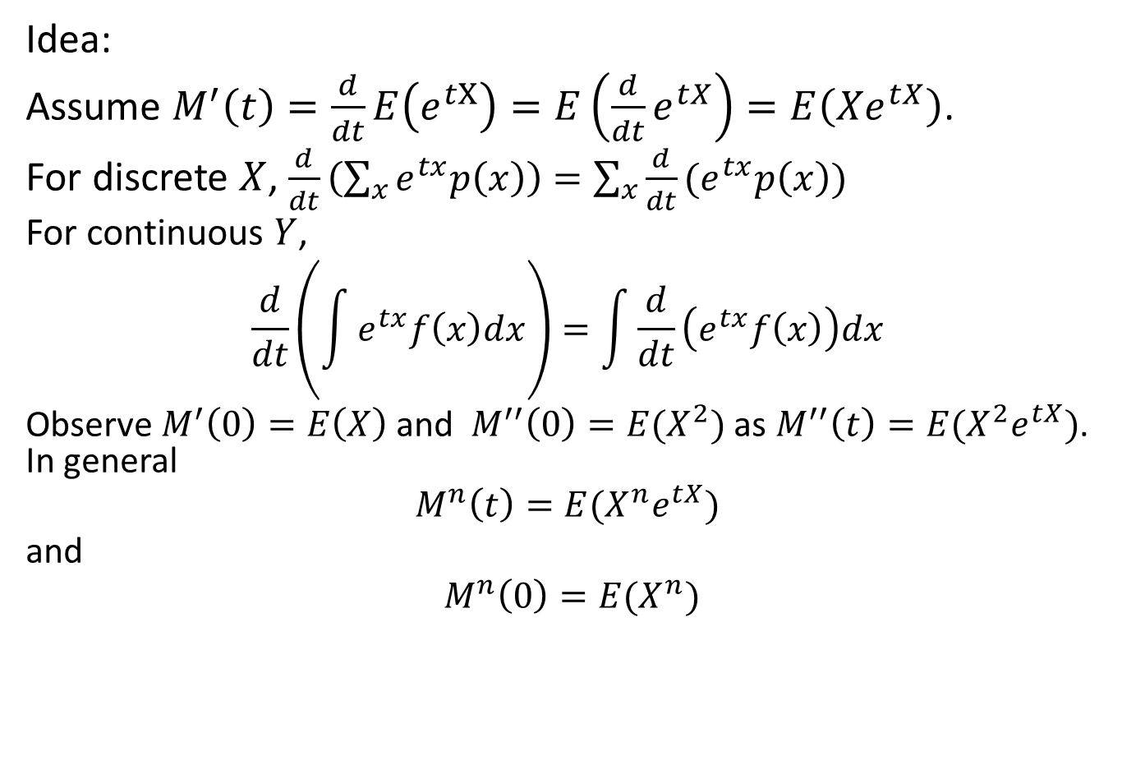
Idea:
Assume $M^{′}\left(t\right)=\frac{d}{dt}E\left(e^{tX}\right)=E\left(\frac{d}{dt}e^{tX}\right)=E\left(Xe^{tX}\right)$.
For discrete $X$, $\frac{d}{dt}\left(\sum_{x}{e^{tx}p\left(x\right)}\right)=\sum_{x}{\frac{d}{dt}(e^{tx}p\left(x\right))}$
For continuous $Y$,
$$\frac{d}{dt}\left(\int{e^{tx}f\left(x\right)dx}\right)=\int{\frac{d}{dt}\left(e^{tx}f\left(x\right)\right)dx}$$
Observe $M^{′}\left(0\right)=E\left(X\right)$ and $M^{′′}\left(0\right)=E(X^{2})$ as $M^{′′}\left(t\right)=E(X^{2}e^{tX})$. In general
$$M^{n}\left(t\right)=E(X^{n}e^{tX})$$
and
$M^{n}\left(0\right)=E(X^{n})$

Slide 18

Examples
Binomial distribution with parameters $(n,p)$
Poisson distribution with mean $λ$
Exponential distribution with parameter $λ$
4. Normal distribution

