Slide 1
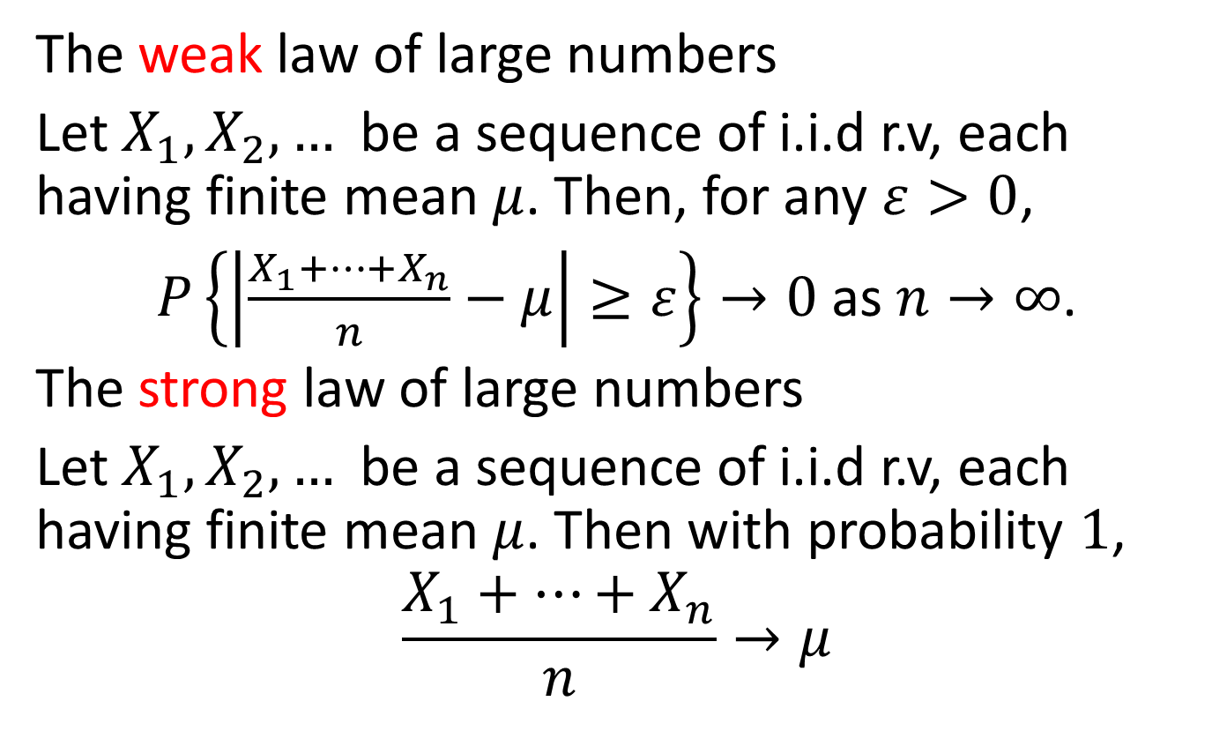
Limit theorems
The weak law of large numbers
Let $X_{1},X_{2},…$ be a sequence of i.i.d r.v, each having finite mean $μ$. Then, for any $ε>0$,
$P\left\{\left|\frac{X_{1}+⋯+X_{n}}{n}−μ\right|≥ε\right\}→0$ as $n→∞$.
The strong law of large numbers
Let $X_{1},X_{2},…$ be a sequence of i.i.d r.v, each having finite mean $μ$. Then with probability $1$,
$$\frac{X_{1}+⋯+X_{n}}{n}→μ$$

Slide 2

Markov inequality
If $X$ is a r.v. taking nonnegative values, then for any $a>0$,
$P\left\{X≥a\right\}≤\frac{E\left(X\right)}{a}$.

Slide 3

Chebyshev inequality
If $X$ is a r.v. with finite mean $μ$ and variance $σ^{2}$, then for any $k>0$,
$$P\left\{\left|X−μ\right|≥k\right\}≤\frac{σ^{2}}{k^{2}}$$

Slide 4
Example 1
Suppose that it is known that the number of items produced in a factory during a week is a r.v. with mean 50.
(a)What can be said about the probability that this week’s production will exceed 75?
(b)If the variance of a week’s production is known to equal 25, then what can be said about the probability that this week’s production will be between 40 and 60?

Slide 5
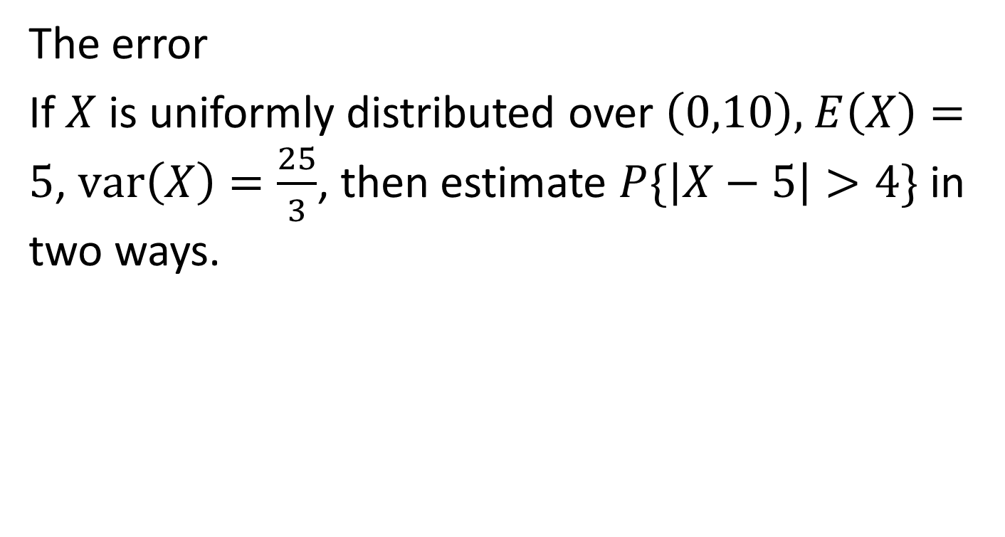
Example 2
The error
If $X$ is uniformly distributed over $\left(0,10\right),$ $E\left(X\right)=5$, $var\left(X\right)=\frac{25}{3}$, then estimate $P\{\left|X−5\right|>4\}$ in two ways.

Slide 6

Example 3
If var$\left(X\right)=0$, then $P\left\{X=E\left(X\right)\right\}=1$.

Slide 7
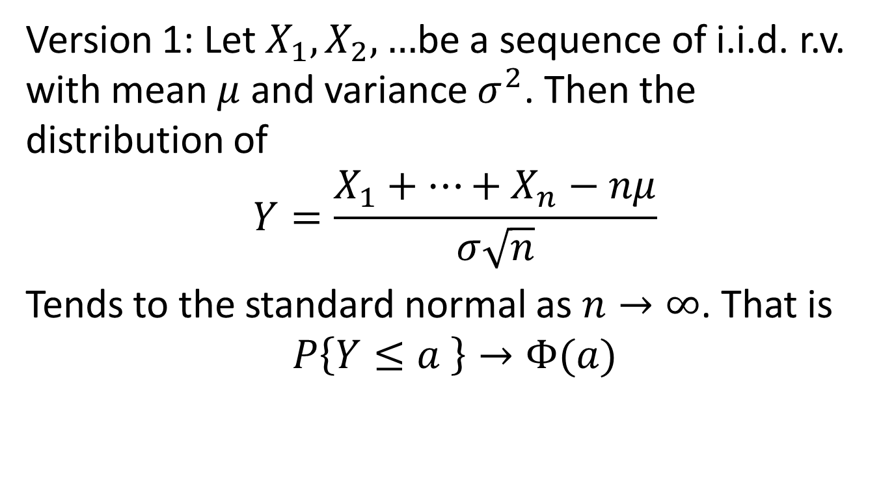
The central limit theorem
Version 1: Let $X_{1},X_{2},…$be a sequence of i.i.d. r.v. with mean $μ$ and variance $σ^{2}$. Then the distribution of
$$Y=\frac{X_{1}+⋯+X_{n}−nμ}{σ\sqrt{n}}$$
Tends to the standard normal as $n→∞$. That is
$$P\left\{Y≤a \right\}→Φ(a)$$

Slide 8
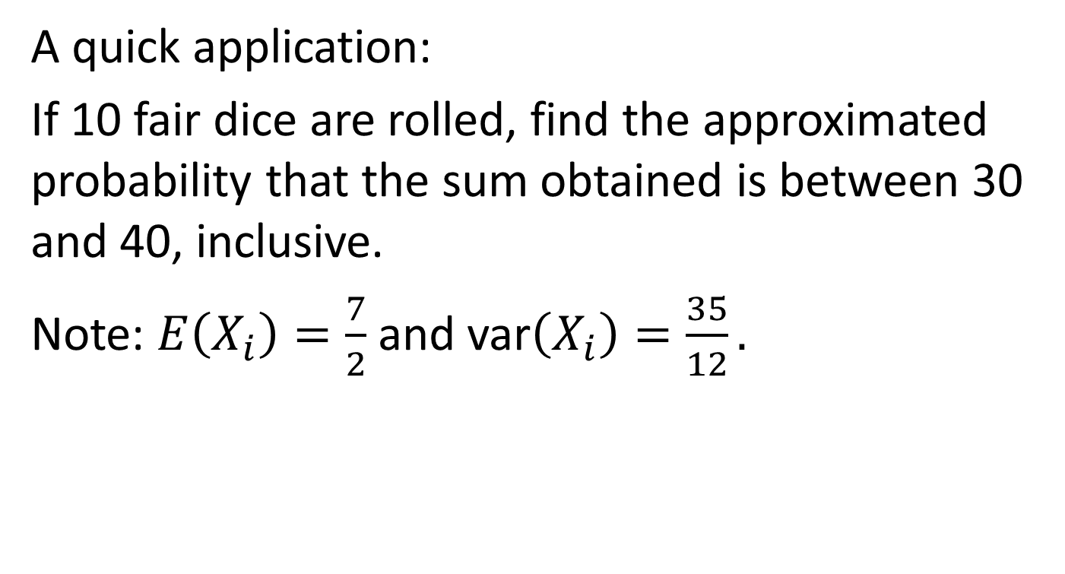
Example 4
A quick application:
If 10 fair dice are rolled, find the approximated probability that the sum obtained is between 30 and 40, inclusive.
Note: $E\left(X_{i}\right)=\frac{7}{2}$ and var$\left(X_{i}\right)=\frac{35}{12}.$

Slide 9
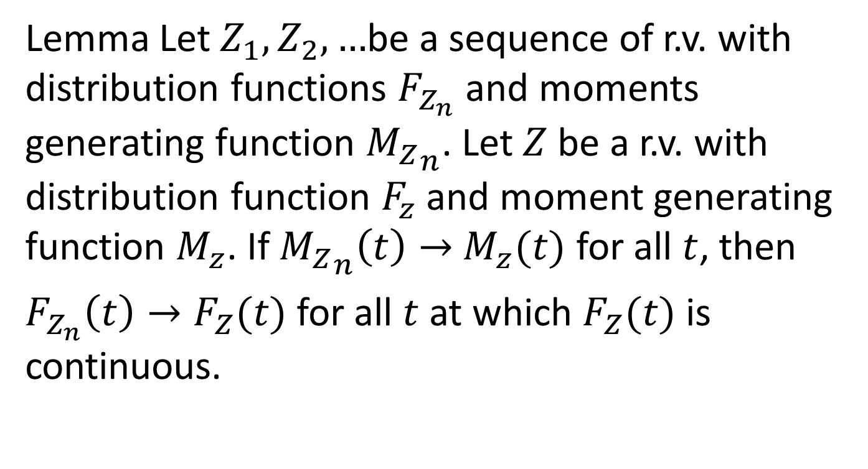
Lemma Let $Z_{1},Z_{2},…$be a sequence of r.v. with distribution functions $F_{Z_{n}}$ and moments generating function ${M_{Z}}_{n}$. Let $Z$ be a r.v. with distribution function $F_{z}$ and moment generating function $M_{z}$. If ${M_{Z}}_{n}\left(t\right)→$ $M_{z}(t)$ for all $t$, then
$F_{Z_{n}}\left(t\right)→F_{Z}(t)$ for all $t$ at which $F_{Z}(t)$ is continuous.

Slide 10
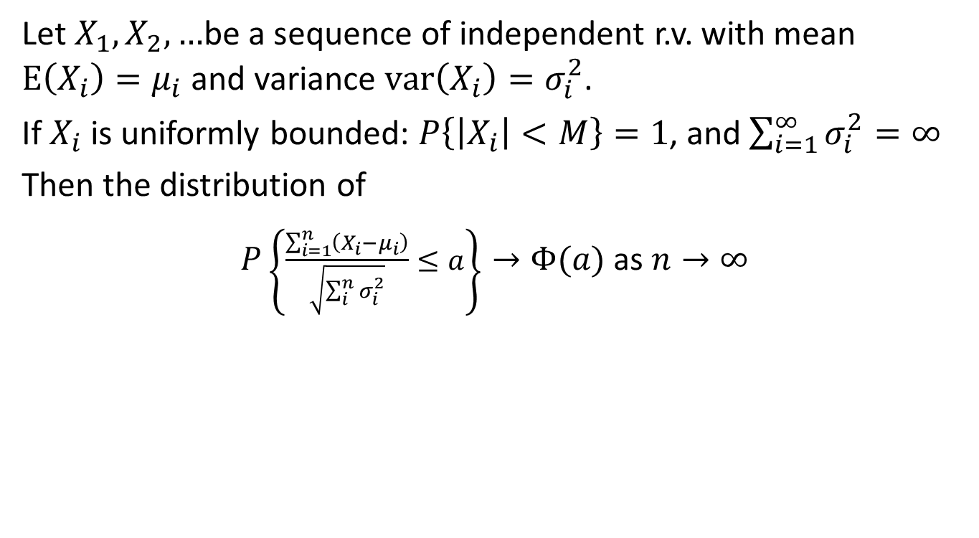
Central limit theorem for independent r.v.s
Let $X_{1},X_{2},…$be a sequence of independent r.v. with mean $E\left(X_{i}\right)=μ_{i}$ and variance $var\left(X_{i}\right)=σ_{i}^{2}$.
If $X_{i}$ is uniformly bounded: $P\left\{\left|X_{i}\right|<M\right\}=1$, and $\sum_{i=1}^{∞}{σ_{i}^{2}=∞}$
Then the distribution of
$P\left\{\frac{\sum_{i=1}^{n}{\left(X_{i}−μ_{i}\right)}}{\sqrt{\sum_{i}^{n}{σ_{i}^{2}}}}≤a\right\}→Φ(a)$ as $n→∞$

Slide 11
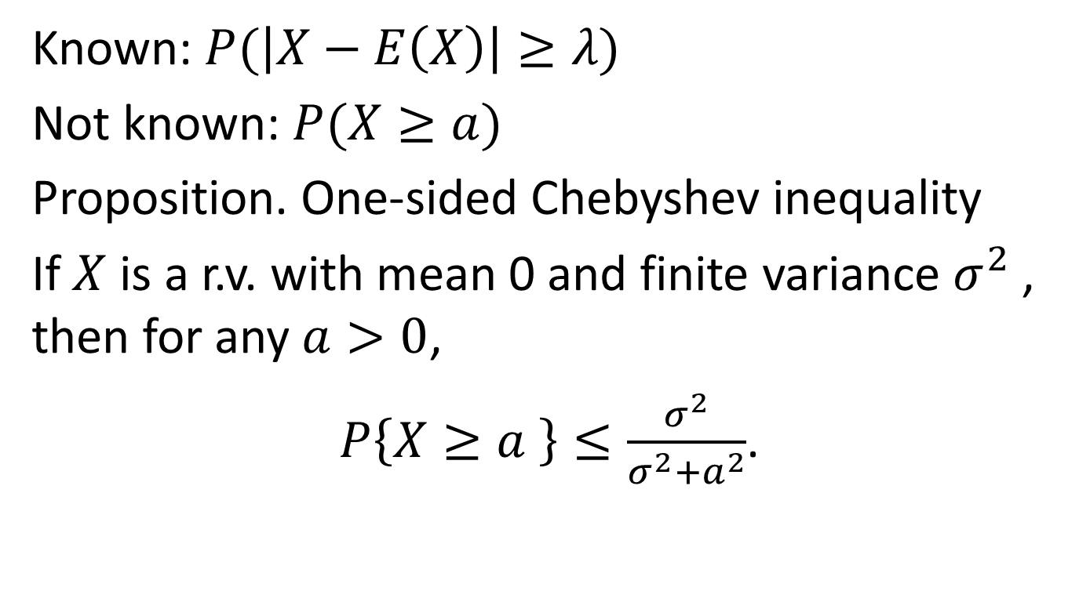
Other inequalities
Known: $P(\left|X−E\left(X\right)\right|≥λ)$
Not known: $P(X≥a)$
Proposition. One-sided Chebyshev inequality
If $X$ is a r.v. with mean 0 and finite variance $σ^{2}$, then for any $a>0$,
$P\left\{X≥a \right\}≤\frac{σ^{2}}{σ^{2}+a^{2}}$.

Slide 12
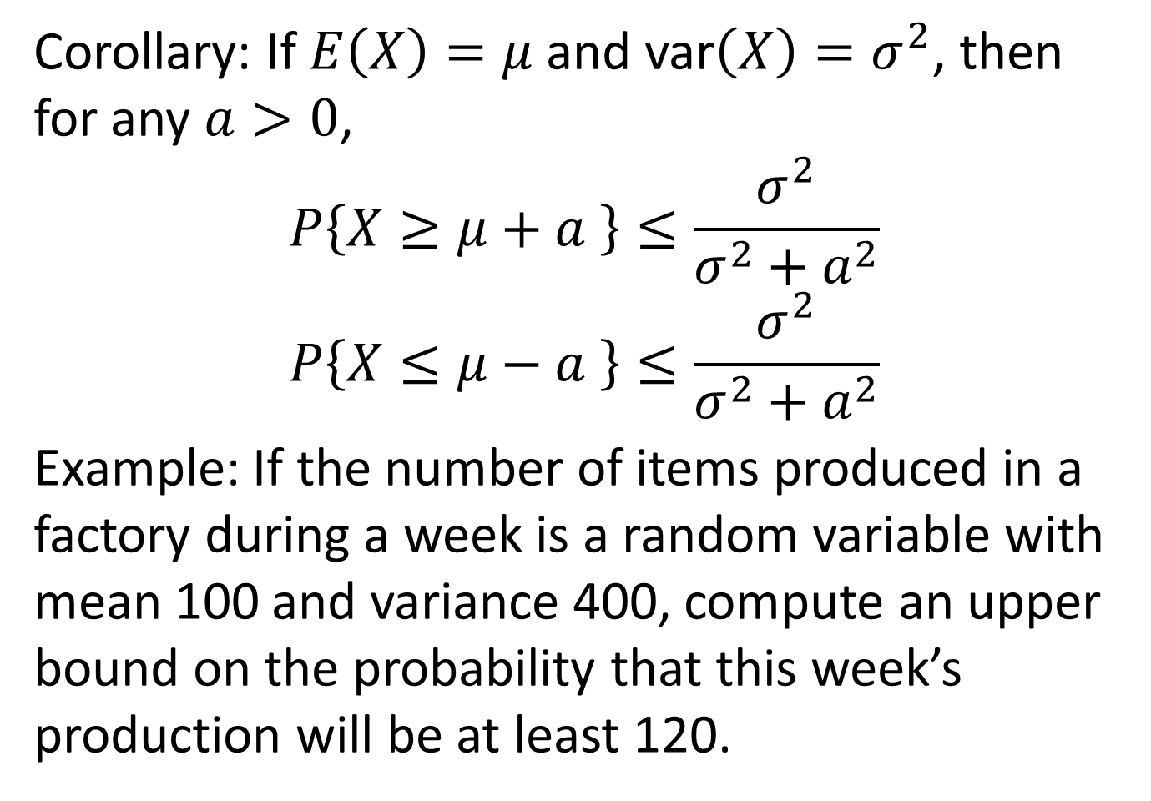
Corollary: If $E\left(X\right)=μ$ and var$\left(X\right)=σ^{2}$, then for any $a>0$,
$$P\left\{X≥μ+a \right\}≤\frac{σ^{2}}{σ^{2}+a^{2}}$$
$$P\left\{X≤μ−a \right\}≤\frac{σ^{2}}{σ^{2}+a^{2}}$$
Example: If the number of items produced in a factory during a week is a random variable with mean 100 and variance 400, compute an upper bound on the probability that this week’s production will be at least 120.

