Slide 1

8.5 Chernoff bounds
Proposition:
$P\left\{X≥a\right\}≤e^{−ta}M(t)$ for all $t>0$
$P\left\{X≤a\right\}≤e^{−ta}M(t)$ for all $t<0$
Choose $t$ properly to minimize the upper bound.

Slide 2

The standard normal r.v.
Let $X$ be the standard normal r.v.
$P\left\{X≥a\right\}≤e^{−a^{2}/2}$ and $P\left\{X≤a\right\}≤e^{−a^{2}/2}$
Exponentially decay

Slide 3
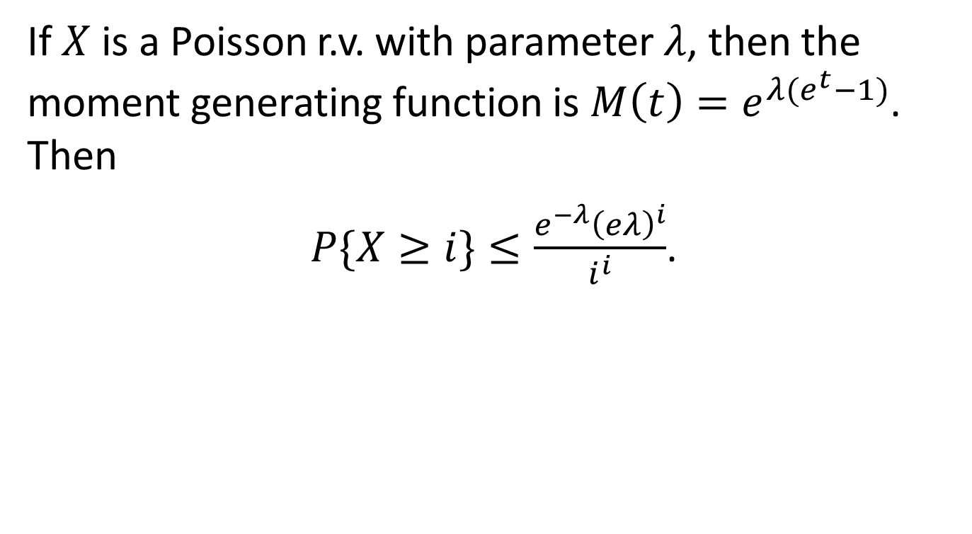
The Poisson r.v.
If $X$ is a Poisson r.v. with parameter $λ$, then the moment generating function is $M\left(t\right)=e^{λ(e^{t}−1)}$. Then
$P\{X≥i\}≤\frac{e^{−λ}{\left(eλ\right)}^{i}}{i^{i}}$.

Slide 4
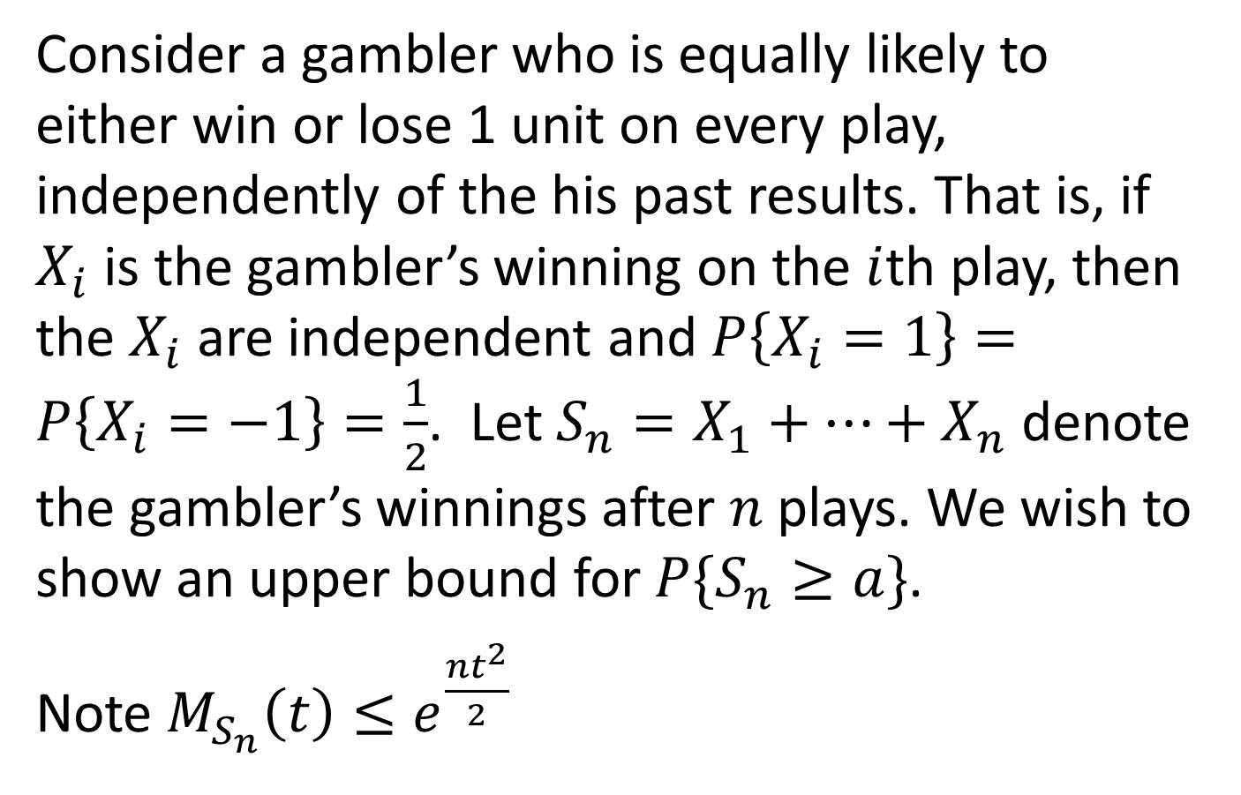
Example 1
Consider a gambler who is equally likely to either win or lose 1 unit on every play, independently of the his past results. That is, if $X_{i}$ is the gambler’s winning on the $i$th play, then the $X_{i}$ are independent and $P\left\{X_{i}=1\right\}=P\left\{X_{i}=−1\right\}=\frac{1}{2}$. Let $S_{n}=X_{1}+⋯+X_{n}$ denote the gambler’s winnings after $n$ plays. We wish to show an upper bound for $P\{S_{n}≥a\}$.
Note $M_{S_{n}}\left(t\right)≤e^{\frac{nt^{2}}{2}}$

Slide 5
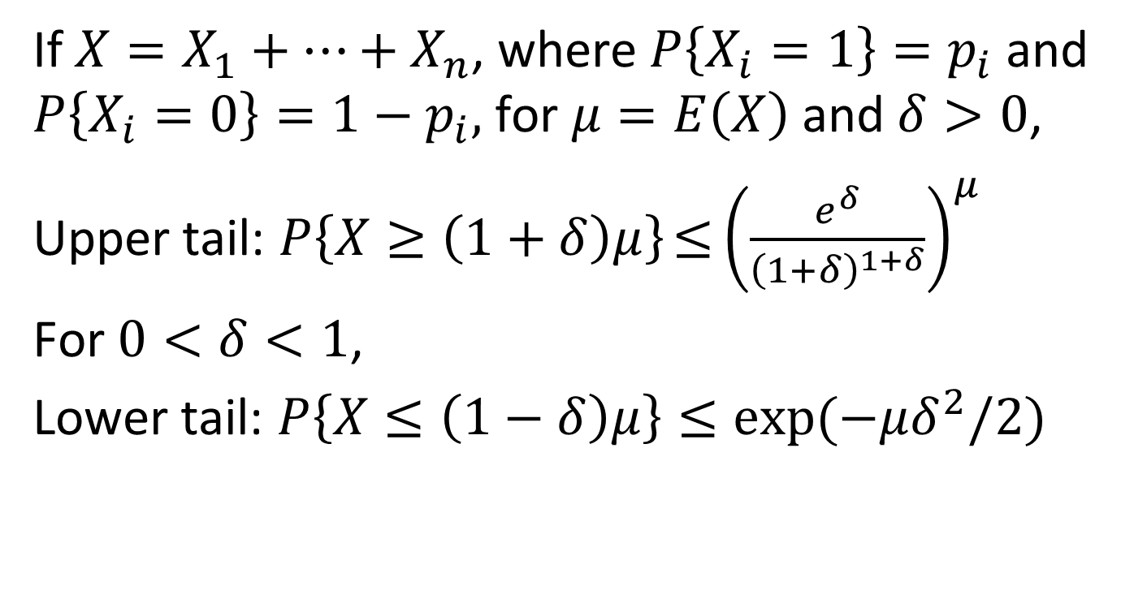
Chernoff bound for binomial r.v.
If $X=X_{1}+⋯+X_{n}$, where $P\left\{X_{i}=1\right\}=p_{i}$ and $P\left\{X_{i}=0\right\}=1−p_{i},$ for $μ=E\left(X\right)$ and $δ>0$,
Upper tail: $P\left\{X≥\left(1+δ\right)μ\right\}{≤\left(\frac{e^{δ}}{{\left(1+δ\right)}^{1+δ}}\right)}^{μ}$
For $0<δ<1$,
Lower tail: $P\left\{X≤\left(1−δ\right)μ\right\}≤\exp{(−μδ^{2}/2)}$

Slide 6
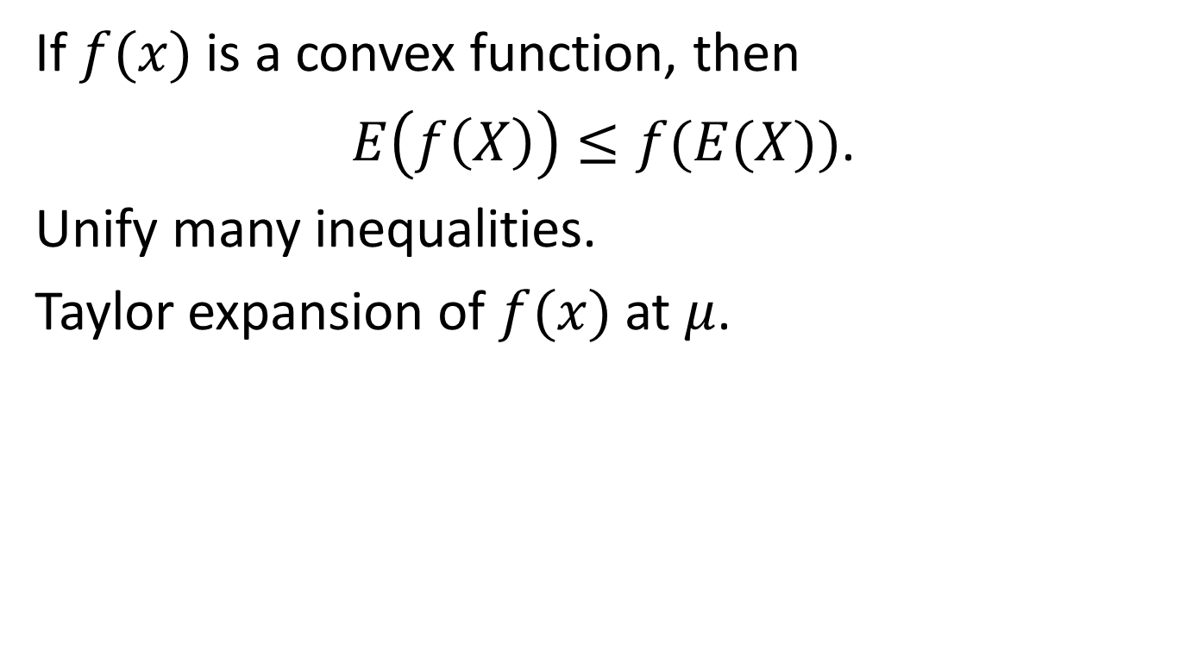
Jensen’s inequality
If $f(x)$ is a convex function, then
$E\left(f\left(X\right)\right)≤f(E(X))$.
Unify many inequalities.
Taylor expansion of $f(x)$ at $μ$.

Slide 7
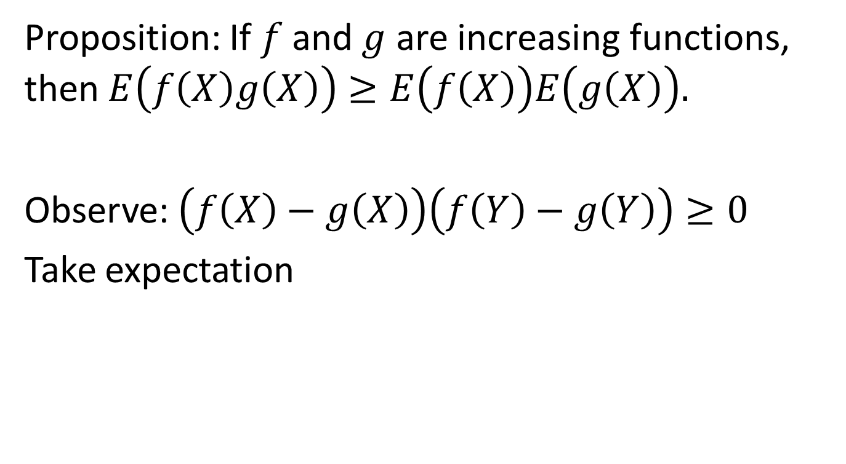
Proposition: If $f$ and $g$ are increasing functions, then $E\left(f\left(X\right)g\left(X\right)\right)≥E\left(f\left(X\right)\right)E\left(g\left(X\right)\right).$
Observe: $\left(f\left(X\right)−g\left(X\right)\right)\left(f\left(Y\right)−g\left(Y\right)\right)≥0$
Take expectation

Slide 8
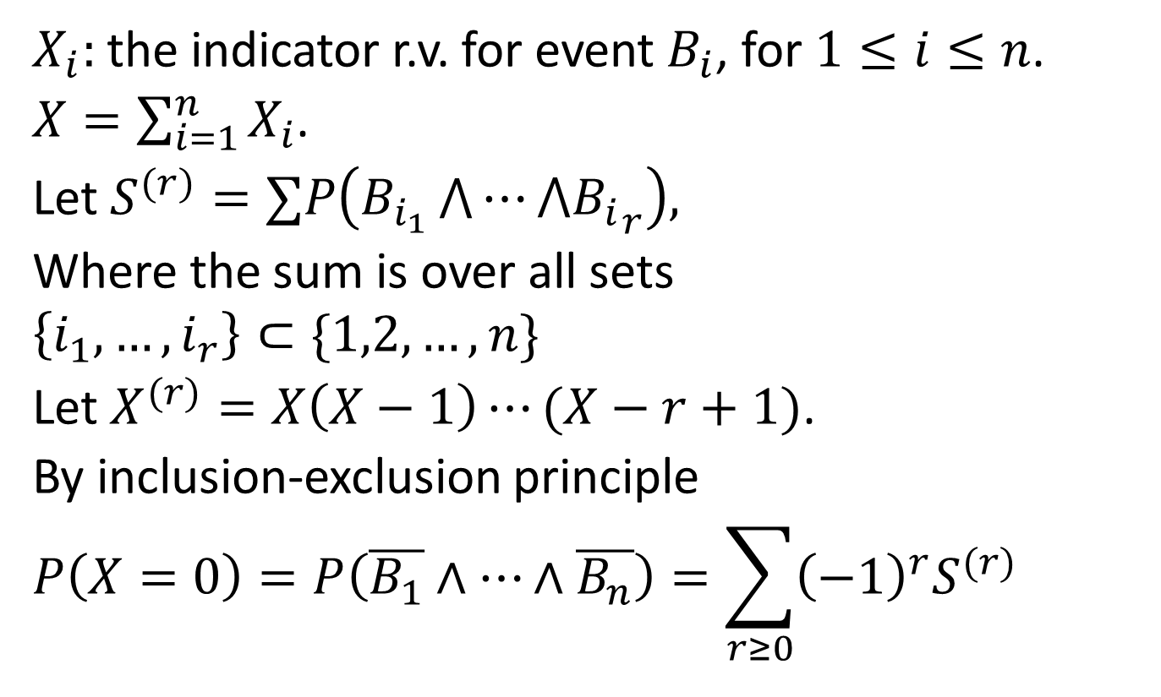
Brun’s sieve
$X_{i}:$ the indicator r.v. for event $B_{i}$, for $1≤i≤n$.
$X=\sum_{i=1}^{n}{X_{i}}$.
Let $S^{(r)}=∑P\left(B_{i_{1}}\bigwedge{⋯⋀{B_{i}}_{r}}\right),$
Where the sum is over all sets
$$\left\{i_{1},…, i_{r}\right\}⊂\{1,2,…,n\}$$
Let $X^{(r)}=X\left(X−1\right)⋯(X−r+1)$.
By inclusion-exclusion principle
$$P\left(X=0\right)=P\left(\overline{B_{1}}∧⋯∧\overline{B_{n}}\right)=\sum_{r≥0}{{\left(−1\right)}^{r}S^{(r)}}$$

Slide 9
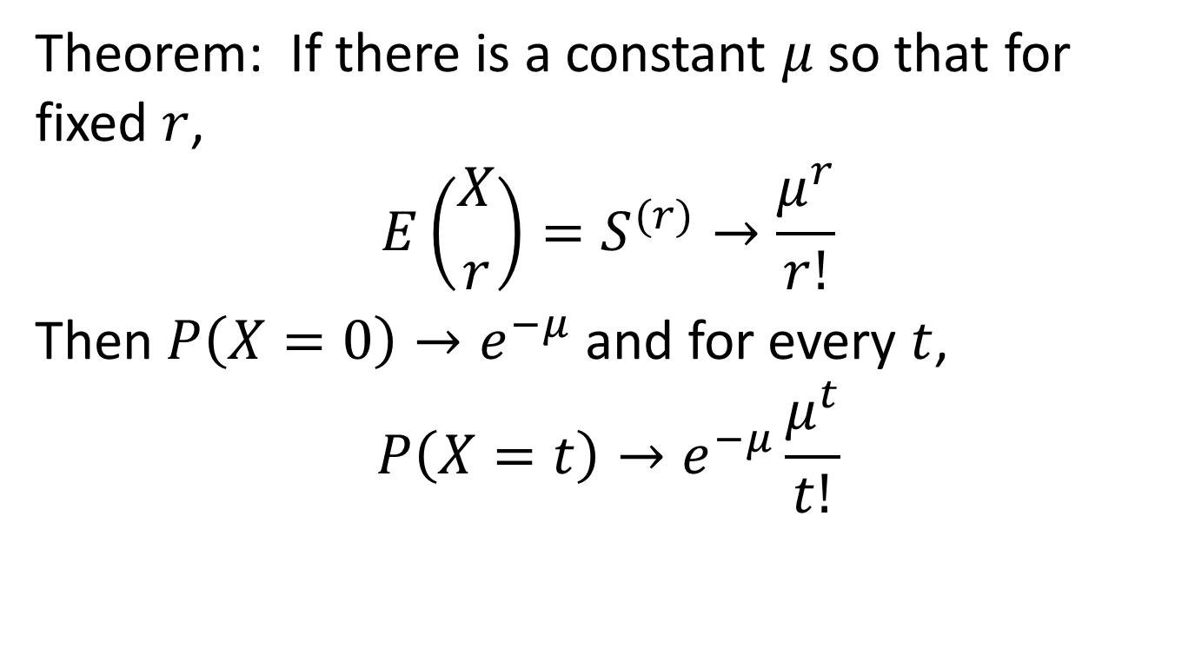
Brun’s sieve
Theorem: If there is a constant $μ$ so that for fixed $r$,
$$E\left({X \atop r}\right)=S^{(r)}→\frac{μ^{r}}{r!}$$
Then $P\left(X=0\right)→e^{−μ}$ and for every $t$,
$$P\left(X=t\right)→e^{−μ}\frac{μ^{t}}{t!}$$

Slide 10
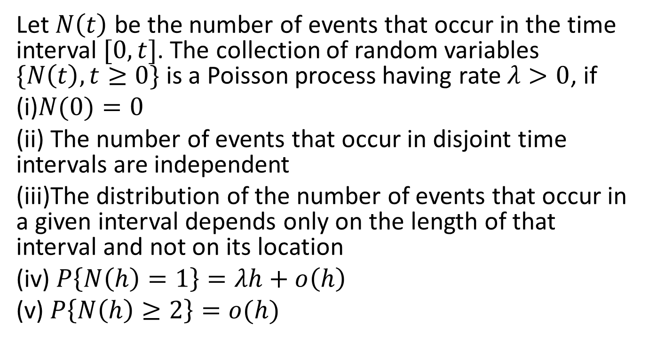
The Poisson process via infinitesimal probabilities
Let $N\left(t\right)$ be the number of events that occur in the time interval $[0,t]$. The collection of random variables $\{N\left(t\right), t≥0\}$ is a Poisson process having rate $λ>0$, if
(i)$N(0)=0$
(ii) The number of events that occur in disjoint time intervals are independent
(iii)The distribution of the number of events that occur in a given interval depends only on the length of that interval and not on its location
(iv) $P\left\{N\left(h\right)=1\right\}=λh+o\left(h\right)$
(v) $P\left\{N\left(h\right)≥2\right\}=o(h)$

Slide 11
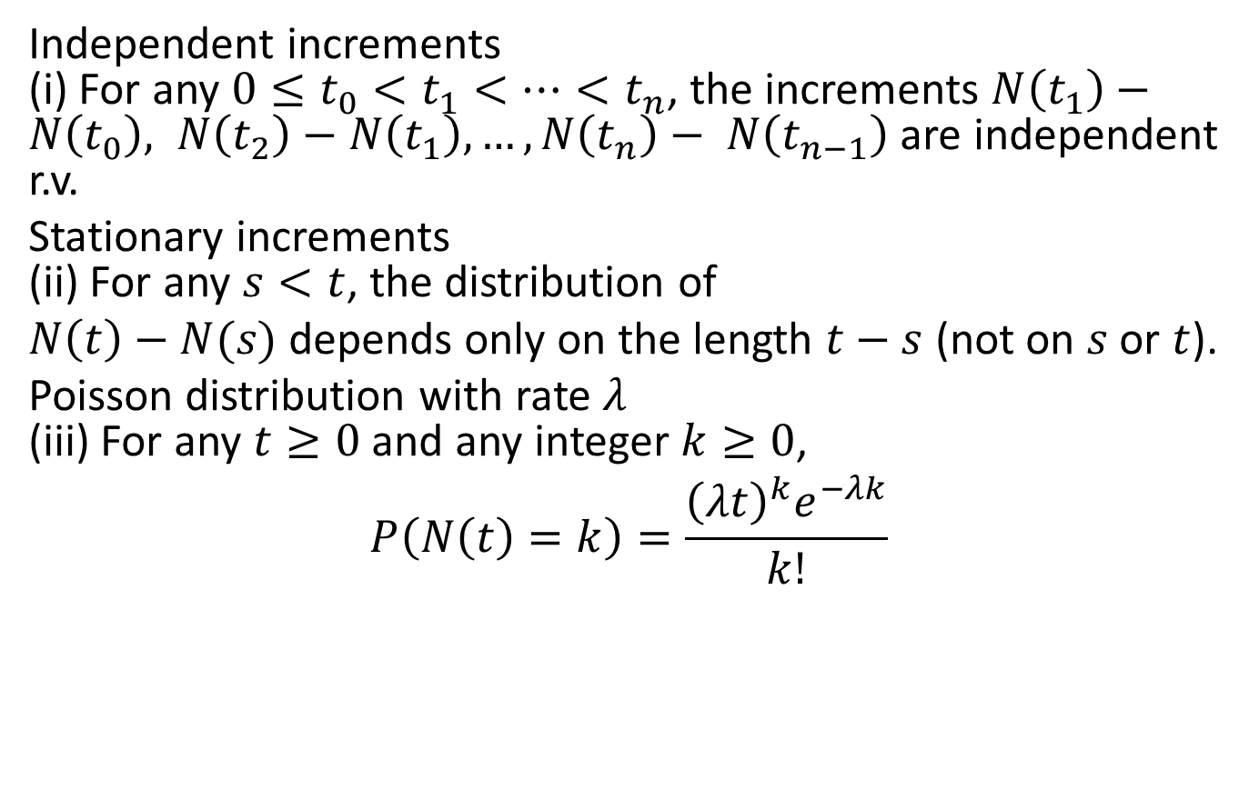
Equivalent definitions Via counting process axioms
Independent increments (i) For any $0≤t_{0}<t_{1}<⋯<t_{n}$, the increments $N\left(t_{1}\right)−$ $N\left(t_{0}\right), N\left(t_{2}\right)−$ $N\left(t_{1}\right),…,N\left(t_{n}\right)− N\left(t_{n−1}\right)$ are independent r.v.
Stationary increments (ii) For any $s<t$, the distribution of
$N\left(t\right)−N(s)$ depends only on the length $t−s$ (not on $s$ or $t$).
Poisson distribution with rate $λ$ (iii) For any $t≥0$ and any integer $k≥0$,
$$P\left(N\left(t\right)=k\right)=\frac{{\left(λt\right)}^{k}e^{−λk}}{k!}$$

Slide 12
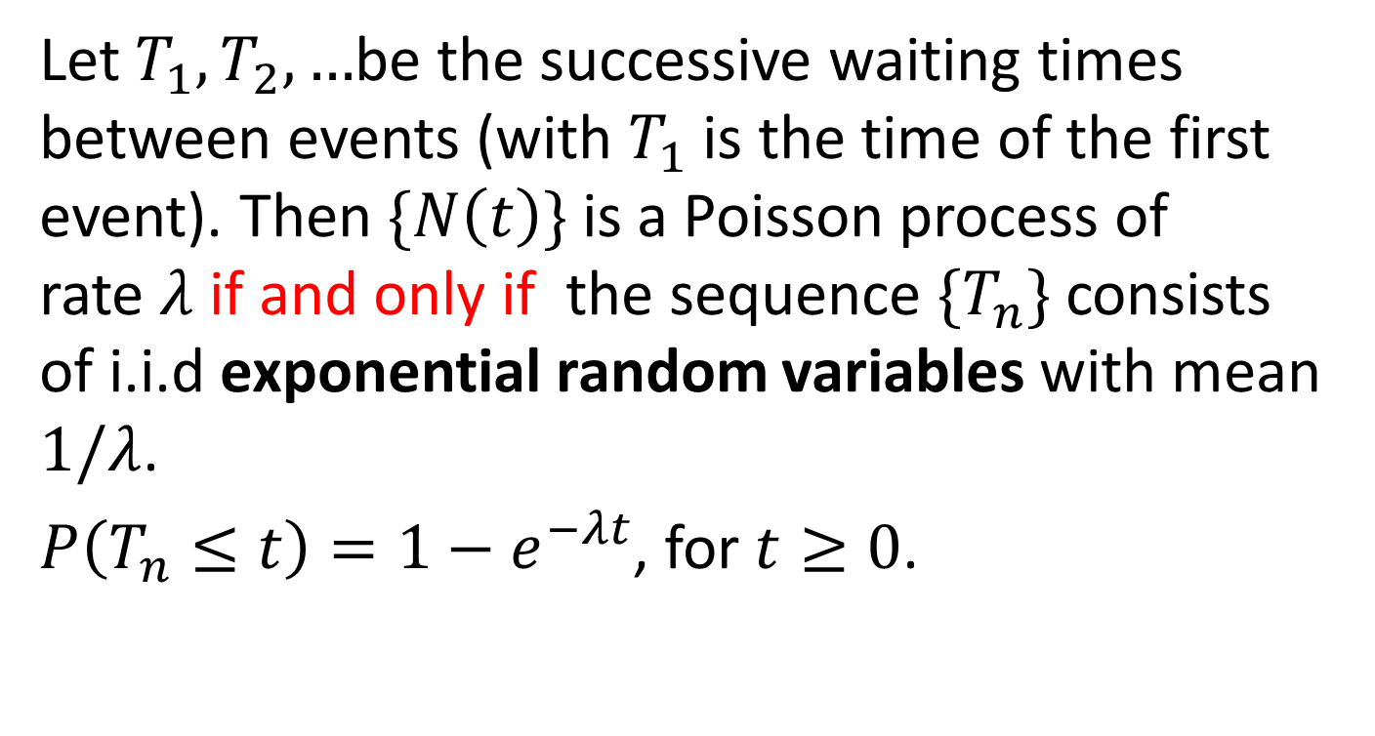
Equivalent definition via interarrival times
Let $T_{1},T_{2},…$be the successive waiting times between events (with $T_{1}$is​ the time of the first event). Then $\{N\left(t\right)\}$ is a Poisson process of rate $λ$ if and only if the sequence $\{T_{n}\}$ consists of i.i.d exponential random variables with mean $1/λ$.
$P\left(T_{n}≤t\right)=1−e^{−λt}$, for $t≥0$.

Slide 13
Examples
If customers arrive at a store at an average rate of 10 per hour (λ=10), then:
(a)The probability that exactly 5 customers arrive in a 30‑minute period is _. (b) The waiting time between two consecutive arrivals follows an exponential distribution with mean _.
Common Applications
Queueing theory (arrivals at a queue)
Telecommunications (packet arrivals)
Reliability (failure times of components)
Epidemiology (occurrence of new cases)

