Slide 1
A Puzzle
Henry has been caught stealing cattle, and is brought into town for justice. The judge is his ex-wife Gretchen, who wants to show him some sympathy, but the law clearly calls for two shots to be taken at Henry from close range. To make things a little better for Henry, Gretchen tells him she will place two bullets into a six-chambered revolver in successive order. She will spin the chamber, close it, and take one shot. If Henry is still alive, she will then either take another shot, or spin the chamber again before shooting. Henry is a bit incredulous that his own ex-wife would carry out the punishment, and a bit sad that she was always such a rule follower. He steels himself as Gretchen loads the chambers, spins the revolver, and pulls the trigger. Whew! It was blank. Then Gretchen asks, "Do you want me to pull the trigger again, or should I spin the chamber a second time before pulling the trigger?" What should Henry choose?
Notes:
From Braingle, “Under which cup?”
Answer
The rightmost cup. The rightmost cup has a half chance of holding the coin, and the other cups have a quarter chance. Pretend that Os represent cups, and Q represents the cup with the coin. The game starts like this: OOQ Then your friend switches the rightmost cup with another, giving two possibilities, with equal chance: OQO QOO Your friend then moves the cups again, but doesn't touch the rightmost cup. The only switch possible is with the leftmost cup and the middle cup. This gives two possibilities with equal chance: QOO OQO Lastly, your friend switches the rightmost cup with another cup. If the first possibility shown above was true, there would be two possibilities, with equal chance: OOQ QOO If the second possibility shown above (In the second switch) was true, there would be two possibilities with equal chance: OOQ OQO This means there are four possibilities altogether, with equal chance: OOQ QOO OOQ OQO This means each possibility equals to a quarter chance, and because there are two possibilities with the rightmost cup having the coin, there is a half chance that the coin is there.

Slide 2
Urn Problems
Given a box (or “urn”) with r red balls and b blue balls in it, select k balls at random and examine their colors
Without replacement vs. With replacement

Slide 3
Example 1: Urn Problem
Disputed Election: There is a close election:
2656 votes for Al
2594 votes for Bob
Of the 5250 votes, we learn 136 should not have voted (e.g., they are dead Chicagoans)
Assume: each vote is equally likely to be one of the 136.
Find P(“election would be reversed if the bad votes are removed from the count”)

Slide 4
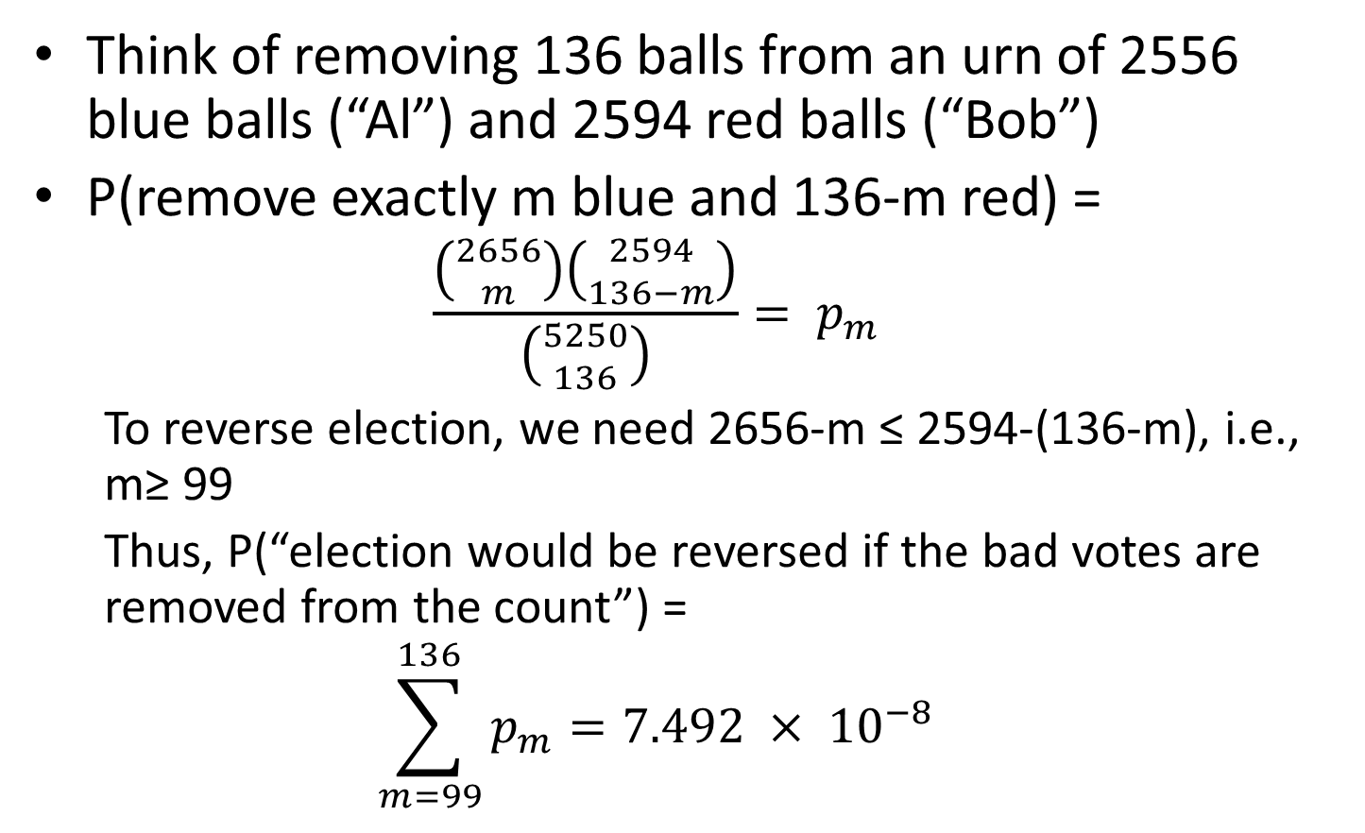
Example (cont)
Think of removing 136 balls from an urn of 2556 blue balls (“Al”) and 2594 red balls (“Bob”)
P(remove exactly m blue and 136-m red) =
$$\frac{\left({2656 \atop m}\right)\left({2594 \atop 136−m}\right)}{\left({5250 \atop 136}\right)}= p_{m}$$
To reverse election, we need 2656-m ≤ 2594-(136-m), i.e., m≥ 99
Thus, P(“election would be reversed if the bad votes are removed from the count”) =
$$\sum_{m=99}^{136}{p_{m}}=7.492 × {10}^{−8}$$

Slide 5
Example 2
Basketball: 3 teams, each with 3 players: Guard, Forward, Center
Select one player from each team
(a). Find P(“you get a full team”)
(b). Find P(“you get 3 players of same type”)
Notes:
#31, p59, Ross7

Slide 6
Example 3
4 married couples sit around a table
Find p = P(“no wife sits next to her husband”)
Let E_{i} = “couple i sits next to each other”
Want p = 1-P(E₁∪E₂ ∪E₃ ∪E₄)
[inclusion-exclusion]
Notes:
Example 5n, Ross7

Slide 7
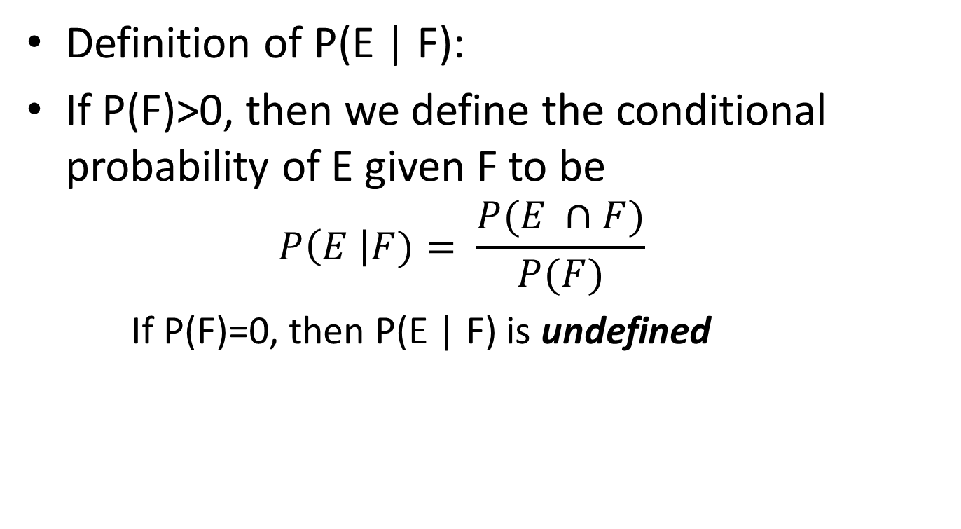
Conditional Probability
Definition of P(E | F):
If P(F)>0, then we define the conditional probability of E given F to be
$$P\left(E \right|F)= \frac{P(E ∩F)}{P(F)}$$
If P(F)=0, then P(E | F) is undefined
F
E

Slide 8
Example 4
Toss 2 fair dice. Observe that the first die is 3. Given this information, what is probability the sum is 8?
Let E=“first=3” = {(3,1),(3,2),…,(3,6)}
Let F=“sum = 8” = {(2,6),(3,5),(4,4),(5,3),(6,2)}
E∩F={(3,5)}
Want: P(F | E) = P(F∩E) / P(E) = (1/36) / (6/36)

Slide 9
Example 5
Parts Inspection: Manufactured parts are of 3 varieties – Good (90%), Slightly Defective (2%), Obviously Defective (8%)
We select a part at random from the factory
It gets passed to an automatic inspection machine, which detects obviously defective
What is probability that a part that passes the inspection is Good?

Slide 10
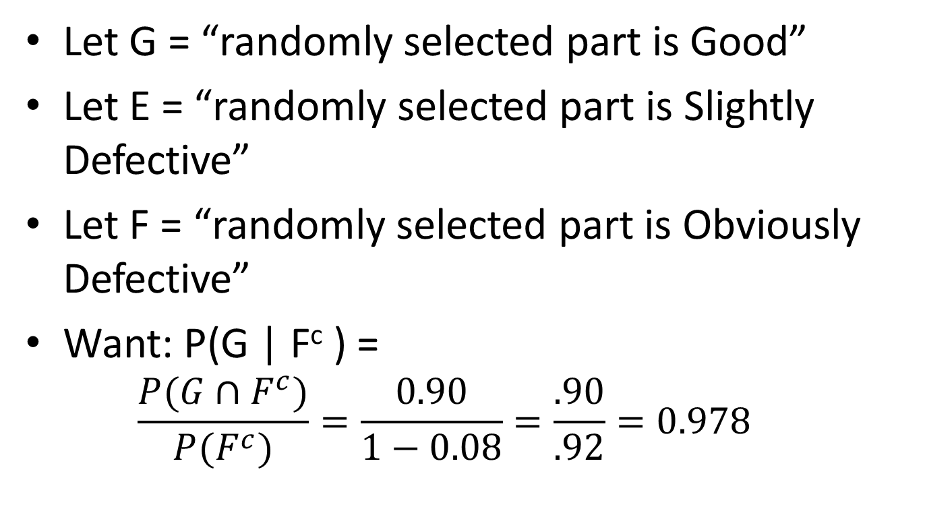
Example (cont)
Let G = “randomly selected part is Good”
Let E = “randomly selected part is Slightly Defective”
Let F = “randomly selected part is Obviously Defective”
Want: P(G | F^{c} ) =
$$\frac{P(G∩F^{c})}{P(F^{c})}=\frac{0.90}{1−0.08}=\frac{.90}{.92}=0.978$$

Slide 11

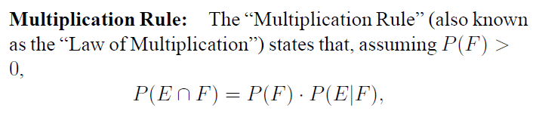
Conditional Probability
Recall Definition:

Slide 12
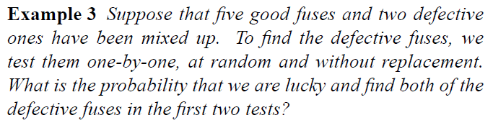
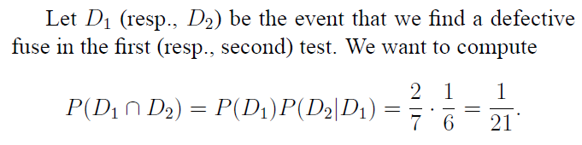
Example 6

Slide 13
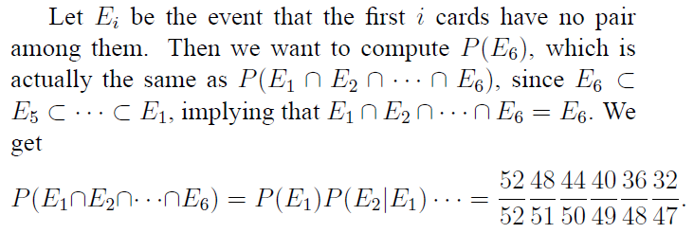
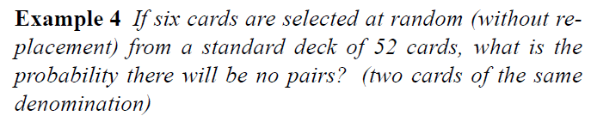
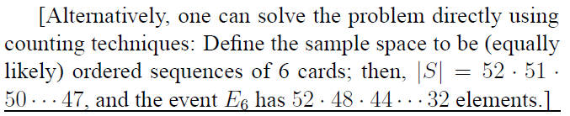
Example 7

Slide 14
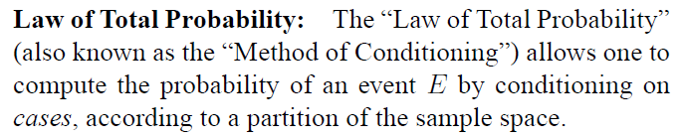
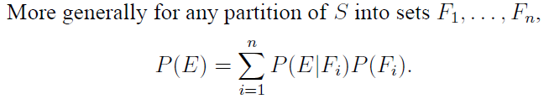
Law of Total Probability: Conditioning
Recall:

Slide 15
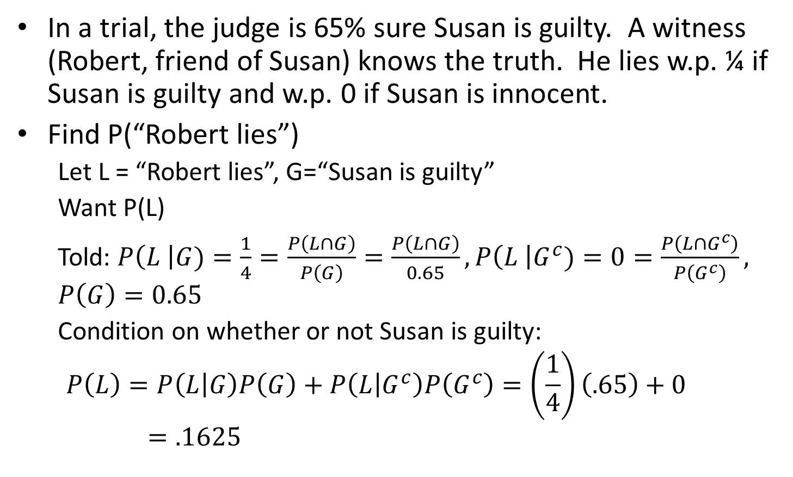
Example 8
In a trial, the judge is 65% sure Susan is guilty. A witness (Robert, friend of Susan) knows the truth. He lies w.p. ¼ if Susan is guilty and w.p. 0 if Susan is innocent.
Find P(“Robert lies”)
Let L = “Robert lies”, G=“Susan is guilty”
Want P(L)
Told: $P\left(L \right|G)=\frac{1}{4}=\frac{P\left(L∩G\right)}{P\left(G\right)}=\frac{P\left(L∩G\right)}{0.65}, P\left(L \right|G^{c})=0=\frac{P\left(L∩G^{c}\right)}{P\left(G^{c}\right)}, P\left(G\right)=0.65$
Condition on whether or not Susan is guilty:
$$P\left(L\right)=P\left(L | G\right)P\left(G\right)+P\left(L | G^{c}\right)P\left(G^{c}\right)=\left(\frac{1}{4}\right)\left(.65\right)+0=.1625$$
Notes:
#1, 3.2, Ghah 2nd

Slide 16
Example 9 Let’s Make A Deal
Monty Hall problem: 3 doors: A,B,C. One has a car (2 have goats). The car is placed at random (Monty knows where). You pick a door (say, door A). Now, Monty opens a door that you did not pick (door B or C), showing you a goat (he definitely picks a goat door, picking at random if both are goats). Now you have the option to switch (to the other un open door). Should you?

Slide 17
Let’s Make A Deal
Want P(you win by switching to B | he shows door C) = … = 2/3
(we do detailed calculation on board)
Notes:
Got to here, 9/5/13

Slide 18
Example 10
Neighbor’s children: Your neighbor has 2 children. You are now told that one of them is a boy. What is the probability that the other one is a boy?

Slide 19
Example
Neighbor’s children: Your neighbor has 2 children. You are now told that one of them is a boy. What is the probability that the other one is a boy?
S = {BB, BG, GB, GG}, equally likely if boys/girls born each with prob 0.5
Want: P( {BB} | {BB,BG,GB} ) = (1/4) / (3/4) = 1/3

Slide 20
Example 10’
Neighbor’s children: Your neighbor has 2 children. Your neighbor selects one child at random and brings to your house – it is a boy. What is the probability that the other child is a boy?

Slide 21
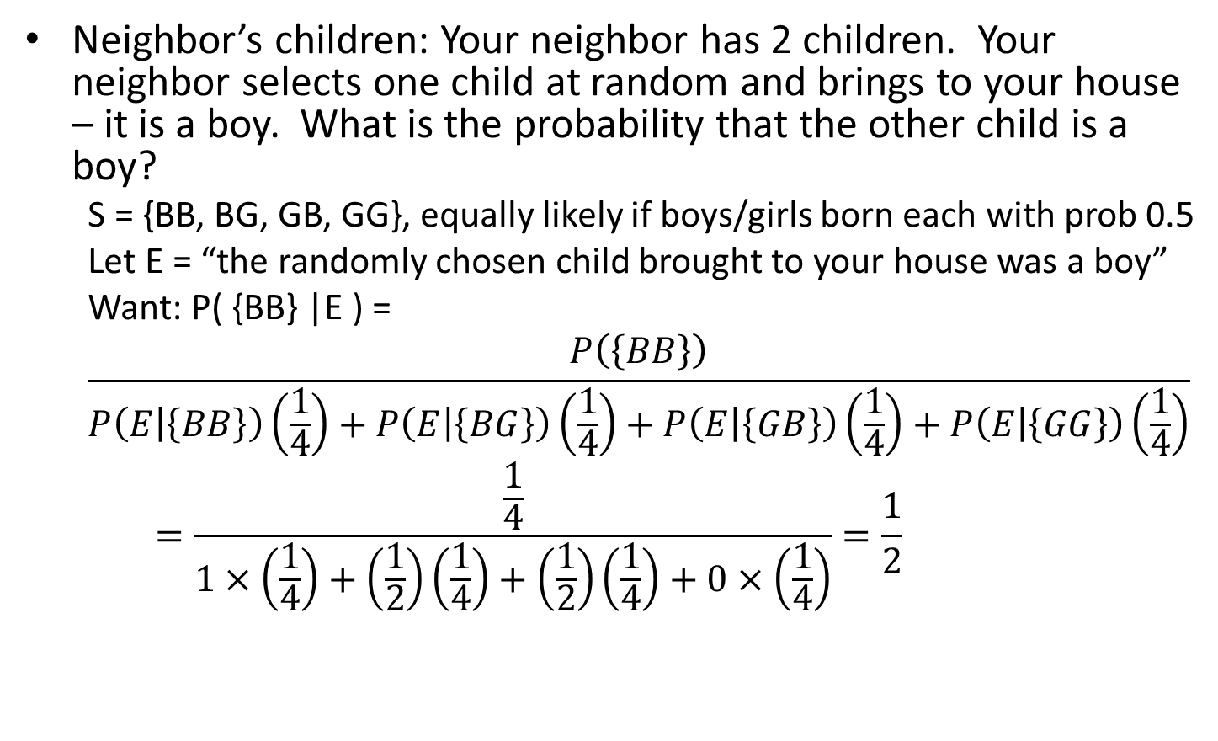
Example
Neighbor’s children: Your neighbor has 2 children. Your neighbor selects one child at random and brings to your house – it is a boy. What is the probability that the other child is a boy?
S = {BB, BG, GB, GG}, equally likely if boys/girls born each with prob 0.5
Let E = “the randomly chosen child brought to your house was a boy”
Want: P( {BB} |E ) =
$$\frac{P\left(\left\{BB\right\}\right)}{P\left(E | \left\{BB\right\}\right)\left(\frac{1}{4}\right)+P\left(E | \left\{BG\right\}\right)\left(\frac{1}{4}\right)+P\left(E | \left\{GB\right\}\right)\left(\frac{1}{4}\right)+P\left(E | \left\{GG\right\}\right)\left(\frac{1}{4}\right)}=\frac{\frac{1}{4}}{1×\left(\frac{1}{4}\right)+\left(\frac{1}{2}\right)\left(\frac{1}{4}\right)+\left(\frac{1}{2}\right)\left(\frac{1}{4}\right)+0×\left(\frac{1}{4}\right)}=\frac{1}{2}$$

Slide 22
Example 10’’
Neighbor’s children: Your neighbor has 2 children. You are now told that one of them is a boy, with a December birth month. What is the probability that the other child is a boy?
(assume that the 12 birth months are equally likely and that gender is independent of birth month)

Slide 23
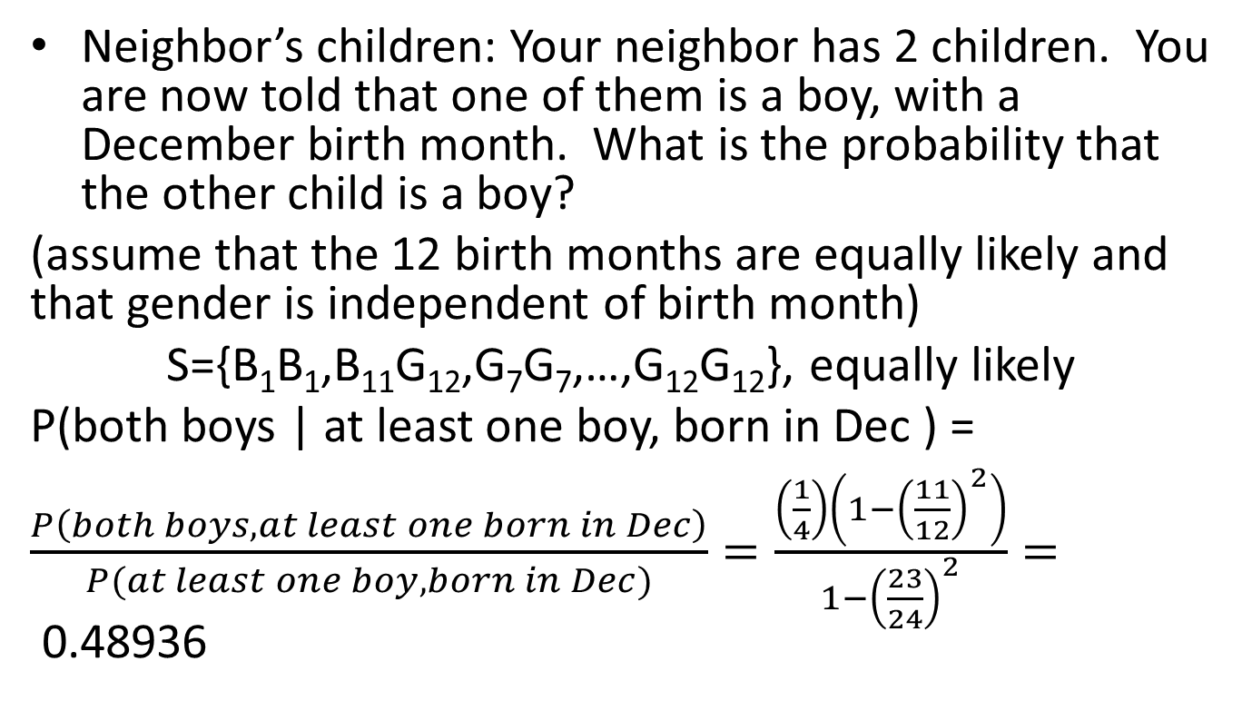
Example
Neighbor’s children: Your neighbor has 2 children. You are now told that one of them is a boy, with a December birth month. What is the probability that the other child is a boy?
(assume that the 12 birth months are equally likely and that gender is independent of birth month)
S={B₁B₁,B₁₁G₁₂,G₇G₇,…,G₁₂G₁₂}, equally likely
P(both boys | at least one boy, born in Dec ) =
$\frac{P\left(both boys, at least one born in Dec\right)}{P(at least one boy, born in Dec)}=\frac{\left(\frac{1}{4}\right)\left(1−{\left(\frac{11}{12}\right)}^{2}\right)}{1−{\left(\frac{23}{24}\right)}^{2}}=$0.48936

