Slide 1
Today
More examples: conditional probability,
Bayes formula
Independent events
P( |F) is a probability

Slide 2
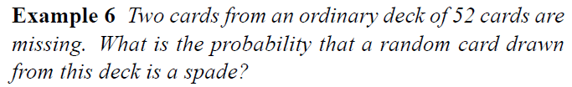
Example

Slide 3
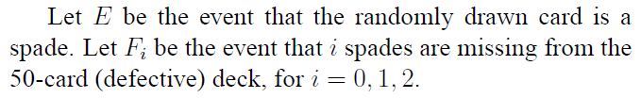

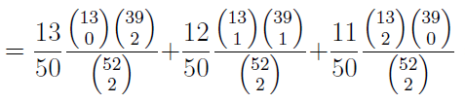
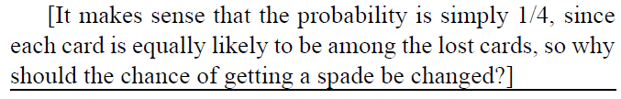
Example

Slide 4
Example: In the card game, the 52 cards are dealt out equally to 4 players-called East, South, West, North. If North and South have a total of 8 spades, then what is the probability that East has 3 of the remaining 5 spades? (see Page 60 in the textbook).

Slide 5
Conditioning: Example
Independent Trials: Roll a pair of distinct dice over and over. Find P(“sum of 5 before a sum of 7”)
Let E = “sum of 5 before a sum of 7”, and let p=P(E).
Want p=P(E)
Notes:
Example 4h, Ross

Slide 6
Conditioning: Example
Independent Trials: Roll a pair of distinct dice over and over. Find P(“sum of 5 before a sum of 7”)
Let E = “sum of 5 before a sum of 7”, and let p=P(E).
Want p=P(E)
Method 1: Condition on result of first roll:
P=P(E)=P(E|1st=5)P(1st=5)+P(E|1st=7)P(1st=7) + P(E|1st ≠ 5,7)P(1st ≠ 5,7)
= 1 * (4/36) + 0 * (6/36) + p * (1-(4/36)-(6/36))
Thus, p = (4/36) + (26/36)p, so 10p=4, so p=2/5
Notes:
Example 4h, Ross

Slide 7
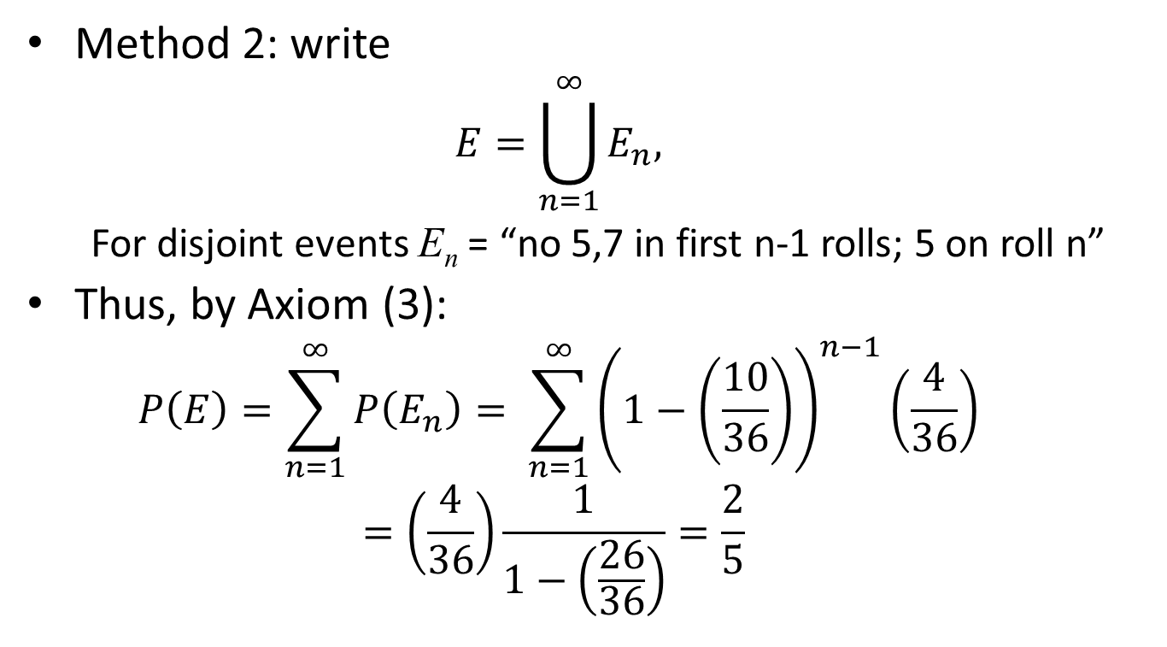
Conditioning: Example
Method 2: write
$$E=\bigcup_{n=1}^{∞}{E_{n}, }$$
For disjoint events E_{n} = “no 5,7 in first n-1 rolls; 5 on roll n”
Thus, by Axiom (3):
$$P\left(E\right)=\sum_{n=1}^{∞}{P\left(E_{n}\right)= \sum_{n=1}^{∞}{{\left(1−\left(\frac{10}{36}\right)\right)}^{n−1}\left(\frac{4}{36}\right)}}$$
$$=\left(\frac{4}{36}\right)\frac{1}{1−\left(\frac{26}{36}\right)}=\frac{2}{5}$$
Notes:
Example 4h, Ross

Slide 8

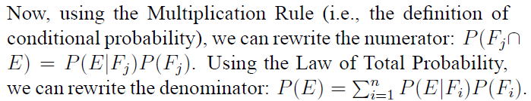

Bayes’s Formula
Recall: For a partition of S into F₁ , F₂ , F₃ ,…, and P(E)>0,

Slide 9
Example
In answering a question on a multiple-choice test, a student either knows the answer or guesses. Let p be the probability that the student knows the answer and 1-p be the probability that the student guesses. Assume that a student who guesses at the answer will be correct with probability 1/m. What is the conditional probability that a student knew the answer to a question that he or she answered it correctly? (see Page 66 in the textbook)

Slide 10
Example
Suppose that we have 3 cards that are identical in form, except that both sides of the first card are colored red, both sides of the second card are colored black, and one side of the third card is colored red and the other side black. The 3 cards are mixed up in a hat and one card is randomly selected and put down. If the upper side of the chosen card is colored red, what is the probability that the other side is colored black? (see Page 73 of the textbook).

Slide 11
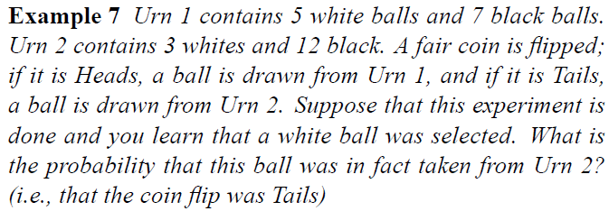
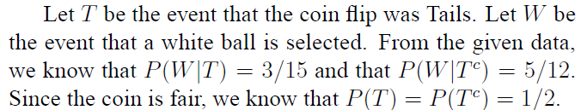
Example
Urn 1
Urn 2

Slide 12


Example
Urn 1
Urn 2

Slide 13
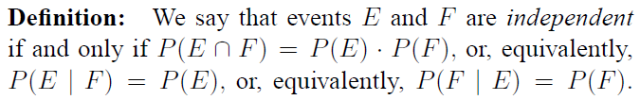
Independence
Recall:

Slide 14
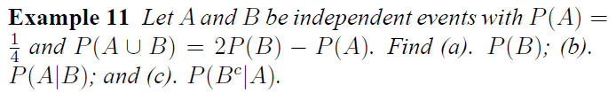

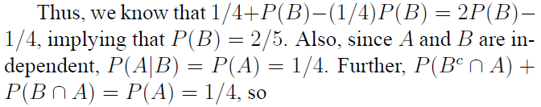
Example

Slide 15
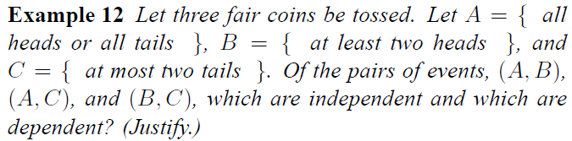



Example

Slide 16
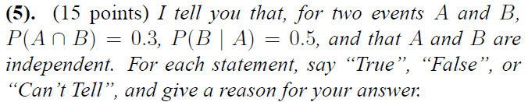
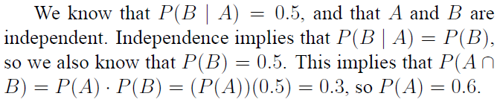
Example
Example

Slide 17
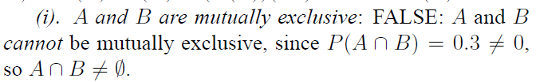
Example
Example
FALSE

Slide 18
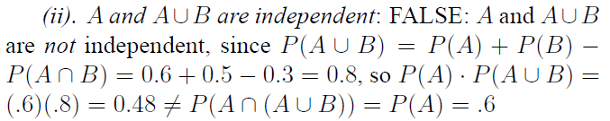
Example
Example
FALSE

Slide 19

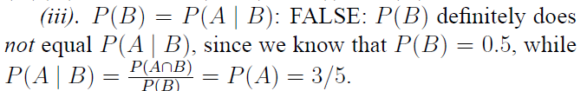
Example
Example
FALSE

Slide 20
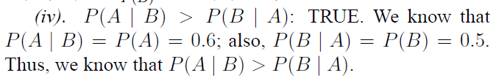
Example
Example
TRUE

Slide 21


Example
Example
TRUE

Slide 22
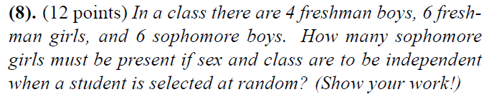

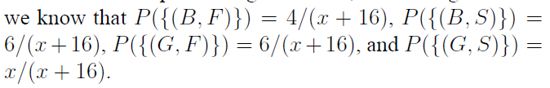
Example
Example
Let x be the number of sophomore girls

Slide 23
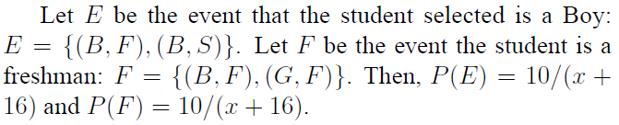
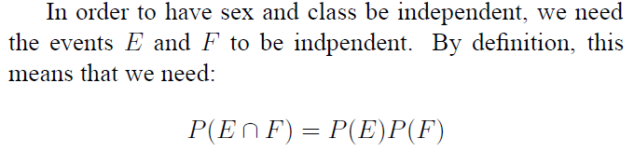
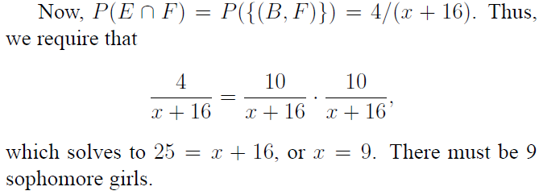
Example

