Slide 1
Today
Introduction to discrete random variables
Expectation, variance,
Bernoulli and Binomial random variables

Slide 2
Puzzle
A gambler goes to bet. The dealer has 3 dice, which are fair, meaning that the chance that each face shows up is exactly 1/6. The dealer says: "You can choose your bet on a number, any number from 1 to 6. Then I'll roll the 3 dice. If none show the number you bet, you'll lose $1. If one shows the number you bet, you'll win $1. If two or three dice show the number you bet, you'll win $3 or $5, respectively." Is it a fair game?
Notes:
http://www.braingle.com/brainteasers/26344/rolling-the-dice.html

Slide 3
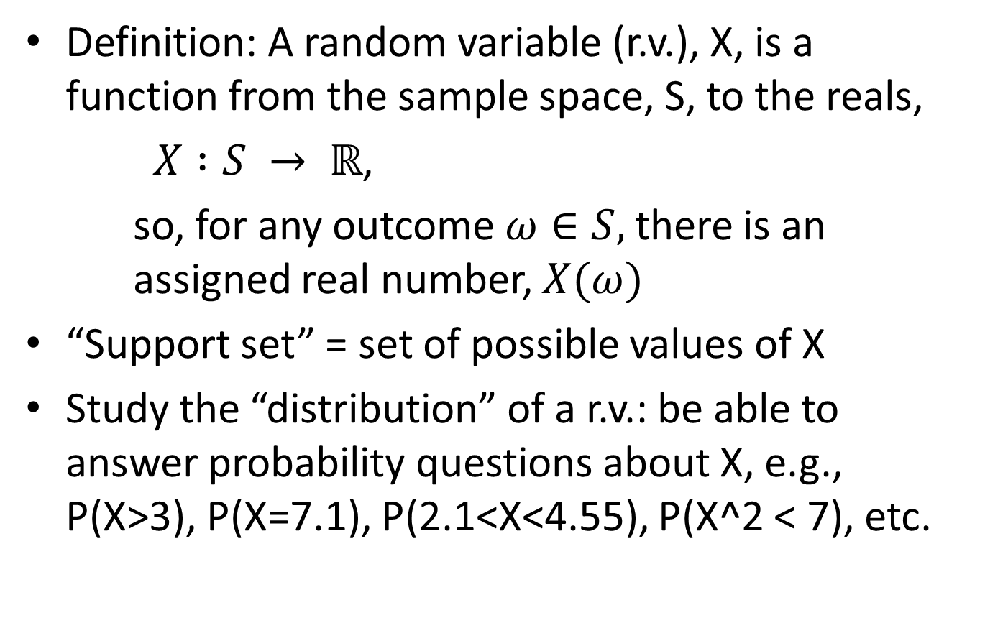
Random Variables
Definition: A random variable (r.v.), X, is a function from the sample space, S, to the reals,
$X :S → ℝ$,
so, for any outcome $ω∈S,$there is an assigned real number, $X(ω)$
“Support set” = set of possible values of X
Study the “distribution” of a r.v.: be able to answer probability questions about X, e.g., P(X>3), P(X=7.1), P(2.1<X<4.55), P(X^2 < 7), etc.

Slide 4
Random Variables, Distributions
Two main classes of distributions/r.v.’s:
Discrete r.v.: X ∈ {x₁, x₂, x₃,…}
Support set is finite or countably infinite
Continuous r.v.: There exists a “probability density function” (pdf) to describe the distribution.
Support set is uncountably infinite (e.g., union of real intervals). We use calculus to deal with continuous r.v.’s
Other types of distributions as well (we may see some “hybrid distribution” r.v.’s, which are like continuous r.v.’s, but with “point masses” as well)

Slide 5
Examples
Roll 2 dice: S = {(1,1),(1,2),…,(6,6) }.
Define X = “sum of dice”, meaning
X( (3,4) ) = 3+4=7, X( (6,6) ) = 12, etc
X∈ {2,3,4,…,12} (support set)
Define Y = “smaller of two dice”, meaning
Y( (3,4) ) = 3, Y( (6,6) ) = 6, etc
Y∈ {1,2,3,4,5,6} (support set)
Discrete r.v.
Discrete r.v.

Slide 6
Examples
Break a meter stick in two pieces
S = { x : 0<x<1 } is the location of the break point, x
Define X = “length of larger piece”, meaning
X(0.3) = 0.7, X(0.5) = 0.5, X(0.912) = 0.912, etc
X ∈ [0.5,1) (support set)
Define Y = “area of right triangle having legs made from the two pieces of the stick”, meaning
Y(0.3) = (1/2)(0.3)(0.7), Y(0.5) = (1/2)(0.5)(0.5), Y(0.912) = (1/2)(0.912)(0.088), etc
Y ∈ (0, 1/8] (support set)
Continuous r.v.
Continuous r.v.

Slide 7
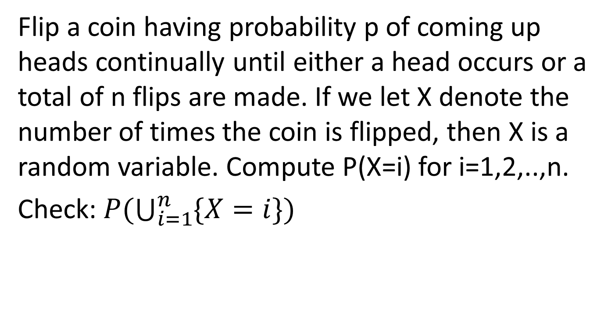
Examples
Flip a coin having probability p of coming up heads continually until either a head occurs or a total of n flips are made. If we let X denote the number of times the coin is flipped, then X is a random variable. Compute P(X=i) for i=1,2,..,n.
Check: $P(\bigcup_{i=1}^{n}{\{X=i\}})$

Slide 8
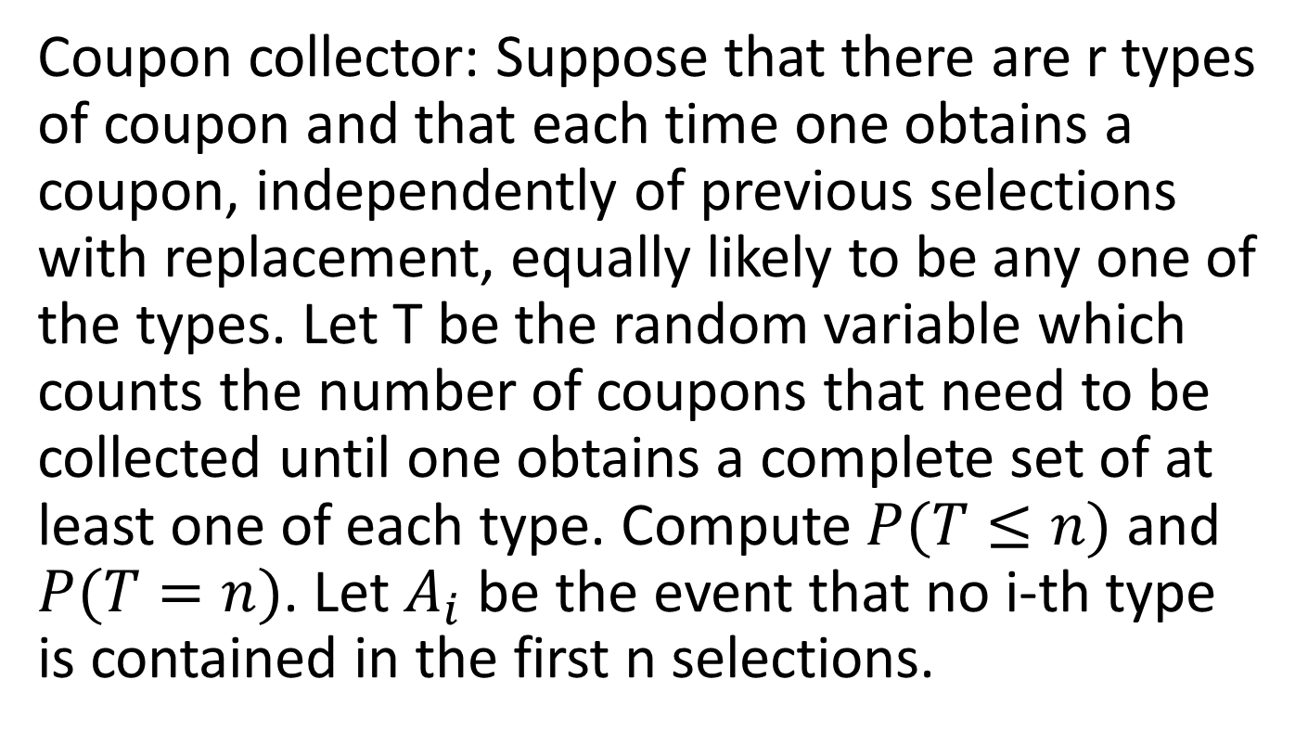
Examples
Coupon collector: Suppose that there are r types of coupon and that each time one obtains a coupon, independently of previous selections with replacement, equally likely to be any one of the types. Let T be the random variable which counts the number of coupons that need to be collected until one obtains a complete set of at least one of each type. Compute $P(T≤n)$ and $P(T=n)$. Let $A_{i}$ be the event that no i-th type is contained in the first n selections.

Slide 9
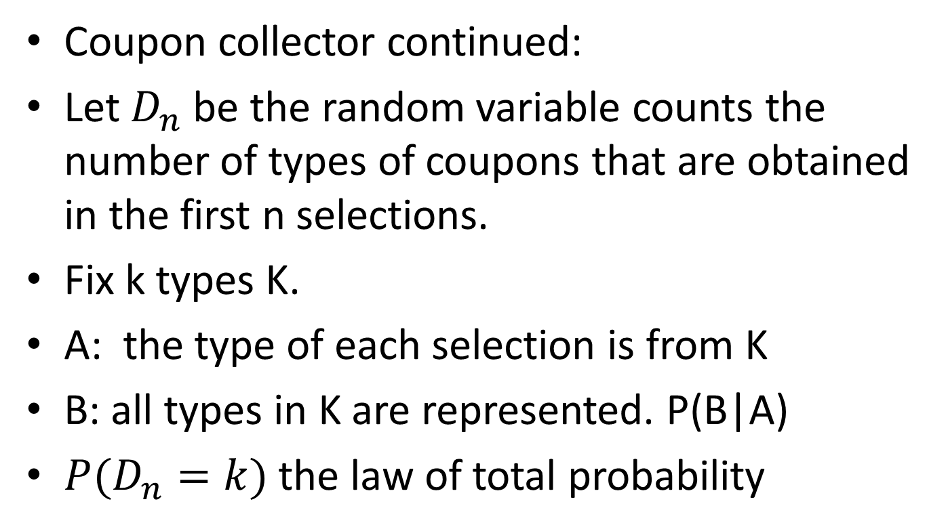
Example
Coupon collector continued:
Let $D_{n}$ be the random variable counts the number of types of coupons that are obtained in the first n selections.
Fix k types K.
A: the type of each selection is from K
B: all types in K are represented. P(B|A)
$P(D_{n}=k)$ the law of total probability

Slide 10
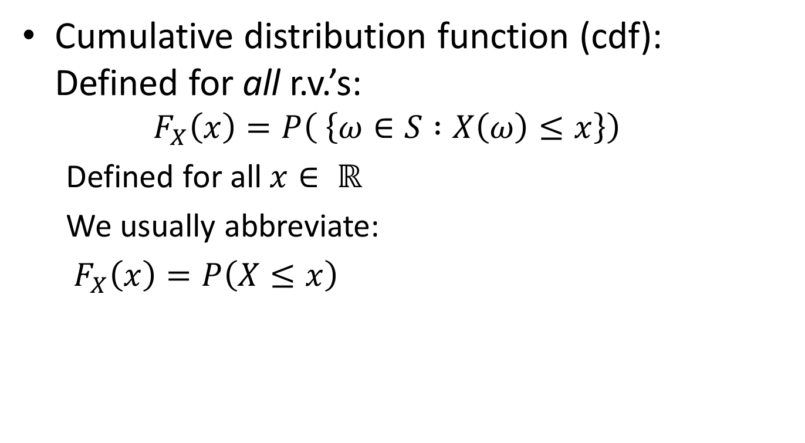
Random Variable Distributions
Cumulative distribution function (cdf): Defined for all r.v.’s:
$$F_{X}\left(x\right)=P\left( \left\{ω∈S :X\left(ω\right)≤x\right\}\right)$$
Defined for all $x∈ ℝ$
We usually abbreviate:
$F_{X}\left(x\right)=P\left(X≤x\right)$

Slide 11
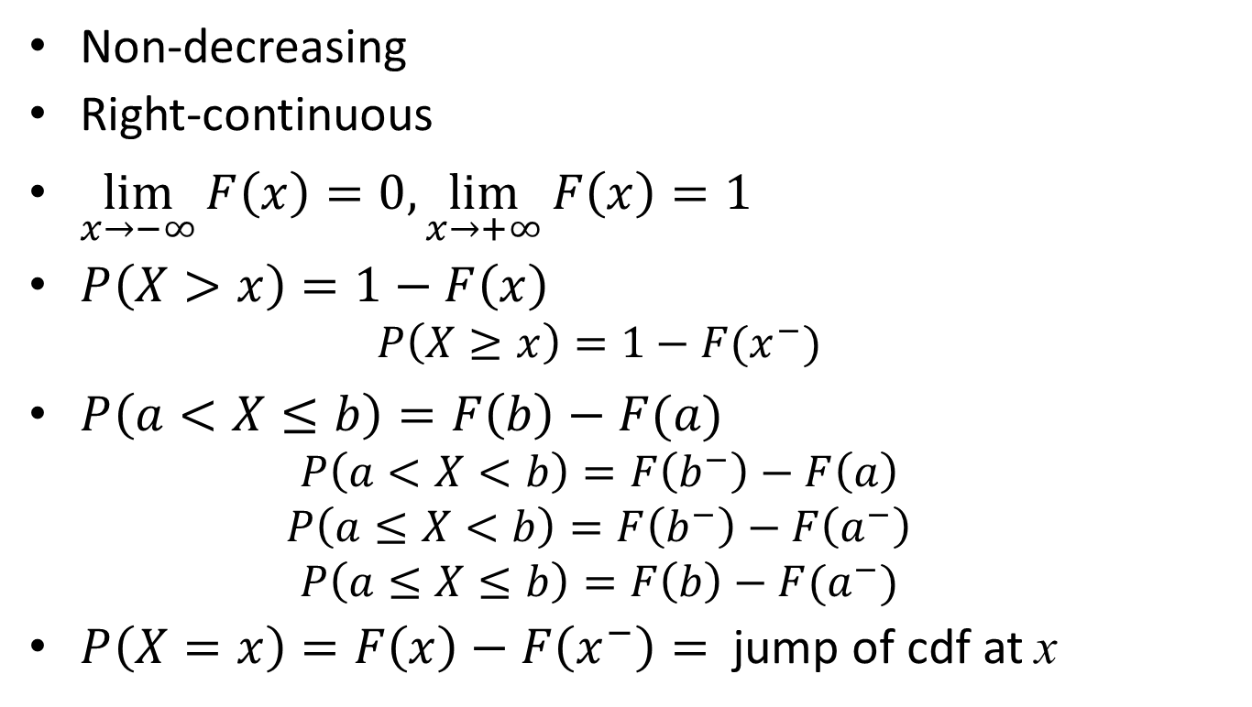
Properties of cdf
Non-decreasing
Right-continuous
$\lim_{x→−∞}{F\left(x\right)=0, \lim_{x→+∞}{F\left(x\right)=1}}$
$P\left(X>x\right)=1−F\left(x\right)$
$$P\left(X≥x\right)=1−F(x^{−})$$
$P\left(a<X≤b\right)=F\left(b\right)−F(a)$
$$P\left(a<X<b\right)=F\left(b^{−}\right)−F\left(a\right)$$
$$P\left(a≤X<b\right)=F\left(b^{−}\right)−F\left(a^{−}\right)$$
$$P\left(a≤X≤b\right)=F\left(b\right)−F(a^{−})$$
$P\left(X=x\right)=F\left(x\right)−F\left(x^{−}\right)=$ jump of cdf at x

Slide 12
Plot of cdf
F(x)
1
a
x

Slide 13
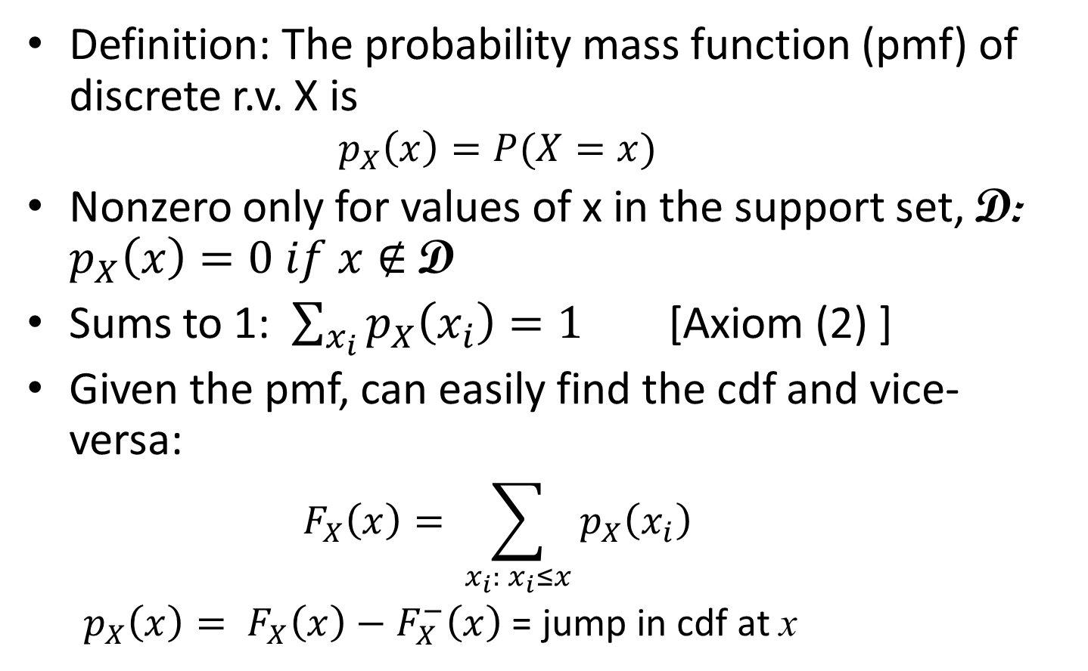
Discrete r.v.’s
Definition: The probability mass function (pmf) of discrete r.v. X is
$$p_{X}\left(x\right)=P(X=x)$$
Nonzero only for values of x in the support set, D: $p_{X}\left(x\right)=0 if x∉$ D
Sums to 1: $\sum_{x_{i}}{p_{X}\left(x_{i}\right)=1}$ [Axiom (2) ]
Given the pmf, can easily find the cdf and vice-versa:
$$F_{X}\left(x\right)= \sum_{x_{i}: x_{i}≤x}{p_{X}\left(x_{i}\right)}$$
$p_{X}\left(x\right)= F_{X}\left(x\right)−F_{X}^{−}\left(x\right)$ = jump in cdf at x

Slide 14

Examples
Let X be a r.v. having the pmf given by
$p\left(1\right)=0.25, p\left(2\right)=0.5, p\left(3\right)=0.125, p\left(4\right)=0.125$
Find the cdf $F(x)$ and plot the graph.

Slide 15

Examples
The probability mass function of a r.v. X is given by $p\left(i\right)=cλ^{i}/i!$, for i=0,1,2,…, where $λ$ is a positive real. Find (a) $P\left(X=0\right)$ and (b) $P\left(X>2\right)$.
Notes:
Got to here, 9/12/13
Example: X = -2, 0, 1.1, 9.2 wp .1,.2,.3,.4

Slide 16
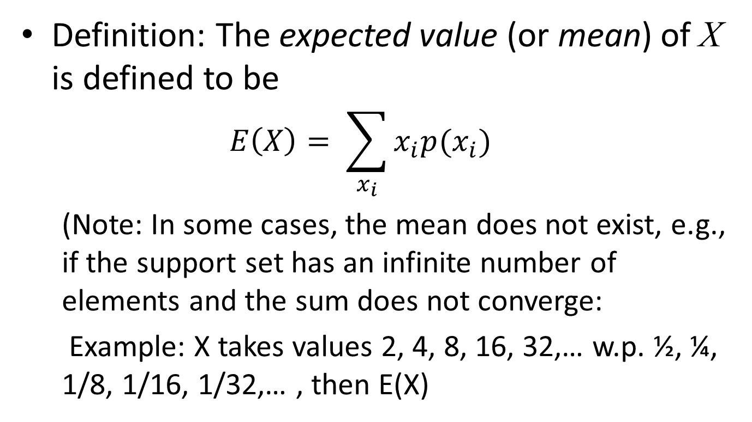
Expected Value (Mean): Discrete r.v.’s
Definition: The expected value (or mean) of X is defined to be
$$E\left(X\right)= \sum_{x_{i}}{x_{i}p(x_{i})}$$
(Note: In some cases, the mean does not exist, e.g., if the support set has an infinite number of elements and the sum does not converge:
Example: X takes values 2, 4, 8, 16, 32,… w.p. ½, ¼, 1/8, 1/16, 1/32,… , then E(X)

Slide 17
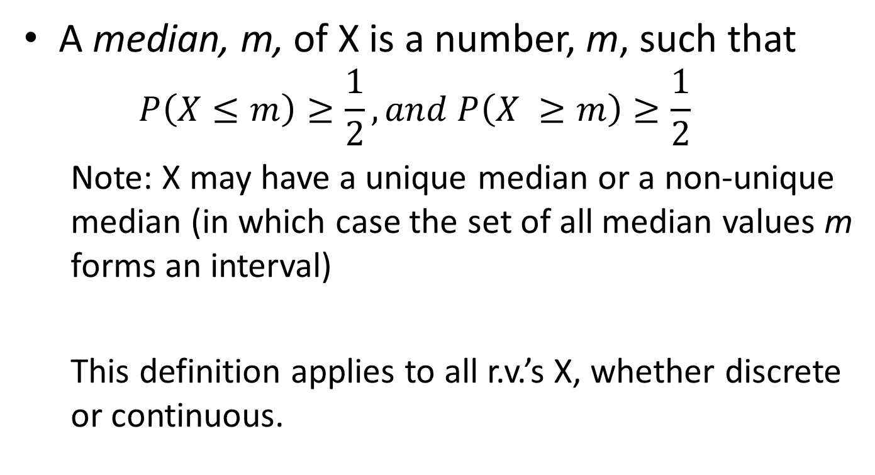
Other Definitions: Median
A median, m, of X is a number, m, such that
$$P\left(X≤m\right)≥\frac{1}{2}, and P\left(X ≥m\right)≥\frac{1}{2}$$
Note: X may have a unique median or a non-unique median (in which case the set of all median values m forms an interval)
This definition applies to all r.v.’s X, whether discrete or continuous.

Slide 18
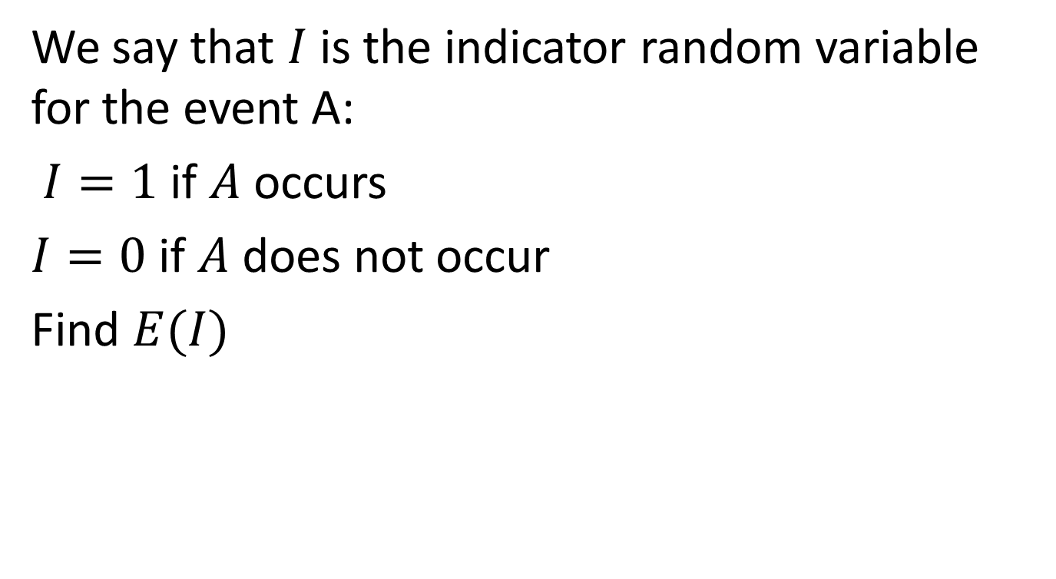
Examples
We say that $I$ is the indicator random variable for the event A:
$I=1$ if $A$ occurs
$I=0$ if $A$ does not occur
Find $E(I)$

Slide 19
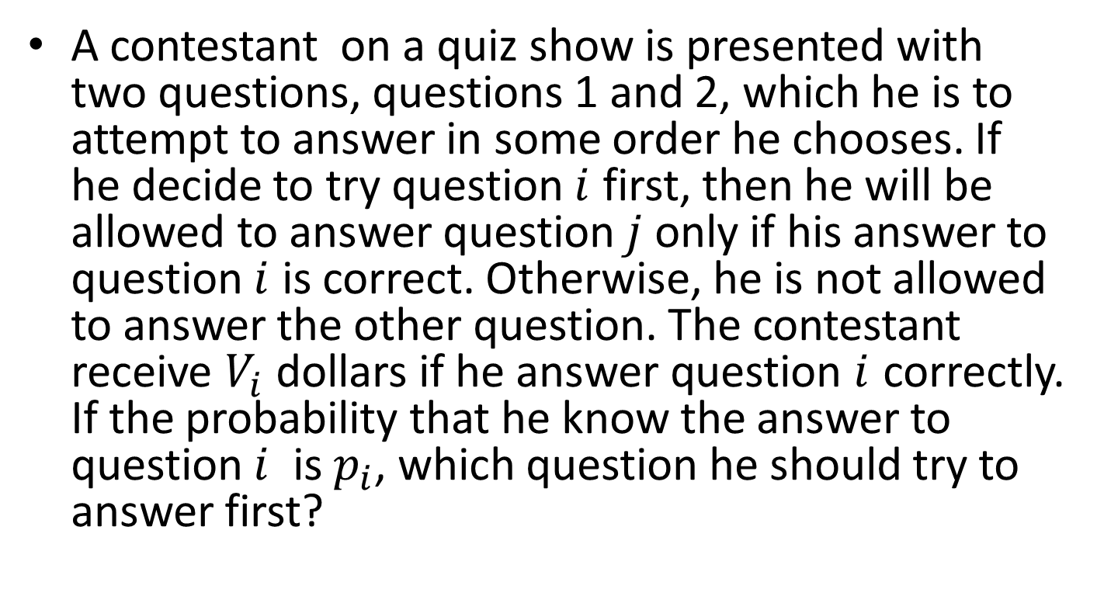
Examples
A contestant on a quiz show is presented with two questions, questions 1 and 2, which he is to attempt to answer in some order he chooses. If he decide to try question $i$ first, then he will be allowed to answer question $j$ only if his answer to question $i$ is correct. Otherwise, he is not allowed to answer the other question. The contestant receive $V_{i}$ dollars if he answer question $i$ correctly. If the probability that he know the answer to question $i$ is $p_{i}$, which question he should try to answer first?

Slide 20
Functions of Discrete r.v.
Function of a r.v.: Let Y = g(X).
How to find pmf, cdf of Y?
Easy!
Support set for Y = D_{Y} = { g(x) : x ∈ D }
pmf of Y : p_{Y}(y) = P(Y=y) = P(g(X)=y)

Slide 21

Expectations: Discrete r.v.
Expectation of functions of r.v.
$$E\left(g\left(X\right)\right)= \sum_{x_{i}}{g(x_{i})p_{X}(x_{i})}$$
(proof in text: easy! Change order of summation)
[Prop 4.1, Ross]

Slide 22
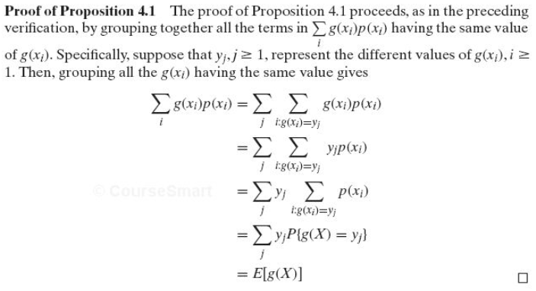
Proof

Slide 23

Examples
Let $X$ denote a r.v. that takes on any of values -1, 0, and 1 with probability
$P\left(X=−1\right)=0.2 P\left(X=0\right)=0.5, P\left(X=1\right)=0.3$
Compute $E(X^{2})$

Slide 24
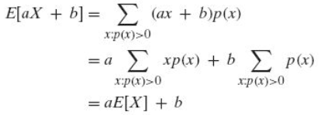
Properties of Expectation
Linearity of Expectation: If a and b are constants, then E(aX+b) = aE(X)+b
Holds for discrete and continuous r.v.’s
Proof for discrete r.v.:
[Cor 4.1, Ross]

Slide 25

Moments of a r.v.
For $k≥1$, the $k$th moment of a r.v. $X$ is defined as $E(X^{k})$
Example: expectation

Slide 26
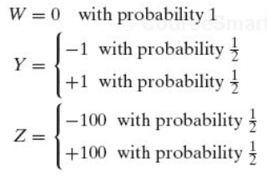
Variance
Goal: Measure the “spread” or variation of a distribution
Compare 3 r.v.’s, each with mean 0:

Slide 27
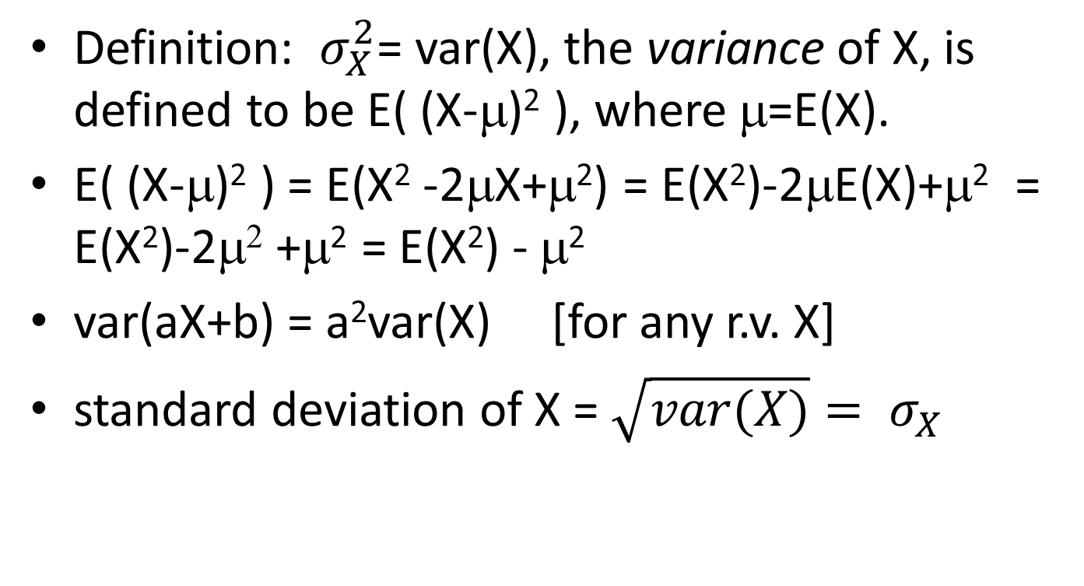
Variance
Definition: $σ_{X}^{2}$= var(X), the variance of X, is defined to be E( (X-μ)² ), where μ=E(X).
E( (X-μ)² ) = E(X² -2μX+μ²) = E(X²)-2μE(X)+μ² = E(X²)-2μ² +μ² = E(X²) - μ²
var(aX+b) = a²var(X) [for any r.v. X]
standard deviation of X = $\sqrt{var(X)}= σ_{X}$

Slide 28
Example
Compute the variances of:

Slide 29
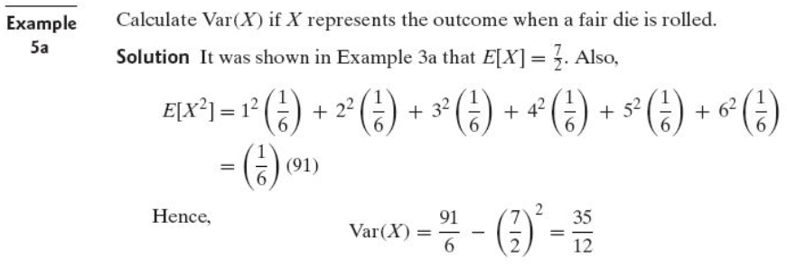
Example

Slide 30
Special (Named) Discrete Distributions
Bernouli(p)
Binomial(n,p)
Poisson(λ)
Geometric(p)
Negative Binomial(r,p) (“Pascal”)
Hypergeometric(N,K,n)
Discrete Uniform

Slide 31
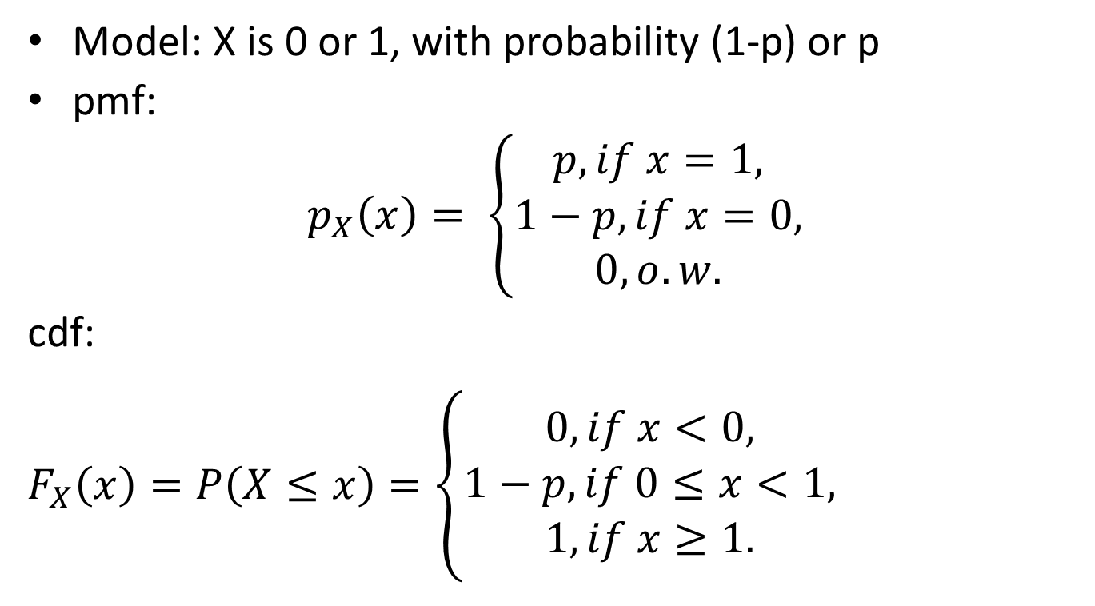
X ∼ Bernoulli(p)
Model: X is 0 or 1, with probability (1-p) or p
pmf:
$$p_{X}\left(x\right)= \left\{\begin{aligned}p, if x=1, \\ 1−p, if x=0, \\ 0, o.w.\end{aligned}\right.$$
cdf:
$F_{X}\left(x\right)=P\left(X≤x\right)=\left\{\begin{aligned}0, if x<0, \\ 1−p, if 0≤x<1, \\ 1, if x≥1.\end{aligned}\right.$

Slide 32
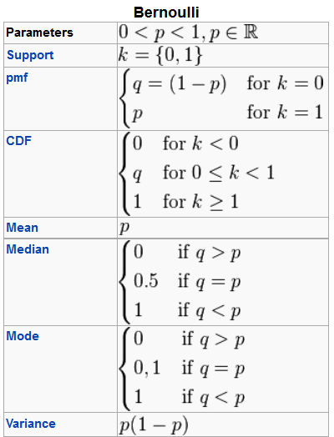
X ∼ Bernoulli(p)
Source: wikipedia

Slide 33
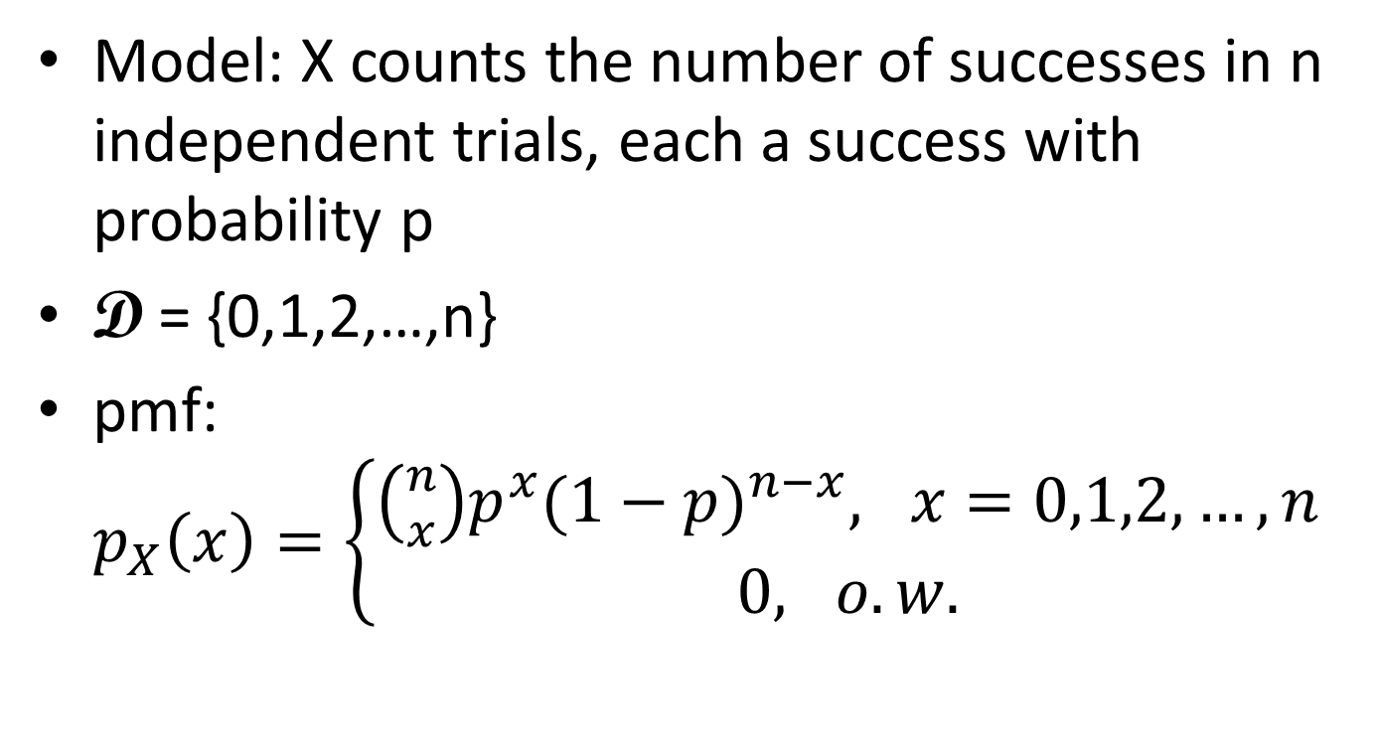
X ∼ Binomial(n,p)
Model: X counts the number of successes in n independent trials, each a success with probability p
D = {0,1,2,…,n}
pmf: $p_{X}\left(x\right)=\left\{\begin{aligned}\left({n \atop x}\right)p^{x}{(1−p)}^{n−x}, x=0,1,2,…,n \\ 0, o.w.\end{aligned}\right.$

Slide 34
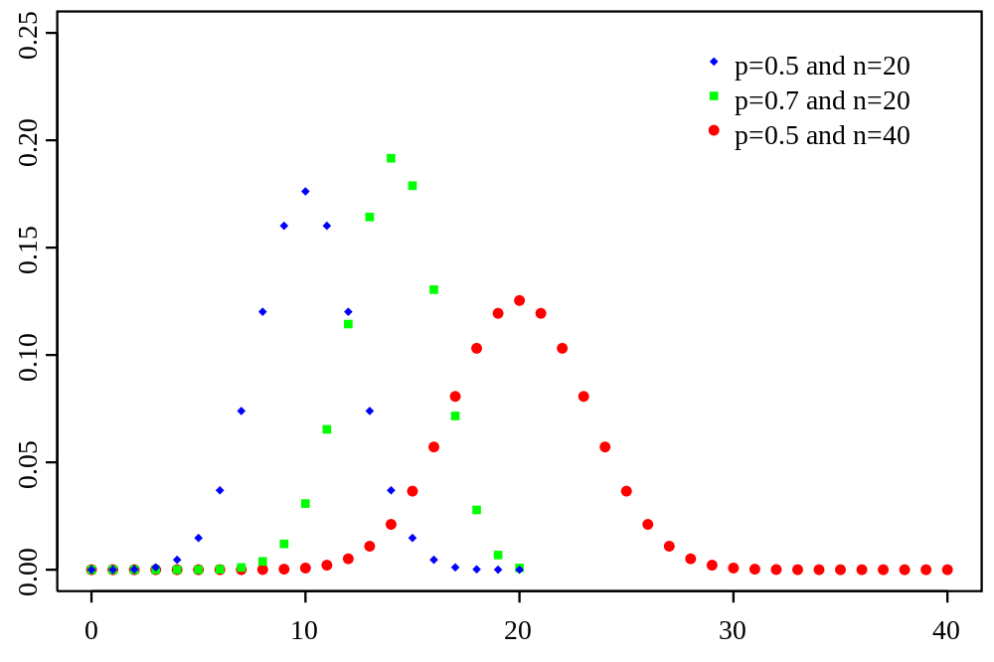
X ∼ Binomial(n,p)
Source: wikipedia

Slide 35
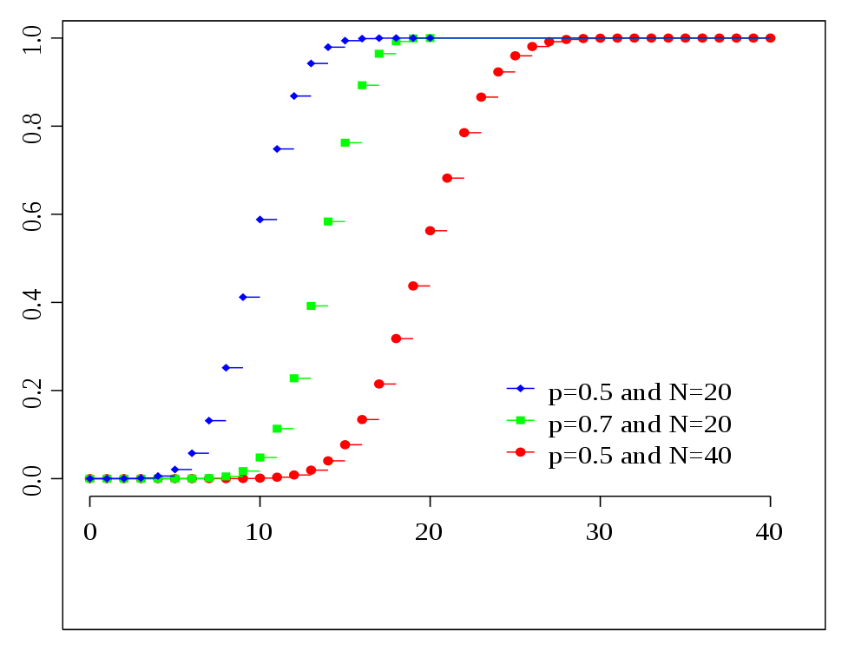
X ∼ Binomial(n,p)
Source: wikipedia

Slide 36
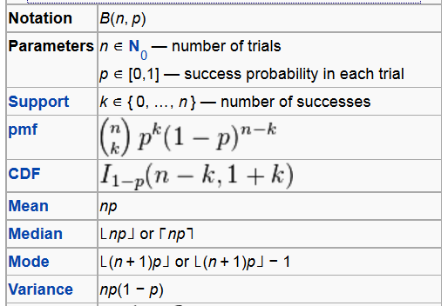
X ∼ Binomial(n,p)
Source: wikipedia

Slide 37
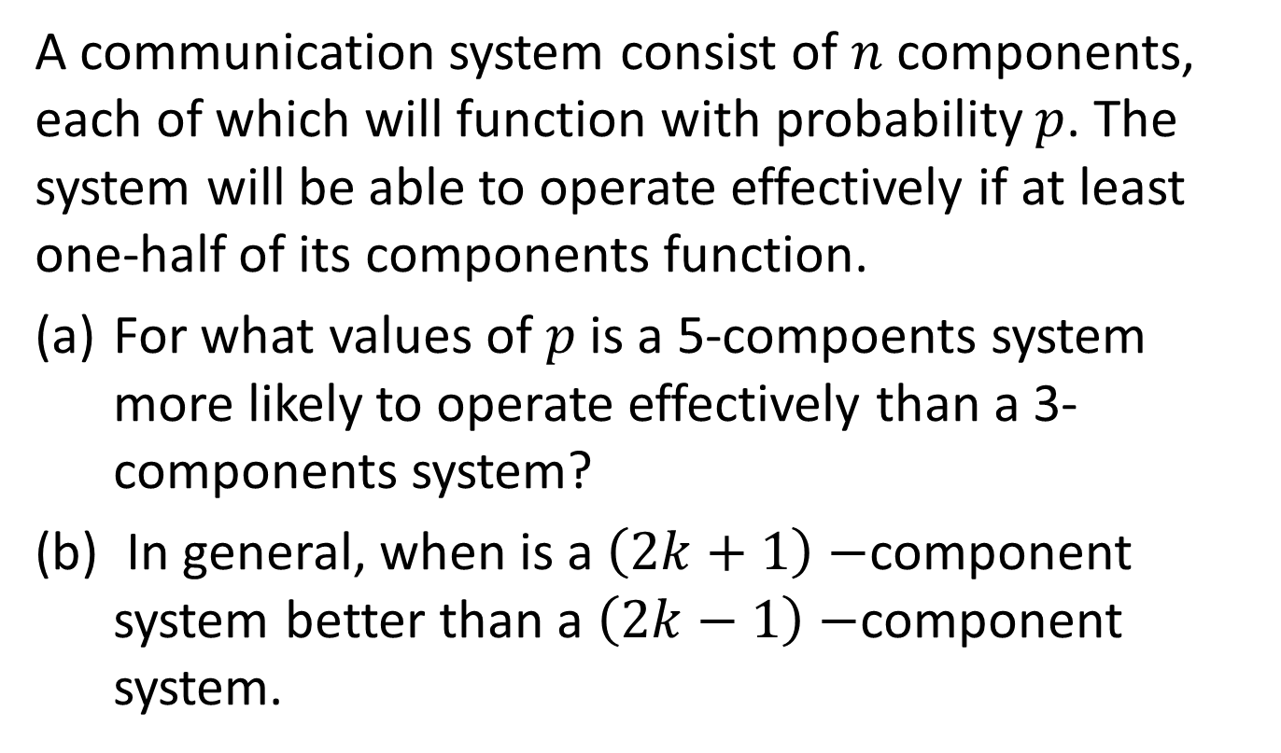
Examples
A communication system consist of $n$ components, each of which will function with probability $p$. The system will be able to operate effectively if at least one-half of its components function.
For what values of $p$ is a 5-compoents system more likely to operate effectively than a 3-components system?
In general, when is a $\left(2k+1\right)−$component system better than a $\left(2k−1\right)−$component system.

Slide 38
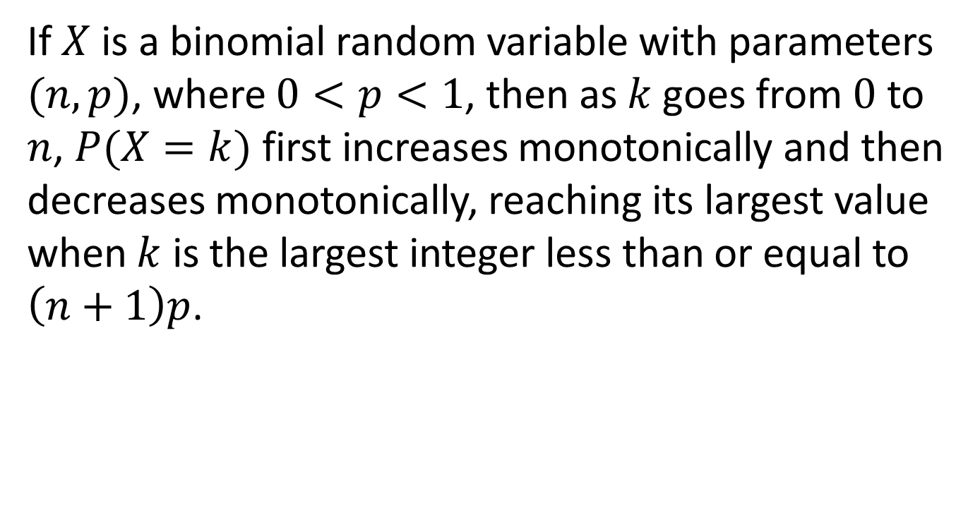
Examples
If $X$ is a binomial random variable with parameters $(n,p)$, where $0<p<1$, then as $k$ goes from $0$ to $n$, $P(X=k)$ first increases monotonically and then decreases monotonically, reaching its largest value when $k$ is the largest integer less than or equal to $\left(n+1\right)p$.

