Slide 1
Puzzle
Mike and James are arguing over who gets the last cookie in the jar, so their dad decides to create a game to settle their dispute. First, Mike flips a coin twice, and each time James calls heads or tails in the air. If James gets both calls right, he gets the last cookie. If not, Mike picks a number between one and six and then rolls a die. If he gets the number right, he gets the last cookie. If not, James picks two numbers between one and five, then spins a spinner with numbers one through five on it. If the spinner lands on one of James' two numbers, he gets the last cookie. If not, Mike does. Who is more likely to win the last cookie, Mike or James? And what is the probability that person wins it?
[braingle.com]
Notes:
http://www.braingle.com/brainteasers/41777/the-game.html

Slide 2
Joint Distribution Functions
Definitions: Joint discrete, continuous
Joint pmf, pdf, cdf

Slide 3
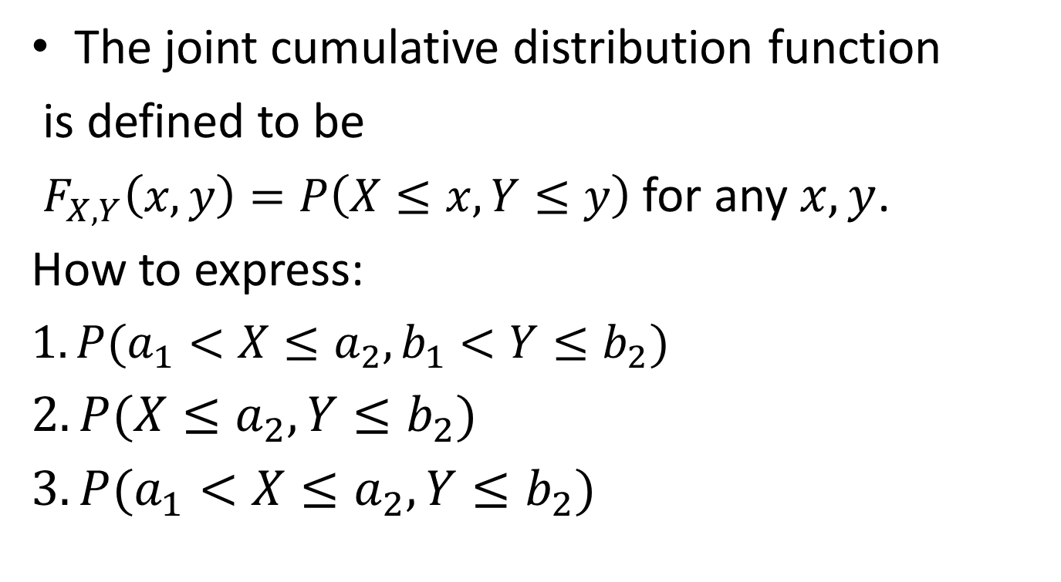
Joint cdf
The joint cumulative distribution function
is defined to be
$F_{X,Y}\left(x,y\right)=P\left(X≤x,Y≤y\right)$ for any $x,y$.
How to express:
$1. P(a_{1}<X≤a_{2},b_{1}<Y≤b_{2})$
$2.P(X≤a_{2}, Y≤b_{2})$
$3. P(a_{1}<X≤a_{2}, Y≤b_{2})$

Slide 4
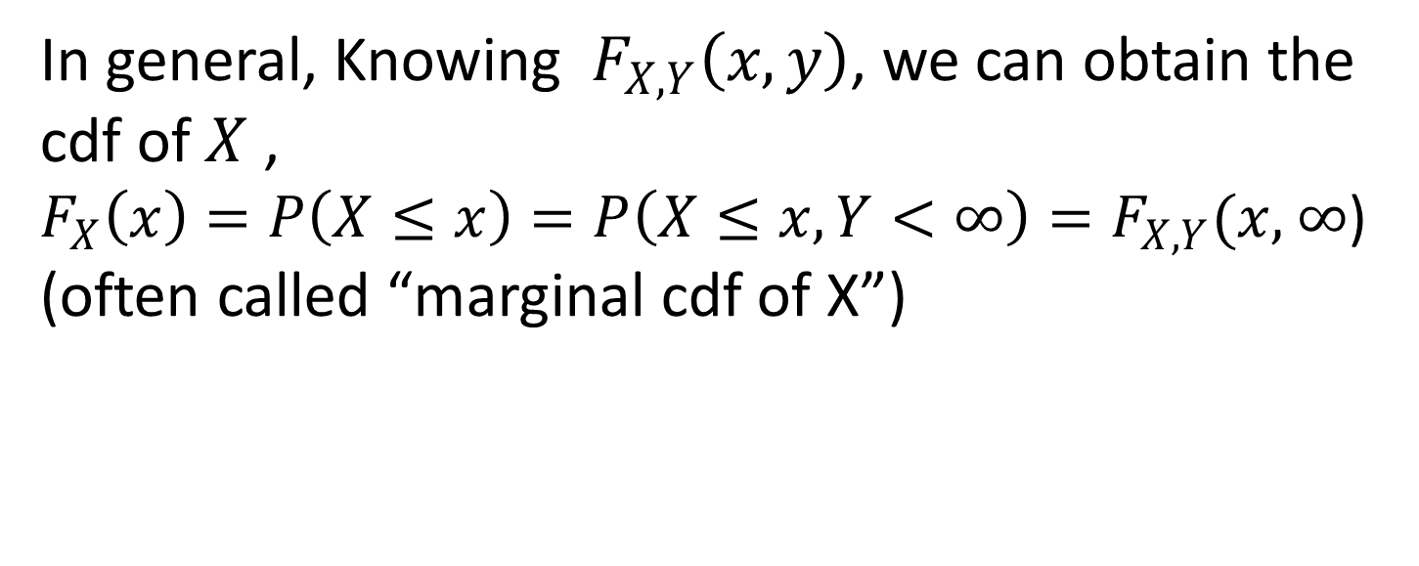
Marginal cdf
In general, Knowing $F_{X,Y}\left(x,y\right)$, we can obtain the cdf of $X$ ,
$F_{X}\left(x\right)=P\left(X≤x\right)=P\left(X≤x,Y<∞\right)=F_{X,Y}(x,$ $∞$)
(often called “marginal cdf of X”)

Slide 5
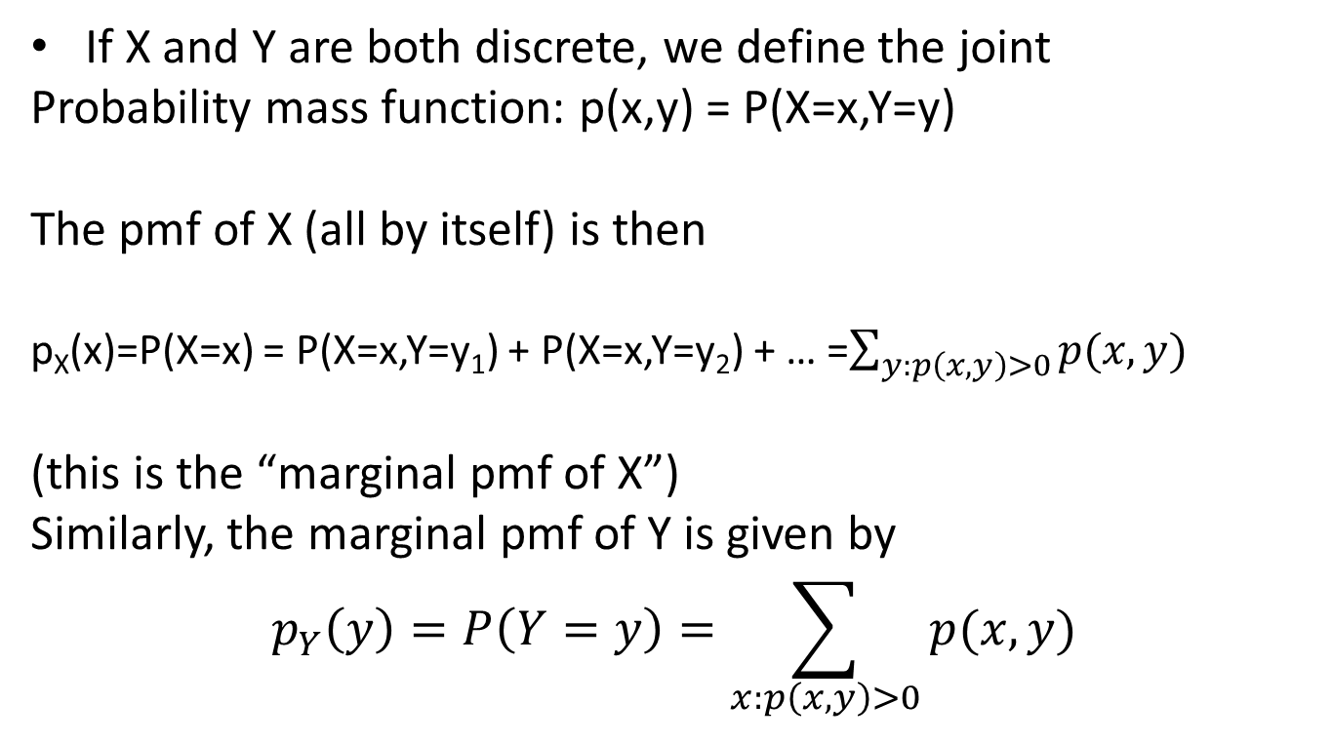
Joint Discrete r.v.’s
If X and Y are both discrete, we define the joint
Probability mass function: p(x,y) = P(X=x,Y=y)
The pmf of X (all by itself) is then
p_{X}(x)=P(X=x) = P(X=x,Y=y₁) + P(X=x,Y=y₂) + … =$\sum_{y:p\left(x,y\right)>0}{p(x,y)}$
(this is the “marginal pmf of X”)
Similarly, the marginal pmf of Y is given by
$$p_{Y}\left(y\right)=P\left(Y=y\right)=\sum_{x:p\left(x,y\right)>0}{p(x,y)}$$

Slide 6
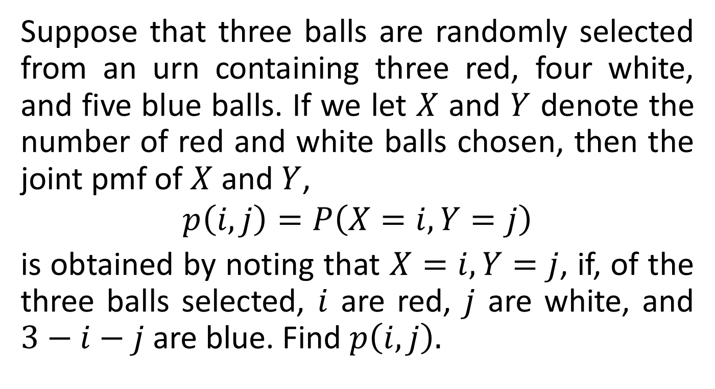
Example 1
Suppose that three balls are randomly selected from an urn containing three red, four white, and five blue balls. If we let $X$ and $Y$ denote the number of red and white balls chosen, then the joint pmf of $X$ and $Y$,
$$p\left(i,j\right)=P\left(X=i,Y=j\right)$$
is obtained by noting that $X=i,Y=j$, if, of the three balls selected, $i$ are red, $j$ are white, and $3−i−j$ are blue. Find $p\left(i,j\right).$

Slide 7
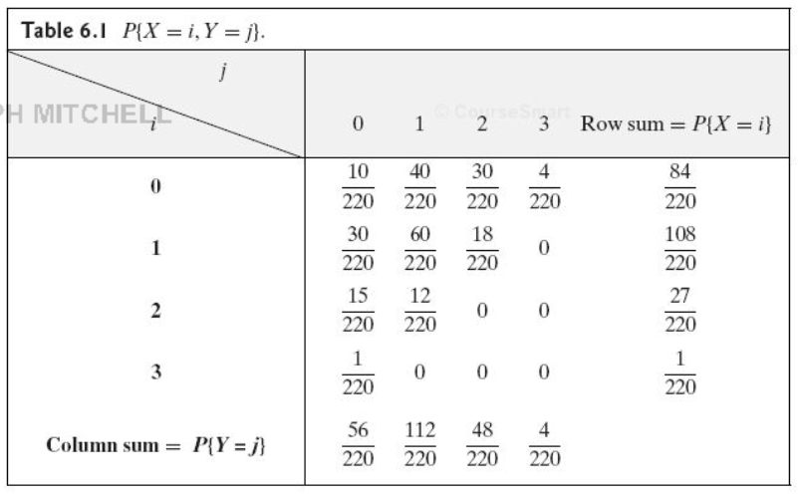

Slide 8
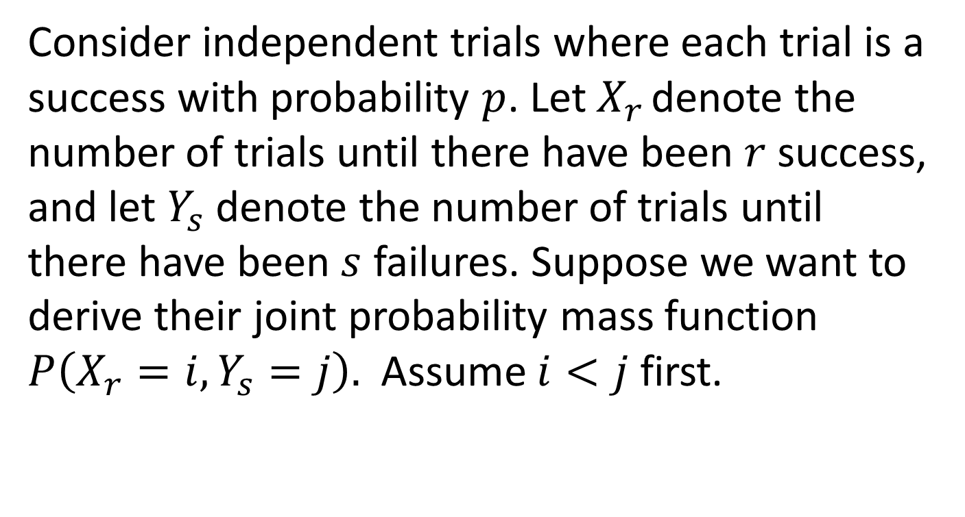
Example 2
Consider independent trials where each trial is a success with probability $p$. Let $X_{r }$denote the number of trials until there have been $r$ success, and let $Y_{s}$ denote the number of trials until there have been $s$ failures. Suppose we want to derive their joint probability mass function $P\left(X_{r}=i,Y_{s}=j\right).$ Assume $i<j$ first.

Slide 9
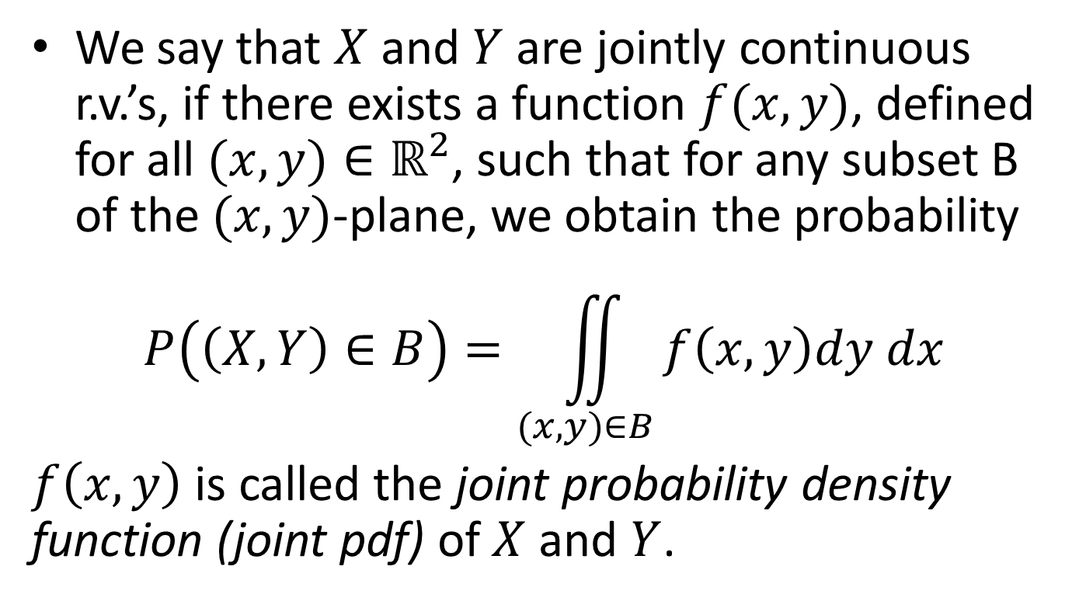
Jointly Continuous r.v.’s
We say that $X$ and $Y$ are jointly continuous r.v.’s, if there exists a function $f(x,y)$, defined for all $(x,y)∈ℝ^{2}$, such that for any subset B of the $(x,y)$-plane, we obtain the probability
$$P\left(\left(X,Y\right)∈B\right)=\iint_{(x,y)∈B}{f\left(x,y\right)dy dx}$$
$f\left(x,y\right)$ is called the joint probability density function (joint pdf) of $X$ and $Y$.
Notes:
Got to here, 10/22/13

Slide 10
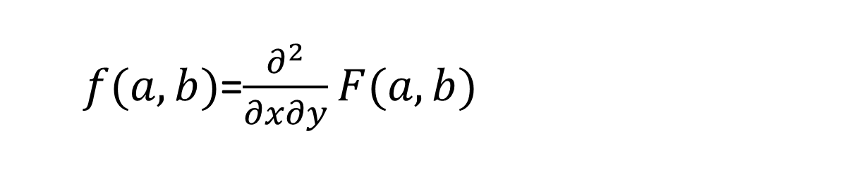

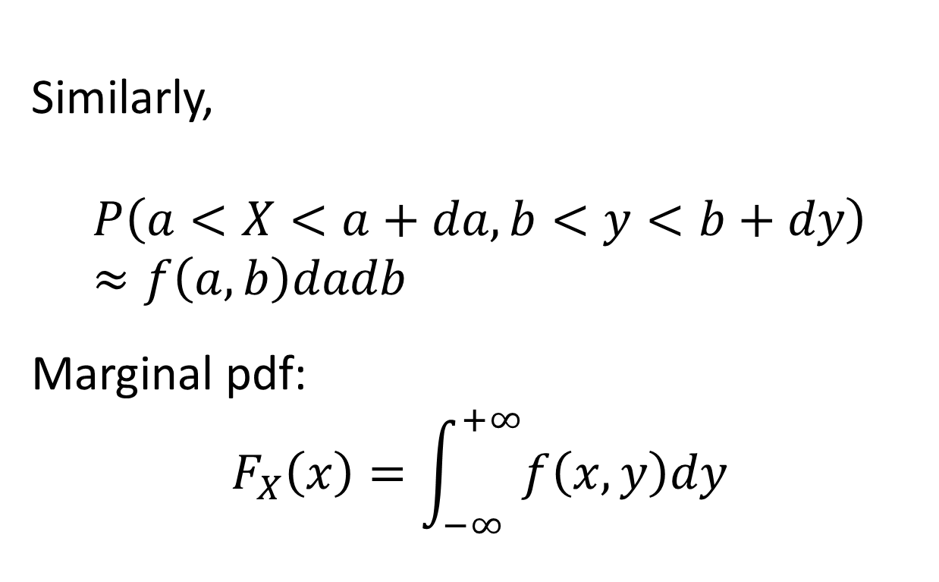
$$F\left(a,b\right)=\int_{−∞}^{a}{\int_{−∞}^{b}{f\left(x,y\right)dxdy}}$$
$f(a,b)$=$\frac{∂^{2}}{∂x∂y}F(a,b)$
Similarly,
$$P\left(a<X<a+da,b<y<b+dy\right)≈f\left(a,b\right)dadb$$
Marginal pdf:
$$F_{X}\left(x\right)=\int_{−∞}^{+∞}{f\left(x,y\right)dy}$$

Slide 11
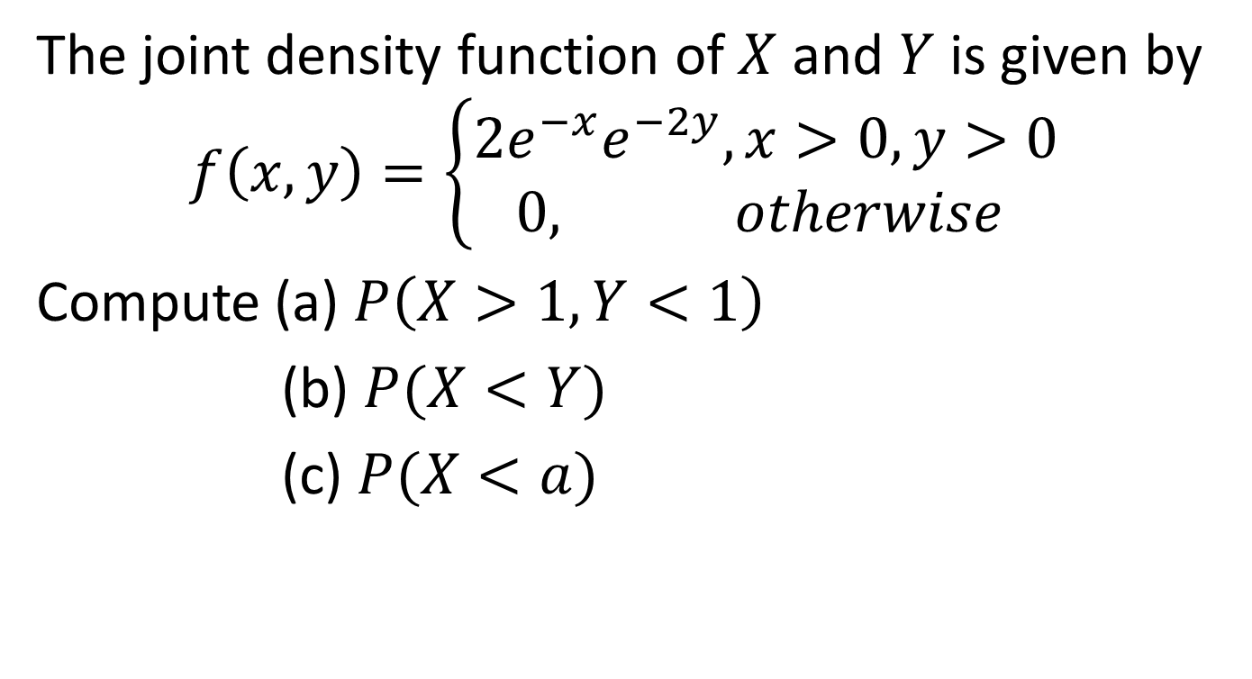
Example 3
The joint density function of $X$ and $Y$ is given by
$$f\left(x,y\right)=\left\{\begin{aligned}2e^{−x}e^{−2y},x>0, y>0 \\ 0, otherwise \end{aligned}\right.$$
Compute (a) $P\left(X>1,Y<1\right)$
(b) $P(X<Y)$
(c) $P(X<a)$

Slide 12
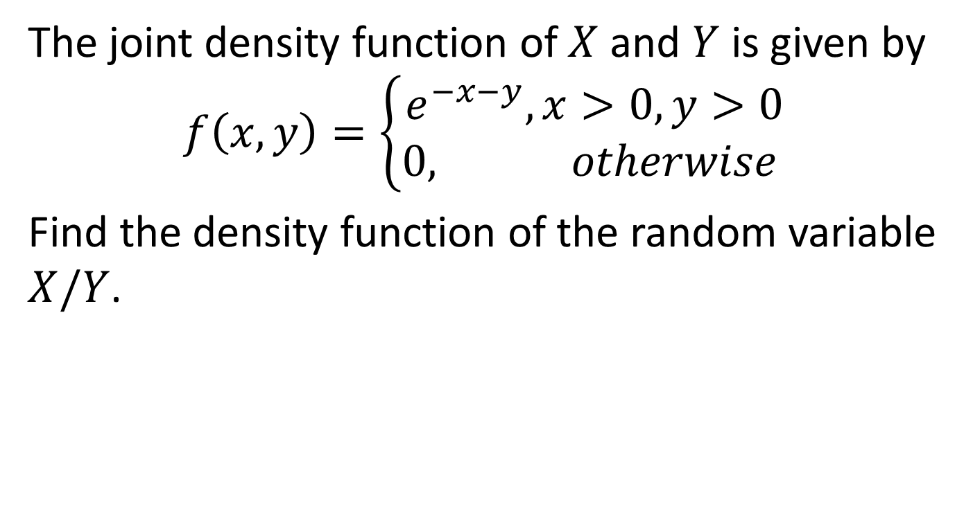
Example 4
The joint density function of $X$ and $Y$ is given by
$$f\left(x,y\right)=\left\{\begin{aligned}e^{−x−y}, x>0, y>0 \\ 0, otherwise \end{aligned}\right.$$
Find the density function of the random variable $X/Y$.

Slide 13
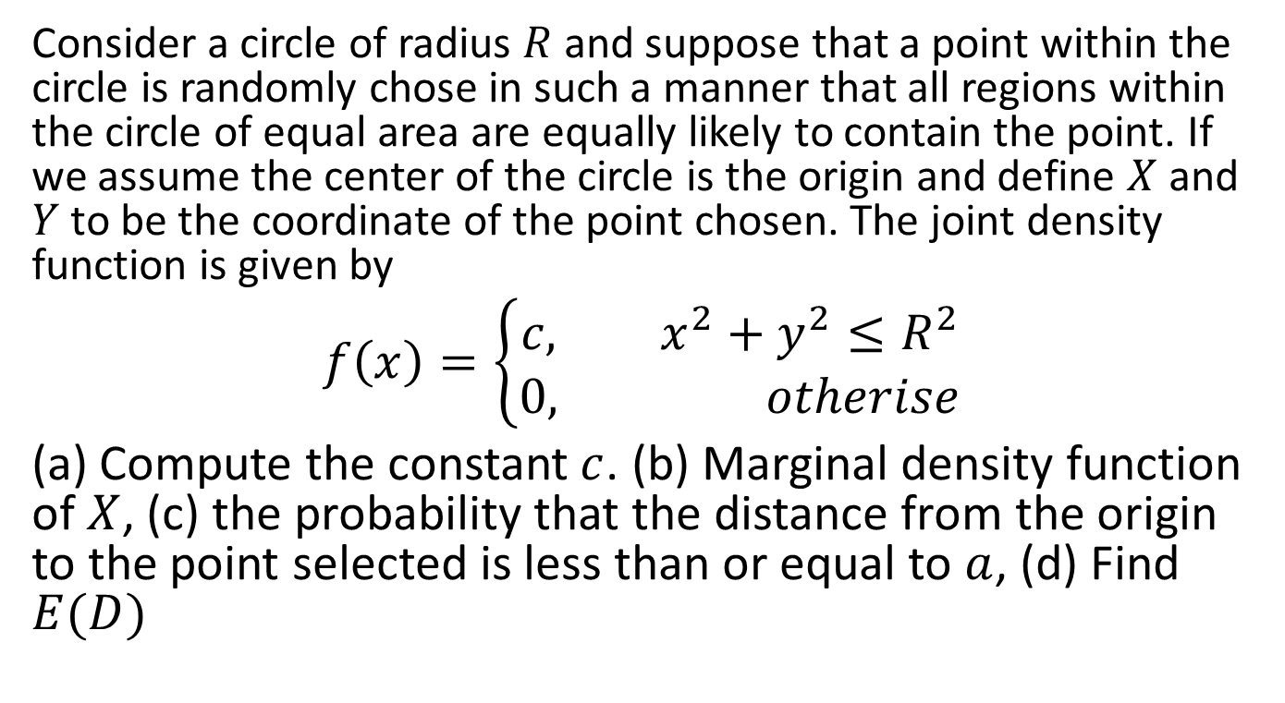
Example 5
Consider a circle of radius $R$ and suppose that a point within the circle is randomly chose in such a manner that all regions within the circle of equal area are equally likely to contain the point. If we assume the center of the circle is the origin and define $X$ and $Y$ to be the coordinate of the point chosen. The joint density function is given by
$$f\left(x\right)=\left\{\begin{aligned}c, x^{2}+y^{2}≤R^{2} \\ &0, otherise\end{aligned}\right.$$
(a) Compute the constant $c$. (b) Marginal density function of $X$, (c) the probability that the distance from the origin to the point selected is less than or equal to $a$, (d) Find $E(D)$

Slide 14
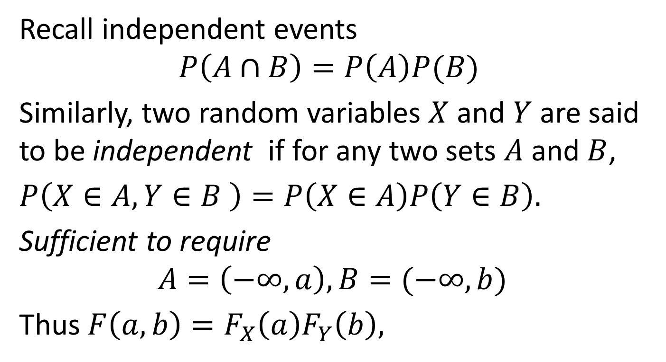
6.2 Independent random variables
Recall independent events
$$P\left(A∩B\right)=P\left(A\right)P(B)$$
Similarly, two random variables $X$ and $Y$ are said to be independent if for any two sets $A$ and $B$,
$P\left(X∈A, Y∈B \right)=P\left(X∈A\right)P\left(Y∈B\right).$
Sufficient to require
$$A=\left(−∞,a\right), B=(−∞,b)$$
Thus $F\left(a,b\right)=F_{X}\left(a\right)F_{Y}\left(b\right),$

Slide 15
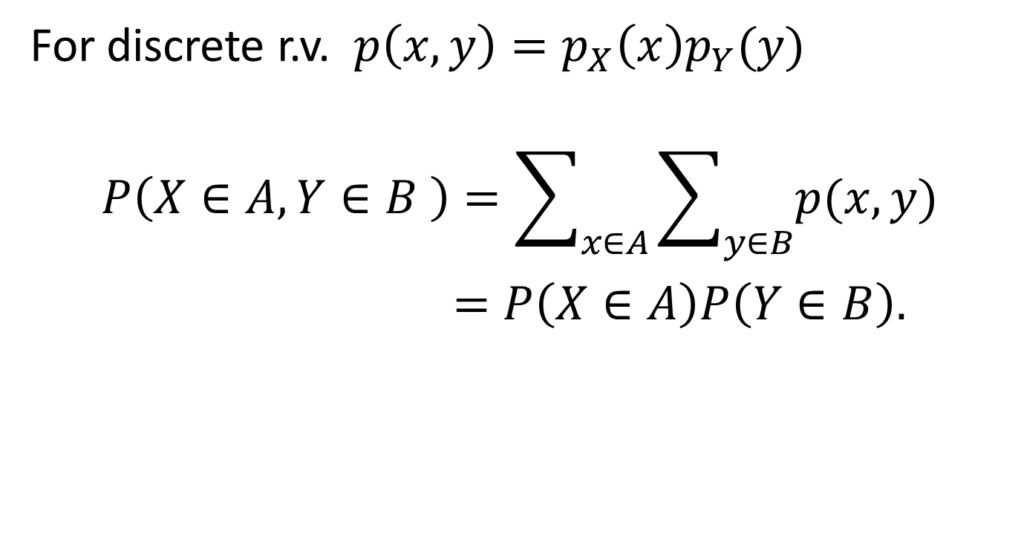
independent discrete r.v.
For discrete r.v. $p\left(x,y\right)=p_{X}\left(x\right)p_{Y}(y)$
$$P\left(X∈A, Y∈B \right)=\sum_{x∈A}{\sum_{y∈B}{p(x,y)}}$$
$=P\left(X∈A\right)P\left(Y∈B\right).$

Slide 16
Example 6
A man and a woman decide to meet at a certain location. If each of them independently arrives at a time uniformly distributed between 12 noon and 1 P.M., find the probability that the first to arrive has to wait longer than 10 minutes.

Slide 17
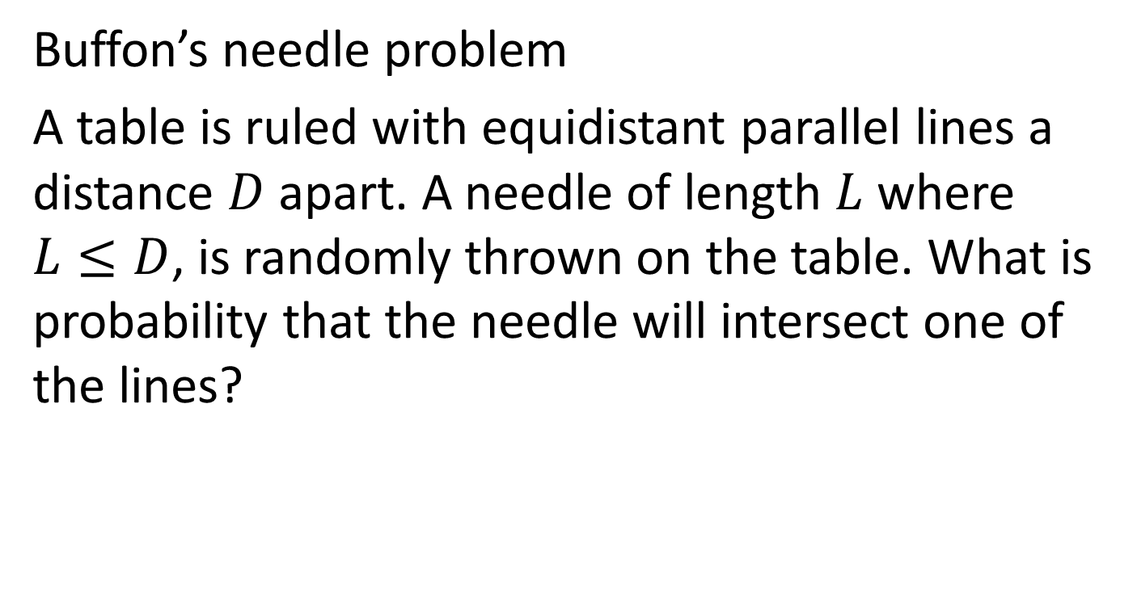
Example 7
Buffon’s needle problem
A table is ruled with equidistant parallel lines a distance $D$ apart. A needle of length $L$ where $L≤D$, is randomly thrown on the table. What is probability that the needle will intersect one of the lines?

Slide 18
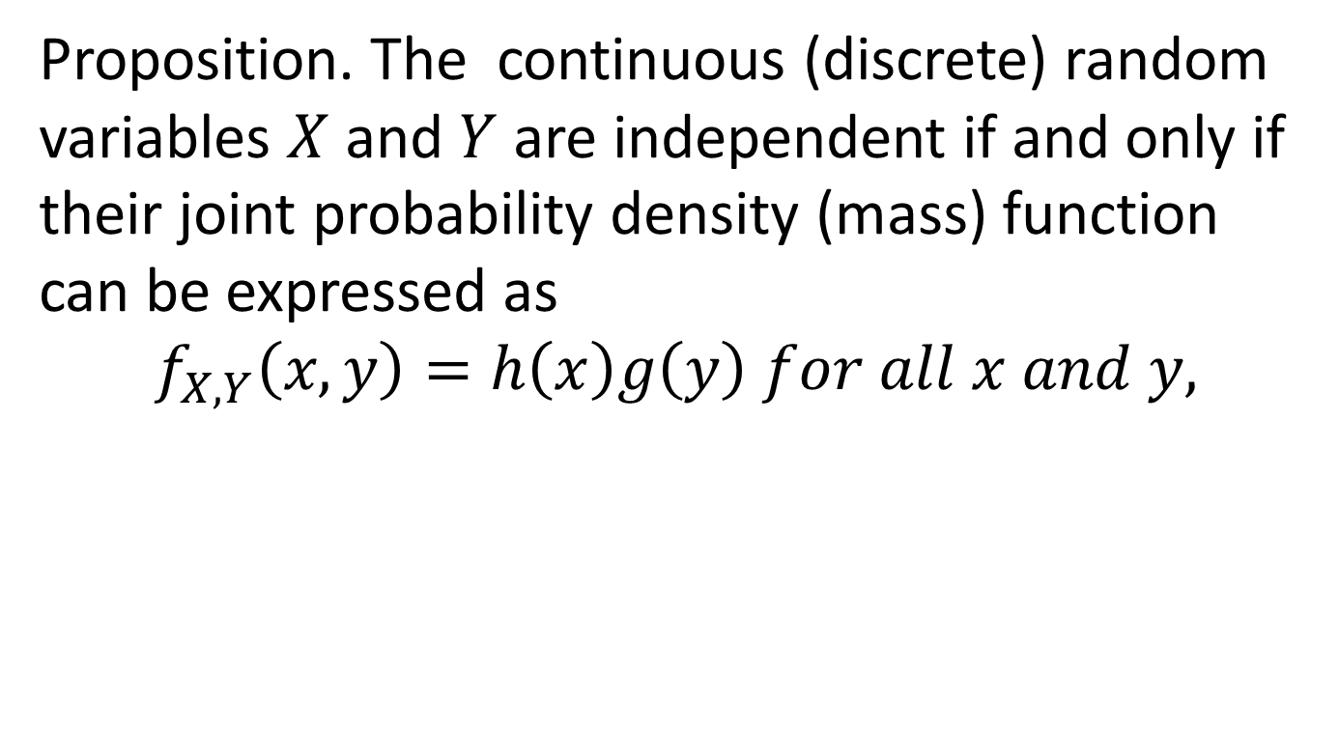
Continuous r.v.
Proposition. The continuous (discrete) random variables $X$ and $Y$ are independent if and only if their joint probability density (mass) function can be expressed as
$$f_{X,Y}\left(x,y\right)=h\left(x\right)g\left(y\right) for all x and y,$$

Slide 19
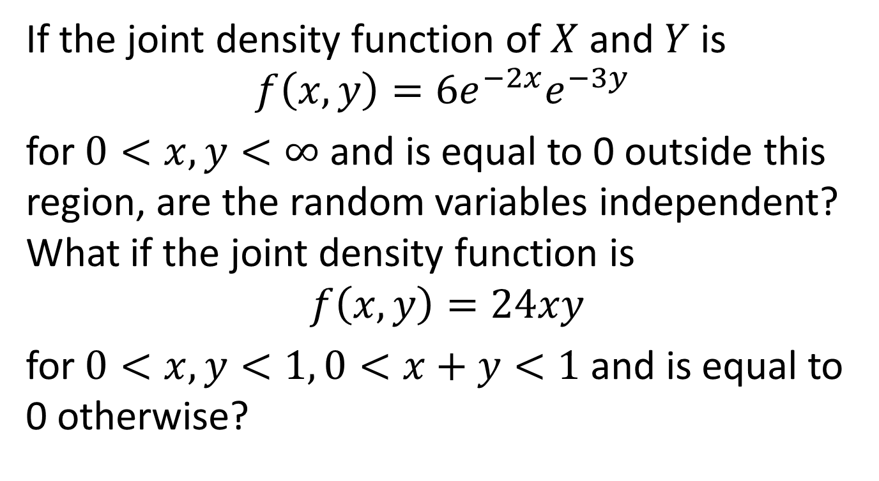
Example 8
If the joint density function of $X$ and $Y$ is
$$f\left(x,y\right)=6e^{−2x}e^{−3y}$$
for $0<x,y<∞$ and is equal to 0 outside this region, are the random variables independent? What if the joint density function is
$$f\left(x,y\right)=24xy$$
for $0<x,y<1, 0<x+y<1$ and is equal to 0 otherwise?

Slide 20
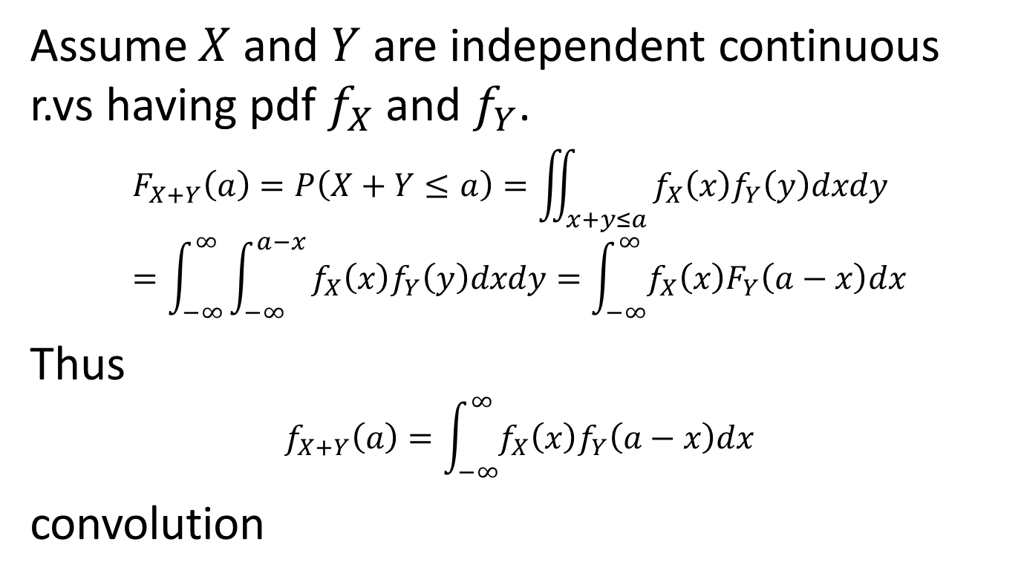
Sums of independent r.v.
Assume $X$ and $Y$ are independent continuous r.vs having pdf $f_{X}$ and $f_{Y}$.
$$F_{X+Y}\left(a\right)=P\left(X+Y≤a\right)=\iint_{x+y≤a }{f_{X}\left(x\right)f_{Y}\left(y\right)dxdy}=\int_{−∞}^{∞}{\int_{−∞}^{a−x}{f_{X}\left(x\right)f_{Y}\left(y\right)dxdy=\int_{−∞}^{∞}{f_{X}\left(x\right)F_{Y}\left(a−x\right)dx}}}$$
Thus
$$f_{X+Y}\left(a\right)=\int_{−∞}^{∞}{f_{X}\left(x\right)f_{Y}\left(a−x\right)dx}$$
convolution

Slide 21
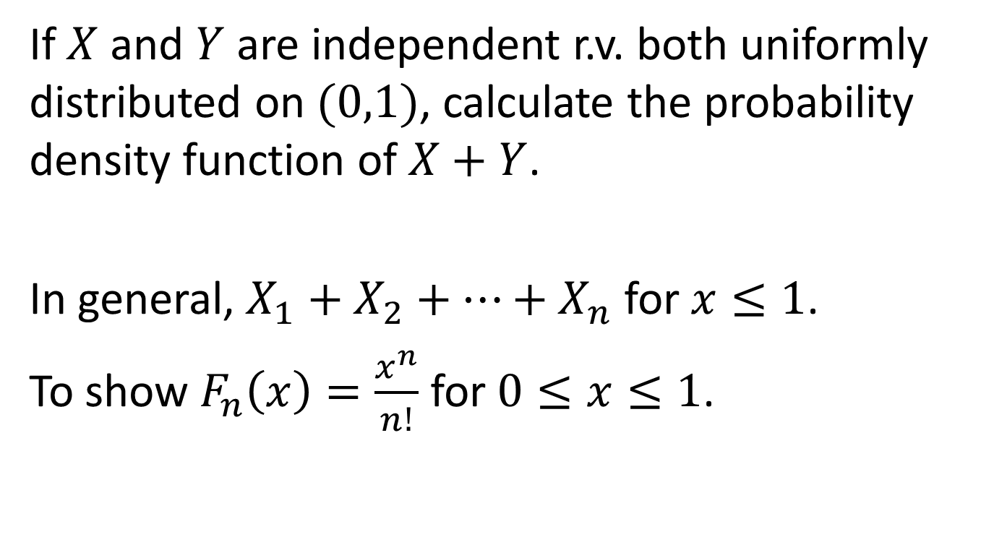
Example 9
If $X$ and $Y$ are independent r.v. both uniformly distributed on $(0,1)$, calculate the probability density function of $X+Y$.
In general, $X_{1}+X_{2}+⋯+X_{n}$ for $x≤1$.
To show $F_{n}\left(x\right)=\frac{x^{n}}{n!}$ for $0≤x≤1$.

Slide 22
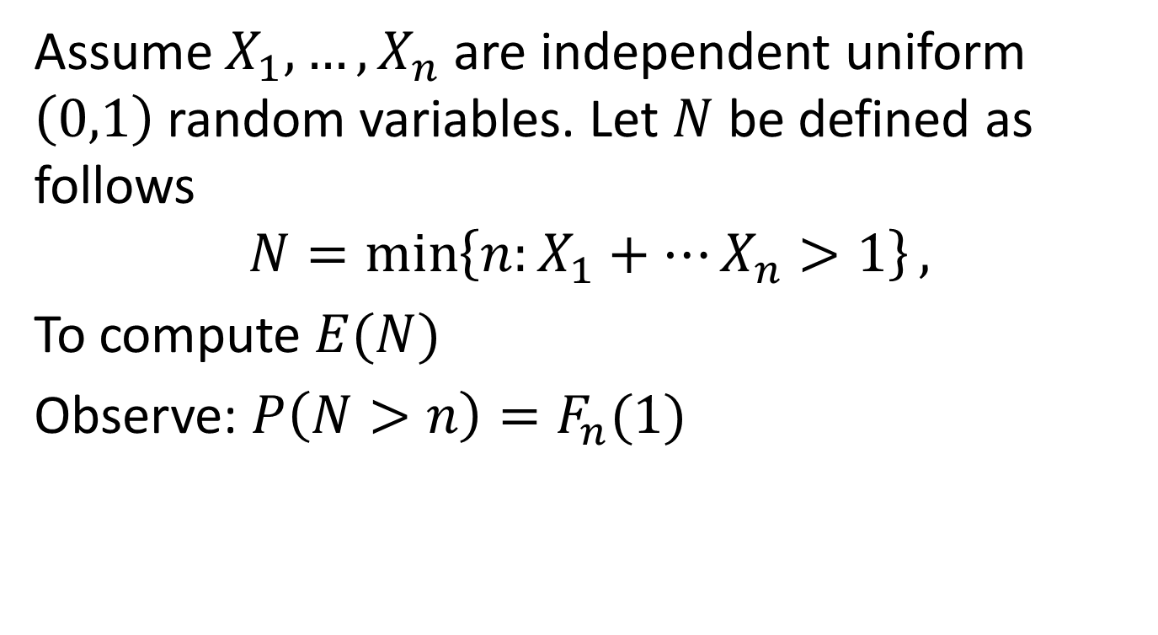
Assume $X_{1},…,X_{n}$ are independent uniform $\left(0,1\right)$ random variables. Let $N$ be defined as follows
$$N=\min\left\{n:X_{1}+…X_{n}>1\right\},$$
To compute $E(N)$
Observe: $P\left(N>n\right)=F_{n}(1)$

Slide 23
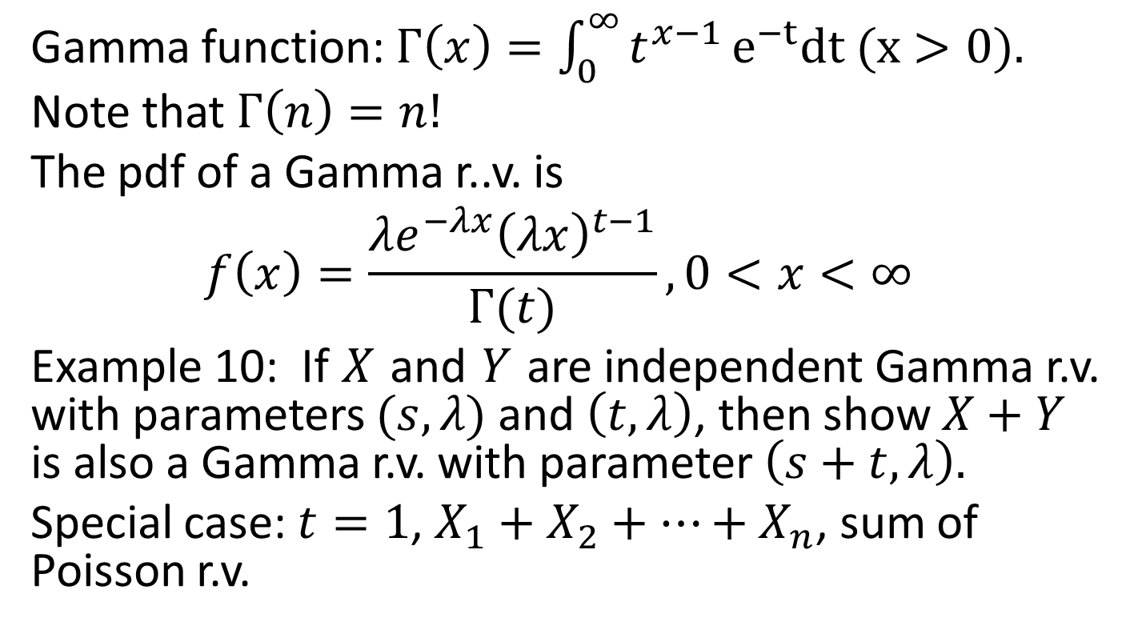
Examples Gamma r.v.
Gamma function: $Γ\left(x\right)=\int_{0}^{∞}{t^{x−1}}e^{−t}dt (x>0).$
Note that $Γ\left(n\right)=n!$
The pdf of a Gamma r..v. is
$$f\left(x\right)=\frac{λe^{−λx}{\left(λx\right)}^{t−1}}{Γ(t)}, 0<x<∞$$
Example 10: If $X$ and $Y$ are independent Gamma r.v. with parameters $(s,λ)$ and $\left(t,λ\right)$, then show $X+Y$ is also a Gamma r.v. with parameter $\left(s+t,λ\right).$
Special case: $t=1$, $X_{1}+X_{2}+⋯+X_{n}$, sum of Poisson r.v.

Slide 24
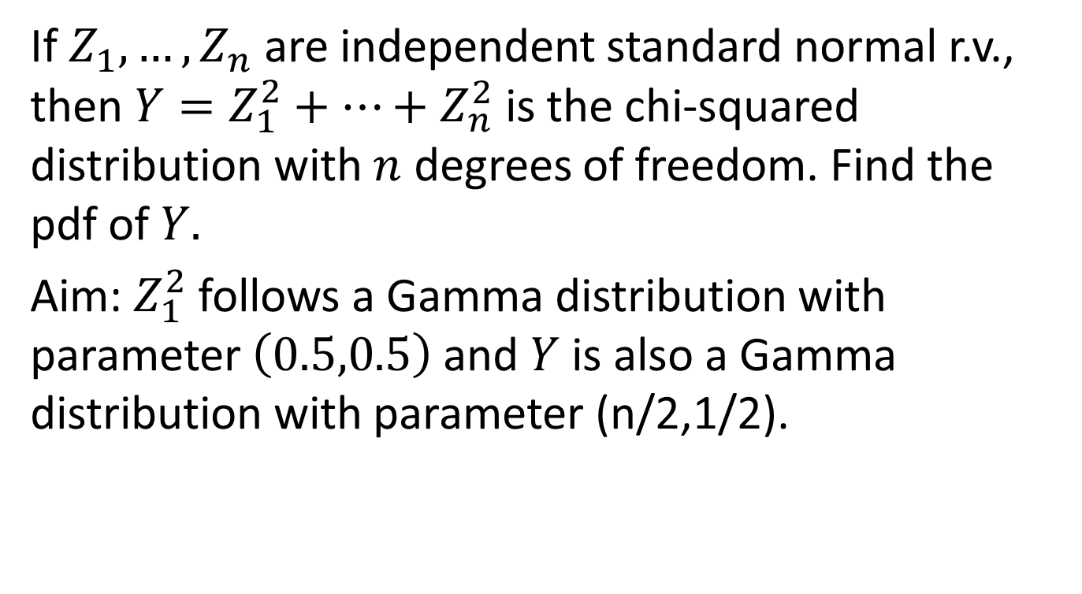
Chi-squared distribution
If $Z_{1},…, Z_{n}$ are independent standard normal r.v., then $Y=Z_{1}^{2}+…+Z_{n}^{2}$ is the chi-squared distribution with $n$ degrees of freedom. Find the pdf of $Y.$
Aim: $Z_{1}^{2}$ follows a Gamma distribution with parameter $\left(0.5,0.5\right)$ and $Y$ is also a Gamma distribution with parameter (n/2,1/2).

Slide 25
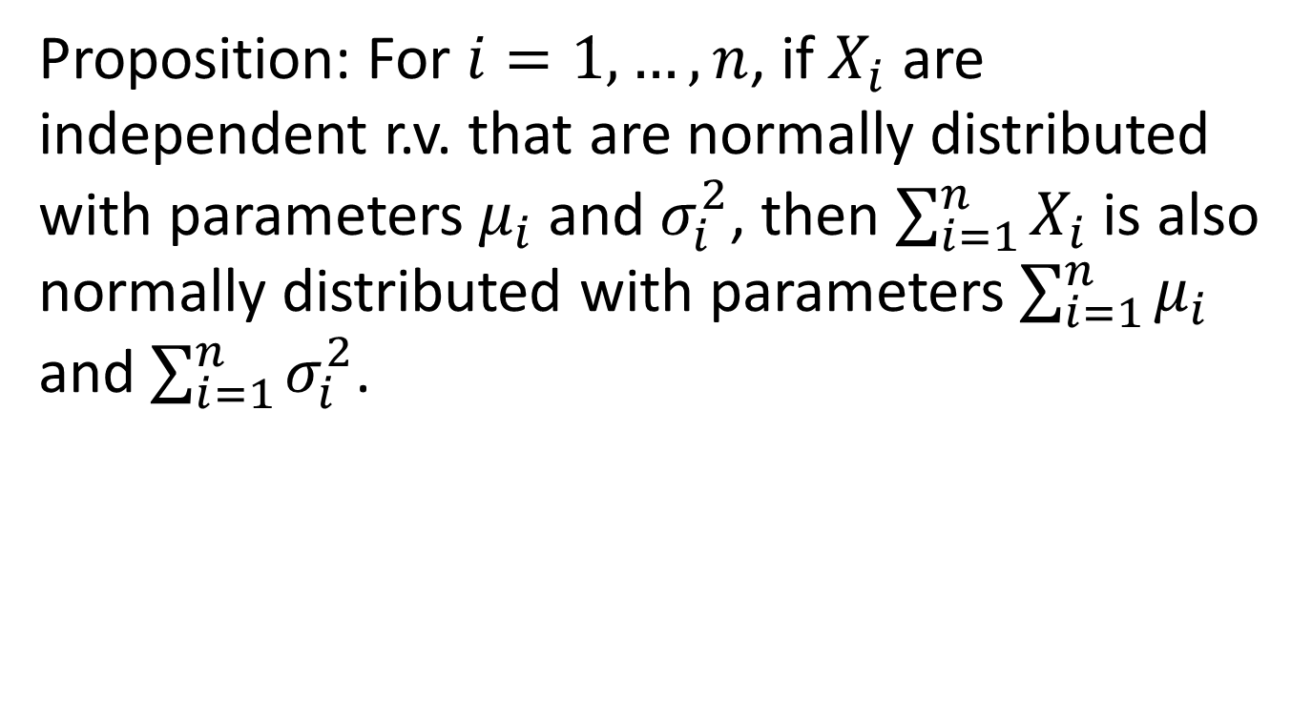
Normal r.v.
Proposition: For $i=1,…,n$, if $X_{i}$ are independent r.v. that are normally distributed with parameters $μ_{i}$ and $σ_{i}^{2}$, then $\sum_{i=1}^{n}{X_{i}}$ is also normally distributed with parameters $\sum_{i=1}^{n}{μ_{i }}$ and $\sum_{i=1}^{n}{σ_{i}^{2}}$.

Slide 26

Poisson and Binomial r.v.
Example 10. If $X$ and $Y$ are independent Poisson r.v. with parameters $λ_{1}$ and $λ_{2}$, then $X+Y$ is also a Poisson r.v. with parameter $λ_{1}+λ_{2}$.

Slide 27
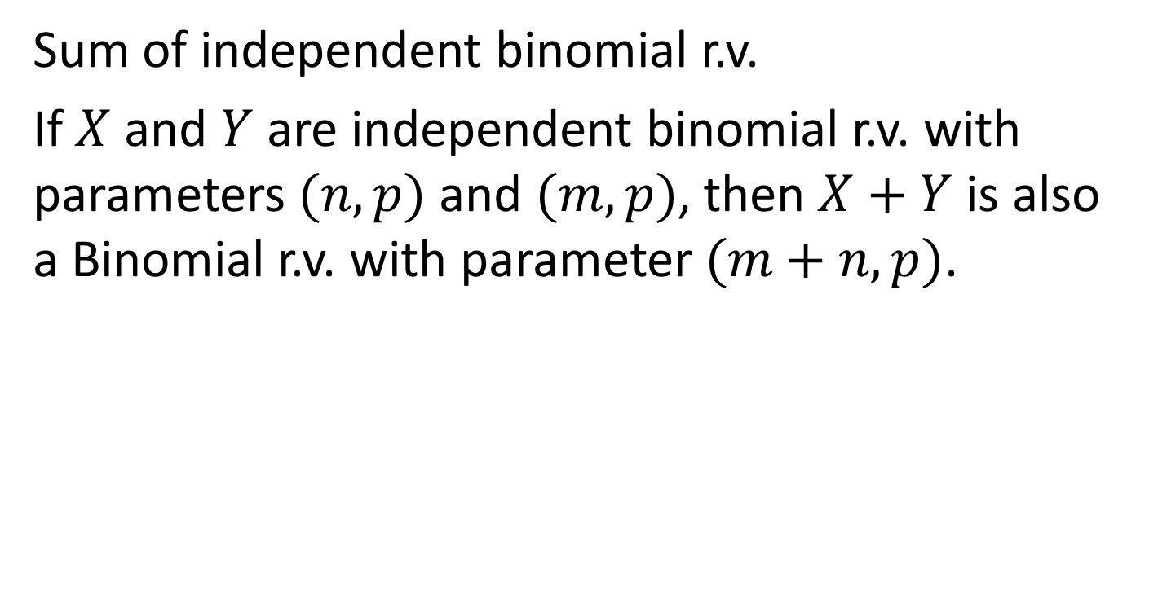
Example 11
Sum of independent binomial r.v.
If $X$ and $Y$ are independent binomial r.v. with parameters $(n,p)$ and $(m,p)$, then $X+Y$ is also a Binomial r.v. with parameter $(m+n,p)$.

