Slide 1
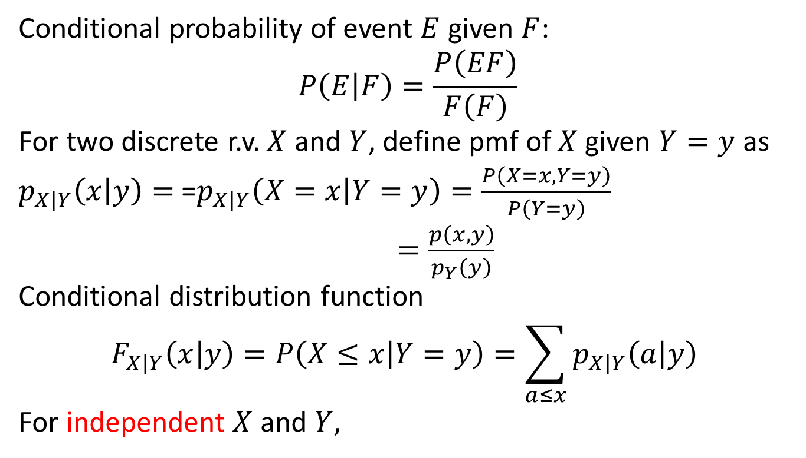
6.4 Conditional distributions Discrete case
Conditional probability of event $E$ given $F$:
$$P\left(E | F\right)=\frac{P\left(EF\right)}{F\left(F\right)}$$
For two discrete r.v. $X$ and $Y$, define pmf of $X$given $Y=y$ as
$p_{X|Y}\left(x | y\right)=$=$p_{X|Y}\left(X=x | Y=y\right)=\frac{P\left(X=x,Y=y\right)}{P\left(Y=y\right)}$
$=\frac{p\left(x,y\right)}{p_{Y}\left(y\right)}$
Conditional distribution function
$$F_{X|Y}\left(x | y\right)=P\left(X≤x | Y=y\right)=\sum_{a≤x}{p_{X|Y}\left(a | y\right)}$$
For independent $X$ and $Y,$

Slide 2
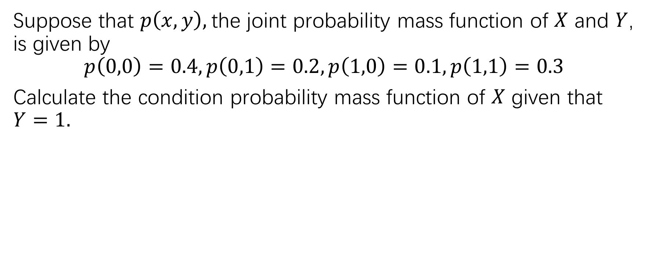
Example 1
Suppose that $p\left(x,y\right),$the joint probability mass function of $X$ and $Y$, is given by
$$p\left(0,0\right)=0.4, p\left(0,1\right)=0.2,p\left(1,0\right)=0.1, p\left(1,1\right)=0.3$$
Calculate the condition probability mass function of $X$ given that $Y=1.$

Slide 3

Example 2
If $X$ and $Y$ are independent Poisson r.v. with respectively parameters $λ_{1}$ and $λ_{2}$, calculate the conditional distribution of $X$ given that $X+Y=n$.

Slide 4
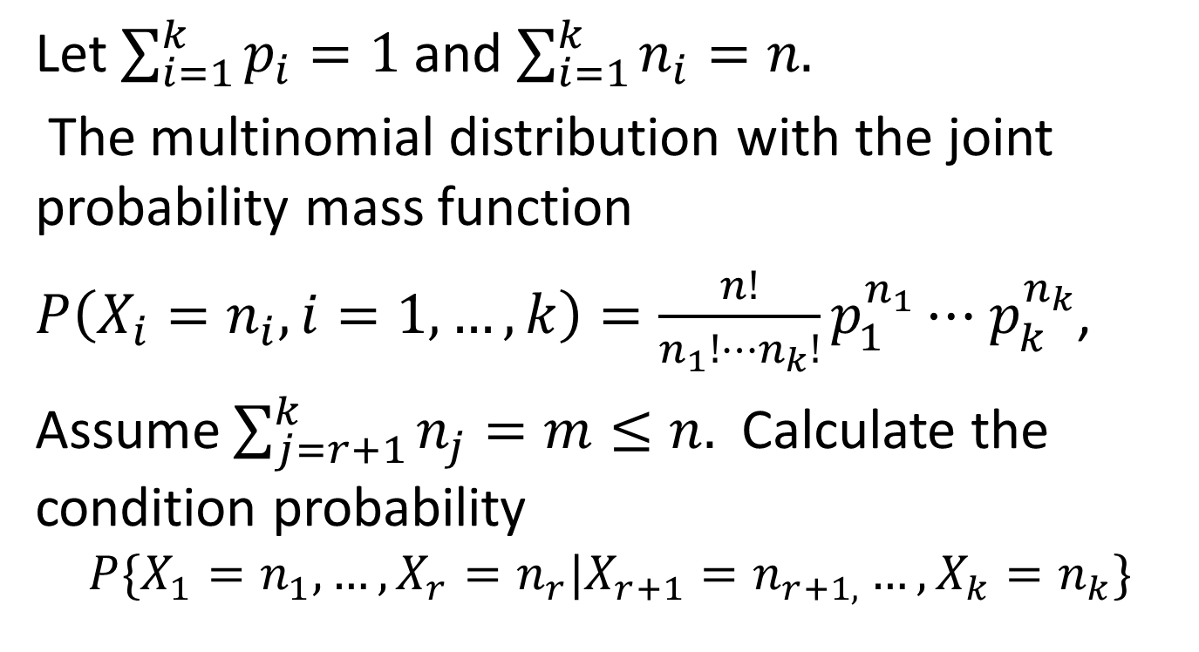
Example 3
Let $\sum_{i=1}^{k}{p_{i}}=1$and $\sum_{i=1}^{k}{n_{i}}=n.$
The multinomial distribution with the joint probability mass function
$P\left(X_{i}=n_{i}, i=1,…, k\right)=\frac{n!}{n_{1}!⋯n_{k}!}p_{1}^{n_{1}}⋯$ $p_{k}^{n_{k}}$,
Assume $\sum_{j=r+1}^{k}{n_{j}}=m≤n.$ Calculate the condition probability
$$P\{X_{1}=n_{1},…, X_{r}=n_{r}|X_{r+1}=n_{r+1,}…,X_{k}=n_{k}\}$$

Slide 5
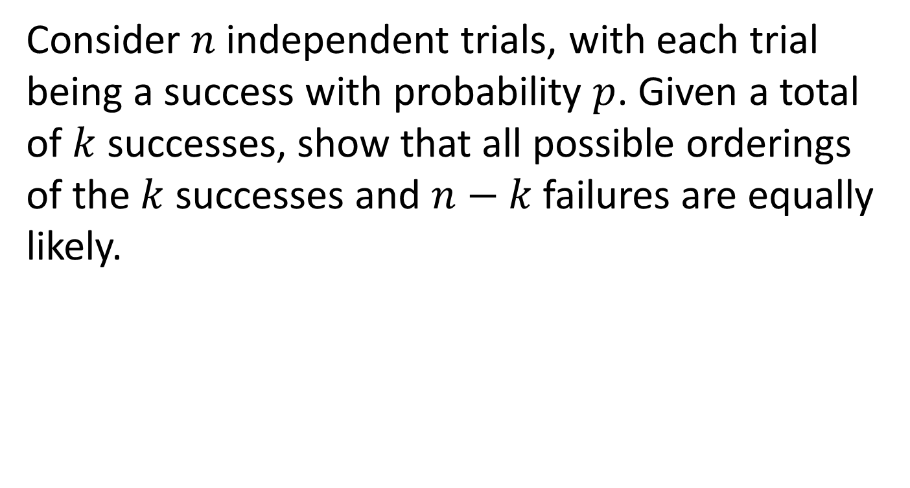
Example 4
Consider $n$ independent trials, with each trial being a success with probability $p$. Given a total of $k$ successes, show that all possible orderings of the $k$ successes and $n−k$ failures are equally likely.

