Slide 1
Chapter 25 INTERFERENCE
25.1 Interference and Coherent Sources
25.2 Two-Source Interference of Light
25.3 Intensity in Interference Patterns
25.4 Interference in Thin Films
25.5 The Michelson Interferometer

Slide 2
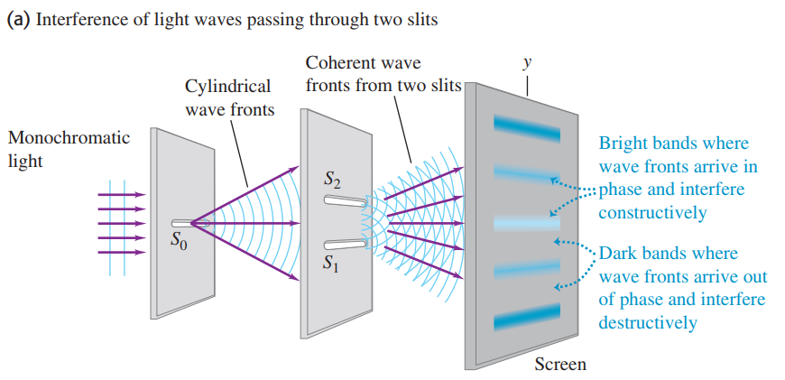
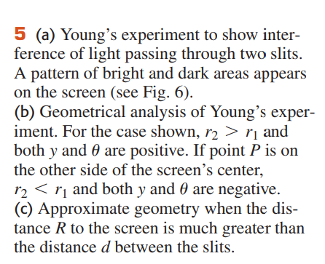
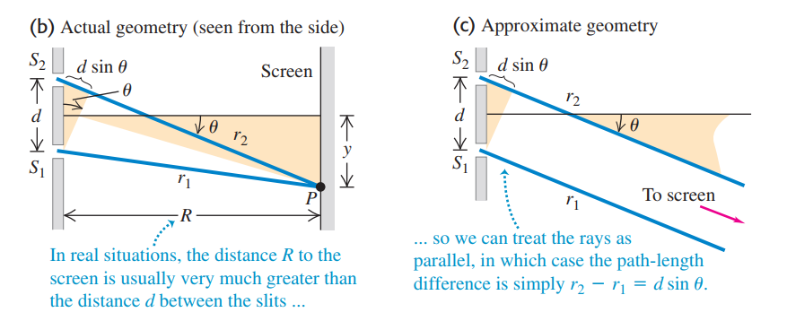


Slide 3
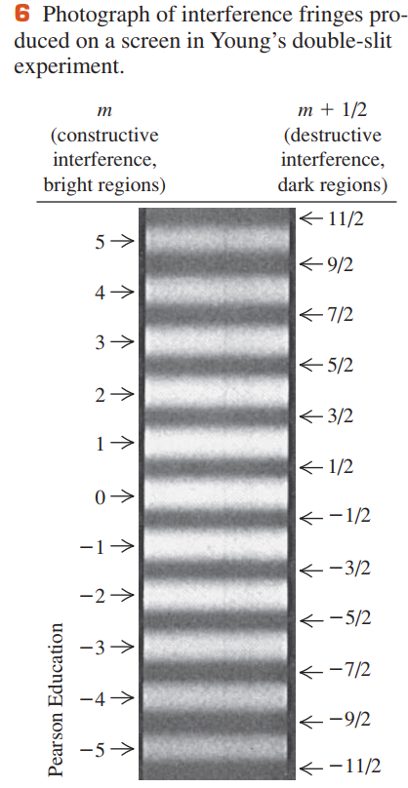




Constructive and Destructive Two-Slit Interference

Slide 4
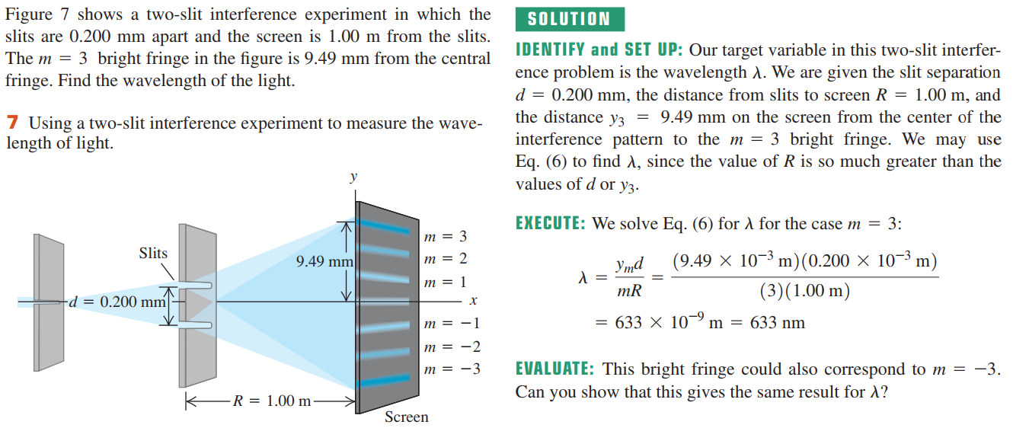
Example 25.1 Two-slit interference

Slide 5
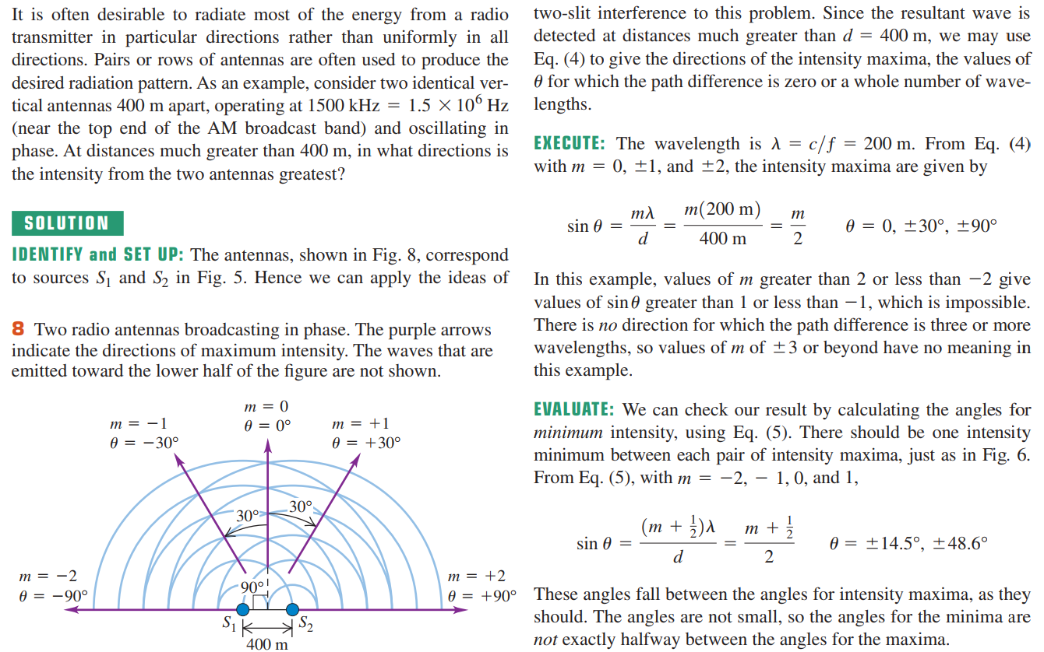
Example 25.2 Broadcast pattern of a radio station

Slide 6
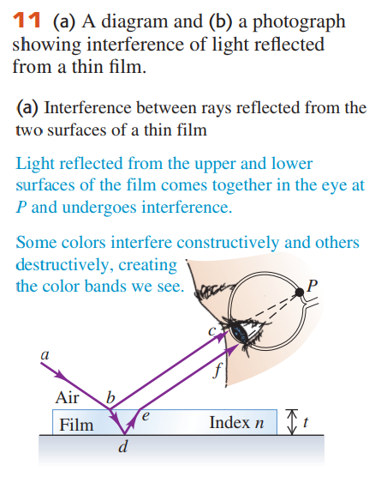
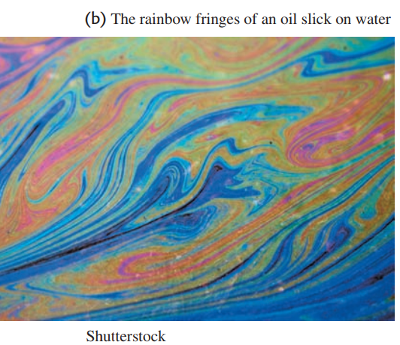
25.4 Interference in Thin Films
The complex shapes of the colored rings in each photograph result from variations in the thickness of the film.

Slide 7
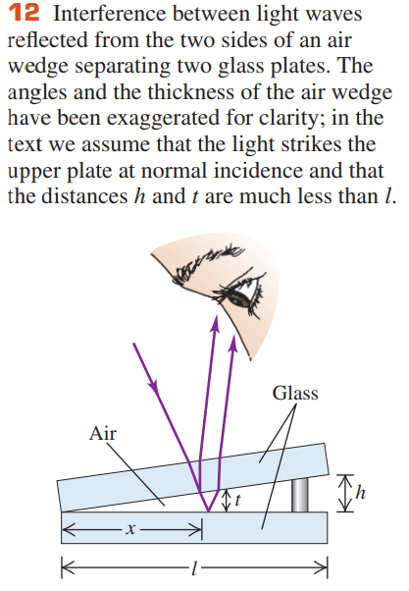

Thin-Film Interference and Phase Shifts During Reflection
The amplitude E_{r} of the wave reflected from the interface is proportional to the amplitude E_{i} of the incident wave and is given by

Slide 8
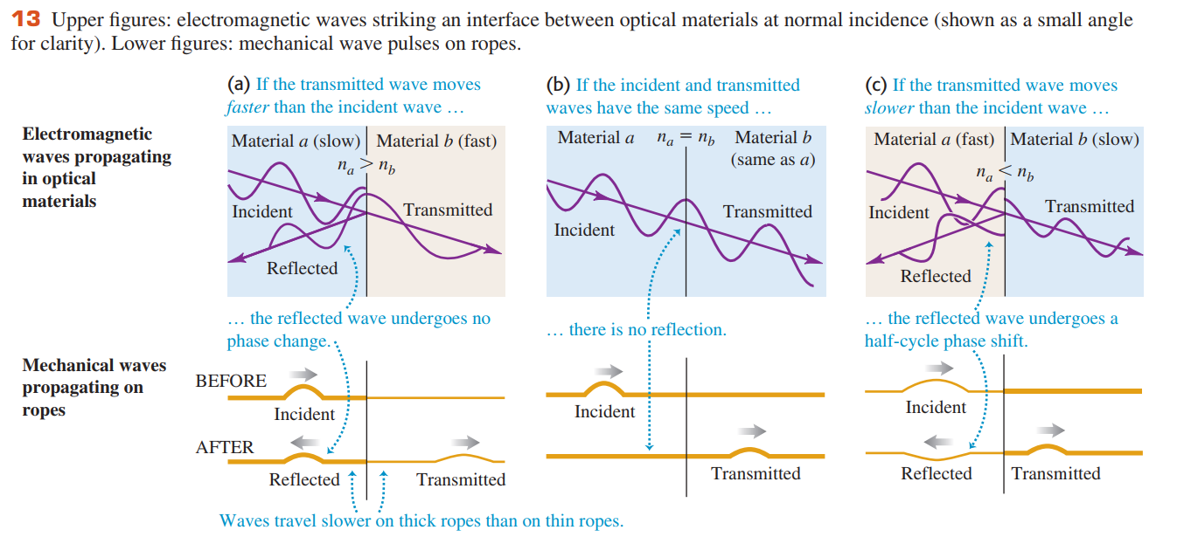

Slide 9
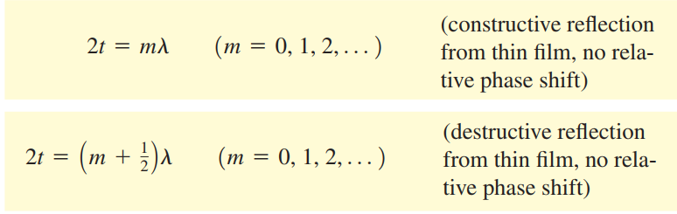
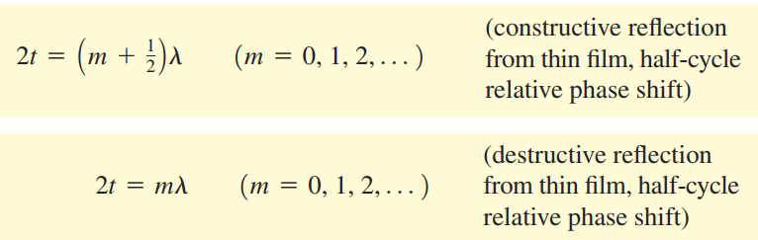
We can summarize this discussion mathematically. If the film has thickness t, the light is at normal incidence and has wavelength λ in the film; if neither or both of the reflected waves from the two surfaces have a half-cycle reflection phase shift, the conditions for constructive and destructive interference are
If one of the two waves has a half-cycle reflection phase shift, the conditions for constructive and destructive interference are reversed

Slide 10
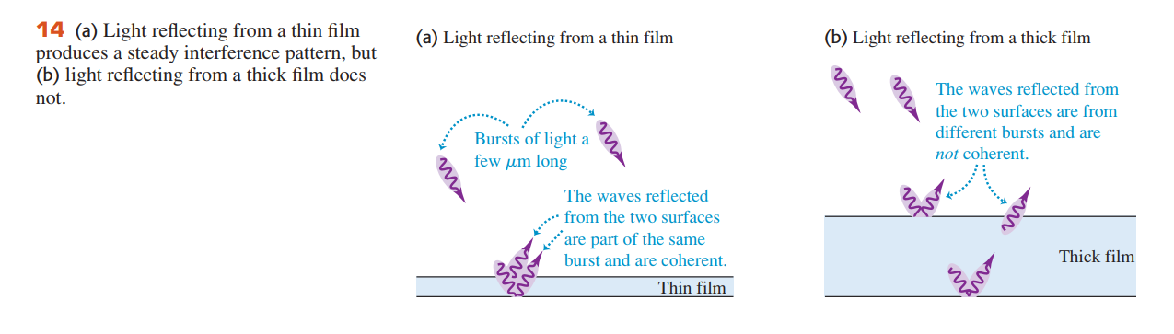

Slide 11
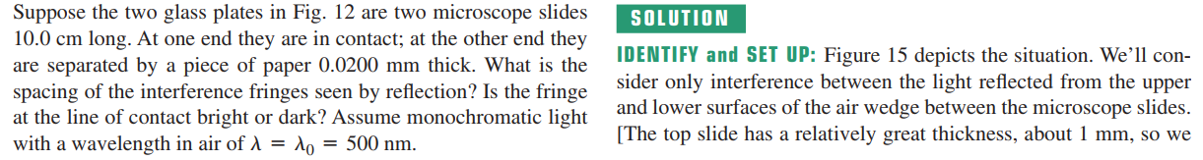
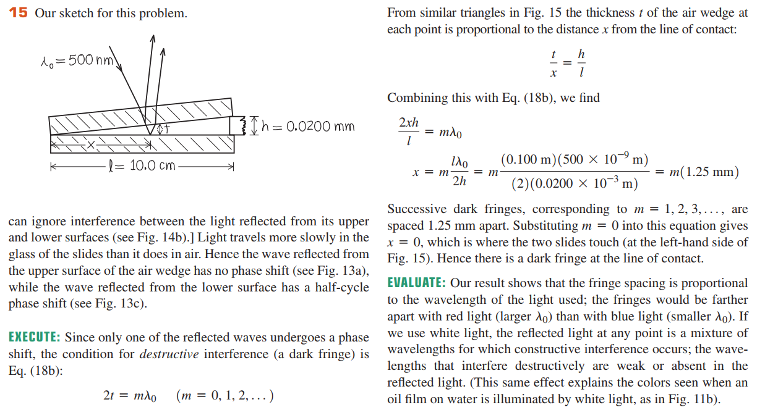
Example 25.4 Thin-film interference I

Slide 12
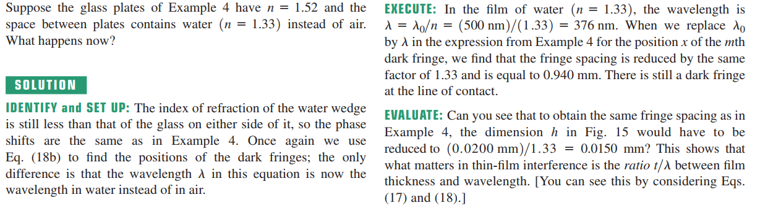
Example 25.5 Thin-film interference II

Slide 13
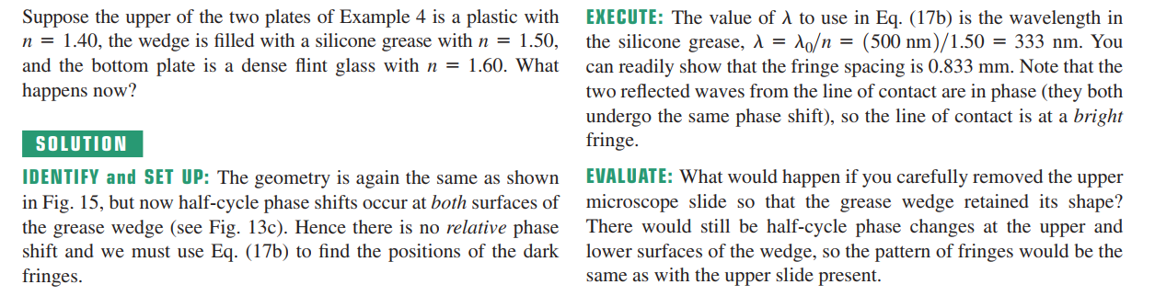
Example 25.6 Thin-film interference III

Slide 14

Example 25.7 Thin-film versus thin films
We have emphasized interference effects in rather thin films. Suppose the film in
Figure25.10 is a layer of water(n=1.33) 1.00cm thick on top of a glass surface with
n =1.52. What will you see if this rather thick film is illminated from above?
_{Solution}
IDENTIFY and SER UP: As in Example 25.6, half-cycle phase changes accur at
both the top and bottom sufaces of the film.
EXECUTE: Equation(25.17) gives the condition for constructive interference in the reflected waves. Hence the wavelengths in air that undergo constructive interference are given by
where n is theindex of refraction of water.
Because t = 1. 00 cm is large in comparison to the wavelengths of visibel light, the values of m in this equation will be large. For instance, using m=40000 in the first equation tells us that light
will be strongly reflected if it has a wavelength in air of
$$λ_{0}=nλ=\frac{2nt}{m}$$

Slide 15
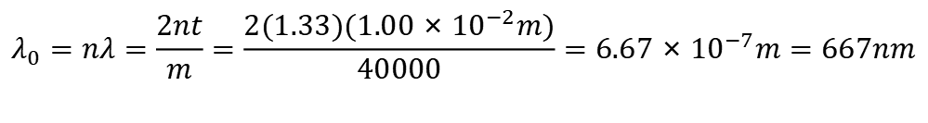
$$λ_{0}=nλ=\frac{2nt}{m}=\frac{2(1.33)(1.00×{10}^{−2}m)}{40000}=6.67×{10}^{−7}m=667nm$$
corresponding to orange-red light. You might be tempted to conclude that this thick film would appear strongly orange-red ; However,there will also be
strong reflection of a slightly longer wavelength corresponding to m=39999 and of a slightly shorter wavelength corresponding to m=40001. These wavelengths differ from each other by only one part in 40000, or (667nm)/(40000)=0.017 nm. This is a much smaller wavelength appears to be emphasized more than any other in the light that is reflected from a thick film. If you shine white light on this thick film, the reflected light appears white
EVALUATE: It’s useful to compare this situation to a thin film that is no more than a few wavelengths in thickness.

Slide 16
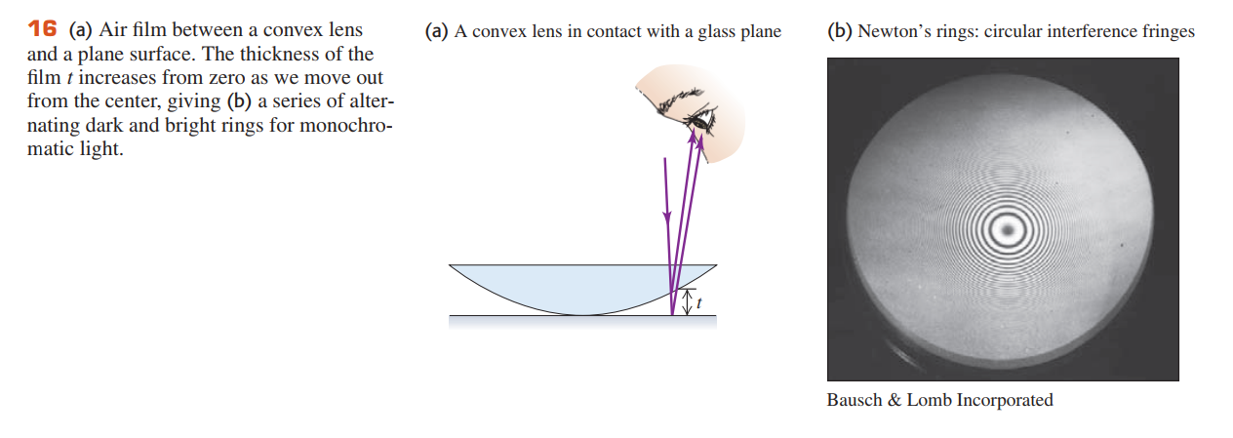
Figure 16a shows the convex surface of a lens in contact with a plane glass plate.
A thin film of air is formed between the two surfaces. When you view the setup with monochromatic light, you see circular interference fringes.

Slide 17
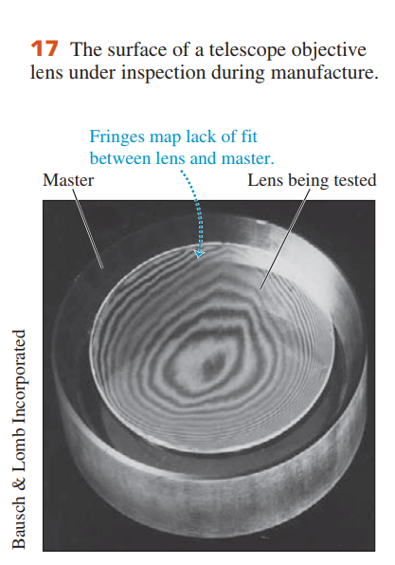
Newton’s Rings
The lower, larger-diameter, thicker disk is the correctly shaped master, and the smaller, upper disk is the lens under test. The “contour lines” are Newton’s interference fringes; each one indicates an additional distance between the specimen and the master of one half-wavelength.

Slide 18
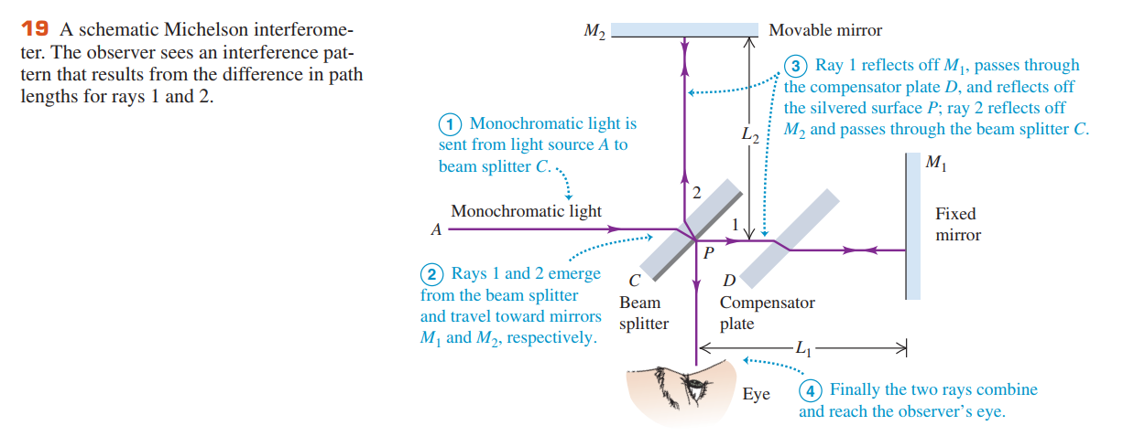

25.5 The Michelson Interferometer

