Slide 1
Chapter 26 DIFFRACTION
26.1 Fresnel and Fraunhofer Diffraction
26.2 Diffraction from a Single Slit
26.3 Intensity in the Single-Slit Pattern
26.4 Multiple Slits
26.5 The Diffraction Grating
26.6 X-ray Diffraction
26.7 Circular Apertures and Resolving Power

Slide 2
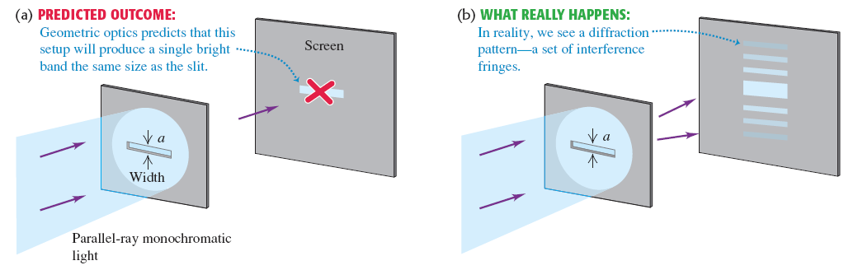
Diffraction from a single slit
The result is not what you might expect.

Slide 3
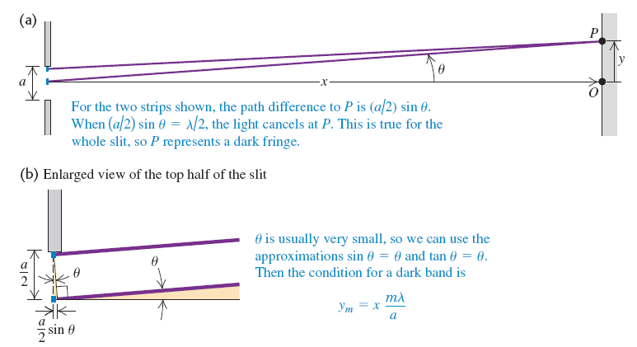
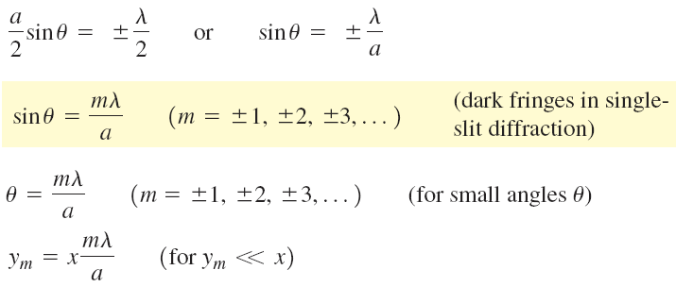
Fresnel or Fraunhofer?
The previous slide outlined two possible outcomes but didn’t set conditions to make a choice.
Figure below outlines a procedure for differentiation.

Slide 4
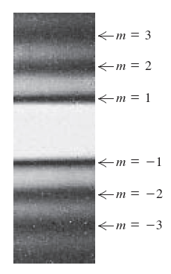
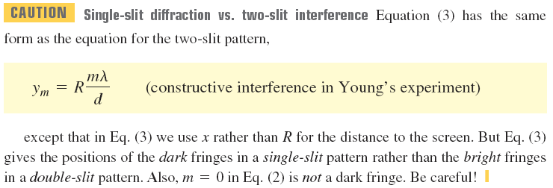

Slide 5
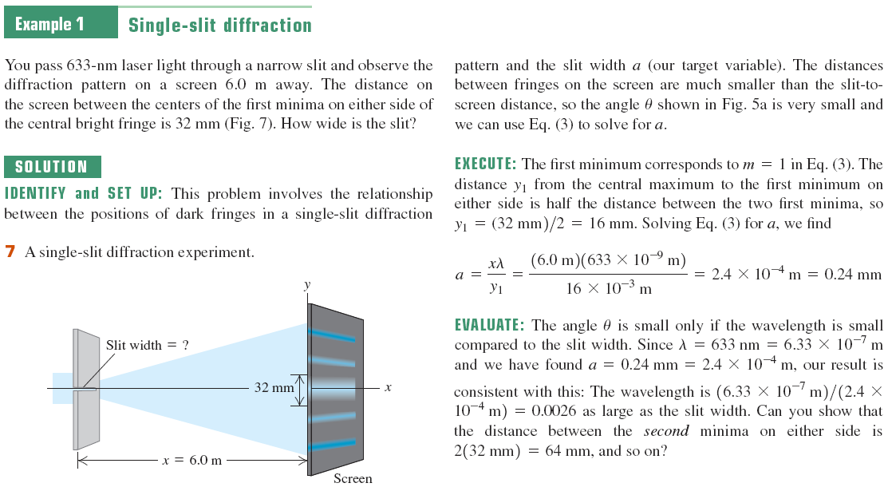

Slide 6
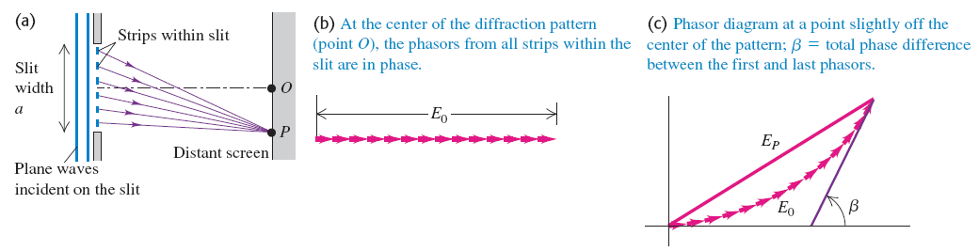
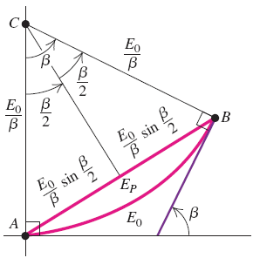
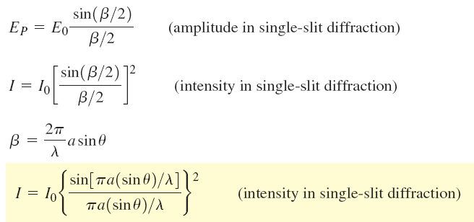
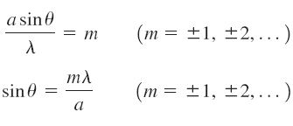
Intensity in a single-slit pattern

Slide 7
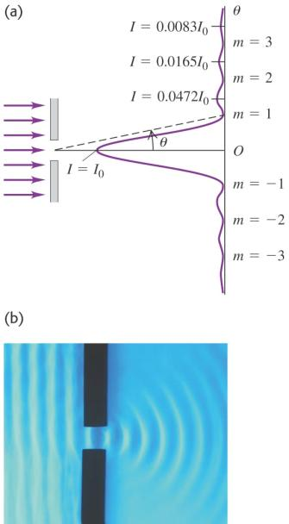
Intensity in a single-slit pattern

Slide 8
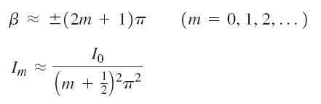
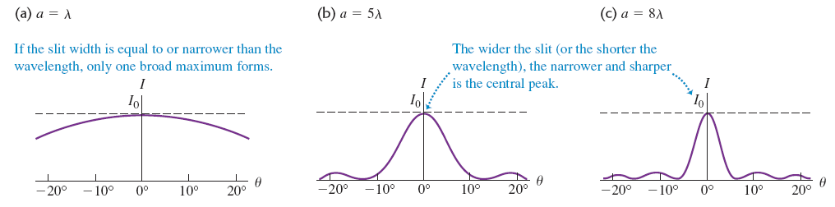
Intensity maxima in a single-slit pattern
The expression for peak maxima is iterated for the strongest peak.
Consider Figure that shows the intensity as a function of angle.

Slide 9
Width of the single-slit pattern
The approximation of sin θ = θ is very good considering the size of the slit and the wavelength of the light.
Consider Figure at the bottom of the slide.

Slide 10
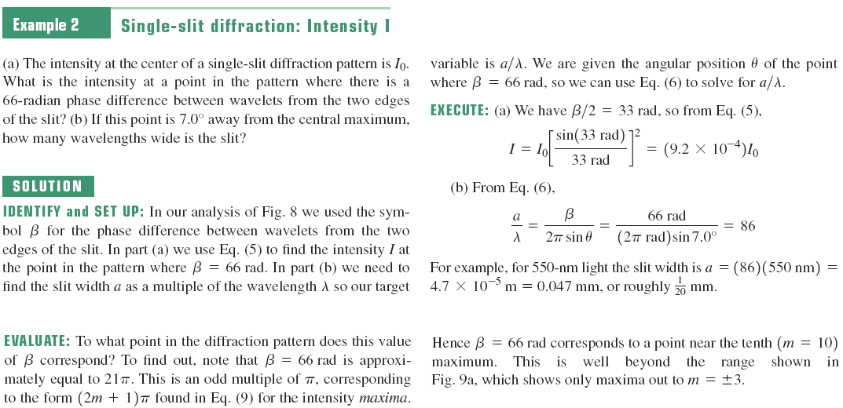

Slide 11
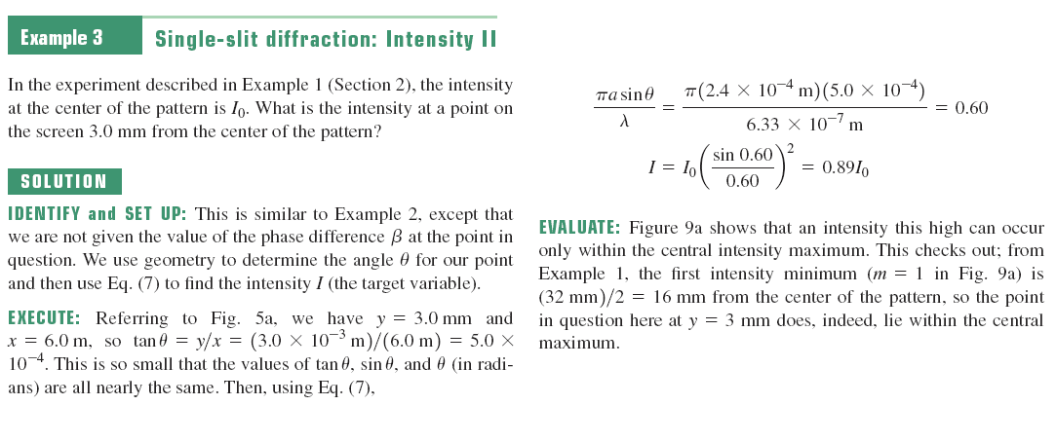

Slide 12
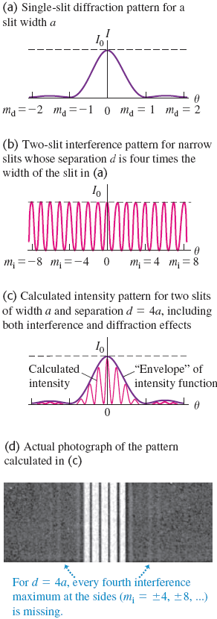
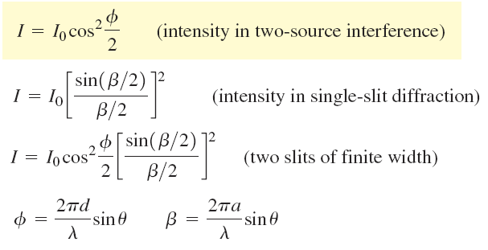
Multiple slits
The analysis of intensity to find the maximum is done in similar fashion as it was for a single slit.

Slide 13

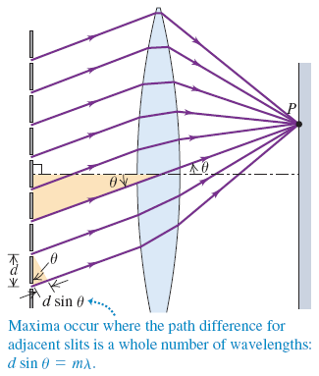
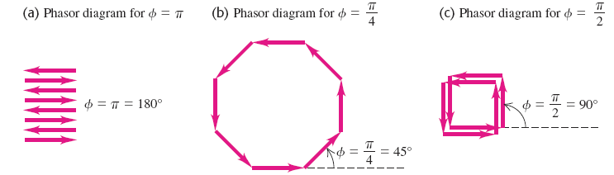
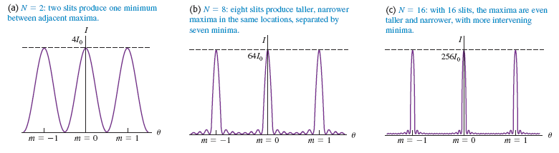
Several slits
The analysis of intensity to find the maximum is done in similar fashion as it was for a single slit.

Slide 14
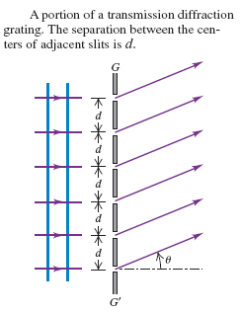
The diffraction grating
The analysis of intensity to find the maximum is done in similar fashion as it was for several slits.

