Slide 1
Chapter 26 DIFFRACTION
26.1 Fresnel and Fraunhofer Diffraction
26.2 Diffraction from a Single Slit
26.3 Intensity in the Single-Slit Pattern
26.4 Multiple Slits
26.5 The Diffraction Grating
26.6 X-ray Diffraction
26.7 Circular Apertures and Resolving Power

Slide 2
Goals for chapter 26
To define and explain Fresnel and Fraunhofer diffraction
To consider single-slit diffraction
To summarize and then apply an understanding of diffraction gratings
To consider the atomic example of x-ray diffraction
To study circular apertures and resolving power

Slide 3
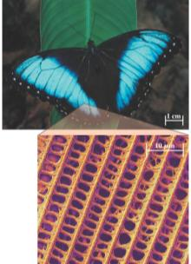
Introduction
The brilliant blue colors of the tropical butterfly morpho peleides are a result of diffraction---the interference of light waves reflected from millions of microscopic scales in the butterfly’s wings. When viewed at the right angle, these scales strongly reflect blue light. The flashes of light from the flapping wings of a morpho may momentarily dazzle predators such as lizards and birds.

Slide 4
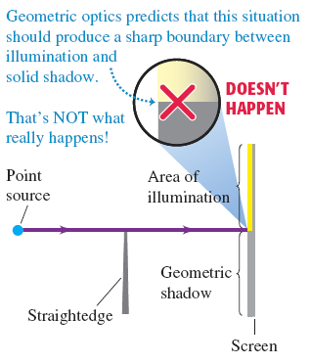
26.1 Fresnel and Fraunhofer diffraction
According to geometric optics, a light source shining on an object in front of a screen will cast a sharp shadow. Surprisingly, this does not occur.

Slide 5
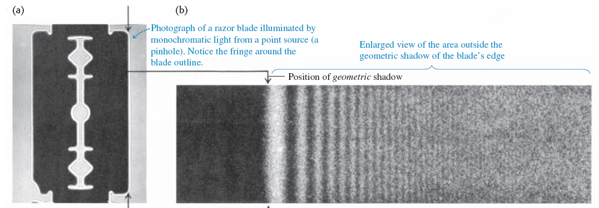
Diffraction and Huygen’s Principle
Diffraction patterns can be analyzed using Huygen’s Principle. Recall, every source of a wave front can be considered to be the source of secondary waves. Superposition of these waves results in diffraction.
If the source and the screen are close to the edge causing the diffraction, the effect is called “near-field” or Fresnel diffraction. If these objects are far apart, so as to allow parallel-ray modeling, the diffraction is called “far-field diffraction” or Fraunhofer diffraction.

Slide 6
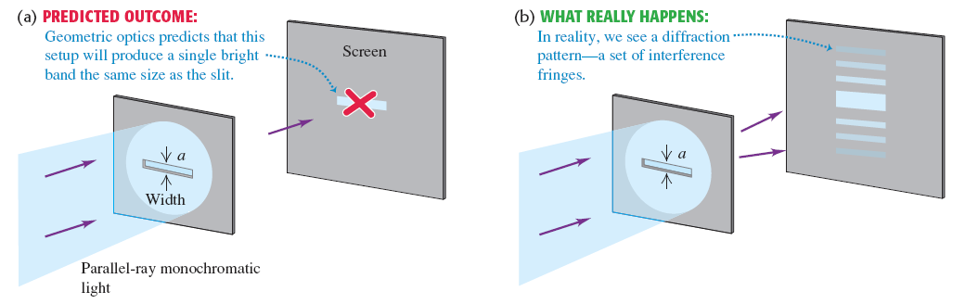
Diffraction from a single slit
The result is not what you might expect.

Slide 7
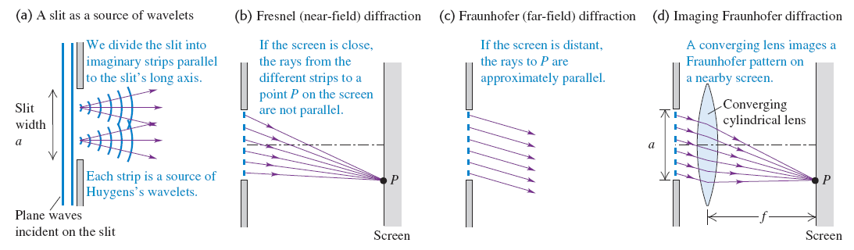
Dark fringes in single-slit diffraction
The figure illustrates Fresnel and Fraunhofer outcomes.

Slide 8
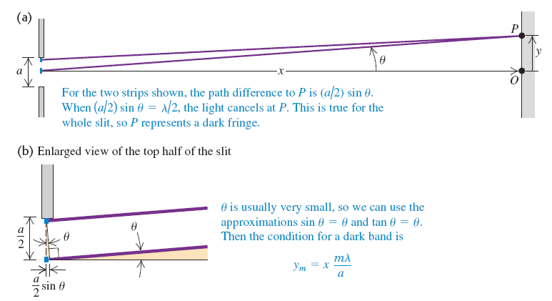
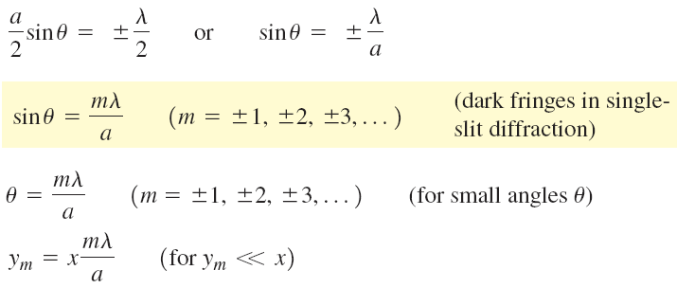
Fresnel or Fraunhofer?
The previous slide outlined two possible outcomes but didn’t set conditions to make a choice.
Figure below outlines a procedure for differentiation.

Slide 9
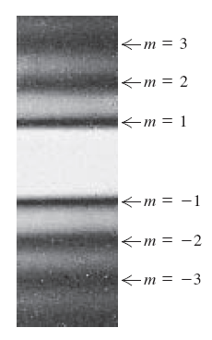
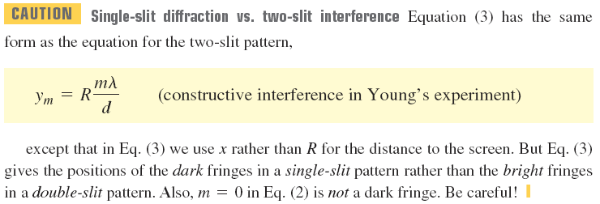

Slide 10
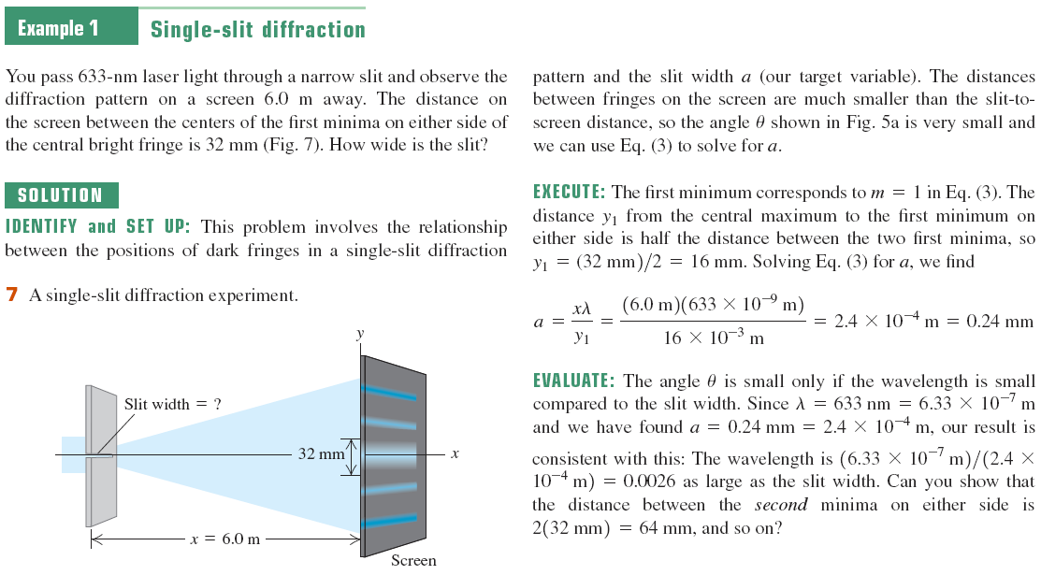

Slide 11
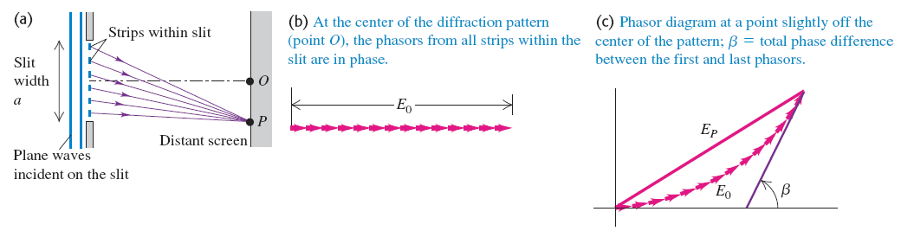
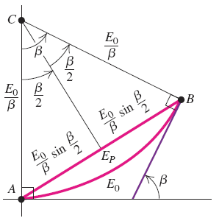
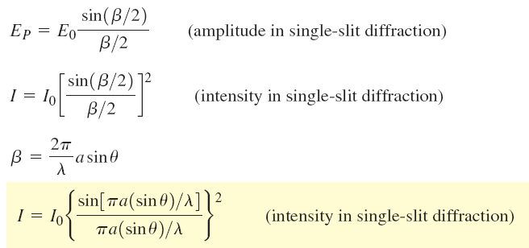
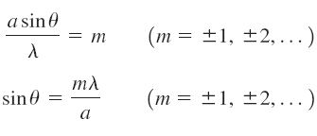
Intensity in a single-slit pattern

Slide 12
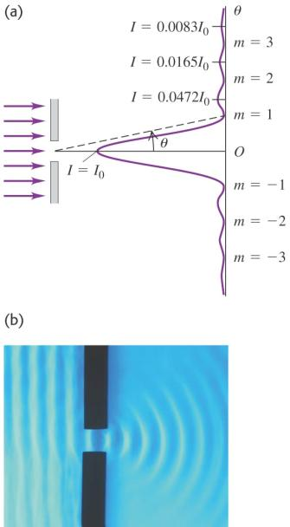
Intensity in a single-slit pattern

Slide 13
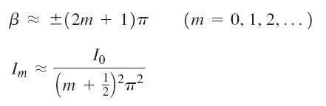
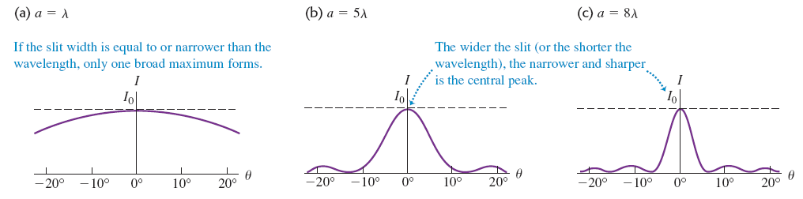
Intensity maxima in a single-slit pattern
The expression for peak maxima is iterated for the strongest peak.
Consider Figure that shows the intensity as a function of angle.

Slide 14
Width of the single-slit pattern
The approximation of sin θ = θ is very good considering the size of the slit and the wavelength of the light.
Consider Figure at the bottom of the slide.

Slide 15
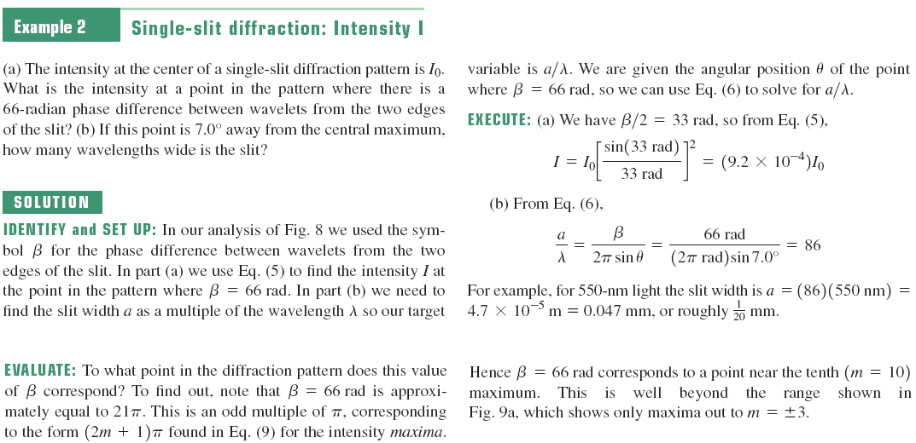

Slide 16
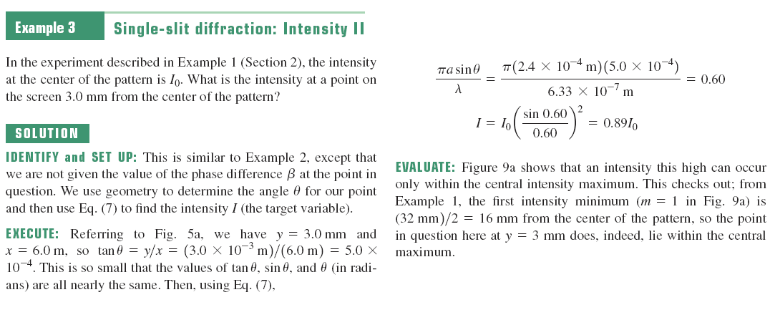

Slide 17
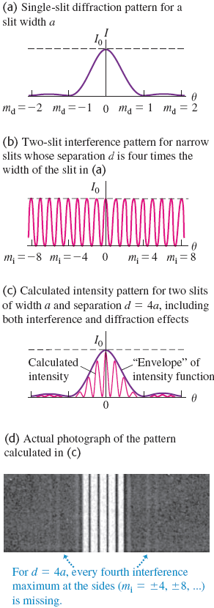
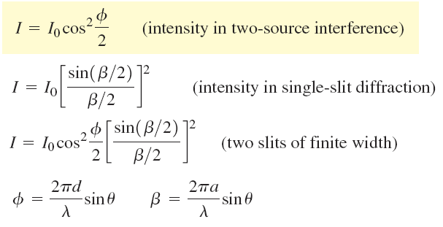
Multiple slits
The analysis of intensity to find the maximum is done in similar fashion as it was for a single slit.

Slide 18

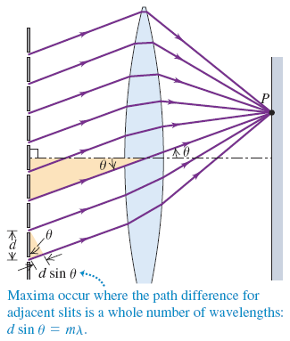
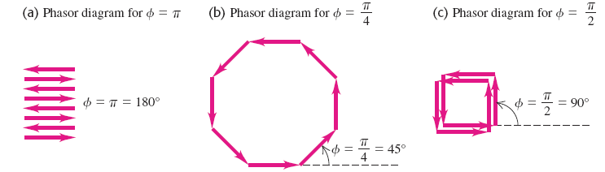
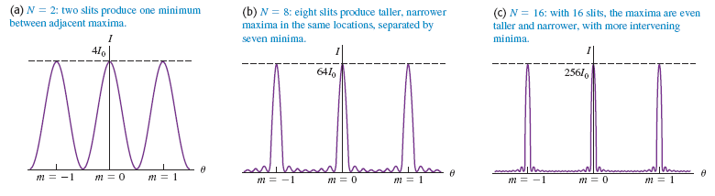
Several slits
The analysis of intensity to find the maximum is done in similar fashion as it was for a single slit.

Slide 19
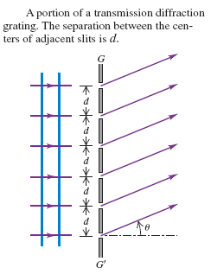
The diffraction grating
The analysis of intensity to find the maximum is done in similar fashion as it was for several slits.

Slide 20
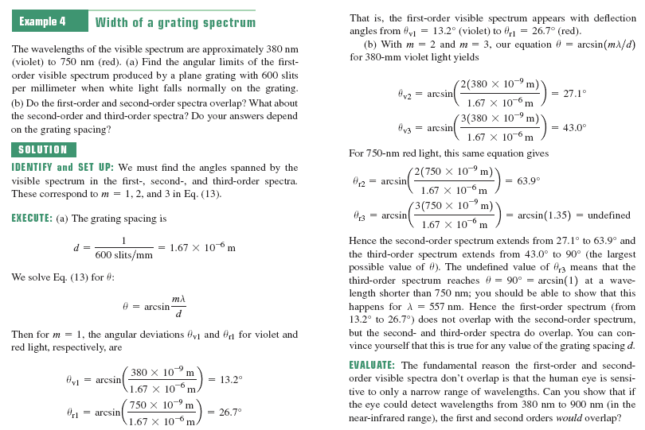

Slide 21
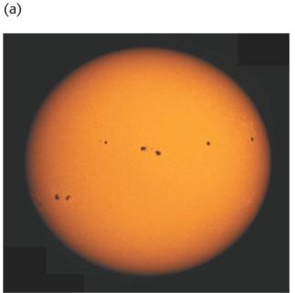
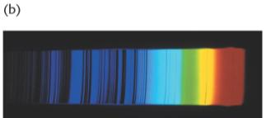
The grating spectrograph
A grating can be used like a prism, to disperse the wavelengths of a light source. If the source is white light, this process is unremarkable, but if the source is built of discrete wavelengths, our adventure is now called spectroscopy. Chemical systems and astronomical entities have discrete absorption or emission spectra that contain clues to their identity and reactivity.

Slide 22
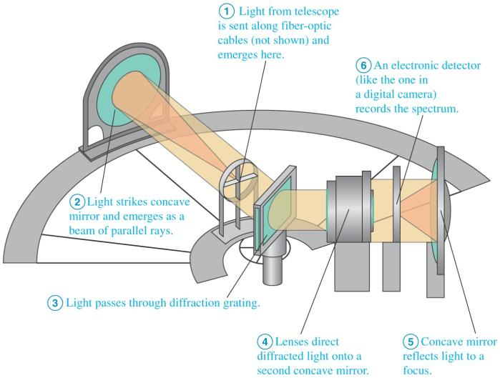
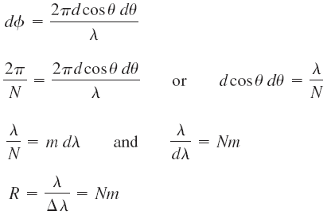
The grating spectrograph II—instrumental detail
Spectroscopy (the study of light with a device such as the spectrograph shown below) pervades the physical sciences.

Slide 23
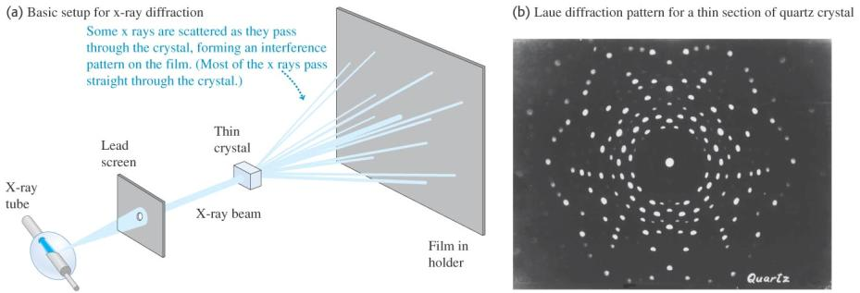
X-ray diffraction
X-rays have a wavelength commensurate with atomic structure. Rontgen had only discovered this high-energy EM wave a few decades earlier when Friederich, Knipping, and von Laue used it to elucidate crystal structures between adjacent ions in salt crystals.

Slide 24
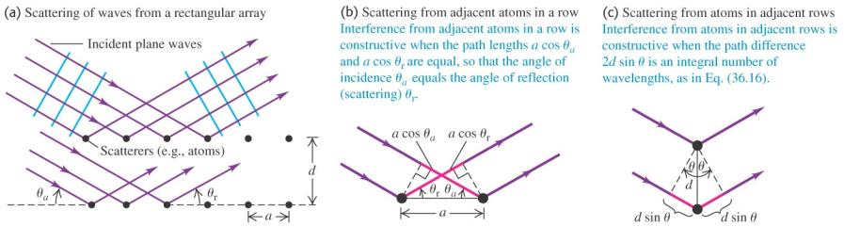
Ionic configurations from x-ray scattering
Arrangements of cations and anions in salt crystals can be discerned from the scattering pattern they produced when irradiated by x-rays.

Slide 25
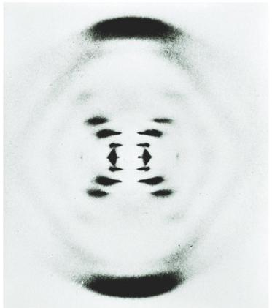
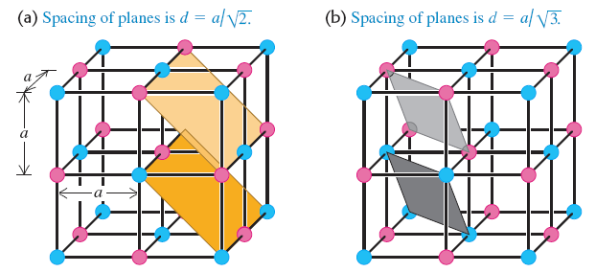
X-ray scattering set Watson and Crick to work
An x-ray scattering pattern recorded by their colleague Dr. Franklin led Watson and Crick to brainstorm the staircase arrangement that eventually led to the Nobel Prize.

Slide 26
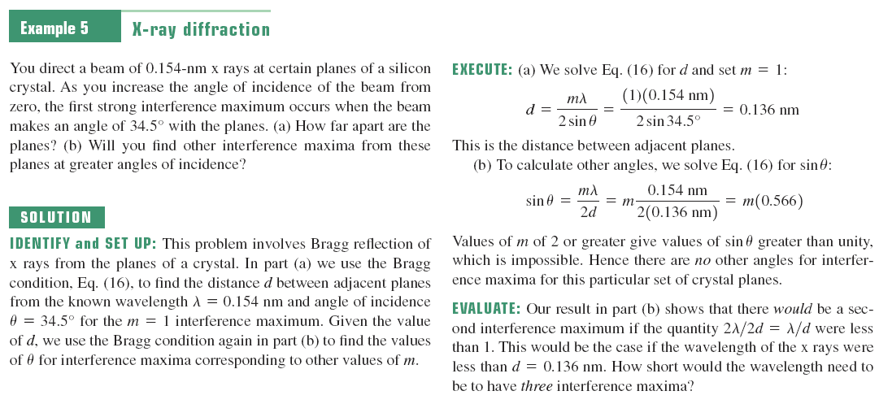

Slide 27
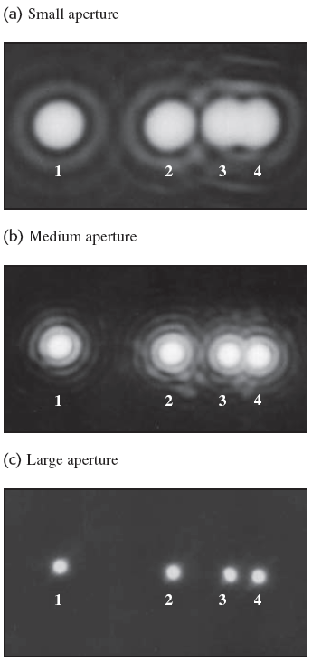
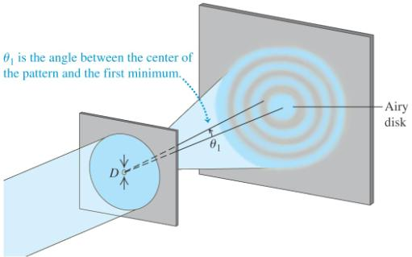
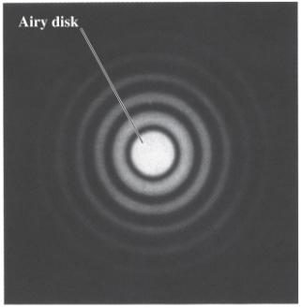
Circular apertures and resolving power
In order to have an undistorted Airy disk (for whatever purpose), wavelength of the radiation cannot approach the diameter of the aperture through which it passes.

