Slide 1
practice1
1.Consider how to implement a mutex lock using an atomic hardware instruction. Assume that the following structure defining the mutex lock is available:
typedef struct {
int available;
} lock;
(available == 0) indicates that the lock is available, and a value of 1 indicates that the lock is unavailable. Using this struct, illustrate how the following functions can be implemented using the test and set() and compare and swap() instructions:
• void acquire(lock *mutex)
• void release(lock *mutex)
Be sure to include any initialization that may be necessary.

Slide 2
Review1
Definition:
boolean test_and_set(boolean *target)
{
boolean rv = *target;
*target = TRUE;
return rv:
}
target =false/0
返回false/0; set target=1;
2. target=true/1
返回true/1； target值不变；
Definition:
int compare and swap(int *value, int expected, int new_value) {
int temp = *value;
if (*value == expected)
*value = new_value;
return temp;
}
使用：compare&swap (*value, 0, 1)
value = 0
返回0; set value=1;
2. value = 1
返回1； value值不变；

Slide 3
Review2
mutexlock/spinlock两个操作的使用：
1. If available=true/可用，跳出while并且将available设置为false，成功acquire，进入critical section，执行完毕后，执行signal.
2. If available=false，while不停循环，busy waiting.
acquire() {
while (!available)
; /* busy wait */
available = false;;
}
release() {
available = true;
}
定义
do {
acquire lock
critical section
release lock
remainder section
} while (true);
进程如何使用mutex lock

Slide 4
Analysis
Consider how to implement a mutex lock using an atomic hardware instruction.
acquire() {
while (!available)
; /* busy wait */
available = false;;
}
release() {
available = true;
}
看左边： acquire里有三行代码；
有被抢占preempted/中断interrupted的可能性，所以题目希望可以用“原子的”硬件指令完成；
Answer下一页

Slide 5
Practice1（cont.）
// initialization
mutex->available = 0;
// acquire using test_and_set()
void acquire(lock *mutex) {
while (test_and_set(&mutex->available) != 0)
;
return;
}
// acquire using compare_and_swap()
void acquire(lock *mutex) {
while (compare_and_swap(&mutex->available, 0, 1) != 0)
;
return;
}
void release(lock *mutex) {
mutex->available = 0;
return; }

Slide 7
Bounded-waiting Mutual Exclusion with test_and_set
do {
waiting[i] = true;
key = true;
while (waiting[i] && key)
key = test_and_set(&lock);
waiting[i] = false;
/* critical section */
j = (i + 1) % n;
while ((j != i) && !waiting[j])
j = (j + 1) % n;
if (j == i)
lock = false;
else
waiting[j] = false;
/* remainder section */
} while (true);
boolean test_and_set(boolean *target)
{
boolean rv = *target;
*target = TRUE;
return rv:
}

Slide 8
Bounded-waiting Mutual Exclusion with compare_and_swap
So, how to satisfy the bounded-waiting using compare and swap()
do {
waiting[i] = 1;
key = 1;
while (waiting[i]==1 && key==1)
key = compare and swap(&lock,0,1)
waiting[i] = 0;
/* critical section */
j = (i+1) % n;
while ((j != i) && waiting[j]==0)
j = (j+1) % n;
if (j == i) lock = 0;
else waiting[j] = 0;
/* remainder section */
} while (TRUE);

Slide 10
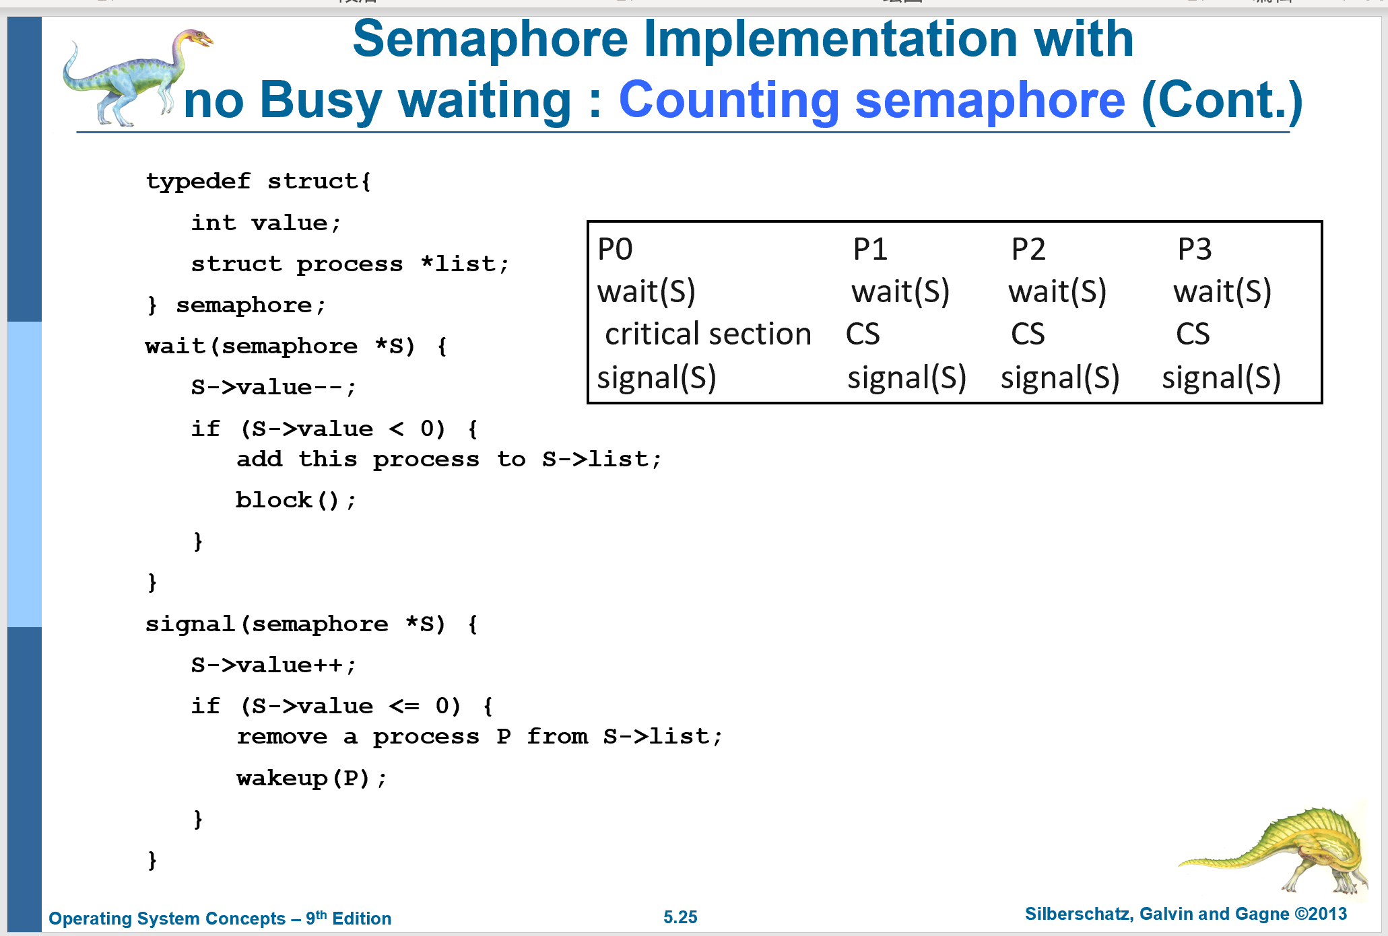
Practice3 (cont.)
Show how to implement the wait() and signal() semaphore operations in multiprocessor environments using the test_and_set() instruction. The solution should exhibit minimal busy waiting.

Slide 11
在多处理器环境下，信号量操作必须以原子方式执行，这一点至关重要。我们必须确保没有两个进程能够同时对同一个信号量执行 wait() 和 signal() 操作。这是一个临界区问题。在单处理器环境中，我们可以通过在 wait() 和 signal() 操作执行期间禁用中断来解决。
这种方法之所以适用于单处理器环境，是因为一旦中断被禁用，来自不同进程的指令便无法交替执行。只有当前正在运行的进程会执行，直到中断被重新启用，调度程序重新获得控制权。
然而，在多处理器环境中，必须在每个处理器上禁用中断。否则，来自不同进程（运行在不同处理器上）的指令可能会以任意方式交织执行。在每个处理器上禁用中断不仅实现困难，还可能严重影响系统性能。因此，对称多处理系统必须提供其他锁定技术——如 compare_and_swap() 或自旋锁——来确保 wait() 和 signal() 操作的原子性。

Slide 12
Practice3(cont.)
Show how to implement the wait() and signal() semaphore operations in multiprocessor environments using the test_and_set() instruction. The solution should exhibit minimal busy waiting.
假设只有1台打印机，4个进程需要打印；它们都会先申请打印机（wait操作），然后打印（进入临界区CS），再释放打印机(singal操作)；
而wait和signal都是对s.value- -或++，所以test&set保护wait和signal操作。
int guard = 0;
int semaphore_value = 1;
wait()
{
while (TestAndSet(&guard) == 1);
semaphore_value--;
if (semaphore_value < 0) {
guard = 0;
/*atomically add process to a
queue of processes
waiting for the semaphore
*/
}
guard = 0;
}
保证不管多少个进程在多少个CPU上，
只有一个进程能够得到guard，并向下执行；
2. 第一个得到guard之后，竞争打印机（semaphore_value==0），执行红色的guard=0，释放以让别的进程可以竞争打印机。
第二个进程得到guard，semaphore_value==-1，先释放guard，再从running状态切换到wait状态。以确保别的进程可以wait或signal；

Slide 13
Practice3(cont.)
signal()
{
while (TestAndSet(&guard) == 1);
semaphore_value++;
if (semaphore_value <= 0)
/*wake up the first process in the queueof waiting processes*/
guard = 0;
}

