Slide 1
ISE305: Database Design and Practice
Database Indexing
Fusheng Wang
Department of Computer Science
Department of Biomedical Informatics

Slide 2
Memory Hierarchy
CPU Registries
CPU Caches
DRAM
SSD
HDD
Network Storage
Faster
Smaller
Expensive
Volatile
Random Access
Byte-Addressable
Non-Volatile
Sequential Access
Block Addressable
Slower
Larger
Cheaper
Introduction

Slide 3
Latency Numbers Every Programmer Should Know
Operation | Latency
L1 cache reference | 1ns
L2 cache reference | 4ns
Main memory reference | 100ns
SSD (random read) | 16,000ns (16μs)
HDD (sequential read 1MB) | 825,000ns
HDD (seek) | 2,000,000ns (2ms)
Network Storage | 50,000,000 ns (50ms)
Tape archives | 1,000,000,000 ns (1s)
1 ns = 10⁻⁹ seconds 1μs = 10⁻⁶ seconds 1ms = 10⁻³ seconds
Source
Memory vs SSD: 1600 times faster; memory vs HDD (seek): 20,000 times faster
Cache data into memory when possible; but memory is far more expensive
Introduction

Slide 4
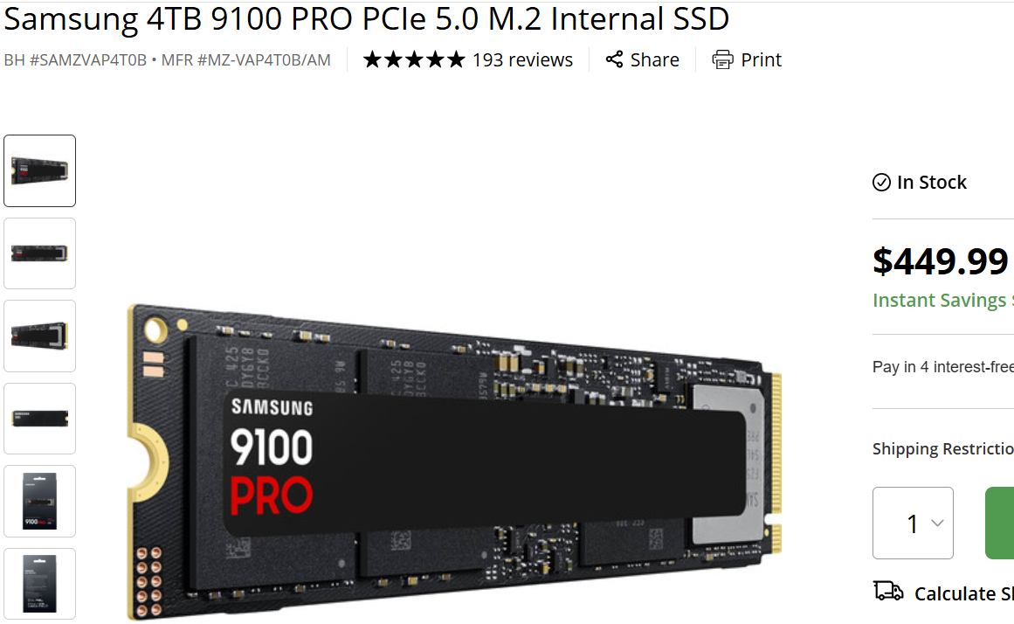
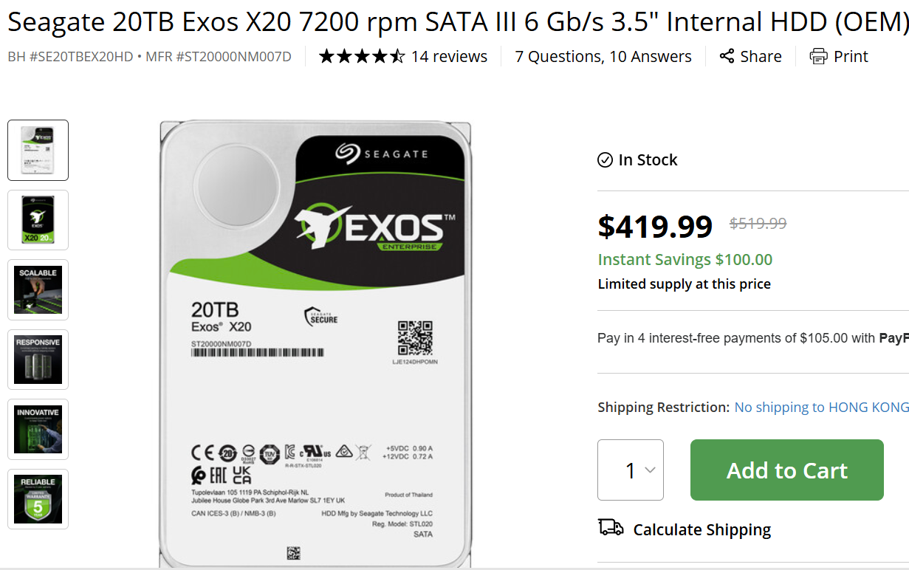

Storage Disks
SSD: ~$98/TB
HDD: ~$21/TB
Memory: ~$3890/TB
Introduction
Notes:
https://www.compuram.de/blog/en/samsung-server-ssd-purchasing-advice/

Slide 5
Book Search at a Library
What are possible ways to search a book?
By book title, author, ISBN
Return: which library, shelf and stack
What if no index?
Almost impossible to find a book!

Slide 6
Database Indexing
﻿﻿Given: emp(id, name, age, dept, address), where id is the primary key
Search key: attribute or combination of attributes used to search emp table
﻿﻿Note: a search key is not the same as a key for a table
﻿﻿We can build an index on any attribute
e.g., <id>, <name>
﻿﻿We can build an index on combination of attributes
﻿﻿e.g., <age, name>
﻿﻿We can build multiple indexes for the same table
Indexing

Slide 7
Index for Database Table
An index is a data structure that speeds up selections (searching) on the search key field(s), e.g.,”id”
An index converts a search key k into a data entry k*
Given k*, we can get to the record(s) with the search key k in one page I/O
Logical Table
Index Page
Data Page
k1 | v1
k1 | v2
k2 | v3
k2 | v4
k3 | v5
k1 | r1
k2 | r2
k3 | r3
r1: <k1, v1, v2>
r2: <k2, v3, v4>
r3: <k3, v5>
data record
k*
Record id (rid): r1,r2: location of the record: page# + offset
Indexing

Slide 8
Example
emp(id, name, age, dept, address),
-- Create an index on the 'id' column
CREATE INDEX idx_emp_id ON emp(id);
-- Create an index on the 'name' column
CREATE INDEX idx_emp_name ON emp(name);
-- drop the indexes
DROP INDEX idx_emp_name;
DROP INDEX idx_emp_id;
DROP INDEX idx_emp_name;

Slide 9
Table and Index in IBM DB2
Logical Table View
Physical Table View
Logical View of Index

Slide 10
Index for Database Table
Alternatives for data entries k*
Actual data record with search value k: e.g., (1000, Joe Doe, 30, 100 Nicolls Rd, Stony Brook, NY 11794)
<k, rid of data record with search key k>, e.g., 1000
<k, list of rids of data records with search key k>, e.g., (1000, 111000, 111001)
Choice depends on the indexing technique used to locate data entry k*
rid: record ID
k*
k1 | r1
k2 | r2
k3 | r3
Index page
Indexing

Slide 11
Most Indexes are Tree Structured
Tree-structured indexes support
Range searches (e.g., gpa > 3.0)
Equality searches (e.g., empno = ‘10000’)
Why not just store the file sorted on search key?
Can perform binary search to find matching records
While binary search is fast O(log n) …, the cost is high because we are doing the search over disk blocks (records stored on disk in blocks)
Indexing

Slide 12
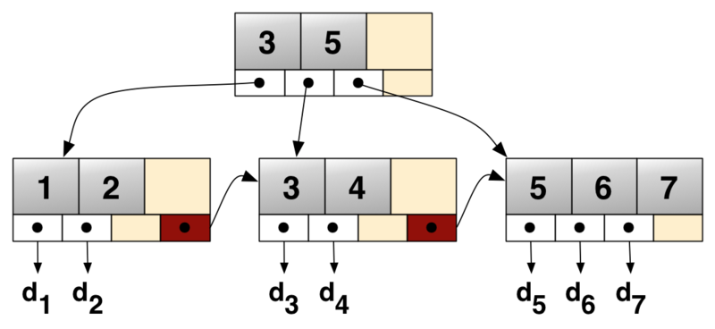
B+ Tree: Most Widely Used Index
A B+Tree is a self-balancing tree data structure that keeps data sorted and allows searches, sequential access, insertions, and deletions always in O(log n)
B+-tree
data page
d1 | d2
d3
d4
d5 | d6 | d7
B+-Tree

Slide 13
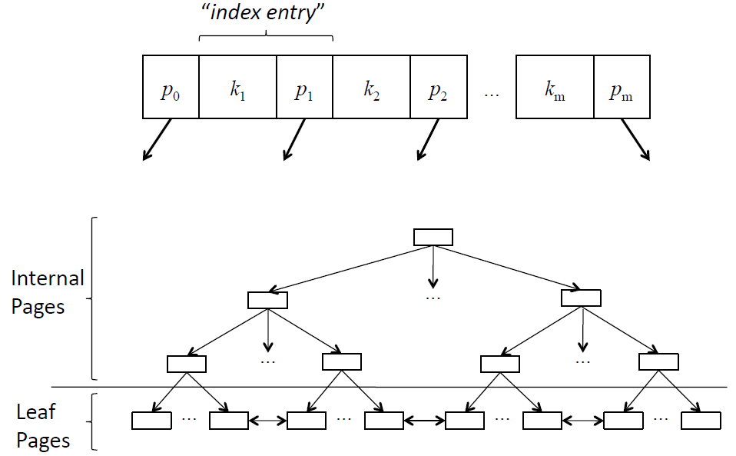
B+-Tree Overview
P₀: <k₁
P₁: >=k₁
Data pages
…
…
…
…
B+-Tree

Slide 14
B+ Tree Properties
The tree stays balanced: same depth for all leaf nodes
Insert, delete, search are O(log_{f} n)
Every node except root must be at least 50% full (fill factor)
Fanout (f): the number of pointers out of the node
height(h): the level of the leaf nodes
Maintains a doubly linked list of data-entry pages
Supports equality and range searches efficiently
Order (b)=4
Note: Definition of “order” is
inconsistency in the literature
Height (h)=2
B+-Tree
Demo: https://www.cs.usfca.edu/~galles/visualization/BPlusTree.html
Notes:
ceiling(x) = is the smallest integer not less than x.

Slide 15
Database Pages
The fundamental unit of data storage in a database is the page
The disk space allocated to a data file in a database is logically divided into pages
Disk I/O operations are performed at the page level. That is, the database server reads or writes only whole data pages
DB page size
Db2: 4KB (default), 8KB, 16KB, or 32 KB
SQL Sever: 8KB; Oracle: 8KB; PostgreSQL: 8KB; MySQL: 16KB
Page size can be specified when creating a database (for buffer pool and tablespace)
CREATE DB mydb PAGESIZE 4096;
Each page is given an ID and the DBMS maps page IDs to physical locations
Hardware and OS page: 4KB
Notes:
https://www.ibm.com/docs/en/db2/11.5?topic=tables-table-page-sizes

Slide 16
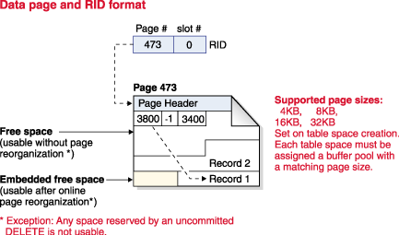
Database Page
Record identifiers consist of a page number followed by a slot number
After a record is assigned a RID, the RID does not change until the table is reorganized
Use larger page sizes for workloads that tend to access rows sequentially. e.g., sequential access for decision support applications
Use smaller page sizes for workloads that tend to access rows randomly
Page size also determines a tablespcae size, e.g., 8KB size -> 128G

Slide 17
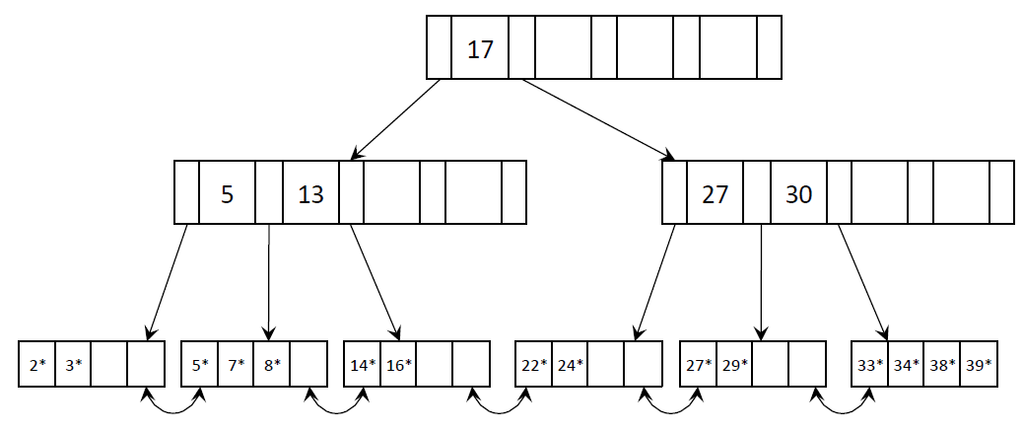
Searching a B+ Tree
How many blocks are required to find
Entry 24*? Entry 30*?
Single key search: depth + data block access
How many blocks are required to find all data entries 30* >= k > 14*?
Range query: 2 x h + target key blocks (# of target keys/avg_fill_factor) + data block access
…
B+-Tree

Slide 18
B+ Trees in Practice
Typical order: 200 (max entries in a node) (or 100 with another definition)
Typical fill-factor: 67%
average fanout = 200 * 67% = 133
Typical capacities:
Height 3: 133³ = 2,352,637 entries (in the leaf)
Height 4: 133⁴ = 312,900,700 entries (in the leaf)
Can often cache top levels in memory:
Level 1 = 1 page = 8 KB
Level 2 = 133 pages = 1 MB
Level 3 = 17,689 pages = 133 MB
B+-Tree
Notes:
For a page size of 4KB, three level B+-Tree,
Assume key size: 8bytes, pointer size: 32bytes;
Each page can hold ~100 keys; fanout factor: 200
Depth four.
Best case keys: 200x200x200 x100 = 8x10^8 = 800M.
Three I/O pages needed for a value search.

Slide 19
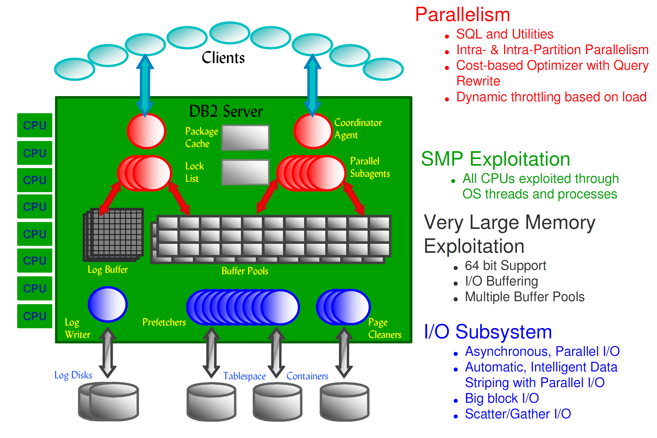
Buffer Pool
A buffer pool (or data buffer) is an area of main memory that has been allocated by the database manager for the purpose of caching table and index data as it is read from
disk
Every database must have a buffer pool
Buffer pool is specified when CREATE DATABASE
A dedicated database server can have 80% memory used for buffer pool
Cache

Slide 20
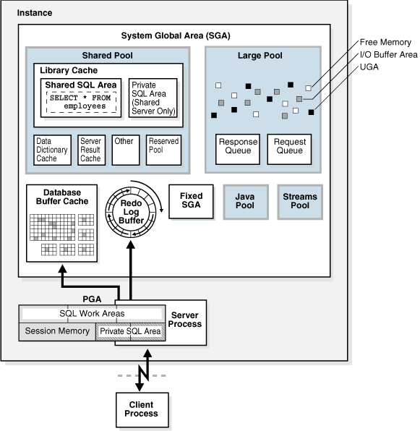
Memory Management in Oracle
Program code
Information about each connected session, even if it is not currently active
Information needed during program execution, for example, the current state of a query from which rows are being fetched
Information such as lock data that is shared and communicated among processes
Cached data, such as data blocks and redo records, that also exists on disk
Cache

Slide 21
B+ Trees: Summary
Searching:
log_{d}(n) – Where d is the order, and n is the number of entries (Why?)
Insertion:
Find the leaf to insert into
If full, split the node, and adjust index accordingly
Similar cost as searching
Deletion
Find the leaf node
Delete
May not remain half-full; must adjust the index accordingly
Notes:
n = 133³; log₁₃₃(n) = h

Slide 22
Indexing Rules of Thumb
Index every primary key in the database
Primary key index is automatically created for many databases
Use a B+tree index for both equality (=) and range queries (a<b<c)
Attributes frequently referenced in SQL WHERE clauses are potentially good candidates for an index
e.g.: empno = ‘111’; salary > 80000 and salary <10000
An exception is an inequality like “WHERE empno <> 1234”, due to high selectivity
Indexing Practices

Slide 23
Indexing Rules of Thumb (2)
Choose carefully one clustered index for each table
Create a clustered index on the most important query on that table
Build a clustered index on a PK for range searches or maintaining an order for efficient batch processing
DB2, SQL Server, Oracle, and Sybase all support clustered indexes:
CREATE INDEX DEPT_IX ON EMP (DEPTNO ASC) CLUSTER;
Indexing Practices

Slide 24
Indexing Rules of Thumb (3)
Create indexes for foreign keys
Even if not required, creating indexes for each foreign key can optimize the performance when accessing and enforcing referential constraints
Index to avoid sorting (GROUP BY)
The GROUP BY and ORDER BY clauses tend to invoke sorts; the optimizer might avoid sorting using index
GROUP BY workdept
Avoid or remove redundant indexes
Indexes that use the same columns or almost the same columns make query optimization more complicated
Indexing Practices

Slide 25
Indexing Rules of Thumb (4)
Add indexes only when absolutely necessary
Add or delete index columns for composite indexes to improve performance
Multiple-column composite indexes can be very efficient for certain complex queries
Keep up index maintenance on a regular basis; drop indexes only when they are clearly hurting performance
Index maintenance is needed constantly when table rows are constantly updated
Either reorganize the index or delete it if a bottleneck
e.g.: runstats; REORG TABLE; REORG INDEXES..
Indexing Practices
Notes:
https://www.ibm.com/docs/en/db2/11.5?topic=organization-index-reorganization

Slide 26
Indexing Rules of Thumb (5)
Consider adding columns for index-only access
SELECT DEPTNAME FROM DEPT WHERE DEPTNO = 'D01’;
Method 1: CREATE INDEX combindx on dept (deptno, deptname);
Method 2: index include columns:
CREATE INDEX IXNAME ON DEPT ( DEPTNO ) INCLUDE ( DEPTNAME );
The index key is only on the DEPTNO column, but the DEPTNAME is also included in the index
111|CS | 112|EE | 113|AMS

