Slide 1
Example Complex Queries:
30-day Readmission Queries for Hospitals

Slide 2
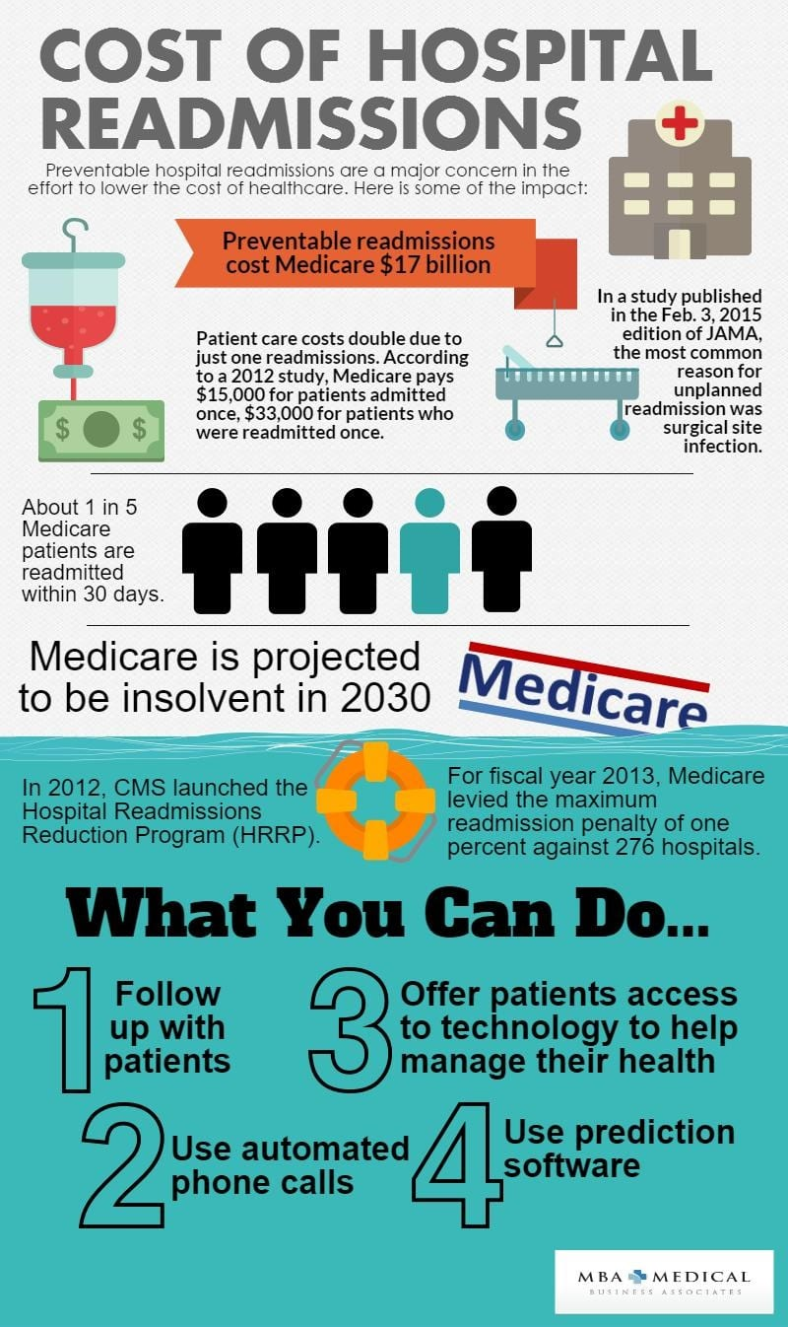
30-day Hospital Readmisisions
The risk of death for patients that were readmitted to the hospital within 30 days of discharge was approximately two times that of patients that were not readmitted within 30 days
US hospitals get penalty if they have two many readmitted patients in 30 days
The entire stay of a patient in a hospital is called an “encounter”

Slide 3
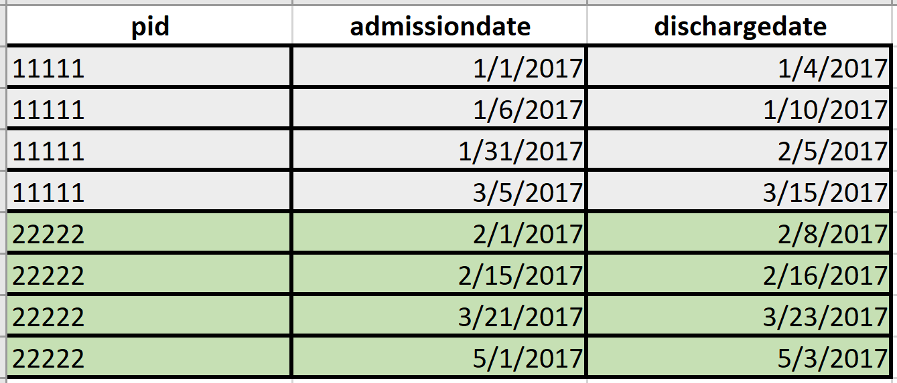
Example Data

Slide 4
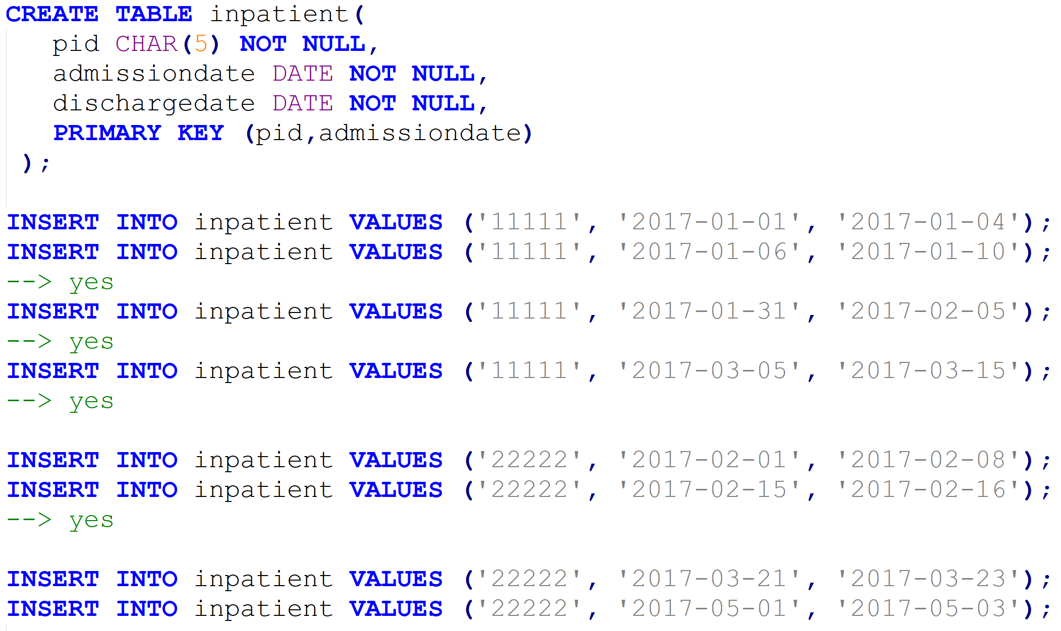
Example Queries: 30-day Readmisisions

Slide 5
Exercise: Write a Query to Find all 30-day Readmissions
The admission date of the readmission is < 30 days from the discharge date of the most recent admission (index admission)
Return all readmissions with their index admission for each patient (each admission is represented by pid and admissiondate)
Difference of dates: DATEDIFF(in2.admissiondate, in1.dischargedate)
Hints:
Find all pairs of visits, calculate the gap, take the index visit with minimal gap
Moving window: each record has a preceding record (using LAG; or using window preceding 1)
A B C D

Slide 6
30-day Readmissions: Self-Join
-- Find visit pairs - temporally ordered
WITH visitpairs (pid, idxadmissiondate, idxdischargedate,
readmissiondate, redischargedate, gap) AS (
SELECT in1.pid, in1.admissiondate AS idxadmissiondate, in1.dischargedate,
in2.admissiondate, in2.dischargedate,
DATEDIFF(in2.admissiondate, in1.dischargedate) AS gap
FROM inpatient in1, inpatient in2
WHERE in1.pid = in2.pid AND
in1.dischargedate < in2.admissiondate
),
-- Join index admission and visit pairs to find the readmission with min gap
idxvisit (pid, idxadmissiondate, idxdischargedate, mingap) AS (
SELECT pid, idxadmissiondate, idxdischargedate, MIN(gap) AS mingap
FROM visitpairs
GROUP BY pid, idxadmissiondate, idxdischargedate
)
-- Return all those with min gap less than 30
SELECT * FROM idxvisit
WHERE mingap < 30;

Slide 7
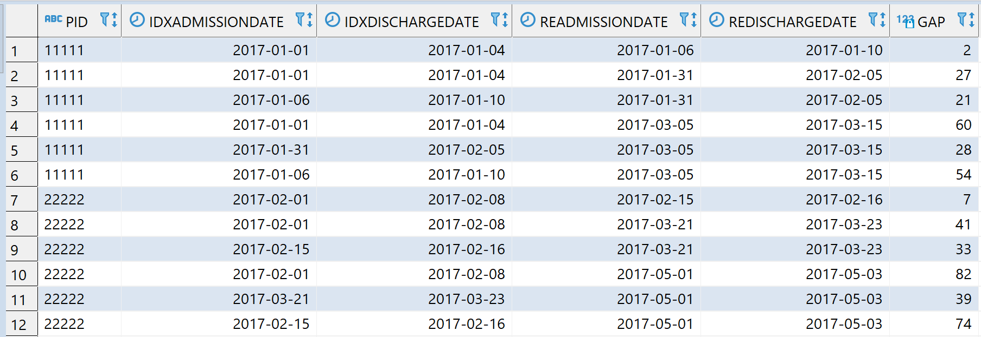
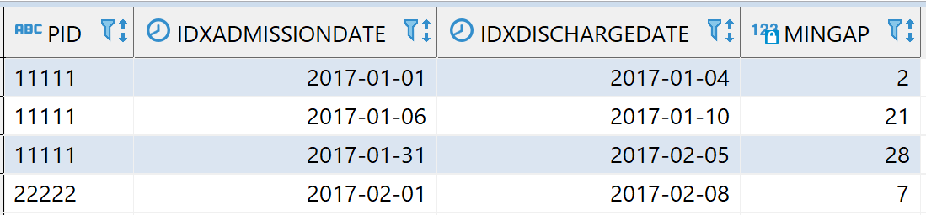
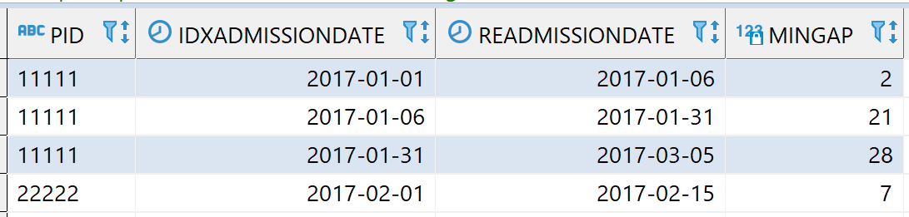
Results
Visit pairs
Index visits
30-day readmission visits

Slide 8
30-day Readmission: Window Query
-- Generate adjacent pairs of admissions
WITH visitpairs AS (
SELECT pid, admissiondate, dischargedate,
LAG(admissiondate) OVER (PARTITION BY pid ORDER BY admissiondate) AS idxadmissiondate,
LAG(dischargedate) OVER (PARTITION BY pid ORDER BY dischargedate) AS idxdischargedate
FROM inpatient
)
-- Return those with gap within 30 days
SELECT pid, idxadmissiondate, idxdischargedate, DATEDIFF(admissiondate, idxdischargedate) AS mingap
FROM visitpairs
WHERE DATEDIFF(admissiondate, idxdischargedate) < 30;

Slide 9
30-day Readmission: Window Query
WITH indexreadmtpair AS (
SELECT pid,
MIN(admissiondate) OVER (PARTITION BY pid ORDER BY admissiondate ROWS 1 PRECEDING) AS indexadmtdate,
MIN(dischargedate) OVER (PARTITION BY pid ORDER BY dischargedate ROWS 1 PRECEDING) AS indexdischdate,
admissiondate, dischargedate
FROM inpatient
)
SELECT pid, indexadmtdate, indexdischdate,
admissiondate, dischargedate,
DATEDIFF(admissiondate, indexdischdate) AS gap
FROM indexreadmtpair
WHERE
DATEDIFF(admissiondate, indexdischdate) <= 30 AND
DATEDIFF(admissiondate, indexdischdate) > 0;

Slide 10
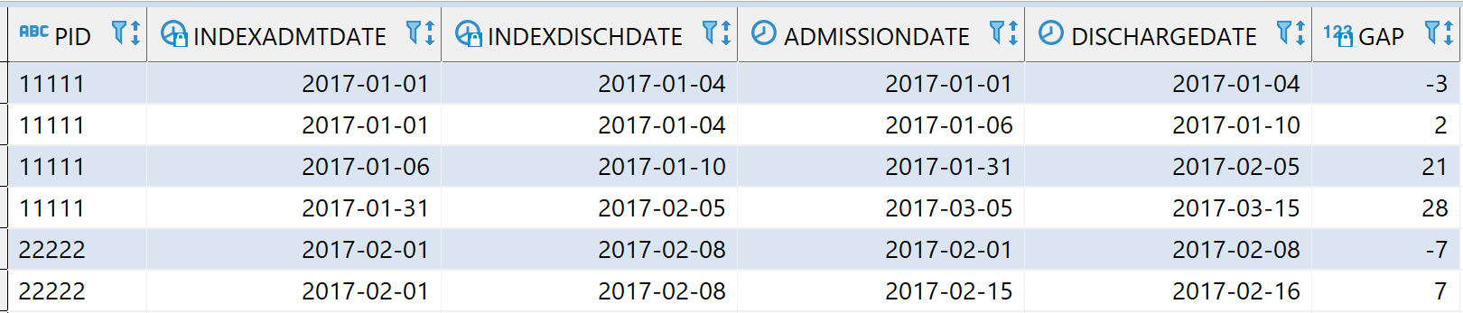
Remove First Record in Window Query

