Slide 1
ISE305: Database Design and Practice
Review of Relational Model and SQL
Fusheng Wang
Department of Computer Science
Department of Biomedical Informatics

Slide 2
Relational Model and Relational Tables
In a relational model, all data is represented in terms of tuples, grouped into relations, using a structure and language consistent with “first-order predicate logic”
Every row in a table can be thought of as a logical fact
Queries (like SQL SELECT) can be thought of as logical expressions
Provide theoretical foundation
A relational table is a fundamental structure in a relational database that stores data in a structured format consisting of rows (tuples) and columns (attributes)
Provide implementation for relational model
Data Model Overview
Notes:
“First-order predicate logic” is a formal way to describe and reason about things and their relationships using logic

Slide 3
Bags versus Sets
Sets = conceptually unordered collections of elements without duplicates e.g., {1,2,3}
Bags = conceptually unordered collections of elements with duplicates e.g.: {1,2,3,3} {3,2,1}
SQL table: bag
Unordered set of rows, not sequences
Data Model Overview

Slide 4
Order in SQL Tables
By default, there is no order for the records in a SQL table
Without ORDER BY, the database may return rows in any order (e.g., storage order, index order, …)
SELECT * FROM employee LIMIT 1;
(no semantic meaning!)
Select the “first” employee in your table in SQL based on highest salary
SELECT * FROM employee
ORDER BY salary DESC LIMIT 1;
(not standard SQL!)
What if there is a tie?

Slide 5
Core of DBMS
Data Model
Query Language
Storage and Indexing
Data Model Overview

Slide 6
Relational Data Model

Slide 7
Data Model
A Data Model is a notation for describing data or information
﻿﻿Structure of data (e.g., arrays, structs)
Conceptual model: in databases, structures are at a higher level
﻿﻿Operations on data (queries and modifications)
﻿﻿Limited operations: ease of programmers and efficiency of database
Constraints on data (what the data can be)
Data Model Overview

Slide 8
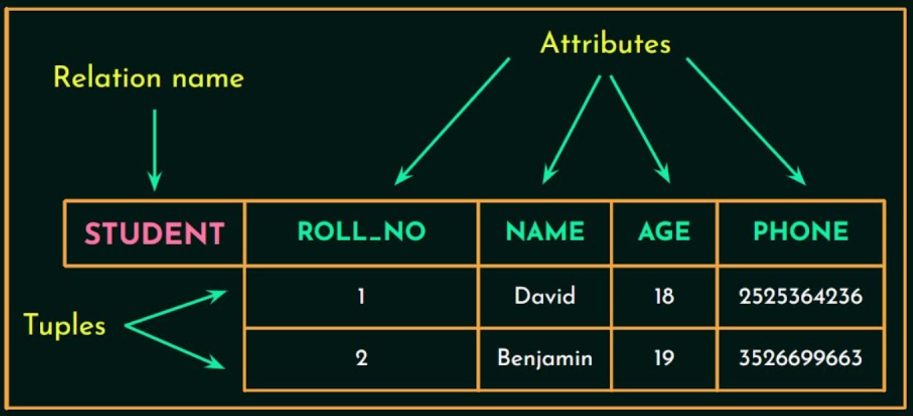
Relational Model
Structures: table, tuples, attributes
A relation schema: R(A₁, A₂, ...,A_{n})
A relation: a set of tuples r = {t₁, t₂, ..., t_{m}}
each tuple t is an ordered list of n values t =<v₁, v₂, ..., v_{n}>
Value v_{i} comes from its domain value or NULL
A1
An
Operations: selection, projection, join..
Constraints: e.g., grades can be only
{A,B,C,D,F}
Degree: number of attributes in schema
Cardinality: number of tuples in relation
t1
t2
Relational Model
Notes:
Relational model: a collection of relations.
Relation: table
Tuple: row
Attribute: column
Domain: a set of atomic values
Atomic values: single values
Degree of a relation: number of attributes in a relation
Cardinality: number of tuples in a relation.
Relation schema: describes the relation by specifying relation name, list of attributes, and degree of the relation.

Slide 9
Relational Model Constraints
Domain constraints: data types
Keys: no pair of tuples should have identical keys
Primary key: the primary key of a relational table uniquely “identifies” each record in the table
Unique keys: all other keys
Referential integrity constraints
Specified between two relations
Maintains consistency among tuples in two relations
A foreign key is an attribute (or collection of attributes) in one relation that uniquely identifies a tuple of another relation (a primary key in another relation)
Relational Model

Slide 10
SQL
Standard language of relational database access is SQL (Structured Query Language)
﻿﻿Data Definition Language (DDL): defines properties of data objects CREATE, ALTER, DROP, TRANSFER OWNERSHIP
﻿﻿Data Manipulation Language (DML): used to retrieve, add, edit and delete data SELECT, INSERT, UPDATE, DELETE
﻿﻿Data Control Language (DCL): ﻿controls access to databases and data objects GRANT, REVOKE
﻿﻿Transaction Control Languages (TCL): groups DML statements into transactions that can collectively be applied to a database or undone in the event of a failure COMMIT, ROLLBACK, SAVEPOINT
SQL

Slide 11
SQL
DROP TABLE city;
DROP TABLE state;
CREATE TABLE STATE (
state CHAR(2) NOT NULL,
PRIMARY KEY (state) );
CREATE TABLE CITY (
city VARCHAR(32) NOT NULL,
statename CHAR(2),
PRIMARY KEY (city),
FOREIGN KEY (statename) REFERENCES STATE(state)
ON DELETE CASCADE);
INSERT INTO state (state) VALUES ('FL');
INSERT INTO city (city, statename) VALUES ('Miami', 'FL’);
INSERT INTO city (city, statename) VALUES (‘Orlando', 'FL’);
--What if we change the order on insertion?
DELETE FROM STATE WHERE state = 'FL';
Referential Integrity Constraints
Notes:
ON DELETE SET NULL
ON DELETE CASCADE ON UPDATE RESTRICT
--UPDATE STATE SET state = 'CA' WHERE state ='FL';
--DELETE FROM STATE WHERE state = 'FL';
--SELECT * FROM STATE;
--SELECT * FROM CITY;

Slide 12
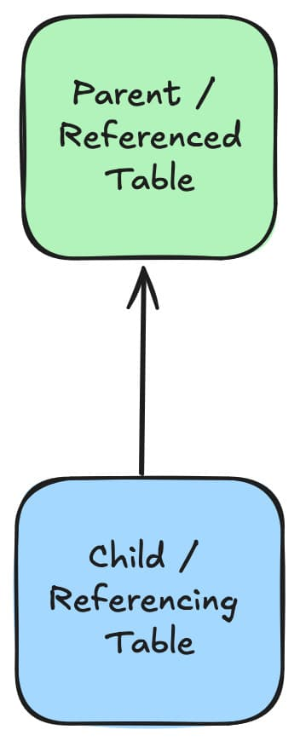
Referential Actions
A DBMS ensures data integrity if rows in a referenced table are to be deleted (or updated)
SET NULL: delete or update the row from the parent table and set the foreign key column or columns in the child table to NULL
RESTRICT: rejects the delete or update operation for the parent table (immediate check). Specifying RESTRICT, like omitting the ON DELETE or ON UPDATE clause
NO ACTION: same as RESTRICT, except that the referential integrity check is delayed AFTER trying to alter the table
CASCADE: Delete or update the row from the parent table and automatically delete or update the matching rows in the child table
state
city
SQL
Notes:
https://dev.mysql.com/doc/refman/8.4/en/example-foreign-keys.html

Slide 13
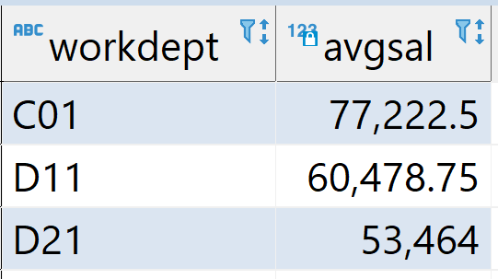
SELECT Statement - Six Clauses
employee ( empno, workdept, salary, … );
SELECT workdept, AVG(salary) as avgsal
FROM employee
WHERE hiredate >'2000-01-01'
GROUP BY workdept
HAVING COUNT(empno) > 3
ORDER BY avgsal DESC;
Columns appearing in ORDER BY and GROUP BY MUST appear in SELECT!
SQL

Slide 14
NULL

Slide 15
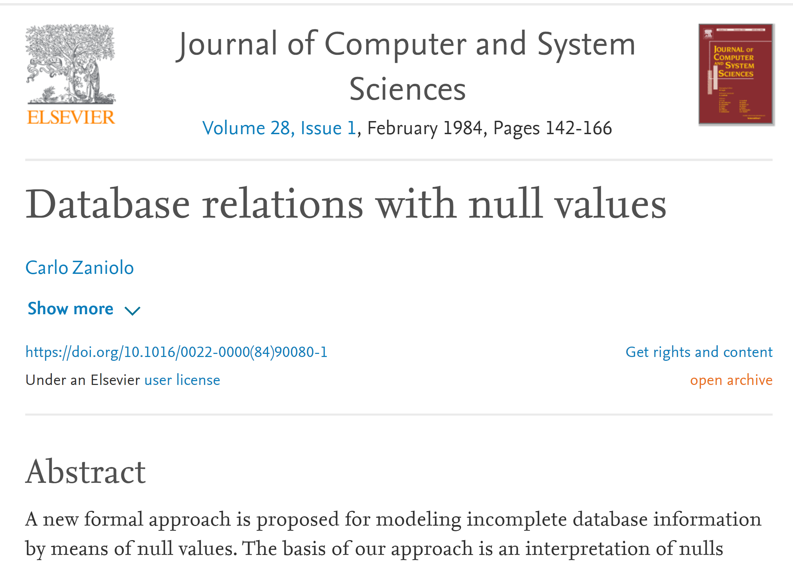
Comparisons Involving NULL and Three-Valued Logic
Meanings of NULL (case insensitive: null, Null, …)
Unknown value
Unavailable or withheld value
Not applicable attribute
Each individual NULL value considered to be different from every other NULL value
SQL uses a three-value logic:
TRUE, FALSE, and UNKNOWN
“NULL = 5” evaluates to UNKNOWN
NULL

Slide 16
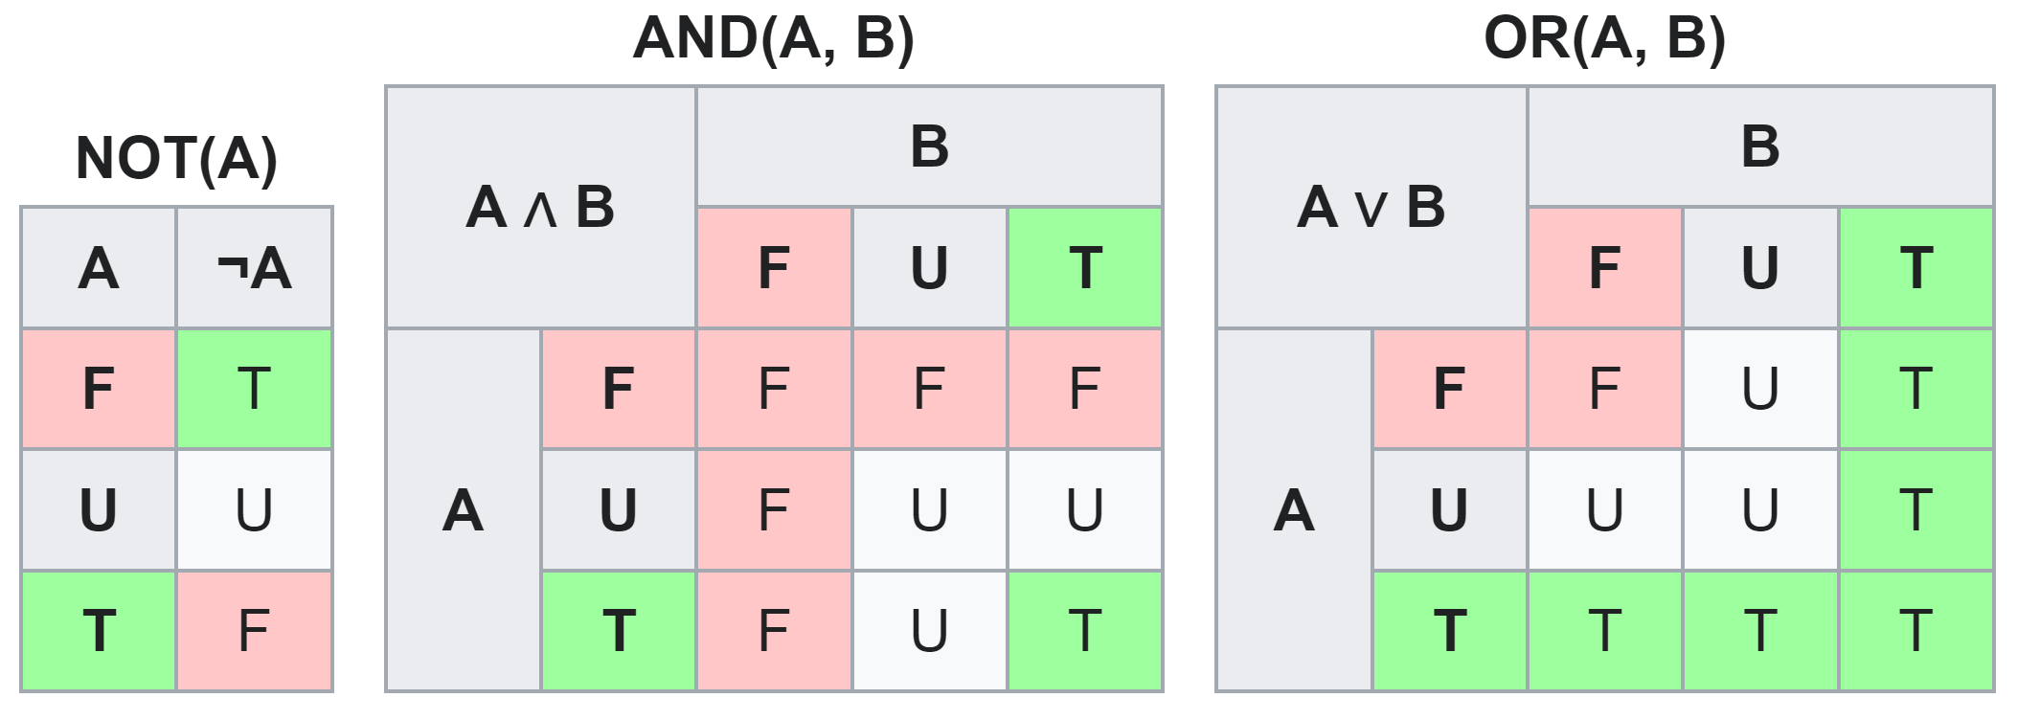
Comparisons Involving NULL and Three-Valued Logic
(F, false; U, unknown/NULL; T, true)
NULL
Notes:
(F, false; U, unknown; T, true)

Slide 17
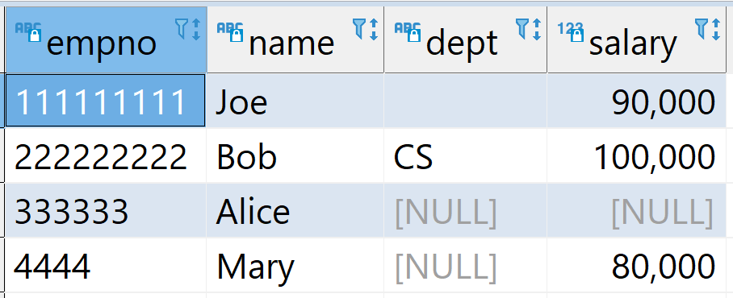
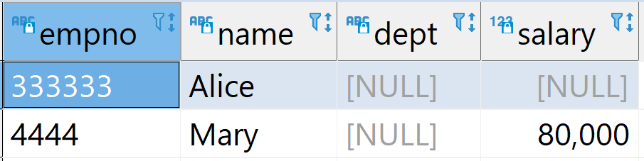
Example NULL Queries
CREATE TABLE emp(
empno CHAR (9) NOT NULL PRIMARY KEY,
name VARCHAR(32),
dept VARCHAR(24),
salary DECIMAL (8,2) );
INSERT INTO emp VALUES ('111111111', 'Joe', '', 90000);
INSERT INTO emp VALUES ('222222222', 'Bob', 'CS', 100000);
INSERT INTO emp VALUES ('333333', 'Alice', NULL, NULL);
INSERT INTO emp VALUES ('4444', 'Mary', NULL, 80000);
SELECT * from emp;
SELECT * FROM emp WHERE dept IS NULL;
NULL

Slide 18
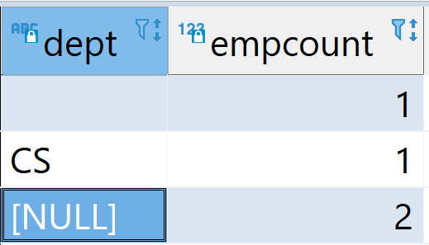
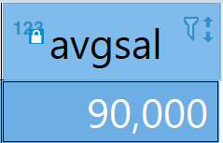
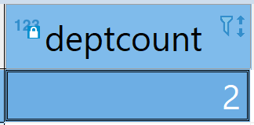
NULLs
emp
Primary key cannot be null:
empno VARCHAR(8) NOT NULL PRIMARY KEY
Nulls are considered to be equal when duplicates
are eliminated by SELECT DISTINCT or COUNT (DISTINCT column)
The AVG, COUNT DISTINCT, SUM, MAX, and MIN functions omit column occurrences set to null
SELECT DISTINCT dept
FROM emp;
SELECT AVG(salary) AS avgsal
FROM emp;
SELECT COUNT(DISTINCT dept) AS deptcount
FROM emp;
NULL

Slide 19
NULLs
For comparison in a SELECT statement, two null columns are not considered equal
X: dept = NULL
When a nullable column participates in a calculation, the result is null:
SELECT 1 + NULL FROM DUAL
Invalid to test if a column is <> NULL, or >= NULL (only logic operation allowed)
X: dept <> NULL
✓: IS NOT NULL
NULL

Slide 20
Set Operations

Slide 21
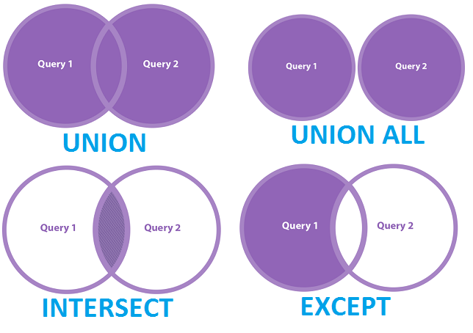
Set Operations
SQL set operations combine the results of multiple query blocks into a single result
UNION: combine the result sets of two or more SELECT statements while eliminating duplicate rows
UNION ALL: similar to UNION, but it does not eliminate duplicate rows
INTERSECT: combine only those rows which the results of two query blocks have in common, omitting any duplicates
EXCEPT (or MINUS in Oracle; or NOT IN): For two query blocks A and B, return all results from A which are not also present in B, omitting any duplicates
SET

Slide 22
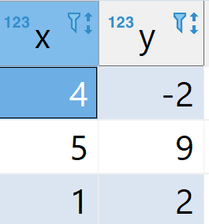
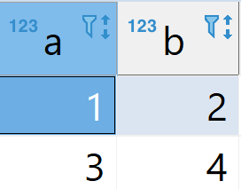
Set Operations
CREATE TABLE t1 (x INT, y INT);
INSERT INTO t1 VALUES ROW(4,-2), ROW(5,9), ROW(1,2);
CREATE TABLE t2 (a INT, b INT);
INSERT INTO t2 VALUES ROW(1,2), ROW(3,4);
SELECT * FROM t1;
SELECT * FROM t2;
TABLE t1 UNION TABLE t2;
TABLE t1 UNION ALL TABLE t2;
== equals to:
SELECT * FROM t1 UNION ALL SELECT * FROM t2;
TABLE t1 INTERSECT TABLE t2;
TABLE t1 EXCEPT TABLE t2;
== equals to:
SELECT x,y FROM t1
WHERE (x,y) NOT IN (SELECT * FROM t2);
t1
t2
SET

Slide 23
Joins

Slide 24
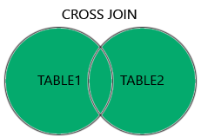
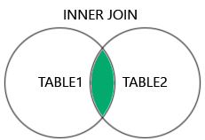
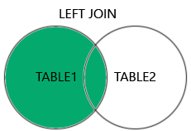
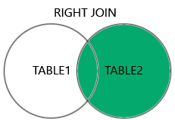
Joins
Cross Join (Cartesian Product): returns all the rows in all the tables listed in a query: rows from both tables paired
Inner Join: selects records that have matching values in both tables
Outer Join (left, right, full): joins that return matched values and unmatched values from either or both tables
Left outer join
Right outer join
Full join: a combination of a left outer join and right outer join
Join

Slide 25

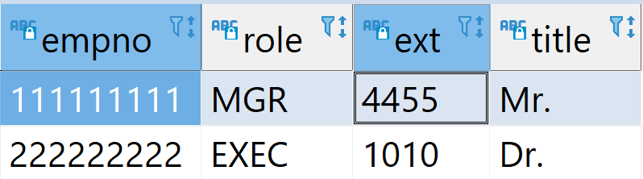
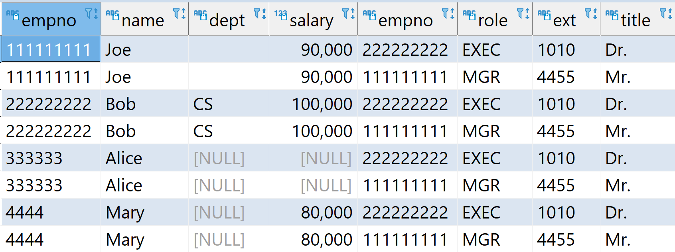
Join: Cross Join Example
emp
detail
CROSS JOIN
SELECT * FROM emp CROSS JOIN detail;
OR: SELECT * FROM emp, detail;
Join

Slide 26
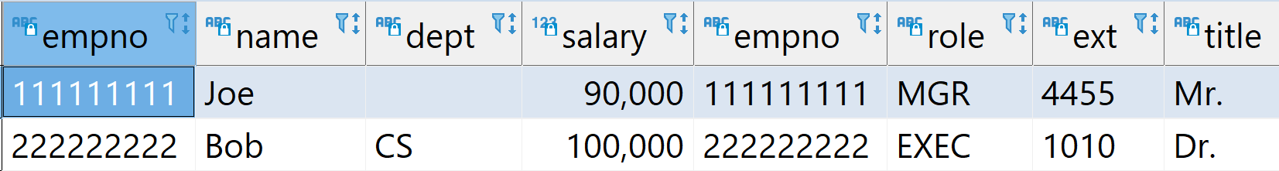
Inner Join
Default type of join in a joined table
Tuple is included in the result only if a matching tuple exists in the other relation
Two notations:
Explicit:
Implicit:
SELECT *
FROM emp e INNER JOIN detail d
ON e.empno = d.empno;
SELECT *
FROM emp e, detail d
WHERE e.empno = d.empno;
ON e.empno = d.empno;
Join

Slide 27
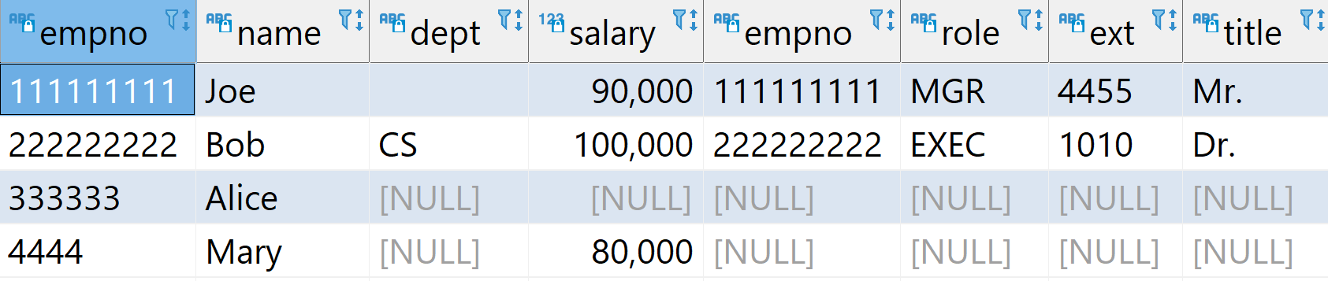
Left Outer Join Example
SELECT *
FROM emp e LEFT OUTER JOIN detail d
ON e.empno = d.empno;
(Left)
(Right)
emp
detail
Left Outer Join
Join

Slide 28
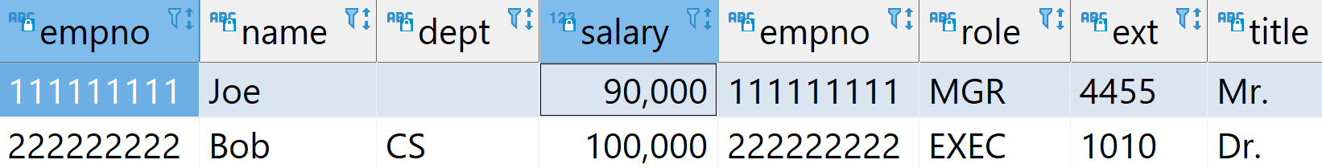
Right Outer Join Example
SELECT *
FROM emp e RIGHT OUTER JOIN detail d
ON e.empno = d.empno;
(Left)
(Right)
emp
detail
Right Outer Join
Join

Slide 29
Group By

Slide 30
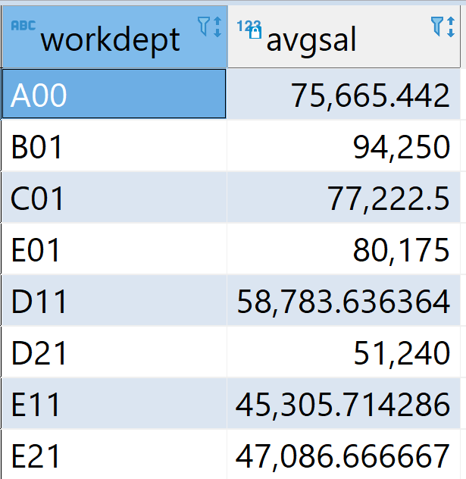
Group By Single Column
employee ( empno, workdept, salary, … );
SELECT workdept, AVG(salary) AS avgsal
FROM employee
GROUP BY workdept;
GROUP BY

Slide 31
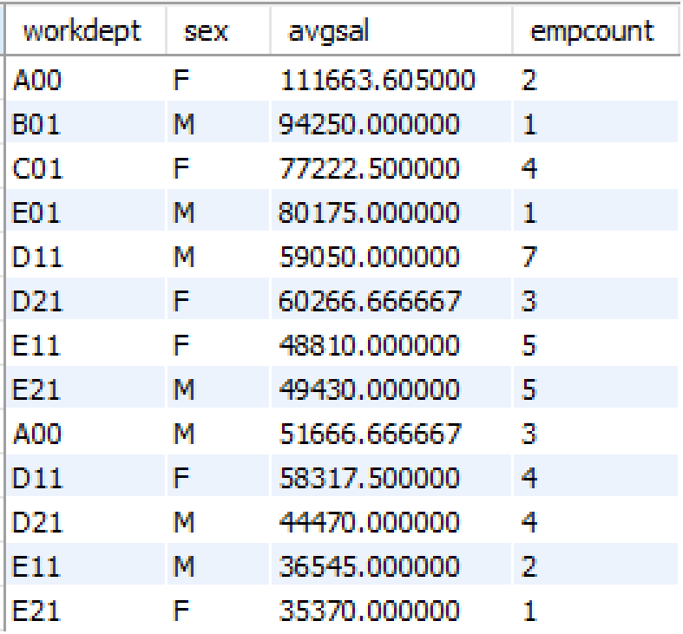
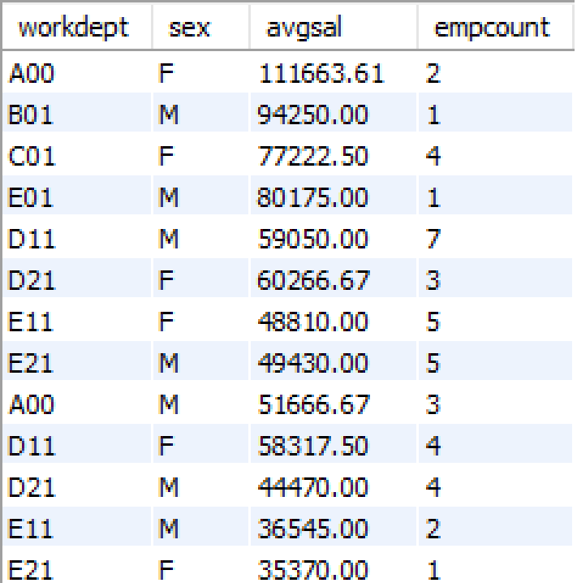
Group By Multiple Columns
SELECT workdept, sex, AVG(salary) AS avgsal
FROM employee
GROUP BY workdept, sex;
SELECT workdept, sex,
CAST(AVG(salary) AS DECIMAL(8,2)) AS avgsal,
COUNT(empno) AS empcount
FROM employee
GROUP BY workdept, sex;
GROUP BY

Slide 32
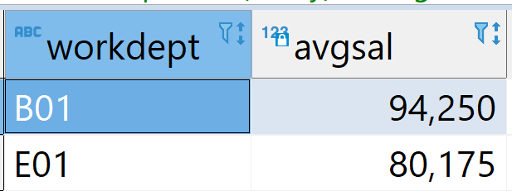
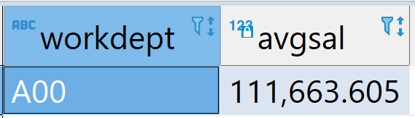
GROUP BY, HAVING
Return the average of salaries of managers for department where the average is large than 80K
HAVING vs WHERE:
The WHERE clause applies the condition to individual rows before the rows are summarized
HAVING clause applies only to groups as a whole, i.e., to the rows in the result set representing groups
SELECT workdept, AVG(salary) AS avgsal
FROM employee
GROUP BY workdept
HAVING avgsal > 80000;
SELECT workdept, AVG(salary) AS avgsal
FROM employee
WHERE sex = 'F'
GROUP BY workdept
HAVING avgsal > 80000;
GROUP BY

Slide 33
Nested Queries

Slide 34
Nested Queries (Subqueries)
A subquery can return:
a scalar value (single value)
a logical condition
a set (table)
There are three subquery/nested query cases:
=, > (single value)
IN, ALL, ANY, or SOME (set)
EXISITS/NOT EXISTS (logic)
Nested Queries

Slide 35
Nested Queries (Single Value)
=, > (single value)
Find employee(s) who earn the highest salary:
SELECT empno, lastname, salary
FROM employee
WHERE salary = (
SELECT MAX(salary)
FROM employee);
SELECT empno, lastname, salary
FROM employee
ORDER BY salary DESC LIMIT 1;
✗
Nested Queries

Slide 36
Nested Queries (Set)
Find employees whose departments must be in the dept table.
SELECT *
FROM employee
WHERE workdept IN (
SELECT deptno FROM department
);
Nested Queries

Slide 37
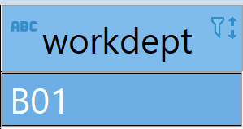
Nested Queries (Logic)
EXISITS/NOT EXISTS (logic)
Find dept which doesn’t have anybody who earns less than 90K
SELECT workdept
FROM employee e1
WHERE NOT EXISTS (
SELECT empno
FROM employee e2
WHERE e2.salary < 90000
AND e2.WORKDEPT = e1.WORKDEPT
);
Nested Queries

Slide 38
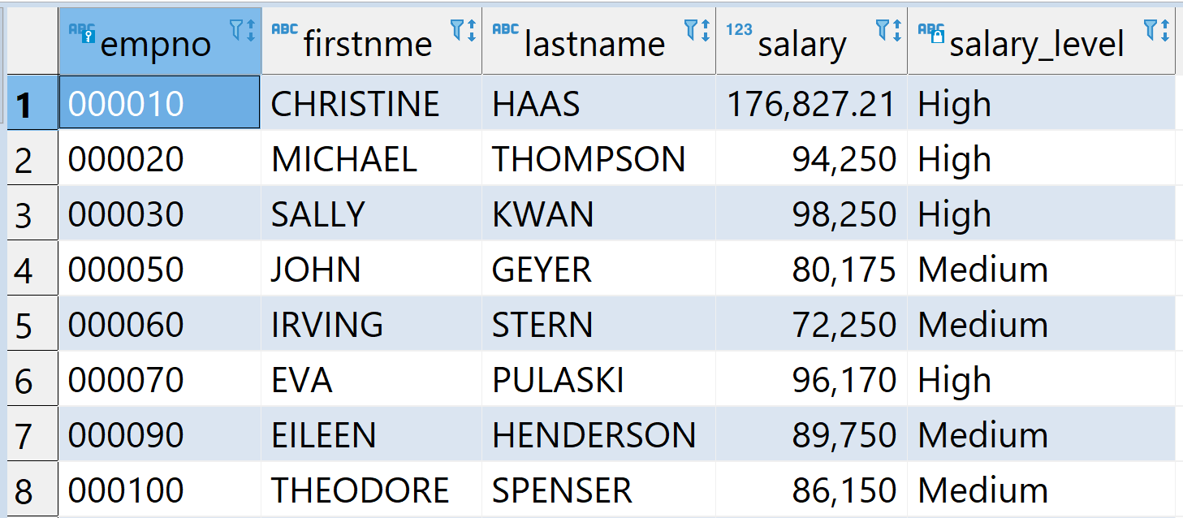
CASE
CASE
WHEN condition1 THEN result1
WHEN condition2 THEN result2
...
ELSE default_result
END
SELECT empno, firstnme, lastname, salary,
CASE
WHEN salary >= 90000 THEN 'High'
WHEN salary BETWEEN 60000 AND 89999
THEN 'Medium'
ELSE 'Low'
END
AS salary_level
FROM employee;
SELECT * FROM census
ORDER BY
(CASE
WHEN city IS NULL THEN state
ELSE city
END);

