Slide 1

Steam Games Database
Qiyun Zhou
Jisong Liao
Shengxuan You

Slide 2
OUTLINE
Topic Introduction
Entities and Attributes
RDM
Tables
Constraints
Queries
Forms
Report

Slide 3
Topic Introduction

Slide 4
Introduction
What is the Personal Steam Library Database?
A collection of all games in the Steam game library of the three members of the group.
Contains information on the type of game, developer, developercountry, release date, system requirements, price, applause rate, owners estimation, DLC quantiy, achievement quantity, and whether the controller is supported.
What is the purpose of this database?
To better manage owned games, categorize the games, and establish rankings based on various criteria.
To facilitate users to choose suitable games to play based on different situation.
How did we populate the Database?
We get the game list from the steam library of the group members.
We obtain detailed information about the game from the website www.steamdb.info

Slide 5
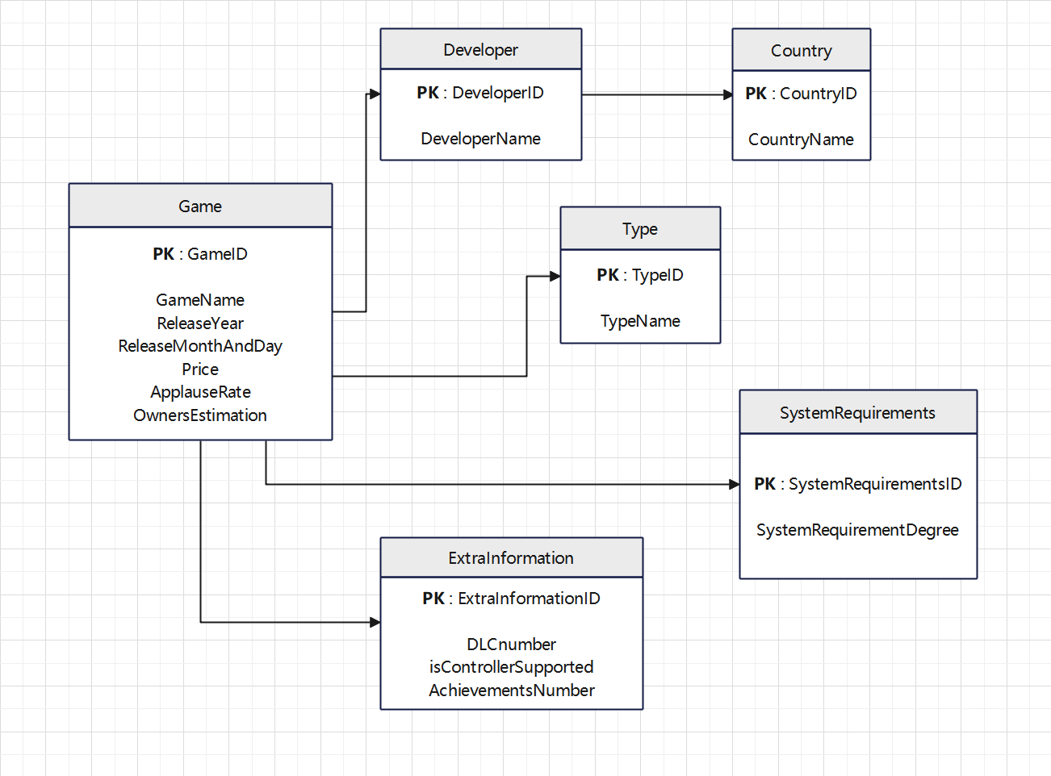
Entities and Attributes

Slide 6
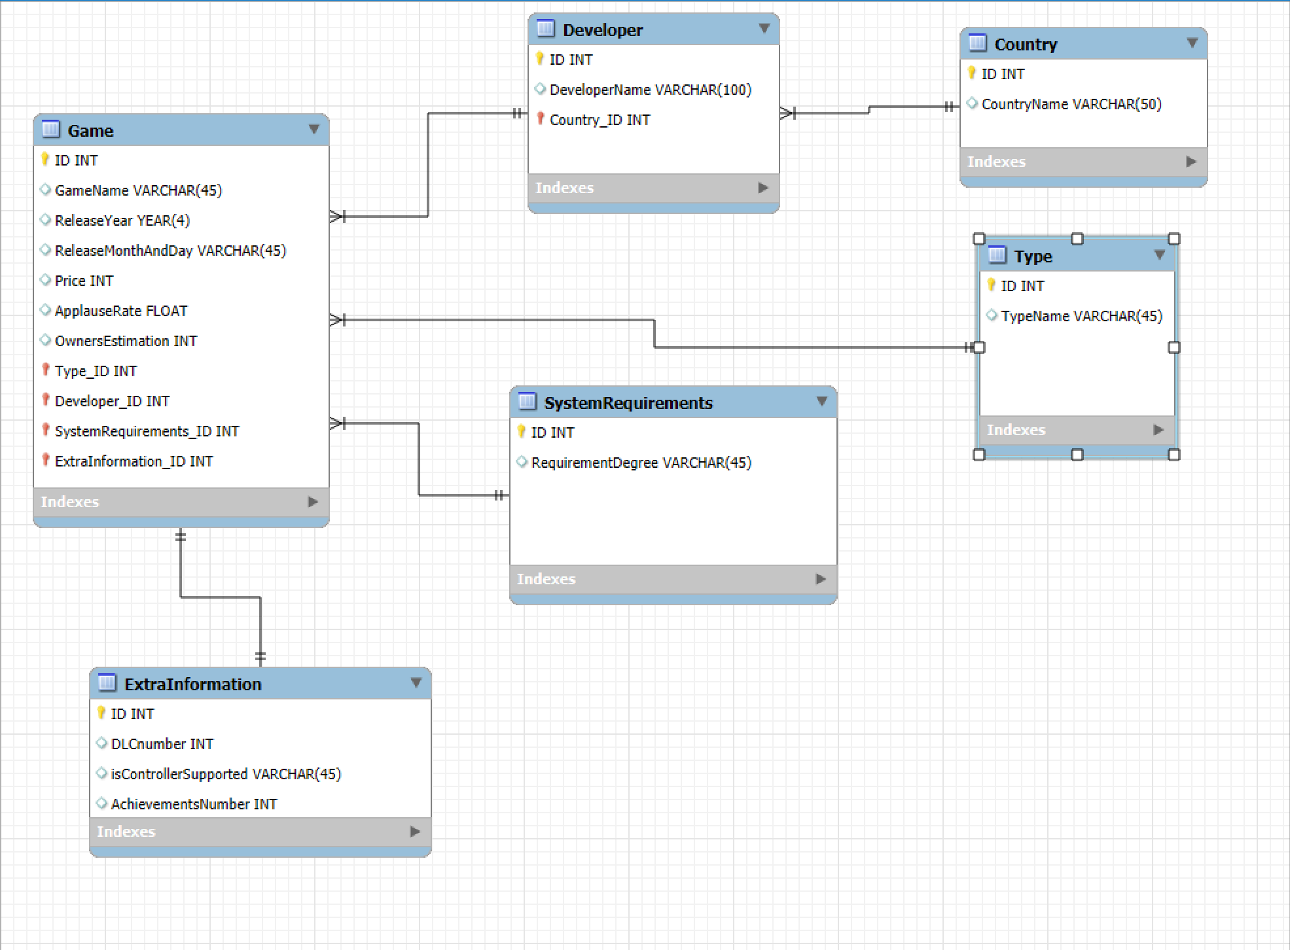
RDM

Slide 7
Tables Refer to the Database

Slide 8
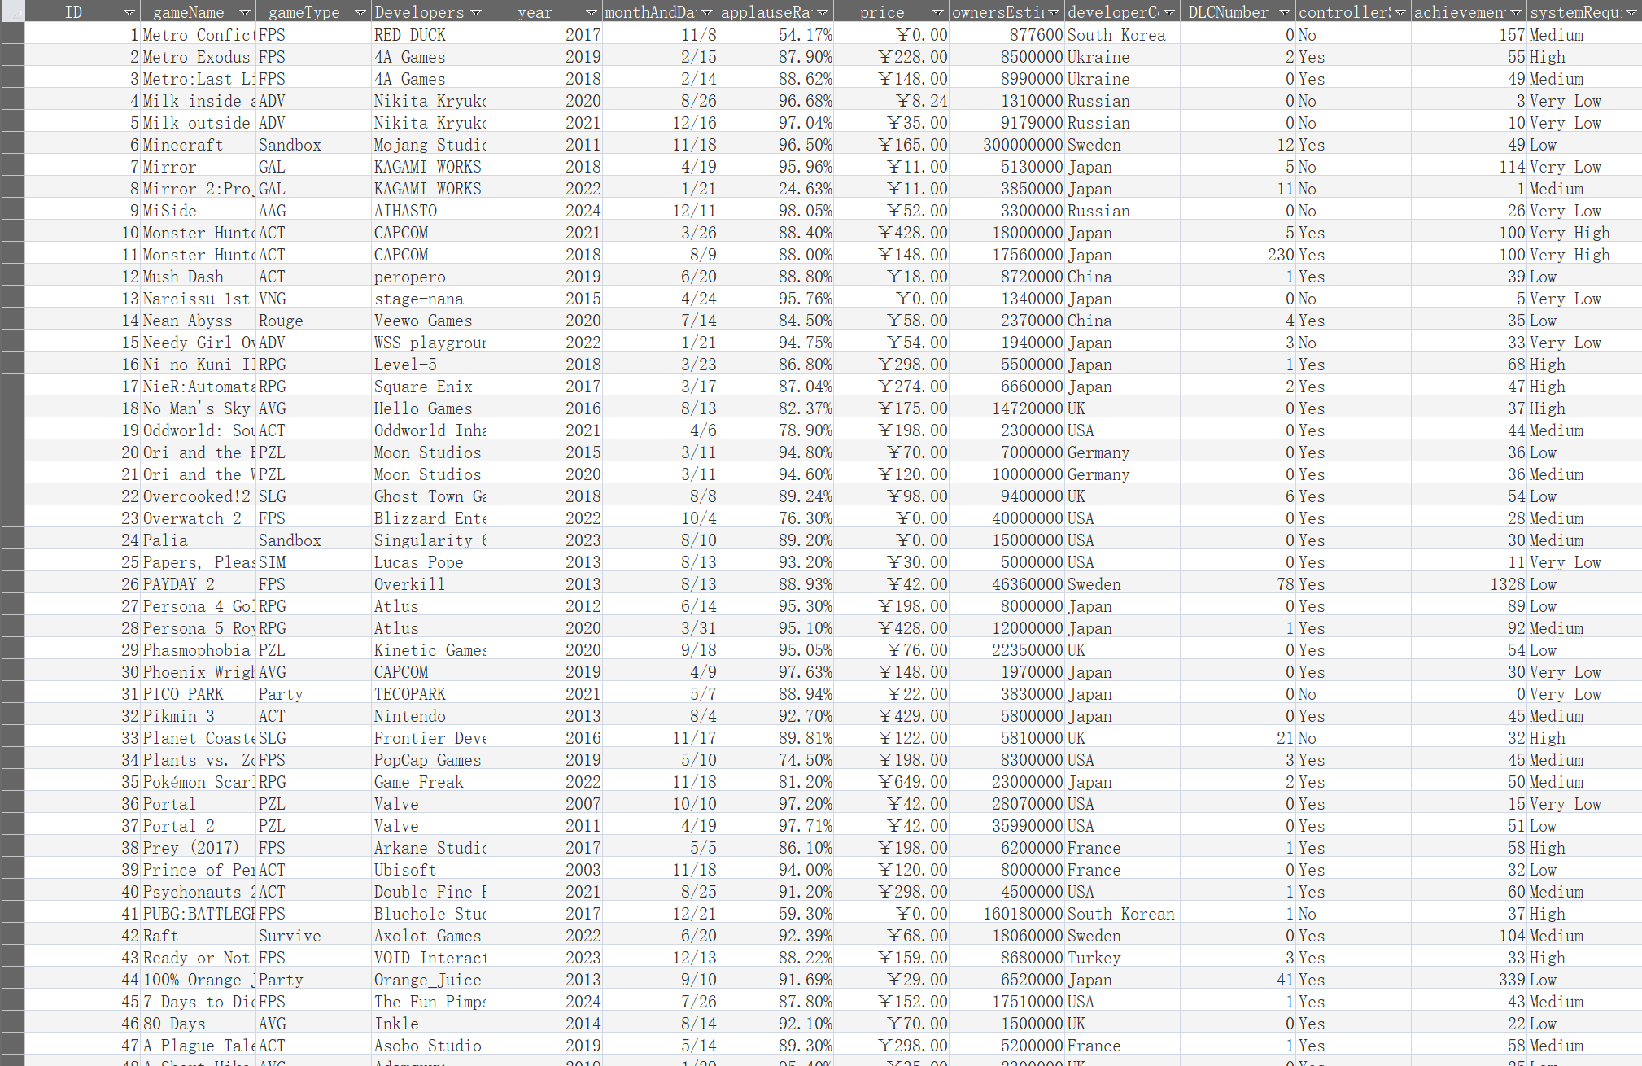
TotalGameList Table

Slide 9
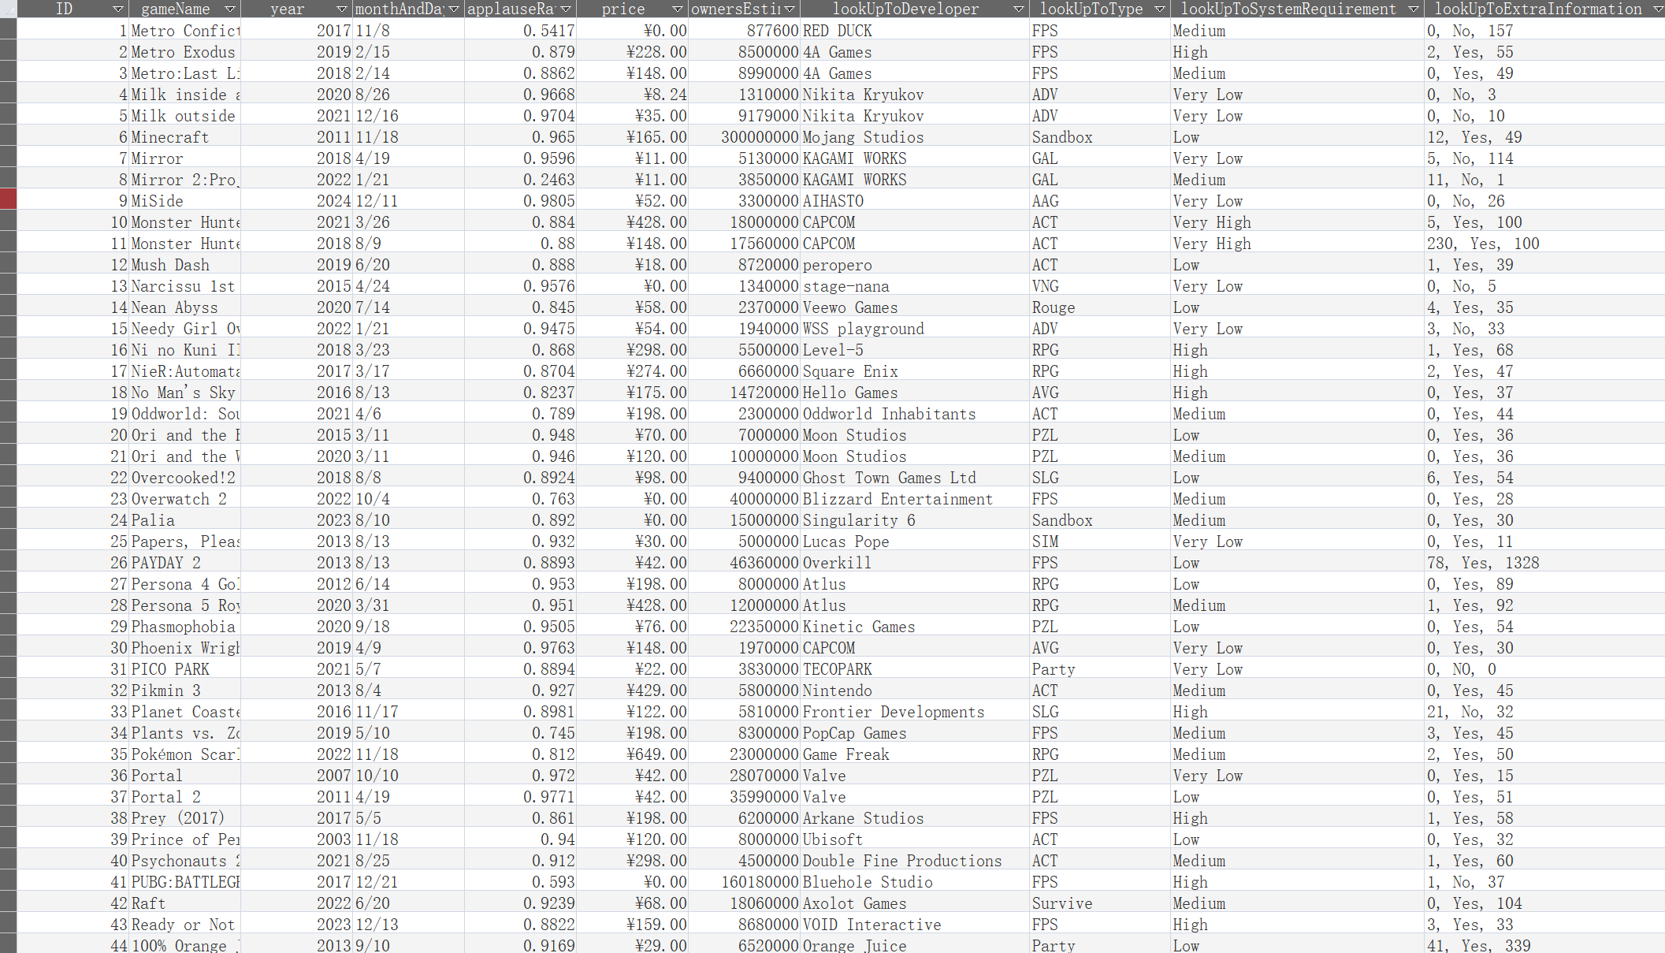
Game Table

Slide 10
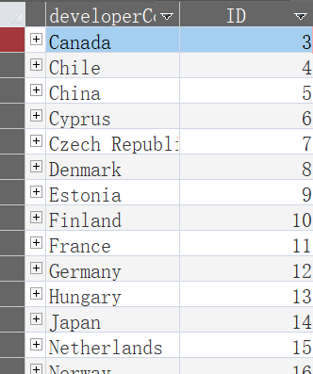
Country Table

Slide 11
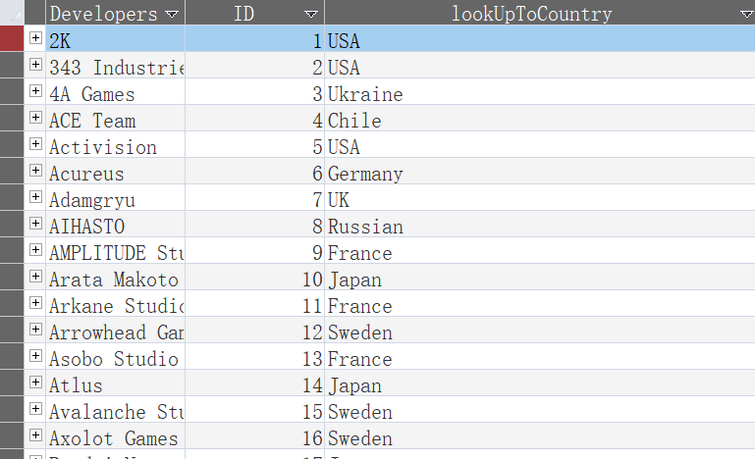
Developers Table

Slide 12
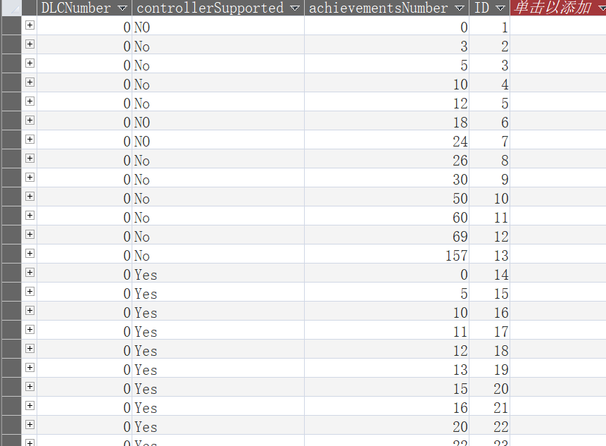
ExtraInformation Table

Slide 13
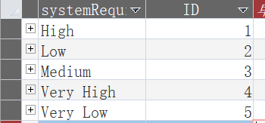
SystemRequirement Table

Slide 14
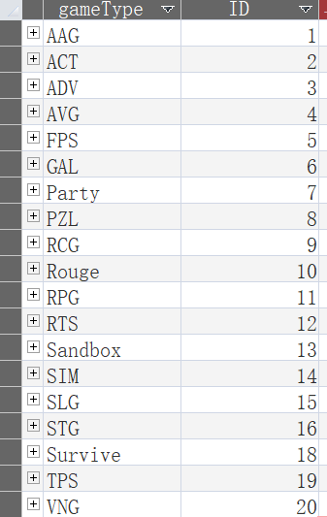
Type Table

Slide 15
Constraints

Slide 16
CONSTRAINTS
GameName: The game name cannot be null.
ReleaseYear: is >1950.
ReleaseMonthAndDay: The format is MM/DD.
Price: In RMB.
ApplauseRate: In percentage form, greater than or equal to 0, less than or equal to 1.
OwnersEstimation: is natural number.
DeveloperName: The content is accurate.
CountryName: The content is accurate.
TypeName: Abbreviations for the genre of the game.
SystemRequirementDegree: There are five categories, which are: very low, low, medium, high, and very high.
DLCnumber:The content is accurate.
isControllerSupported: Must be Yes or NO.
AchievementsNumber: is natural number.

Slide 17
Queries

Slide 18
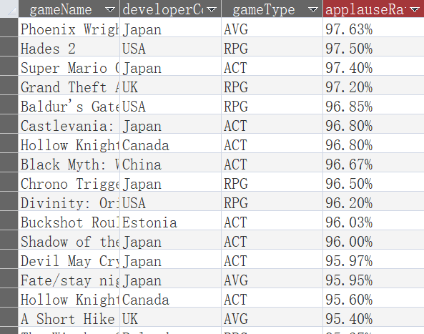
ControllerFriendlyQuery
SELECT Game.gameName, Country.developerCountry, Type.gameType, FORMATPERCENT(Game.applauseRate) AS applauseRate
FROM Country INNER JOIN (Developer INNER JOIN (Type INNER JOIN (Game INNER JOIN ExtraInformation ON Game.[lookUpToExtraInformation]=ExtraInformation.ID) ON Type.ID=Game.[lookUpToType]) ON Developer.ID=Game.[lookUpToDeveloper]) ON Country.ID=Developer.[lookUpToCountry]
WHERE (ExtraInformation.AchievementsNumber > 0) AND (ExtraInformation.controllerSupported = 'Yes') AND Type.gameType IN ('ACT', 'RPG', 'AVG')
GROUP BY Game.gameName, Country.developerCountry, Game.applauseRate, Type.gameType
ORDER BY Game.applauseRate DESC;

Slide 19
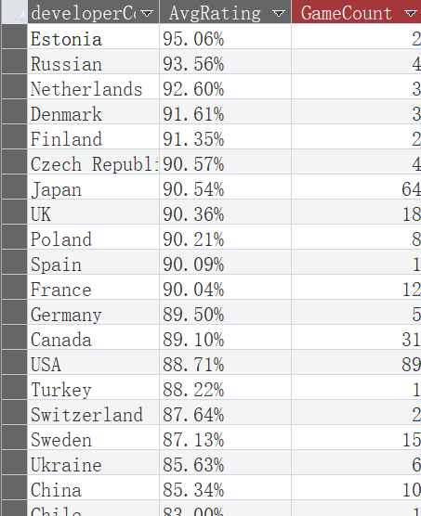
OrderedAVGRateQuery
SELECT Country.developerCountry, FORMATPERCENT(Round(AVG(Game.applauseRate),4)) AS AvgRating, COUNT(*) AS GameCount
FROM Country INNER JOIN (Developer INNER JOIN (Type INNER JOIN Game ON Type.ID=Game.[lookUpToType]) ON Developer.ID=Game.[lookUpToDeveloper]) ON Country.ID=Developer.[lookUpToCountry]
GROUP BY Country.developerCountry
ORDER BY AVG(Game.applauseRate) DESC;

Slide 20
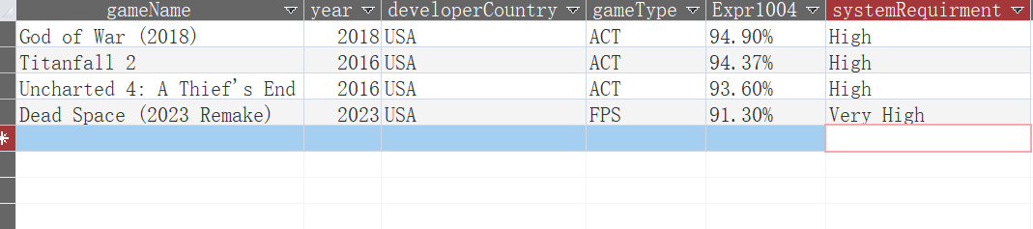
FindSuitableGameQuery
SELECT Game.gameName, Game.year, Country.developerCountry, Type.gameType, FORMATPERCENT(Game.applauseRate), SystemRequirement.systemRequirment
FROM Country INNER JOIN (Developer INNER JOIN (Type INNER JOIN (Game INNER JOIN SystemRequirement ON Game.[lookUpToSystemRequirement]=SystemRequirement.ID) ON Type.ID=Game.[lookUpToType]) ON Developer.ID=Game.[lookUpToDeveloper]) ON Country.ID=Developer.[lookUpToCountry]
WHERE Type.gameType IN ('ACT', 'FPS') AND Game.year >= 2015 AND Game.applauseRate >= 0.90 AND Country.developerCountry = 'USA' AND SystemRequirement.systemRequirment IN ('High', 'Very High')
ORDER BY Game.applauseRate DESC;

Slide 21
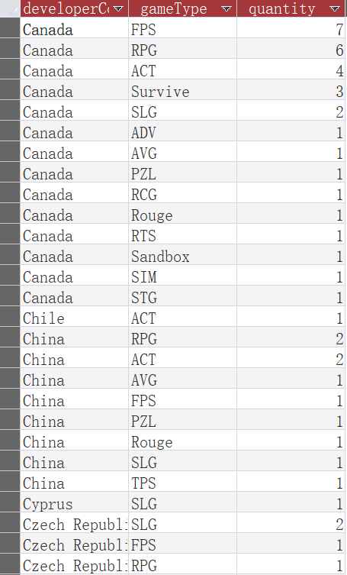
OrderedQuantityQuery
SELECT Country.developerCountry, Type.gameType, Count([Game].[gameName]) AS quantity
FROM Country INNER JOIN (Developer INNER JOIN (Type INNER JOIN Game ON Type.ID=Game.[lookUpToType]) ON Developer.ID=Game.[lookUpToDeveloper]) ON Country.ID=Developer.[lookUpToCountry]
GROUP BY Country.developerCountry, Type.gameType
ORDER BY Country.developerCountry, Count([Game].[gameName]) DESC;

Slide 22
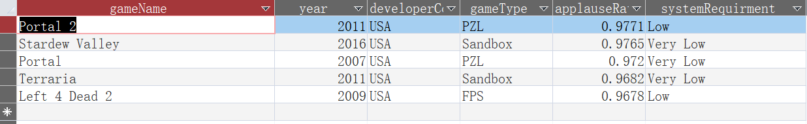
Top5CostPerformanceQuery
SELECT TOP 5 Game.gameName, Game.year, Country.developerCountry, Type.gameType, Game.applauseRate, SystemRequirement.systemRequirment
FROM Country INNER JOIN (Developer INNER JOIN (Type INNER JOIN (Game INNER JOIN SystemRequirement ON Game.[lookUpToSystemRequirement]=SystemRequirement.ID) ON Type.ID=Game.[lookUpToType]) ON Developer.ID=Game.[lookUpToDeveloper]) ON Country.ID=Developer.[lookUpToCountry]
WHERE Game.price <=50 AND Game.applauseRate >= 0.90 AND Game.ownersEstimation>10000000
ORDER BY Game.applauseRate DESC;

Slide 23
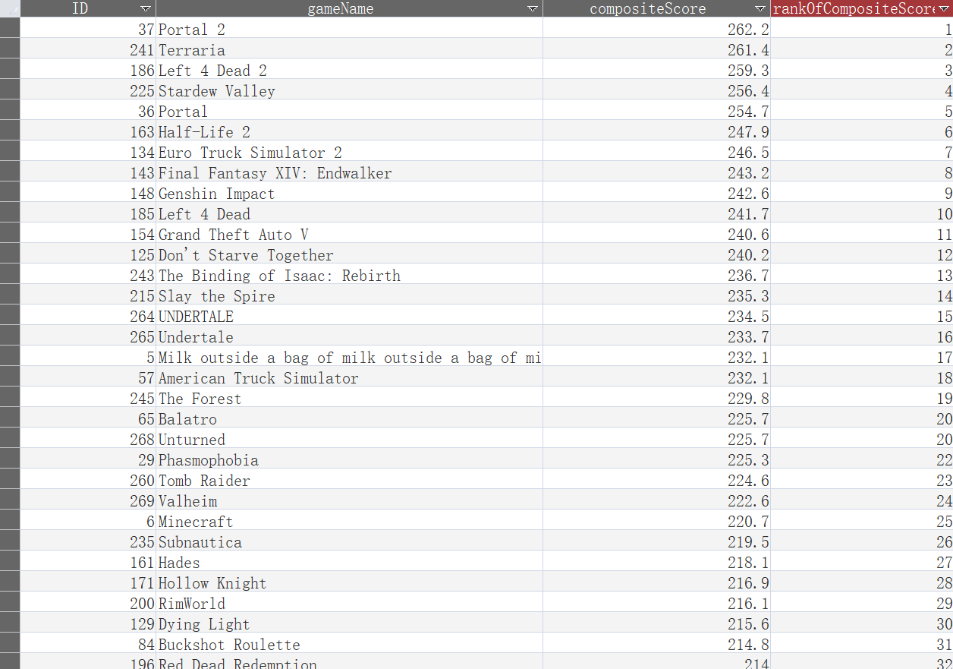
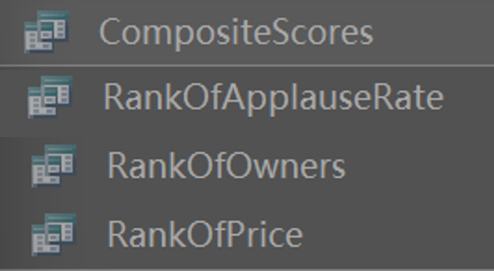
RankOfCompositeScore
SELECT CompositeScores.ID, CompositeScores.gameName, CompositeScores.compositeScore, (SELECT COUNT(*) + 1
FROM CompositeScores AS t2
WHERE t2.compositeScore > CompositeScores.compositeScore) AS rankOfCompositeScore
FROM CompositeScores
ORDER BY compositeScore DESC;

Slide 24
Forms

Slide 25
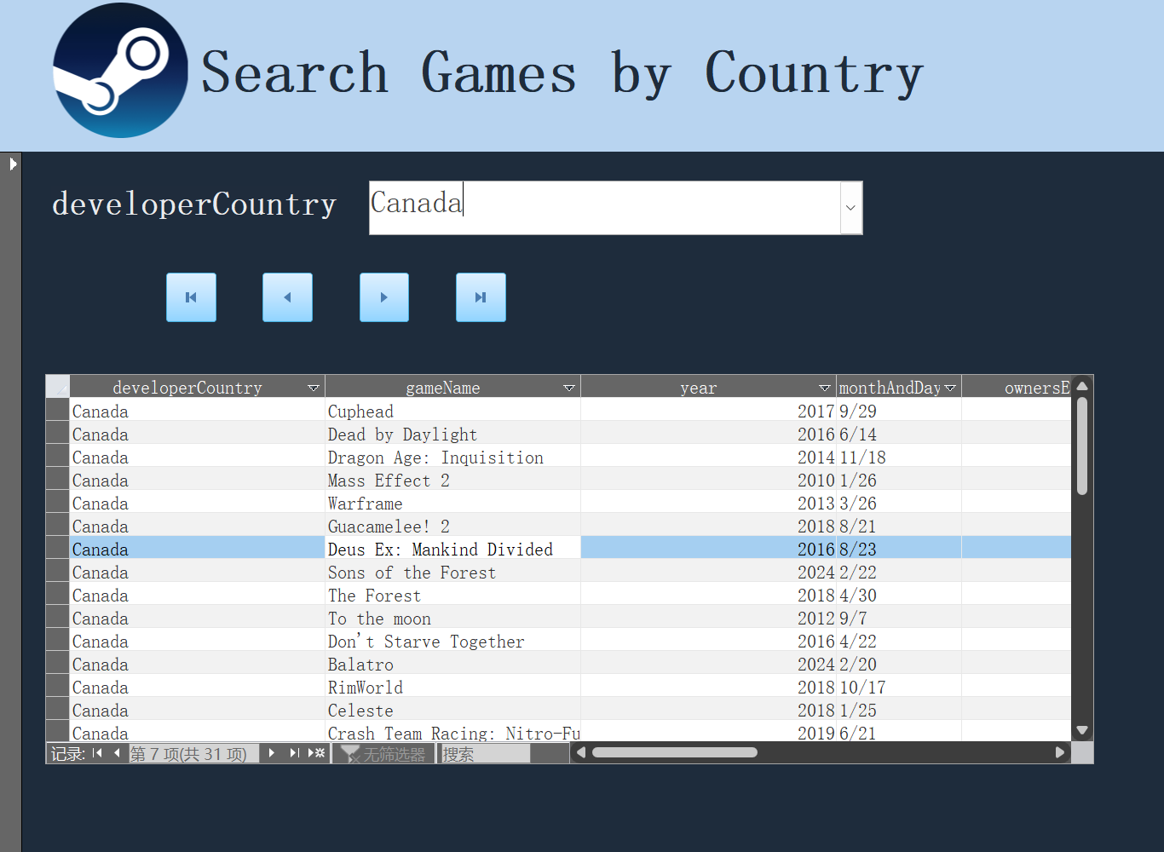

Slide 26
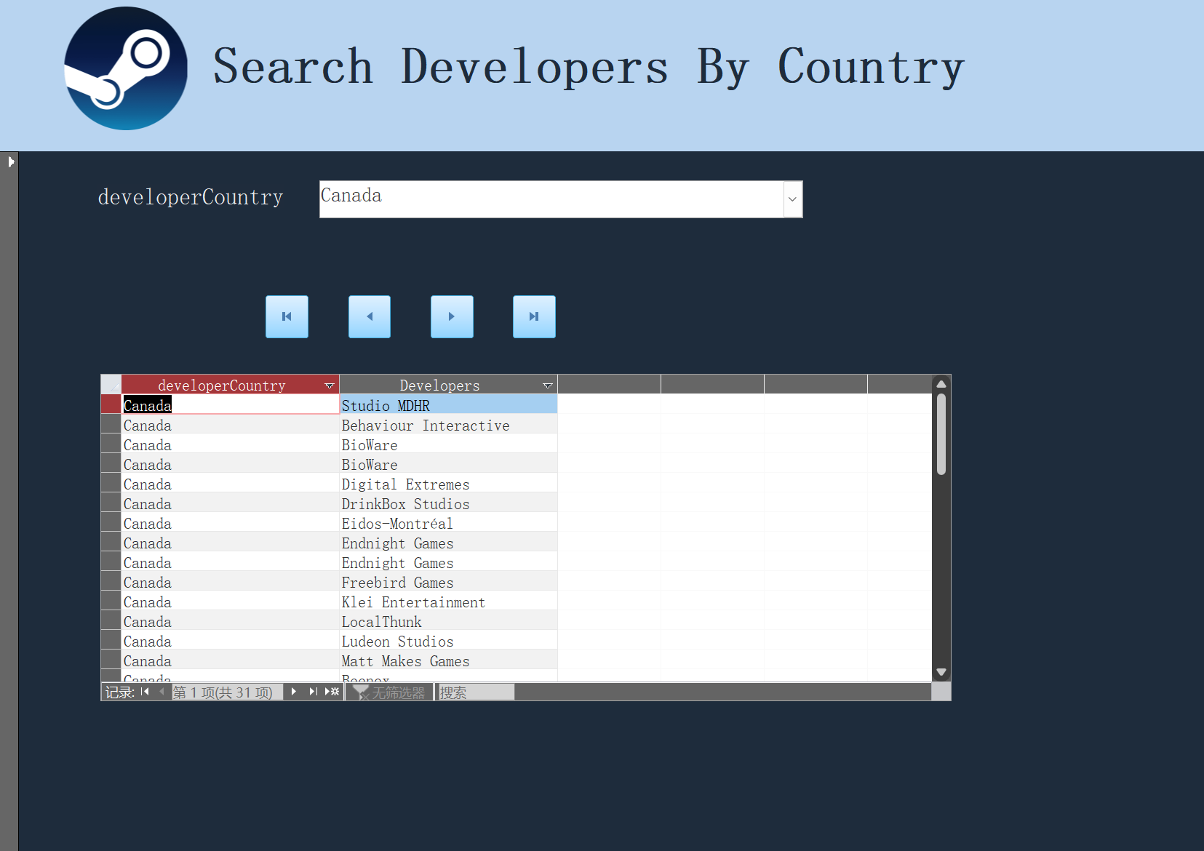

Slide 27
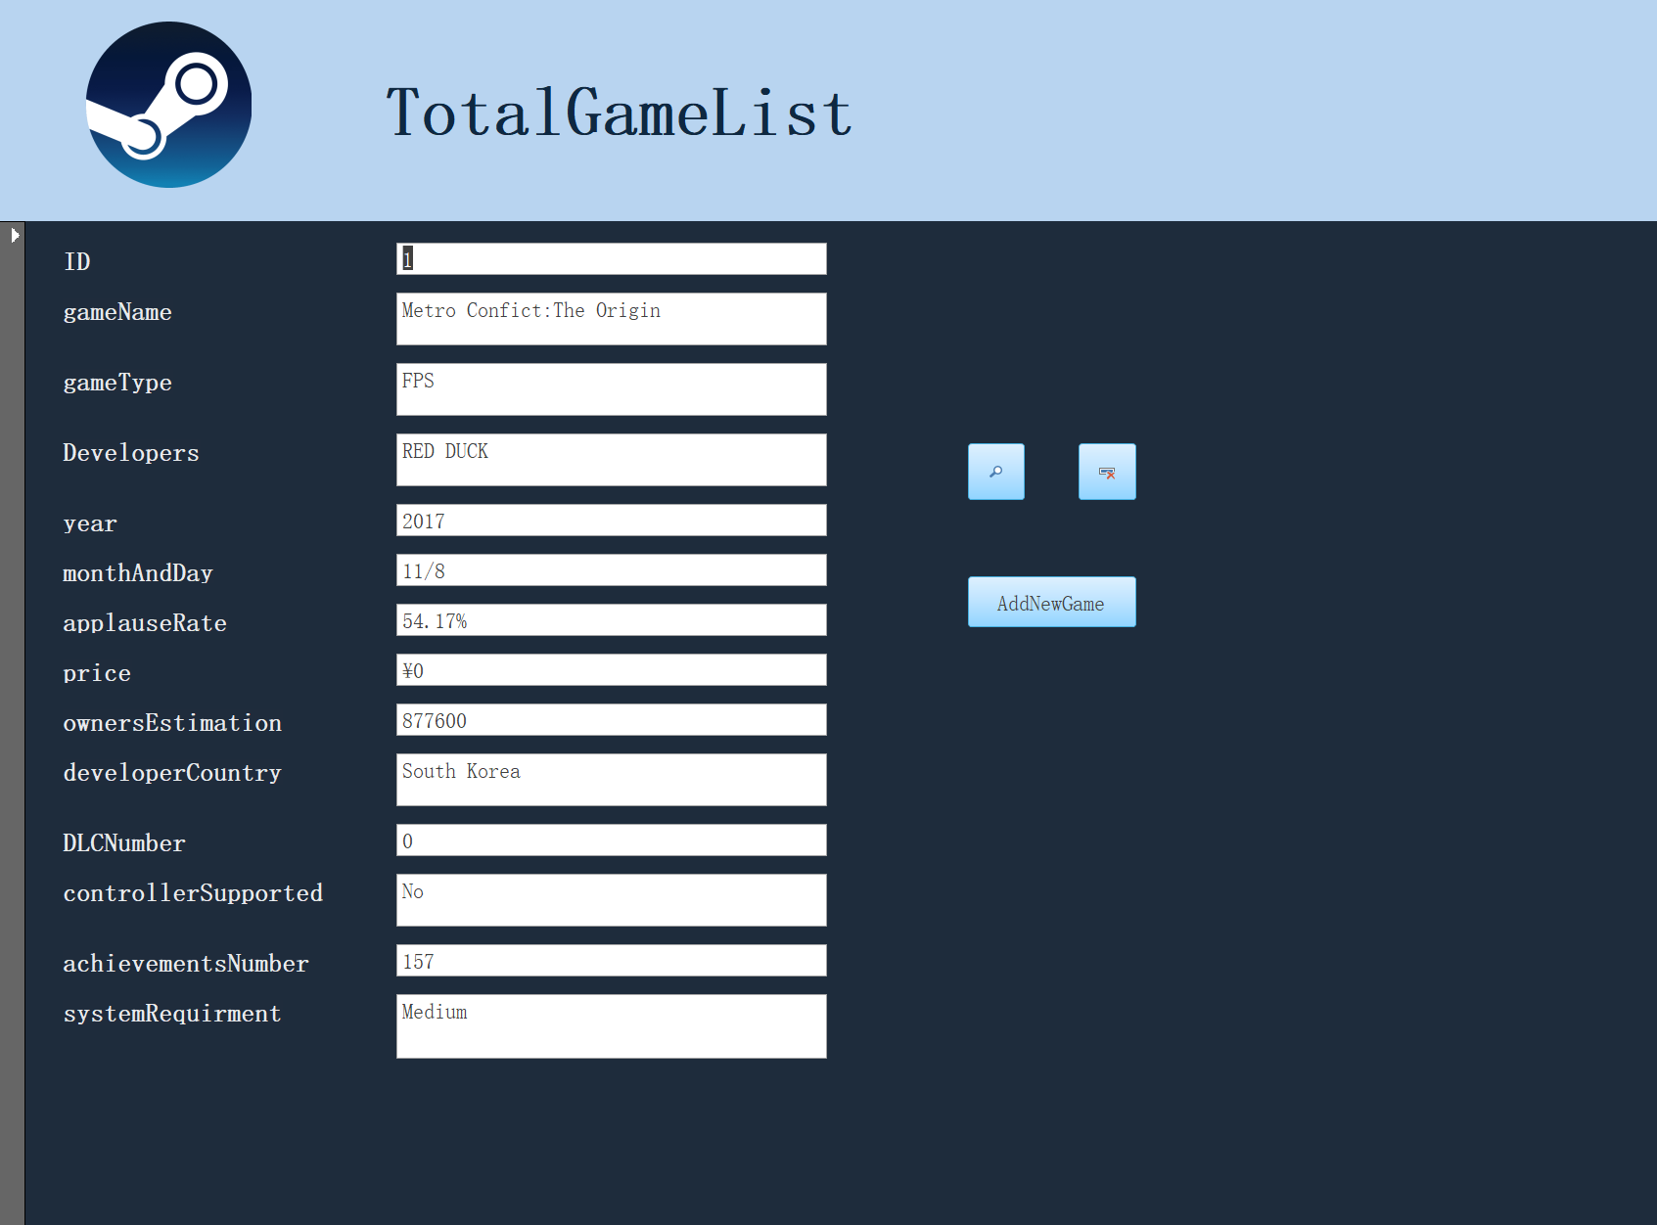

Slide 28
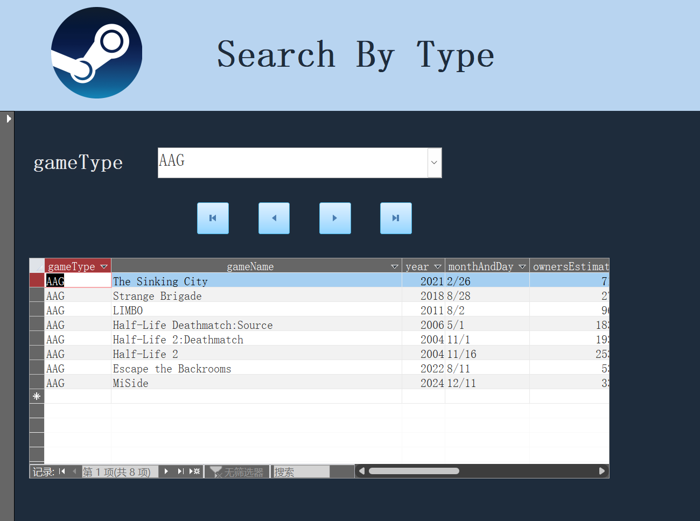

Slide 29
Report

Slide 30
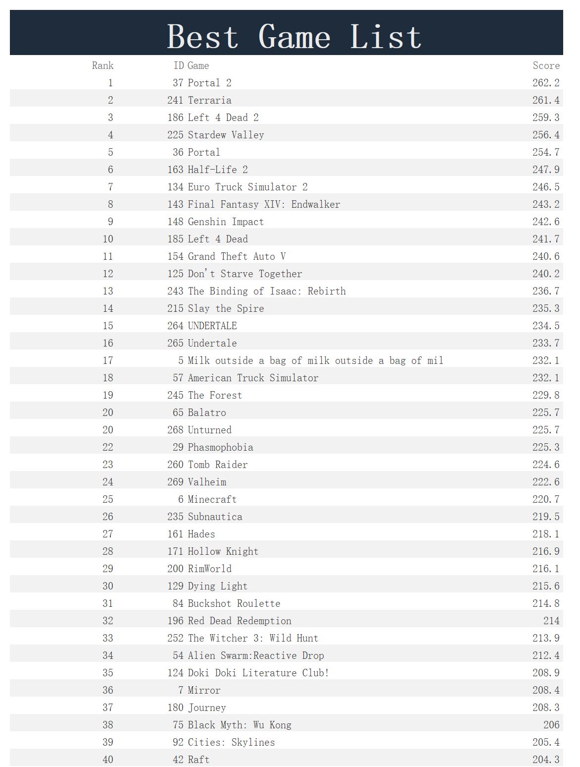

Slide 31
Thank You!

