Slide 1

ISE 333: User Interface Development (Design)
Practice Overview
Spring 2026
Instructor: Hao Li

Slide 2
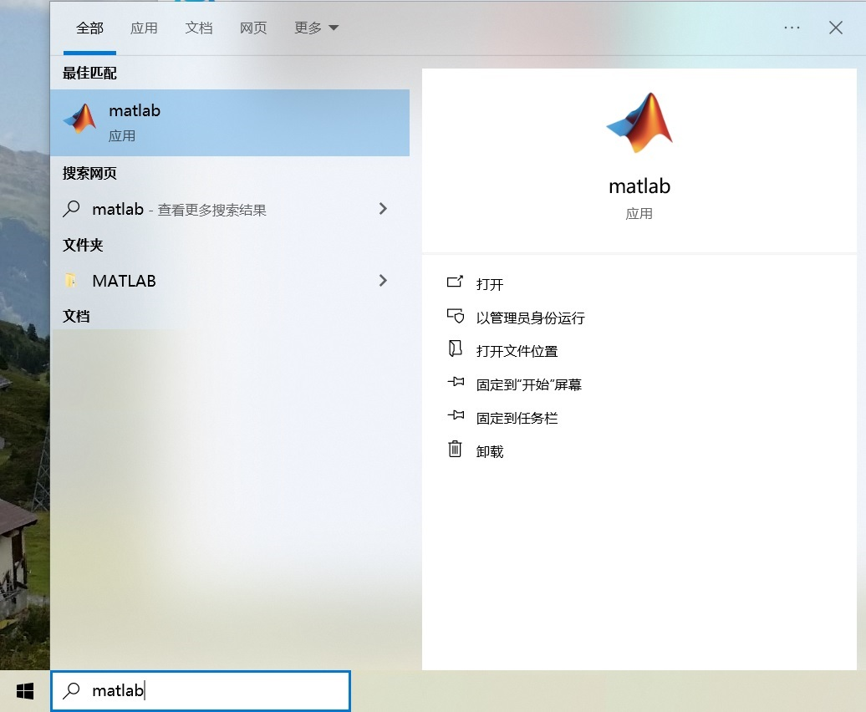
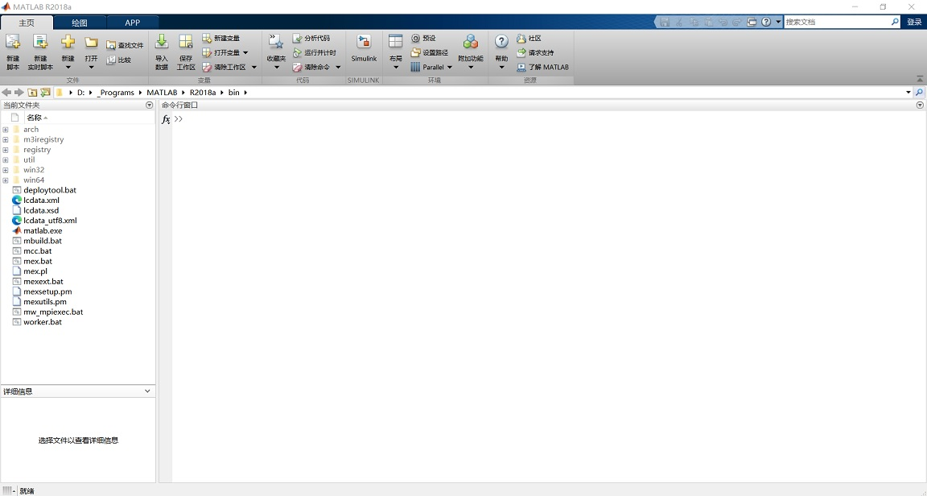
Practice Overview
Why Matlab?
  A powerful, comprehensive, and suitable platform for teaching purpose

Slide 3
Practice Overview
Why Matlab?
  A powerful, comprehensive, and suitable platform for teaching purpose
Practice Topics
  Matlab basics
  UI-oriented image processing
  UI-oriented computational geometry
  Projective geometry and camera model
  UI-oriented simple simulation/animation generation
  Linux/CLI UI (contingent on future conditions)
Practice Objective
  Obtain a basic working knowledge of graphical UI primary development as well as secondary development

Slide 4
ISE 333: User Interface Development (Design)
Practice 1: Matlab Basics
Spring 2026
Instructor: Hao Li

Slide 5
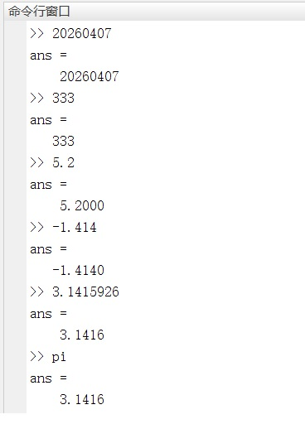
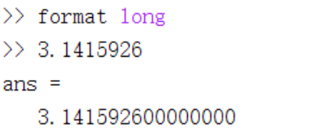
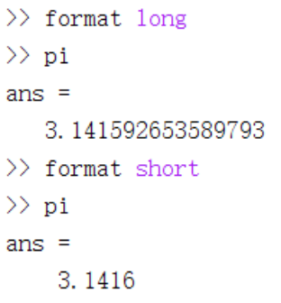
Numbers
Directly-Specified Constant Numbers
Special symbols

Slide 6
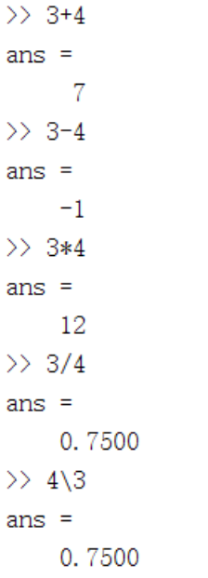
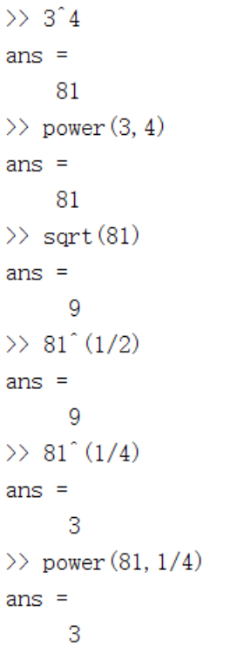
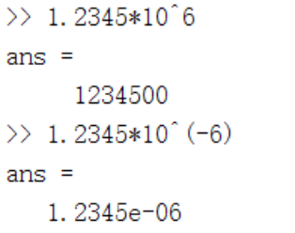
Numbers
Arithmetic Operations
  Addition +
  Subtraction -
  Multiplication *
  Division / or \
  Power ^ or power()
  Root sqrt, ^ or power()
  Scientific notation

Slide 7
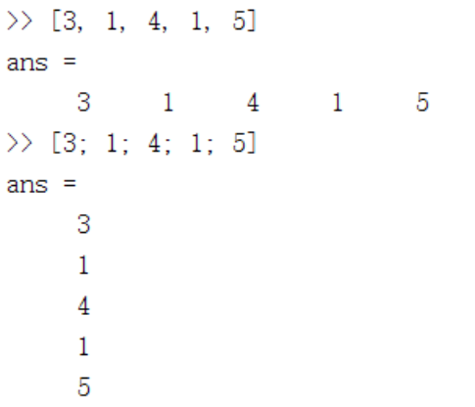
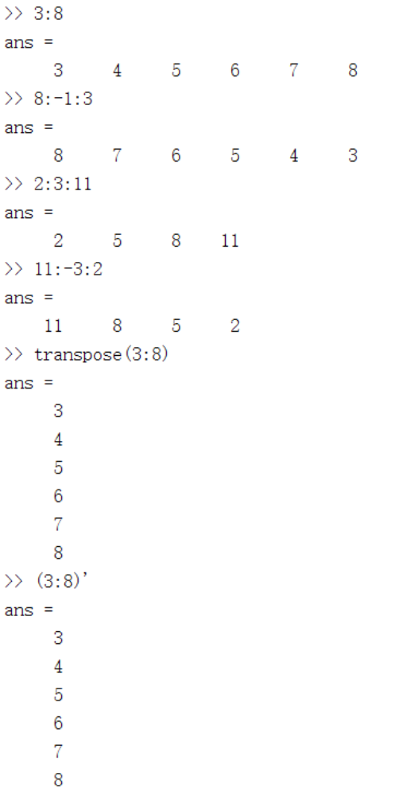
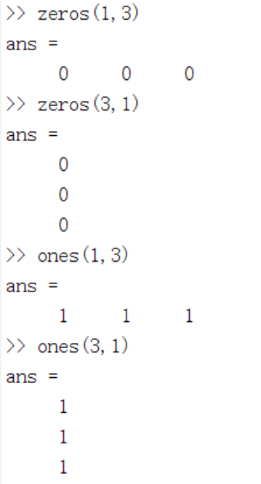
Numbers
Vectors
  Row vectors [num1, ... , num_k]
    Separated by ,
  Column vectors [num1; ... ; num_k]
    Separated by ;
  Regular vectors
    zeros()
    ones()
    Arithmetic progression

Slide 8
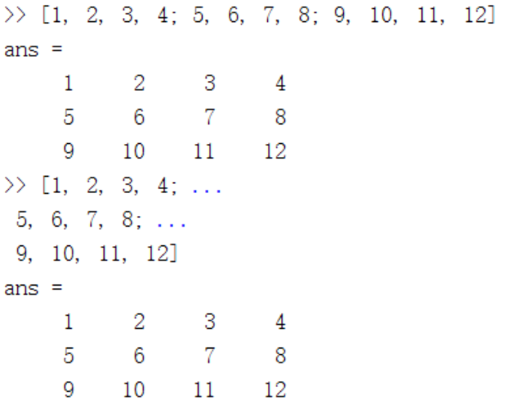
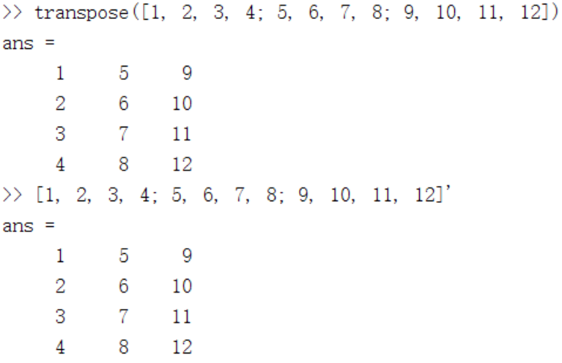
Numbers
Matrices
  [A11, ... , A1n; ... ... ; Am1, ... , Amn]
    Elements separated by ,
    Rows separated by ;
  Coding line continuing mark ...
  Transpose
    Attention: For complex matrices, transpose() and ‘ mean different things
... means continuing the line

Slide 9
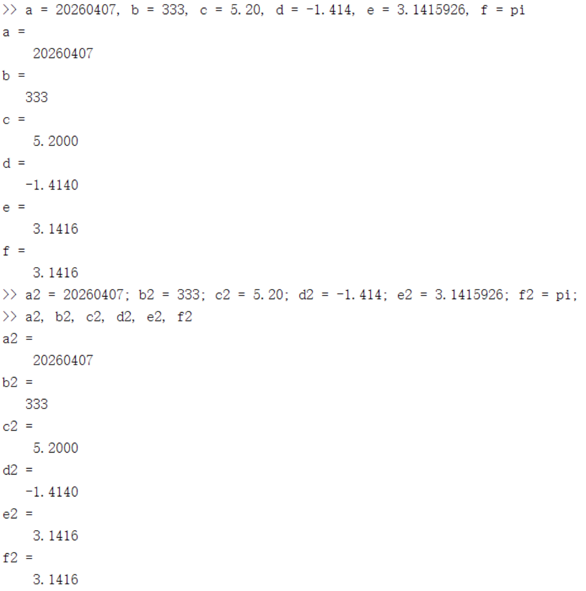
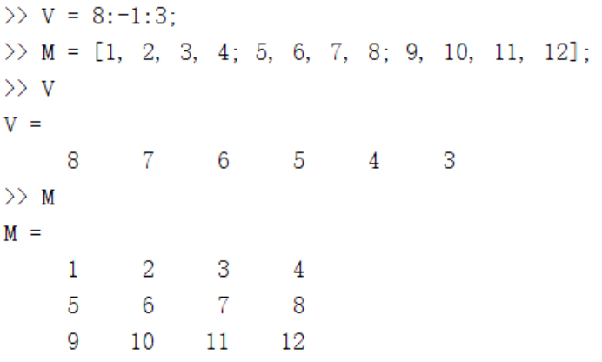
Variables
Direct Assignment and Usage
Commands separated by ,
Commands separated by ;

Slide 10
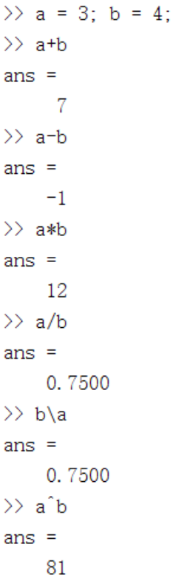
Variables
Arithmetic Operations
  Addition +
  Subtraction -
  Multiplication *
  Division / or \
  Power ^ or power()
  Root sqrt, ^ or power()

Slide 11
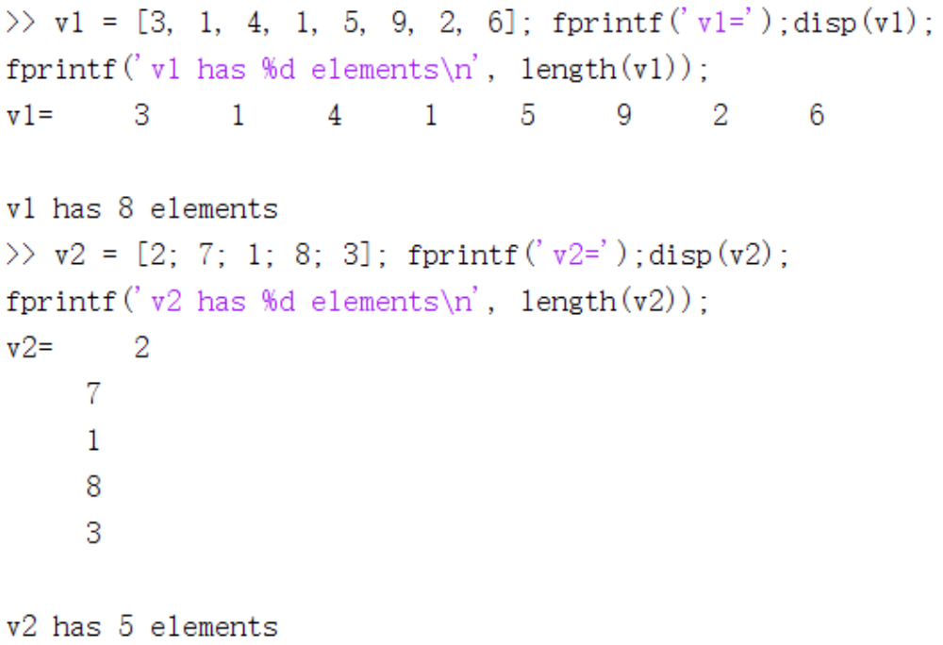
Retrieval of Variable Properties
Variable Length
  length()
Matrix Dimensions

Slide 12
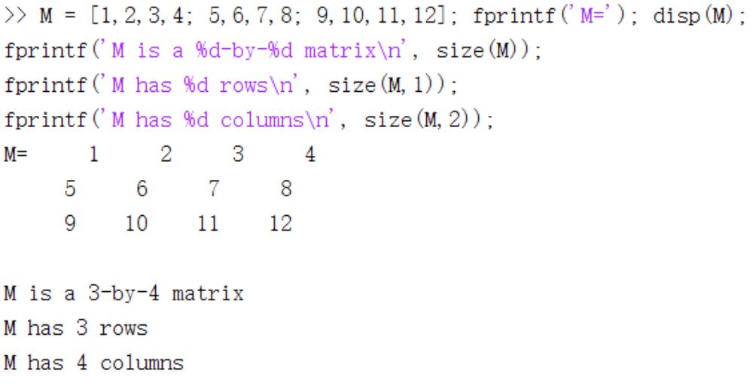
Retrieval of Variable Properties
Variable Length
  length()
Matrix Dimensions
  size()
  size( , {DIM})
    size(, 1) : Row number
    size(, 2) : Column number
    size(, 3) : Channel number
    ... ...

Slide 13
Types of Execution (Control Flow)
Sequential Execution
Conditional Execution / Selection
Loop Execution / Looping / Iteration
Function Call

Slide 14
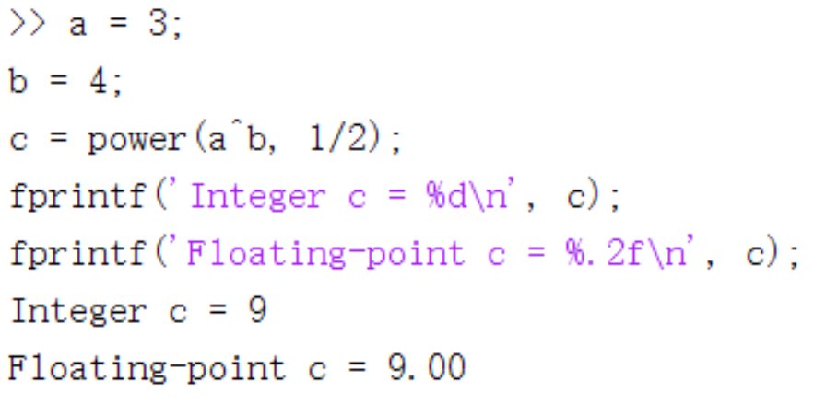
Types of Execution (Control Flow)
Sequential Execution
  Separated into different lines
    Command_1
    Command_2
    Command_3
    ... ...
  Separated by the comma ,
    Command_1, Command_2, Command_3, ... ...
    Displaying execution results
  Separated by the semicolon ;
    Command_1; Command_2; Command_3; ... ...
    Not displaying execution results
    Command_1 ;
    Command_2 ;
    Command_3 ;
    ... ...

Slide 15
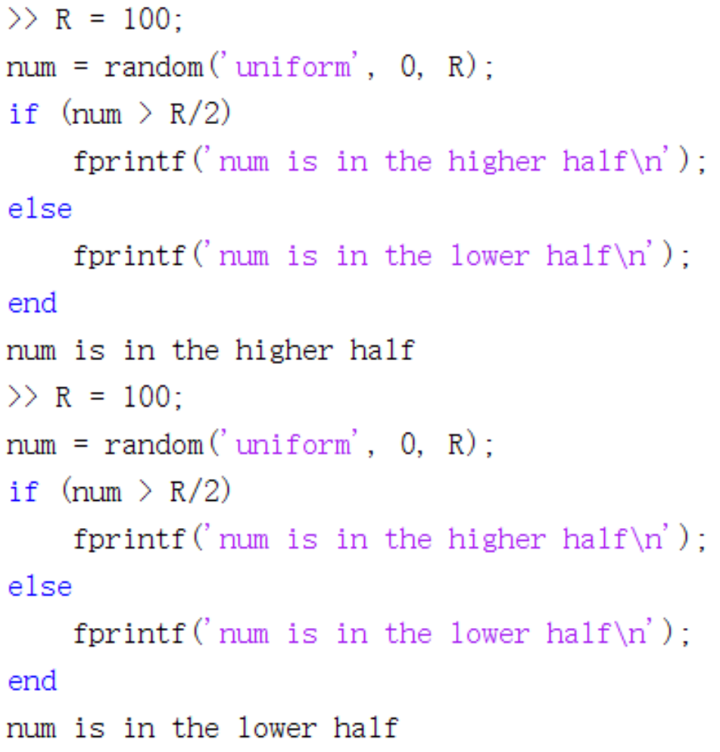
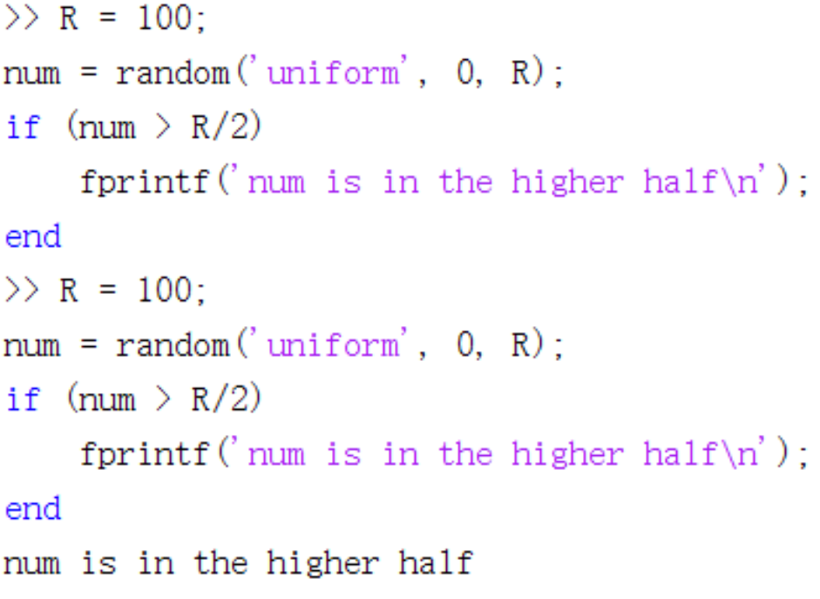
Types of Execution (Control Flow)
Conditional Execution
  if ... ... end
  if ... ... else ... ... end

Slide 16
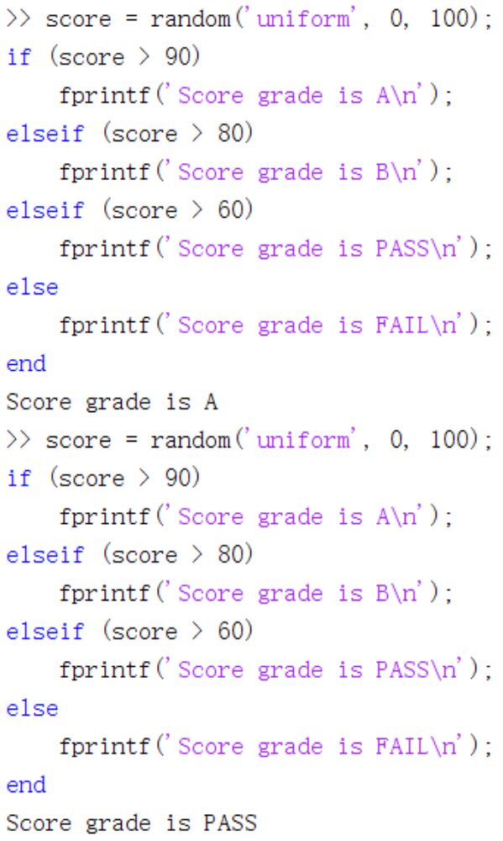
Types of Execution (Control Flow)
Conditional Execution
  if ... ... end
  if ... ... else ... ... end
  if ... ... elseif ... ... else ... ... end

Slide 17
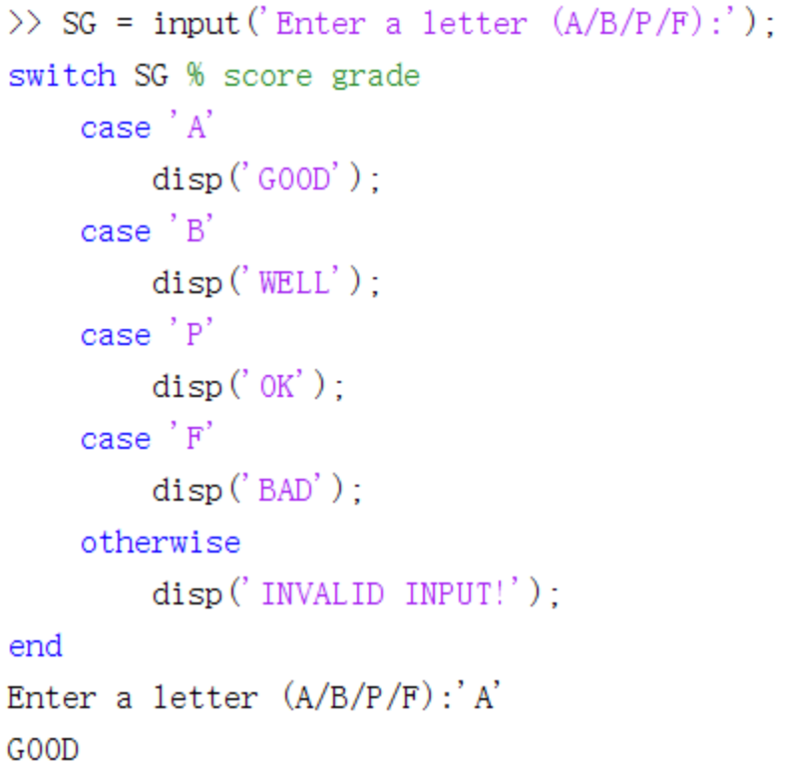
Types of Execution (Control Flow)
Conditional Execution
  if ... ... end
  if ... ... else ... ... end
  if ... ... elseif ... ... else ... ... end
  switch ... ... case ... ... otherwise ... ... end
    Suitable to concrete values instead of ranges

Slide 18
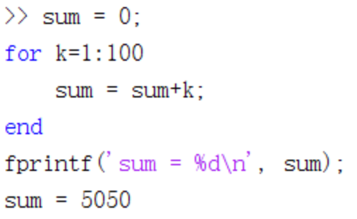
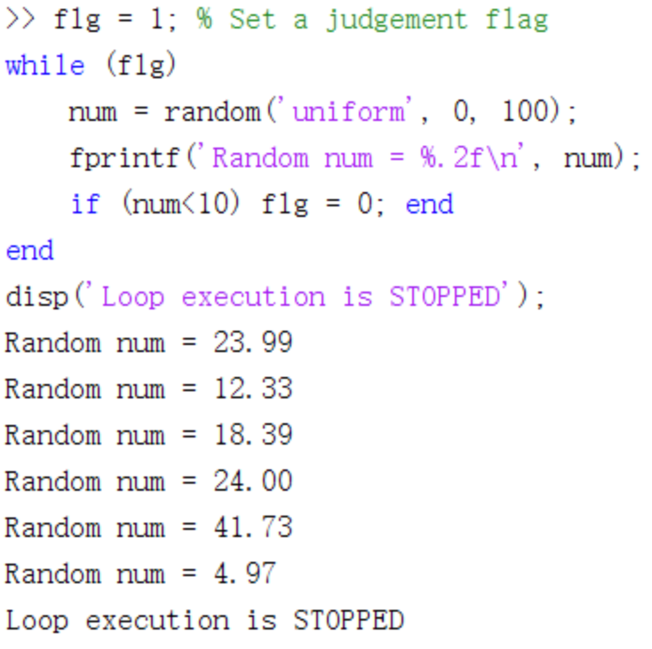
Types of Execution (Control Flow)
Loop Execution
  for var={RANGE} ... ... end
  while {CONDITION} ... ... end

Slide 19
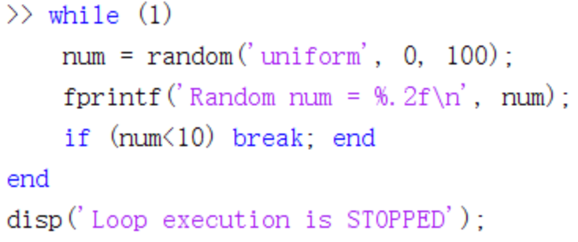
Types of Execution (Control Flow)
Loop Execution
  for var={RANGE} ... ... end
  while {CONDITION} ... ... end
  break stops the immediate loop

Slide 20
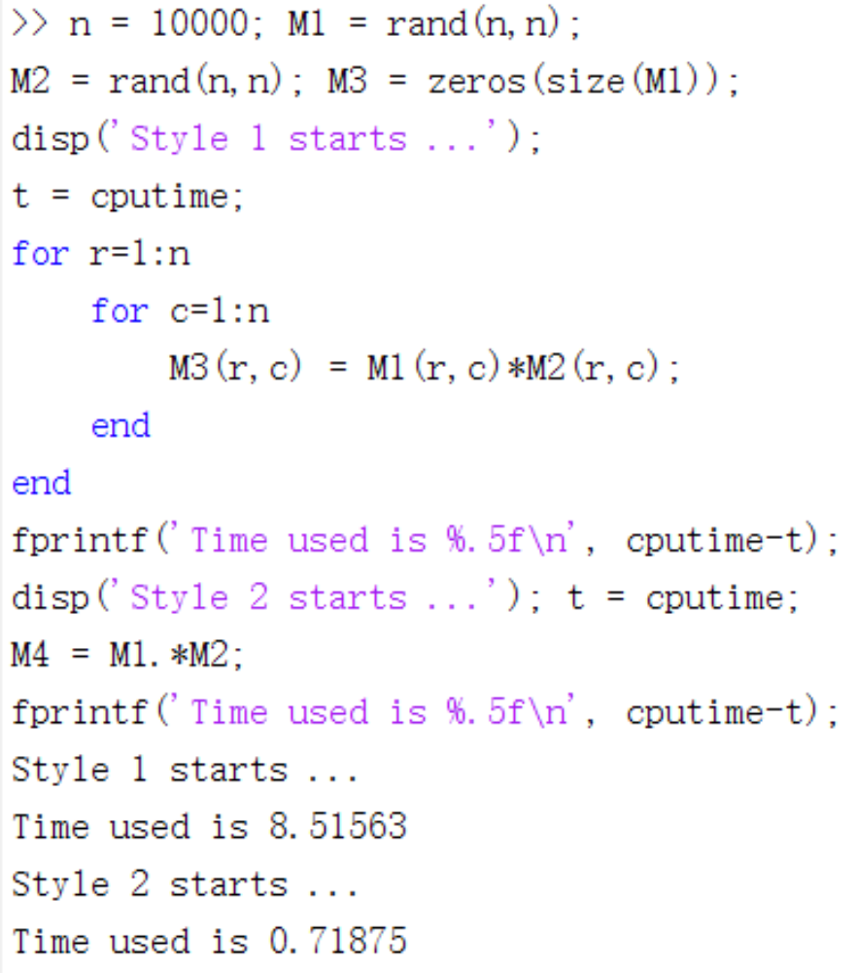

Types of Execution (Control Flow)
Loop Execution
  for var={RANGE} ... ... end
  while {CONDITION} ... ... end
  break stops the immediate loop
Advice on Matlab Loop Execution
  Matlab looping is slow
  Use matrix-oriented processing
    Dot . means element-wise processing

Slide 21
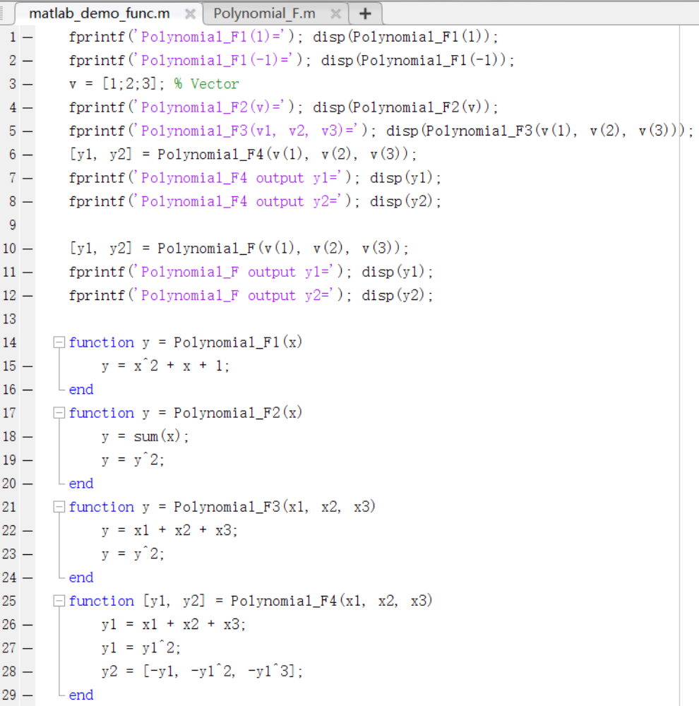
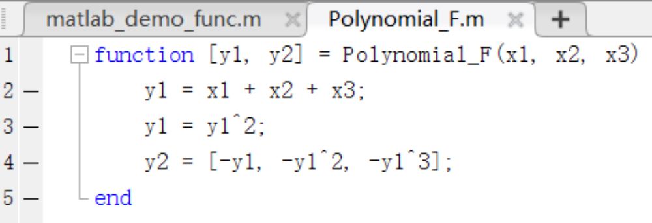
Types of Execution (Control Flow)
Function Call
  function out={F}(in) ... ... end
  At the script end
    For internal call/invocation
  In a separate script
    For external call/invocation

Slide 22
DISCUSSION
Q & A

Slide 23
Matrix Computation
Matrix Definition Review
  [A11, ... , A1n; ... ... ; Am1, ... , Amn]
    Elements separated by ,
    Rows separated by ;
  Coding line continuing mark ...
  Transpose
    Attention: For complex matrices, transpose() and ‘ mean different things
... means continuing the line

Slide 24
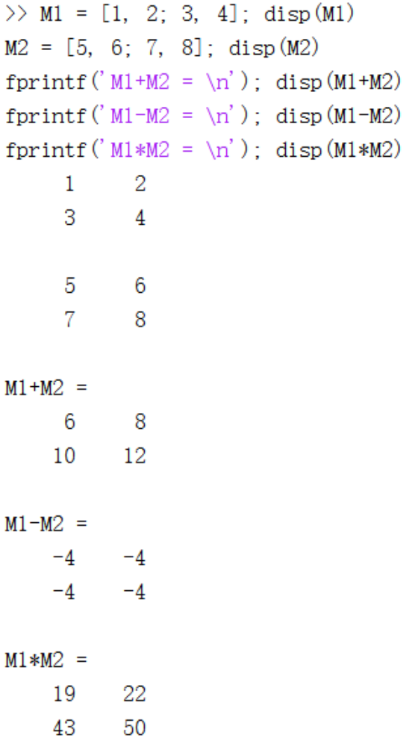
Matrix Computation
Arithmetic Operations
  Addition +
  Subtraction -
  Multiplication *
  Attention: Dimension consistency

Slide 25
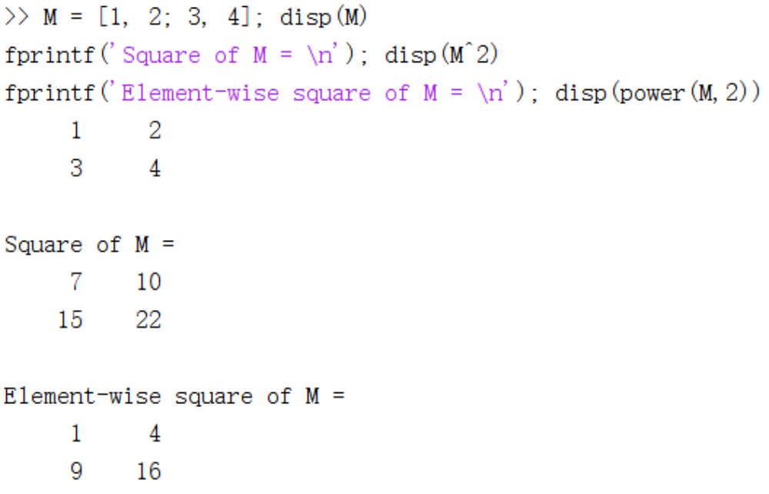
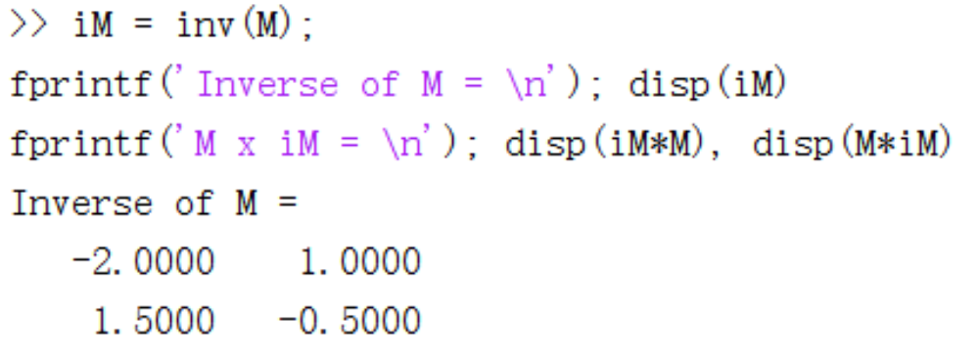
Matrix Computation
Arithmetic Operations
  Addition +
  Subtraction -
  Multiplication *
Square Matrix Operations
  Power ^
    Attention: Not power()
  Inverse inv() or ^(-1)

Slide 26
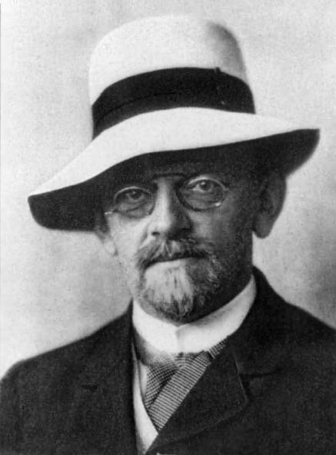
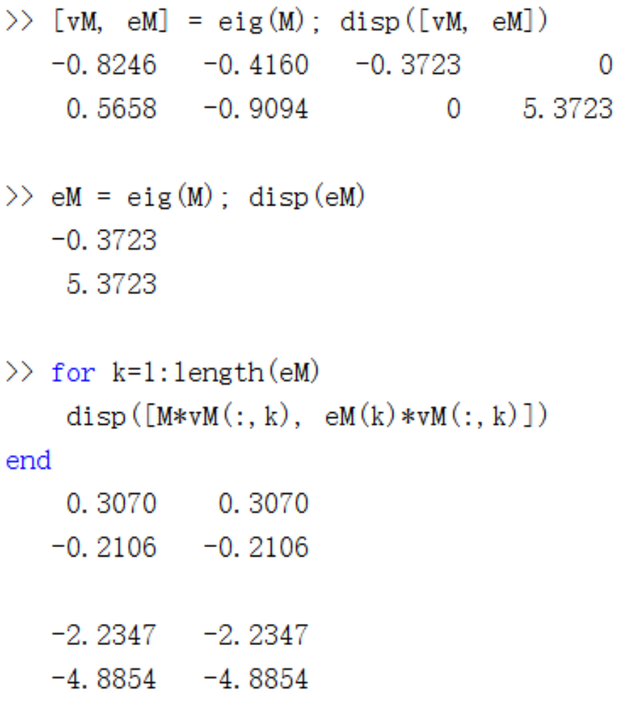
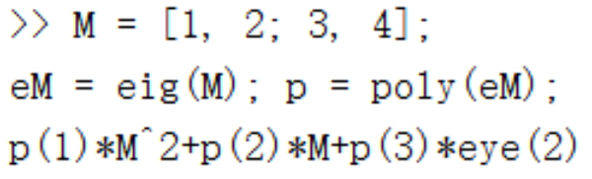
Matrix Computation
Square Matrix Operations
  Power ^
  Inverse inv() or ^(-1)
  Eigenvalue eig()
  Characteristic poly()
Amazing characteristic polynomial
Eigenwert

Slide 27
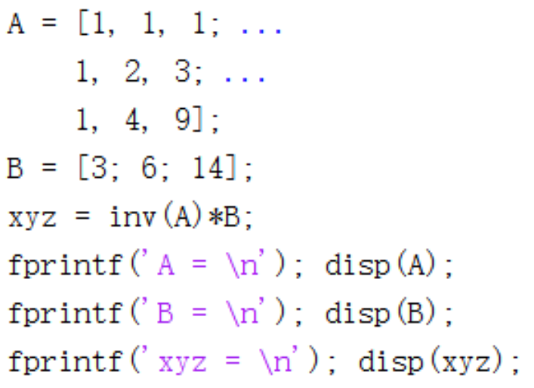
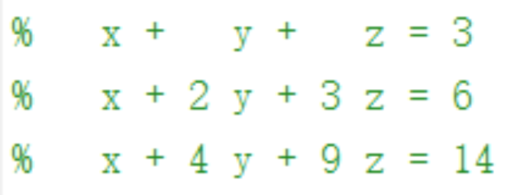
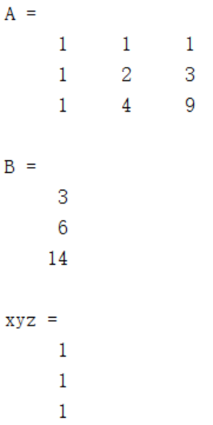
Matrix Computation
Linear Equation Solving
  xyz = inv(A)*B

Slide 28
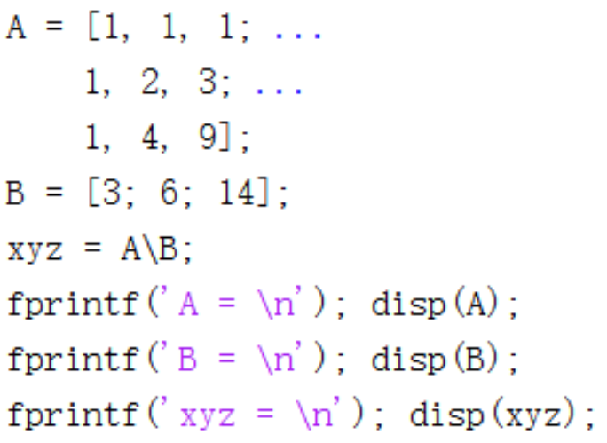
Matrix Computation
Linear Equation Solving
  xyz = A\B

Slide 29
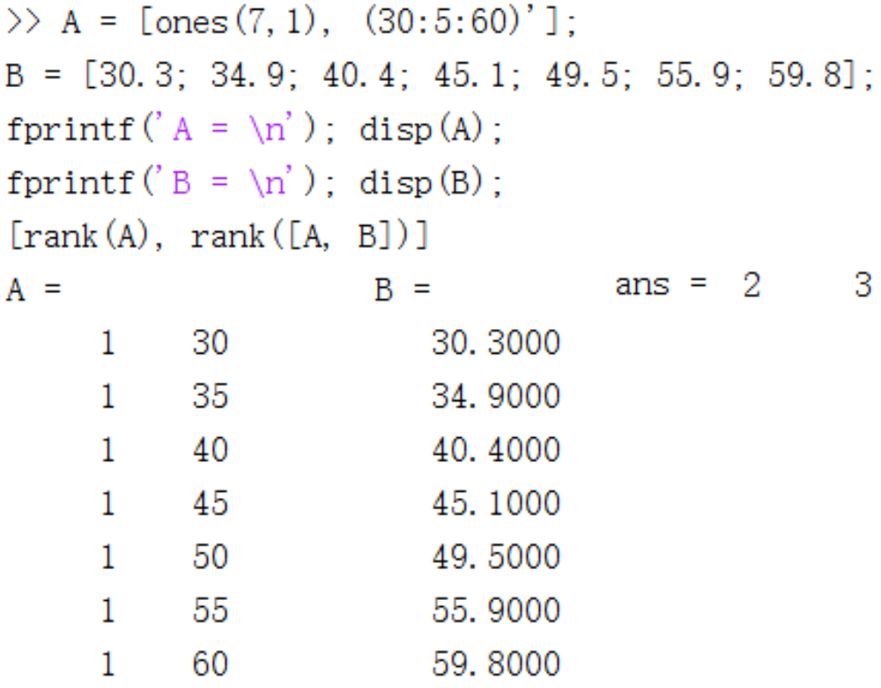
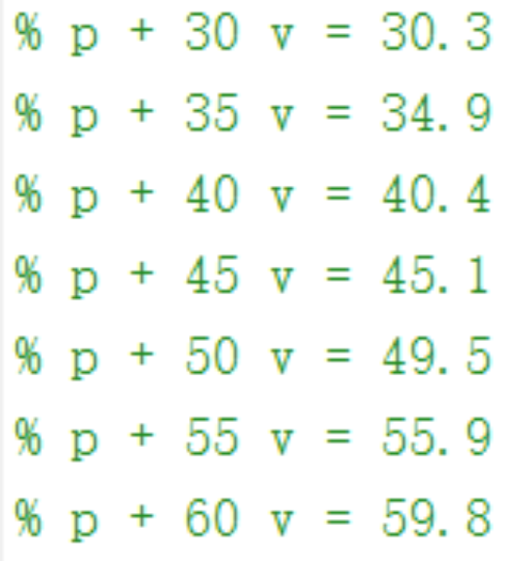
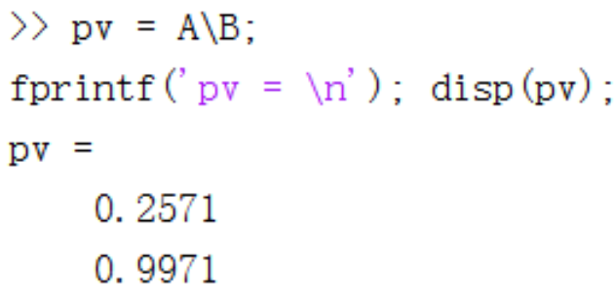
Matrix Computation
Linear Equation Solving
  pv = A\B

Slide 30

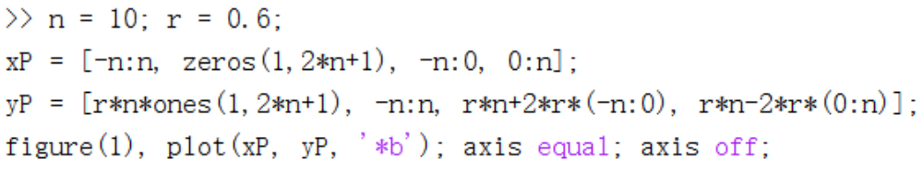
Matrix Computation
Matrix-Oriented Processing

Slide 31
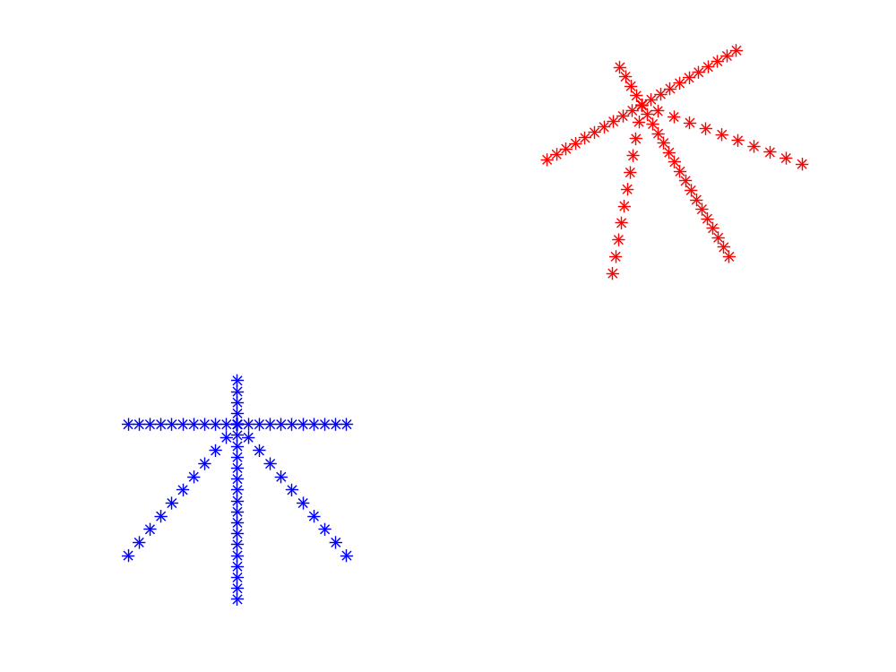
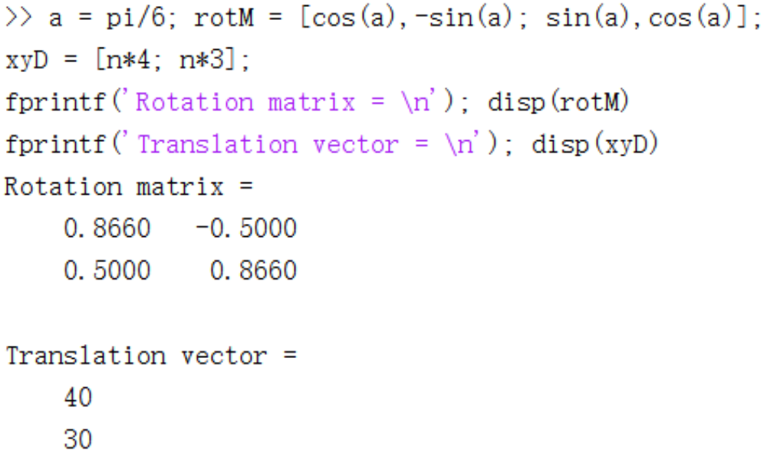
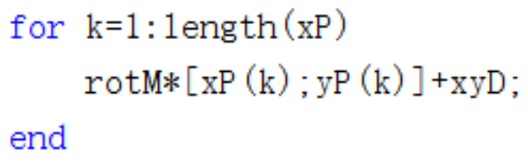
Matrix Computation
Matrix-Oriented Processing

Slide 32
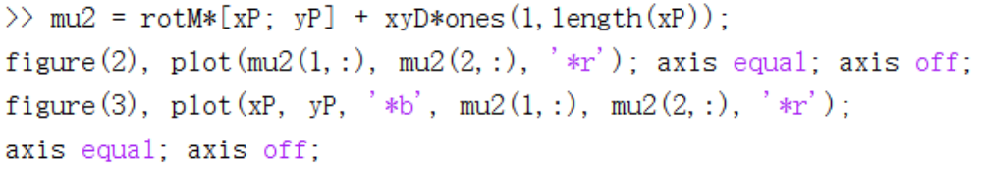
Matrix Computation
Matrix-Oriented Processing

Slide 33
DISCUSSION
Q & A

