Slide 1


String Data Type
String Data Type

Slide 2
Objectives:
String variable example
String is immutable
String concatenation
Some important String methods
Special characters
String substring methods
String equals method
Formatted output
Notes:
Immutable 不可改动

Slide 3
The String Type
The char type only represents one character.
To represent a string of characters, use the data type called String.
String message = "Welcome to Java";
String is a predefined class in the Java library just like the System class
The String type is NOT a primitive type.
The String type is a reference type.
A String variable is a reference variable, an "address" which points to an object storing the value or actual text

Slide 4
More about Strings
Each character is stored at an index:
String sentence = "A statement";
012345678910
The String class has methods to process strings:
System.out.println("charAt(6) is " + sentence.charAt(6));
System.out.println(sentence.toUpperCase());
System.out.println(sentence.substring(0,7) + sentence.substring(9));

Slide 5
Strings are immutable!
There are no methods to change them once they have been created
any new assignment will assign a new String to the old variable
String word = "Steven";
word = word.substring(0, 5);
the variable word is now a reference to a new String that contains "Steve"

Slide 6
byte b1
byte b2
short s1
int i1
long l1
String a

Slide 7
byte b1
Example: Drawers and Shelves
112
byte b2
-37
short s1
Shelf 6, Level 3, Book 12
“The quick brown fox jumps over the lazy dog”
62,105
int i1
114,751,251
long l1
12484214746328914…
String a
Shelf 6,
Level 3,
Book 12

Slide 8
String Concatenation
“+” is used for making a new string by concatenating strings:
// Three strings are concatenated
String message = "Welcome " + "to " + "Java";
// String Chapter is concatenated with number 2
String s = "Chapter" + 2; // s becomes Chapter2
// String Supplement is concatenated with character B
String s1 = "Supplement" + 'B';
// s1 becomes SupplementB

Slide 9
Useful String functions
charAt, equals, equalsIgnoreCase, compareTo, startsWith, endsWith, indexOf, lastIndexOf, replace, substring, toLowerCase, toUpperCase, trim
s.equals(t)
returns true if s and t have same letters and sequence
false otherwise

Slide 10
Special Characters
\n – newline
\t – tab
\" – quotation mark
Example:
String s = "<img src=\"./pic.jpg\" />";
System.out.print(s + "\n");

Slide 11
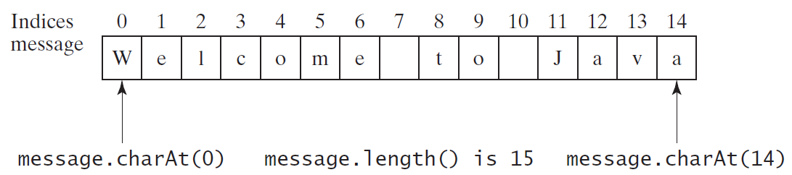
Getting Characters from a String
String message = "Welcome to Java";
System.out.println(
"The first character in message is "
+ message.charAt(0));
Notes:
Class 01 ended here last week

Slide 12
Reading a String from the Console
Scanner input = new Scanner(System.in);
System.out.print("Enter three words separated by spaces:");
String s1 = input.next();
String s2 = input.next();
String s3 = input.next();
System.out.println("s1 is " + s1);
System.out.println("s2 is " + s2);
System.out.println("s3 is " + s3);

Slide 13
Reading a Character from the Console
Scanner input = new Scanner(System.in);
System.out.print("Enter a character: ");
String s = input.nextLine();
char ch = s.charAt(0);
System.out.print("The character entered is "+ch);

Slide 14
Comparing Strings
Don’t use ‘==’ to compare Strings
it compares their memory addresses and not actual strings (character sequences)
Instead use the equals method supplied by the String class

Slide 15
Comparing Strings: Example1
String word1 = new String("Hello");
String word2 = new String("Hello");
if (word1 == word2){
System.out.println(true);
} else {
System.out.println(false);
}
Result?

Slide 16
Comparing Strings: Example1
String word1 = new String("Hello");
String word2 = new String("Hello");
if (word1 == word2){
System.out.println(true);
} else {
System.out.println(false);
}
Result? false
Because: two different addresses

Slide 17
Comparing Strings: Example2
String word1 = new String("Hello");
String word2 = new String("Hello");
if (word1.equals(word2)){
System.out.println(true);
} else {
System.out.println(false);
}
Result?

Slide 18
Comparing Strings: Example2
String word1 = new String("Hello");
String word2 = new String("Hello");
if (word1.equals(word2)){
System.out.println(true);
} else {
System.out.println(false);
}
Result? true

Slide 19
Comparing Strings: Example3
String word1 = "Hello";
String word2 = "Hello";
if (word1 == word2){
System.out.println(true);
} else {
System.out.println(false);
}
Result ?

Slide 20
Comparing Strings: Example3
String word1 = "Hello";
String word2 = "Hello";
if (word1 == word2){
System.out.println(true);
} else {
System.out.println(false);
}
Result ? true
Interned Strings: Only one instance of "Hello" is stored
word1 and word2 will have the same address
Notes:
Java checks string pool
Class 02 ended here last week

Slide 21
Comparing Strings: Methods
Notes:
如果第一个字符和参数的第一个字符不等，结束比较，返回第一个字符的ASCII码差值。
如果第一个字符和参数的第一个字符相等，则以第二个字符和参数的第二个字符做比较，以此类推,直至不等为止，返回该字符的ASCII码差值。 如果两个字符串不一样长，可对应字符又完全一样，则返回两个字符串的长度差值。

Slide 22
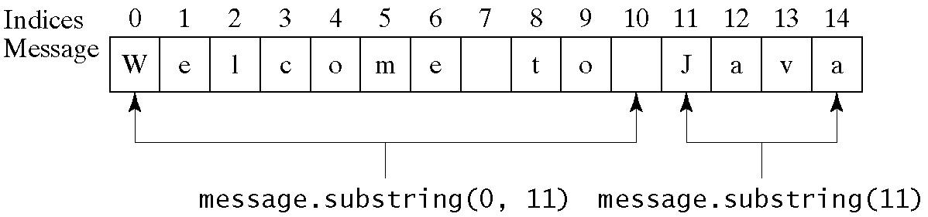
Obtaining Substrings

Slide 23
Finding a Character or a Substring in a String

Slide 24
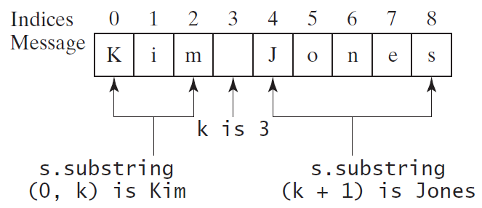
Finding a Character or a Substring in a String
int k = s.indexOf(' '); //3
String firstName = s.substring(0, k);
String lastName = s.substring(k + 1);

Slide 25
Conversion between Strings and Numbers
String intString = "15";
String doubleString = "56.77653";
int intValue =
Integer.parseInt(intString);
double doubleValue =
Double.parseDouble(doubleString);
String s2 = "" + intValue;

Slide 26
Formatting Output
The printf statement:
System.out.printf(format, items);
format is a string that may consist of substrings and format specifiers
A format specifier begins with a percent sign and specifies how an item should be displayed: a numeric value, character, boolean value, or a string

Slide 27
Frequently-Used Specifiers
Specifier Output Example
%b a boolean value true or false
%c a character 'a'
%d a decimal integer 200
%f a floating-point number 45.460000
%e a number in standard scientific notation 4.556000e+01
%s a string "Java iscool"

Slide 28
Formatting output: Example

