Slide 1


Iterations
Iterations
Notes:
Iteration (eteration) 迭代 word origin: to repeatedly do something

Slide 2
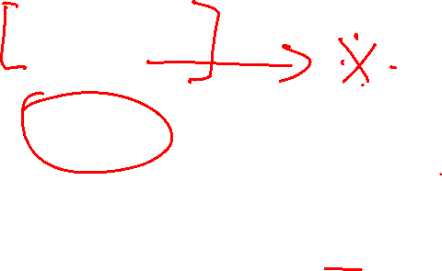
Objectives:
Motivation of iterations
What is an iteration?
while loop
do-while loop
for loop
break
continue

Slide 3
Motivation
Suppose that you need to print a string (e.g., "Welcome to Java!") a user-defined times N:
System.out.println("Welcome to Java!");
...
System.out.println("Welcome to Java!");
While loop:
int count = 0;
while (count < N) {
System.out.println("Welcome to Java");
count++;
}
N?

Slide 4

What is Iteration?
Repeating a set of instructions a specified number of times or until a specific result is achieved
How do we repeat steps?
Imagine 3 instructions A, B, & C:
Instruction A
Instruction B
Instruction C can be jump A (meaning go back to A)
Iteration might result in:
Execute A
Execute B
Execute C
Execute A
Execute B
...

Slide 5
Why use Iteration?
To make our code more practical and efficient
To make our code more flexible and dynamic
Example:
How would we write code to print N! (factorial), where N is a number entered by the user?
Without iteration (or recursion) this would be impractical
We do not know N, when we are about to write the program

Slide 6

Without iteration or recursion
System.out.print("Enter n: ");
int n = input.nextInt();
int factorial = 1;
if ((n == 1) || (n == 0)) factorial = 1;
else if (n == 2) factorial = 2 * 1;
else if (n == 3) factorial = 3 * 2 * 1;
else if (n == 4) factorial = 4 * 3 * 2 * 1;
else if (n == 5) factorial = 5 * 4 * 3 * 2 * 1;
…
System.out.println(factorial);
Inefficient coding (repetition)!

Slide 7

With iteration
System.out.print("Enter n: ");
int n = input.nextInt();
int factorial = 1;
int i = 1;
while(i <= n){
factorial *= i;
i++;
}
System.out.println(factorial);

Slide 8

Java and iteration
We have 3 types of iterative statements
a while loop
a do … while loop
a for loop
All 3 can be used to do similar things
Which one should you use?
a matter of individual preference/convenience

Slide 9
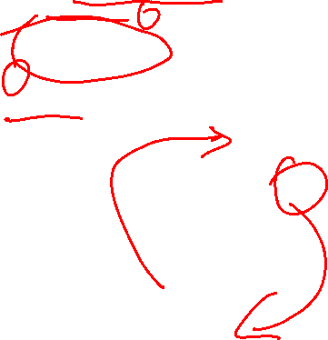
while Loop Flow Chart
int count = 0;
while (count < 100) {
System.out.println("Welcome to Java!");
count++;
}
while (loop-continuation-condition) {
// loop-body;
Statement(s);
}
Notes:
Class 01 ended here 03/10

Slide 10
Trace while Loop
int count = 0;
while (count < 2) {
System.out.println("Welcome to Java!");
count++;
}

Slide 11
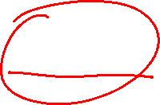
Trace while Loop
Initialize count
int count = 0;
while (count < 2) {
System.out.println("Welcome to Java!");
count++;
}

Slide 12

Trace while Loop
(count < 2) is true
int count = 0;
while (count < 2) {
System.out.println("Welcome to Java!");
count++;
}

Slide 13
Trace while Loop
Print Welcome to Java
int count = 0;
while (count < 2) {
System.out.println("Welcome to Java!");
count++;
}

Slide 14
Trace while Loop
int count = 0;
while (count < 2) {
System.out.println("Welcome to Java!");
count++;
}
Increase count by 1
count is 1 now

Slide 15
Trace while Loop
(count < 2) is still true since count is 1
int count = 0;
while (count < 2) {
System.out.println("Welcome to Java!");
count++;
}

Slide 16
Trace while Loop
Print Welcome to Java
int count = 0;
while (count < 2) {
System.out.println("Welcome to Java!");
count++;
}

Slide 17
Trace while Loop
Increase count by 1
count is 2 now
int count = 0;
while (count < 2) {
System.out.println("Welcome to Java!");
count++;
}

Slide 18
Trace while Loop
(count < 2) is false since count is 2 now
int count = 0;
while (count < 2) {
System.out.println("Welcome to Java!");
count++;
}

Slide 19
Trace while Loop
int count = 0;
while (count < 2) {
System.out.println("Welcome to Java!");
count++;
}
The loop exits. Execute the next statement after the loop.
Notes:
Class 02 ends here 03/10

Slide 20
do-while Loop
do {
// Loop body;
Statement(s);
} while (loop-continuation-condition);

Slide 21
Why use do … while?
For when you have a loop body that must execute at least once.
Example: a program menu
Scanner in = new Scanner(System.in);
String selection;
int counter = 0;
do{
System.out.println("Choose a Menu Option:");
System.out.println("P) Print Counter");
System.out.println("Q) Quit");
System.out.print("ENTER: ");
selection = in.nextLine();
if (selection.toUpperCase().equals("P"))
System.out.println("Counter: " + counter++);
}while(!selection.toUpperCase().equals("Q"));
System.out.println("Goodbye!");

Slide 22
Why use do … while? Contd..
An Example Session
Choose a Menu Option:
P) Print Counter
Q) Quit
ENTER: P
Counter: 0
Choose a Menu Option:
P) Print Counter
Q) Quit
ENTER: A
Choose a Menu Option:
P) Print Counter
Q) Quit
ENTER: P
Counter: 1
Choose a Menu Option:
P) Print Counter
Q) Quit
ENTER: Q
Goodbye!

Slide 23
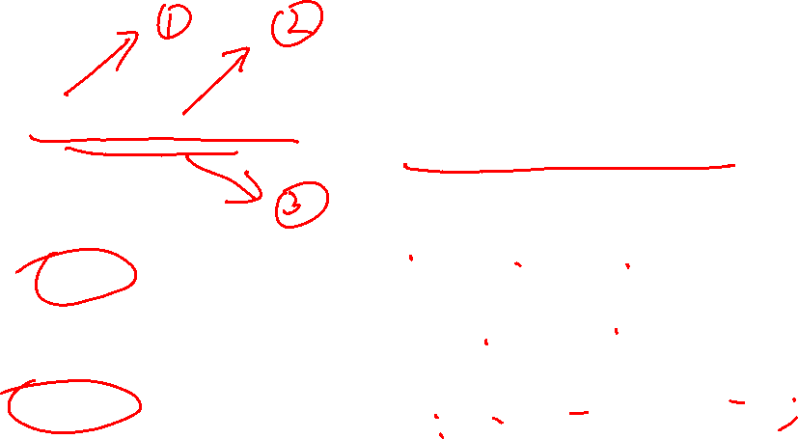
for Loops
for (initial-action;
loop-continuation-condition;
action-after-each-iteration) {
// loop body;
Statement(s);
}
int i;
for (i = 0; i < 100; i++){
System.out.println("Welcome to Java!");
}

Slide 24
Notes:
End of class 02 on 10/15 (do-while skipped)

Slide 25
for loops and counting
for loops are popular for counting loops
through the indices of a string
through the indices of an array (later)
through iterations of an algorithm
Good for algorithms that require a known number of iterations
counter-controlled loops

Slide 26
Trace for Loop
Declare i
int i;
for (i = 0; i < 2; i++) {
System.out.println(
"Welcome to Java!");
}

Slide 27
Trace for Loop
Execute initializer
i is now 0
int i;
for (i = 0; i < 2; i++) {
System.out.println(
"Welcome to Java!");
}

Slide 28
Trace for Loop
(i < 2) is true
since i is 0
int i;
for (i = 0; i < 2; i++) {
System.out.println(
"Welcome to Java!");
}

Slide 29
Trace for Loop
Print Welcome to Java
int i;
for (i = 0; i < 2; i++) {
System.out.println(
"Welcome to Java!");
}

Slide 30
Trace for Loop
Execute adjustment statement
i now is 1
int i;
for (i = 0; i < 2; i++) {
System.out.println(
"Welcome to Java!");
}

Slide 31
Trace for Loop
(i < 2) is still true
since i is 1
int i;
for (i = 0; i < 2; i++) {
System.out.println(
"Welcome to Java!");
}

Slide 32
Trace for Loop
Print Welcome to Java
int i;
for (i = 0; i < 2; i++) {
System.out.println(
"Welcome to Java!");
}

Slide 33
Trace for Loop
Execute adjustment statement
i now is 2
int i;
for (i = 0; i < 2; i++) {
System.out.println(
"Welcome to Java!");
}

Slide 34
Trace for Loop
(i < 2) is false
since i is 2
int i;
for (i = 0; i < 2; i++) {
System.out.println(
"Welcome to Java!");
}

Slide 35
Trace for Loop
Exit the loop. Execute the next statement after the loop
int i;
for (i = 0; i < 2; i++) {
System.out.println(
"Welcome to Java!");
}

Slide 36
for loops
The initial-action in a for loop can be a list of zero or more comma-separated expressions.
The action-after-each-iteration in a for loop can be a list of zero or more comma-separated statements.
for (int i = 0, j = 0; (i + j < 10); i++, j++) {
// Do something
}
for (int i = 1; i < 100; System.out.println(i++));

Slide 37
Infinite loops
If the loop-continuation-condition in a for loop is omitted, it is implicitly true.

Slide 38
Caution ;
Adding a semicolon at the end of the for clause before the loop body is a common mistake:
for (int i=0; i<10; i++);
{
System.out.println("i is " + i);
}
Logic Error

Slide 39
Caution ;
Adding a semicolon at the end of the while clause before the loop body is a common mistake:
int i=0;
while (i < 10);
{
System.out.println("i is " + i);
i++;
}
Logic Error

Slide 40
Which Loop to Use?
while, do-while, and for loops are expressively equivalent

Slide 41
Examples of loops
int sum = 0;
for (int j=1; j<=4; j++){
sum = sum + j;
j++;
}
Be careful not to double the update of your counting variable

Slide 42
Using a flag
A flag is a boolean loop control
boolean moreWorkFlag = true;
int factorial = 1;
while (moreWorkFlag){
factorial *= N;
N--;
if (N == 1) moreWorkFlag = false;
}
How does it work?
flag used as loop condition
inside the loop, test for ending condition
when condition is reached, turn flag off
once turned off, loop ends

Slide 43
Sums
int sum = 0;
for (int i=1; i<=4; i++)
sum = sum + i;
sum i
0 1
1 2
3 3
6 4

Slide 44
Nested Loops
for (int i = 1; i <= 10; i++){
for (int j = 1; j <= 10; j++){
int product = i*j;
System.out.print(product + " ");
}
System.out.print("\n");
}
1 2 3 4 5 6 7 8 9 10
2 4 6 8 10 12 14 16 18 20
3 6 9 12 15 18 21 24 27 30
...
10 20 30 40 50 60 70 80 90 100

Slide 45
Local Variables and Blocks
A variable declared inside a block is known only inside that block
it is local to the block, therefore it is called a local variable
when the block finishes executing, local variables disappear
references to it outside the block cause a compiler error
That includes Init field of for loops:
for(int i=0; i < 10; i++){...}
Notes:
局部变量（相对于全局变量）

Slide 46
Keywords break and continue
You can also use break in a loop to immediately terminate the loop:
public static void main(String[] args) {
int sum = 0;
int number = 0;
while (number < 20) {
number++;
sum += number;
if (sum >= 100) // increments until the sum is
break; // greater than 100
}
System.out.println("The number is " + number);
System.out.println("The sum is " + sum);
}
The number is 14
The sum is 105

Slide 47
Keywords break and continue
You can also use continue in a loop to end the current iteration and program control goes to the end of the loop body (and continues the loop):
public static void main(String[] args) {
int sum = 0;
int number = 0;
while (number < 20) { // adds integers from 1 to 20
number++; // except 10 and 11 to sum
if (number ==10 || number == 11)
continue;
sum += number;
}
System.out.println("The number is " + number);
System.out.println("The sum is " + sum);
} The number is 20
The sum is 189

