Slide 1


Inheritance and Polymorphism: Part2
Inheritance and Polymorphism: Part 2

Slide 2
Inheritance: Overriding Methods
A method is overridden if it is redefined in a derived class (child class) using the same method Signature.
Person (parent class):
public void reset()
{ age = 0; }
Student (child class):
public void reset()
{ setAge(0);
gpa = 0.0; }
OR, Calling an overridden method:
public void reset()
{ super.reset();
gpa = 0.0; }

Slide 3
The Object class
Every class is a subclass of the java.lang.Object class, even if not specified directly.
The 3 methods above are overridden nearly every time a new class is defined.
The Object class also contains 8 other methods we won’t use
Method Summary
protected Object
clone() Creates and returns a copy of this object.
boolean
equals(Object obj) Indicates whether some other object is "equal to" this one.
String
toString() Returns a string representation of the object.

Slide 4
Overriding toString() method Example
public class Person
{ …
public String toString()
{ return name + ", age " + age; }
}
public class Student extends Person
{ …
public String toString()
{ return super.toString() + ", GPA: " + gpa; }
}
public class Employee extends Person
{ …
public String toString()
{ return super.toString() + ", Salary: $" + salary; }
}

Slide 5
Printing using toString()
public class StoogePrinter
{
public static void main(String[] args)
{
Person p = new Person("Peter Parker");
Student s = new Student("Sean Smith");
Employee e = new Employee("Emma Evans");
System.out.println(p.toString());
//equivalent to System.out.println(p);
System.out.println(s.toString());
System.out.println(e);
}
}
OUTPUT: Peter Parker, age 0
Sean Smith, age 0, GPA: 0.0
Emma Evans, age 0, Salary: $0

Slide 6
Inheritance Diagram
Think of an inheritance diagram as a family tree for classes, except for a couple of differences:
A class may only have 1 immediate parent (No multiple inheritance of classes in Java)
Every class has all the properties (state and behavior) of all of its ancestors (so much for Darwinism)
Person
A class may have any number of ancestors, in this case Instructor has 2.
Student
Employee
Instructor

Slide 7
Inheritance Diagram- Example
Object
A class may only have 1 immediate parent
Component
Container
JComponent
Window
JPanel
AbstractButton
Frame
JFrame
JButton

Slide 8
UML class Diagram and Inheritance
Person
public class Student
extends Person
name: String
age : int
getAge() : int
getName() : String
setAge(newAge: int) : void
Triangle denotes inheritance
Student IS-A Person
Student
gpa: double
getGPA() : double
setGPA(newGPA: double) : void

Slide 9
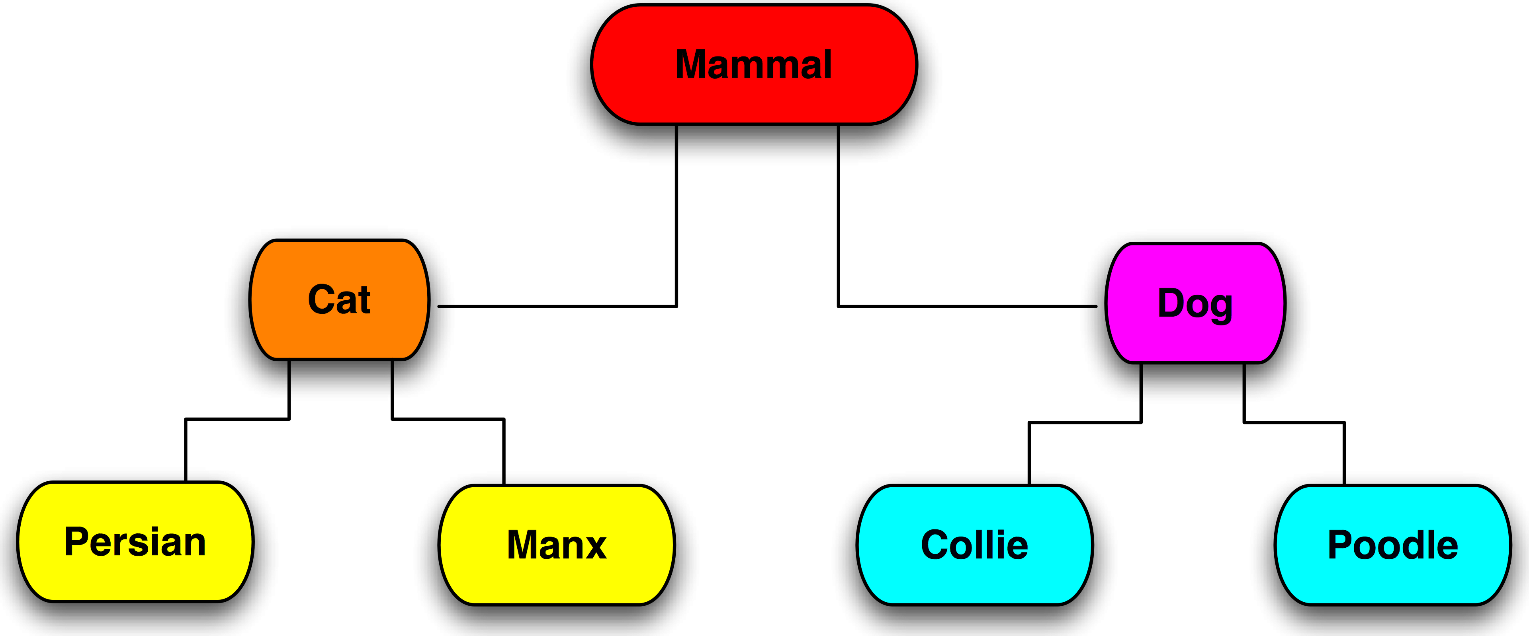
Cats and Dogs (yes, again)

Slide 10
Cats and Dogs Revisited
public class Cat extends Mammal
{ ...
public void makeSound() {
System.out.println(“Meow!”);
}
}
Public class Dog extends Mammal
{ ...
public void makeSound() {
System.out.println(“Woof!”);
}
}

Slide 11
Cats and Dogs Revisited (II)
Cat garfield = new Cat();
Dog odie = new Dog();
garfield.makeSound();
odie.makeSound();
Mammal m = new Cat();
m.makeSound();
What does each call to makeSound() produce?

Slide 12
Polymorphism
In simple terms, a variable of a supertype can refer to a subtype object.
Mammal m = new Cat();
We can have duplicate method names in an inheritance hierarchy and to decide which method is appropriate to call depending on the class of the object to which the method is applied.

Slide 13
Assignment
We can always assign a derived class to any parent class variable
the derived class IS-A parent object
Mammal m = new Cat();
Cat meets all of Mammal’s criteria, plus Cat-specific features
We CANNOT go the other way, though!
Cat c = new Mammal(): // Illegal

Slide 14
Assignment (II)
c expects to point to an object with all of Cat’s features
There is no guarantee that Mammal has all of those features
In fact, it probably doesn’t

Slide 15
Method invocation
Suppose that Mammal and Cat both define a makeSound() method
Cat’s version overrides Mammal’s
Which version of makeSound() will be called?
Mammal m = new Mammal();
Mammal x = new Cat();

Slide 16
Basic Rules
Every variable has two types:
reference type (declared type)
actual type
The reference type determines what methods can be called.
The actual type determines which versions of those methods are called.

Slide 17
Examples
Mammal m = new Mammal();
Reference and actual types are both Mammal
Mammal x = new Cat();
Reference type: Mammal
Actual type: Cat

Slide 18
Polymorphism
Polymorphism means that you can send the same message to different objects
Inheritance means that objects share the same code
Results may vary depending upon the specific object involved
Cat responds differently from Dog
Notes:
For example: ask employee to do self-introduction
Employees in different departments behave differently

Slide 19
The Object Class and Its Methods
Every class in Java is descended from the java.lang.Object class
If no inheritance is specified when a class is defined, the superclass of the class is java.lang.Object

Slide 20
Polymorphism, Dynamic Binding and Generic Programming
public class PolymorphismDemo {
public static void main(String[] args) {
m(new GraduateStudent());
m(new Student());
m(new Person());
m(new Object());
}
public static void m(Object x) {
System.out.println(x.toString());
}
}
class GraduateStudent
extends Student {
}
class Student extends Person {
public String toString() {
return "Student";
}
}
class Person extends Object {
public String toString() {
return "Person";
}
}
Method m takes a parameter of the Object type – can be invoked with any object
Polymorphism: an object of a subtype can be used wherever its supertype value is required
Dynamic binding: the Java Virtual Machine determines dynamically at runtime which implementation is used by the method
When the method m(Object x) is
executed, the argument x’s toString
method is invoked.
Output:
Student
Student
Person
java.lang.Object@12345678

Slide 21
Dynamic Binding
Suppose an object o is an actual instance of classes C₁, C₂, ..., C_{n-1}, and C_{n}
C₁ is a subclass of C₂, C₂ is a subclass of C₃, ..., and C_{n-1} is a subclass of C_{n}
C_{n} is the most general class, and C₁ is the most specific class
If o invokes a method p, the JVM searches the implementation for the method p in C₁, C₂, ..., C_{n-1} and C_{n}, in this order, until it is found, the search stops and the first-found implementation is invoked

Slide 22
Dynamic Binding: Example
public class PolymorphismDemo {
public static void main(String[] args) {
m(new GraduateStudent());
m(new Student());
m(new Person());
m(new Object());
}
public static void m(Object x) {
System.out.println(x.toString());
}
}
class GraduateStudent extends Student {
}
class Student extends Person {
public String toString() {
return "Student";
}
}
class Person extends Object {
public String toString() {
return "Person";
}
}
Output:
Student
Student
Person
java.lang.Object@12345678

Slide 23
Method Matching Vs. Binding
The compiler finds a matching method according to parameter type, number of parameters, and order of the parameters at compilation time
The Java Virtual Machine dynamically binds the implementation of the method at runtime

Slide 24
Generic Programming
public class PolymorphismDemo {
public static void main(String[] args) {
m(new GraduateStudent());
m(new Student());
m(new Person());
m(new Object());
}
public static void m(Object x) {
System.out.println(x.toString());
}
}
class GraduateStudent extends Student {
}
class Student extends Person {
public String toString() {
return "Student";
}
}
class Person extends Object {
public String toString() {
return "Person";
}
}
Generic programming: polymorphism allows methods to be used generically for a wide range of object arguments: if a method’s parameter type is a superclass (e.g.,Object), you may pass an object to this method of any of the parameter’s subclasses (e.g., Student or String) and the particular implementation of the method of the object that is invoked is determined dynamically

Slide 25
Casting Objects
Casting can be used to convert an object of one class type to another within an inheritance hierarchy
m(new Student());
is equivalent to:
Object o = new Student(); // Implicit casting
m(o);
public static void m(Object x) {
System.out.println(x.toString());
}
Legal because an instance of Student is automatically an instance of Object
Notes:
对象转换/转型

Slide 26
Why Casting is Necessary
Student b = o;
A compilation error would occur because an Object o is not necessarily an instance of Student
We use explicit casting to tell the compiler that o is a Student object - syntax is similar to the one used for casting among primitive data types
Student b = (Student)o;
This type of casting may not always succeed (check this with instanceof operator)
Notes:
类型检查运算符

Slide 27
The instanceof Operator
Use the instanceof operator to test whether an object is an instance of a class:
Object myObject = new Circle();
...
if (myObject instanceof Circle) {
System.out.println("The circle diameter is "
+ ((Circle)myObject).getDiameter());
...
}

Slide 28
public class CastingDemo{
public static void main(String[] args){
Object object1 = new Circle(1);
Object object2 = new Rectangle(1, 1);
displayObject(object1);
displayObject(object2);
}
public static void displayObject(Object object) {
if (object instanceof Circle) {
System.out.println("The circle area is " +
((Circle)object).getArea());
System.out.println("The circle diameter is " +
((Circle)object).getDiameter());
}else if (object instanceof Rectangle) {
System.out.println("The rectangle area is " +
((Rectangle)object).getArea());
}
}
}

Slide 29
The equals Method
The equals()method compares the contents of two objects - the default implementation of the equals method in the Object class is as follows:
Override the equals()method in other classes:
public boolean equals(Object obj) {
return (this == obj);
}
public boolean equals(Object o) {
if (o instanceof Circle) {
return radius == ((Circle)o).radius;
}
else return false;
}

Slide 30
2015/12/02 Tuesday
Homework 4 due tonight
Midterm 2 Practice Solutions Posted (Note short answer questions)
Quiz and review on 12/05
This lab continues on 12/05

