Slide 1


ArrayList
ArrayList

Slide 2
The ArrayList Class
ArrayList is a Java collection that removes some of the limitations of arrays.
An array’s size is set at the time it’s created; an ArrayList can grow to hold more items.
An ArrayList still maintains constant-time insertion(update) and access.
Java collection framework (JCF) is set of classes and interfaces that implement commonly reusable collection data structures.
import java.util.ArrayList;
Remember Homework 4?

Slide 3
Regarding ArrayList
It is an object (ArrayList itself).
It is typed (ArrayList<Integer>, ArrayList<String>).
It uses methods (add(), remove(), get()).
It involves dynamic memory, which is a step beyond primitive array management.
Notes:
Different typed ArrayList belong to the same class! Type check is performed during compilation; Type Erasure is performed at execution.

Slide 4
The ArrayList Class contd..
𝐴𝑟𝑟𝑎𝑦𝐿𝑖𝑠𝑡<𝑇> ()
𝑇 must be an object type!
Ex. 𝐴𝑟𝑟𝑎𝑦𝐿𝑖𝑠𝑡<𝑆𝑡𝑟𝑖𝑛𝑔>()
𝐴𝑟𝑟𝑎𝑦𝐿𝑖𝑠𝑡<𝑇> (𝑖𝑛𝑡 𝑛)
Creates an 𝐴𝑟𝑟𝑎𝑦𝐿𝑖𝑠𝑡 of type 𝑇 with space for n elements

Slide 5
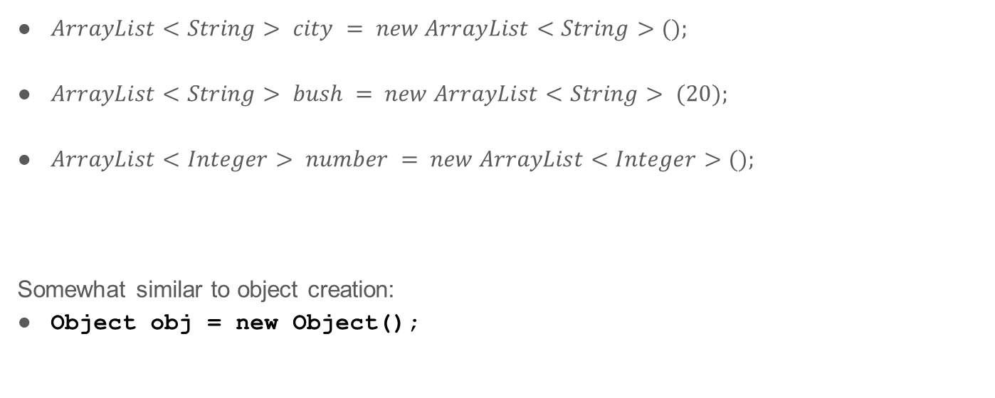
Examples
$ArrayList<String> city = new ArrayList<String>();$
$ArrayList<String> bush = new ArrayList<String> (20);$
$ArrayList<Integer> number = new ArrayList<Integer>();$
Somewhat similar to object creation:
Object obj = new Object();
wrapper class for int
Notes:
Integer is a wrapper class of int. ArrayList can only store objects, so wrapper class is needed for primitive data types.

Slide 6

Adding Elements
$add (v)$
appends $v$ to the end of the $ArrayList$
$add (int i, v)$
Inserts $v$ at position $i$ in the $ArrayList$
Shifts elements at $i…$down one space
Notes:
Index always in front

Slide 7
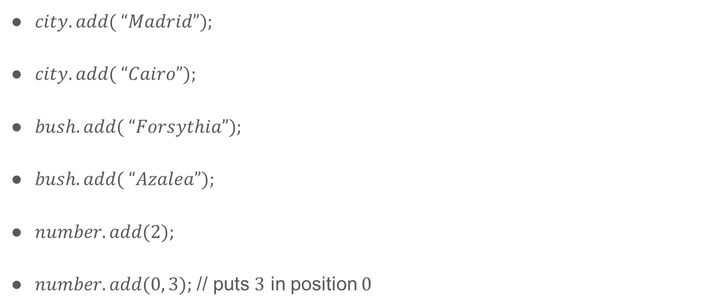
Insertion Examples
$city.add( “Madrid”);$
$city.add( “Cairo”);$
$bush.add( “Forsythia”);$
$bush.add( “Azalea”);$
$number.add(2);$
$number.add(0, 3);$ // puts $3$ in position $0$

Slide 8
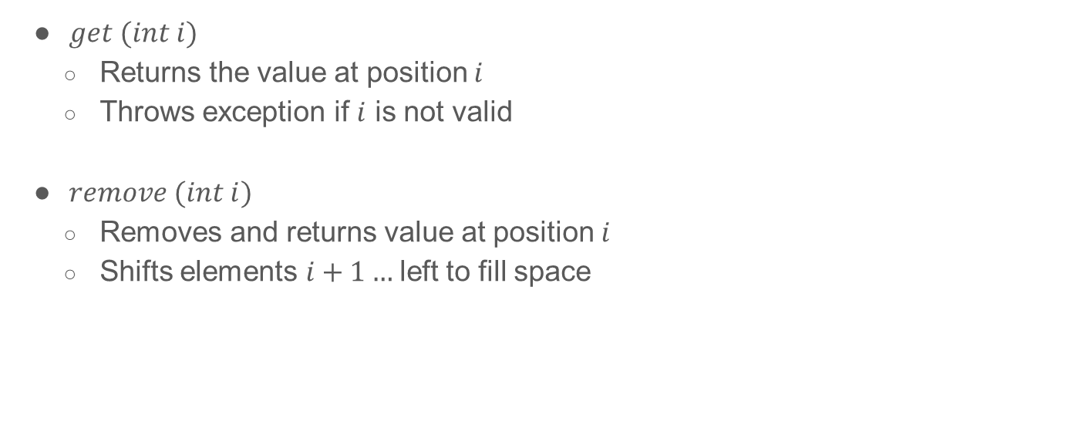
Access Methods
$get (int i)$
Returns the value at position $i$
Throws exception if $i$ is not valid
$remove (int i)$
Removes and returns value at position $i$
Shifts elements $i+1…$left to fill space

Slide 9

Access Example
$String value = city.get(1);$
$System.out.print(city.get(0));$
$int temp = 2 ∗ number.get(0).intValue();$
$number.remove(1);$
Notes:
.intValue()：将 Integer 对象转换成基本数据类型 int。从 number 这个 ArrayList 中取出第一个元素，把它转换成基本的 int 类型，然后乘以 2，最后把结果赋值给 temp 变量。
在新版 Java 中，存在自动拆箱（autounboxing），使得number.get(0) 直接可以当作 int 来用，所以 .intValue() 可以省略

Slide 10

Other Useful Methods
$size()$
Returns # of elements in the $ArrayList$
$clear()$
Removes all elements from the $ArrayList$

Slide 11
The ArrayList Class
You can create arrays to store objects - But the array’s size is fixed once the array is created.
Java provides the java.util.ArrayList class that can be used to store an unlimited number of objects:
Notes:
Note that remove(index: int) returns the removed object

Slide 12
Arrays Vs ArrayList
Notes:
数组访问是 a[index]，ArrayList 访问是 list.get(index)；
数组更新（重新赋值）是 a[index] = "London"，ArrayList 更新是 list.set(index, "London")

Slide 13
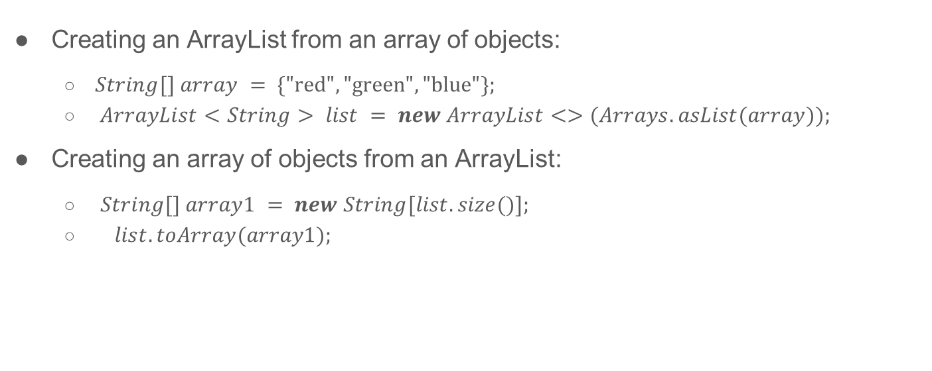
Array Lists from/to Arrays
Creating an ArrayList from an array of objects:
$String[] array = \{"red", "green", "blue"\};$
$ArrayList<String> list = new ArrayList<>(Arrays.asList(array));$
Creating an array of objects from an ArrayList:
$String[] array1 = new String[list.size()];$
$list.toArray(array1);$

Slide 14
max and min in an Array List
String[] array = {"red", "green", "blue"};
System.out.println(java.util.Collections.max(newArrayList<String>(Arrays.asList(array)));
String[] array = {"red", "green", "blue"};
System.out.println(java.util.Collections.min(newArrayList<String>(Arrays.asList(array)));

Slide 15
Shuffling an Array List
Integer[] array = {3, 5, 95, 4, 15, 34, 3, 6, 5};
ArrayList<Integer> list = new ArrayList<>(Arrays.asList(array));
java.util.Collections.shuffle(list);
System.out.println(list);

