Slide 1


Introduction to Computers
Introduction to Computers

Slide 2
Objectives:
Introduction to computer
CPU
Memory
Number systems:
Decimal
Binary
Octal
Hexadecimal
Programming languages:
Machine language
Assembly language
High level programming language
Assembler and compiler
Operating systems

Slide 3
What is a Computer?
Is an electronic device that stores and processes data.
A computer consists of a CPU, memory, hard disk, monitor, printer, and communication devices.
Introduction To Java Programming, Brief Version, Author: Daniel Liang, Publisher: Pearson , Edition: 11th, 2018

Slide 4
CPU: Central Processing Unit
1 MHz = 1 million pulses per second, 1 GHz = 1 billion pulses per second.
Retrieves instructions from memory and executes them
The CPU speed is measured in hertz = cycles per second (Hz, MHz = Megahertz, GHz = Gigahertz) [example: Intel i-5: 2.60 GHz ]
Introduction To Java Programming, Brief Version, Author: Daniel Liang, Publisher: Pearson , Edition: 11th, 2018
Notes:
Every computer has an internal clock, which emits electronic pulses at a constant rate. These pulses are used to control and synchronize the pace of operations. Higher the clock speed enables more instructions to be executed in a given period of time.

Slide 5
Memory
Stores data and program instructions for CPU to execute
Ordered sequence of bytes (8 bits – binary base unit)
1000Mbps = 125MB/s (MB)
Introduction To Java Programming, Brief Version, Author: Daniel Liang, Publisher: Pearson , Edition: 11th, 2018
Notes:
Computer is really nothing more than a series of switches. Each switch exists in two states: on or off. Storing information in a computer is a matter of setting a sequence of switches to on or off. If the switch is on it’s value is 1, otherwise it is a 0. A small number like 3 can be stored in a byte whereas a bigger number like 1405 will need multiple bytes (2 bytes).

Slide 6
Memory: How Data is Stored?
Introduction To Java Programming, Brief Version, Author: Daniel Liang, Publisher: Pearson , Edition: 11th, 2018

Slide 7
Number Systems: Binary and Decimal
Decimal:
digits: 0, 1, 2, 3, 4, 5, 6, 7, 8, 9
base (radix): 10
Binary:
digits: 0, 1
base (radix): 2
Each 0 and 1 is called a bit (short for binary digit)

Slide 8
Binary numbers
Computers use binary numbers internally because storage devices like memory and disk are made to store 0s and 1s.
A number or a text inside a computer is stored as a sequence of 0s and 1s.
Binary numbers are not intuitive, since we use decimal numbers in our daily life, when we write 20 in our program, it is assumed to be a decimal number.
Internally, computer software is used to convert decimal numbers into binary numbers, and vice versa.

Slide 9
Decimal numbers:
A decimal number is represented using a sequence of one or more of decimal digits (i.e., 0-9).
The value that each digit in the sequence represents depends on its position that has a value which is an integral power of 10.
Example: 7423

Slide 10
Decimal number: Example
Example: decimal number: 7423
The digits 7, 4, 2, and 3 in decimal number 7423 represent 7000, 400, 20, and 3, respectively:
$7423=7∗{10}^{3}+4 ∗{10}^{2}+2 ∗{10}^{1}+3∗{10}^{0}$
$= 7000 + 400 + 20 + 3$

Slide 11
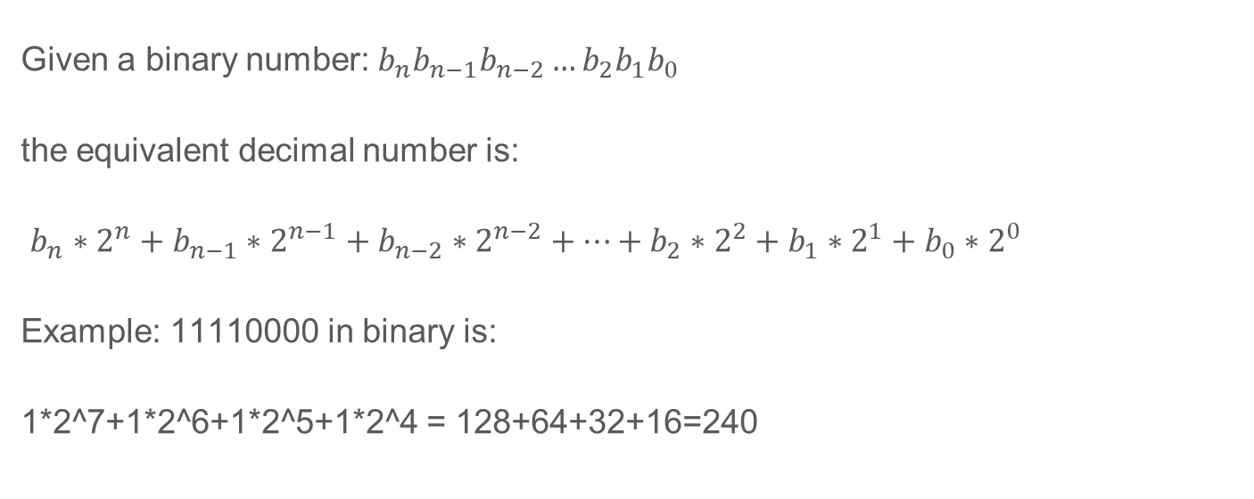
Binary numbers to Decimals
Given a binary number: $b_{n}b_{n−1}b_{n−2}…b_{2}b_{1}b_{0}$
the equivalent decimal number is:
$b_{n}∗2^{n}+b_{n−1}∗2^{n−1}+b_{n−2}∗2^{n−2}+…+b_{2}∗2^{2}+b_{1}∗2^{1}+b_{0}∗2^{0}$
Example: 11110000 in binary is:
1*2^7+1*2^6+1*2^5+1*2^4 = 128+64+32+16=240

Slide 12
Binary numbers to Decimals: Example
1010 in binary is:
$1∗2^{3}+0∗2^{2}+1∗2^{1}+0∗2^{0}=10$ in decimal
10101011 in binary is:
$1∗2^{7}+0∗2^{6}+1∗2^{5}+0∗2^{4}+1∗2^{3}+0∗2^{2}+1∗2^{1}+1∗2^{0}=171$ in decimal

Slide 13
Decimals to Binary
To convert a decimal number ‘𝑑’ to a binary number is to find the binary digits $b_{n}b_{n−1}b_{n−2}…b_{2}b_{1}b_{0}$
such that
$d=b_{n}∗2^{n}+b_{n−1}∗2^{n−1}{+ b}_{n−2}∗2^{n−2}+…+b_{2}∗2^{2}+b_{1}∗2^{1}+b_{0}∗2^{0}$
These numbers can be found by successively dividing 𝑑 by 2 until the quotient is 0. The remainders are $b_{n}b_{n−1}b_{n−2}…b_{2}b_{1}b_{0}$

Slide 14
Decimals to Binary Example:
For example, consider the decimal number 123.
The conversion is conducted as follows:
Corresponding binary number is: 1111011

Slide 15
Number Systems: Octal and Hexadecimal
Octal:
digits: 0, 1, 2, 3, 4, 5, 6, 7
base (radix): 8
Hexadecimal:
digits: 0, 1, 2, 3, 4, 5, 6, 7, 8, 9, A, B, C, D, E, F
base (radix): 16

Slide 16
Hexadecimal
The base of the hex number system is 16 since the hex number system has sixteen digits: 0, 1, 2, 3, 4, 5, 6, 7, 8, 9, A, B, C, D, E, and F
The letters A, B, C, D, E, and F correspond to the decimal numbers 10, 11, 12, 13, 14, and 15.
Binary numbers tend to be very long and cumbersome:
For example: 1010 1010 1010 (2730 in decimal)
Hexadecimal numbers are often used to abbreviate binary numbers: For example: AAA

Slide 17
Hexadecimal to decimal
Given a hexadecimal number $h_{n}h_{n−1}h_{n−2}…h_{2}h_{1}h_{0}$, the equivalent decimal value is $h_{n}∗{16}^{n}+h_{n−1}∗{16}^{n−1}+h_{n−2}∗{16}^{n−2}+…+h_{2}∗{16}^{2}+h_{1}∗{16}^{1}+h_{0}∗{16}^{0}$
Example: 7F in hex is:
$7∗{16}^{1}+15∗{16}^{0 }=127$ in decimal
FFFF in hex is: $15∗{16}^{3}+15∗{16}^{2}+15 ∗{16}^{1}+15∗{16}^{0}=65536$ in decimal

Slide 18
Decimals to Hexadecimals
Given decimal number $d$: Find a hexadecimal number: $h_{n}h_{n−1}h_{n−2}…h_{2}h_{1}h_{0}$, such that: $d=h_{n}∗{16}^{n}+h_{n−1}∗{16}^{n−1}h_{n−2}∗{16}^{n−2}+…+h_{2}∗{16}^{2}+h_{1}∗{16}^{1}+h_{0}∗{16}^{0}$
These numbers can be found by successively dividing $d$ by 16 until the quotient is 0.
The remainders are: $h_{n}h_{n−1}h_{n−2}…h_{2}h_{1}h_{0}$, which is the corresponding hexadecimal number.

Slide 19
Decimals to Hexadecimals: Example
123=127-4
127=01111111
4= 00000100
123=01111011
7 B

Slide 20
Hexadecimals to Binary and Vice Versa
To convert a hexadecimal number to a binary number, simply convert each digit in the hexadecimal number into a four-digit binary number.
To convert a binary number to a hexadecimal, convert every four binary digits from right to left in the binary number into a hexadecimal number.

Slide 21
Binary, Hexadecimal and Decimal: Table
Binary | Hex. | Decimal
0000 | 0 | 0
0001 | 1 | 1
0010 | 2 | 2
0011 | 3 | 3
0100 | 4 | 4
0101 | 5 | 5
0110 | 6 | 6
0111 | 7 | 7
Binary | Hex. | Decimal
1000 | 8 | 8
1001 | 9 | 9
1010 | A | 10
1011 | B | 11
1100 | C | 12
1101 | D | 13
1110 | E | 14
1111 | F | 15

Slide 22
Octal to Binary and Vice Versa
To convert an octal number to a binary number, simply convert each digit in the octal number into a three-digit binary number.
To convert a binary number to an octal number, convert every three binary digits from right to left in the binary number into an octal digit.

Slide 23
Hexadecimals to Binary: Table
Binary | Octal | Decimal
000 | 0 | 0
001 | 1 | 1
010 | 2 | 2
011 | 3 | 3
100 | 4 | 4
101 | 5 | 5
110 | 6 | 6
111 | 7 | 7

Slide 24
Programming Languages: Machine Language
Machine language is a set of instructions executed directly by a computer's central processing unit (CPU).
A program called assembler is used to convert assembly language programs into machine code.
For example, to add two numbers, you might write an instruction in assembly code like this:
ADD 2, 3, result
Introduction To Java Programming, Brief Version, Author: Daniel Liang, Publisher: Pearson , Edition: 11th, 2018

Slide 25
Assembly Language and HLL:
Assembly: Far easier to use than binary.
BUT: Not very user friendly, very low-level operations, programming is time consuming.
High Level programming Languages (HLL):
More user friendly, easy to use.
More flexible.
Platform independent.

Slide 26
Popular High-Level Languages
COBOL (COmmon Business Oriented Language)
FORTRAN (FORmula TRANslation)
BASIC (Beginner All-purpose Symbolic Instructional Code)
Pascal (named for Blaise Pascal)
Ada (named for Ada Lovelace)
C (whose developer designed B first)
Visual Basic (Basic-like visual language developed by Microsoft)
Delphi (Pascal-like visual language developed by Borland)
C++ (an object-oriented language, based on C)
C# (a Java-like language developed by Microsoft)
Java
Python

Slide 27
Source Code
What’s a Source code?
A program written in a high level language is called a source program or source code.
Computer (CPU) cannot understand the source program :
Source program must be translated into machine code for execution.
Translation can be done using interpreter or a compiler.

Slide 28
Interpreting Source Code
What’s an Interpreter?
A program that reads one statement from the source code, translates it to machine code or virtual machine code, and then executes it.
High-Level Source File
…
Area = 5 * 5 * 3.1415;
…
Interpreter
Output
Introduction To Java Programming, Brief Version, Author: Daniel Liang, Publisher: Pearson , Edition: 11th, 2018

Slide 29
Compiling Source Code
What’s a Compiler?
A program that translates the entire source code into a machine-code file, and the machine code file is then executed.
High-Level Source File
Machine code File
…
area = 5 * 5 * 3.1415;
…
…
0101100011011100
1111100011000100
…
Compiler
Executer
Output
Introduction To Java Programming, Brief Version, Author: Daniel Liang, Publisher: Pearson , Edition: 11th, 2018

Slide 30
Operating Systems
The operating system (OS) is a program that manages and controls a computer’s activities
Windows: 98, XP, Vista, 7, 8, 10,and 11
Mac OsX
Android
Linux, Unix
Introduction To Java Programming, Brief Version, Author: Daniel Liang, Publisher: Pearson , Edition: 11th, 2018

