Slide 1


Java and Platform Independence

Slide 2
Objectives:
Java history, motivation
Java platform independence
Java compilation process
Tracing a Java program
Scanner class: getting user input
Anatomy of a Java program

Slide 3
Java History
James Gosling, Mike Sheridan, and Patrick Naughton initiated the Java language project in June 1991 [*]
Sun Microsystems released the first public implementation as Java 1.0 in 1996[*]
As of Sep, 2025, latest Java edition with LTS (Long Term Support) is Java 21.
[*] https://en.wikipedia.org/wiki/Java_(programming_language)

Slide 4
Why Java ?
Java is somewhat different: Platform independence.
Java has a principle, “write once, run anywhere”.
What does that mean?
Platform independence for compiled Java code.
How?
The Java Virtual Machine.
Java programs are compiled into Java bytecode.
bytecode is executed by the Java Virtual Machine (JVM).

Slide 5
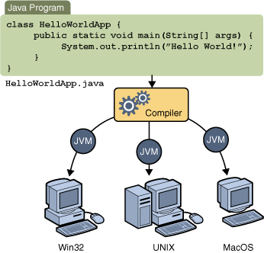
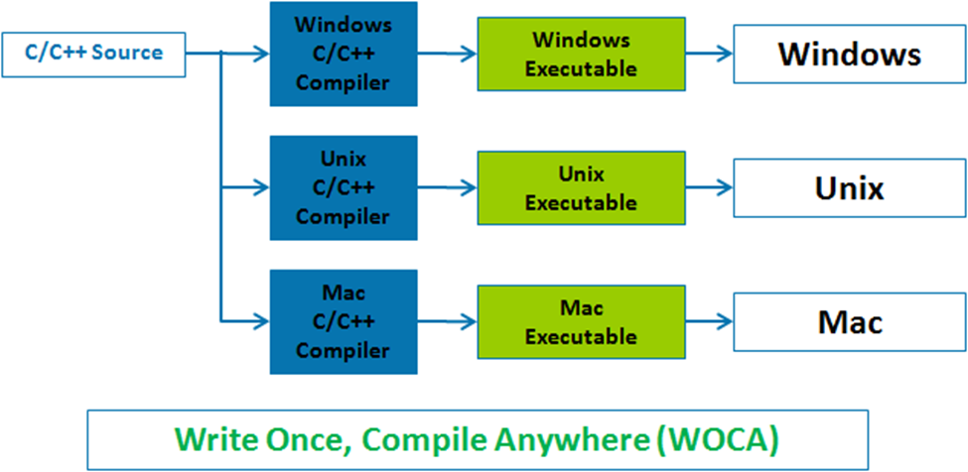
Java: Platform Independence
Source: https://www.thejavaprogrammer.com/java-platform-independent-language/
Source: https://learnittolive.wordpress.com/2015/07/11/why-java-is-platform-independent/

Slide 6
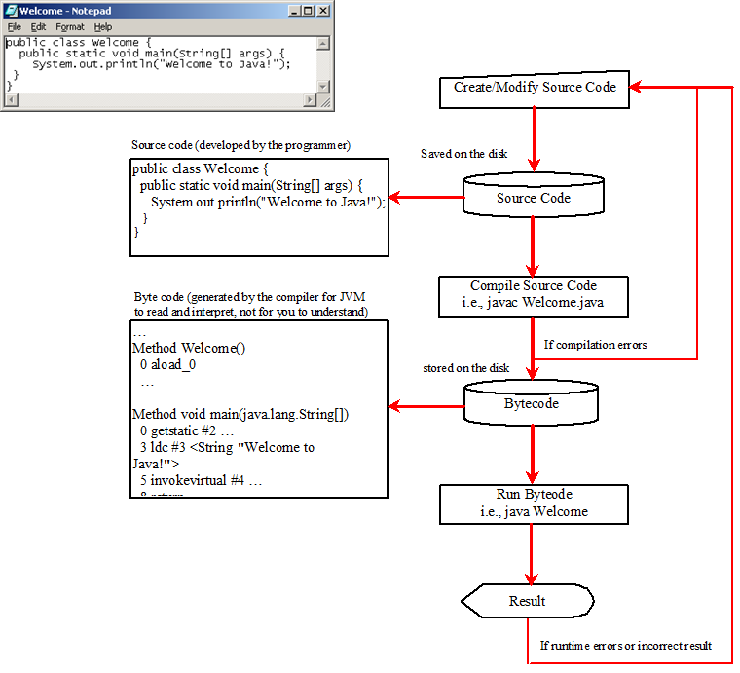
Creating, Compiling, and Running Programs:
Introduction To Java Programming, Brief Version, Author: Daniel Liang, Publisher: Pearson , Edition: 11th, 2018

Slide 7
“Hello, world!” Comparison
Python
print(“Hello, World!”)
Java
public class Hello {
public static void main (String [] args) {
System.out.println(“Hello, World!”);
}
}

Slide 8
My First Java Program
public class MyProgram { public static void main (String [ ] args) { System.out.println(“Hello, world!”); } }

Slide 9
Line-by-Line Breakdown
public class MyProgram { public static void main (String [ ] args) { System.out.println(“Hello, world!”); } }
Every Java program consists of one or more classes.
A class is a block of Java code.
Classes are indicated by the reserved word class.
public is a modifier that tells Java that the class can be seen/used all over.
Curly braces surround the contents of the class.

Slide 10
Braces vs Parentheses vs Brackets
Braces (Curly braces): {}
Parentheses: ()
Brackets: []

Slide 11
Line-by-Line Breakdown (contd.)
public class MyProgram { public static void main (String [ ] args) { System.out.println(“Hello, world!”); } }
A method is a block of Java statements.
main() is a special method.
It tells the JVM how to start the program.
Every Java program (not every class) must have a main() method.
main() always has the same header (first line).
The body of a method is surrounded by curly braces.

Slide 12
Line-by-Line Breakdown
public class MyProgram { public static void main (String [ ] args) { System.out.println(“Hello, world!”); } }
System.out.println() is another Java method.
It tells the program to print something to the console (screen).
The information to print goes inside the parentheses.
Here, we’re printing a string of characters.
This is a method call — main() was a method definition.

Slide 13
Compiling Your Java Code
Write and save your source code using a text editor
The source code MUST be a plain text file.
The file should be named after the class it contains (e.g., a class named Welcome must live in a file named Welcome.java ).
Run the Java compiler (javac) to compile your source code file into a Java bytecode file:
javac Welcome.java
This will produce a file named Welcome.class.

Slide 14
Executing Your Java Code
To execute your program, run the JVM with your compiled .class file:
java Welcome
Note that the “.class” extension is omitted (The JVM fills that in automatically).
You can only directly execute a class file that contains a main() method.

Slide 15
Trace a Program Execution
Enter main method
//This program prints Welcome to Java!
public class Welcome {
public static void main(String[] args) {
System.out.println("Welcome to Java!");
}
}

Slide 16
Trace a Program Execution
Execute statement
//This program prints Welcome to Java!
public class Welcome {
public static void main(String[] args) {
System.out.println("Welcome to Java!");
}
}

Slide 17
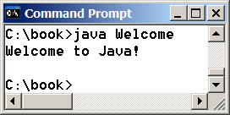
Trace a Program Execution
//This program prints Welcome to Java!
public class Welcome {
public static void main(String[] args) {
System.out.println("Welcome to Java!");
}
}
print a message to the console

Slide 18
Getting User Input
You must include import java.util.Scanner; at the top of your source code file!
Create a Scanner object:
Scanner input = new Scanner (System.in);
Use the method nextDouble() to obtain a double value.
Example:
System.out.println(“Enter a double value: ”);
Scanner input = new Scanner (System.in);
double d = input.nextDouble();

Slide 19
Scanner class methods:
Method | Description
nextByte() | Reads an integer of the byte type.
nextShort() | Reads an integer of the short type.
nextInt() | Reads an integer of the int type.
nextLong() | Reads an integer of the long type.
nextFloat() | Reads a number of the float type.
nextDouble() | Reads a number of the double type.
next() | Read a String that ends with a whitespace character.
nextLine() | Read an entire line of text (String).

Slide 20
A Simple Java program Structure:
May constist of:
Class name
Main method
Statements
Statement terminator
Reserved words
Comments
Blocks

Slide 21
Class name
Every Java program must have at least one class
By convention class name starts with an uppercase letter.
//This program prints Welcome to Java!
public class Welcome {
public static void main(String[] args) {
System.out.println("Welcome to Java!");
}
}

Slide 22
Main method
In order to run a class, the class must contain a method named main
//This program prints Welcome to Java!
public class Welcome {
public static void main(String[] args) {
System.out.println("Welcome to Java!");
}
}

Slide 23
Statement
A statement represents an action or a sequence of actions.
Statement below displays the greeting “Welcome to Java!”
//This program prints Welcome to Java!
public class Welcome {
public static void main(String[] args) {
System.out.println("Welcome to Java!");
}
}

Slide 24
Statement Terminator
Every statement in Java ends with a semicolon (;)
//This program prints Welcome to Java!
public class Welcome {
public static void main(String[] args) {
System.out.println("Welcome to Java!");
}
}

Slide 25
Reserved words
Reserved words or Keywords have a specific meaning to the compiler.
Can’t use keywords for other purposes in the program.
//This program prints Welcome to Java!
public class Welcome {
public static void main(String[] args) {
System.out.println("Welcome to Java!");
}
}

Slide 26
Blocks
A pair of braces in a program forms a block that groups components of a program.
//This program prints Welcome to Java!
public class Welcome {
public static void main(String[] args) {
System.out.println("Welcome to Java!");
}
}
Method block
Class block

Slide 27
Special Symbols:
Character name | Description
{ } Opening and closing braces | Denotes a block that encloses statements.
( ) Opening and closing parentheses | Used with methods.
[ ] Opening and closing brackets | Denotes an array.
// Double slashes | Precedes a comment line.
" " Opening and closing quotation marks | Enclosing a string (i.e., sequence of characters).
; Semicolon | Marks the end of a statement.

Slide 28
{ …}
//This program prints Welcome to Java!
public class Welcome {
public static void main(String[] args) {
System.out.println("Welcome to Java!");
}
}

Slide 29
(…)
//This program prints Welcome to Java!
public class Welcome {
public static void main(String[] args) {
System.out.println("Welcome to Java!");
}
}

Slide 30
;
//This program prints Welcome to Java!
public class Welcome {
public static void main(String[] args) {
System.out.println("Welcome to Java!");
}
}

Slide 31
// …
//This program prints Welcome to Java!
public class Welcome {
public static void main(String[] args) {
System.out.println("Welcome to Java!");
}
}

Slide 32
"…"
//This program prints Welcome to Java!
public class Welcome {
public static void main(String[] args) {
System.out.println("Welcome to Java!");
}
}

