Slide 1


Character Data Type
Character Data Type

Slide 2
Objectives:
ASCII and Unicode
ASCII code table
Unicode format
Generating random characters
Comparing and testing characters

Slide 3
Character Data Type: Example
char letter = 'A'; (ASCII)
char numChar = '4'; (ASCII)
char letter = '\u0041'; (Unicode)
char numChar = '\u0034'; (Unicode)
NOTE: The increment and decrement operators can also be used on char variables to get the next or preceding Unicode character.
char ch = 'a';
System.out.println(++ch);
American Standard Code for Information Interchange
Four hexadecimal digits.

Slide 4
Unicode Format
Java characters use Unicode, a 16-bit encoding scheme by the Unicode Consortium.
Unicode support the interchange, processing, and display of written texts in the world’s diverse languages.
Unicode takes two bytes, preceded by \u, expressed in four hexadecimal numbers that run from '\u0000' to '\uFFFF' So, Unicode can represent 65536 characters.
Unicode includes ASCII code, with '\u0000' to '\u007F' corresponding to the 128 ASCII characters.

Slide 5
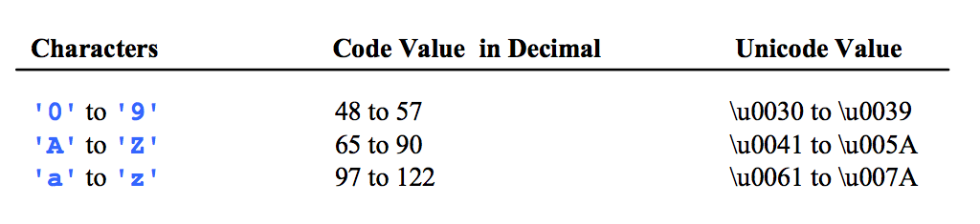
ASCII Code for Commonly Used Characters

Slide 6
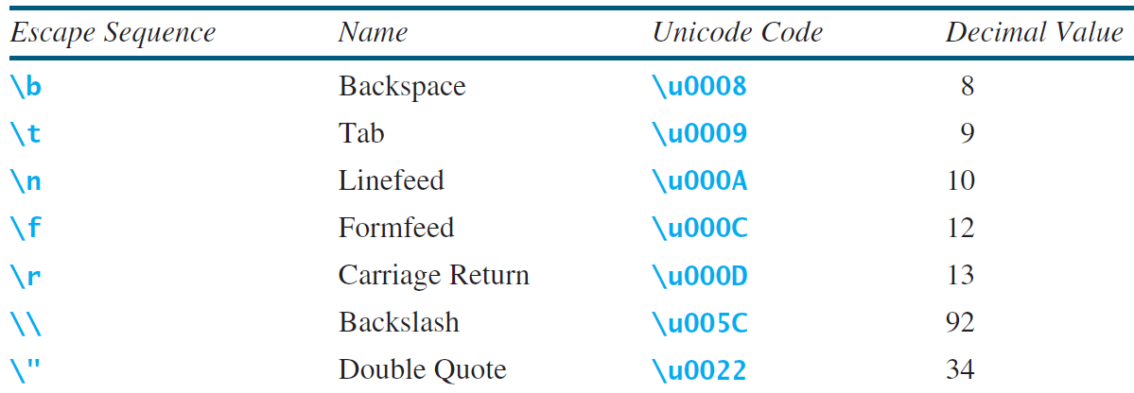
Escape Sequences for Special Characters

Slide 7
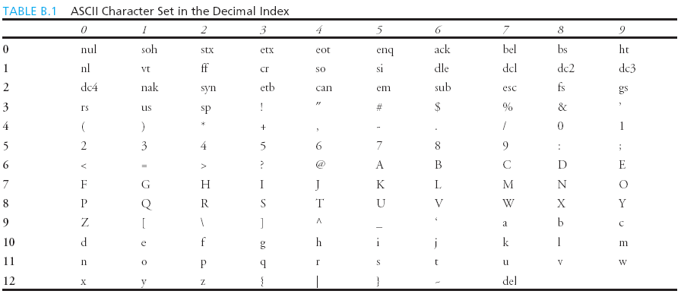
Appendix B: ASCII Character Set
ASCII Character Set is a subset of the Unicode from '\u0000' to '\u007F'

Slide 8
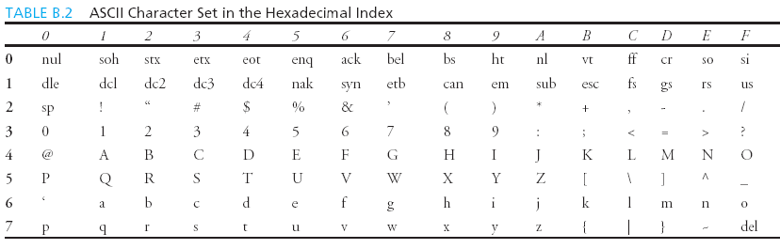
ASCII Character Set, cont.
ASCII Character Set is a subset of the Unicode from '\u0000' to '\u007F'

Slide 9
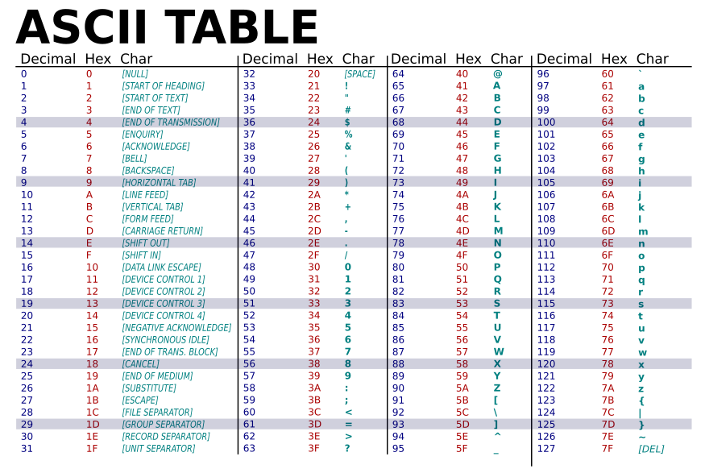

Slide 10
Generating Random Characters
(char)((int)'a' + Math.random() * ((int)'z' - (int)'a' + 1))
All numeric operators can be applied to the char operands
The char operand is cast into a number if the other operand is a number or a character.
So, the preceding expression can be simplified as follows:
(char)('a' + Math.random() * ('z' - 'a' + 1))

Slide 11
Comparing and Testing Characters
if (ch >= 'A' && ch <= 'Z')
System.out.println(ch + " is an uppercase letter");
if (ch >= 'a' && ch <= 'z')
System.out.println(ch + " is a lowercase letter");
if (ch >= '0' && ch <= '9')
System.out.println(ch + " is a numeric character");

Slide 12
Methods in the Character Class

