Slide 1

ISE 333: User Interface Development (Design) Chapter 4: Design
Spring 2026
Instructor: Hao Li

Slide 2
Introduction
Conception
Design can be loosely defined as the outcome or the process of creating specifications for synthetic artifacts, such as products, services, and processes
All manufactured objects in the world --- objects that were made by people and are not found in nature --- are the result of some form of design process, whether a deliberate one or otherwise
UIs, which are very much synthetic and decidely do not occur in nature, are no exception
UIs are digital artifacts
If UIDers carefully consider how digital products and services are created, they can make appealing products and services that respond to human needs with UIs that are easy to learn, comprehensible, and efficient to use
Design is innovation

Slide 3
Introduction
Historical Lessons
Early computer applications were designed by programmers to be highly functional for the programmers themselves and their peers
The kind of design approach for early computer applications quickly failed when the audience for computers grew to non-technical fields
The phenomenon is called “kind to chips but cruel to people”
Early failing of UID
幂势相同则积不容异
cogito ergo sum
Powerful and beautiful, but difficult for knowledge propagation as well as general education

Slide 4
Introduction
Nowadays
The current generation of users for various UIs have vastly different backgrounds from programmers and engineers
The current generation of users are less dedicated to the technology itself, but are more oriented toward their professional or recreational needs
Effective UIDers take the intended user as their starting point and focus on facilitating (not only providing) the function of the artifact
Carefully observe their users
Iteratively refine their prototypes based on thoughtful analysis
Systematically validate their UIs through early usability and acceptance tests
“Tech Brain”技术脑

Slide 5
Traditional Software Engineering
Waterfall Model
Requirements
Design
Development
Testing
a.k.a. Integration & Testing
Deploying/deployment
Maintenance
Requirements
Design
Development
Testing
Deploying
Maintenance

Slide 6
Design Process
Operational Characteristics
Design is a dynamic process and cannot be adequately represented statically
The design process is nonhierarchical and is neither strictly bottom-up nor strictly top-down
The design process is unpredictable and radically transformational, involving the development of partial and interim solutions that may ultimatley play no role in the final outcome
Design intrinsically involves discovery of new goals

Slide 7
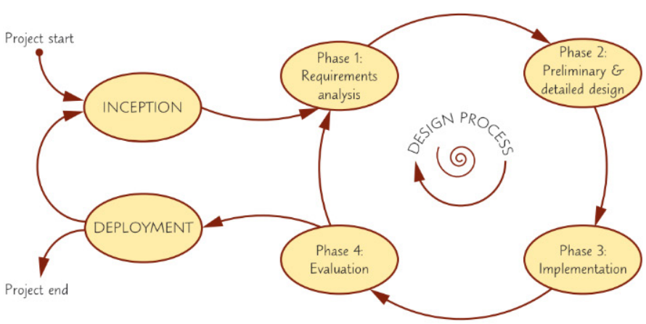
Design Process
Four-Phase Iterative Design Process
Requirements analysis
Preliminary and detailed design
Build and implementation
Evaluation

Slide 8
Design Process
Requirements Analysis
Collecting UID requirements is part of the overall requirements analysis and management phase, and often has a direct impact on the engineering aspects of UID
Functional requirements
Define specific behaviour that the UI system should support (often captured in use cases)
Non-functional requirements
Specify overall criteria governing the operation of the UI system (hardware, software, system performance, reliability, etc.) without being tied to a specific action or behaviour
User experience (UX) requirements
Specify concrete non-functional requirements for user interaction and the UI system (navigation, input, colours, etc.)

Slide 9
Design Process
Requirements Analysis
Requirements documents provide a shared understanding between the members of the product team
The success or failure of software projects often depends on the precision and completeness of the shared understanding between all designers, developers, and users
Use cases
A concept from software engineering, intended for writing functional requirements
Formalized scenarios that capture operations between the actor and the system in a step-by-step manner
In general software engineering, the actor could be another system, but the focus is on the human user and the UI system in our context
The set of UI functionalities should simply be a sum of its use cases
No functionality should be implemented that does not explicitly support at least one use case
Use cases give a straightforward recipe for evaluation of the UI system
If all use cases can be completed successfully, the UI system is correct and valid

Slide 10
Design Process
Preliminary and Detailed Design
Preliminary design, a.k.a. architectural/conceptual design Strategy
Consists of mapping out the high-level concepts such as the user, controls, UI displays, navigation mechanisms, and overall workfolow
Organizes the high-level concepts into a conceptual map with their relations
Develops the mental model that users should have about the UI system when using it
Detailed design Tactics
Specifics of each preliminary design outcome are planned out
Build and Implementation
Actual software and hardware engineering (outside the course scope)
Evaluation
Developers test and validate the UI system implementation to ensure that it conforms to the design and requirements set out earlier (postponed to Chapter 5)

Slide 11
Design Frameworks
User-Centered Design
Prescribes a design process that primarily takes the needs, wants, and limitations of the actual end users into account during each phase of the design process
Successful developers work carefully to understand the business’s needs and refine their skills in eliciting accurate requirements from non-technical business managers
Participatory Design
Is the direct involvement of users in the design of the things and technologies they use (a.k.a. cooperative design)
Agile Design
Is a family of design/development methods for self-organizing, dynamic teams that facilitate flexible, adaptive, and rapid development robust to changing needs
Based on evolutionary development, where software is built incrementally and in rapid release cycles

Slide 12
Agile Software Engineering
Revisit the Waterfall Model
Requirements
Design
Development
Testing
a.k.a. Integration & Testing
Deploying/deployment
Maintenance
Middleware (internal)
Enables agile feedback loops/cycles
Requirements
Design
Middleware
Development
Testing
Deploying
Maintenance

Slide 13
Design Process
Feedback
Control
Four-Phase Iterative Design Process
Requirements analysis
Preliminary and detailed design
Build and implementation
Evaluation
Error
0

Slide 14
DISCUSSION Q & A

Slide 15
Design/Development Process (Advanced)
Feedback
Control
Four-Phase Iterative Design Process
Requirements analysis
Preliminary and detailed design
Build and implementation
Evaluation
Error Modelling
Error
0

Slide 16
Design/Development Process (Advanced)
Requirements Analysis Error Modelling
Requirements documents provide a shared understanding between the members of the product team
The success or failure of software projects often depends on the precision and completeness of the shared understanding between all designers, developers, and users
There can be and tends to be misunderstanding, namely error in the shared understanding between the members
Unfortunately, such misunderstanding or error is difficult to be realized at the very beginning, even with careful and intensive communications
Such misunderstanding or error normally can be realized only during project progress
Requirements analysis (RA) error rate or misunderstanding rate (denoted by R)
Roughly speaking, for N requirements, R x N ones among them are misunderstood
The amount of requirements is simply assumed proportional to the gap between current achievement and the expected achievement

Slide 17
Design/Development Process (Advanced)
Preliminary and Detailed Design Error Modelling
Preliminary design, a.k.a. architectural/conceptual design Strategy
Conceptual map of high-level concepts with their relations and the mental model
Detailed design Tactics
Specifics of each preliminary design outcome
There can be and tends to be design error
Preliminary and detailed design hardly can strictly capture requirements analysis outcomes
Preliminary and detailed design (PDD) error rate (denoted by D)
Build and Implementation
Build and implementation (BI) error rate (denoted by I)
Build and implementation hardly can strictly follow design outcomes
Evaluation
Error negligible or neglected for simplicity

Slide 18
Design/Development Process (Advanced)
Open-Loop Error Rate
Requirements analysis (RA) error rate or misunderstanding rate R
Preliminary and detailed design (PDD) error rate D
Build and implementation (BI) error rate I
OL error rate E = (1 + R) x (1 + D) x (1 + I) - 1
Practice
Given the RA error rate 15%, the PDD error rate 15%, and the BI error rate 15%, what is the OL error rate? E = (1+0.15) (1+0.15) (1+0.15) - 1 ≈ 52%
Given the RA error rate 10%, the PDD error rate 10%, and the BI error rate 10%, what is the OL error rate? E = (1+0.1) (1+0.1) (1+0.1) - 1 ≈ 33%
Error superposition and enlargement

Slide 19
Design/Development Process (Advanced)
Open-Loop Period
Requirements analysis (RA) period T_{R}
Preliminary and detailed design (PDD) period T_{D}
Build and implementation (BI) period T_{I}
Evaluation (EV) period T_{v}
OL period T = T_{R} + T_{D} + T_{I} + T_{v}
Engineering Lessons
Do not naively think that the project duration is roughly the OL period T
The needed time is usually much larger than the OL period T

Slide 20
Design/Development Process (Advanced)
Closed-Loop Error Convergence (or Divergence)
Open-loop (OL) error rate E = (1 + R) x (1 + D) x (1 + I) - 1
Closed-loop (CL) error rate
1 T (1st OL period) E
2 T (2nd OL period) E²
3 T (3rd OL period) E³
... ...
n T (n-th OL period) E^{n}
Convergence criterion E^{n} → 0 ⟺ E < 1
Practice
Given the RA error rate 30%, the PDD error rate 25%, and the BI error rate 25%, can the design process converge? E = (1+0.3) (1+0.25) (1+0.25) - 1 ≈ 103% > 1 so impossible to converge (namely divergent)

Slide 21
Design/Development Process (Advanced)
Closed-Loop Error Convergence (or Divergence)
Open-loop (OL) error rate E = (1 + R) x (1 + D) x (1 + I) - 1
Closed-loop (CL) error rate
1 T (1st OL period) E
2 T (2nd OL period) E²
3 T (3rd OL period) E³
... ...
n T (n-th OL period) E^{n}
Convergence criterion E^{n} → 0 ⟺ E < 1
Convergence threshold C
OL periods needed for convergence E^{n} < C ⟺ n > log _{E} C

Slide 22
Design/Development Process (Advanced)
Closed-Loop Error Convergence (or Divergence)
Open-loop (OL) error rate E = (1 + R) x (1 + D) x (1 + I) - 1
Closed-loop (CL) error rate E^{n} (n-th OL period)
Convergence criterion E^{n} → 0 ⟺ E < 1
Convergence threshold C
OL periods needed for convergence E^{n} < C ⟺ n > log _{E} C
Practice
Given the RA error rate 10%, the PDD error rate 10%, the BI error rate 10%, and the convergence threshold 1%, how many OL periods can achieve convergence?
E=33%; E²=10.9%; E³=3.6%; E⁴=1.2%; E⁵=0.4% < 1%
What if the RA error rate 15%, the PDD error rate 15%, and the BI error rate 15%?
E=52%; E²=27.0%; E³=14.1%; E⁴=7.3%; E⁵=3.8%; E⁶=2.0%; E⁷=1.0%; E⁸=0.5% < 1%

Slide 23
Design/Development Process (Advanced)
Practice
A director is confused by a tricky phenomenon: The company’s departments work rather effectively in her/his opinion, but the actual project duration needed to achieve 99.5% project objective is always about five times her/his imagined project duration (i.e. roughly the open-loop period), much slower than her/his expectation.
First, try to clarify confusion for the director.
Second, estimate the open-loop error rate of the company’s working system.
E⁵ = 1-99.5% = 0.005 ⟺ E = 0.005^{1/5} = 34.7%

Slide 24
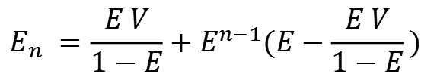
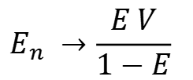
Design/Development Process (Advanced)
Closed-Loop Error Under Dynamic Requirements
Open-loop (OL) error rate E = (1 + R) x (1 + D) x (1 + I) - 1
Requirements variation (RV) rate V
Closed-loop (CL) error rate
1 T (1st OL period) E₁ = E
2 T (2nd OL period) E₂ = E (E₁ + V)
3 T (3rd OL period) E₃ = E (E₂ + V)
... ...
n T (n-th OL period) E_{n} = E (E_{n-1} + V)
If E < 1 ⟺ E^{n} → 0 and as n → ∞
Static error rate remains

Slide 25
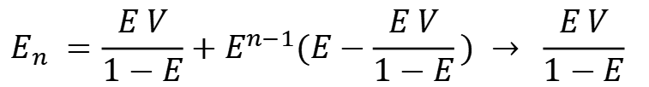
Design/Development Process (Advanced)
Closed-Loop Error Under Dynamic Requirements
Open-loop (OL) error rate E = (1 + R) x (1 + D) x (1 + I) - 1
Requirements variation (RV) rate V
Closed-loop (CL) error rate
n T (n-th OL period) E_{n} = E (E_{n-1} + V)
If E < 1 ⟺ E^{n} → 0 and as n → ∞
Static error rate remains
Practice
Given the OL error rate 50% and the requirements variation rate 20%, what is the CL static error rate? Suppose no more RV since certain OL period and the convergence threshold 1%, what is the extra project duration to achieve convergence?
E_{n → ∞} = 0.5 x 0.2/(1-0.5) = 20%
E∞ E = 0.2 x 0.5 = 10%; E∞ E² = 5%; E∞ E³ = 2.5%; E∞ E⁴ = 1.3%; E∞ E⁵ = 0.6% < 1% Extra project duration = Five OL periods

Slide 26
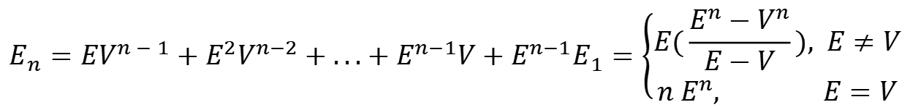

Design/Development Process (Advanced)
Closed-Loop Error Under Dynamic Requirements
Open-loop (OL) error rate E = (1 + R) x (1 + D) x (1 + I) - 1
Requirements variation (RV) rate V, V², V³, V⁴, ... ... (V < 1)
Closed-loop (CL) error rate
1 T (1st OL period) E₁ = E
2 T (2nd OL period) E₂ = E (E₁ + V)
3 T (3rd OL period) E₃ = E (E₂ + V²)
... ...
n T (n-th OL period) E_{n} = E (E_{n-1} + V^{n-1})
If E < 1 and as n → ∞

Slide 27
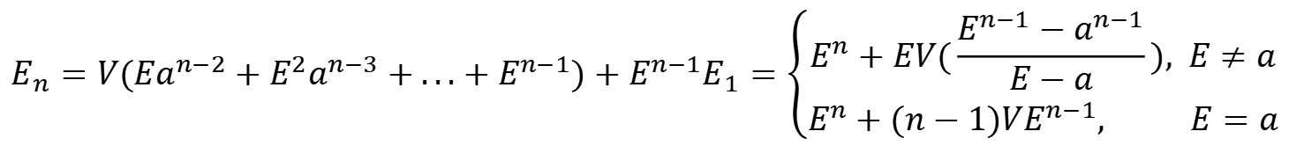
Design/Development Process (Advanced)
Closed-Loop Error Under Dynamic Requirements
Open-loop (OL) error rate E = (1 + R) x (1 + D) x (1 + I) - 1
Requirements variation (RV) rate V, V a, V a², V a³, V a⁴, ... ... (a < 1)
Closed-loop (CL) error rate
1 T (1st OL period) E₁ = E
2 T (2nd OL period) E₂ = E (E₁ + V)
3 T (3rd OL period) E₃ = E (E₂ + V a)
... ...
n T (n-th OL period) E_{n} = E (E_{n-1} + V a^{n-2})
If E < 1 and as n → ∞

Slide 28
DISCUSSION Q & A

