Slide 1
Medical Management System
Presented by the ‘G-SRS’ Team
Rheeya Uppaal – 133
Gauri Desai – 321
Sanjan Shetty – 139
Saumya Shandilya - 143

Slide 2
Introduction and Overview

Slide 3
The project aims to create a complete medical shop management software, designed to ease the work load of medical shop professionals. The main features include invoicing, inventory and stock control, accounting, client and vendor management.
This software helps the user to track all the profits, loss, profitable clients and products of medical shop, also serving the purpose of being as a medical shop accounting software. It is a flexible and adaptive software suited to medical shops or stores or pharmacies of any size.

Slide 4
Development Tools:
Front end Interface – Dev C++
Back end Code - Dev C++
Hardware – Any system with Dev C++ software and an Intel Pentium (or more advanced) microprocessor.
The system must run on a Windows Operating System.

Slide 5
Overall Description

Slide 6
Process Model
A “process model” or a “software engineering paradigm” is a development strategy that encompasses the process, methods and tools used, and the generic phases of development.
The spiral model is an evolutionary software model that couples the iterative nature of prototyping with the controlled and systematic aspects of the linear sequential model.

Slide 7
Process Model
Our spiral model is divided into six task regions:
  Customer Communication
  Planning
  Risk Analysis
  Engineering
  Construction and Release
  Customer Evaluation
Each of these regions contains a set of tasks called a task set.
Umbrella activities have been applied throughout.

Slide 8
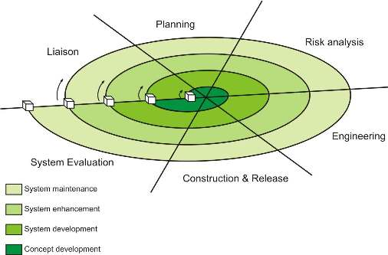
Process Model

Slide 9
Process Model
Why the Spiral Process Model?
Follows a realistic approach to the development of systems and software.
Better understanding between developer and customer regarding risks.
Prototyping can be applied at any stage.
Direct consideration of technical risks at all stages of the project, reducing risks before they become problematic.
Additional Functionality can be added at a later date.
Software is produced early in the software life cycle.
Costs and risk evaluation are important to the project

Slide 10
System Features
Menu driven, key board and mouse navigation.
Paperless practice.
Improve efficiency, productivity.
Cost effective solution.
Option for Multi-User login.
Separate login for HR Manager and Retail Executive.
Admin maintains records of all the employees working for the store.
Retail Executive can insert, delete, search records in medicine inventory and calculate the day’s sale.

Slide 11
Functional Requirements
The HR Manager/ Retail Executive should login the system through a username and password.
The HR Manager can add /delete /create /search /edit a record in the employee database
The HR Manager can do so by giving the employee’s name /id /serial no.
The HR Manager can view the entire database.
The HR Manager can exit from the system anytime.

Slide 12
Functional Requirements
The retail executive can add/ create/ search/ delete/ edit a record from the inventory database.
The retail executive can do so by giving the medicine’s code.
The retail executive can view his/her entire inventory.
The retail executive can view the nearest chemists’ inventory as well.
A calculator is provided for calculation purposes.
The retail executive can exit from the system anytime.

Slide 13
Non - Functional Requirements
Performance characteristics:
The software shall accommodate 1 user at a time.
The software shall have a multiuser login system which will allow the admin and the employee to use the same software.
The software shall be accessible by the end user 24*7 as long as the end user has his/ her username and password.
The software shall not take more than 1 second to begin running.
Logical data structure

Slide 14
Non - Functional Requirements
Safety Requirements :
While the end user is accessing the software, no form of virus shall disrupt/harm the computer system.
A login id – password system has been provided to allow only authorized users to access the software.

Slide 15
Assumptions and Dependencies
The users are already aware of their passwords.
Only 2 users can login to the system.
The users must be specially trained to use the system.
The user must know how to express an expression in prefix format.
The employee database is dependent on the HR Manager for its records.
The system hardware and software requirements are available.

Slide 16
Risks
A risk table provides a project manager with a simple technique for risk projection. It consists of five columns:
  Risk Summary – short description of the risk
  Risk Category
  Probability – estimation of risk occurrence based on group input
  Impact – (1) catastrophic (2) critical (3) marginal (4) negligible
  RMMM – Pointer to a paragraph in the Risk Mitigation, Monitoring, and Management Plan

Slide 17
Risks
Risk Summary | Risk Category | Probability | Impact | RMMM
Power Failure | Known Risk | 0.3 | 3 | Use a back up power supply. Monitor the risk often.
System Crashed | Unpredictable | 0.25 | 2 | Keep a backup of all the data in the database as there can be easy retrieval of data
Software Corrupted | Unpredictable | 0.2 | 2 | Use a premium antivirus or apply effective cyber security measures as well as restore points to avoid risks

Slide 18
Project Estimation

Slide 19
COCOMO
The basic COCOMO estimation model is given by the following expressions:
Effort = a¹ х (KLOC)^{a2} PM
Tdev = b¹ x (Effort)^{b2} Months
Where ,
KLOC is the estimated size of the software product expressed in Kilo Lines of Code,
a¹, a², b¹, b² are constants for each category of software products,
Tdev is the estimated time to develop the software, expressed in months,
Effort is the total effort required to develop the software product, expressed in person months (PMs).

Slide 20
COCOMO
Lines of Code – 850
Assuming per LOC is Rs.15/-
Estimated cost for the project is Rs.12750/-
We have implemented the Basic COCOMO MODEL (i.e. Organic),
Effort developed is 2.4 * (0.85)^1.05 = 2.0235 PM
Time developed is 2.5* (2.0235)^0.38 = 3.26 Month

Slide 21
Project Design

Slide 22
Analysis Models
The software design process consists of three main parts:
Data modeling – makes use of the Entity Relationship Diagram (ERD)
Functional modeling - makes use of the Data Flow Diagram (DFD)
Behavioral modeling – makes use of the State Transition Diagram (STD)

Slide 23
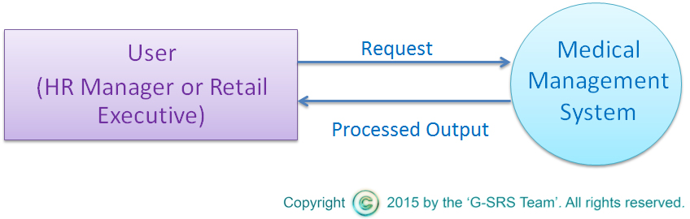
Data Flow Diagrams
Data Flow Diagram – Level 0

Slide 24
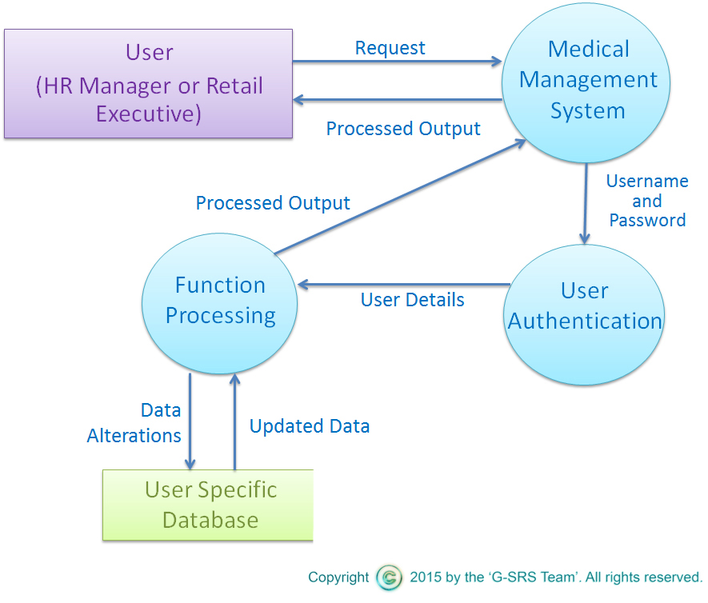
Data Flow Diagrams
Data Flow Diagram – Level 1

Slide 25
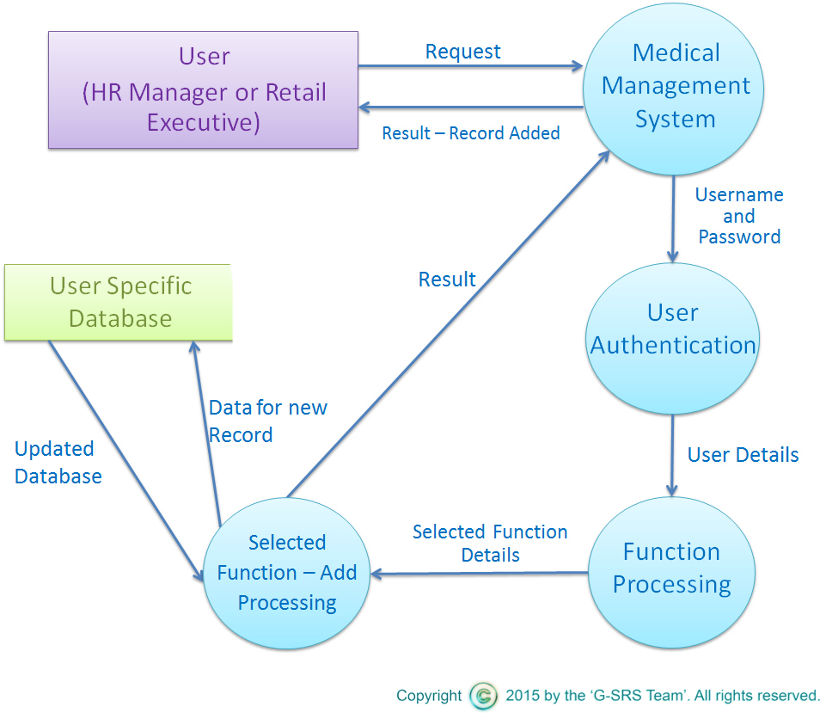
Data Flow Diagram – Level 2 – Insert Function

Slide 26

Data Flow Diagram – Level 2 – Delete Function

Slide 27
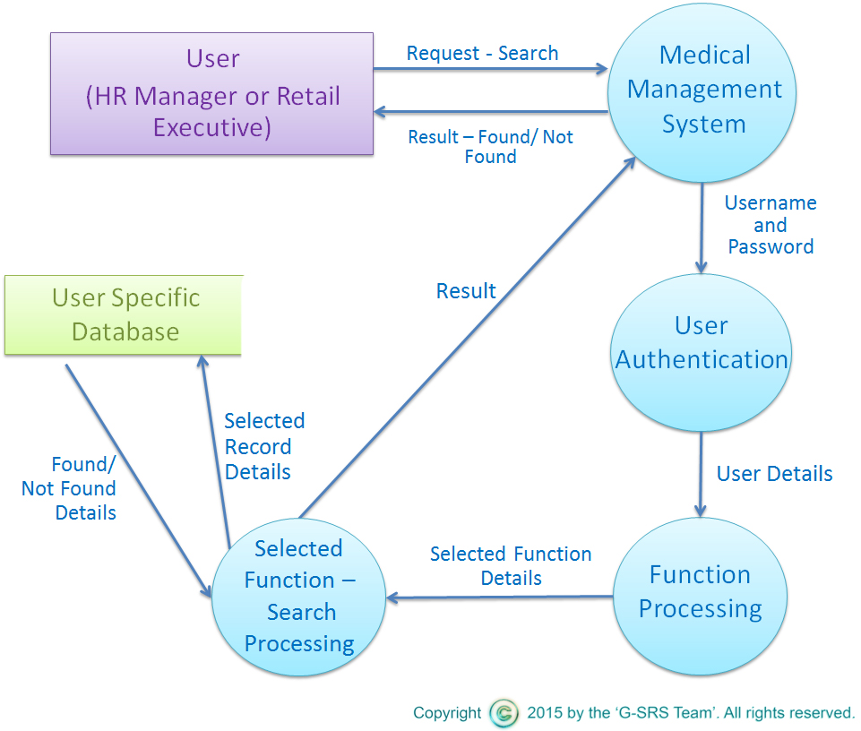
Data Flow Diagram – Level 2 – Search Function

Slide 28

Data Flow Diagram – Level 2 – Display Function

Slide 29
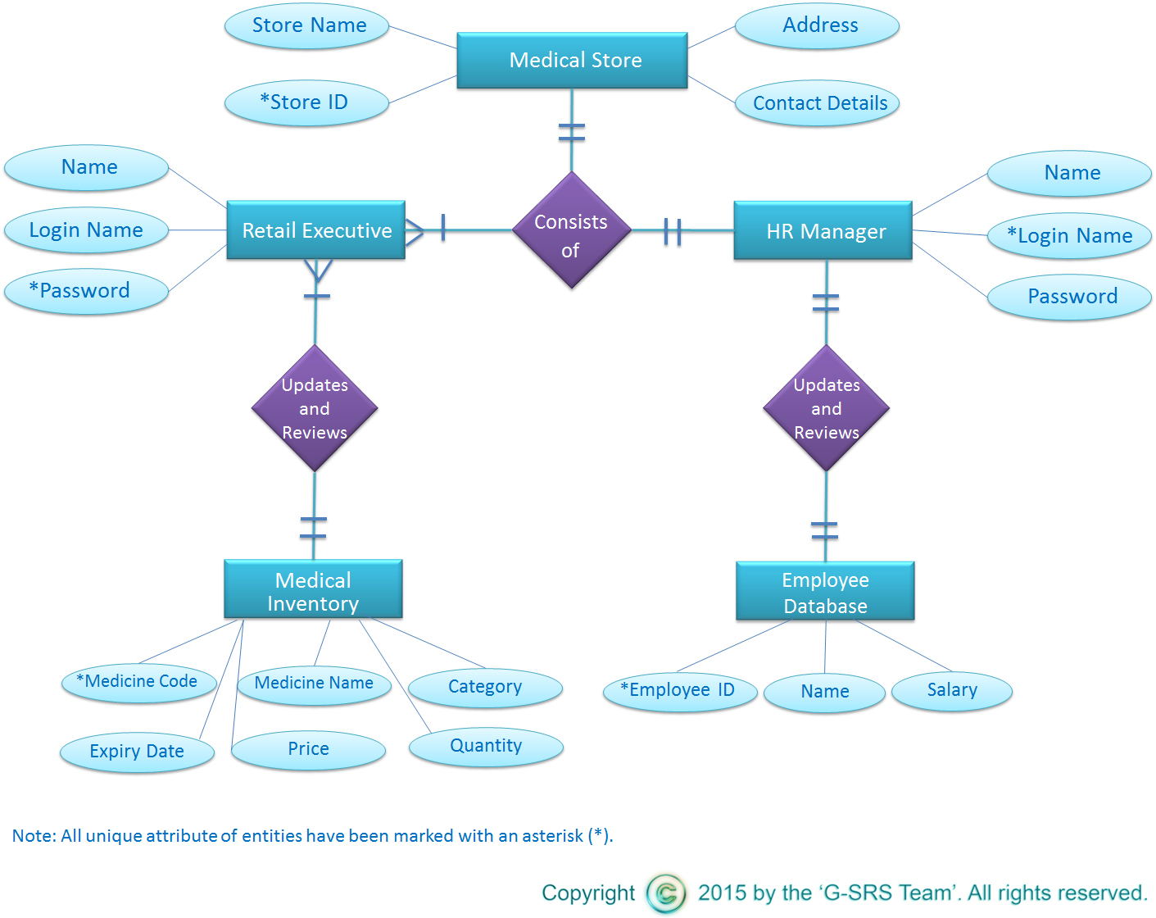
Entity Relationship Diagram

Slide 30
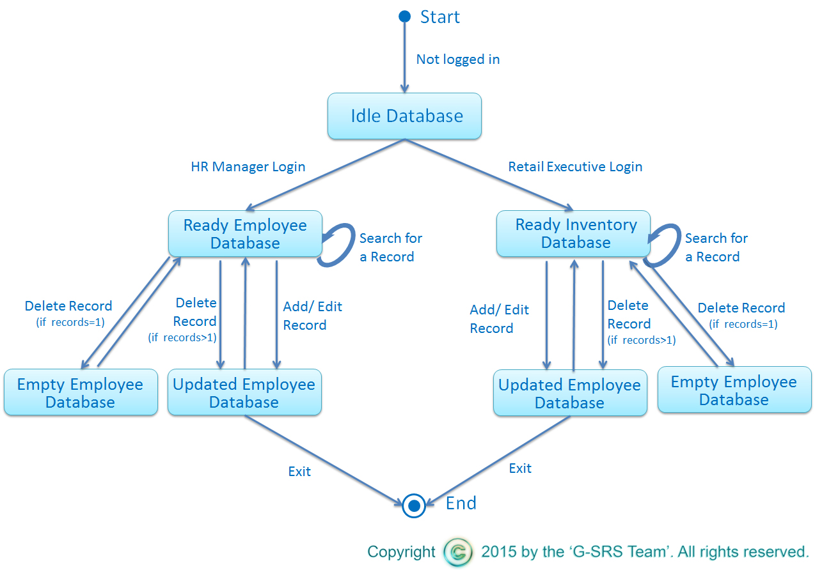
State Transition
Diagram

Slide 31
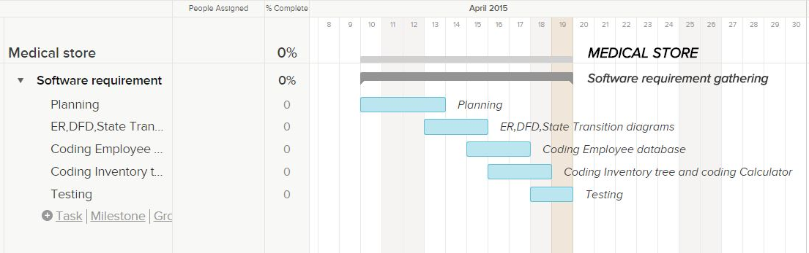
Timeline Chart

Slide 32
Software System Attributes
Reliability - HR Manager and the executive retailer can perform the required functions with precision
Availability - available on normal business hours
Security - no unauthorized access to the software
Maintainability – minimum effort to resolve an error
Portability – feasible to transfer software

Slide 33
Test Cases and Results

Slide 34
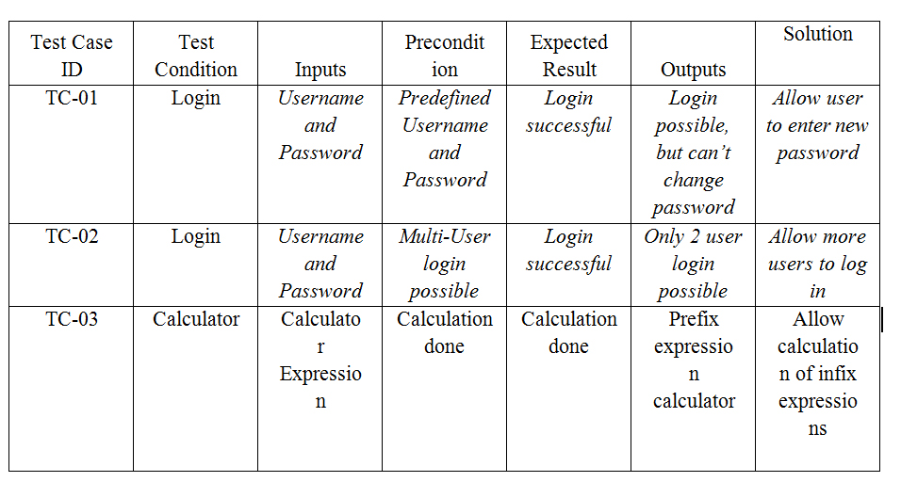
Test Cases

Slide 35
Conclusion
In conclusion, we would like to present the point that we care about people’s health. We also care about making money.
Hence our team developed this project to improve the efficiency of medical dispensaries.

Slide 36
Thank You!

