Slide 1
IMPLEMENTING TIC TAC TOE USING GAMES TREES AND THE MINIMAX ALGORITHM
Rheeya Uppaal
Second Year
Computer Science
PRN: 13070121133

Slide 2
Introduction

Slide 3

Introduction
“Tic-Tac-Toe” is also called “Noughts and Crosses” (in the Commonwealth Countries), “Xs and Os” (in Ireland)
Paper-and-pencil game for two players: X and O,
Players take turns marking the spaces in a 3×3 grid. The player who succeeds in placing three respective marks in a horizontal, vertical, or diagonal row wins the game.
An Example of the Game, Tic Tac Toe

Slide 4
Statistics and Purpose
19,683 (3⁹ ) possible board layouts
362,880 (i.e. 9!) possible games
Tic Tac Toe closely relates to the branch of artificial intelligence that deals with the searching of game trees
Widespread, global scope of the game

Slide 5
Overall Description

Slide 6
Process Model
The “Prototyping” software process model has been adopted for this project.
A prototype is built, tested, and then reworked as necessary until an acceptable prototype is finally achieved.
Works best when not all of the project requirements are known ahead of time.
The phases of development are not performed formally.
Errors can be detected much earlier as the system is made side by side.

Slide 7
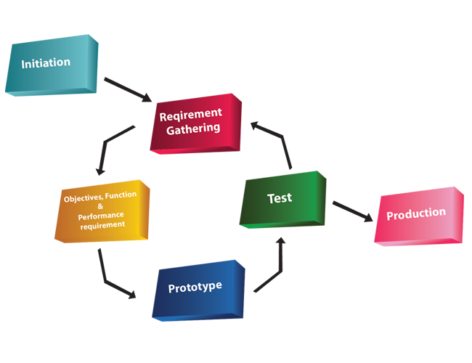
Process Model
The Prototyping Process Model

Slide 8
Functional Requirements
User friendly and efficient
Minimum maintenance and development cost
Availability of expected requirements within the required configuration
Ease of operation
Measured coding
Minimum hardware requirements
Efficient design
User friendly interface

Slide 9
Assumptions and Dependencies
Identical board positions have not been eliminated, increasing the number of nodes.
Alpha-Beta pruning has not been included.

Slide 10
Project Design

Slide 11
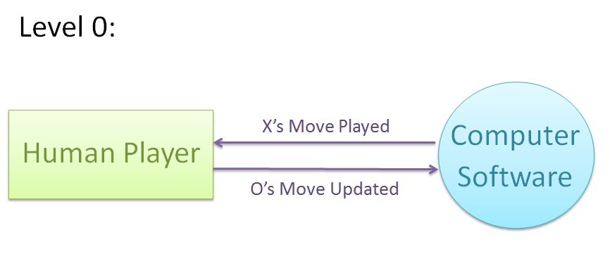
Data Flow Diagram
Data Flow Diagram for Tic Tac Toe – Level 0

Slide 12
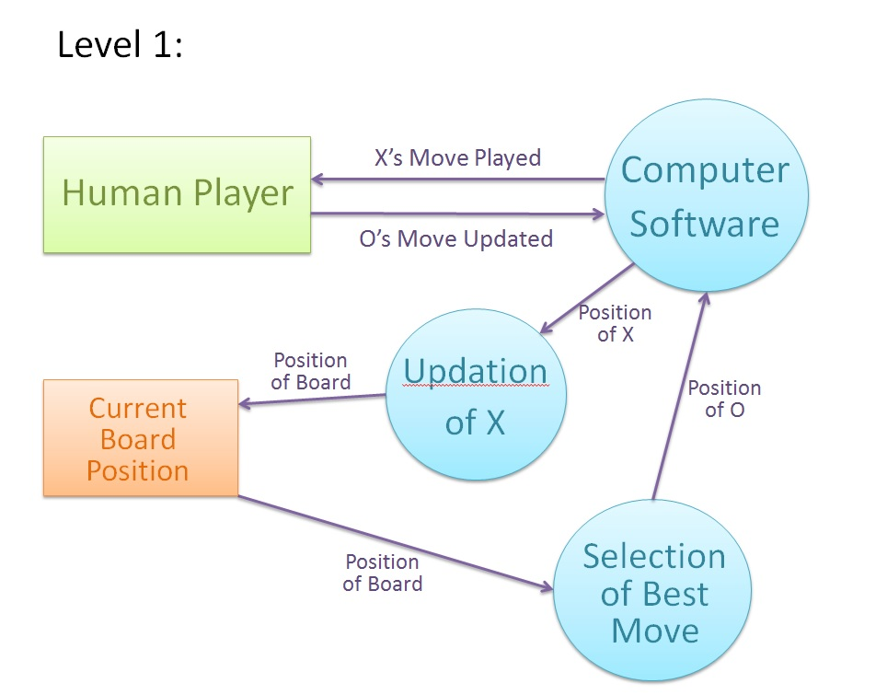
Data Flow Diagram
Data Flow Diagram for Tic Tac Toe – Level 1

Slide 13
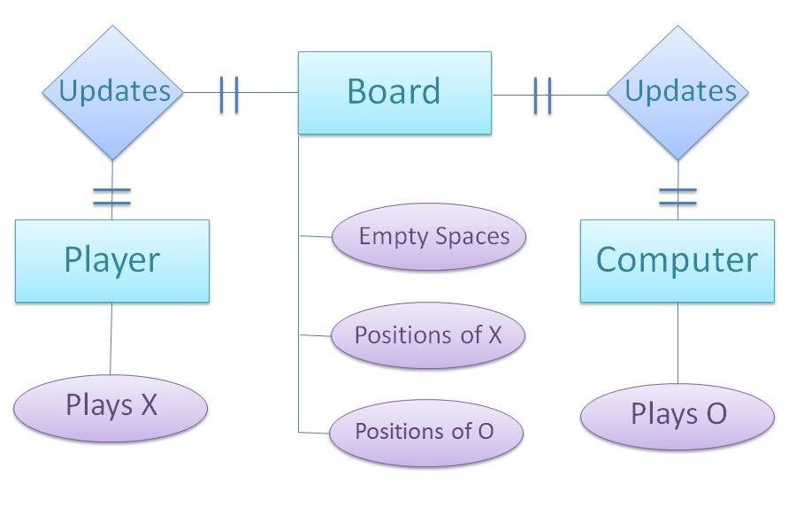
Entity - Relationship Diagram
Entity Relationship Diagram

Slide 14
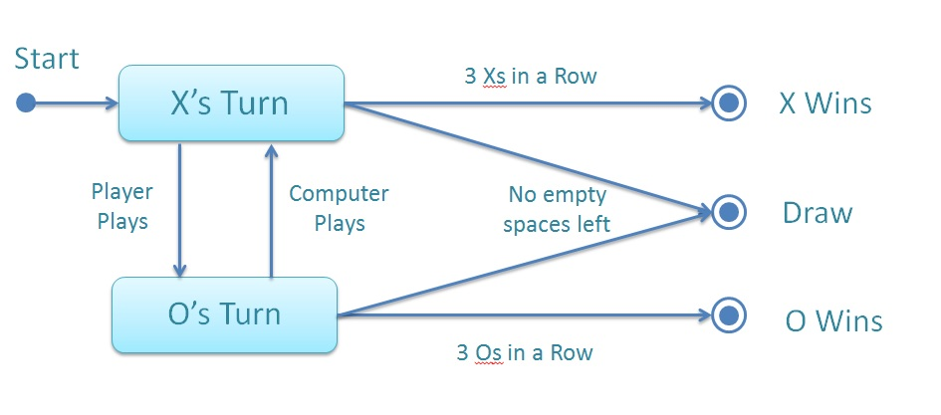
State Transition Diagram
Sate Transition Diagram

Slide 15
Application of Data Structures

Slide 16
Game Trees
In game theory, a game tree is a directed graph whose nodes are positions in a game and whose edges are moves.
The complete game tree for a game starts at the initial position and contains all possible moves from each position.
  Each node in the game tree represents a state of the game.
  Every level, or “ply”, represents a change in state through a move by either player.
For games like chess, complete game trees for are very large. Such games use a partial game tree.

Slide 17
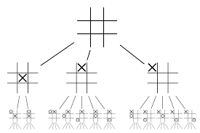
Game Trees
The diagram shows the first two levels in the game tree for tic-tac-toe. The first player has three choices of move: in the center, at the edge, or in the corner. The second player has two choices for the reply if the first player played in the center, otherwise five choices. And so on.

Slide 18
Game Trees
Using game trees, the computer can “look ahead” and “predict” all the future moves of the game.
However, the computer needs to select the best move. This is done using the Minimax Algorithm.

Slide 19
Minimax Algorithm
Minimax is a decision rule used in decision theory, game theory, statistics and philosophy for minimizing the possible loss for a worst case (maximum loss) scenario.
Initially created for two player games.
Has been extended to more complicated games and scenarios.

Slide 20
Minimax Algorithm
Leaf nodes in the game tree are assigned a minimax value.
The value could be either 1 (X wins), 0 (draw) or -1 (O wins).
Lower values are better for O (MIN)
Higher values are better for X (MAX)
Parents of leaf nodes are assigned the maximum or minimum value of all children.
Process repeated till all nodes have a minimax value.

Slide 21
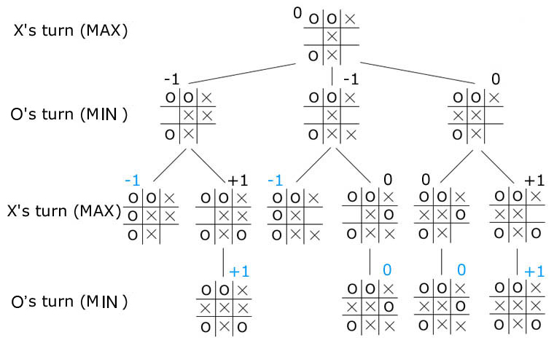
Minimax Algorithm

Slide 22
The Program

Slide 23
Class: Game
Contains basic functions regarding the general operation of the game.
Game() – Initializes board array, and calls for creation of game tree
Input() – Accepts value from user
MakePlayerMove() – Updates player’s legal move to board
MakeComputerMove() – Calls functions to find best move
Display() – Displays the current status of the game
EndGame() – Checks if the game is over, and determines the winner

Slide 24
Class: BoardNode
Contains the general structure for every node in the game tree.
The data members are:
char b[9] – Stores the condition of the board, i.e. ‘state’ for every node
int minimax – Minimax value for every node
BoardNode *child[8] - Links to all children of a node (Maximum of eight children)
BoardNode *parent – Link to the parent of a node.

Slide 25
Class: GameTree
Contains functions regarding the creation of the game tree, assignment of minimax values and choosing the best move. Essentially, the AI part of the program.
FirstMove() – Accepts the very first play of X in the game, for the creation of the game tree
CreateTree() – Creates the game tree for the game
MinimaxTraverse() – Traverses the tree and assigns minimax values to all nodes
ChooseMove() – Chooses the best move that can be played by the computer

Slide 26
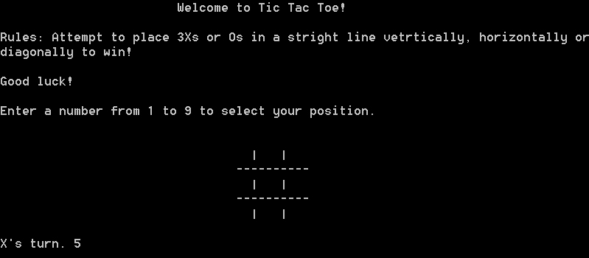
The Interface

Slide 27
Thank You

