Slide 1

BurpSuite
Discover the power of BurpSuite, a versatile web application security testing tool that empowers ethical hackers and security professionals.
by
22B81A1292
Uppala Nikhitha

Slide 2
Understanding the Burp Suite Interface
Intuitive Layout
Customizable Views
Comprehensive Toolset
Organized modules for seamless workflow
Tailor the interface to your needs
Modules for every phase of testing

Slide 3
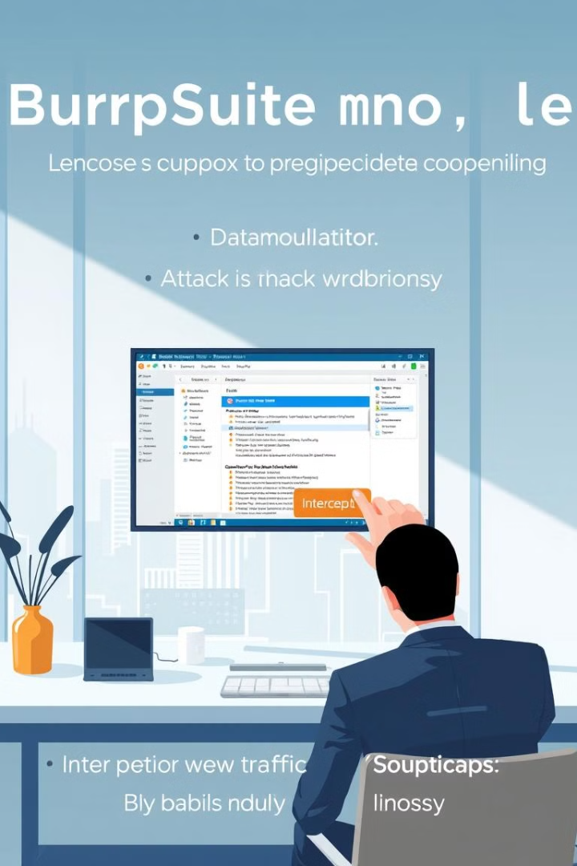
Exploring the Proxy Module
1
Intercept Traffic
Capture and inspect web requests/responses
2
Modify Content
Tamper with data to uncover vulnerabilities
3
Replay Scenarios
Test attacks and validate findings

Slide 4
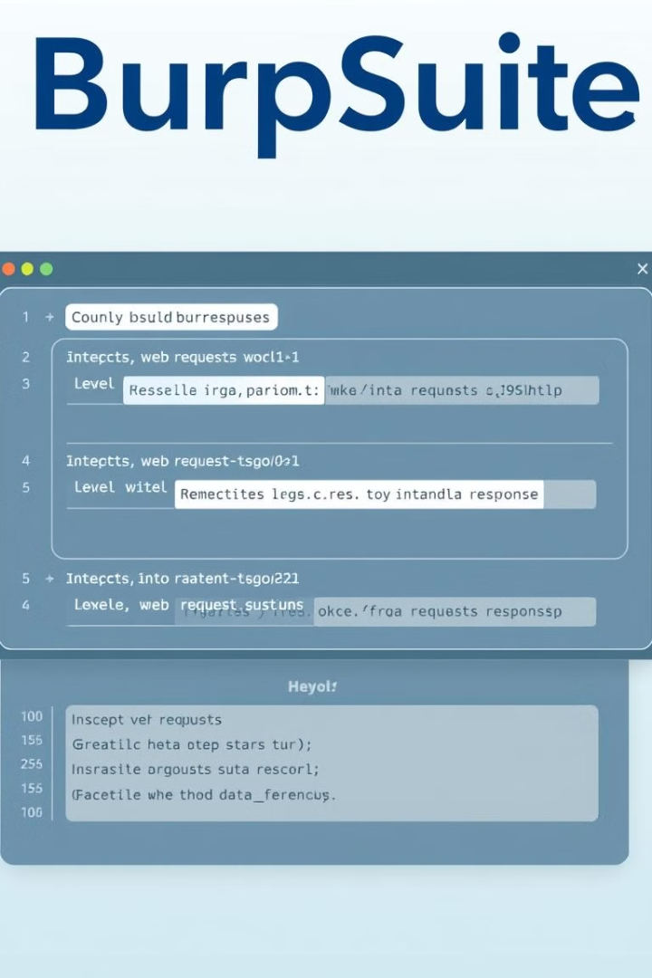
Intercepting and Modifying Web Traffic
Inspect Requests
Manipulate Responses
View and edit all HTTP/HTTPS traffic
Identify and exploit vulnerabilities
Automated Rules
Real-time Analysis
Streamline repetitive modifications
Gain deep insights into web application

Slide 5
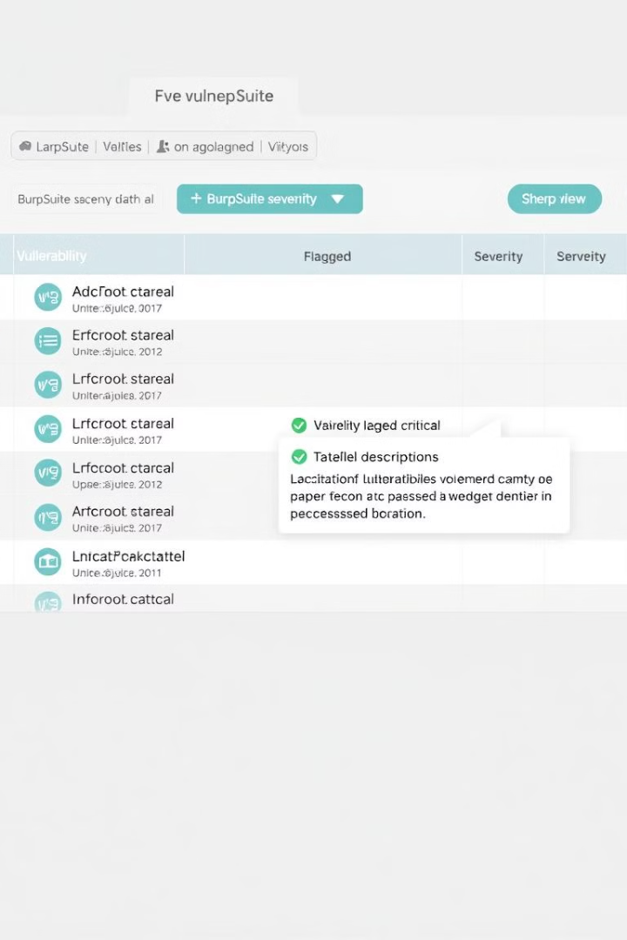



Scanning for Vulnerabilities with the Scanner
Configuration
Customize scan settings and scope
Detection
Identify a wide range of vulnerabilities
Validation
Verify findings and assess impact

Slide 6
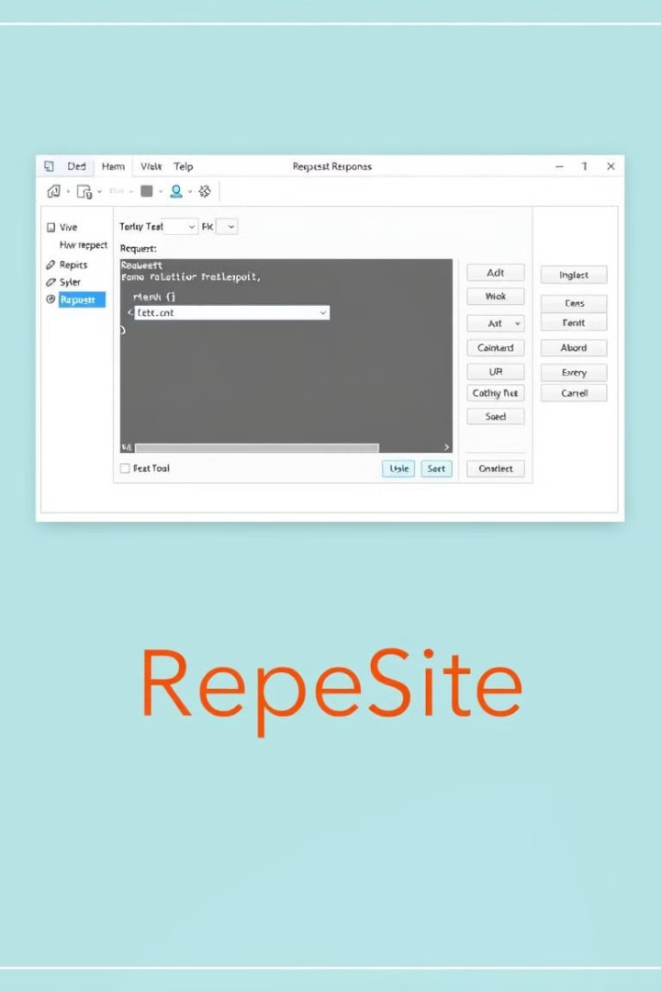
Automating Tasks with the Repeater
1
Replay Requests
2
Modify Payloads
Easily re-send intercepted traffic
Test different attack vectors
3
Scripting Capabilities
4
Real-time Feedback
Enhance automation with Burp Extensions
Observe the impact of your actions

Slide 7
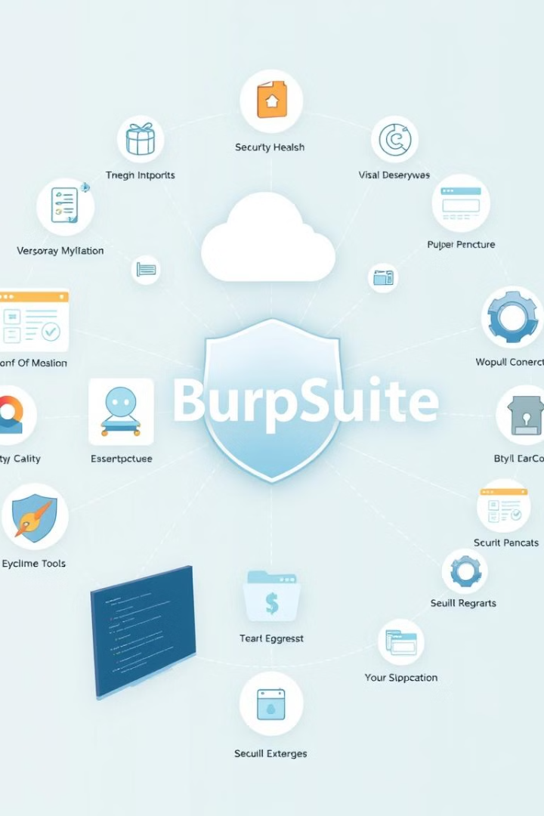
Burp Suite Integrations and Extensions
Browser Extensions
Extend Burp's functionality
Integration with Other Tools
Seamless workflow with popular security tools
Community-Driven Plugins
Access a vast library of add-ons
Customizable Automation
Automate repetitive tasks with scripting

