Slide 1
FIFO BRANCHAID BOUND SEARCH
FIFO Branch and Bound Search is an efficient algorithm for optimization problems, utilizing a queue-based approach to explore the solution space. -22B81A1292
UPPALA NIKHITHA

Slide 2
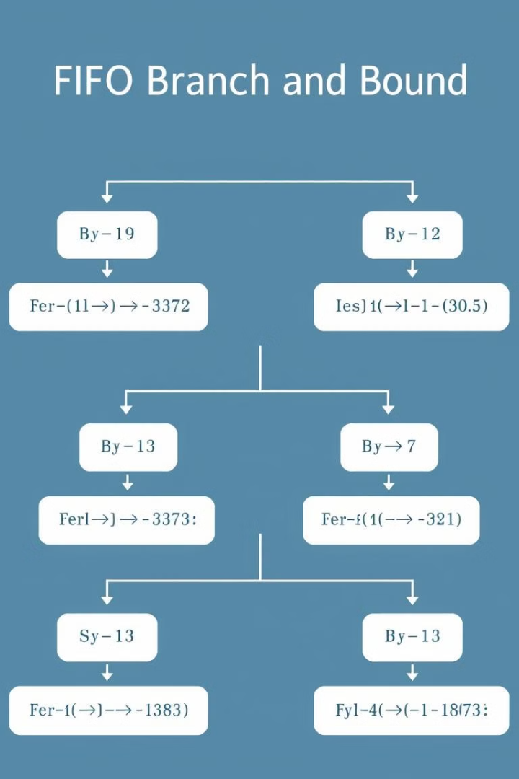
Understanding FIFO Branch and Bound
1
Branching
Recursively explore the solution space by generating child nodes.
2
Bounding
Estimate the cost of each branch to prune unproductive paths.
3
FIFO Queue
Manage the order of exploration using a First-In-First-Out approach.

Slide 3
The FIFO Approach
Efficient Exploration
Memory Management
Guaranteed Optimality
FIFO ensures a systematic and thorough search of the solution space.
The queue structure simplifies bookkeeping and resource allocation.
The FIFO approach ensures the optimal solution is found, if it exists.

Slide 4
Advantages of FIFO Branch and Bound
1
Broad Applicability
2
Guaranteed Optimality
Can solve a wide range of optimization problems effectively.
Ensures the discovery of the best possible solution.
3
Efficient Exploration
Scalability
4
The FIFO approach maximizes the utilization of available resources.
Can handle large, complex problems with high computational demands.

Slide 5
Applications of FIFO Branch and Bound
Scheduling and Sequencing
Routing and Logistics
Finding the most efficient paths for transportation and delivery.
Optimizing the order of tasks, jobs, or activities.
Resource Allocation
Combinatorial Optimization
Distributing limited resources to maximize productivity or output.
Solving complex problems with many possible solutions.

Slide 6
Limitations and Drawbacks
Memory Consumption
Computational Complexity
Potential for Suboptimal Solutions
Maintaining the queue can be resource-intensive for large problems.
The algorithm's runtime can be exponential in the worst case.
The FIFO approach may not always find the global optimum.

Slide 7
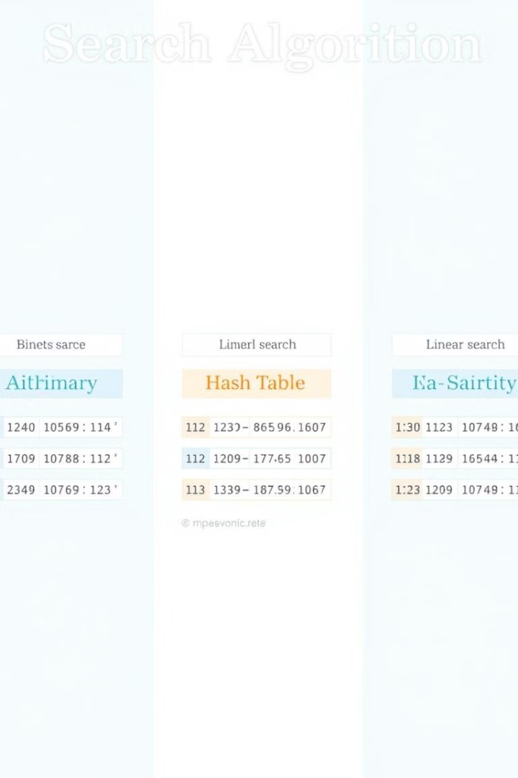




Comparison to Other Search Algorithms
Breadth-First Search
Depth-First Search
Explores all neighboring nodes before moving deeper.
Explores a single path to the maximum depth before backtracking.
Greedy Search
FIFO Branch and Bound
Chooses the locally optimal choice at each step.
Balances exploration and pruning to find the global optimum.

Slide 8
Conclusion
FIFO Branch and Bound is a powerful optimization algorithm with diverse applications and advantages, though it also faces certain limitations
THANK YOU

