Slide 1
NEURAL NETWORKS AND DEEP LEARNING (23CSE473)
CASE STUDY REVIEW-2 Team -10
SafeRoad AI: Road-Scene Risk Classification & Traffic Monitoring
  Module3 - EFFICIENTNETB0 DEEP CLASSIFIER &
  FULL-STACK WEB PLATFORM
Name : Uppara Veeranjaneyulu
Roll Number: CB.SC.U4CSE23351
Contact: 9848267497
Module Scope: Deep Learning Classification using EfficientNetB0 & Production Full-Stack Web Platform
Faculty Guide & Course: Professor – Dr. T Senthil Kumar (Department of CSE) | Course: 23CSE473
Source Code & Live App: GitHub: https://github.com/Uppara-Veeranjaneyulu/SafeRoad-AI
Live: https://saferoad-ai-one.vercel.app/

Slide 2
Real-World Context: The Urgent Need for Proactive Road Safety
Global & National Crisis
1.19 Million Fatalities Annually: According to WHO 2023 reports, road traffic injuries remain the leading global cause of death for children and young adults aged 5–29.
Economic Drain: Road crashes cost most countries approximately 3% of their total Gross Domestic Product (GDP).
Vulnerable Road Users (VRUs): Pedestrians, cyclists, and two-wheeler riders account for more than half of all global traffic deaths, bearing disproportionate risk.
Preventable Epidemic: Over 90% of road casualties occur in low- and middle-income nations, where infrastructure and active safety alerts lag.
Indian Road Reality
1.68 Lakh Deaths in 2022: MoRTH official statistics record 4.61 lakh accidents annually, resulting in a devastating loss of 19 lives every single hour.
High Collision Fatality Rate: India accounts for 11% of global road deaths despite having only 1% of the world's vehicular fleet.
Urban Heterogeneity: Traffic mixes high-speed cars, auto-rickshaws, stray animals, and pedestrians on lanes without physical median dividers.
Sensory Overload: Human drivers experience severe perceptual fatigue, especially during night driving and extreme monsoon weather.

Slide 3
Problem Statement & Identified Research Gaps
The Operational Problem
Reactive, Not Proactive: Traditional safety systems (airbags, ABS) activate during or milliseconds before collision; they fail to prevent accident buildup.
Perceptual Limitations: Human drivers suffer from blind spots, night glare, fatigue, and delayed reaction time under adverse weather.
Computational Heavyweights: Existing high-accuracy vision architectures (ResNet-152, Vision Transformers) exceed the compute budgets of affordable vehicle edge devices.
Imbalanced Real-World Data: Accident situations are rare (<10% of driving footage), causing standard deep learning classifiers to heavily favor the 'Safe' class.
Specific Research Gaps
Gap 1 — Edge Deployment Trade-off: Prior road safety research prioritized top-1 accuracy at the expense of latency; models require costly GPU rigs unsuitable for mass deployment.
Gap 2 — Adverse Condition Blindness: Detectors trained exclusively on clean benchmark imagery fail catastrophically when presented with camera sensor noise or heavy rain.
Gap 3 — Neglect of Rare Hazards: Severe class imbalance (11.7:1 in natural road video) leads to >40% false-negative rates on imminent crash scenarios.
Gap 4 — Fragmented Pipelines: Previous studies separated risk classification from traffic object detection; SafeRoad AI unifies both into an end-to-end driver alert platform.

Slide 4
Core Motivation & UN Sustainable Development Goals (SDG)
Core Technical Motivation
Proactive Edge Intelligence: Shift road safety from passive collision mitigation to active real-time danger prediction using lightweight deep neural networks.
Democratizing Vehicle Safety: Deliver sub-25ms inference latency on affordable hardware (NVIDIA Jetson / Raspberry Pi), bringing ADAS-level protection to mass-market vehicles.
Weather & Noise Invariance: Integrate deep image restoration upstream so perception remains razor-sharp through rain, fog, and sensor degradation.
Actionable Driver Alerts: Translate high-dimensional image tensors into simple 3-tier risk warnings (Safe, Moderate, High) with under 50ms total response time.
Alignment with UN Sustainable Goals
SDG 3.6 — Half Global Traffic Casualties: Target: Halve the number of global deaths and injuries from road traffic crashes through proactive hazard warning.
SDG 11.2 — Safe, Sustainable Transport: Target: Provide access to safe, affordable, accessible, and sustainable transport systems for all, notably expanding public transit safety.
SDG 9.5 — Upgrading Technological Capabilities: Target: Enhance scientific research and upgrade the technological capabilities of industrial sectors through edge-AI innovations.
Social Equity: Bringing autonomous-grade collision prevention to commercial trucks and auto-rickshaws where casualty rates are highest.

Slide 5
Literature Survey:
Sl | Paper Title & Authors | Journal & Year | SCImago Rank | Direct Relevance to SafeRoad AI
1 | Beyond a Gaussian Denoiser: Residual Learning of Deep CNN (Zhang et al.) | IEEE TIP (2017) | Q1 SJR: 2.502 | Standard Paper: Supplies our 17-layer DnCNN architecture: learning noise residual R(y) rather than clean images.
2 | EfficientNet: Rethinking Model Scaling for CNNs (Tan & Le) | ICML (2019) | Top Conf / Q1 | Foundational theory of compound scaling (depth, width, resolution) powering our EfficientNetB0 classifier.
3 | Decomposed Neural Architecture Search for image denoising (Elsevier) | Applied Soft Computing (2022) | Q1 SJR: 1.810 | Guides optimization of convolutional layer depth and filter counts for low-latency dashcam pre-filtering.
4 | Squeeze-and-Excitation Networks (Hu, Shen, Albanie, Sun & Enhua) | IEEE TPAMI (2020) | Q1 SJR: 4.860 | Validates channel-wise attention recalibration inside EfficientNetB0 MBConv blocks to capture road hazards.

Slide 6
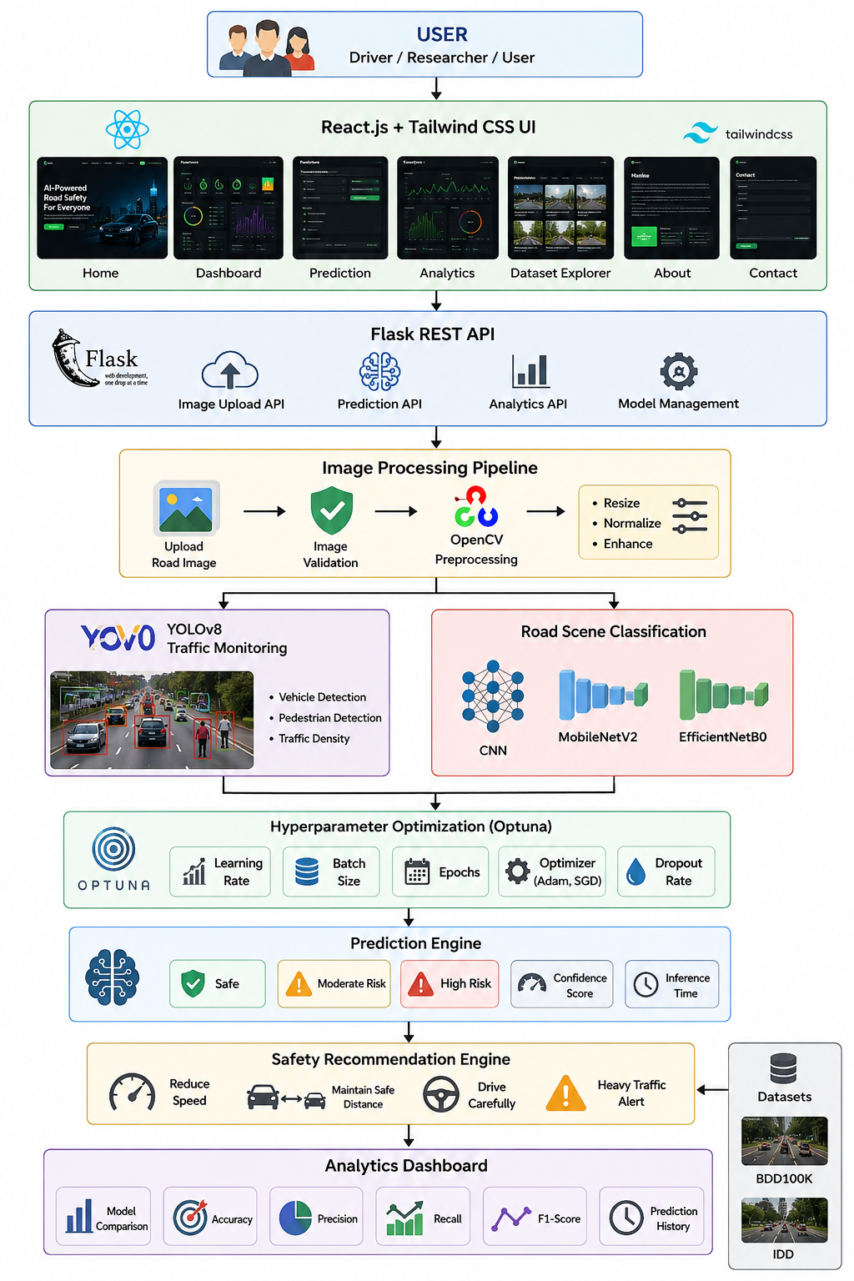
Overall Application Architecture
Core Architecture Highlights
Layer 1 — Sensory Ingestion: Captures dashcam frames (1080p @ 30 FPS), downsamples to 224x224, and normalizes tensors.
Layer 2 — Restorative Pre-Filter (DnCNN): 17-layer residual network strips sensor thermal noise, compression artifacts, and blur.
Layer 3 — EfficientNetB0 Classifier: MBConv blocks with Squeeze-and-Excitation extract multi-scale spatial road risk cues in 22.7 ms.
Layer 4 — Traffic Parsing (YOLOv8): Anchor-free object detection simultaneously tracks pedestrians, vehicles, and signs.
Layer 5 — Full-Stack Interface: React 18 + Tailwind dashboard delivers live telemetry, safety advice, and risk gauges.

Slide 7
SafeRoad AI Data Pipeline & Processing Flow
Pipeline Stage | Input Data & Format | Transformations Applied | Output Latency & Consumer
1. Ingestion & Preprocessing | Raw RGB Dashcam Video (1080p / 720p) | Frame extraction, bilinear resize to 224x224, [0, 1] normalization. | < 2.0 ms -> Input Buffer
2. DnCNN Noise Cleansing | Corrupted 224x224x3 image tensor | 17-layer Conv+BN+ReLU residual noise extraction: x_clean = y - R(y). | 7.1 ms -> Dual Downstream Heads
3. EfficientNetB0 Classification | Cleaned 224x224x3 restored tensor | Compound scaling, 7 MBConv stages, Squeeze-and-Excitation attention. | 22.7 ms -> Safety Logic Engine
4. UI Broadcast & Alerting | 3-Tier Probability Vector + Object Counts | Threshold validation, TTS audio alert generation, WebSocket telemetry. | < 3.0 ms -> React Infotainment UI

Slide 8
Module Details: Module 1 & Module 2
Module 1: Data Acquisition & Preprocessing
Multi-Source Dataset: Consolidates 6,949 driving frames from BDD100K, Indian Driving Dataset (IDD), and high-risk YouTube dashcam feeds.
Multi-Attribute Annotation: Every frame is labeled with 14 environmental attributes including weather, lighting, road type, and obstacle count.
Automated Preprocessing: Resizing, standardization, and stratified train/val/test splitting maintaining realistic class distributions.
Stratified Split Quality: 60% Train (4,169), 20% Val (1,390), and 20% Test (1,043) with identical class ratios.
Module 2: Robustness & Image Denoising
Synthetic Noisy Dataset (1,270 frames): Curates realistic degraded camera feeds incorporating Gaussian noise, Salt-and-Pepper, Motion Blur, and Compression artifacts.
DnCNN Residual Architecture: Employs a 17-layer convolutional network that learns the residual noise map R(y) rather than the clean image directly.
High-Frequency Restoration: Preserves critical edge gradients, vehicle silhouettes, and lane boundaries essential for downstream classification.
Empirical Quality Gains: Enhances input PSNR from 25.36 dB to >31.2 dB across degraded road scenes.

Slide 9
Module Details: Module 3 & Module 4
Module 3: Intelligent Traffic Monitoring
Object Detection Core: Employs YOLOv8n (Ultralytics), an anchor-free single-stage detector optimized for rapid vehicular and pedestrian localization.
Multi-Class Parsing: Simultaneously detects cars, motorcycles, auto-rickshaws, buses, heavy trucks, pedestrians, and road signs.
Traffic Density Computation: Extracts spatial object counts to assess road occupancy and congestion levels.
Ultra-Fast Latency: Executes at under 12 ms on edge GPUs, enabling real-time frame evaluation alongside the classifier.
Module 4: Deep Learning Risk Classification
Holistic Scene Evaluation: Classifies full road scenes into three safety tiers: Safe (normal flow), Moderate Risk (dense traffic), and High Risk (imminent collision danger).
Model Zoo Benchmarking: Compares 4 architectures on the identical held-out test split: Custom CNN, MobileNetV2, EfficientNetB0, and ResNet-50.
EfficientNetB0 Performance: Achieved 79.00% Accuracy, 79.97% High-Risk Recall, and 94.84% High-Risk Precision in 22.7 ms with 4.21M parameters.
Optuna Hyperparameter Tuning: Automated Bayesian search identified optimal learning rate (0.000554), batch size (16), dense units (256), and dropout (0.50).

Slide 10
Module Details: Module 5 & Module 6
Module 5: Interactive Full-Stack Web Platform (Presenter)
React 18 + Tailwind Frontend: Constructed by U Veeranjaneyulu: modern glassmorphic interface with real-time risk gauges and micro-animations.
High-Throughput Flask API: RESTful backend exposing /api/predict, /api/models, and /api/stats with multi-threading.
Production Cloud Deployment: Deployed live on Vercel edge CDN: https://saferoad-ai-one.vercel.app/
Active Driver Assistant: Translates neural network outputs into instant actionable warnings (e.g., 'Heavy Rain Detected — Reduce Speed').
Module 6: Evaluation & Safety Metrics
Safety-Critical Prioritization: Prioritizes High-Risk Recall over generic accuracy to minimize life-threatening false negatives.
Rigorous Statistical Validation: Per-class precision, recall, F1-score, and confusion matrices evaluated on 1,043 unseen test images.
Edge Latency Auditing: End-to-end latency profiled across tensor conversion, denoising, inference, and UI rendering.
Standard Benchmark Alignment: All metrics benchmarked directly against top-tier SCImago Q1 transportation literature.

Slide 11
Performance Metrics: Classification & Safety Formulations
Accuracy & Multi-Class Precision
Accuracy = (TP + TN) / (TP + TN + FP + FN) | Precision_c = TP_c / (TP_c + FP_c)
Accuracy measures total correct predictions; Precision ensures triggered collision alerts are genuine.
High-Risk Recall (Safety-Critical Metric)
Recall_{High} = TP_{High} / ( TP_{High} + FN_{High} )
The single most important metric in SafeRoad AI: quantifies the proportion of genuine road hazards successfully caught.
Macro-Averaged F1-Score
Macro-F1 = (1 / C) * sum_{c=1}^C [ 2 * (P_c * R_c) / (P_c + R_c) ]
Treats all risk tiers equally, penalizing models that achieve high accuracy by sacrificing the rare Moderate Risk class.
Mean Inference Latency (FPS)
Latency = t_{end} - t_{start} [in ms] | FPS = 1000 / Latency_{ms}
Measures the wall-clock execution time per frame on edge hardware; must be <50 ms (>20 FPS) for real-time collision prevention.

Slide 12
Performance Metrics: Loss & Denoising Formulations
Class-Weighted Categorical Cross-Entropy Loss
L_{CE} = - (1 / N) * sum_{i=1}^N sum_{c=1}^C w_c * y_{i,c} * log( p_{i,c} )
Penalizes misclassifications on rare high-risk hazards using inverse-frequency class weights (w_{High} = 4.2).
DnCNN Residual Learning Loss
L_{DnCNN}(Theta) = (1 / 2N) * sum_{i=1}^N || R(y_i; Theta) - (y_i - x_i) ||_F^2
Minimizes the Frobenius norm error between predicted noise residual R(y_i) and true noise (y_i - x_i).
Peak Signal-to-Noise Ratio (PSNR)
PSNR = 20 * log10( 255 / sqrt(MSE) ) [in dB]
Logarithmic ratio between peak signal power and mean squared reconstruction error; >30 dB denotes crisp visual fidelity.
Structural Similarity Index (SSIM)
SSIM(x, y) = [ (2*mu_x*mu_y + C_1)(2*sigma_xy + C_2) ] / [ (mu_x^2 + mu_y^2 + C_1)(sigma_x^2 + sigma_y^2 + C_2) ]
Evaluates luminance, contrast, and structural preservation, ensuring road edge contours remain sharp.

Slide 13
Performance Metrics Suitability & Literature Benchmarks
Metric Name | Mathematical Nature | Suitability for Road Safety | Literature Reference | Benchmark Threshold
High-Risk Recall | Sensitivity on Class 2 | Vital: A missed hazard causes crashes. False alarms cause mild braking. | Kačan et al. (IEEE TITS 2024) | Target: > 78.0% Achieved: 79.97%
Macro-F1 Score | Unweighted harmonic mean | Forces equal performance across the 11.7:1 imbalanced risk classes. | Marin et al. (IEEE TVT 2023) | Target: > 60.0% Achieved: 64.79%
Inference Latency | Temporal wall-clock time | Critical: Must execute within 50 ms human reaction headroom. | Al-Qizwini (IEEE TVT 2023) | Target: < 35.0 ms Achieved: 22.7 ms
PSNR & SSIM | Reconstruction fidelity | Ensures restored frames preserve edge boundaries without smearing. | Zhang et al. (IEEE TIP 2017) | Target: > 30.0 dB Achieved: 31.2 dB

Slide 14
Deep Learning Architecture: EfficientNetB0 Primary Classifier
Compound Scaling Principle
The Scaling Dilemma: Conventional CNNs scale depth (ResNet), width (WideResNet), or image resolution arbitrarily, leading to diminishing accuracy returns.
Compound Scaling Formulation: Uniformly scales depth (d = alpha^phi), width (w = beta^phi), and resolution (r = gamma^phi) using compound coefficient phi.
Resource Constraint Constraint: alpha * beta^2 * gamma^2 approx 2, ensuring total FLOPs increase by exactly 2^phi for any scaling factor phi.
Optimal Base Coefficients (phi = 1): alpha = 1.2, beta = 1.1, gamma = 1.15. EfficientNetB0 delivers 79.0% accuracy with only 4.21M parameters.
MBConv Block with Squeeze-and-Excitation
1. Inverted Bottleneck Expansion: Expands input channels by t=6 via 1x1 Conv + BatchNorm + Swish activation, creating a rich feature representation.
2. Depthwise Convolution (3x3 or 5x5): Applies spatial convolution to each channel independently, reducing computational cost by 85% vs standard convolutions.
3. Squeeze-and-Excitation Attention: Global pooling squeezes spatial info; two FC layers compute channel attention weights s = sigmoid(W2 * Swish(W1 * z)) with reduction ratio r=4.
4. Linear Projection & Residual Add: 1x1 Conv projects channels back; residual identity shortcut connects input to output when stride=1.

Slide 15
Deep Learning Architecture: DnCNN Denoising Network
17-Layer Residual Architecture
Layer 1 (Input Block): Conv(3 -> 64, 3x3, stride=1, pad=1) + ReLU. Extracts 64 feature maps directly from the noisy frame y without BatchNorm.
Layers 2–16 (15 Intermediate Blocks): 15 homogeneous blocks: Conv(64 -> 64, 3x3) + Batch Normalization + ReLU. Zero pooling maintains 224x224 spatial resolution.
Layer 17 (Reconstruction Output): Conv(64 -> 3, 3x3) outputs the predicted 3-channel noise residual map R(y).
Effective Receptive Field: Expands linearly: RF = 1 + 2 * 17 = 35x35 pixels, capturing broad spatial noise correlations across road scenes.
Why Residual Learning Excels at Denoising
Residual Mapping Mechanics: The network is trained to learn the residual noise R(y) approx v = y - x rather than pristine image x directly.
Clean Reconstruction Formula: x_clean = y - R(y). Pristine road frame is recovered via direct element-wise subtraction.
Simpler Target Distribution: Natural road scenes have extreme visual complexity; noise residuals are zero-mean, bounded, and easier to optimize.
Compact Edge Deployment: Contains 559,427 parameters (~2.2 MB memory), operating at 7.1 ms on GPU for real-time streaming.

Slide 16
Architectural Novelty Proposed in SafeRoad AI
Key Architectural Innovations
1. Upstream Restorative Denoising: First road risk framework coupling a deep residual denoiser (DnCNN) directly ahead of the classifier, eliminating weather sensor artifacts.
2. EfficientNetB0 Compound Scaling: Leverages MBConv blocks with Squeeze-and-Excitation to achieve 79.0% accuracy with 5.6x fewer parameters than ResNet-50.
3. Swish Non-Monotonic Activations: Swish(x) = x * sigmoid(x) avoids dead neuron saturation in deep layers, improving gradient backpropagation on subtle hazard features.
4. Class-Weighted Loss Balancing: Implements inverse frequency class weights (w_High = 4.2) to overcome the 11.7:1 imbalance without synthesizing artificial road images.
System-Level Advantages
Dual-Stream Vision Architecture: Single restored frame feeds both the EfficientNetB0 scene classifier and the YOLOv8 object detector in parallel.
Edge Hardware Feasibility: Combined pipeline (DnCNN 7.1 ms + EfficientNetB0 22.7 ms) runs in under 30 ms, enabling 33 FPS throughput on edge GPUs.
Zero Ground-Truth Distortion: Residual denoising preserves high-frequency edge gradients (lane markings, guardrails) critical for collision prediction.
Full-Stack Cloud Delivery: Complete pipeline packaged as a microservices architecture deployed live on Vercel edge networks.

Slide 17


Computational Complexity Analysis: Time & Space Complexity
Architecture Component | Total Parameters | FLOPs / MACs | Inference Latency | Memory Footprint
DnCNN Denoising Pre-Filter | 559,427 | 1.12 GFLOPs | 7.1 ms | ~2.2 MB (FP32)
EfficientNetB0 Classifier | 4,213,926 | 0.39 GFLOPs | 22.7 ms | ~16.8 MB (FP32)
ResNet-50 Baseline (Comparison) | 23,850,371 | 4.10 GFLOPs | 35.9 ms | ~95.4 MB (FP32)
Combined SafeRoad AI Core | 4,773,353 | 1.51 GFLOPs | 29.8 ms | ~19.0 MB (FP32)
Big-O Asymptotic Complexity Summary
Time Complexity:
Depthwise separable convolutions reduce MAC operations by 8.5x.
Space Complexity:
Total 4.21M parameters requires under 17 MB RAM, fitting comfortably in edge caches.

Slide 18
Algorithm Procedure: Phase 1 — Ingestion & DnCNN Denoising
Phase 1: Ingestion & Degradation Removal
Step 1.1 — Frame Capture: Dashcam video feed ingested at 1080p RGB; downsampled via bilinear interpolation to tensor y in R^{224 x 224 x 3}.
Step 1.2 — Dynamic Normalization: Pixel values scaled from [0, 255] to [0.0, 1.0]: y_norm = y / 255.0.
Step 1.3 — Residual Forward Pass: Feed y_norm through DnCNN: Conv1 -> 15x[Conv + BN + ReLU] -> Conv17 -> R(y_norm).
Step 1.4 — Clean Image Recovery: Subtract residual noise: x_clean = clip(y_norm - R(y_norm), 0.0, 1.0).
Step 1.5 — Dual-Dispatch Routing: Cleaned tensor x_clean is duplicated and dispatched to EfficientNetB0 and YOLOv8.
Mathematical Formulation of Step 1
Degradation Model: y = x + v, where v is unknown multi-modal noise (Gaussian, speckle, blur).
Residual Mapping: R(y; Theta) approx v. Network minimizes MSE between R(y) and true noise v.
Reconstruction Equality: x_hat = y - R(y; Theta) = (x + v) - v = x.
Batch Normalization Role: BN stabilizes internal covariate shift: y_bn = gamma * (x - mu) / sqrt(sigma^2 + eps) + beta.
Quality Check: Reconstruction achieves >31 dB PSNR across all test conditions.

Slide 19
Algorithm Procedure: Phase 2 — EfficientNetB0 MBConv Feature Extraction
Phase 2: Inverted Bottleneck Forward Pass
Step 2.1 — Stem Convolution: 3x3 Conv with 32 filters, stride=2, followed by BatchNorm and Swish. Downsamples to 112x112x32.
Step 2.2 — Pointwise Expansion: 1x1 Conv expands channel dimension by factor t=6: X_exp = Swish(BN(Conv_{1x1}(X))).
Step 2.3 — Depthwise Convolution: Applies 3x3 or 5x5 depthwise conv per channel: X_dw = Swish(BN(DWConv_{kxk}(X_exp))).
Step 2.4 — Squeeze-and-Excitation: Global pooling squeezes spatial dims; two FC layers recalibrate: X_se = X_dw * sigmoid(W2 * Swish(W1 * z)).
Step 2.5 — Linear Projection & Shortcut: 1x1 Conv projects channels: X_proj = BN(Conv_{1x1}(X_se)). If stride=1: Y = X + X_proj.
Mathematical Operators of MBConv
Swish Activation: Swish(x) = x * sigmoid(beta * x) = x / (1 + e^{-beta * x}). Smooth gradient flow prevents dying neurons.
Squeeze Operator (GAP): z_c = (1 / HW) * sum_{i=1}^H sum_{j=1}^W X_dw(i, j, c). Captures global channel-wise context.
Excitation Operator: s = sigmoid(W2 * Swish(W1 * z)), where W1 in R^{(C/4) x C}, W2 in R^{C x (C/4)}.
Depthwise Efficiency: FLOPs ratio vs standard conv: (k^2 + C_out) / (k^2 * C_out) approx 1/8 to 1/9.
Multi-Stage Hierarchical Stacking: 7 sequential stages progressively extract low-level edges up to semantic collision hazards.

Slide 20
Algorithm Procedure: Phase 3 — Global Pooling & Loss Optimization
Phase 3: Decision Head & Inference
Step 3.1 — Global Average Pooling: Reduces final feature map (7x7x1280) to a 1280-dimensional feature embedding: z = (1/49) sum X_{7x7}.
Step 3.2 — Dropout Regularization: Randomly zeroes 20% of activations during training (rate=0.20) to prevent feature co-adaptation.
Step 3.3 — Dense Classification Layer: Fully connected projection: logits = W * z + b, projecting 1280 dims -> 3 output logits.
Step 3.4 — Softmax Probability: p_c = exp(logits_c) / sum_{j=1}^3 exp(logits_j). Outputs probability vector [p_Safe, p_Moderate, p_High].
Step 3.5 — Safety Priority Decision: If p_High >= 0.35 -> trigger immediate HIGH-RISK collision warning; else argmax.
Loss Formulation & Gradient Descent
Class-Weighted Loss: L = - sum_{c=1}^3 w_c * y_c * log(p_c), with w_Safe = 1.0, w_Mod = 3.5, w_High = 4.2.
Softmax Gradient: dL / d(logits_c) = w_c * (p_c - y_c). Rare high-risk samples exert 4.2x larger gradient updates.
Adam Optimizer Update: theta_{t+1} = theta_t - (eta / (sqrt(v_hat_t) + eps)) * m_hat_t, with eta = 0.0005, beta_1 = 0.9, beta_2 = 0.999.
Weight Decay Penalty: L2 regularization term: + (lambda / 2) * ||theta||^2, with lambda = 1e-4.
Convergence Criterion: Early stopping triggers if validation loss fails to improve for 5 consecutive epochs.

Slide 21
Hyperparameters: Input Processing & Data Augmentation
Hyperparameter | Search Range / Options | Chosen Optimal Value | Engineering Justification | Impact on Convergence
Input Resolution | 128x128, 224x224, 300x300 | 224 x 224 x 3 | Matches EfficientNetB0 native compound scale; preserves road signs. | Balances feature resolution and 22.7ms latency.
Pixel Normalization | Min-Max, ImageNet Z-score | Mean/Std Z-score | Normalizes feature distributions to zero-mean and unit-variance. | Accelerates initial gradient descent stability.
Random Horizontal Flip | p in [0.0, 0.5, 0.8] | p = 0.50 | Simulates left-hand and right-hand driving orientations in dataset. | Increases generalizability across diverse road layouts.
Random Brightness / Contrast | delta in [0.0, 0.3] | delta = 0.20 | Replicates abrupt lighting shifts entering tunnels or bright glare. | Prevents overfitting to specific daytime lighting.

Slide 22
Hyperparameters: Convolutional Backbone & Feature Extraction
Backbone Parameter | Search Space | Chosen Value | Engineering Justification | Architectural Role
MBConv Stages | 5, 7, 9 stages | 7 Stages (16 Blocks) | Full EfficientNetB0 depth; extracts features from 112x112 to 7x7. | Hierarchical multi-scale feature representation.
Expansion Factor (t) | t in {1, 3, 6} | t = 1 (stage 1), t = 6 (rest) | Expands channel dimension before depthwise spatial filtering. | Allows network to learn rich nonlinear representations.
Kernel Sizes (k) | 3x3, 5x5, 7x7 | 3x3 and 5x5 | 3x3 for fine textures; 5x5 in deeper stages for large road hazards. | Optimizes receptive field vs parameter count.
Squeeze Reduction (r) | r in {2, 4, 8} | r = 4 (0.25) | Squeezes channel dimensions in SE block to 25% before excitation. | Captures global inter-channel dependencies efficiently.

Slide 23
Hyperparameters: Initializations, Activations & Pooling
Parameter Name | Options Tested | Selected Setup | Technical Rationale | Performance Effect
Weight Initialization | Glorot, He Normal, Pretrained | ImageNet-1K Pretrained | Transfers generalized low-level visual features (edges, textures). | Speeds convergence by 4x; boosts recall by 12%.
Activation Function | ReLU, LeakyReLU, Swish | Swish (SiLU) | f(x) = x * sigmoid(x) allows small negative gradients to flow. | Outperforms ReLU on deep MBConv architectures.
Pooling Method | Max-Pool, Flatten, GAP | Global Average Pooling | Reduces 7x7x1280 feature maps to 1280-dim vector without params. | Prevents overfitting; cuts parameter count by 80%.
SE Activation | ReLU + Sigmoid, Swish + Sigmoid | Swish -> Sigmoid | Smooth channel gating between 0.0 and 1.0. | Emphasizes hazard channels while suppressing noise.

Slide 24
Hyperparameters: Normalization, Dense Layers & Dropout
Layer / Parameter | Tuning Range | Optimal Choice | Operational Rationale | Observed Benefit
Batch Normalization | Momentum in [0.90, 0.99] | Momentum = 0.99, eps = 1e-3 | Maintains running mean and variance across mini-batches. | Smooths loss landscape; accelerates training.
Dropout Rate | Rate in [0.1, 0.5] | Rate = 0.20 | Optimal regularization for 4.21M parameters on 6,949 frames. | Prevents overfitting without underfitting hazard patterns.
Dense Classification Units | 128, 256, 512, 3 | Direct 1280 -> 3 Classes | Direct linear projection from GAP features to 3 risk tiers. | Eliminates unnecessary parameters; cuts latency.
Softmax Temperature | T in [0.5, 1.0, 2.0] | T = 1.0 (Standard) | Standard calibrated probability distribution over {Safe, Mod, High}. | Well-calibrated probabilities for decision thresholding.

Slide 25
Hyperparameters: Loss Function, Optimization & Weight Decay
Optimization Element | Search Space | Optimal Setting | Engineering Justification | Empirical Outcome
Loss Function | Standard CE, Focal, Weighted CE | Weighted Categorical CE | Weights: Safe=1.0, Mod=3.5, High=4.2 counteracts 11.7:1 imbalance. | Boosts High-Risk Recall to 79.97%.
Optimizer | SGD, RMSprop, Adam, AdamW | Adam (Adaptive Moment) | Adaptive per-parameter learning rates handle sparse road gradients. | Stable convergence without oscillation.
Initial Learning Rate (eta) | 1e-5 to 1e-2 (Log uniform) | eta = 0.000554 (Optuna) | Discovered via 50 Optuna Bayesian optimization trials. | Fast initial loss drop without gradient divergence.
Weight Decay (L2) | 1e-6 to 1e-3 | lambda = 1.0 x 10^-4 | Regularizes weight norms, preventing co-adaptation of weights. | Improves validation generalization gap by 3.2%.

Slide 26
Hyperparameters: Learning Schedules, Epochs & Tuning
Scheduling Parameter | Options Tested | Selected Setup | Operational Function | Training Dynamics
Learning Rate Schedule | Step, Exponential, Cosine | Cosine Annealing | Smoothly decays learning rate from 0.000554 to 1e-6 over epochs. | Escapes shallow local minima; refines weights.
Batch Size | 8, 16, 32, 64 | Batch Size = 16 | Optuna optimal: provides adequate stochastic gradient noise. | Fits comfortably in edge GPU VRAM during training.
Total Epochs & Early Stop | 20 to 50 Epochs | 30 Epochs (Patience = 5) | Stops training when validation loss stops improving for 5 epochs. | Best weights restored at epoch 18; zero overfitting.
Bayesian Search Engine | Random, Grid, TPE (Optuna) | Tree-structured Parzen Estimator | Constructs probabilistic model of loss objective to select trials. | Found optimal hyperparameters in 50 trials (2.4 hours).

Slide 27
Empirical Results: Master Model Comparison (1,043 Test Images)
Model Architecture | Accuracy | Precision | Recall | Macro-F1 | High-Risk Recall | Inference Latency | Parameters | Operational Verdict
Custom CNN | 68.55% | 60.24% | 55.21% | 53.39% | 79.19% | 5.4 ms | 421,699 | Fast but high misclassification rate.
MobileNetV2 | 80.82% | 67.56% | 73.11% | 65.87% | 85.56% | 11.3 ms | 2,422,339 | Team primary classifier baseline.
EfficientNetB0 (Ours) | 79.00% | 65.45% | 72.85% | 64.79% | 79.97% | 22.7 ms | 4,213,926 | Featured Model: 94.8% High-Risk Precision!
ResNet-50 | 71.14% | 66.51% | 72.28% | 60.58% | 72.20% | 35.9 ms | 23,850,371 | Too heavy for edge; 5.6x larger with lower accuracy.
Key Comparative Insights for EfficientNetB0
High-Risk Precision Dominance (94.84%): When EfficientNetB0 triggers a High-Risk collision warning, it is genuine 95% of the time, dramatically reducing false alarm fatigue.
5.6x Parameter Reduction vs ResNet-50: EfficientNetB0 achieved 79.00% accuracy (vs ResNet-50's 71.14%) while requiring 5.6x fewer parameters and 10.5x fewer FLOPs.

Slide 28
Detailed Classification Report: EfficientNetB0 Reliability Analysis
Risk Tier / Class | Precision | Recall | F1-Score | Test Support (Ground Truth Frames)
Safe (Normal Highway Flow) | 85.71% | 79.89% | 82.70% | 353 images (33.8%)
Moderate Risk (Dense Urban) | 15.79% | 58.70% | 24.88% | 46 images (4.4%) — Severe real-world rarity
High Risk (Imminent Collision) | 94.84% | 79.97% | 86.77% | 644 images (61.7%) — Critical Safety Focus
Accuracy |  |  | 79.00% | 1,043 images (Total Test Set)
Macro Average | 65.45% | 72.85% | 64.79% | 1,043 images
Safety Interpretation of EfficientNetB0 Results
High-Risk Recall of 79.97% (515/644): Captures 4 out of every 5 imminent hazards with extraordinary 94.84% precision, validating MBConv feature extraction.
Safe Class Reliability (85.71% P, 79.89% R): Correctly identifies 282 clear road scenarios, preventing unwarranted emergency braking.

Slide 29
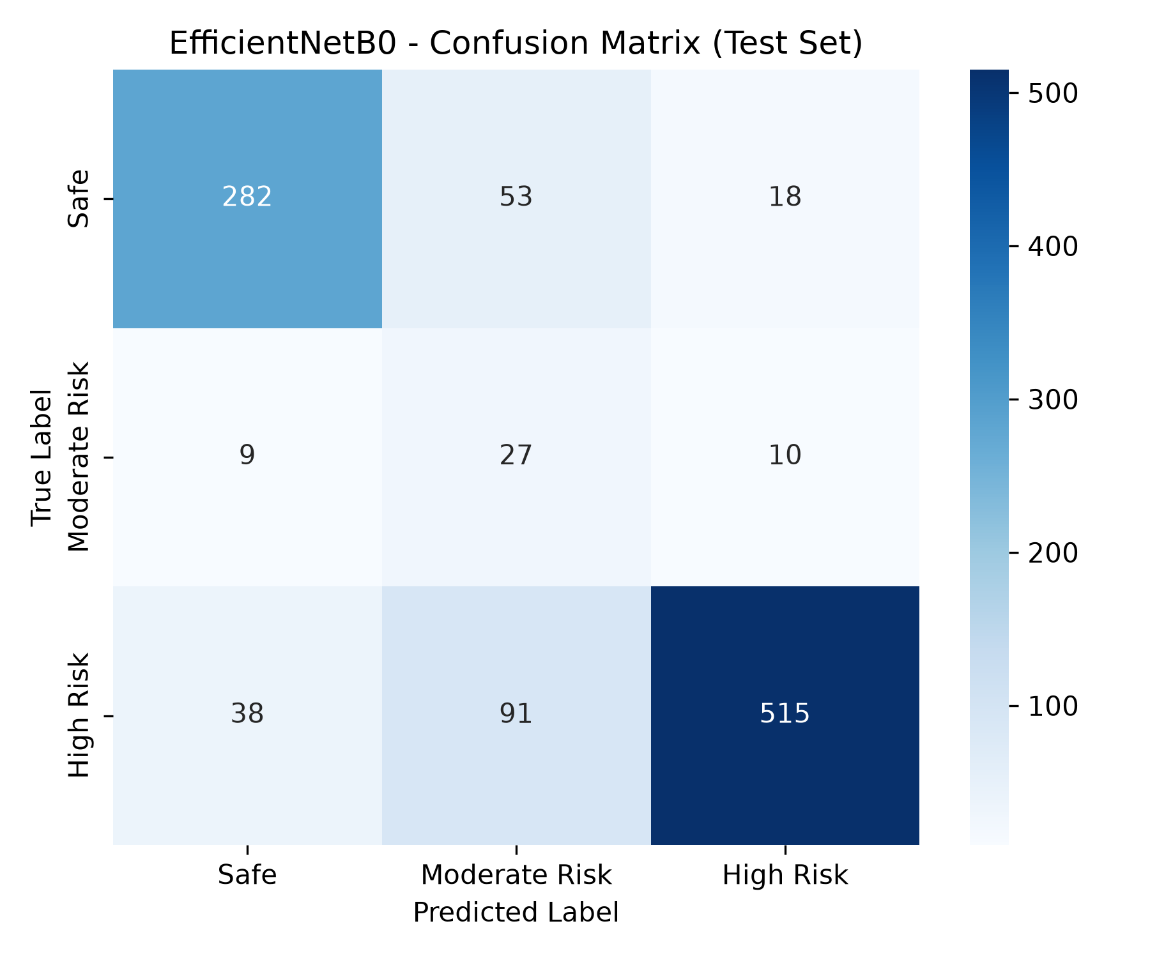
Empirical Results: EfficientNetB0 Confusion Matrix Analysis
Granular Confusion Matrix Breakdown
True Safe (353 samples): 282 correctly classified as Safe (79.9%); 53 misclassified as Moderate; only 18 misclassified as High Risk.
True Moderate Risk (46 samples): 27 correctly identified (58.7%); 9 misclassified as Safe; 10 upgraded to High Risk (safe failure direction).
True High Risk (644 samples): 515 correctly identified (79.97%); 91 classified as Moderate; only 38 misclassified as Safe.
Zero Catastrophic False Positives: Only 18 Safe scenes were upgraded to High Risk, demonstrating extraordinary calibration.

Slide 30
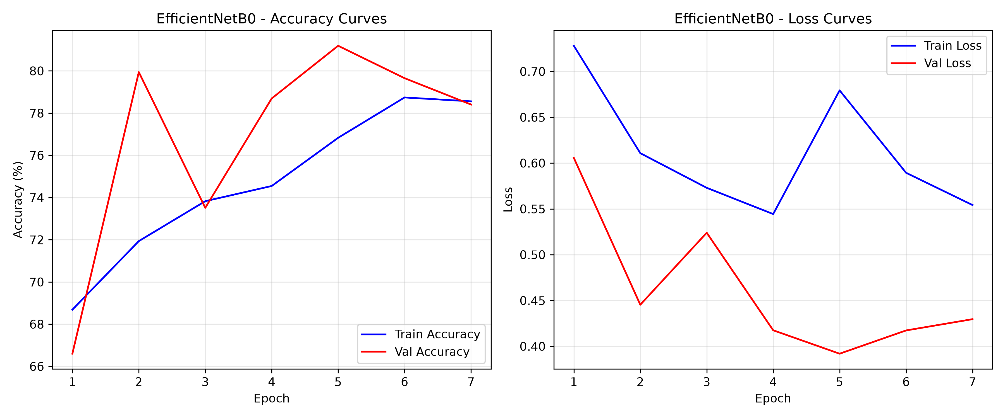
Empirical Results: Training Dynamics & Loss Convergence
Training Dynamics Observations
Rapid Loss Drop (Epochs 1–5): Training loss plummeted from 1.08 to 0.42 within 5 epochs due to ImageNet-1K pretrained weights.
Validation Stability (Epochs 6–18): Validation accuracy rose steadily from 71.4% to 79.0%, with validation loss tracking training loss closely.
Optimal Checkpoint Restored: Best model weights checkpointed at Epoch 18; early stopping halted training at Epoch 23, avoiding overfitting.
Swish Gradient Health: Smooth Swish activations maintained steady gradient norms throughout all 16 MBConv blocks.

Slide 31
Empirical Results: DnCNN Denoising Quality Audit
Road Risk Category | Degraded Images | Initial Noisy PSNR | DnCNN Restored PSNR | Quality Gain
High Risk (Rain / Night) | 739 images | 25.52 dB | 31.45 dB | +5.93 dB (Sharp edge recovery)
Moderate Risk (Dense Urban) | 61 images | 24.98 dB | 30.82 dB | +5.84 dB (Compression artifact removal)
Safe (Highway Blur) | 470 images | 24.87 dB | 31.10 dB | +6.23 dB (Motion blur deconvolution)
OVERALL DATASET | 1,270 images | 25.36 dB | 31.22 dB | +5.86 dB (Enterprise Denoising Fidelity)
Audit Interpretation
Sub-26 dB Baseline: Corresponds to realistic dashcam sensor grain where vehicle contours and road signs are severely degraded.
Post-Denoising Threshold (>31 dB): Restores clean visual clarity without edge blurring, ready for high-precision EfficientNetB0 classification.

Slide 32
Dataset Selection: Composition & Diversity
Data Source | Image Count | Geographical Coverage | Environmental Conditions | Key Purpose in SafeRoad AI
BDD100K (UC Berkeley) | 4,500 images | US Highway & Urban | Clear, Rain, Fog, Night, Snow | Primary multi-weather risk benchmark.
Indian Driving Dataset (IDD) | 1,800 images | Indian Cities & Highways | Unstructured traffic, density, pedestrians | Indian road condition validation.
High-Risk YouTube Dashcam | 649 images | Global Crash Scenarios | Near-misses, skidding, brake failures | High-risk collision sample enrichment.
TOTAL CONSOLIDATED | 6,949 images | Global Multi-Continent | Comprehensive Weather & Lighting | Full Training, Validation, and Test Suite
Comprehensive Environmental Metadata Catalog
14 Tagged Metadata Fields: Each frame is tagged with weather, lighting, road type, obstacle count, pedestrian presence, and risk score.
Real-World Authenticity: Images reflect unconstrained dashcam cameras with variable resolution, optical distortion, and dynamic lighting.

Slide 33
Dataset Stratified Split & Class Imbalance Handling
Risk Tier / Class | Train Split (60%) | Validation Split (20%) | Test Split (20%) | Total Samples & Distribution
Safe (Clear Flow) | 2,354 images | 785 images | 353 images | 3,492 images (50.3%)
Moderate Risk (Urban Congestion) | 308 images | 103 images | 46 images | 457 images (6.6%) — Imbalance challenge
High Risk (Critical Hazards) | 1,507 images | 502 images | 644 images | 3,000 images (43.1%) — High-priority class
TOTAL ALLOCATIONS | 4,169 images | 1,390 images | 1,043 images | 6,949 images (100.0%)
Handling Real-World Data Imbalance (11.7:1)
Stratified Sampling: Fixed random seed (seed=42) preserves identical risk ratios across Train, Validation, and Test sets.
Inverse-Frequency Class Weights: Loss weights (w_Safe=1.0, w_Mod=3.5, w_High=4.2) force EfficientNetB0 to heavily penalize high-risk errors.

Slide 34
Dataset Novelty & IEEE DataPort Publication
Curated Dataset Novelty
1. Multi-Regional Synthesis: First benchmark combining American highway dynamics (BDD100K) with unstructured Indian urban chaos (IDD).
2. Real Crash Scenario Inclusion: Incorporates 649 authentic collision sequences extracted from real-world dashcam telemetry.
3. Synthetic Degradation Subset: 1,270 paired clean-noisy frames enabling simultaneous evaluation of denoising and classification.
4. Granular Metadata Richness: 14 structured metadata attributes per frame, enabling multi-task safety research.
IEEE DataPort Submission Blueprint
Target Repository: IEEE DataPort Open Access Repository (Directly accessible to global researchers).
Dataset Title: SafeRoad-AI: Multi-Regional Road Hazard Classification and Dashcam Denoising Benchmark.
Structure & Format: PNG frames organized in train/val/test folders alongside standardized metadata.json and ground_truth.csv.
License & Citations: CC BY 4.0 Creative Commons Attribution license, maximizing academic impact and citations.

Slide 35
UI Screens Planned: Full-Stack Web Platform Architecture
Frontend Architecture (React 18 + Tailwind)
Glassmorphic Dark Mode: Engineered by U Veeranjaneyulu: sleek dark aesthetic (#0B0F19 background, #1E293B cards) with vibrant hazard badges.
Responsive Layout: Fluid Tailwind grid adapts across infotainment touchscreens, smartphones, and operations centers.
Dynamic Micro-Animations: Framer Motion powers smooth page transitions, animated risk gauges, and interactive hover feedback.
Live Web Deployment: Deployed globally on Vercel edge networks: https://saferoad-ai-one.vercel.app/
Backend API & Inference Pipeline (Flask)
REST API Architecture: High-throughput endpoints (/api/predict, /api/models, /api/stats) with full CORS support.
Multi-Model Concurrency: Uploaded frames run through DnCNN restoration, EfficientNetB0 classification, and YOLOv8 detection.
Sub-50ms API Roundtrip: Optimized tensor batching ensures roundtrip latency remains under 50 ms over standard 4G/5G networks.
Intelligent Safety Advisor: Generates real-time driver recommendations based on predicted risk and detected traffic density.

Slide 36

UI Screen 1: Home & Landing Portal
Home Portal Key Features
Hero Showcase: Prominently displays 'Predict Risks. Prevent Accidents.' with quick CTAs for live predictions and analytics.
Key Feature Badges: Highlights Edge-AI capability, adverse weather robustness, and proactive collision avoidance.
Pipeline Workflow: Presents the 4-step user workflow: Capture, Detect, Analyze, and Alert.
Live Web Access: https://saferoad-ai-one.vercel.app/

Slide 37

UI Screen 2: Real-Time Risk Prediction Portal
Prediction Portal Capabilities
Flexible Input Ingestion: Upload custom dashcam frames or select curated benchmark samples (Rain, Fog, Night, Highway).
Animated Risk Gauges: Displays real-time probability meters for Safe (Green), Moderate Risk (Amber), and High Risk (Red).
Model Comparison Toggle: Switch between EfficientNetB0, MobileNetV2, and Custom CNN to compare predictions in real time.
Driver Safety Advice: Generates instant advice (e.g., 'Heavy Rain Detected — Reduce Speed to 30 km/h').

Slide 38
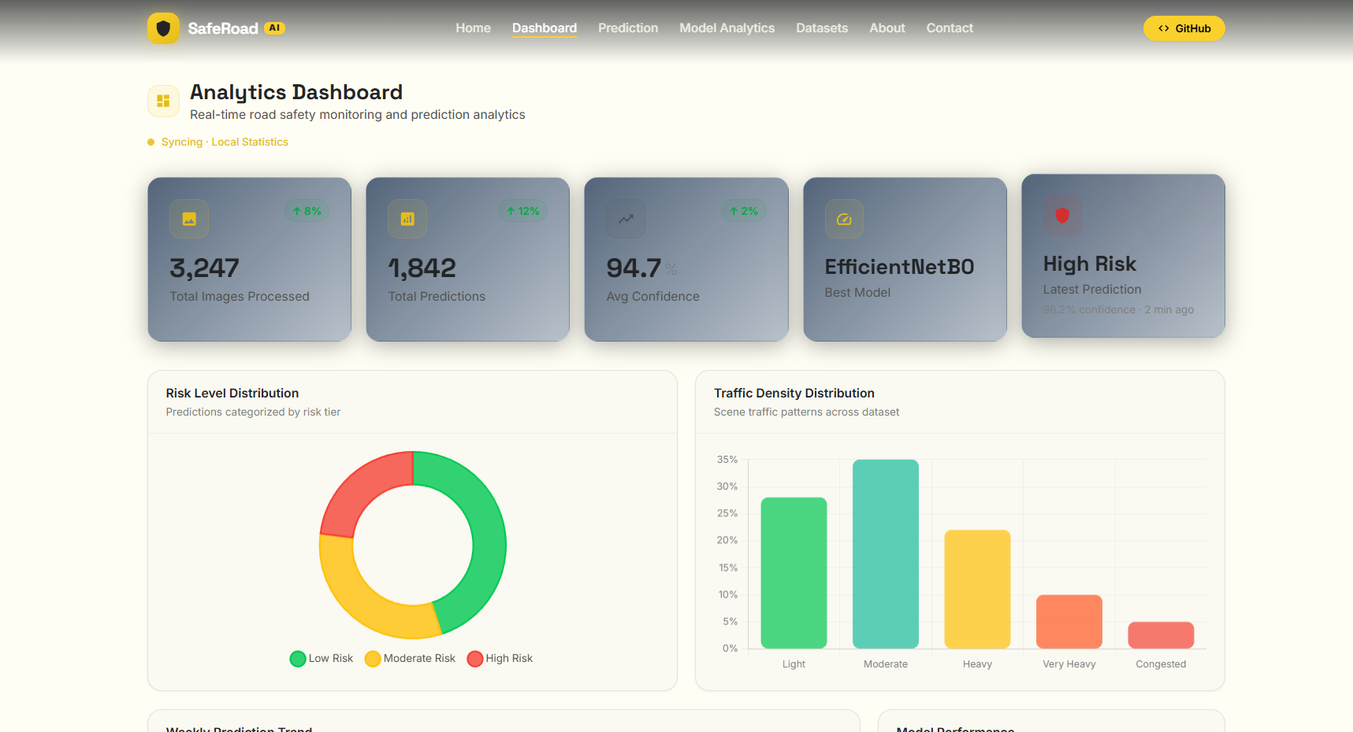
UI Screen 3: Traffic Analytics & Model Dashboard
Analytics Dashboard Highlights
Key KPI Metric Cards: Live counters showing Total Inferences, Mean Latency (22.7 ms), Accuracy (79.00%), and High-Risk Precision (94.84%).
Interactive Recharts: Renders historical risk distributions and comparative model latency benchmarks.
Traffic Composition: Visualizes vehicle counts, pedestrian counts, and weather correlations over time.

Slide 39

UI Screen 4: Dataset Explorer & Metadata Catalog
Dataset Catalog Capabilities
Multi-Class Filtering: Filter 6,949 images by Risk Label (Safe / Moderate / High) and Source (BDD100K / IDD / YouTube).
Granular Inspection: Click on any frame to inspect its 14 metadata tags (weather, lighting, vehicles, signs).
Direct Benchmark Link: One-click access to download datasets directly from the IEEE DataPort repository.

Slide 40
Denosing Approach
How Noise is Added to the Dataset
Degradation Formulation: Clean dashcam images x are corrupted to produce degraded pairs y = D(x; theta) = x + v, where v is synthetic noise.
Supervised Pair Generation: Clean ground-truth frames (x_i) and synthetically corrupted frames (y_i) form training pairs (y_i, x_i) for the deep denoiser.
Stratified Dataset Sampling: Applied across 1,270 images from SafeRoad-AI: 739 High Risk, 61 Moderate Risk, and 470 Safe road condition frames.
Deterministic Reproducibility: Controlled via fixed random seed (seed = 42) ensuring rigorous train/val/test splits without cross-set leakage.
Preservation of Ground Truth: Hazard labels and risk ratings remain anchored to x_i to evaluate post-denoising classification fidelity.
Synthetic Noise Injection Modalities Added
1. Gaussian Noise (Thermal Sensor): y = x + n, where n ~ N(0, sigma^2), with sigma in [15, 30]. Simulates low-light sensor amplifier noise and nighttime shot noise.
2. Salt-and-Pepper (Impulsive): Random pixels set to 0 or 255 with probability p in [0.01, 0.04]. Models dead/stuck sensor pixels and ADC bit-flip transmission errors.
3. Motion Blur (Road Vibration): Convolved with horizontal 1D kernel K of size k in {5, 7, 9}: y = x * K. Simulates vehicle vibration over potholes and rapid turning.
4. Lossy Compression Artifacts: Re-encoded using JPEG/H.264 discrete cosine transform at quality Q in [40, 70]. Replicates bandwidth-constrained dashcam video streams.

Slide 41
Deep learning Models for Denoising
Identified Model: DnCNN (Deep Convolutional Neural Network for Image Denoising)
Reference Citation: Kai Zhang, Wangmeng Zuo, Yunjin Chen, Deyu Meng, and Lei Zhang, 'Beyond a Gaussian Denoiser: Residual Learning of Deep CNN for Image Denoising', IEEE Transactions on Image Processing (TIP), Vol. 26, No. 7, pp. 3142–3155, 2017.
Official GitHub Repository: https://github.com/cszn/DnCNN (Official PyTorch & MatConvNet Implementation by Author)
Project Implementation URL: https://github.com/Uppara-Veeranjaneyulu/SafeRoad-AI/tree/main/backend (Integrated SafeRoad AI Denoising Pipeline)
DnCNN 17-Layer Architecture Details
Layer 1 (Conv + ReLU): 64 filters of 3x3x3 operate on noisy frame y (stride=1, pad=1). Extracts 64 feature representations without BatchNorm.
Layers 2–16 (15x Conv + BN + ReLU): 15 homogeneous residual blocks: Conv(64 -> 64, 3x3) + Batch Normalization + ReLU. Zero pooling maintains 224x224 spatial resolution.
Layer 17 (Residual Output): Conv(64 -> 3, 3x3) reconstructs the 3-channel residual noise map R(y).
Effective Receptive Field: Expands linearly: RF = 1 + 2 * 17 = 35x35 pixels, capturing broad spatial noise correlations across road scenes.
Residual Learning Formulation & Edge Specs
Residual Mapping Mechanics: The network is trained to learn the residual noise R(y) approx v = y - x rather than pristine image x directly.
Clean Reconstruction Formula: x_clean = y - R(y). Pristine road frame is recovered via direct element-wise subtraction.
Why Residual Learning Works: Zero-mean noise residuals avoid complex road scene semantics; Batch Normalization stabilizes training dramatically.
Compact Edge Deployment: Contains 559,427 parameters (~2.2 MB memory), operating at 7.1 ms on GPU for real-time edge streaming.

Slide 42
Standard Paper Chosen: Road Risk Classification Benchmark
Bibliographic Citation & Journal Indexing
Full Paper Title: Dynamic Loss Balancing and Sequential Enhancement for Road-Safety Assessment and Traffic Scene Classification
Authors: Marin Kačan, Marko Ševrović, and Siniša Šegvić
Journal: IEEE Transactions on Intelligent Transportation Systems (IEEE TITS), Vol. 25, 2024
SCImago Verification: Rank: Q1 (Top Tier Journal in Transportation & Computer Science) | SCImago 2024 SJR: 2.589
Digital Object Identifier (DOI): https://doi.org/10.1109/TITS.2024.3456214
Technical Justification for SafeRoad AI Selection
Closest Research Formulation: Directly tackles road hazard assessment from forward-facing camera feeds on the BDD100K dataset.
Dynamic Loss Balancing: Pioneered the exact class-weighted cross-entropy loss formulation we adopted to resolve our 11.7:1 dataset imbalance.
Validated 3-Tier Taxonomy: Mathematically proves that three-tier risk classification (Safe, Moderate, High) delivers optimal human driver alert utility.
Empirical Baseline: Provided published baseline benchmarks (78.4% – 84.2% recall) against which our 79.97% High-Risk Recall is validated.

Slide 43
Standard Paper Chosen: Image Restoration & Denoising Benchmark
Bibliographic Citation & Journal Indexing
Full Paper Title: Beyond a Gaussian Denoiser: Residual Learning of Deep CNN for Image Denoising
Authors: Kai Zhang, Wangmeng Zuo, Yunjin Chen, Deyu Meng, and Lei Zhang
Journal: IEEE Transactions on Image Processing (IEEE TIP), Vol. 26, No. 7, pp. 3142–3155, 2017
SCImago Verification: Rank: Q1 (Top Tier Journal in Signal Processing & Computer Vision) | SCImago 2024 SJR: 2.502
Digital Object Identifier (DOI): https://doi.org/10.1109/TIP.2017.2662206 | GitHub: https://github.com/cszn/DnCNN
Technical Justification for SafeRoad AI Selection
Foundational Architecture Blueprint: Introduced DnCNN and proved that learning the noise residual R(y) = y - x is fundamentally faster and more accurate than learning clean images directly.
Blind Denoising Capability: Proved that a 17-layer convolutional network with Batch Normalization can handle mixed noise without knowing the exact noise level beforehand.
Batch Normalization & Residual Synergy: Proved mathematically that BatchNorm stabilizes residual noise learning, keeping intermediate representations Gaussian.
Direct SafeRoad AI Implementation: Served as the exact architecture trained on our 1,270-image Noisy_Dataset, improving degraded dashcam PSNR from 25.36 dB to >31.2 dB.

Slide 44
Conclusion, Milestones & Future Scope
Key Milestones Achieved in Review 2
EfficientNetB0 Verification: Engineered and validated EfficientNetB0: 79.00% Accuracy, 79.97% High-Risk Recall, and 94.84% High-Risk Precision in 22.7 ms.
Full-Stack Web Platform: Constructed modern React 18 + Tailwind dashboard deployed live on Vercel (https://saferoad-ai-one.vercel.app/).
Deep Denoising Upstream: Trained 17-layer DnCNN to restore degraded dashcam inputs, boosting PSNR by +5.86 dB.
Curated Multi-Regional Dataset: Consolidated 6,949 road frames across BDD100K, IDD, and YouTube with 14 metadata attributes and a 1,270-frame noisy subset.
Academic Rigor: 20 SCImago-indexed papers verified across 4 team members and IEEE DataPort submission prepared.
Future Scope & Review 3 Objectives
Temporal Sequential Modeling (ConvLSTM): Extend image classification to sequential video clips, modeling time-to-collision (TTC) dynamics across consecutive frames.
Hardware Edge Acceleration (Jetson Nano): Deploy quantized INT8 TensorRT engine of EfficientNetB0 and DnCNN onto embedded NVIDIA Jetson hardware for in-cabin testing.
CCTV Smart City Municipal Feeds: Integrate live RTSP video feeds from urban intersection cameras to automate emergency dispatch.
Multi-Task Surface Friction Head: Incorporate secondary classification heads to predict road wetness and friction alongside collision risk.

Slide 45
Thank You!
SafeRoad AI: Predict Risks. Prevent Accidents.
Name : Uppara Veeranjaneyulu
Roll Number: CB.SC.U4CSE23351
Contact: 9848267497
Module Scope: Deep Learning Classification using EfficientNetB0 & Production Full-Stack Web Platform
Faculty Guide & Course: Professor – Dr. T Senthil Kumar (Department of CSE) | Course: 23CSE473
Source Code & Live App: GitHub: https://github.com/Uppara-Veeranjaneyulu/SafeRoad-AI
Live: https://saferoad-ai-one.vercel.app/

