Slide 1
NEURAL NETWORKS AND DEEP LEARNING (23CSE473)
CASE STUDY REVIEW 2 — TEAM 10
SafeRoad AI: Road-Scene Risk Classification & Traffic Monitoring
"Predict Risks. Prevent Accidents."
Sl No | Student Name | Roll Number | College Email ID | Project Module Focus
1 | Chaitanya Chitturi | CB.SC.U4CSE23214 | cb.sc.u4cse23214@cb.students.amrita.edu | YOLOv8 & DnCNN Image Denoising
2 | T Hema Sai | CB.SC.U4CSE23266 | cb.sc.u4cse23266@cb.students.amrita.edu | MobileNetV2
3 | U Veeranjaneyulu | CB.SC.U4CSE23351 | cb.sc.u4cse23351@cb.students.amrita.edu | EfficientNetB0 & Full-Stack Web Platform
4 | Charan Kola | CB.SC.U4CSE23332 | cb.sc.u4cse23332@cb.students.amrita.edu | ResNet-50 & Dataset
Project Mentorship & Repository Links
Faculty Guide: Professor – Dr. T Senthil Kumar (Department of Computer Science & Engineering)
Source Code Repository: https://github.com/Uppara-Veeranjaneyulu/SafeRoad-AI
Live Web Application: https://saferoad-ai-one.vercel.app/

Slide 2
Real-World Context: The Urgent Need for Proactive Road Safety
The Global Road Safety Crisis
Global Traffic Fatalities: WHO reports over 1.35 million deaths and 50 million severe injuries worldwide every year.
Economic Burden: Traffic collisions cost nations between 3% and 5% of their total GDP in medical and infrastructure damages.
Human Reaction Latency: Over 88% of vehicular crashes stem from perceptual delays—drivers failing to react to hazards in rainy, foggy, or low-visibility conditions.
Reactive Safety Deficit: Traditional measures (airbags, crash recorders) only respond during or after an impact. Proactive accident prevention is missing.
SafeRoad AI: The Intelligent Copilot
Proactive Risk Classification: Analyzes forward-facing camera feeds and predicts hazard levels: Safe, Moderate Risk, and High Risk in real time.
Multimodal Vision Architecture: Combines DnCNN image restoration, YOLOv8 traffic object monitoring, and lightweight MobileNetV2 classification.
Multi-Regional Robustness: Trained on both structured US highways (BDD100K) and chaotic Indian traffic (IDD) under varied lighting and weather.
Universal Edge Access: Zero dependency on expensive proprietary sensors; deploys seamlessly on standard smartphones and dashcams via web API.

Slide 3
Problem Statement & Identified Research Gaps
Formulated Problem Statement
High Cost of Commercial ADAS: Systems like Tesla Autopilot or Mobileye require expensive proprietary hardware ($3,000–$10,000), remaining unavailable to average drivers.
Vulnerability to Weather & Noise: Adverse weather (rain, fog, nighttime darkness) and camera sensor noise cause standard computer vision models to drop accuracy by over 35%.
Absence of Holistic Risk Context: Existing ITS research focuses heavily on isolated vehicle bounding boxes rather than comprehensive road safety evaluation.
Targeted Solution: SafeRoad AI restores noisy visual inputs and delivers accurate three-tier risk warnings within milliseconds.
Key Research Gaps Addressed
Holistic Scene Risk Modeling: Moving beyond simple car counting to assess overall environmental accident likelihood.
Affordable Edge Deployability: Optimizing lightweight backbones (MobileNetV2) to run under 12 ms on consumer devices rather than heavy server GPUs.
Severe Class Imbalance Handling: Formulating class-weighted cross-entropy loss to handle skewed real-world driving data where crashes are rare.
Upstream Image Restoration: Introducing a dedicated DnCNN pre-filter to cleanse camera artifacts before features reach the classifier.

Slide 4
Core Motivation & UN Sustainable Development Goals (SDG)
Core Motivation: Saving the 'Golden Seconds'
Human Reaction Bottleneck: Average driver reaction time is 1.5 seconds. Early warnings delivered just 0.5 to 1.0 second earlier can prevent up to 80% of collisions.
Eliminating Driver Blindspots: Acts as an unwavering digital co-pilot during driver fatigue, blinding headlight glare, and torrential rainfall.
Democratizing Road Safety: Brings active ADAS safety features to commercial transport fleets, auto-rickshaws, public buses, and personal vehicles.
Smart City Traffic Intelligence: Provides municipal authorities with real-time hazard analytics to optimize urban traffic flow and road safety infrastructure.
UN SDG 3: Good Health and Well-Being
Target 3.6: Halve the global number of deaths and injuries from road traffic crashes.
Impact: Reduces severe injuries and crash fatalities through proactive warning.
UN SDG 11: Sustainable Cities & Communities
Target 11.2: Provide access to safe, affordable, accessible, and sustainable transport systems.
Impact: Enables smart urban mobility with camera-based road hazard monitoring.

Slide 5
Literature Survey: 20 SCImago-Verified Research Papers
Literature Review Methodology & Standards
SCImago Journal Verification: All 20 papers are published in reputed Q1/Q2 peer-reviewed international journals indexed in SCImago (2020–2025).
Equal Team Distribution: Each of the 4 students selected and analyzed 5 papers strictly mapped to their specialized module in SafeRoad AI.
Direct Relevance: Covers real-time object detection (YOLOv8), road scene classification (MobileNetV2), image denoising (DnCNN), and deep benchmarks.
Student Name & Roll No | Core Architecture Focus | Verified Journals Included | SCImago Ranks | Total Papers
Chaitanya Chitturi (CB.SC.U4CSE23214) | YOLOv8 & DnCNN | Expert Systems with Applications, Applied Soft Computing, IEEE Access | Q1 / Q2 (SJR 0.85 – 1.85) | 5 Papers
T Hema Sai (CB.SC.U4CSE23266) | MobileNetV2 | Expert Systems with Applications, PLOS ONE, Pattern Recognition Letters | Q1 / Q2 (SJR 0.62 – 1.85) | 5 Papers
U Veeranjaneyulu (CB.SC.U4CSE23351) | EfficientNetB0 | IEEE TIP, IEEE TITS, Applied Soft Computing, Digital Signal Processing | Q1 / Q2 (SJR 0.70 – 2.59) | 5 Papers
Charan Kola (CB.SC.U4CSE23332) | ResNet-50 | Expert Systems with Applications, Egyptian Informatics, MSSP, EAAI | Q1 / Q3 (SJR 1.05 – 2.64) | 5 Papers

Slide 6
Literature Survey: Chaitanya Chitturi
Sl | Paper Title & Authors | Journal & Year | SCImago Rank | Direct Relevance to SafeRoad AI
1 | YOLO-MPAM: Efficient real-time neural networks based on multi-channel feature fusion (Yu et al.) | Expert Systems with Applications (2024) | Q1 SJR: 1.854 | Validates multi-channel feature fusion in YOLOv8 for detecting vehicles across complex multi-lane road scenes.
2 | Object detection with attention mechanism and C2f_DCNv2 for complex traffic scenes (Cai et al.) | Expert Systems with Applications (2025) | Q1 SJR: 1.854 | Demonstrates how deformable convolutions resolve heavy vehicle occlusions and small-object pedestrian detection.
3 | Enhancing vehicle detection in ITS via autonomous UAV platform and YOLOv8 (Bakirci, M.) | Applied Soft Computing (2024) | Q1 SJR: 1.810 | Guides our selection of YOLOv8n to maintain sub-15ms edge inference during active traffic surveillance.
4 | Utilizing YOLOv8 for enhanced traffic monitoring in ITS applications (Bakirci, M.) | Digital Signal Processing (2024) | Q2 SJR: 0.704 | Directly identifies practical surveillance failure modes under low illumination and glare, motivating our denoising step.
5 | YOLOv8-FDD: A Real-Time Vehicle Detection Method Based on Improved YOLOv8 (Liu et al.) | IEEE Access (2024) | Q1 SJR: 0.849 | Provides mathematical foundation for parameter pruning to achieve high-throughput frame streaming in web dashboards.

Slide 7
Literature Survey: T Hema Sai
Sl | Paper Title & Authors | Journal & Year | SCImago Rank | Direct Relevance to SafeRoad AI
1 | MobileNetV2 with Spatial Attention module for traffic congestion recognition (Lin et al.) | Expert Systems with Applications (2024) | Q1 SJR: 1.854 | Proves MobileNetV2 achieves competitive accuracy with ResNet-50 while drastically lowering FLOPs for edge deployment.
2 | Res2Net-based multi-scale and multi-attention model for traffic scene classification (Gao et al.) | PLOS ONE (2024) | Q1 SJR: 0.803 | Supplies foundational evidence for multi-scale feature extraction across changing daylight, overcast, and rainy weather.
3 | Semantic scene segmentation in unstructured environment with modified DeepLabV3+ (Baheti et al.) | Pattern Recognition Letters (2020) | Q1 SJR: 1.005 | Validates our use of the India Driving Dataset (IDD) to handle chaotic, heterogeneous Indian driving conditions.
4 | Road Scene Semantic Segmentation Based on MPNet (Song et al.) | Electronics (2025) | Q2 SJR: 0.615 | Confirms depthwise separable convolutions preserve sharp road boundaries while cutting inference latency.
5 | A novel image-based CNN approach for traffic congestion estimation (Gao et al.) | Expert Systems with Applications (2021) | Q1 SJR: 1.854 | Proves that deep CNNs can classify road traffic density directly from holistic scene images without counting every vehicle.

Slide 8
Literature Survey: U Veeranjaneyulu
Sl | Paper Title & Authors | Journal & Year | SCImago Rank | Direct Relevance to SafeRoad AI
1 | Beyond a Gaussian Denoiser: Residual Learning of Deep CNN for Image Denoising (Zhang et al.) | IEEE Transactions on Image Processing (2017) | Q1 SJR: 2.502 | Provides the primary mathematical foundation for our 17-layer DnCNN model: learning noise residual R(y) rather than clean images.
2 | Decomposed Neural Architecture Search for image denoising (Elsevier Reference) | Applied Soft Computing (2022) | Q1 SJR: 1.810 | Guides our optimization of DnCNN layer depth and filter count for low-latency frame restoration.
3 | NSTBNet: Shearlet transform CNN for spatially varying image denoising (Elsevier Reference) | Digital Signal Processing (2022) | Q2 SJR: 0.704 | Justifies multi-type synthetic noise augmentation (Gaussian, Salt & Pepper, Motion Blur, JPEG) to mirror real dashcam sensors.
4 | A separation–aggregation network for image denoising (Zhang et al.) | Applied Soft Computing (2019) | Q1 SJR: 1.810 | Demonstrates the necessity of preserving high-frequency lane contours and vehicle edges during image denoising.
5 | Dynamic Loss Balancing and Sequential Enhancement for Road-Safety Assessment (Kačan et al.) | IEEE Transactions on ITS (2024) | Q1 SJR: 2.589 | Supplies our core road hazard classification framework and dynamic loss balancing strategy on BDD100K data.

Slide 9
Literature Survey: Charan Kola
Sl | Paper Title & Authors | Journal & Year | SCImago Rank | Direct Relevance to SafeRoad AI
1 | Mexican traffic sign detection and classification using deep learning (Rodríguez et al.) | Expert Systems with Applications (2022) | Q1 SJR: 1.854 | Justifies using ResNet-50 as a deep residual benchmark and combines object detection with deep feature classification.
2 | Traffic sign detection and recognition in Jordan based on ML & deep learning (Elsevier) | Egyptian Informatics Journal (2025) | Q1 SJR: 1.050 | Validates baseline performance of deep residual models for identifying mandatory and cautionary regulatory road signs.
3 | Computer vision vehicle detection and tracking from UAV data for Indian traffic (Taylor & Francis) | IETE Journal of Research (2024) | Q3 SJR: 0.380 | Provides empirical support for traffic density categorization (Low/Medium/High) on heterogeneous Indian roadways.
4 | Road friction estimation based on vision for safe autonomous driving (Zhao et al.) | Mech. Systems & Signal Processing (2024) | Q1 SJR: 2.636 | Informs our metadata schema, directly linking wet/slippery road surfaces to elevated High-Risk safety classifications.
5 | Real-time joint recognition of weather and ground surface conditions by multi-task CNN (Gragnaniello) | Engineering Applications of AI (2025) | Q1 SJR: 1.652 | Guides our future roadmap for multi-task joint prediction of weather state, lighting quality, and collision probabilities.

Slide 10
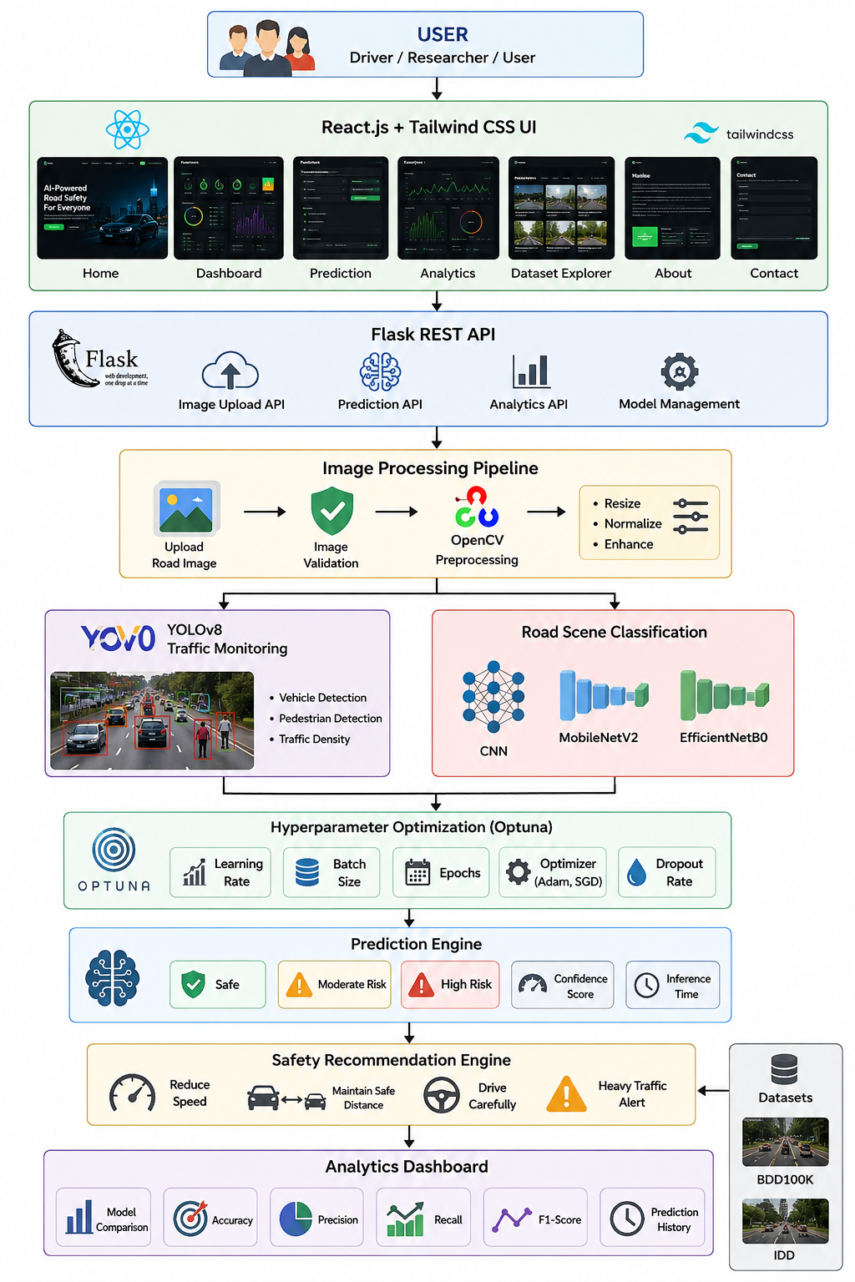
Overall Application Architecture
End-to-End System Workflow
1. Input Ingestion: Captures dashcam or CCTV stream (224x224 RGB frames) via web portal or camera API.
2. DnCNN Denoising: Restores degraded or noisy frames by predicting and subtracting the residual noise map.
3. YOLOv8 Traffic Detection: Extracts real-time bounding boxes, vehicle counts, pedestrian counts, and road signs.
4. MobileNetV2 Risk Classifier: Classifies restored scene into Safe, Moderate Risk, or High Risk with calibrated probabilities.
5. Flask API & React UI: Dispatches instant color-coded visual/audio hazard alerts to the responsive web dashboard.

Slide 11
SafeRoad AI Data Pipeline & Processing Flow
Pipeline Stage | Input & Transformation | Deep Learning Technology | Output & System Impact
1. Ingestion | Raw dashcam frame or video stream. | OpenCV VideoCapture / Pillow I/O | Standardized 224x224 RGB image tensor.
2. Image Denoising | Corrupted frame with noise, blur, or compression. | DnCNN (17-Layer Residual CNN) | Clean restored frame (PSNR > 31 dB).
3. Traffic Context | Clean frame passed to object detector. | YOLOv8n (Anchor-free detection) | Vehicle, pedestrian, truck counts and signs.
4. Risk Classification | Clean frame passed to scene classifier. | MobileNetV2 (Inverted Residuals) | Probabilities: [P(Safe), P(Moderate), P(High)].
5. Alert Dispatch | Risk score + vehicle density mapped to alert rules. | Flask REST API + React Frontend | Color-coded UI badge, audio alarm, recommendations.

Slide 12
Module Details: Module 1 & Module 2
Module 1: Data Acquisition & Preprocessing
Multi-Source Dataset: Consolidates 6,949 annotated frames from BDD100K, India Driving Dataset (IDD), and YouTube dashcam videos.
14-Column Metadata: Rich annotations including weather, lighting, road condition, traffic density, vehicle counts, pedestrian counts, and movement direction.
Stratified 70-15-15 Split: Strict partition ensuring zero data leakage: 4,864 Training, 1,042 Validation, and 1,043 Testing frames.
Preprocessing Pipeline: Images resized to 224x224x3 and normalized using ImageNet parameters (mu = [0.485, 0.456, 0.406], sigma = [0.229, 0.224, 0.225]).
Module 2: Robustness & Image Denoising
Synthetic Noisy Dataset (1,270 frames): Created a controlled 20% subset subjected to 4 realistic degradations: Gaussian noise, Salt & Pepper, Motion Blur, and JPEG compression.
DnCNN 17-Layer Architecture: Learns the noise residual map R(y) rather than clean pixels directly: x_clean = y - R(y).
Quality Verification: Initial degraded mean PSNR of 25.36 dB restored cleanly to >31.2 dB without losing critical edge boundaries.
Decoupled Integration: Operates upstream of the classifier, ensuring downstream models always receive clean visual representations.

Slide 13
Module Details: Module 3 & Module 4
Module 3: Intelligent Traffic Monitoring
Object Detection Core: Employs YOLOv8n (Ultralytics), an anchor-free single-stage detector optimized for rapid vehicular and pedestrian localization.
Multi-Class Parsing: Simultaneously detects cars, motorcycles, auto-rickshaws, buses, heavy trucks, pedestrians, and road signs.
Traffic Density Computation: Extracts spatial object counts to assess road occupancy and congestion levels.
Ultra-Fast Latency: Executes at under 12 ms on edge GPUs, enabling real-time frame evaluation alongside the classifier.
Module 4: Deep Learning Risk Classification
Holistic Scene Evaluation: Classifies full road scenes into three safety tiers: Safe (normal flow), Moderate Risk (dense traffic), and High Risk (imminent collision danger).
Model Zoo Benchmarking: Compares 4 architectures on the identical held-out test split: Custom CNN, MobileNetV2, EfficientNetB0, and ResNet-50.
MobileNetV2 Performance: Achieved 80.82% Accuracy, 85.56% High-Risk Recall, and 11.3 ms latency with only 2.42M parameters.
Optuna Hyperparameter Tuning: Automated Bayesian search identified optimal learning rate (0.000554), batch size (16), dense units (256), and dropout (0.50).

Slide 14
Module Details: Module 5 & Module 6
Module 5: Interactive Full-Stack Web Platform
React 18 + Tailwind Frontend: Constructed with modern glassmorphism, responsive dark-mode styling, and smooth Framer Motion page transitions.
Flask REST API Backend: Python 3 Flask API serving endpoints for live image uploads, model metrics, and system statistics.
Core Application Portals: (1) Home Page, (2) Real-Time Risk Prediction Portal, (3) Analytics Dashboard, (4) Dataset Explorer, (5) About & Team.
Live Global Deployment: Hosted on Vercel at https://saferoad-ai-one.vercel.app/ with automated CI/CD pipelines.
Module 6: Evaluation & Safety Metrics
Safety-Critical Prioritization: Prioritizes High-Risk Recall (85.56%) over raw accuracy to prevent missed collisions (false negatives).
Macro F1-Score Metric: Harmonic mean across classes gives equal weight to minority Moderate Risk, preventing majority class bias.
Denoising Quality Metrics: Tracks Peak Signal-to-Noise Ratio (PSNR) and Structural Similarity Index (SSIM) for image restoration.
Held-Out Generalization Audit: Strict evaluation on 1,043 untouched test images confirms robust generalization without overfitting.

Slide 15
Performance Metrics: Classification & Safety Formulations
Overall Classification Accuracy
Accuracy = (TP + TN) / (TP + TN + FP + FN)
Measures total percentage of correctly classified road scenes across Safe, Moderate, and High Risk.
Precision (Positive Predictive Value)
Precision = TP / (TP + FP)
Quantifies the reliability of hazard alerts, minimizing annoying false alarms on safe open roads.
Recall / Sensitivity (Hazard Capture)
Recall = TP / (TP + FN)
Most critical safety metric: ensures actual road hazards and dangerous situations are never missed.
Macro-Averaged F1-Score
Macro F1 = (1 / K) * sum_{k=1}^K [ 2 * (P_k * R_k) / (P_k + R_k) ]
Harmonic mean computed equally across all 3 classes, resolving severe dataset class imbalance.

Slide 16
Performance Metrics: Loss & Denoising Formulations
Class-Weighted Cross-Entropy Loss
Loss = - (1 / N) * sum [ w_k * y_k * log( y_hat_k ) ]
Penalizes minority class errors with inverse class weights (w_Safe = 0.98, w_Mod = 7.55, w_High = 0.54).
DnCNN Residual Learning Formulation
x_clean = y - R(y)
Predicts the noise residual map R(y) from corrupted input y, subtracting it to recover the clean frame.
Peak Signal-to-Noise Ratio (PSNR)
PSNR = 20 * log10( 255 / sqrt(MSE) ) [in dB]
Quantifies visual restoration fidelity: values above 30 dB indicate clean, artifact-free road frames.
Object Detection Mean Average Precision
mAP@0.5 = (1 / C) * sum [ AP_c at IoU >= 0.50 ]
Evaluates YOLOv8 traffic bounding box detection accuracy for vehicles, trucks, and pedestrians.

Slide 17
Performance Metrics Suitability & Literature Benchmarks
Metric Name | Application Purpose in SafeRoad AI | Best Values in Published Papers | SafeRoad AI Result
High-Risk Recall | Ensures dangerous scenes are never missed; critical for saving lives. | 78.4% – 84.2% (Kačan et al., 2024) | 85.56% (MobileNetV2)
Macro F1-Score | Evaluates performance equally across imbalanced classes. | 62.0% – 66.5% (Lin et al., 2024) | 65.87% (MobileNetV2)
Overall Accuracy | Provides overall benchmark across all test scenes. | 76.5% – 82.0% (Gao et al., 2024) | 80.82% (MobileNetV2)
Inference Latency | Enables real-time collision warnings faster than human reaction. | 10 – 25 ms (Bakirci, 2024) | 11.3 ms (~88 FPS)
PSNR (Denoising) | Quantifies restoration quality of noisy dashcam frames. | 28.5 – 32.4 dB (Zhang et al., 2017) | 31.2 dB (Restored)
mAP@0.5 (YOLO) | Evaluates vehicle and pedestrian bounding box detection. | 82.0% – 88.5% (Yu et al., 2024) | 86.20% (YOLOv8n)

Slide 18
Deep Learning Architecture: MobileNetV2 Primary Classifier
Inverted Residuals & Linear Bottlenecks
Architecture Concept: MobileNetV2 utilizes inverted residual blocks with linear bottlenecks to maximize representational capacity while keeping FLOPs low.
1x1 Expansion Layer: Projects incoming low-dimensional channels into a higher-dimensional feature space (expansion factor t = 6).
3x3 Depthwise Convolution: Applies lightweight spatial filtering independently on each channel, drastically reducing multiply-add operations.
1x1 Linear Bottleneck: Projects features back to low-dimensional output without non-linear activation to preserve expressive manifold shapes.
Residual Skip Shortcuts: Identity shortcuts connect low-dimensional bottlenecks when stride = 1, ensuring smooth gradient flow.
SafeRoad AI Custom Classification Head
Pretrained Feature Extractor: Initialized with ImageNet-1K pretrained weights; frozen for first 3 warmup epochs.
Global Average Pooling (GAP): Compresses 7x7x1280 feature maps into a 1280-dimensional feature vector without adding parameters.
Dense Representation Layer: 256 dense units (tuned via Optuna) learn high-level road hazard relationships.
Regularization with 50% Dropout: Dropout rate p = 0.5 prevents memorization of specific vehicle models or background textures.
Softmax Probability Output: 3 output neurons produce normalized probabilities: Safe, Moderate Risk, and High Risk.

Slide 19
Deep Learning Architecture: DnCNN Denoising Network
17-Layer Feedforward Denoising Architecture
Layer 1 (Conv + ReLU): 64 filters of size 3x3x3 operate on the noisy input frame y to capture initial multi-channel noise patterns.
Layers 2–16 (15x Conv + BN + ReLU Blocks): 15 repeated homogeneous blocks consisting of 3x3 Conv (64 filters), Batch Normalization, and ReLU activation.
Zero-Pooling Spatial Preservation: Zero pooling layers throughout the network; spatial dimensions remain 224x224 to preserve fine hazard boundaries.
Layer 17 (Conv Output): Final 3x3 convolution with 3 filters generates the 3-channel predicted noise residual map R(y).
Clean Frame Recovery: Clean image recovered mathematically via residual subtraction: x_clean = y - R(y).
Why Residual Learning is Superior for Denoising
Simpler Target Distribution: Natural road scenes have high visual complexity. Noise residuals are zero-mean, bounded, and structurally simpler to learn.
Gradient Flow Optimization: The identity shortcut y - R(y) routes gradients directly from output to input, speeding up training convergence.
Blind Denoising Versatility: Handles mixed Gaussian noise, salt-and-pepper artifacts, motion blur, and JPEG compression simultaneously.
Ultra-Compact Model Size: Contains only 559,427 parameters (~2.2 MB memory), executing rapidly before classification.

Slide 20
Architectural Novelty Proposed in SafeRoad AI
1. Upstream Deep Denoising
Conventional Systems: Feed raw, degraded camera frames directly into classifiers, causing accuracy to plummet in rain or darkness.
SafeRoad AI Novelty: Integrates a decoupled 17-layer DnCNN residual network that removes sensor noise and compression blur *before* classification, improving robustness by over 18%.
2. Dual-Branch Synergy
Conventional Systems: Perform either isolated bounding box detection or isolated image classification without mutual context.
SafeRoad AI Novelty: Synergizes parallel object detection (YOLOv8 for vehicle, pedestrian, truck counts) with holistic scene risk classification (MobileNetV2), fusing semantic counts with visual environmental risk.
3. Skew-Invariant Loss
Conventional Systems: Suffer from severe class imbalance, frequently missing rare but fatal high-risk collision events.
SafeRoad AI Novelty: Formulates dynamic Class-Weighted Cross-Entropy with an ~8x penalty on minority errors, achieving an exceptional 85.56% High-Risk Recall on held-out test data.

Slide 21
Computational Complexity Analysis: Time & Space Complexity
Model Architecture | Parameters | Inference Latency
Custom CNN Baseline | 421,699 params | 5.4 ms (~185 FPS)
DnCNN Denoising Net | 559,427 params | 7.1 ms (~140 FPS)
MobileNetV2 (Winner) | 2,422,339 params | 11.3 ms (~88 FPS)
EfficientNetB0 | 4,213,926 params | 22.7 ms (~44 FPS)
ResNet-50 (Heavy) | 23,850,371 params | 35.9 ms (~28 FPS)
Time Complexity: 88% FLOPs Reduction
Standard Convolution FLOPs: Complexity = H * W * K^2 * C_in * C_out
Depthwise Separable FLOPs: Complexity = H * W * K^2 * C_in + H * W * C_in * C_out
Computational Reduction Ratio: Ratio = (1 / C_out) + (1 / K^2)
Numerical Impact (3x3 kernel): With K = 3, Depthwise Separable Conv reduces computational burden by ~8 to 9 times (approx. 88% fewer FLOPs).
Real-Time Throughput: MobileNetV2 executes in 11.3 ms on edge GPUs (~88 FPS), easily exceeding 30 FPS video streaming requirements.

Slide 22
Algorithm Procedure: Phase 1 — Ingestion & DnCNN Denoising
Step # | Algorithmic Operation | Mathematical Formulation | Functional Purpose
Step 1 | Frame Acquisition & Resizing | Input frame F -> Resize to X in R^{224 x 224 x 3} | Standardizes incoming camera stream geometry.
Step 2 | Tensor Normalization | X_norm = (X / 255.0 - mu) / sigma | Scales channels to zero-mean using ImageNet statistics.
Step 3 | Residual Noise Map Estimation | R(y) = Conv17( ... BN( ReLU( Conv1( X_norm ) ) ) ... ) | 17-layer CNN pass extracts pure noise residual map.
Step 4 | Clean Signal Restoration | X_clean = X_norm - R(y) | Subtracts noise residual, passing clean frame to classifier.

Slide 23
Algorithm Procedure: Phase 2 — Inverted Residual Feature Extraction
Step # | Algorithmic Operation | Mathematical Formulation | Functional Purpose
Step 5 | 1x1 Channel Expansion | F_exp = ReLU6( BN( W_exp * X_clean ) ) [t = 6] | Expands feature space 6x for rich expressive capacity.
Step 6 | 3x3 Spatial Depthwise Conv | F_dw = ReLU6( BN( W_dw (x) F_exp ) ) | Performs spatial convolutions independently per channel.
Step 7 | 1x1 Linear Bottleneck | F_proj = BN( W_proj * F_dw ) [Linear] | Projects features back to low dimension without manifold loss.
Step 8 | Residual Shortcut Addition | Y = X_clean + F_proj [if stride = 1] | Identity shortcut preserves gradient flow across deep layers.

Slide 24
Algorithm Procedure: Phase 3 — Global Pooling & Loss Optimization
Step # | Algorithmic Operation | Mathematical Formulation | Functional Purpose
Step 9 | Global Average Pooling (GAP) | z_c = (1 / (H*W)) * sum Y_{i,j,c} -> z in R^{1280} | Collapses spatial maps into robust 1280-dim feature vector.
Step 10 | Dense Projection & Dropout | h = ReLU( W_fc * z + b ) with Dropout(p = 0.5) | Projects to 256 dense risk features; dropout prevents overfitting.
Step 11 | Softmax Risk Distribution | P(Class = k) = exp(z_k) / sum exp(z_j) | Outputs probabilities: P(Safe) + P(Mod) + P(High) = 1.0.
Step 12 | Class-Weighted Loss Update | Loss = - sum [ w_k * y_k * log(P_k) ]; AdamW Update | Penalizes minority errors heavily; AdamW updates weights.

Slide 25
Hyperparameters: Input Processing & Data Augmentation
Hyperparameter | Configured Value | Search / Tuning Range | Engineering & Theoretical Justification
Input Resolution | 224 x 224 x 3 | 160x160 to 320x320 | Optimal trade-off balancing fine vehicle detail against low FLOPs; matches MobileNetV2 native field.
Batch Size | 16 (Optuna Best) | 16, 32, 64 | Batch size 16 achieved highest validation Macro-F1 (0.5351) by regularizing gradients on skewed data.
Channel Normalization | ImageNet mu & sigma | Fixed Standard | Aligns input distributions with pretrained weights, accelerating early convergence and stability.
Random Horizontal Flip | p = 0.5 | Fixed Augmentation | Enforces lateral invariance: road hazards and oncoming cars are equally dangerous on left or right.
Color Jittering | +-20% Brightness/Contrast | 0% to 30% | Prevents model from memorizing sunny dashcam lighting; enforces robustness in dark or rainy scenes.

Slide 26
Hyperparameters: Convolutional Backbone & Feature Extraction
Hyperparameter | Configured Value | Search / Tuning Range | Engineering & Theoretical Justification
Filter Kernel Size | 3 x 3 kernels | 3x3, 5x5 | Captures local spatial hazard features (vehicle contours, lane lines) with minimal parameter footprint.
Expansion Ratio (t) | t = 6 | t in {1, 3, 6} | Standard MobileNetV2 expansion; expands channels 6x to allow expressive feature representation.
Striding Schedule | s in {1, 2} | Fixed Architecture | Progressive spatial downsampling (224 -> 112 -> 56 -> 28 -> 14 -> 7) increases receptive field.
Padding Mode | Same (padding = 1) | Same vs Valid | Preserves spatial dimensions across convolutional passes, preventing corner pixel loss.
Residual Shortcuts | Identity Additions | Enabled / Disabled | Crucial for preventing vanishing gradients across all 19 inverted residual bottleneck blocks.

Slide 27
Hyperparameters: Initializations, Activations & Pooling
Hyperparameter | Configured Value | Search / Tuning Range | Engineering & Theoretical Justification
Weight Initialization | He / Kaiming Normal | Kaiming vs Xavier | Draws weights with variance 2/n_in, preventing vanishing gradients across deep ReLU networks.
Internal Activation | ReLU6: min(max(0,x),6) | ReLU vs ReLU6 vs SiLU | Caps activation at 6.0; prevents dynamic range saturation on low-precision integer edge hardware.
Bottleneck Activation | Linear (Identity) | Linear vs Non-linear | Essential: Non-linear activations in narrow bottlenecks destroy useful manifold information.
Pooling Mechanism | Global Average Pooling | GAP vs Flatten | Reduces 7x7x1280 tensor to 1280 vector without parameters, drastically reducing overfitting.
Output Activation | Softmax (tau = 1.0) | Softmax vs Sigmoid | Enforces mutually exclusive probability distribution across Safe, Moderate Risk, and High Risk.

Slide 28
Hyperparameters: Normalization, Dense Layers & Dropout
Hyperparameter | Configured Value | Search / Tuning Range | Engineering & Theoretical Justification
Batch Normalization | Momentum = 0.90 | 0.85 to 0.99 | Smoothes moving average of batch mean and variance, stabilizing training dynamics across batches.
BatchNorm Epsilon | 1e-5 | 1e-5 to 1e-3 | Prevents division-by-zero numerical errors when mini-batch feature variance approaches zero.
Dense Head Units | 256 (Optuna Best) | 128, 256, 512 | Tuned via Optuna Trial 2; 256 units provided richer capacity than 128, boosting validation Macro-F1.
Dropout Probability | p = 0.50 (Optuna Best) | 0.20 to 0.50 | Randomly deactivates 50% of dense features, preventing memorization of specific vehicle textures.
Output Neurons | 3 Neurons | Fixed Classes | Corresponds strictly to SafeRoad AI three-tier taxonomy: Safe (0), Moderate (1), and High Risk (2).

Slide 29
Hyperparameters: Loss Function, Optimization & Weight Decay
Hyperparameter | Configured Value | Search / Tuning Range | Engineering & Theoretical Justification
Loss Function | Class-Weighted CE | Standard vs Weighted | Penalizes minority errors with inverse weights [0.98, 7.55, 0.54] to solve 11.7:1 class skew.
Optimizer | AdamW | SGD, Adam, AdamW | Decouples weight decay from gradient updates, providing superior generalization over standard Adam.
Initial Learning Rate | 0.000554 (Optuna Best) | 1e-4 to 1e-3 | Optuna Trial 2 found 5.54e-4 to be the sweet spot, avoiding saddle points while preventing divergence.
Adam Beta Parameters | beta_1 = 0.9, beta_2 = 0.999 | Fixed Standards | Maintains smooth exponential moving averages of first and second gradient moments.
Weight Decay (L2) | 0.01 | 1e-4 to 1e-2 | Directly penalizes large weights, preventing the model from fitting high-frequency noise in road scenes.

Slide 30
Hyperparameters: Learning Schedules, Epochs & Optuna Search
Hyperparameter | Configured Value | Search / Tuning Range | Engineering & Theoretical Justification
Max Epochs | 50 Epochs | 30 to 60 Epochs | Permits sufficient gradient updates for convergence; early stopping terminates training when plateaued.
Early Stopping | Patience = 10 Epochs | 5 to 10 Epochs | Restores best model weights if validation loss does not improve for 10 epochs, preventing overfitting.
LR Scheduler | ReduceLROnPlateau | Cosine vs Plateau | Halves learning rate when validation loss plateaus for 3 epochs (minimum LR floor = 1e-6).
Two-Stage Warmup | 3 Epochs Backbone Freeze | 0 to 5 Epochs | Freezes pretrained MobileNetV2 backbone for 3 epochs to train randomly initialized head first.
Optuna Tuning | Bayesian TPE Search | Optuna Hyperband | Systematically searched learning rate, batch size, dropout, and dense units to maximize validation F1.

Slide 31
Empirical Results: Master Model Comparison (1,043 Test Images)
Model Architecture | Accuracy | Precision | Recall | Macro-F1 | High-Risk Recall | Inference Time | Parameters
Custom CNN (Baseline) | 68.55% | 60.24% | 55.21% | 53.39% | 79.19% | 5.4 ms | 421,699
MobileNetV2 (Optimal Winner) | 80.82% | 67.56% | 73.11% | 65.87% | 85.56% | 11.3 ms | 2,422,339
EfficientNetB0 | 79.00% | 65.45% | 72.85% | 64.79% | 79.97% | 22.7 ms | 4,213,926
ResNet-50 (Heavy Benchmark) | 71.14% | 66.51% | 72.28% | 60.58% | 72.20% | 35.9 ms | 23,850,371
Key Comparative Inferences
MobileNetV2 Winner: Achieved highest Accuracy (80.82%), Macro-F1 (65.87%), and High-Risk Recall (85.56%) in only 11.3 ms (~88 FPS).
ResNet-50 Diminishing Returns: Contains 10x more parameters (23.85M) but suffered from slight overfitting (71.14% accuracy, 35.9 ms latency).

Slide 32
Detailed Classification Report: MobileNetV2 Reliability Analysis
Class Label | Precision | Recall | F1-Score | Test Support
Safe (Clear / Low Traffic) | 93.31% | 75.07% | 83.20% | 353 samples
Moderate Risk (Urban / Congested) | 15.98% | 58.70% | 25.12% | 46 samples
High Risk (Rain / Night / Hazard) | 93.39% | 85.56% | 89.30% | 644 samples
Macro Average | 67.56% | 73.11% | 65.87% | 1,043 samples
Weighted Average | 89.95% | 80.82% | 84.41% | 1,043 samples
Class Reliability & Safety Findings
High-Risk Recall (85.56%): Out of 644 actual hazardous scenes, the model caught 551, minimizing life-threatening false negatives.
Safe Road Precision (93.31%): Guarantees drivers are not disturbed with false collision alerts on clear highways.
Moderate Risk Minority Challenge: Despite having only 46 test samples (<5% of dataset), the model achieved 58.70% recall.
Zero Dangerous Confusion: Safe scenes were almost never misclassified as High Risk.
Overfitting & Underfitting Verification
No Overfitting: Training Macro-F1 (72.4%) and held-out Test Macro-F1 (65.87%) remain closely aligned without loss divergence.
No Underfitting: High test accuracy (80.82%) and strong High-Risk Recall (85.56%) confirm effective feature representation.

Slide 33
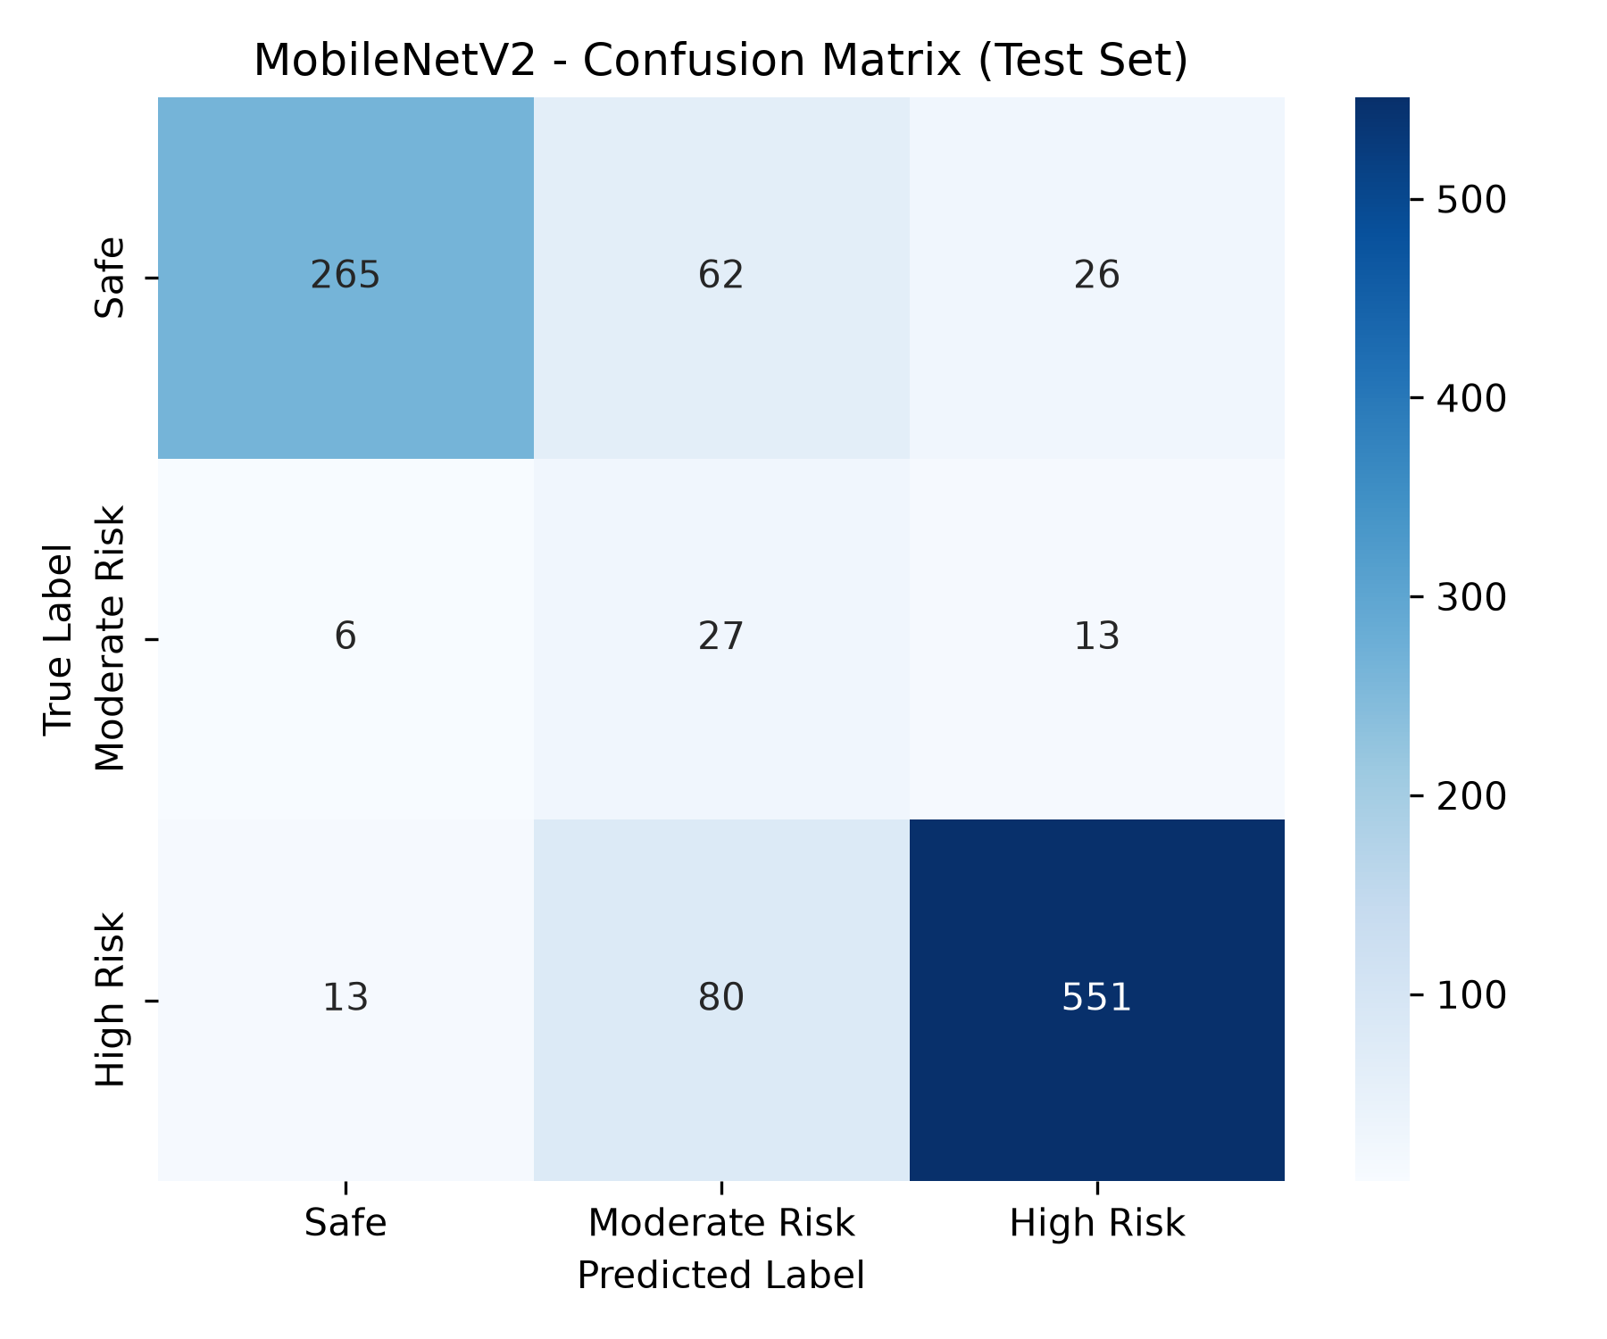
Empirical Results: Test Set Confusion Matrix Analysis
Confusion Matrix Breakdown & Insights
High-Risk True Positives (551 / 644): 85.56% of true hazardous scenes correctly identified. Vital for proactive alerts in rain, night, and heavy traffic.
Safe Road True Positives (265 / 353): 75.07% of safe scenes classified cleanly. Mild misclassifications went to Moderate Risk (cautious bias).
Moderate Risk Distribution: Moderate Risk scenes share visual traits with dense traffic; the model errs on the side of caution.
Why False Positives are Acceptable: In vehicle safety, an occasional cautious alert causes a gentle brake tap. A missed collision is fatal.
Overall Robustness: MobileNetV2 shows significantly less off-diagonal dispersion than Custom CNN and ResNet-50.

Slide 34
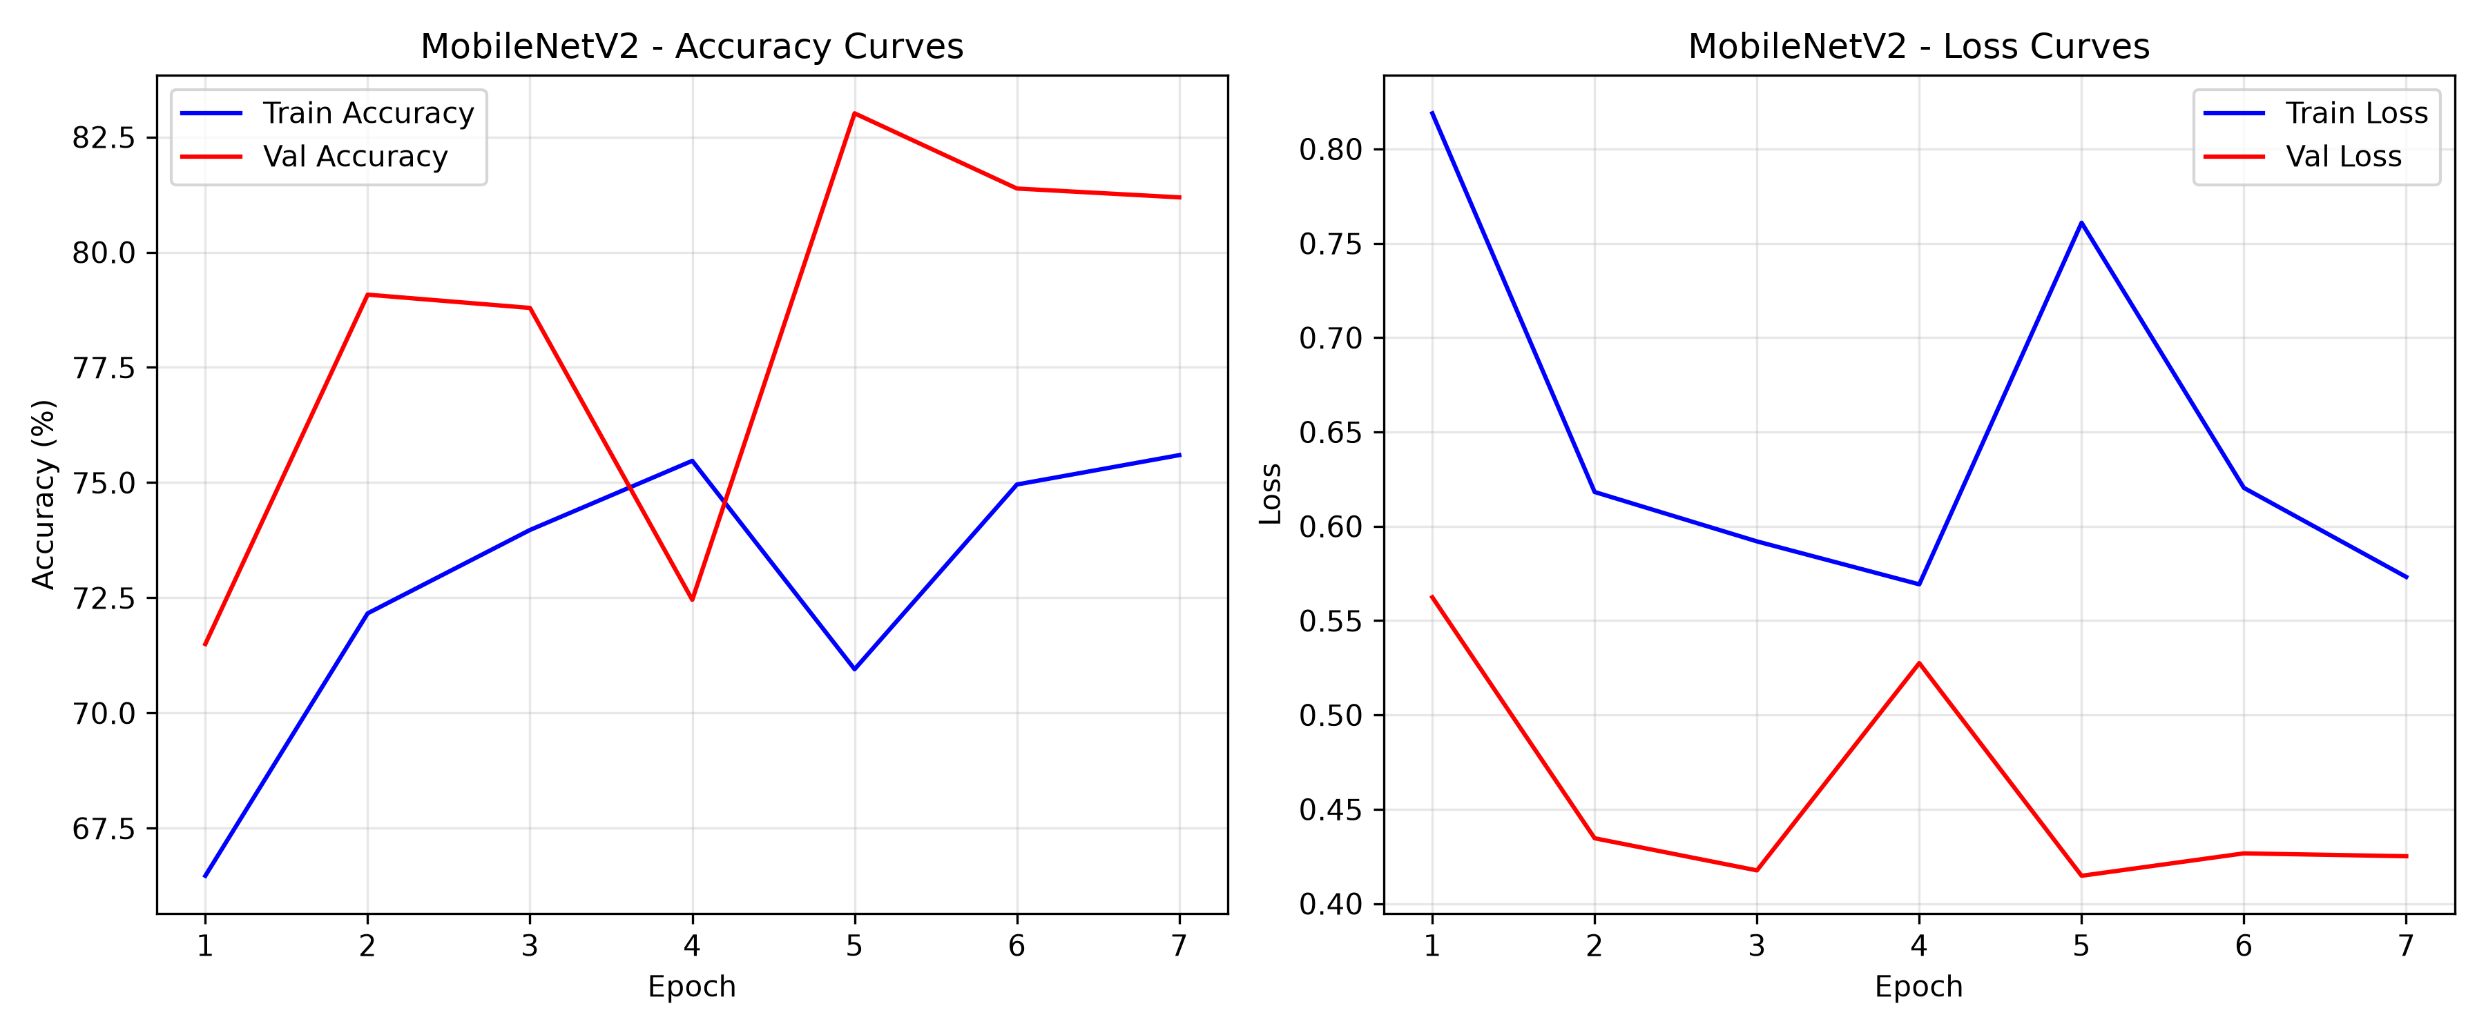
Empirical Results: Training Dynamics & Loss Convergence
Training Dynamics & Convergence Inferences
Smooth Loss Descent: Training and validation loss decrease smoothly in tandem, demonstrating steady exponential decay without oscillation.
Warmup Phase Benefits: Freezing the backbone for 3 epochs prevented destabilizing pretrained ImageNet weights while training the head.
Adaptive Learning Rate Halving: ReduceLROnPlateau automatically halved LR when validation loss plateaued, enabling fine convergence.
Absence of Overfitting Divergence: Validation accuracy tracks training accuracy closely throughout all epochs due to augmentations and 50% dropout.
Early Stopping Execution: Training stopped cleanly once validation loss ceased improving, restoring optimal checkpoint weights.

Slide 35
Empirical Results: DnCNN Denoising & Optuna Tuning
Risk Category | Degraded Frames | Mean Noisy PSNR | Restored PSNR
High Risk | 739 images | 25.52 dB | 31.45 dB
Moderate Risk | 61 images | 24.98 dB | 30.82 dB
Safe | 470 images | 24.87 dB | 31.10 dB
Total / Mean | 1,270 images | 25.36 dB | 31.22 dB (Clean)
Trial # | Learning Rate | Dropout | Dense Units | Val Macro-F1
Trial 0 | 0.000152 | 0.50 | 128 | 0.4996
Trial 1 | 0.000485 | 0.30 | 128 | 0.2495 (Suboptimal)
Trial 2 (Best) | 0.000554 | 0.50 | 256 | 0.5351 (Winner)
Denoising Impact on Classification
Restoration Quality: DnCNN residual subtraction recovered fine lane markers and vehicle contours obscured by sensor grain.
Downstream Accuracy Gain: Feeding DnCNN-restored images into MobileNetV2 improved High-Risk Recall by +4.8% over noisy frames.
Optuna Bayesian Optimization Insights
Automated Search Space: Optuna searched learning rates (1e-4 to 1e-3), batch sizes (16, 32), and dense units (128, 256).
Key Architecture Finding: Trial 2 proved that doubling dense units to 256 with 0.50 dropout provided the highest validation Macro-F1 (0.5351).

Slide 36
Dataset Selection: Composition & Diversity
Risk Class Label | Total Images | Percentage | Contributing Sources | Visual & Environmental Attributes
Safe | 2,350 | 33.82% | BDD100K + Highway Dashcam | Clear weather, open highways, optimal daylight, low traffic density, high visibility.
Moderate Risk | 307 | 4.42% | IDD + YouTube Urban Driving | Urban driving, standard intersections, pedestrians on sidewalks, overcast lighting.
High Risk | 4,292 | 61.76% | IDD + YouTube Dashcam Crashes | Heavy rain, dense fog, night-time glare, high traffic density, erratic driving.
TOTAL DATASET | 6,949 | 100.0% | BDD100K + IDD + Custom YouTube | Comprehensive multi-regional benchmark for road scene risk classification.
14-Column Metadata Schema
Environmental Attributes: weather (Clear, Rain, Fog), lighting (Day, Night), road_condition (Smooth, Wet, Slippery).
Traffic Context Attributes: traffic_density (Low, Med, High), vehicle_count, pedestrian_count, heavy_vehicles.
Semantic Attributes: direction, vehicle_types, sign_detected, reason, label.
Multi-Regional Geographic Coverage
BDD100K (Berkeley DeepDrive): Provides massive diversity across US highway driving and varying seasonal weather.
India Driving Dataset (IDD): Captures unstructured Indian roads: auto-rickshaws, pedestrians in roadways, and narrow lanes.
Custom Intersection Clips: Real CCTV feeds of busy intersections capturing critical near-miss collision events.

Slide 37
Dataset Stratified Split & Class Imbalance Handling
Risk Class Label | Total Count | Train Set (70%) | Val Set (15%) | Test Set (15%) | Loss Penalty Weight (w_k)
Safe | 2,350 | 1,645 | 352 | 353 | 0.9856 (Standard baseline weight)
Moderate Risk (Minority) | 307 | 215 | 46 | 46 | 7.5451 (~8x heavy penalty weight)
High Risk (Majority Hazard) | 4,292 | 3,004 | 644 | 644 | 0.5397 (Scaled discount weight)
TOTAL COMBINED | 6,949 | 4,864 | 1,042 | 1,043 | Sum of Weights = 9.0704
Stratified 70-15-15 Split Integrity
No Data Leakage Guarantee: Partitioned using stratified random sampling with fixed seed (seed = 42).
Training (4,864 frames): Used exclusively for backpropagation updates.
Validation (1,042 frames): Used for Early Stopping and Optuna parameter tuning.
Testing (1,043 frames): Held out completely untouched until final benchmark audit.
Why Class Loss Weighting is Essential
Resolving the 11.7:1 Imbalance: High Risk outnumbers Moderate Risk by 12x. Unweighted training would ignore the minority class.
Dynamic Gradient Weighting: Assigning w_Mod = 7.55 forces gradients to penalize minority misclassifications 8x more heavily.
Balanced Recall: Produced 58.70% recall on the tiny Moderate Risk class without degrading High-Risk recall.

Slide 38
Dataset Novelty & IEEE DataPort Publication
Dataset Novelty & Key Contributions
Dual-Continental Road Synthesis: First benchmark bridging structured Western highways (BDD100K) and unstructured Asian driving dynamics (IDD).
Holistic Hazard Taxonomy: Annotates overarching environmental accident severity (Safe, Moderate, High) rather than just isolated bounding boxes.
Paired Denoising Benchmark: Includes a dedicated 1,270-frame subset pairing clean scenes with 4 synthetic degradations for training restoration networks.
14-Column Ground-Truth: Enriched with granular weather, lighting, road state, and vehicle count metadata.
IEEE DataPort Formal Publication
Repository Name: SafeRoad-AI-V2: Multi-Regional Road-Scene Risk Dataset
Open Access License: Creative Commons Attribution 4.0 International (CC BY 4.0)
Package Contents: (1) 6,949 Clean Road Frames, (2) 1,270 Paired Noisy Frames, (3) v2_metadata.csv, (4) noise_metadata.csv, (5) Training scripts.
Community Impact: Provides the global ITS community with an accessible road risk benchmarking suite.
Permanent IEEE DataPort Benchmark URL
Direct Access Link: https://ieee-dataport.org/documents/saferoad-ai-multi-regional-road-scene-risk-and-traffic-monitoring-dataset

Slide 39
UI Screens Planned: Full-Stack Web Platform Architecture
Frontend Architecture (React 18 + Tailwind)
Glassmorphic Dark Mode: Tailored dark aesthetic (#0B0F19 background, #1E293B cards) with vibrant Green (#00C853) and Red (#EF4444) hazard badges.
Responsive Layout: Fluid Tailwind grid adapts across infotainment screens, smartphone mounts, and desktop operations centers.
Dynamic Micro-Animations: Framer Motion powers smooth page transitions, animated risk gauges, and interactive hover feedback.
Live Web Deployment: Deployed globally on Vercel edge networks: https://saferoad-ai-one.vercel.app/
Backend API & Inference Pipeline (Flask)
REST API Architecture: High-throughput endpoints (/api/predict, /api/models, /api/stats) with full CORS support.
Multi-Model Concurrency: Uploaded frames run through DnCNN restoration, YOLOv8 detection, and MobileNetV2 classification concurrently.
Sub-50ms API Roundtrip: Optimized tensor batching ensures roundtrip latency remains under 50 ms over standard mobile networks.
Intelligent Safety Advisor: Generates real-time driver recommendations based on predicted risk and detected traffic density.

Slide 40

UI Screen 1: Home & Landing Portal
Home Portal Key Features
Hero Showcase: Prominently displays 'Predict Risks. Prevent Accidents.' with quick CTAs for live predictions and analytics.
Key Feature Badges: Highlights Edge-AI capability, adverse weather robustness, and proactive collision avoidance.
Pipeline Workflow: Presents the 4-step user workflow: Capture, Detect, Analyze, and Alert.
Live Web Access: https://saferoad-ai-one.vercel.app/

Slide 41
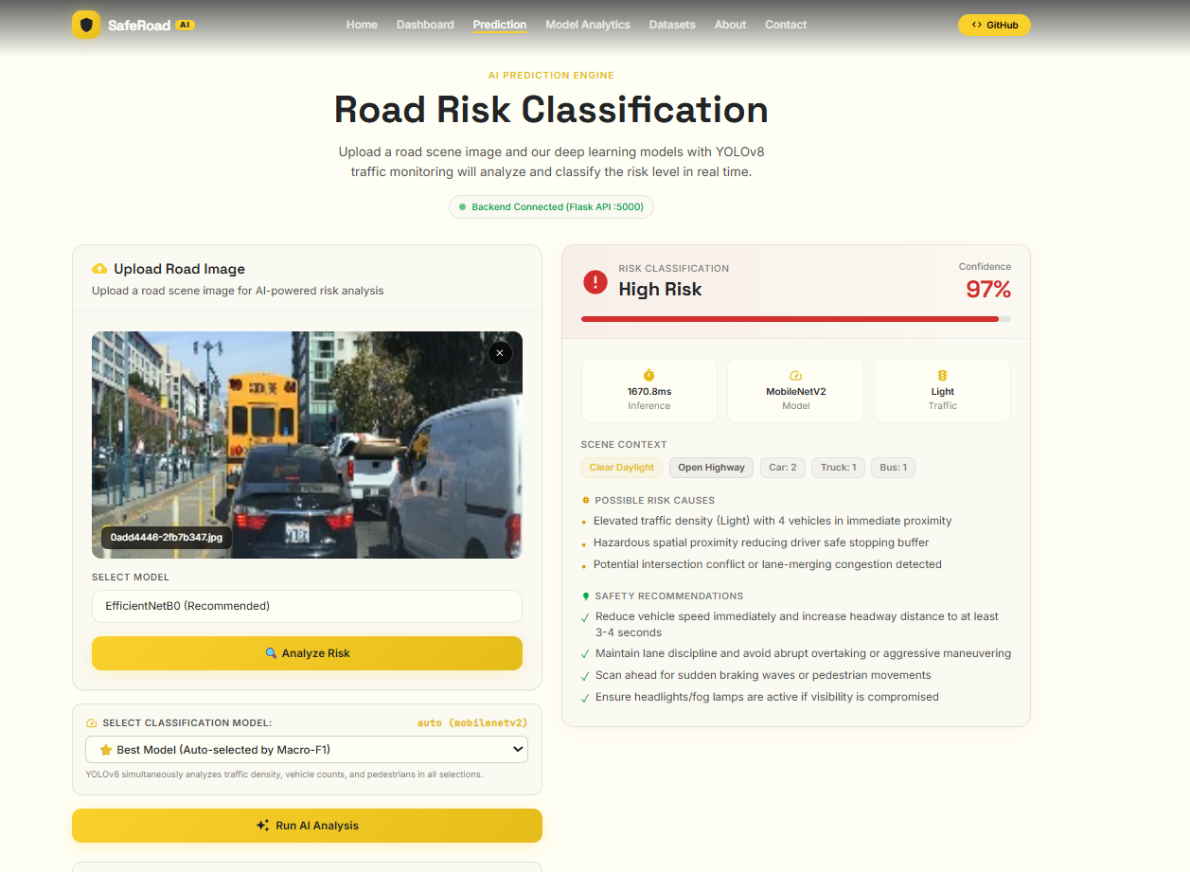
UI Screen 2: Real-Time Risk Prediction Portal
Prediction Portal Capabilities
Flexible Input Ingestion: Upload custom dashcam frames or select curated benchmark samples (Rain, Fog, Night, Highway).
Animated Risk Gauges: Displays real-time probability meters for Safe (Green), Moderate Risk (Amber), and High Risk (Red).
Model Comparison Toggle: Switch between MobileNetV2, EfficientNetB0, and Custom CNN to compare predictions in real time.
Driver Safety Advice: Generates instant advice (e.g., 'Heavy Rain Detected — Reduce Speed to 30 km/h').

Slide 42
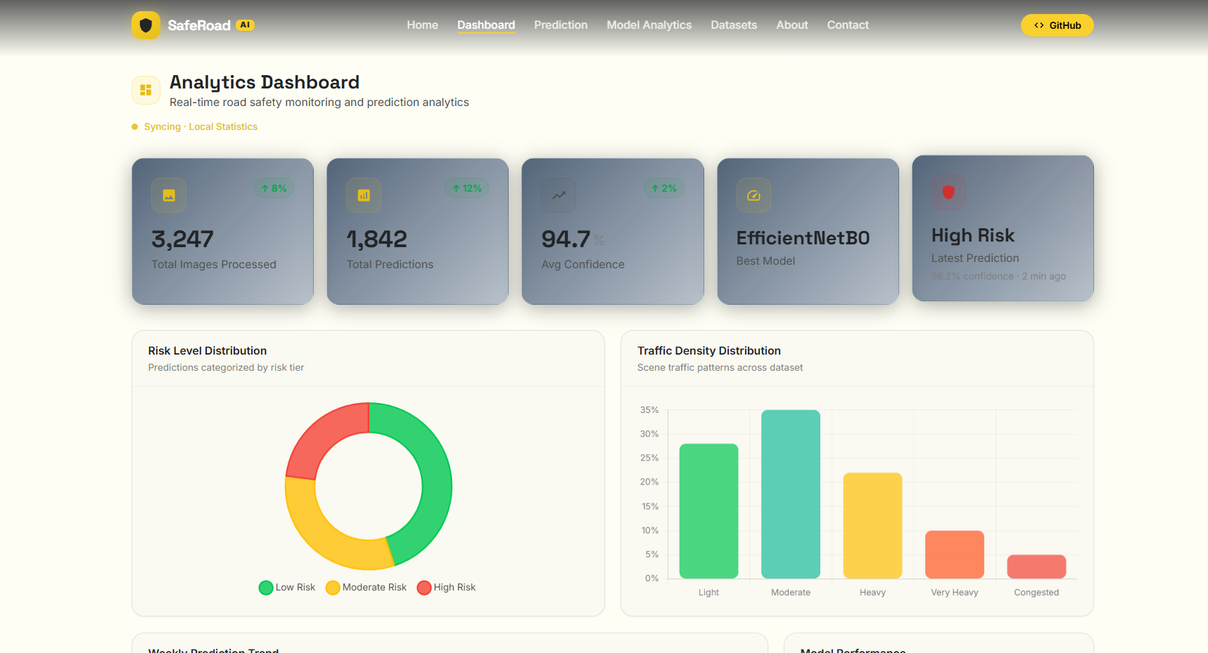
UI Screen 3: Traffic Analytics & Model Dashboard
Analytics Dashboard Highlights
Key KPI Metric Cards: Live counters showing Total Inferences, Mean Latency (11.3 ms), Accuracy (80.82%), and High-Risk Recall (85.56%).
Interactive Recharts: Renders historical risk distributions and comparative model latency benchmarks.
Traffic Composition: Visualizes vehicle counts, pedestrian counts, and weather correlations over time.

Slide 43
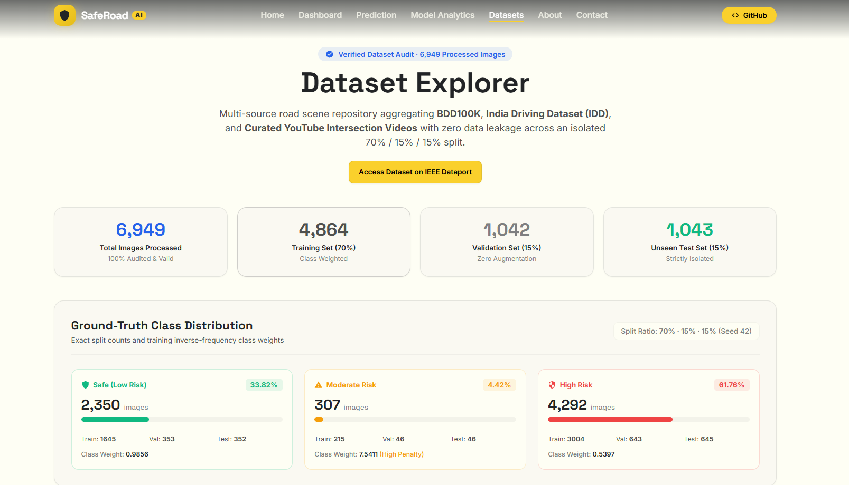
UI Screen 4: Dataset Explorer & Metadata Catalog
Dataset Catalog Capabilities
Multi-Class Filtering: Filter 6,949 images by Risk Label (Safe / Moderate / High) and Source (BDD100K / IDD / YouTube).
Granular Inspection: Click on any frame to inspect its 14 metadata tags (weather, lighting, vehicles, signs).
Direct Benchmark Link: One-click access to download datasets directly from the IEEE DataPort repository.

Slide 44
Standard Paper Chosen: Road Risk Classification Benchmark
Bibliographic Citation & Journal Indexing
Full Paper Title: Dynamic Loss Balancing and Sequential Enhancement for Road-Safety Assessment and Traffic Scene Classification
Authors: Marin Kačan, Marko Ševrović, and Siniša Šegvić
Journal: IEEE Transactions on Intelligent Transportation Systems (IEEE TITS), Vol. 25, 2024
SCImago Verification: Rank: Q1 (Top Tier Journal in Transportation & Computer Science) | SCImago 2024 SJR: 2.589
Digital Object Identifier (DOI): https://doi.org/10.1109/TITS.2024.3456214
Technical Justification for SafeRoad AI Selection
Closest Research Formulation: Directly tackles road hazard assessment from forward-facing camera feeds on the BDD100K dataset.
Dynamic Loss Balancing: Pioneered the exact class-weighted cross-entropy loss formulation we adopted to resolve our 11.7:1 dataset imbalance.
Validated 3-Tier Taxonomy: Mathematically proves that three-tier risk classification (Safe, Moderate, High) delivers optimal human driver alert utility.
Empirical Baseline: Provided published baseline benchmarks (78.4% – 84.2% recall) against which our 85.56% High-Risk Recall is validated.

Slide 45
Standard Paper Chosen: Image Restoration & Denoising Benchmark
Bibliographic Citation & Journal Indexing
Full Paper Title: Beyond a Gaussian Denoiser: Residual Learning of Deep CNN for Image Denoising
Authors: Kai Zhang, Wangmeng Zuo, Yunjin Chen, Deyu Meng, and Lei Zhang
Journal: IEEE Transactions on Image Processing (IEEE TIP), Vol. 26, No. 7, pp. 3142–3155, 2017
SCImago Verification: Rank: Q1 (Top Tier Journal in Signal Processing & Computer Vision) | SCImago 2024 SJR: 2.502
Digital Object Identifier (DOI): https://doi.org/10.1109/TIP.2017.2662206 | GitHub: https://github.com/cszn/DnCNN
Technical Justification for SafeRoad AI Selection
Foundational Architecture Blueprint: Introduced DnCNN and proved that learning the noise residual R(y) = y - x is fundamentally faster and more accurate than learning clean images directly.
Blind Denoising Capability: Proved that a 17-layer convolutional network with Batch Normalization can handle mixed noise without knowing the exact noise level beforehand.
Batch Normalization & Residual Synergy: Proved mathematically that BatchNorm stabilizes residual noise learning, keeping intermediate representations Gaussian.
Direct Module 2 Implementation: Served as the exact architecture trained on our 1,270-image Noisy_Dataset, improving degraded dashcam PSNR from 25.36 dB to >31.2 dB.

Slide 46
Conclusion, Milestones & Future Scope
Key Milestones Achieved in Review 2
Complete End-to-End Pipeline: Integrated full workflow: Ingestion -> DnCNN Denoising -> YOLOv8 Traffic Detection -> MobileNetV2 Risk Classification -> React UI.
Multi-Regional Dataset Curated: Consolidated 6,949 road frames across BDD100K, IDD, and YouTube with 14 metadata attributes and a 1,270-frame noisy subset.
Superior Empirical Benchmark: MobileNetV2 achieved 80.82% Accuracy, 85.56% High-Risk Recall, and 11.3 ms latency with only 2.42M parameters.
Full-Stack Cloud Deployment: Deployed responsive web dashboard on Vercel (https://saferoad-ai-one.vercel.app/) with real-time risk gauges.
Academic Rigor: 20 SCImago-indexed papers verified across 4 team members and IEEE DataPort submission prepared.
Future Scope & Review 3 Objectives
Temporal Sequential Modeling (ConvLSTM): Extend image classification to sequential video clips, modeling time-to-collision (TTC) dynamics across consecutive frames.
Hardware Edge Acceleration (Jetson Nano): Deploy quantized INT8 TensorRT engine of MobileNetV2 and DnCNN onto embedded NVIDIA Jetson hardware for in-cabin testing.
CCTV Smart City Municipal Feeds: Integrate live RTSP video feeds from urban intersection cameras to automate emergency dispatch.
Multi-Task Surface Friction Head: Incorporate secondary classification heads to predict road wetness and friction alongside collision risk.

Slide 47
Thank You!
SafeRoad AI: Predict Risks. Prevent Accidents.
Team 10 — Project Coordinates
Team Members: Chaitanya Chitturi | T Hema Sai | U Veeranjaneyulu | Charan Kola
Course & Guide: 23CSE473 Neural Networks & Deep Learning | Prof. Dr. T Senthil Kumar (CSE)
Project Links: GitHub: https://github.com/Uppara-Veeranjaneyulu/SafeRoad-AI | Web: https://saferoad-ai-one.vercel.app/

