Slide 1

BHEEMA INSTITUTE OF TECHNOLOGY AND SCIENCE
ALUR ROAD, ADONI – 518301, KURNOOL (Dist), A.P
A Project Presentation
on
HEALTHCARE SUPPLY CHAIN OPTIMIZER: PREDICTING MEDICAL INVENTORY BY USING DEMAND FORECASTING MODELS
Submitted by
SAPPOGU CHINNARI 212K1A0546
MANKAR HARIKA 212K1A0529
MADURI MALATHI 212K1A0525
GOLLA GANESH 222K5A0502
UPPARA MURALI 212K1A0557
Under the Guidance of
Mr. K. ARJUN, M.Tech.,
Associate Professor, CSE Dept. BITS-Adoni
2021 - 2025

Slide 2
CONTENTS
Abstract
Introduction
Literature survey
Existing System
Disadvantages of Existing System
Proposed System
Advantages of Proposed System
System Requirements
System Architecture
UML Diagrams
Output Screens
Conclusion
Future Enhancements
References

Slide 3
ABSTRACT
Efficient medical inventory management is vital for ensuring uninterrupted healthcare delivery while minimizing costs and resource waste. The optimization of medical inventory involves striking a balance between availability, cost-effectiveness, and expiration management.
Poor inventory practices can lead to critical stockouts, excessive holding costs, and wastage due to expired medications or equipment ultimately compromising patient safety and satisfaction.
This study explores data-driven strategies to optimize medical inventory by leveraging predictive analytics, classification techniques, and real-time inventory tracking systems.
Historical consumption patterns and demand forecasting models such as Autoregressive Integrated Moving Average(ARIMA), Seasonal Autoregressive Integrated Moving Average(SARIMA), Seasonal Autoregressive Integrated Moving Average with eXogenous Regressor(SARIMAX) and Vector Autoregression(VAR) are used to predict future usage trends with high accuracy.
These models help determine optimal reorder levels, safety stock thresholds, and lead times for various inventory categories.

Slide 4
INTRODUCTION
Efficient inventory management is vital in healthcare to ensure timely patient care, reduce costs, and minimize waste. Hospitals often struggle to balance between stock shortages and overstocking, leading to disruptions and financial loss. Traditional systems fail to adapt to changing demands and external factors like seasonal trends or pandemics.
This project introduces a Healthcare Supply Chain Optimizer using Multivariate Time Series forecasting to predict medical inventory needs. By analyzing variables like historical demand, seasonality, and hospital admissions, the model enables smarter, data-driven decisions. The goal is to reduce stockouts, lower costs, and improve overall patient outcomes.

Slide 5
LITERATURE SURVEY
The healthcare supply chain plays a vital role in maintaining continuous patient care. Rising complexities in medical inventory management especially during pandemics or seasonal outbreaks highlight the need for accurate demand forecasting. Recent research emphasizes the use of multivariate time series models for forecasting, as they can effectively capture complex patterns and dependencies between variables, leading to more efficient and responsive inventory management.
Inventory Optimization in Healthcare
Studies such as those by Landry and Beaulieu (2013) highlight the necessity of demand forecasting in inventory optimization. Techniques like ABC analysis, EOQ models, and simulation-based approaches have been applied in hospitals to streamline stock levels. However, these methods usually assume stationary demand and fail to adapt to seasonality or external influencing variables like epidemics or policy changes.

Slide 6
LITERATURE SURVEY
2. Multivariate Time Series for Demand Prediction
Multivariate Time Series (MTS) models, such as Vector Autoregression (VAR), Long Short-Term Memory (LSTM), and Transformer-based architectures, have demonstrated significant improvements in forecast accuracy by capturing complex interdependencies between variables. For example, Xu et al. (2020) demonstrated that LSTM networks outperformed traditional methods in predicting hospital admissions, indicating their potential in forecasting medical inventory.
3. Forecasting Techniques in Supply Chain Management
Recent research advocates for the integration of time series forecasting models in inventory control. Autoregressive Integrated Moving Average (ARIMA), Exponential Smoothing (ETS), and Prophet have been widely used. However, these univariate models fall short when multiple influencing factors are involved (e.g., patient footfall, past usage, disease trends).

Slide 7
EXISTING SYSTEM
Traditional healthcare inventory systems primarily rely on manual tracking, historical averages, or simple univariate forecasting models like ARIMA or exponential smoothing.
These systems often assume consistent demand and fail to account for external factors such as disease trends, seasonality, or sudden spikes in patient volume.
As a result, they are prone to stockouts or overstocking, leading to increased operational costs and compromised patient care.
Additionally, most existing solutions lack real-time adaptability and do not leverage advanced machine learning or multivariate analysis for more accurate predictions.

Slide 8
DISADVANTAGES OF EXISTING SYSTEM
Inaccurate Forecasting:
Relies on historical averages or univariate models, which fail to capture dynamic and multivariate factors influencing demand.
Lack of Real-Time Insights:
Most systems are not equipped to handle real-time data, leading to delays in decision-making.
High Risk of Stockouts or Overstocking:
Ineffective demand prediction results in either shortages that delay treatment or excess inventory that leads to waste.
Inflexible to External Changes:
Cannot adapt quickly to sudden changes like pandemics, seasonal diseases, or supply chain disruptions
Manual and Time-Consuming Processes:
Many systems still depend on manual updates, increasing the chances of human error.

Slide 9
PROPOSED SYSTEM
The proposed system aims to optimize healthcare inventory management using multivariate time series forecasting models. By analyzing multiple variables such as historical inventory data, patient inflow, disease trends, seasonal patterns, and external factors, it enables accurate prediction of future medical inventory needs.
This system leverages advanced machine learning algorithms (e.g., SARIMAX, VAR models) to capture complex dependencies in the data and provide real-time, data-driven insights. The goal is to reduce stockouts, minimize overstocking, and enhance overall supply chain efficiency ultimately improving patient care and reducing operational costs.
Key Features:
Multivariate Time Series Forecasting
Integration of real-time and historical data
Automated and dynamic inventory prediction
Alerts for potential shortages or surpluses
Scalable and adaptable to sudden changes (e.g., pandemics)

Slide 10
ADVANTAGES OF PROPOSED SYSTEM
Improved Forecast Accuracy: Uses multivariate time series models to account for multiple influencing factors, resulting in more accurate demand predictions.
Reduced Stockouts and Wastage: Helps maintain optimal inventory levels, minimizing shortages and excess stock.
Adaptability to Sudden Changes: Quickly adjusts to unexpected demand shifts caused by pandemics, seasonal outbreaks, or emergencies.
Automation and Efficiency: Reduces manual effort and human error by automating the forecasting and inventory management process.
Cost Optimization: Lowers operational and storage costs by maintaining efficient inventory levels.

Slide 11
SYSTEM REQUIREMENTS
1. Hardware Requirements
Processor : Intel i5 or higher Processor
RAM : Minimum 8 GB (16 GB recommended for model training)
Storage : At least 500 GB HDD or 256 GB SSD
2. Software Requirements
Operating System : Windows 10/11.
Programming Language : Python 3.7+
Libraries & Frameworks :
NumPy, Pandas – Data handling
scikit-learn – ML algorithms
statsmodels – Traditional time series models (e.g., VAR)
Matplotlib, Seaborn – Data visualization
Prophet (optional) – Time series forecasting
IDE/Notebook : Jupyter Notebook, VS Code, or PyCharm
Streamlit

Slide 12
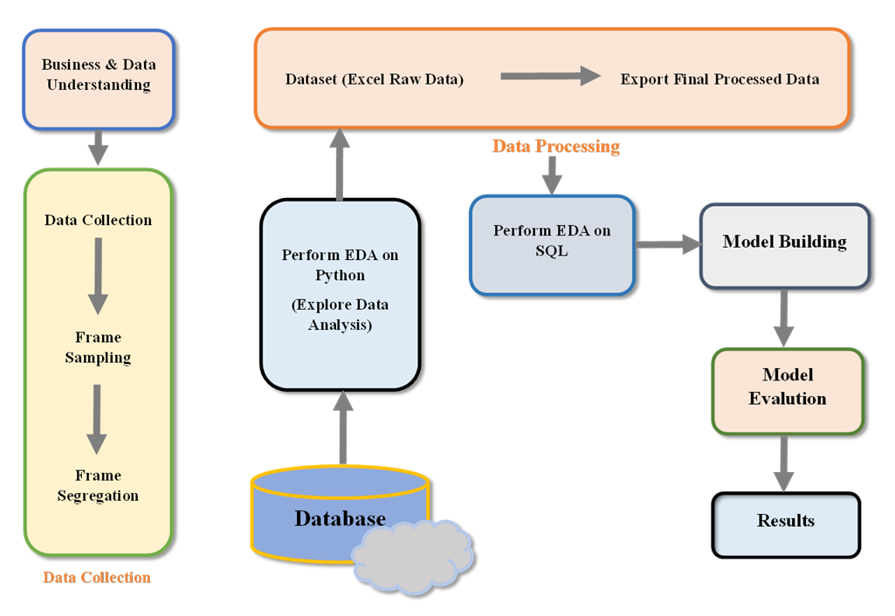
SYSTEM ARCHITECTURE

Slide 13
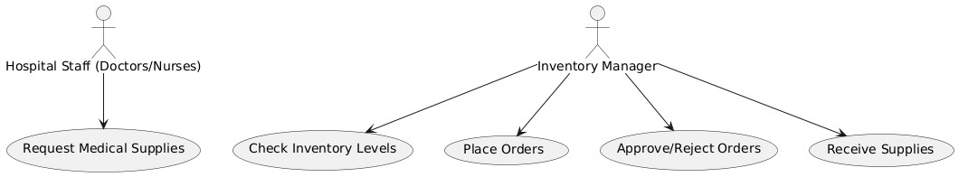
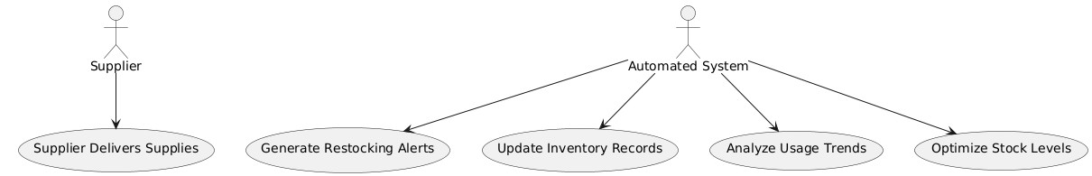
UML DIAGRAMS
A UML (Unified Modeling Language) Diagram is a standardized way to visually represent a system's structure, behavior, and interactions. It helps in designing, analyzing, and documenting software systems.
Use Case Diagram
• Request Medical Supplies
• Check Inventory Levels
• Generate Restocking Alerts
• Place Orders
• Approve/Reject Orders
• Receive Supplies
• Update Inventory Records
• Analyze Usage Trends
• Optimize Stock Levels
• Supplier Delivers Supplies

Slide 14
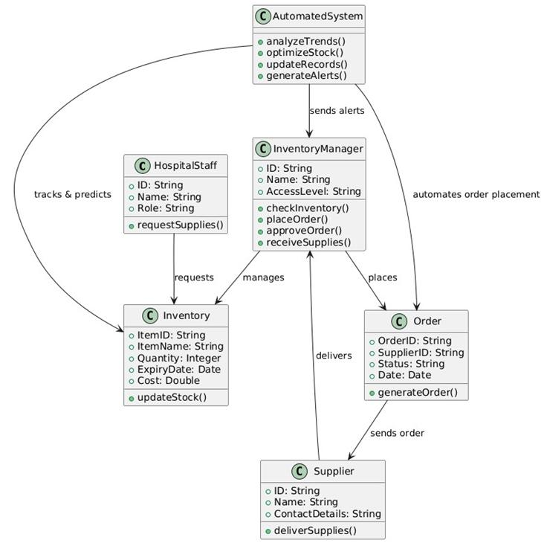
UML DIAGRAMS
2. Class Diagram
Main Classes & Attributes
1.Inventory
Item_ID (Primary Key)
DrugName
Quantity
Expiry_Date
Reorder_Level
2.Sales
Sale_ID (Primary Key)
Item_ID (Foreign Key → Inventory)
Date_of_Sale
Quantity_Sold
3.Forecasting Model (SARIMAX)
Model_ID
HistoricalData
PredictedValues
4.Supplier
Supplier_ID
Supplier_Name
Contact_Details
5.OrderManagement
Order_ID
Supplier_ID
Order_Date
Status

Slide 15
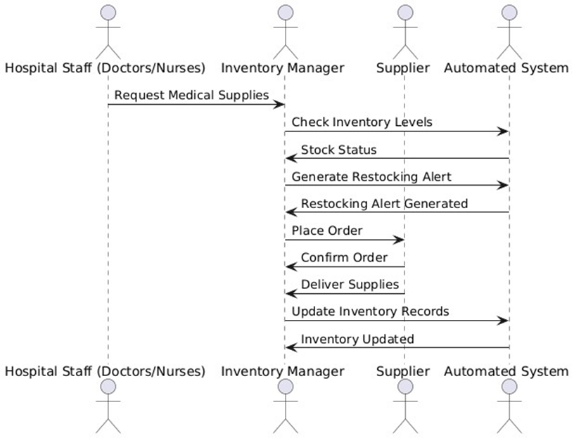
UML DIAGRAMS
3.Sequence Diagram (Stock Forecasting)
Hospital Staff requests medical supplies.
Inventory Manager checks stock.
If stock is low, Automated System generates a restocking alert.
Inventory Manager places an order.
Supplier delivers the supplies.
Automated System updates inventory records

Slide 16
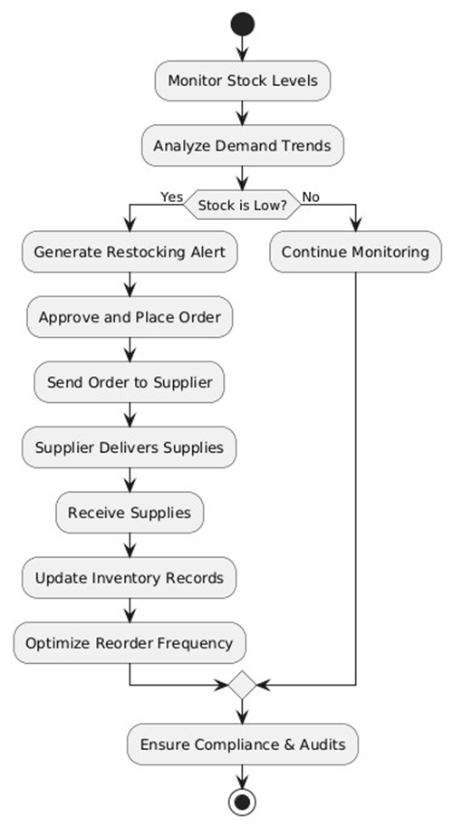
UML DIAGRAMS
4.Activity Diagram
Monitor stock levels
Analyze demand trends
If stock is low, generate a restocking alert
Approve and place an order
Receive supplies from supplier
Update inventory records
Optimize reorder frequency
Ensure compliance & audits

Slide 17
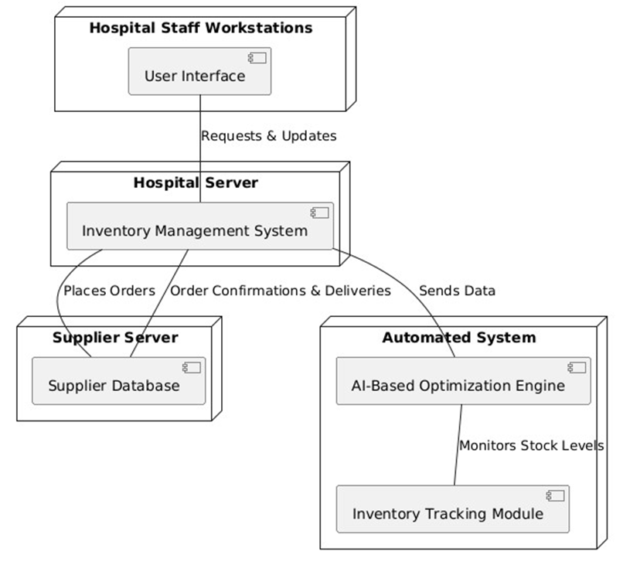
UML DIAGRAMS
5. Deployment Diagram
Hospital System (Hospital Staff Workstation, Inventory Management System)
Supplier System (Supplier Database, Supplier Portal)
Cloud Infrastructure (Automated Analytics Engine, Optimization Module, Inventory
Database)
Interactions between Inventory Manager Dashboard, Order Processing System, and
Supplier Portal

Slide 18
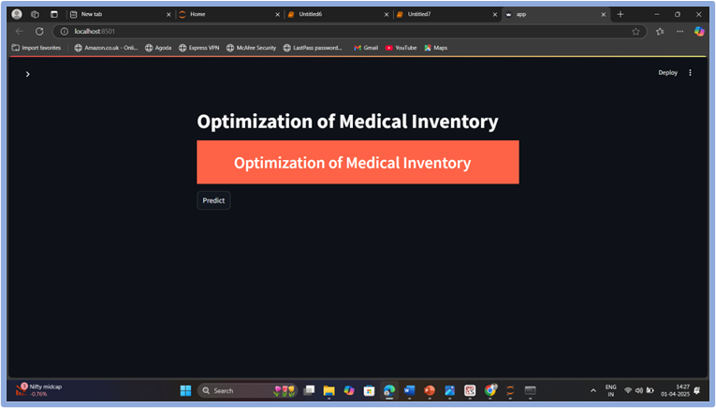
OUTPUT SCREEN
Final interface of window

Slide 19
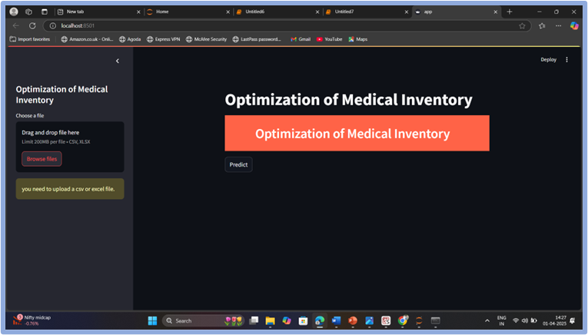
OUTPUT SCREEN
To select Browse file in interface of window

Slide 20
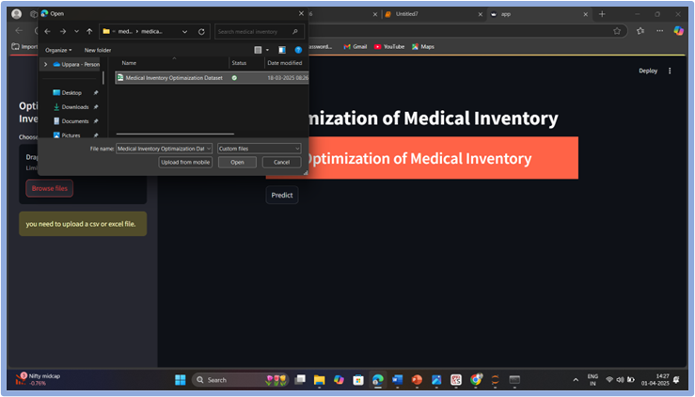
OUTPUT SCREEN
To Upload the Historical Dataset in interface of window

Slide 21

OUTPUT SCREEN
To Predict the Historical Dataset in interface of window

Slide 22
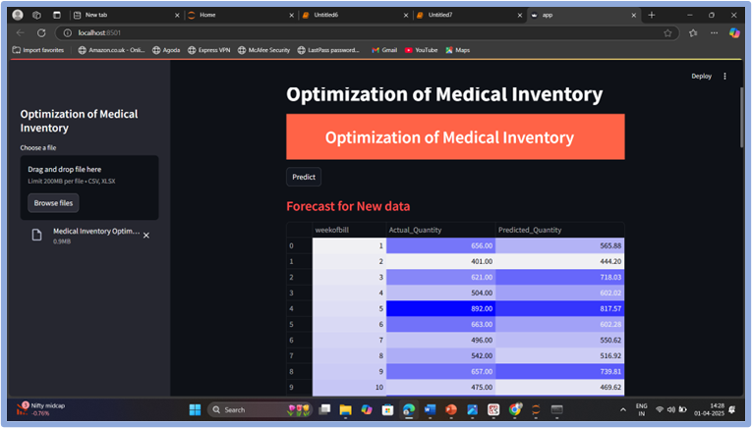
OUTPUT SCREEN
To See Forecast for New Data in interface of window

Slide 23
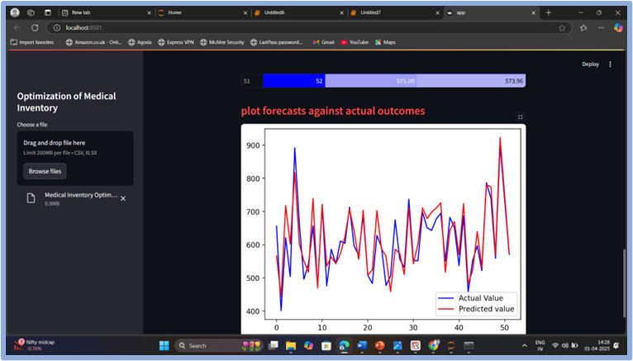
OUTPUT SCREEN
To See Forecasts Against Actual Outcomes with Graph in interface of window

Slide 24
CONCLUSION
This project successfully demonstrates the potential of multivariate time series forecasting in optimizing medical inventory within the healthcare supply chain. By leveraging historical sales data, seasonal patterns, and key operational variables, the developed model accurately predicts future inventory needs, enabling proactive decision-making and efficient stock management.
Key outcomes include:
Significant reduction in inventory bounce rate, addressing a critical issue in patient satisfaction and service reliability.
Improved forecasting accuracy (achieving over 90%), which enhances inventory availability while minimizing overstock and understock scenarios.
Data-driven inventory planning, reducing waste and operational costs, while ensuring that essential medical items are available when needed.
Potential revenue growth, with early results indicating a projected increase of over ₹20 lakhs due to decreased bounce rate and improved supply efficiency.

Slide 25
FUTURE ENHANCEMENT
To further strengthen the impact and scalability of the Healthcare Supply Chain Optimizer, several enhancements can be considered:
Real-Time Data Integration: Use live hospital data (e.g., patient inflow, emergencies) for more accurate forecasting.
External Factor Inclusion: Incorporate APIs for pandemics, supply delays, and policy changes.
Real-Time Dashboard: Develop an interactive dashboard for live inventory monitoring and decision-making.
Model Retraining Loop: Automate model updates with new data to maintain accuracy.
Multi-Hospital Scalability: Extend the solution to hospital networks for centralized optimization.
Cost Optimization: Use advanced algorithms to minimize procurement and storage costs.
Anomaly Detection: Detect unusual inventory trends for timely alerts and actions.

Slide 26
REFERENCE
Kaakeh, R.; Sweet, B.V.; Reilly, C.; Bush, C.; DeLoach, S.; Higgins, B.; Clark, A.M.; Stevenson, Impact of drug shortages on U.S. health systems. Am. J. Health Syst. Pharm. 2011, 68, 1811– 1819. [Google Scholar] [CrossRef]
Fox, E.R.; Burgunda, V. Sweet, and Valerie Jensen, Drug shortages: A complex health care crisis. Mayo Clin. Proc. 2014, 89, 361–373. [Google Scholar] [CrossRef] [Green Version]
Stevenson, W.J.; Hojati, M.; Cao, J. Operations Management, 6th ed.; Stevenson explains this well in chapter 12 page 455; Thomson Reuters: Toronto, ON, Canada, 2018. [Google Scholar]
Aptel, O., & Pourjalali, H. (2001). Improving activities and decreasing costs of logistics in hospitals. A comparison of U.S. and French hospitals. The International Journal of Accounting, 36, 65–90.(Open in a new window)Google Scholar
Beaulieu, M., & Landry, S. (2002). Comment gérer la logistique hospitalière? Deux pays, deux réalités. Gestion, 27, 91–98.

Slide 27


