Slide 1

MedicinalProductDefinition
Organization
formOf
Task
AdministrableProductDefinition
Product-classification
Subscription
for
Ingredient
SubstanceDefinition

Slide 2
3
2
5
POST
Maintenance org
Task
GET - status
Publish
SubstanceDefinition
(GSID)
SubstanceDefinition
(Draft – no GSID)
GET - status
1
4
GET
6

Slide 3
Simplified
2
Task
3
5
POST
Maintenance org
MedicinalProductDefinition
GET - status
Publish
AdministrableProductDefinition
(PhPID)
1
GET - status
Ingredient
4
6
GET

Slide 4
Extended
2
Task
3
5
POST
Maintenance org
MedicinalProductDefinition
GET - status
Publish
AdministrableProductDefinition
(PhPID)
GET - status
1
Ingredient
4
Organization
6
GET

Slide 5
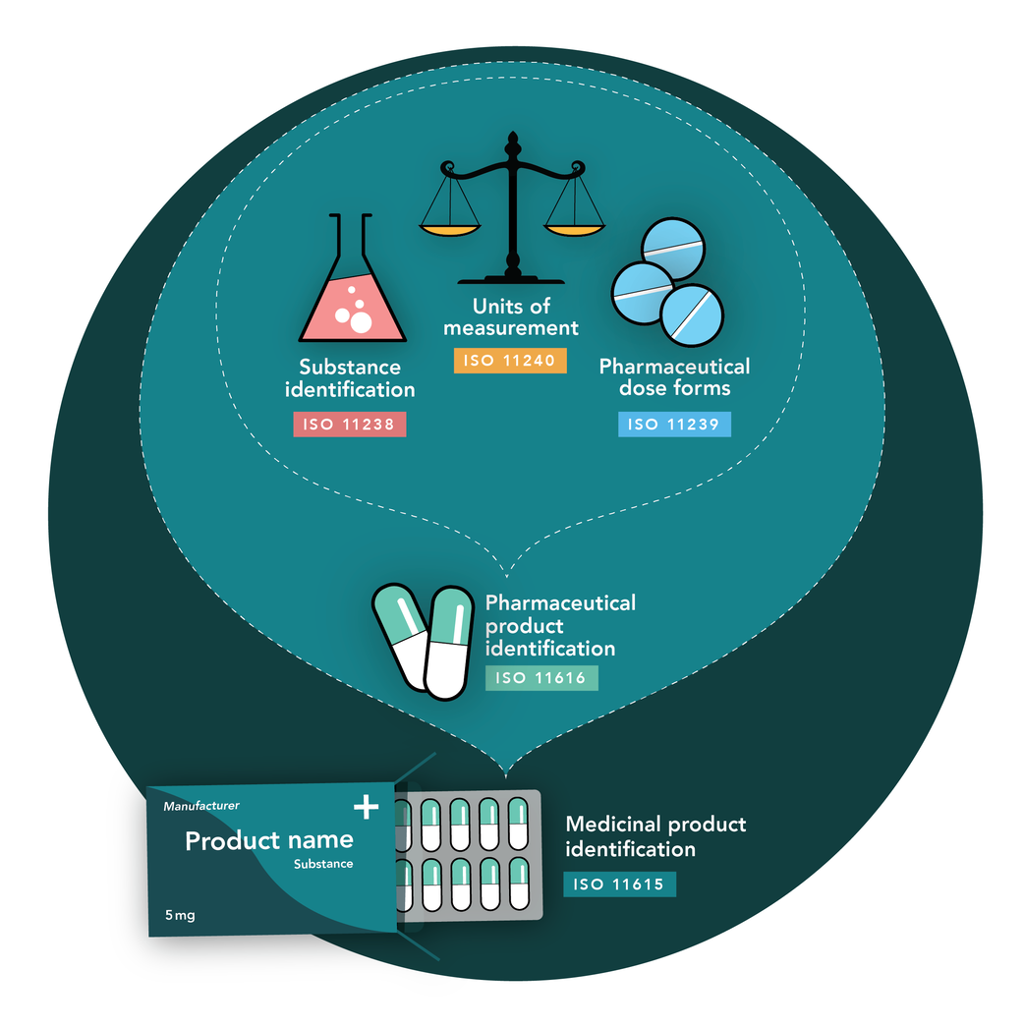
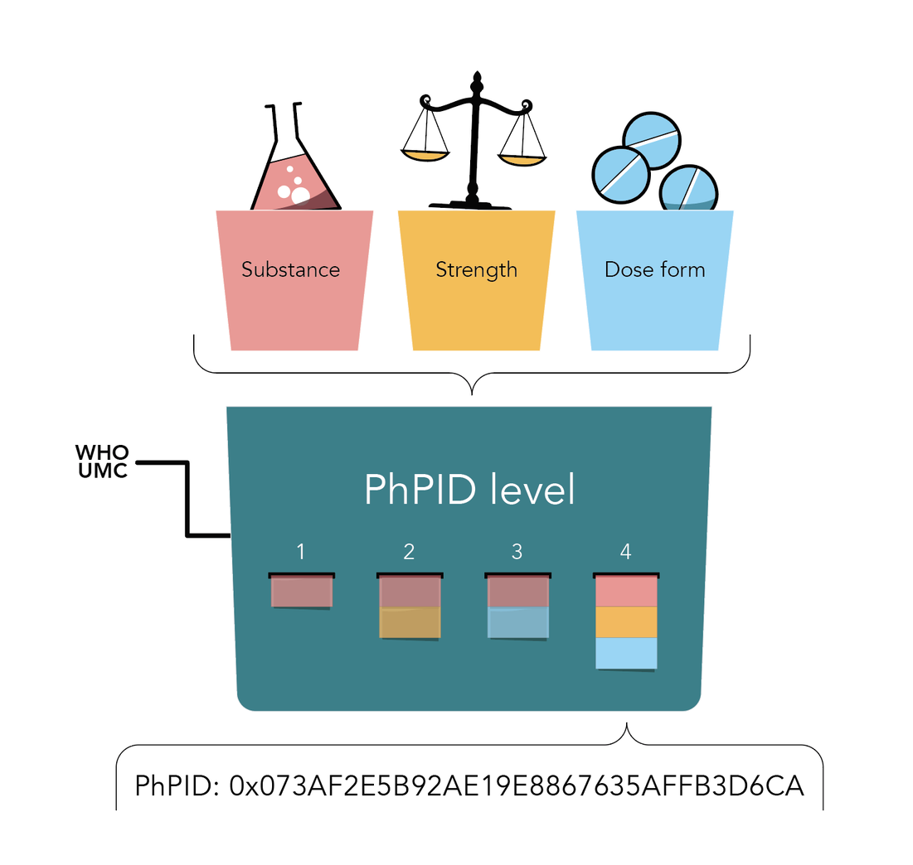
Global PhPID and Substance ID (GSID)

Slide 6
API
SubstanceDefinition (GET)
AdministrableProductDefinition (GET)
MedicinalProductDefinition (GET)
(Special license)
Task (POST, GET, DELETE)
Subscription (POST, PUT, GET, DELETE)
Requires authentication

Slide 7
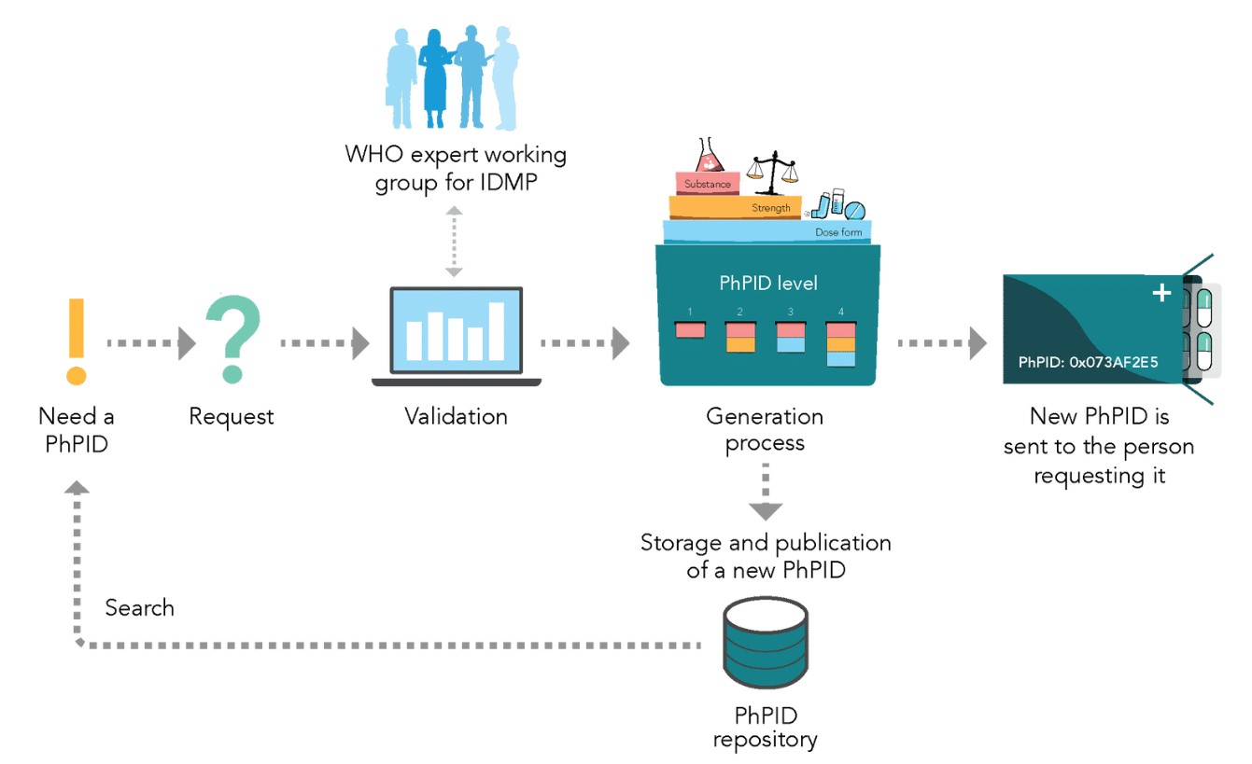
4
1
3
2
5

