Slide 1

Regulated Authorization
holder
Organization
subject
Task
MedicinalProductDefinition
Subscription
formOf
AdministrableProductDefinition
Product-classification
for
Ingredient
SubstanceDefinition

Slide 2
3
2
5
POST
Maintenance org
Task
GET - status
Publish
SubstanceDefinition
(GSID)
SubstanceDefinition
(Draft – no GSID)
GET - status
1
4
GET
6

Slide 3
Simplified
2
Task
3
5
POST
Maintenance org
MedicinalProductDefinition
GET - status
Publish
AdministrableProductDefinition
(PhPID)
1
GET - status
Ingredient
4
6
GET

Slide 4
Extended
2
Task
MedicinalProductDefinition
Including ref to Source (e.g. ePI)
3
5
POST
Maintenance org
Ingredient
Publish
GET - status
AdministrableProductDefinition
(PhPID)
1
GET - status
Regulated Authorization
4
Organization
Marketing Auth Holder
6
GET

Slide 5
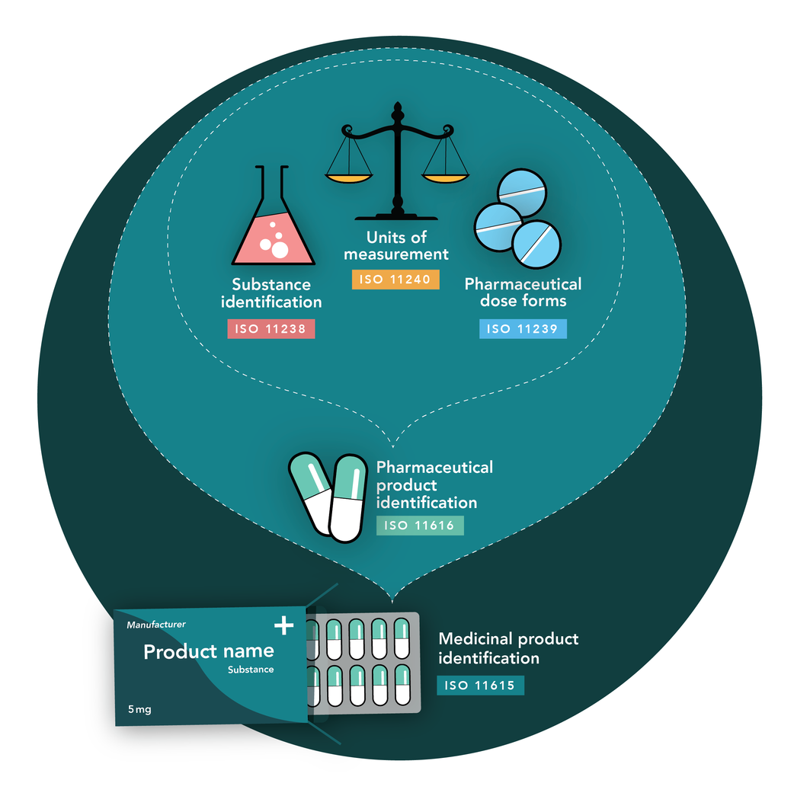
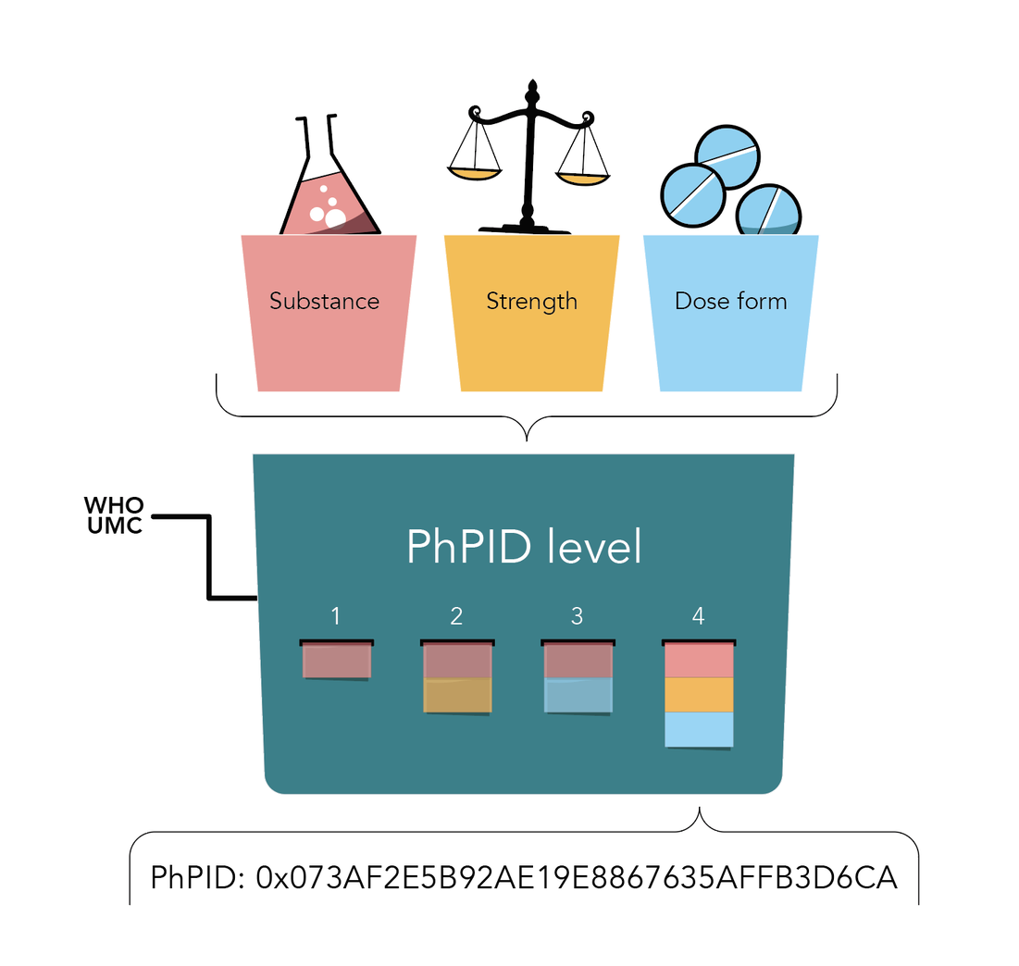
Global PhPID and Substance ID (GSID)

Slide 6
API
SubstanceDefinition (GET)
AdministrableProductDefinition (GET)
MedicinalProductDefinition (GET)
(Special license)
Task (POST, GET, DELETE)
Subscription (POST, PUT, GET, DELETE)
Requires authentication

Slide 7
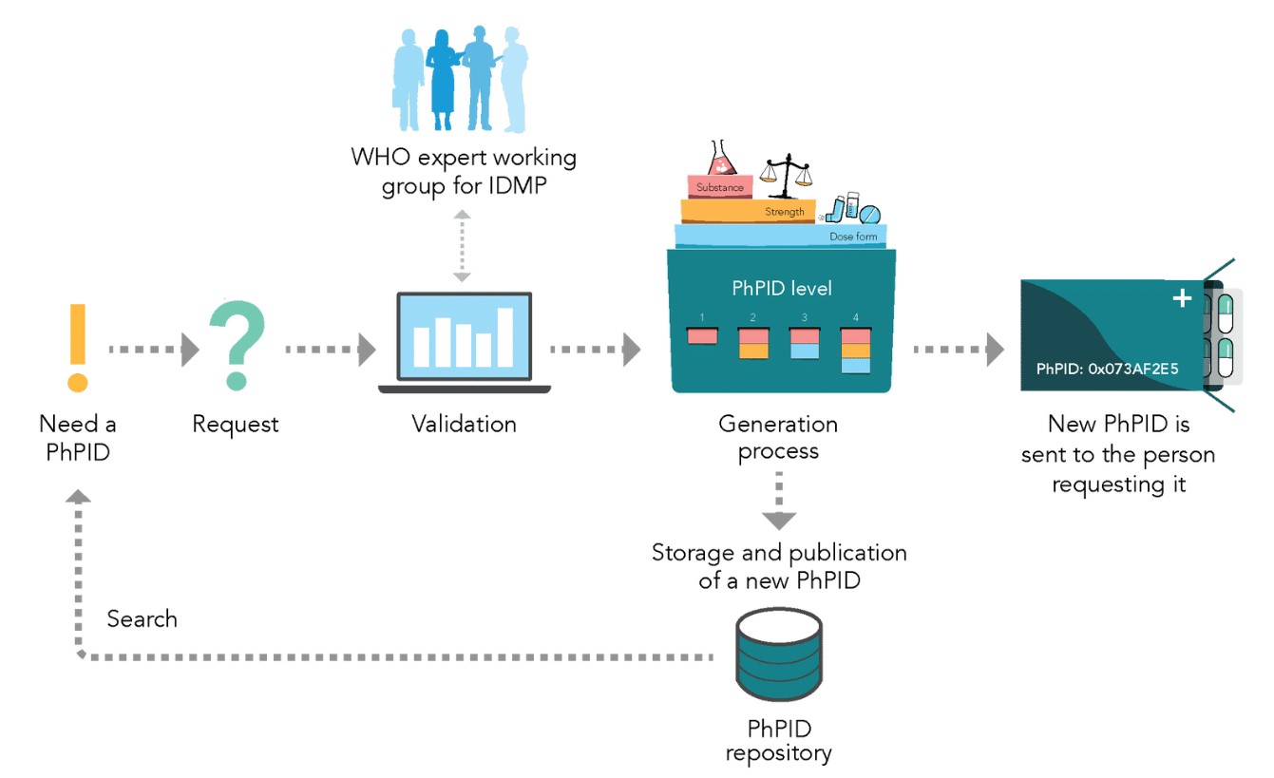
4
1
3
2
5

Slide 8
MedicinalProductDefinition
identifier:
system: http://who-umc.org/idmp/CodeSystem/product
value: 1A0661AE2A40
name:
type: MedicinalProduct
domain: Human
combinedPharmaceuticalDoseForm: Tablets
classification: 91B3CA582581F57E4092F13AAF476215
contact: #auropharmainc
code:
system: http://who-umc.org/idmp/CodeSystem/drugcode
code: 00113802216
name:
productName: Auro methotrexate
usage-country: CAN
RegulatedAuth.
identifier:
system: http://xxx/yy
value: 123-456
Organization
id: auropharmainc
name: Auro Pharma Inc
type: ProposedMAH
Ingredient
role: Active
Substance: GSID9XBS2KCF3K1Z1
strength:
presentationQuantity:
value: 2.74
unit: mg
SubstanceDefinition
identifier:
system: http://who-umc.org/idmp/gsid
value: GSID9XBS2KCF3K1Z1
name:
name: METHOTREXATE SODIUM
preferred: true
language: en
domain: Human
code:
system: https://open.fda.gov/data/unii
code: 3IG1E710ZN
relationship:
type: Salt to parent
reference: GSID23G92UMX93H45
AdministrableProductDefinition
Identifier:
system: http://who-umc.org/idmp/CodeSystem/product
value: 91B3CA582581F57E4092F13AAF476215
Extension:
url: http://who-umc.org/idmp/StructureDefinition/basic-dose-form
value: Tablet
…
url: http://who-umc.org/idmp/StructureDefinition/parent-phpid
code: PhPIDLevel1
value: 93FE88350C2E8868F7E8BD220C4E0010
…

Slide 9
Organization
name
type = MAH
resources in FHIR API
contained
“virtual” resources
holder (0..1)
Regulated
Authorization
identifier
PhPID
GSID
contained
subject (1..1)
formOf(n..1)
for (n..1)
code (1..1)
MPD
id, name, MPID(s), code (DrugCode, …)
APD
form parts
Ingredient
strength
SD
id (GSID), name(s),
code (UNII, SMSid…)
classification
contained
parent (0..3)
extension

