Slide 1

Regulated Authorization
holder
Organization
subject
Task
MedicinalProductDefinition
Subscription
formOf
AdministrableProductDefinition
Product-classification
for
Ingredient
SubstanceDefinition

Slide 2
3
2
5
POST
Maintenance org
Task
GET - status
Publish
SubstanceDefinition
(GSID)
SubstanceDefinition
(Draft – no GSID)
GET - status
1
4
GET
6

Slide 3
Simplified
2
Task
3
5
POST
Maintenance org
MedicinalProductDefinition
GET - status
Publish
AdministrableProductDefinition
(PhPID)
1
GET - status
Ingredient
4
6
GET

Slide 4
Extended
2
Task
MedicinalProductDefinition
Including ref to Source (e.g. ePI)
3
5
POST
Maintenance org
Ingredient
Publish
GET - status
AdministrableProductDefinition
(PhPID)
1
GET - status
Regulated Authorization
4
Organization
Marketing Auth Holder
6
GET

Slide 5
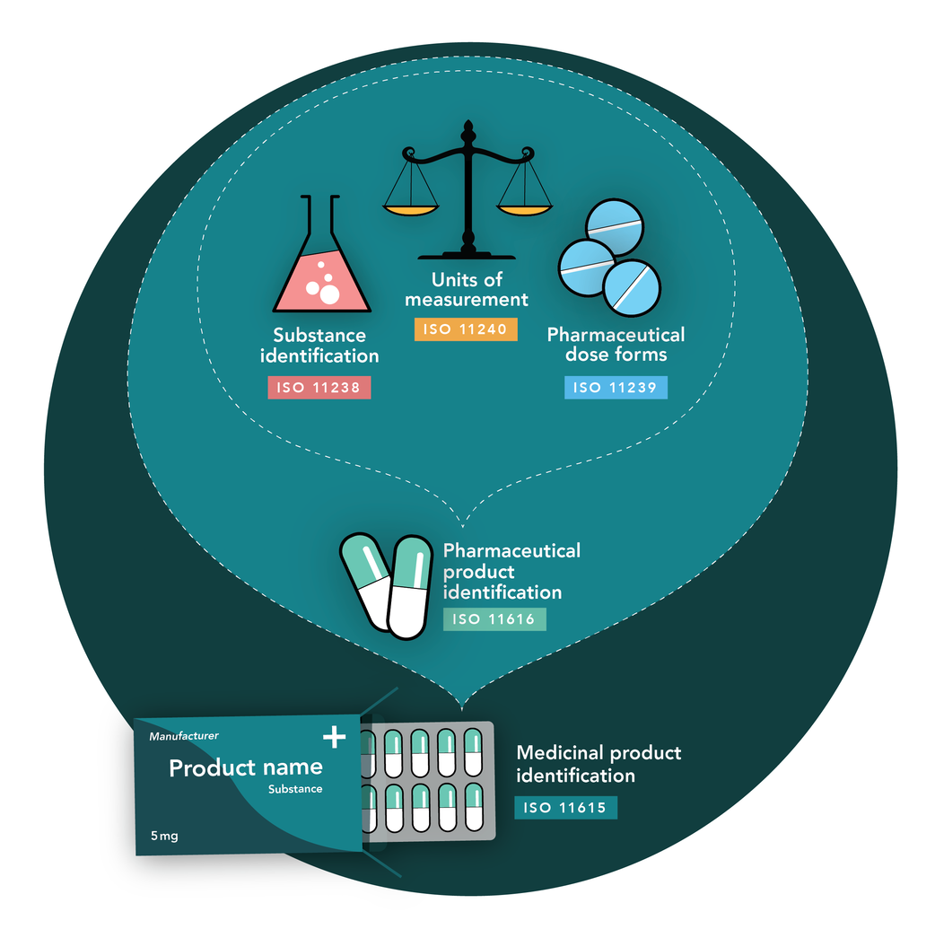
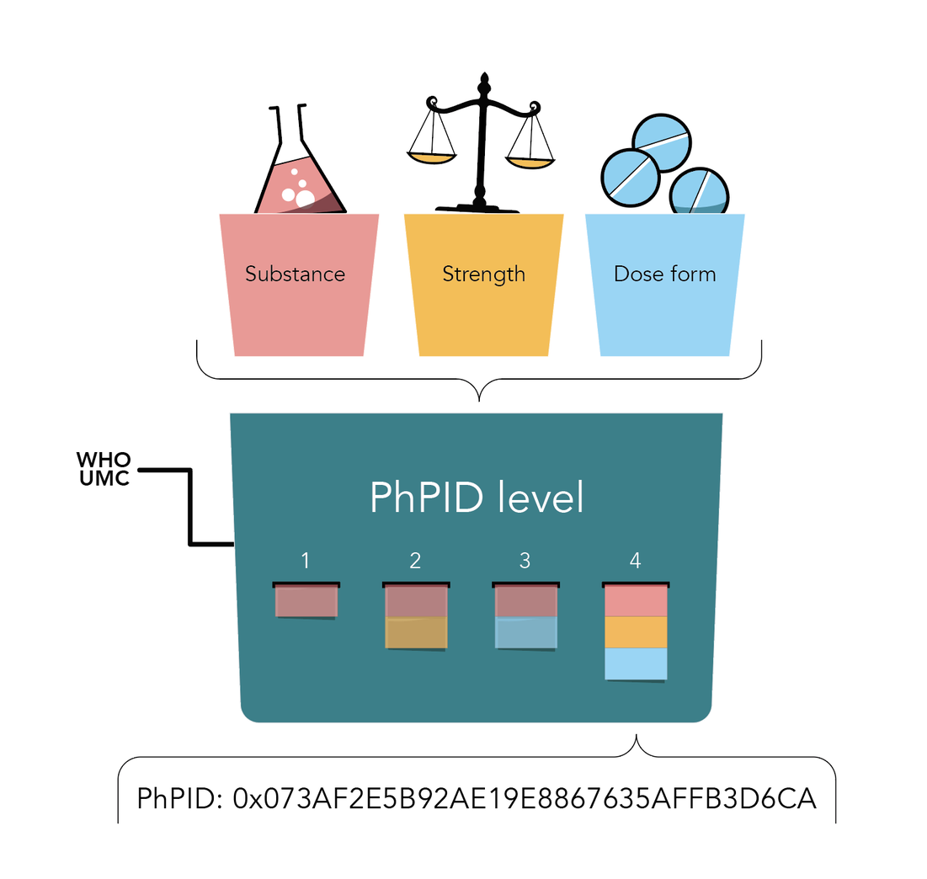
Global PhPID and Substance ID (GSID)

Slide 6
API
SubstanceDefinition (GET)
AdministrableProductDefinition (GET)
MedicinalProductDefinition (GET)
(Special license)
Task (POST, GET, DELETE)
Subscription (POST, PUT, GET, DELETE)
Requires authentication

Slide 7
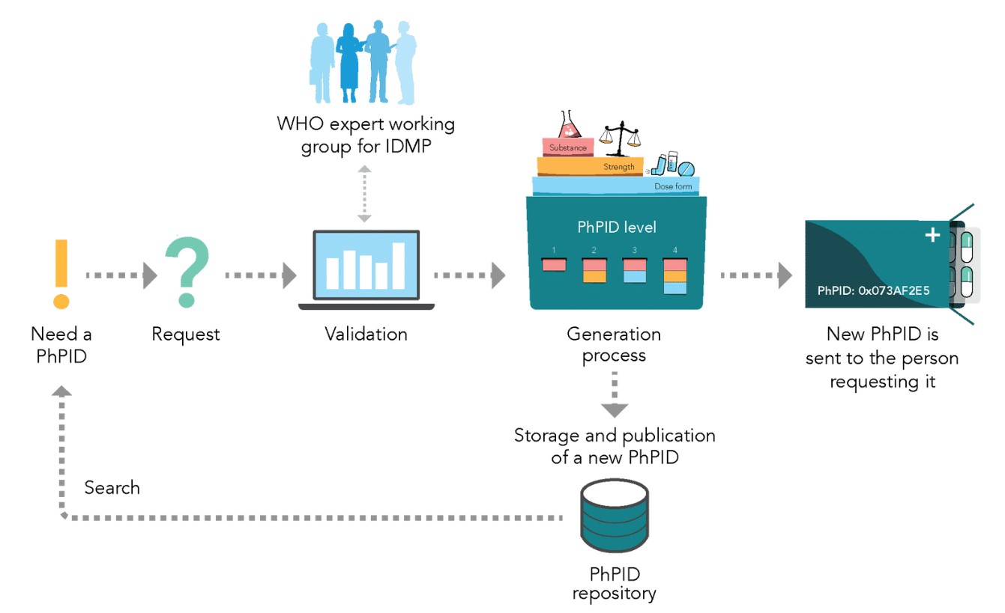
4
1
3
2
5

Slide 8
MedicinalProductDefinition
identifier:
system: http://who-umc.org/idmp/CodeSystem/product
value: 1A0661AE2A40
name:
type: MedicinalProduct
domain: Human
combinedPharmaceuticalDoseForm: Tablets
classification: 91B3CA582581F57E4092F13AAF476215
contact: #auropharmainc
code:
system: http://who-umc.org/idmp/CodeSystem/drugcode
code: 00113802216
name:
productName: Auro methotrexate
usage-country: CAN
RegulatedAuth.
identifier:
system: http://xxx/yy
value: 123-456
Organization
id: auropharmainc
name: Auro Pharma Inc
type: ProposedMAH
Ingredient
role: Active
Substance: GSID9XBS2KCF3K1Z1
strength:
presentationQuantity:
value: 2.74
unit: mg
SubstanceDefinition
identifier:
system: http://who-umc.org/idmp/gsid
value: GSID9XBS2KCF3K1Z1
name:
name: METHOTREXATE SODIUM
preferred: true
language: en
domain: Human
code:
system: https://open.fda.gov/data/unii
code: 3IG1E710ZN
relationship:
type: Salt to parent
reference: GSID23G92UMX93H45
AdministrableProductDefinition
Identifier:
system: http://who-umc.org/idmp/CodeSystem/product
value: 91B3CA582581F57E4092F13AAF476215
Extension:
url: http://who-umc.org/idmp/StructureDefinition/basic-dose-form
value: Tablet
…
url: http://who-umc.org/idmp/StructureDefinition/parent-phpid
code: PhPIDLevel1
value: 93FE88350C2E8868F7E8BD220C4E0010
…

