Slide 1
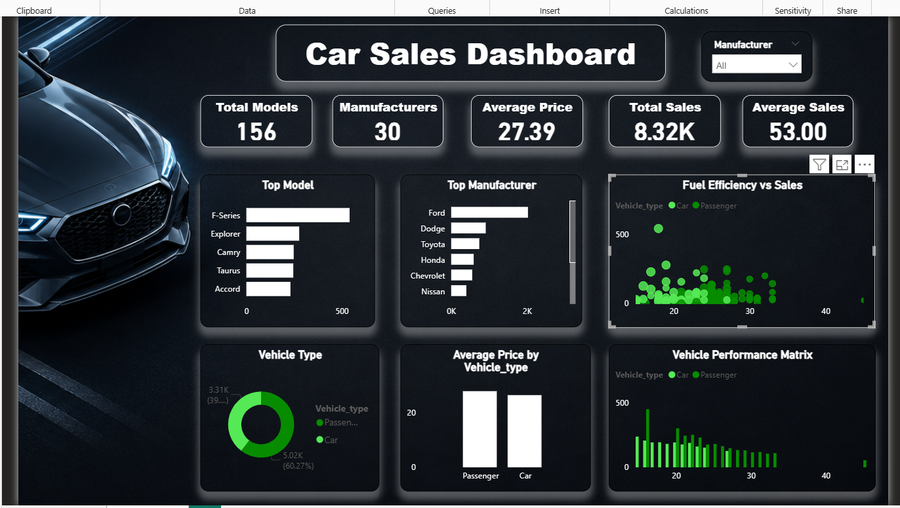
CAR SALES
ANALYTICS
Power BI Dashboard Project
Sales • Manufacturers • Models • Pricing • Performance
Prepared from the provided Car_sales(4).csv dataset

Slide 2
1. Project Overview
Turning vehicle records into a concise, decision-ready sales dashboard.
Project Goal
Solution Structure
Build an interactive Power BI dashboard that helps a business user answer five practical questions:
KPI row
5 headline measures
How large is the market represented in the data?
Comparison layer
Top models + manufacturers
Which manufacturers generate the most sales?
Category layer
Vehicle type + pricing
Which models are the strongest volume drivers?
Diagnostic layer
Fuel efficiency + performance
How do vehicle types compare on price and sales?
Filter
Manufacturer slicer
How do efficiency and performance relate to demand?
Outcome: a dark, automotive-themed executive view focused on fast comparison and business storytelling.

Slide 3
2. Dataset Profile & Data Quality
The supplied CSV contains a compact vehicle-market snapshot.
Rows
Fields
Distinct Models
Manufacturers
Missing Cells
157
16
156
30
51
records
columns
one duplicate model name
unique brands
mainly resale value
Data Quality Findings
Main Field Groups
No fully duplicated rows were found.
Commercial
Sales, price, resale value
Vehicle identity
Manufacturer, model, vehicle type
36 rows have missing resale-value entries.
Specifications
Engine, horsepower, dimensions
Most other blanks occur in technical numeric fields.
Efficiency
Fuel capacity, fuel efficiency
Performance
Power performance factor
Power BI averages exclude blank numeric cells.
Date
Latest launch

Slide 4
3. Dashboard Overview
The final report page combines KPIs, rankings, distributions, and relationships.

Slide 5
4. KPI Snapshot
The KPI row establishes scale before the viewer explores details.
DISTINCT MODELS
MANUFACTURERS
AVERAGE PRICE
TOTAL SALES
AVERAGE SALES
156
30
27.39K
8.32K
53.00
distinct model names
brands represented
thousand dollars
thousand units
thousand units / row
Interpretation
• The dataset is broad enough to support manufacturer and model comparisons.
• Total sales are heavily influenced by a small set of high-volume models.
• Average price provides context for the demand picture, but price alone does not explain sales.
• The KPI row works best as an executive entry point, not as the full analysis.

Slide 6
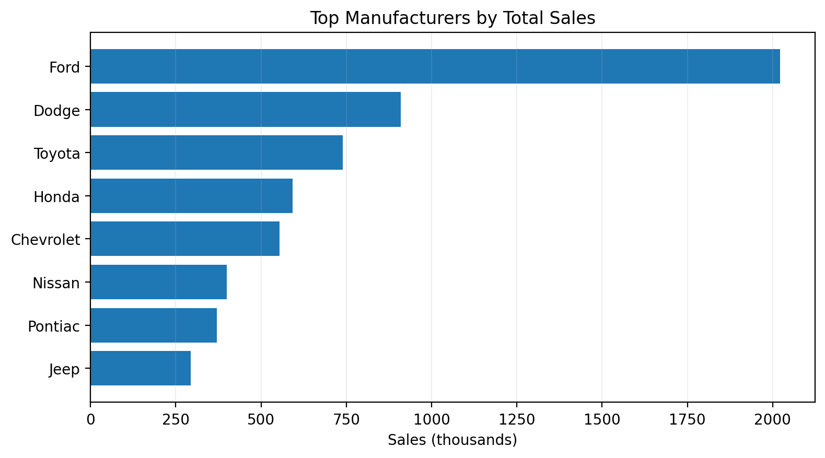
5. Manufacturer Performance
Brand-level ranking makes market concentration immediately visible.
Top 5 Manufacturers
Ford
2,022.6K
Dodge
910.1K
Toyota
740.2K
Honda
592.7K
Chevrolet
554.4K
Ford leads the dataset by a wide margin, making it the clearest manufacturer-level performance story.

Slide 7
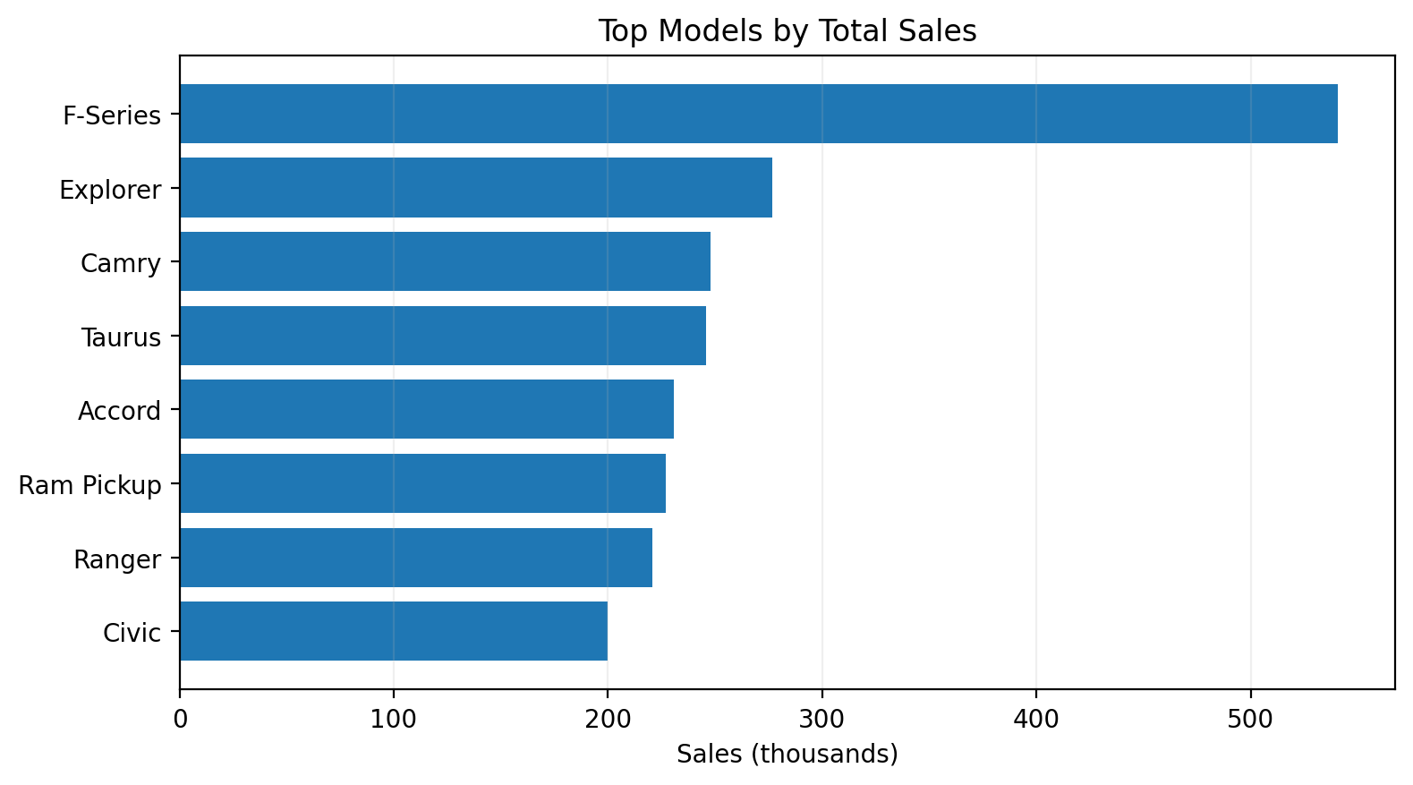
6. Model-Level Sales
The model ranking shows where individual demand is concentrated.
Top Model Insight
F-Series
540.6K
recorded sales (thousand units)
Next tier
Explorer • Camry • Taurus • Accord
Implication: model-level strategy matters because a few products can dominate the sales mix.

Slide 8
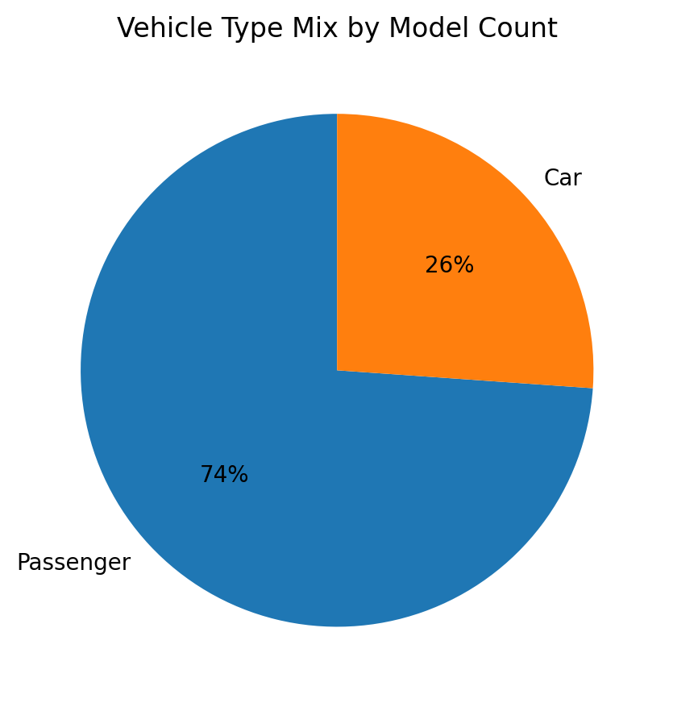
7. Vehicle Type & Pricing
Category mix and pricing add product context to the sales rankings.
Vehicle Type
Average Price
Passenger
Passenger
27.76K
116 rows | 74%
Car
26.32K
Car
41 rows | 26%
The two vehicle types have fairly similar average prices, so category alone is not enough to explain price variation.
Passenger vehicles are the larger category in the dataset.

Slide 9
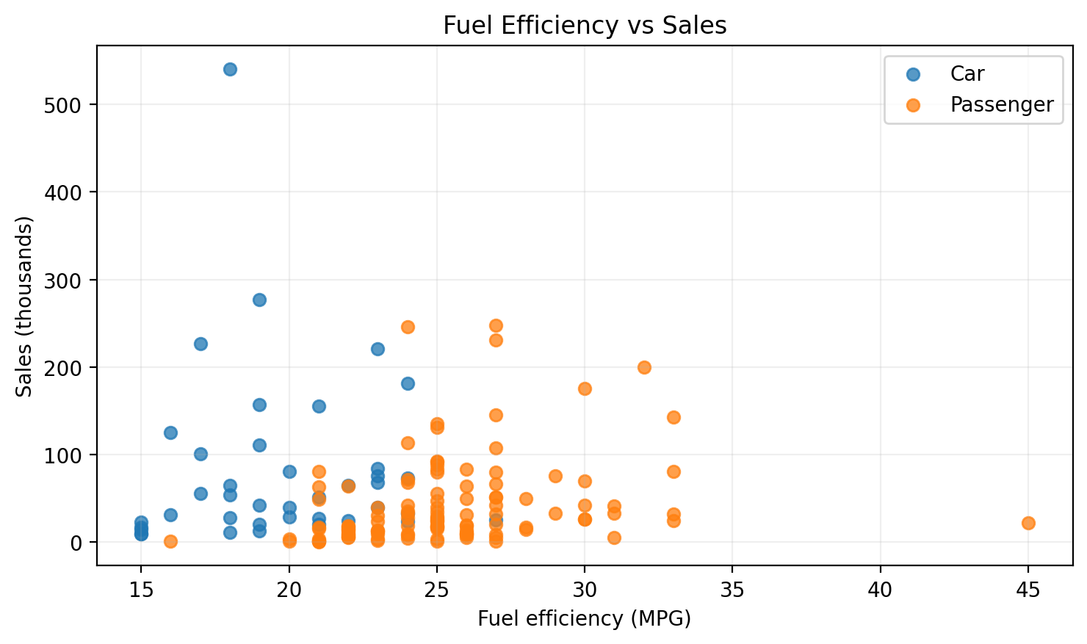
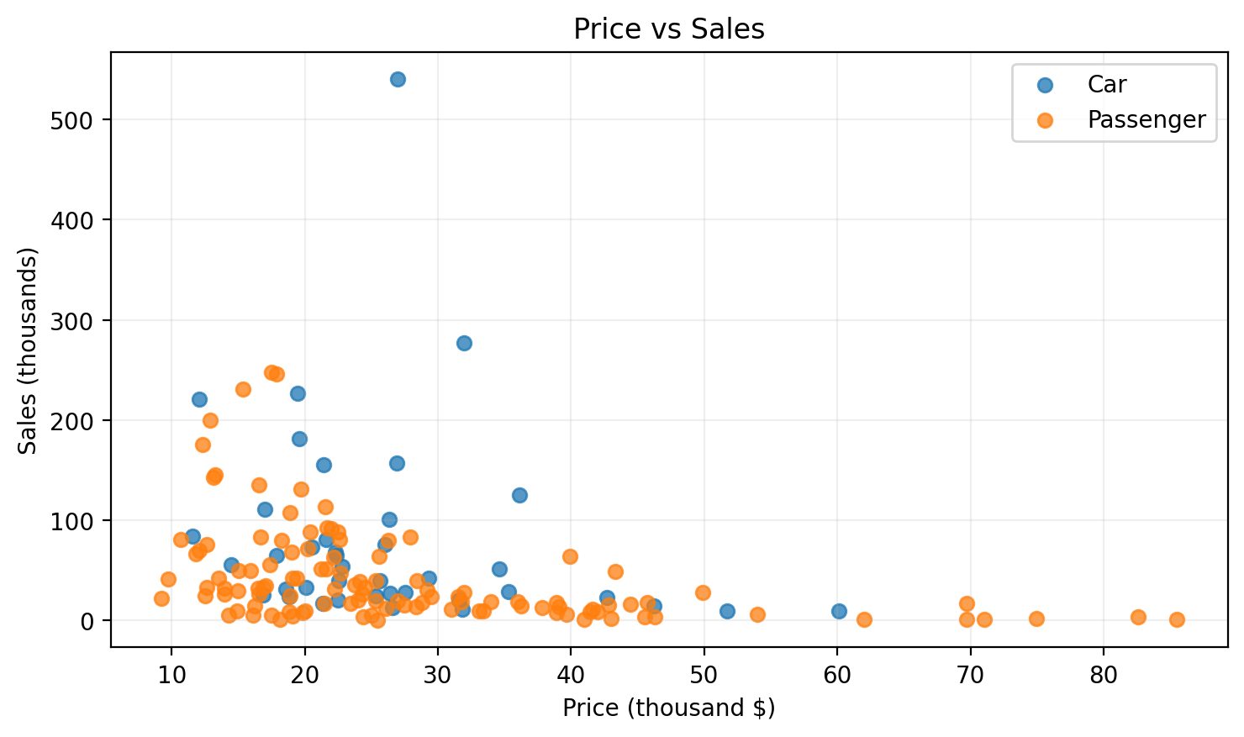
8. Efficiency, Price & Performance
Relationship visuals test whether vehicle characteristics move with sales.
What the relationships suggest
Fuel efficiency vs sales: r ≈ -0.02 (almost no linear relationship). | Price vs sales: r ≈ -0.30 (moderate negative association).

Slide 10
9. Key Business Insights
Five observations that stand out from the dashboard.
Market scale
30 manufacturers and 156 distinct models create a broad comparison set.
1
Demand concentration
Ford and F-Series are the strongest manufacturer and model leaders.
2
Category mix
Passenger vehicles are more numerous and carry more total recorded sales.
3
Pricing signal
Higher-priced vehicles are not the strongest sellers in this sample.
4
Efficiency signal
Fuel efficiency alone is a weak linear predictor of sales here.
5

Slide 11
10. Recommendations & Future Scope
How the dashboard can become a more powerful decision-support product.
Recommended Next Steps
Future Enhancements
Prioritize high-volume models in inventory and sales planning.
Add time-series sales trends when valid date-level sales data is available.
Use manufacturer/model rankings as a recurring management view.
Add geography, dealer, discount, or customer-segment data.
Create drill-through pages for manufacturer → model analysis.
Segment vehicles by price band, vehicle type, and performance level.
Add price bands and performance bands for clearer segmentation.
Document units clearly: sales are in thousands; price is in thousand dollars.
Introduce bookmarks for Executive, Product, and Performance views.

Slide 12
11. Conclusion
A compact project demonstrating end-to-end Power BI analytics skills.
Project Outcome
The Car Sales dashboard turns raw vehicle records into a clear executive story: who sells the most, which models drive demand, how product categories compare, and whether vehicle characteristics align with sales.
Skills Demonstrated
Core Tools
Portfolio Value
Data profiling
Power Query
DAX measures
Dashboard design
Power BI
CSV
DAX
Power Query
Business storytelling
Analytical thinking
Decision-ready visuals
Interactive reporting
Thank you

