Slide 1
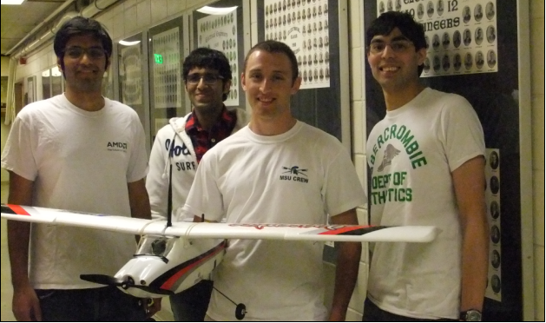
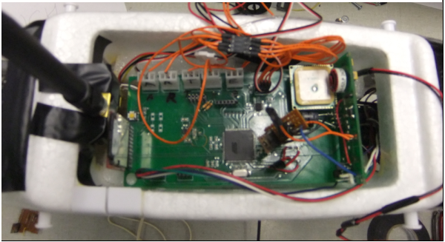
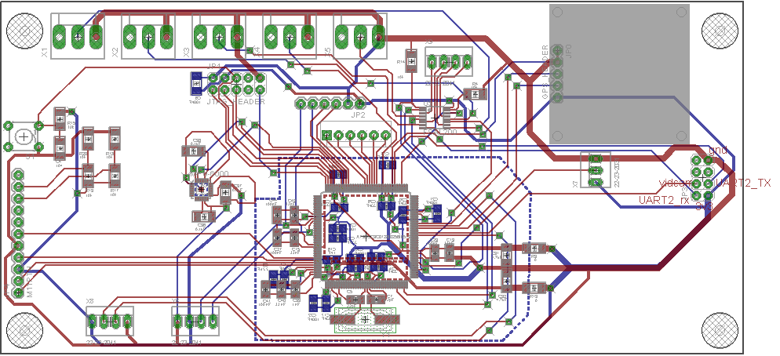
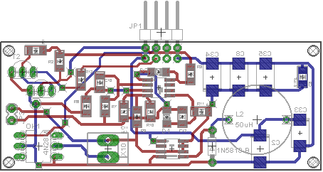
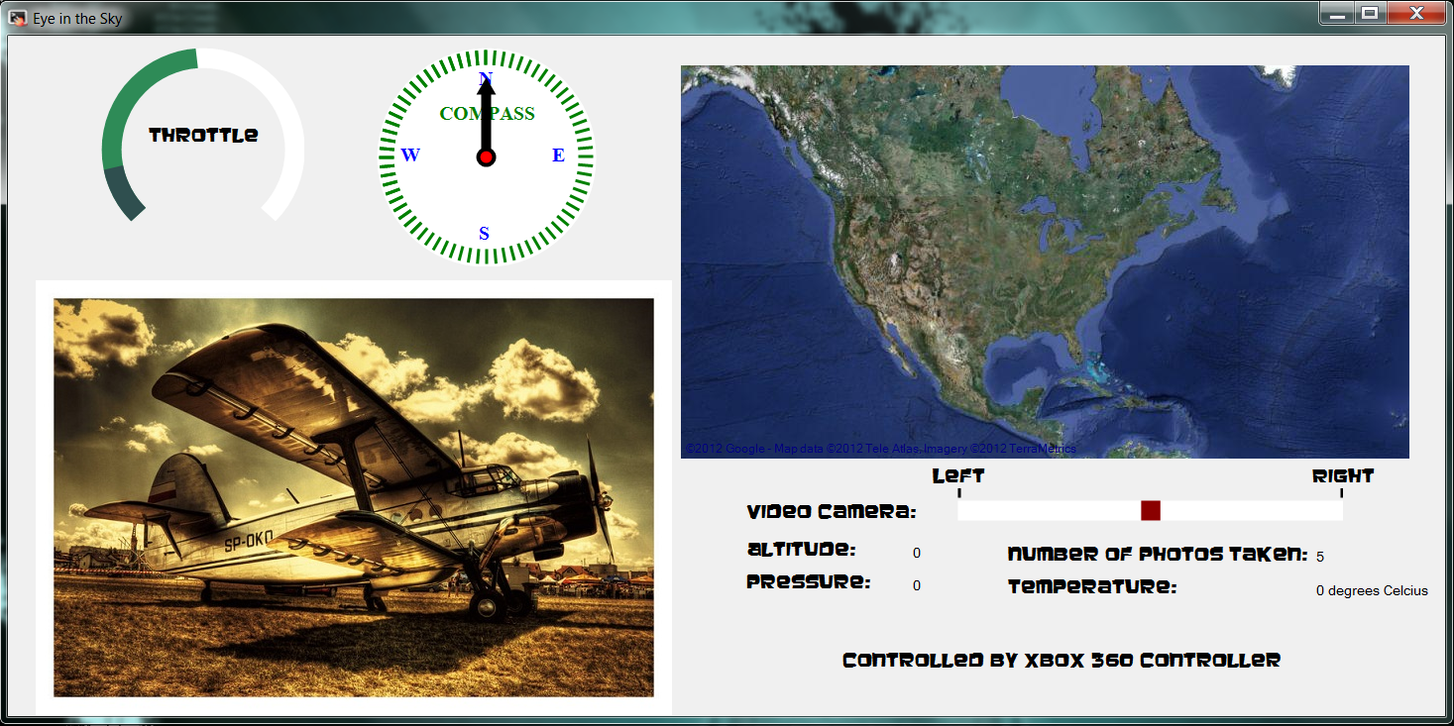
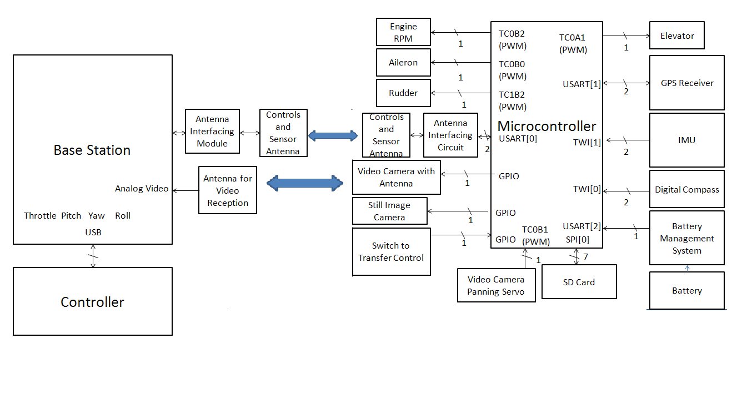

ECE 477 Digital Systems Senior Design Project - Spring 2012
Eye in the Sky
Figure 3a: Digital board layout
Figure 4: Internal circuitry, mounted in fuselage
Figure 1: (from left) Ashwin Shankar, Upsham Dawra, Joe Katz and Samit Sura
Base Station
Relays commands from Xbox controller to base station via XBee
Receives sensor data from plane via XBee
Receives video from plane using separate receiver
Logs GPS data using Google maps
Description
Portable, low-cost aerial drone
Relay real-time video and sensor data to a base station
Record high-resolution still images of the ground during flight
Store still images and flight data in non-volatile memory during flight
Control drone manually via a control unit at a base station
Figure 3b: Power board layout
Hardware
Eflite Apprentice 15e
AT32UC3A3256 microcontroller
XBee antenna: UART interface
Sensors: GPS receiver, inertial measurement unit (IMU), barometric pressure sensor, compass, video camera, still image camera, battery monitor
Circuit boards: power regulator/monitor, digital board
Figure 6: Virtual Cockpit
Figure 2: Block Diagram
Digijock(ette)-Strength Digital System DesignTM

