Slide 1
10
7
8
9
4
5
6
2
3
1
BIG BANG

Slide 2
NEBULA
The birthplace of stars.

Slide 3
BROWN DWARF
Why are you so bad at this?

Slide 4
RED DWARF
Spectral Class: M
0.6 M☉
The weakest and most common star. Also lives the longest.

Slide 5
ORANGE DWARF
Spectral Class: K
0.8 M☉
Second weakest star type. Good candidates for planetary systems.

Slide 6
YELLOW DWARF
Spectral Class: G
1.15 M☉
The class our Sun is in. It will grow to become a red giant at the end of its life.

Slide 7
YELLOW-WHITE
Spectral Class: F
1.4 M☉
A star one spectral class above our Sun. Emits stronger UV radiation.

Slide 8
WHITE
Spectral Class: A
2.1 M☉
A hot and luminous star type. Includes stars such as Sirius and Vega.

Slide 9
WHITE DWARF
The heart of a low mass star

Slide 10
BLUE-WHITE
Spectral Class: B
16 M☉
A star with very strong stellar winds. Can become a supernova when it dies.

Slide 11
NEUTRON STAR
The heart of a high mass star

Slide 12
QUARK STAR
A core so dense it forms a quark-gluon plasma

Slide 13
BLUE GIANT
Spectral Class: O
90 M☉
The brightest and rarest star type. Loses mass and energy very quickly.

Slide 14
BLACK HOLE
BLACK HOLE
Spectral Class: --
Spectral Class: ?
∞ M☉
Devours everything including light itself.
Devours everything including light itself.

Slide 15
BLACK HOLE
UNKNOWN
Spectral Class: ?
Spectral Class: ?
? M☉
Devours everything including light itself.
Keep on playing to discover this star.

Slide 16
BLACK HOLE
SUPERNOVA
Spectral Class: ?
Devours everything including light itself.
An incredibly catastrophic stellar explosion.

Slide 17
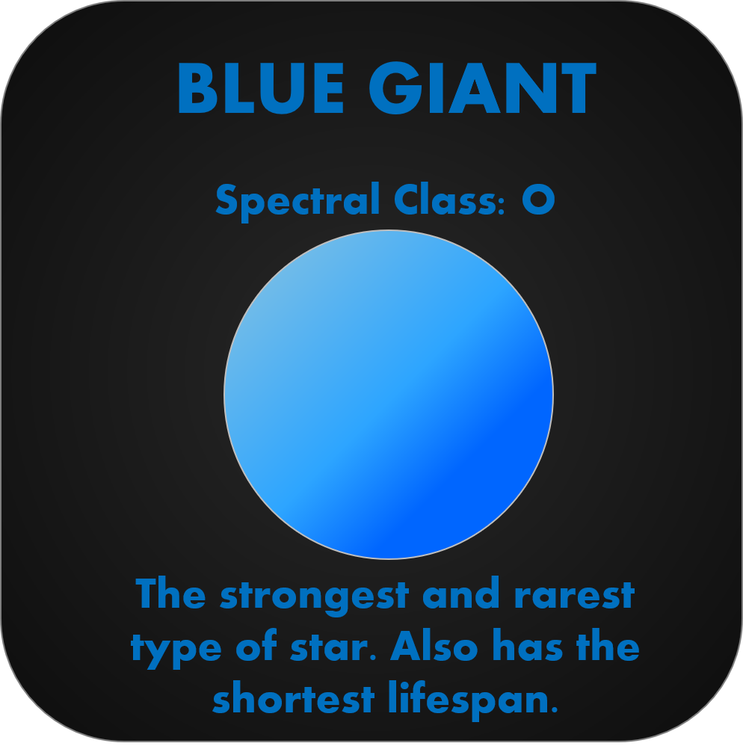
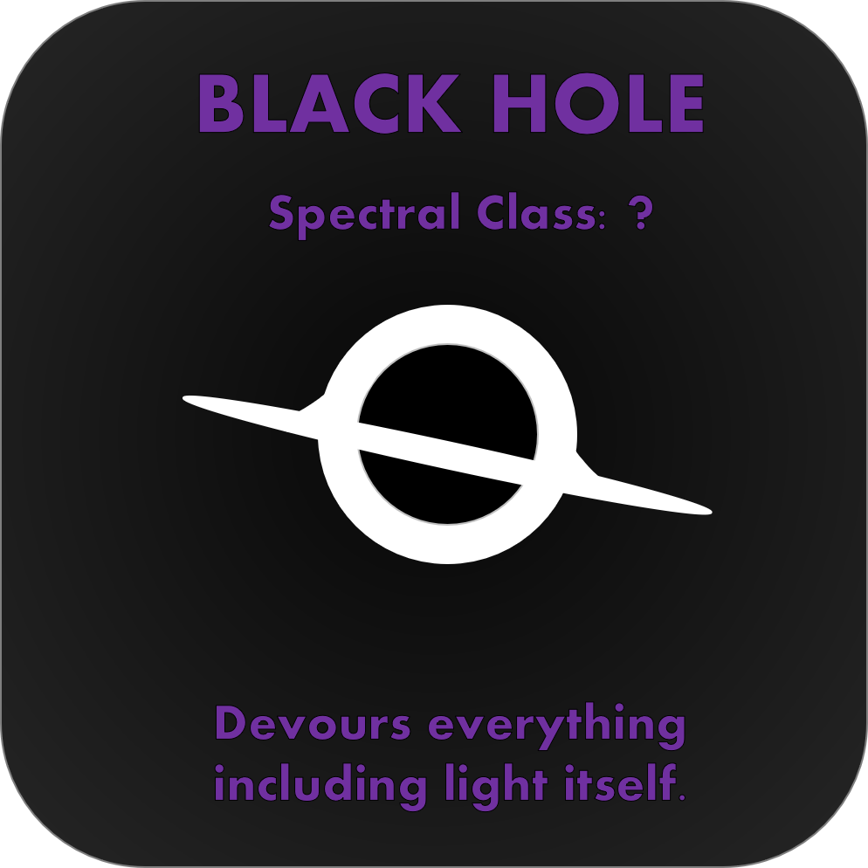
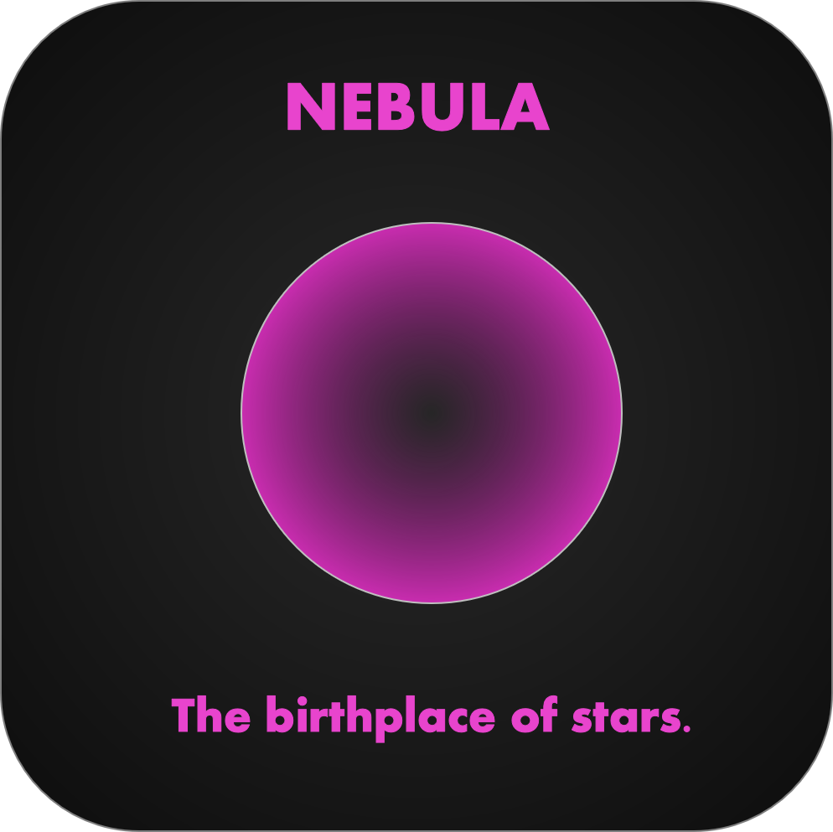
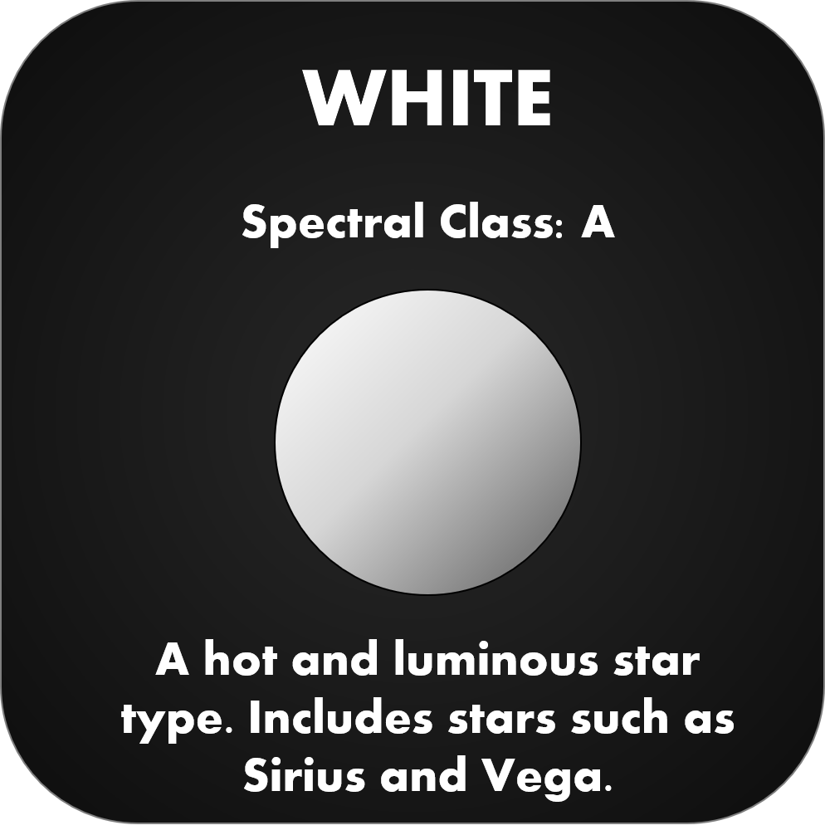
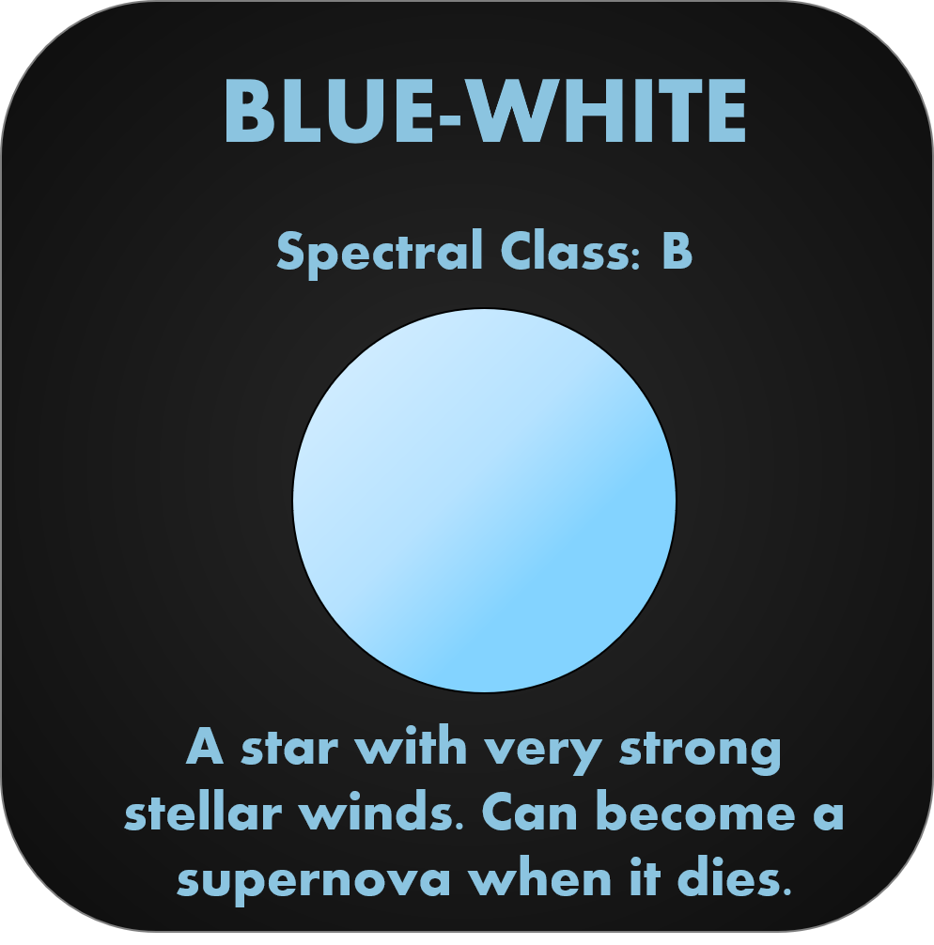
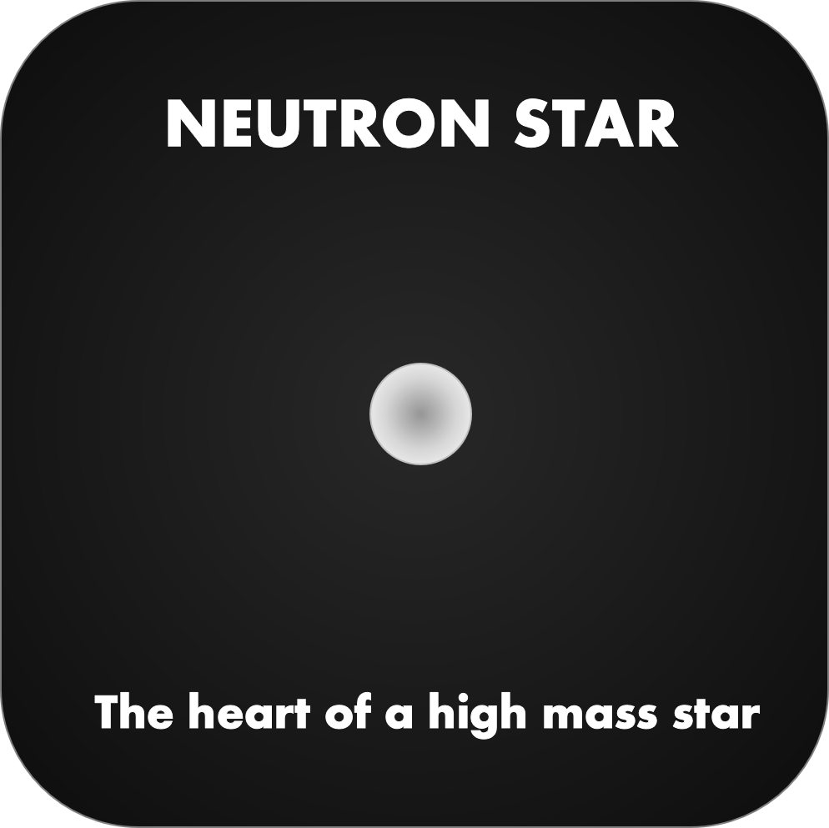
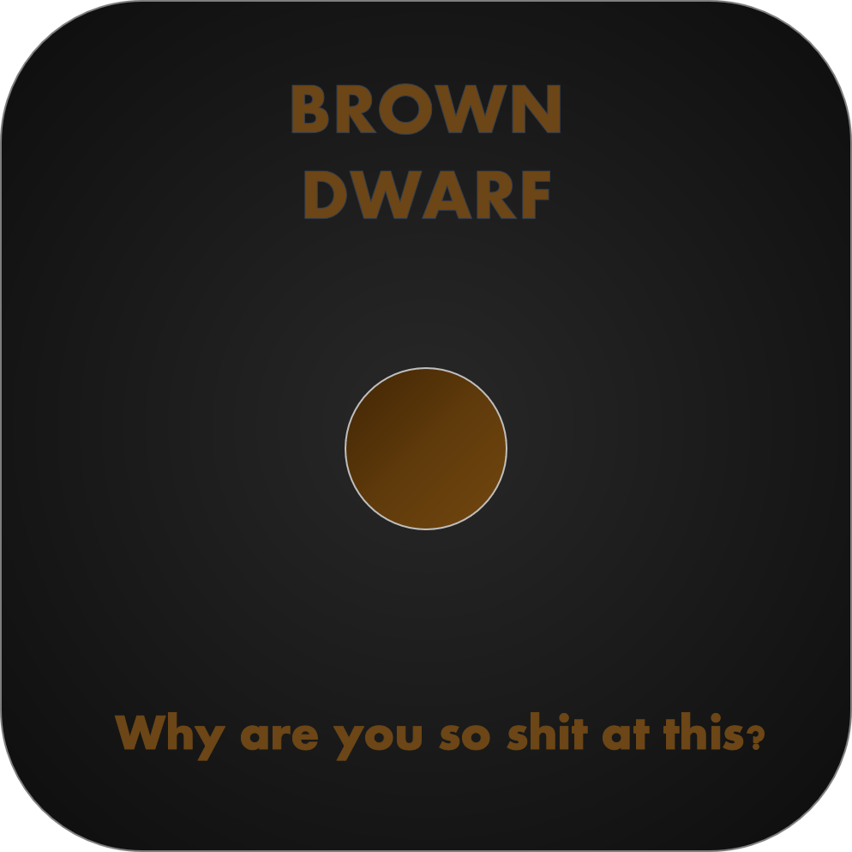
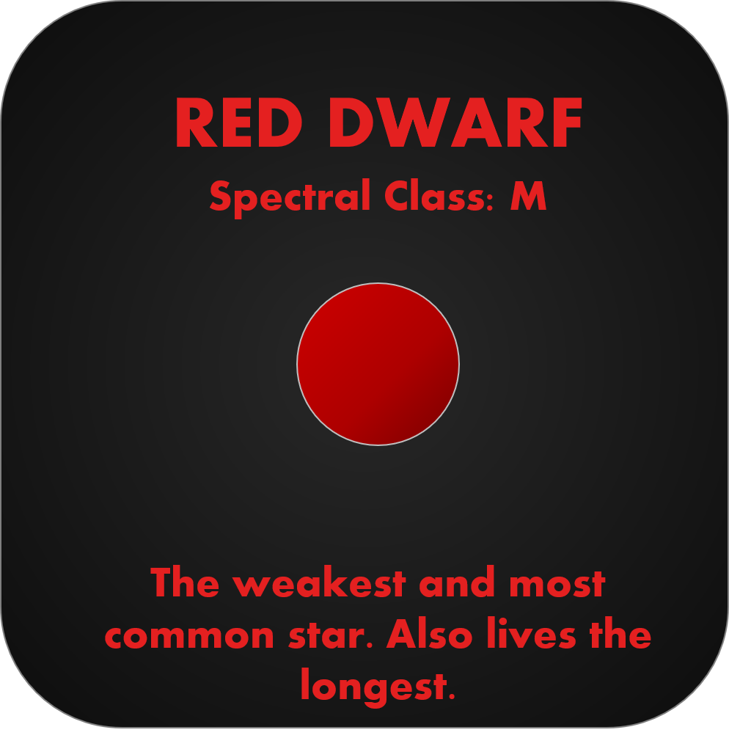
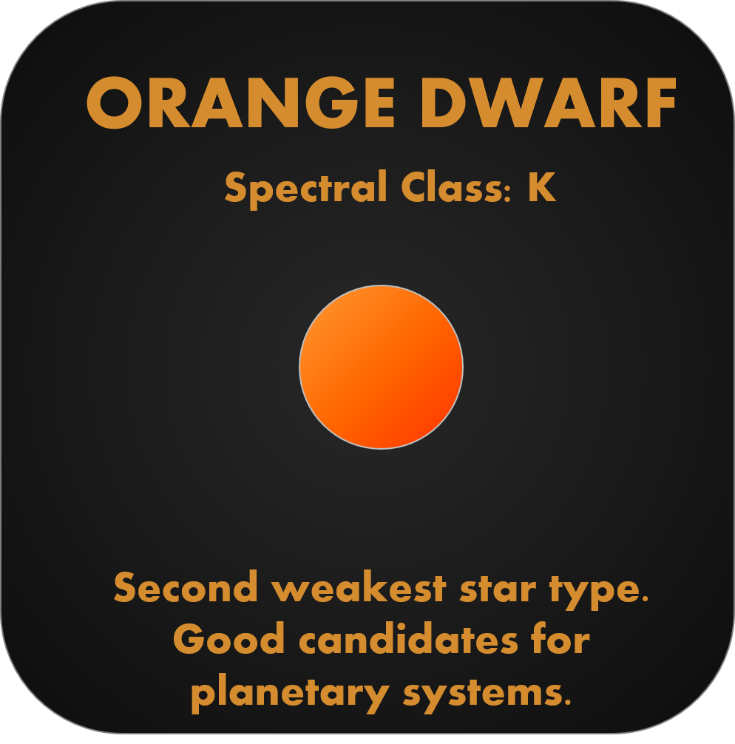
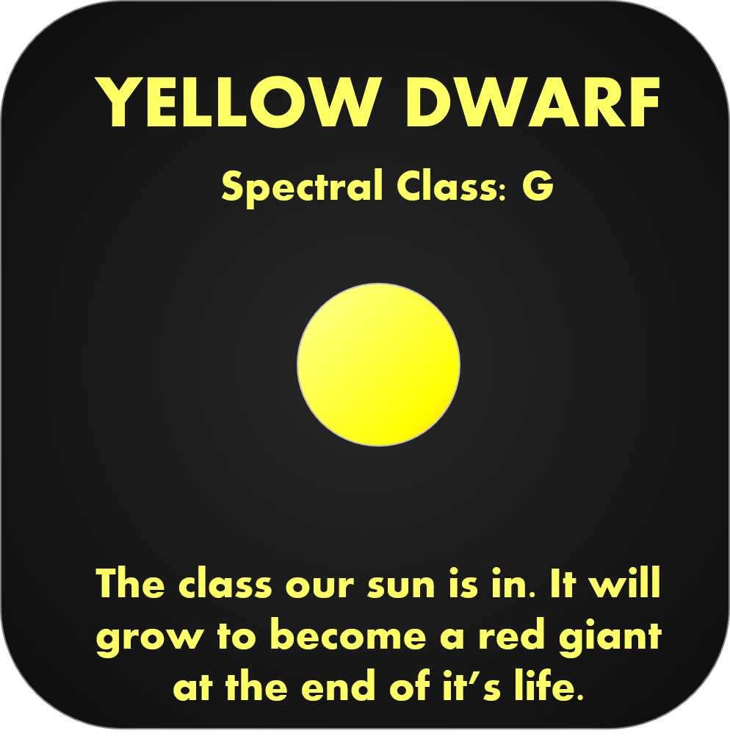
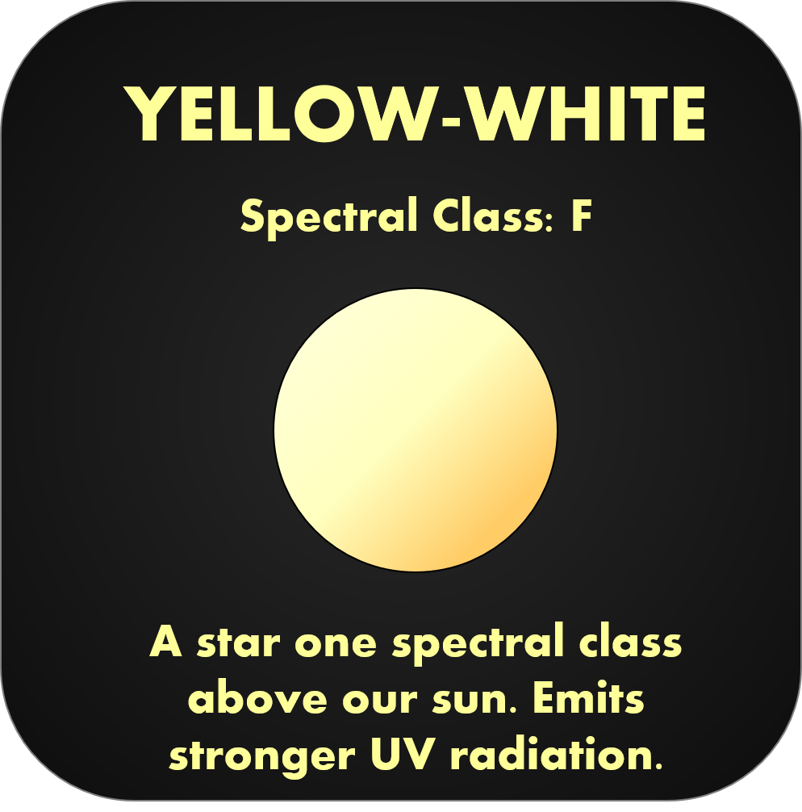
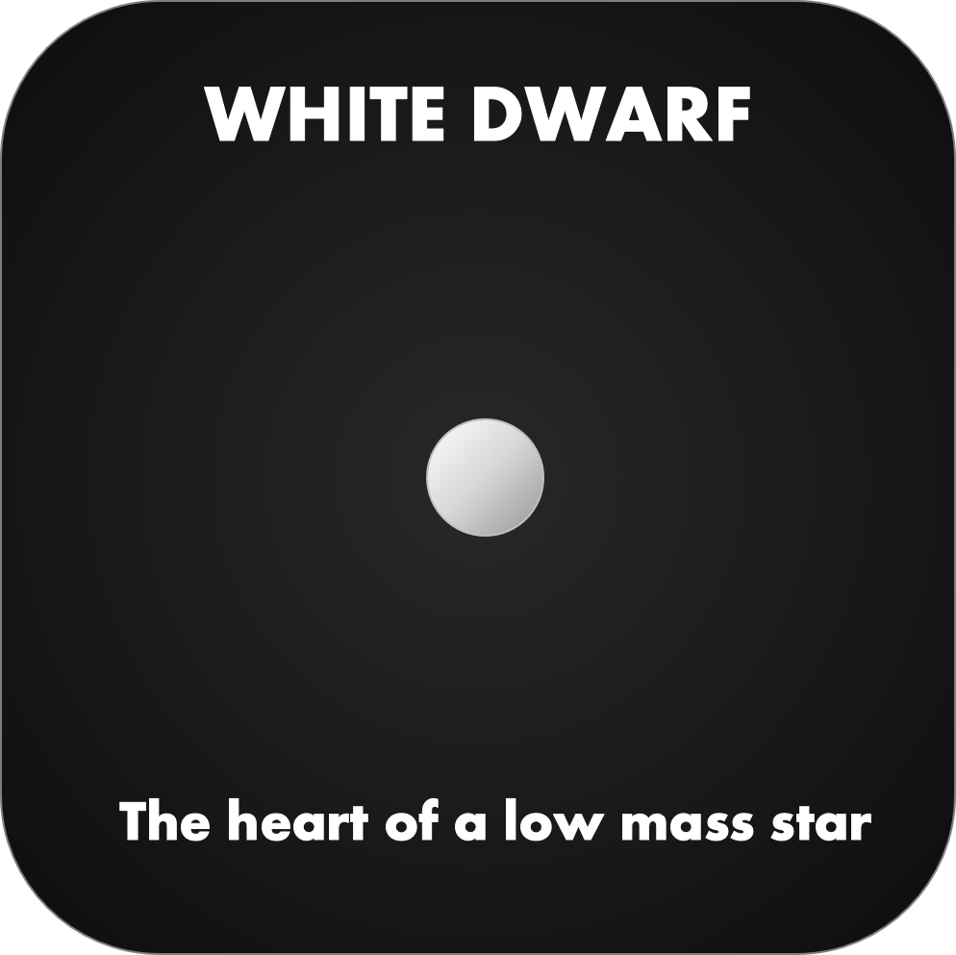

Slide 18








The lightest element, hydrogen makes up 90% of all atoms in the universe and is the primary fuel for fusion within stars.
Formed by the triple alpha-process, carbon fuses into oxygen which becomes neon. It is also a part of the CNO cycle.
Deuterium, also known as ‘heavy hydrogen’ is created when two protons fuse releasing a positron.
A noble gas like helium, Neon forms oxygen when hit with a gamma ray, or magnesium fusing with an alpha particle.
Created when deuterium nuclei fuse with protons. It is a possible form of fusion fuel in reactors on Earth.
Although lighter than Neon, Oxygen fuses later due to its doubly-magic nucleus, mostly producing silicon and sulfur.
The nucleus of helium-4 is known as an alpha particle and can fuse with almost any other nucleus element.
Fuses with alpha particles to climb the ‘alpha-ladder’ to iron, in temperatures hot enough to cause photodisintegration.

