Slide 1

Approach
Phase I pipeline — preprocessing, cleaning, EDA, no target use
1
2
3
4
Load
Merge
Clean
Explore
7 source files in 5 different formats (TSV, CSV, XLSX, PKL, JSON). Each loaded with format-specific parsing logic.
▶
Outer join on international_id / medical_id. Mom's notes matched via (first_name, last_name) after deduplication.
▶
Normalise units, fix typos, flag missing and invalid values. No blind imputation in Phase I.
▶
EDA on the merged 10,000-player dataset: missingness, domain validity, correlations and visual patterns — without target use.
⚠ Noise / free-text / ID-like fields are documented as non-direct features. Unknown values are handled cautiously, not blindly filled.

Slide 2
Preprocessing ①
Loading & Standardization
File | Format | Key Quirk
identity_card_0.tsv | TSV | Column names in Latin; IDs as Roman numerals
identity_card_1.csv | CSV | English columns; 9,112 players (complements id0)
performance.tsv | TSV | Typo: penality_minutes → penalty_minutes
medical_information.xlsx | XLSX | Junk metadata row + split header across rows 1-2
hockey_scouting_notes.csv | CSV | Clean; includes position, experience, scout notes
contracts_competition.pkl | PKL | Loaded from pickle; joined on international_id
moms_notes.json | JSON | No ID field; name-based matching required
Roman Numerals
CCLXXV → 275
custom ID parser
Latin → English
praenomen → first_name
cognomen → last_name
Excel Header
manual header reconstruction
unit parsing for medical data

Slide 3
Preprocessing ②
Merging Strategy & Unknown Data
10,000
68
7
5
players in
master dataset
columns after
merging
source files
loaded
file formats
handled
Merge Pipeline
Mom's Notes — Matching Strategy
id0 + id1 → outer join on international_id + medical_id
Coalesce duplicate columns (first_name, age, birth_city…)
+ performance.tsv on international_id
+ medical_information.xlsx on medical_id
+ hockey_scouting_notes.csv on international_id
+ contracts_competition.pkl on international_id
+ moms_notes.json via name + closest-age matching
Problem: moms_notes.json has no stable ID column
Unique names: direct match on (first_name, last_name)
Ambiguous names: choose closest age, keep uncertainty visible
Unmatched rows: kept as missing values, not deleted
Missingness mechanism cannot be proven in Phase I (MCAR/MAR/NMAR only discussed cautiously)
Processed output keeps invalid flags for later Phase II preprocessing

Slide 4
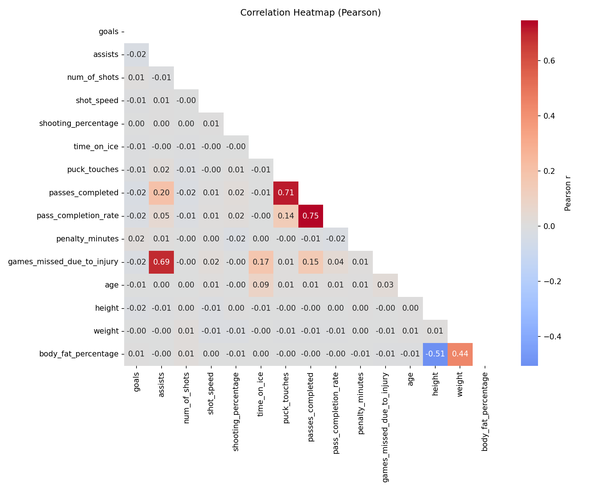
Data Relationships ①
Numeric Correlations
Key Insights
passes_completed ↔ pass_completion_rate: r = +0.75
puck_touches ↔ passes_completed: r = +0.71
height ↔ body_fat_percentage: r = −0.70
Pearson is linear only and can still be affected by outliers
No causal claims; high correlations mainly warn about multicollinearity

Slide 5
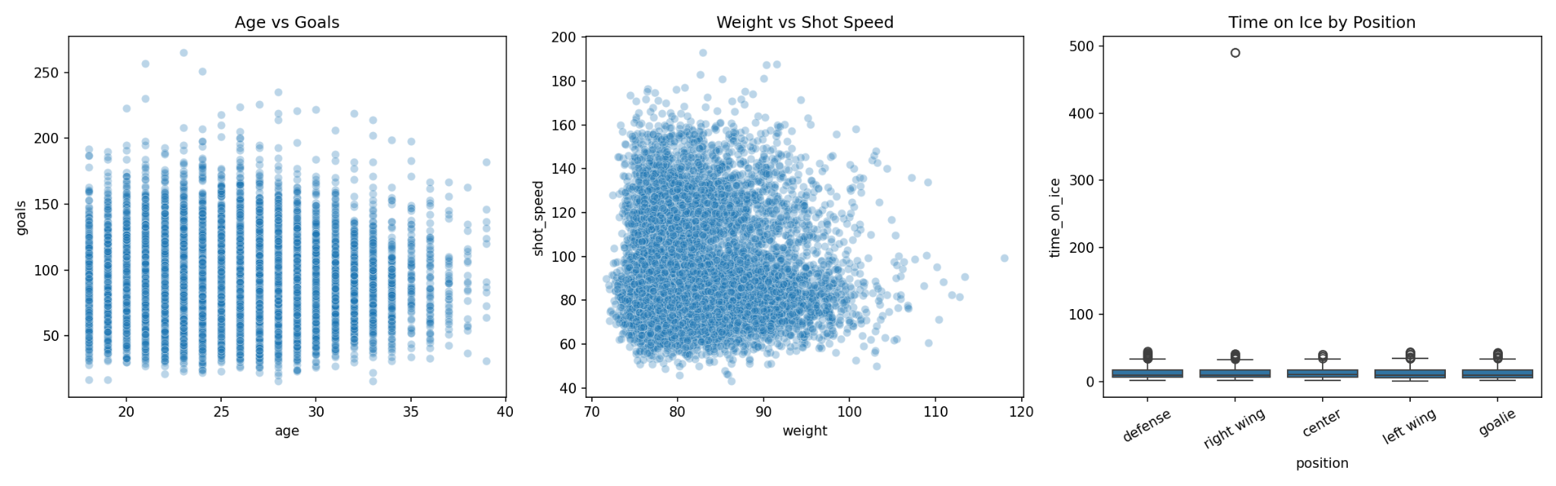
Data Relationships ②
Scatter & Grouped Views
Visual Relationship Checks
Interpretation
Age vs goals and weight vs shot speed show broad scatter rather than a clean deterministic rule.
Time on ice differs by position and contains one extreme value, so role-specific context matters.
These plots support relationship exploration only — not causal conclusions.
1.70m
82.9kg
23.9%
25.3 yrs
Avg. Height
Avg. Weight
Avg. Body Fat
Avg. Age

Slide 6
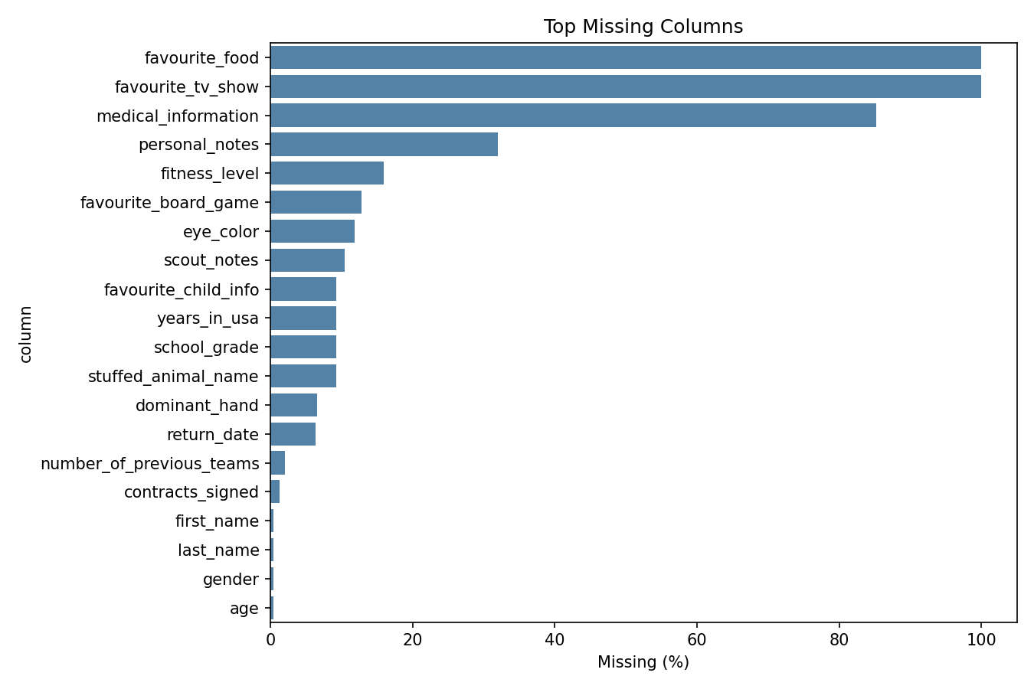
Data Cleaning ①
Missing Values
Handling Strategy
100% missing: favourite_tv_show, favourite_food → unusable/drop candidates
medical_information (85%): sparse free text; not a direct model feature
fitness_level (15.9%): categorical → possible 'Unknown' later
Numeric missing values: median imputation only after train/test split
Date missingness: keep NaT + missing flag; no blind date imputation
Mechanism check is only evidence: MCAR/MAR/NMAR cannot be proven from Phase I
⚠ No values are blindly imputed in Phase I. Missingness is quantified and documented; final imputation belongs after the Phase II train/test split.

Slide 7
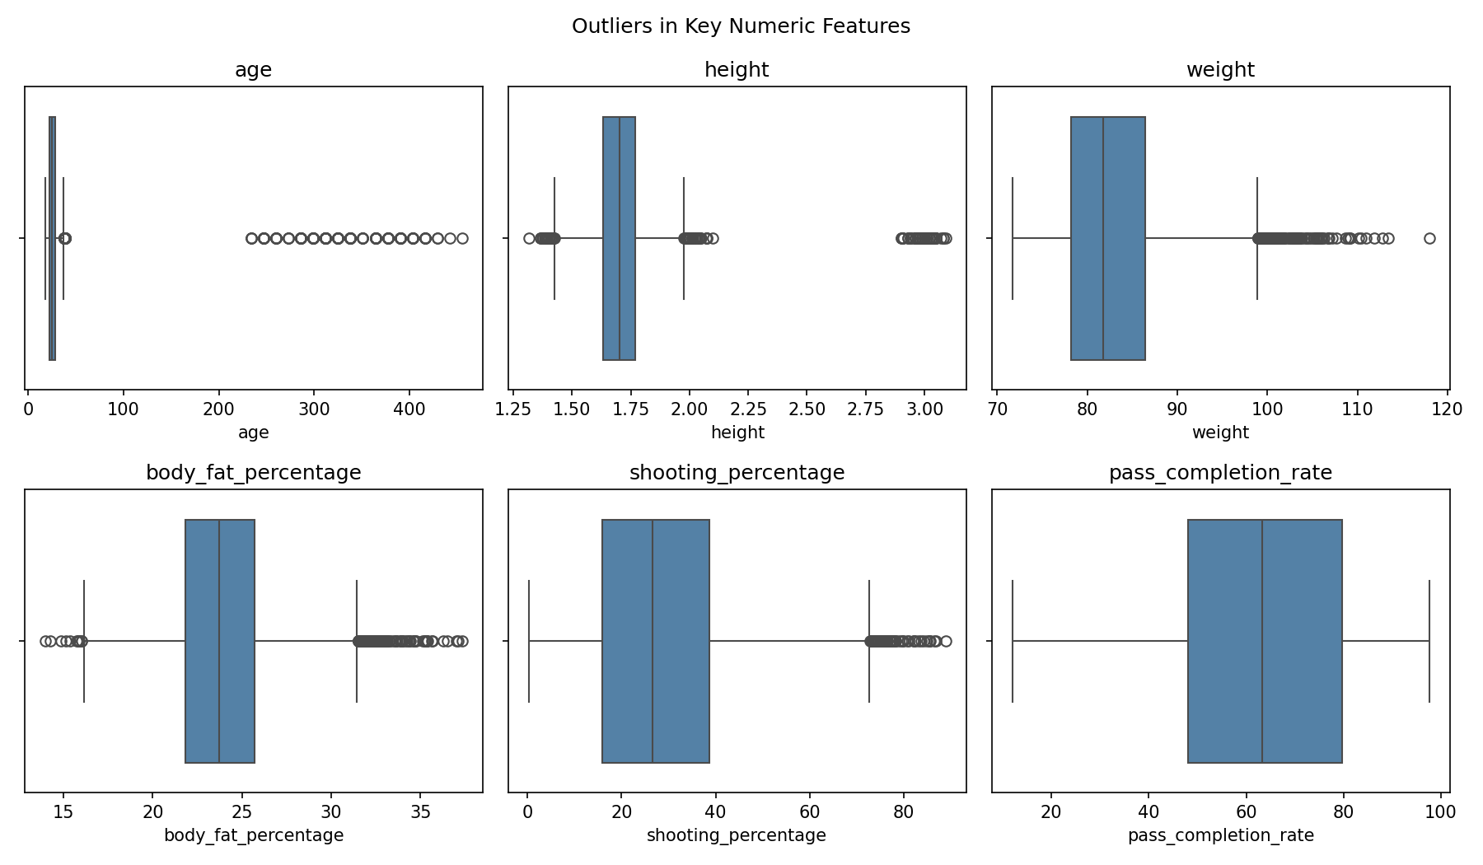
Data Cleaning ②
Outliers & Invalid Values
Treatment by Type
IQR outliers: flagged as unusual, not removed automatically
Domain-impossible values: replaced with NaN in processed dataset
Invalid flags preserve where impossible values occurred
Examples: age up to 455, height up to 3.09m, body fat > 35%
Rare but plausible players are kept; no rows are deleted
No winsorising/capping of impossible values
age max 455
61
0 rows deleted
invalid → NaN + flag
height violations
only values flagged/NaN

Slide 8

Key Findings & Discussion
⚙ Heterogeneous Sources
📋 Missingness is Structured
🧹 Invalid ≠ Unusual
7 source files in 5 formats merged into a 10,000-row, 68-column master dataset with custom parsing and careful joins.
Two columns are 100% missing; medical_information is 85.18% missing. MCAR/MAR/NMAR cannot be proven, so strategy stays cautious.
Domain-impossible values such as age 455 or height >3m are replaced with NaN and flagged; IQR outliers are not automatically removed.
🔗 Strong Associations
💾 Processed Output
🚀 Phase II Next Steps
Top Pearson pairs: passes_completed/pass_completion_rate (r=+0.75), puck_touches/passes_completed (r=+0.71), height/body fat (r=−0.70).
phase1_processed_dataset.csv keeps all rows, replaces only domain-impossible values with NaN, and adds <column>_invalid_flag fields.
Impute after train/test split, handle text separately, reduce redundant features, and keep correlation caveats in mind.
Phase II → Train/test split · Type-wise imputation · Feature selection · Model evaluation

