Slide 1

I
KDDM1 PROJECT 2026 · PHASE I
Ice Hockey
Talent Scouting
Phase I: data loading, preprocessing, cleaning and
exploratory data understanding — without using the target variable.
7
5
10k
68
source files
file formats
players / rows
raw columns

Slide 2





APPROACH
Phase I pipeline — preprocessing, cleaning, EDA, no target use
1
Load
2
Merge
3
Clean
4
Explore
7 source files in 5 different formats (TSV, CSV, XLSX, PKL, JSON). Each loaded with format-specific parsing logic.
Outer join on international_id / medical_id. Mom's notes matched via (first_name, last_name) after deduplication.
Normalise units, fix typos, flag missing and invalid values. No blind imputation in Phase I.
EDA on the merged 10,000-player dataset: missingness, domain validity, correlations and visual patterns — without target use.
⚠ Noise / free-text / ID-like fields are documented as non-direct features. Unknown values are handled cautiously, not blindly filled.
1 / 8

Slide 3
PREPROCESSING ①
Loading & Standardization
Roman Numerals
File | Format | Key Quirk
identity_card_0.tsv | TSV | Column names in Latin; IDs as Roman numerals
identity_card_1.csv | CSV | English columns; 9,112 players (complements id0)
performance.tsv | TSV | Typo: penality_minutes → penalty_minutes
medical_information.xlsx | XLSX | Junk metadata row + split header across rows 1–2
hockey_scouting_notes.csv | CSV | Clean; includes position, experience, scout notes
contracts_competition.pkl | PKL | Loaded from pickle; joined on international_id
moms_notes.json | JSON | No ID field; name-based matching required
CCLXXV → 275
custom ID parser
Latin → English
praenomen → first_name
cognomen → last_name
Excel Header
manual header reconstruction
unit parsing for medical data
2 / 8

Slide 4
PREPROCESSING ②
Merging Strategy & Unknown Data
10,000
68
7
5
players in
master dataset
columns after
merging
source files
loaded
file formats
handled
Merge Pipeline
Mom's Notes — Matching Strategy
id0 + id1 → outer join on international_id + medical_id
Coalesce duplicate columns (first_name, age, birth_city…)
+ performance.tsv on international_id
+ medical_information.xlsx on medical_id
+ hockey_scouting_notes.csv on international_id
+ contracts_competition.pkl on international_id
+ moms_notes.json via name + closest-age matching
Problem: moms_notes.json has no stable ID column
Unique names: direct match on (first_name, last_name)
Ambiguous names: choose closest age, keep uncertainty visible
Unmatched rows: kept as missing values, not deleted
Missingness mechanism cannot be proven in Phase I (MCAR/MAR/NMAR only discussed cautiously)
Processed output keeps invalid flags for later Phase II preprocessing
3 / 8

Slide 5
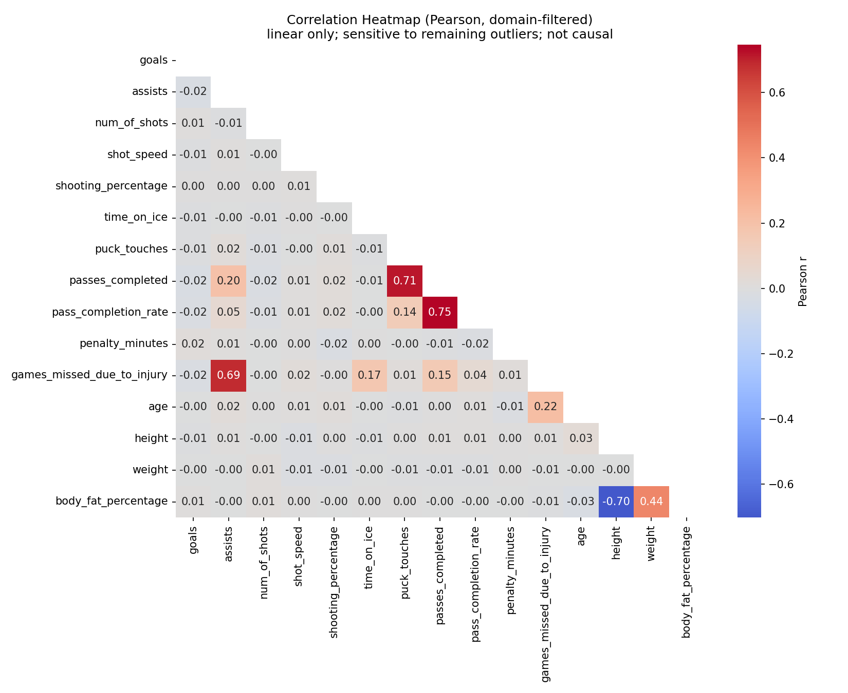
DATA RELATIONSHIPS ①
Numeric Correlations
Key Insights
r = +0.75
passes_completed ↔ pass_completion_rate
r = +0.71
puck_touches ↔ passes_completed
r = −0.70
height ↔ body_fat_percentage
r = +0.69
assists ↔ games_missed_due_to_injury
Pearson is linear only; sensitive to outliers; no causal claims; high correlations
warn about multicollinearity.
4 / 8

Slide 6
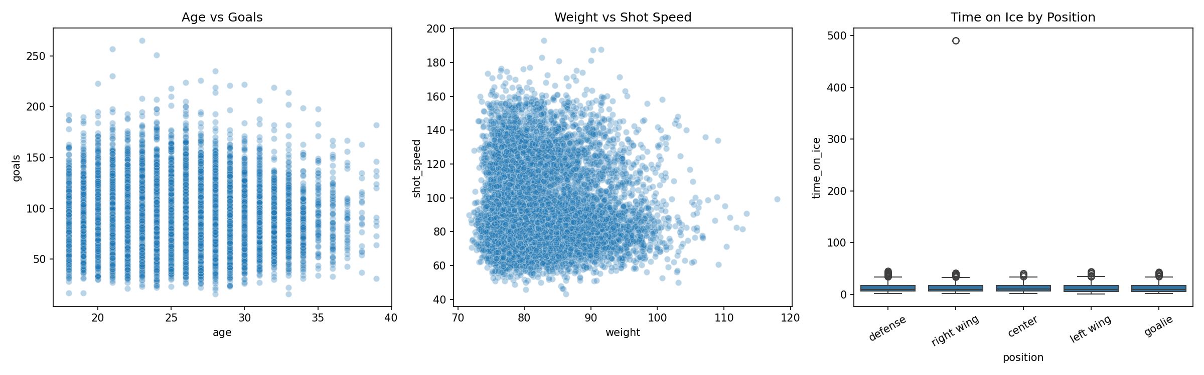
DATA RELATIONSHIPS ②
Scatter & Grouped Views
Visual Relationship
Checks
Age vs goals and weight vs shot speed show broad scatter rather than a clean deterministic rule.
1
Time on ice differs by position and contains one extreme value, so role-specific context matters.
2
These plots support relationship exploration only — not causal conclusions.
3
5 / 8

Slide 7
DATA CLEANING ①
Missing Values
Handling Strategy
favourite_tv_show
100%
100% missing: favourite_tv_show, favourite_food → unusable / drop candidates
medical_information (85%): sparse free text; not a direct model feature
fitness_level (15.9%): categorical → possible 'Unknown' label later
Numeric missing: median imputation only after train/test split
Date missingness: keep NaT + missing flag; no blind date imputation
~0.37% missing across 50+ performance columns: likely one source record absent, not random noise
Mechanism check is only evidence: MCAR/MAR/NMAR not proven in Phase I, but first assumptions tested.
favourite_food
100%
medical_information
85.18%
personal_notes
31.99%
fitness_level
15.9%
⚠ No values are blindly imputed in Phase I. Missingness is quantified and documented; final imputation belongs after the Phase II train/test split.
6 / 8

Slide 8
DATA CLEANING ②
Outliers & Invalid Values
Treatment by Type
age max 455
invalid → NaN + flag
IQR outliers: flagged as unusual, not removed automatically
Domain-impossible values: replaced with NaN in processed dataset
Invalid flags preserve where impossible values occurred
Examples: age up to 455, height up to 3.09m, save % up to 106%, time on ice 490 min
Rare but plausible players are kept; no rows are deleted
No winsorising/capping of impossible values
61 height violations
up to 3.09m → NaN
save % up to 106%
10 impossible values → NaN
time on ice: 490 min
right wing outlier → NaN
0 rows deleted
only values flagged
7 / 8

Slide 9






MOST IMPORTANT FINDINGS
Phase I result: the data is usable, but only after explicit cleaning rules
Heterogeneous Sources
Missingness is Structured
7 source files in 5 formats merged into a 10,000-row, 68-column master dataset with custom parsing and careful joins.
Two columns are 100% missing; medical_information is 85.18% missing. MCAR/MAR/NMAR is tested, but strategy stays cautious for detailed analysis in phase 2 if necessary.
Invalid ≠ Unusual
Strong Associations
Domain-impossible values such as age 455 or height >3m are replaced with NaN and flagged; IQR outliers are not automatically removed.
Top Pearson pairs: passes_completed/pass_completion_rate (r=+0.75), puck_touches/passes_completed (r=+0.71), height/body fat (r=−0.70).
Processed Output
Phase II Next Steps
phase1_processed_dataset.csv keeps all rows, replaces domain-impossible values with NaN, and adds 6 <column>_invalid_flag columns (68 → 74 cols total).
Impute after train/test split, handle text separately, reduce redundant features, and keep correlation caveats in mind.
8 / 8

