Slide 1
Juniper Salon
Waitlist prototype
Notes:
For Lena and Carla. Source: CUSTOMER_CHAT.md. Today staff update Square, scan a Google Sheet and text clients manually, focusing on openings within 48 hours. In the Saturday incident, two clients accepted the same opening and both arrived. The goal is less follow-up and one clear confirmation.

Slide 2
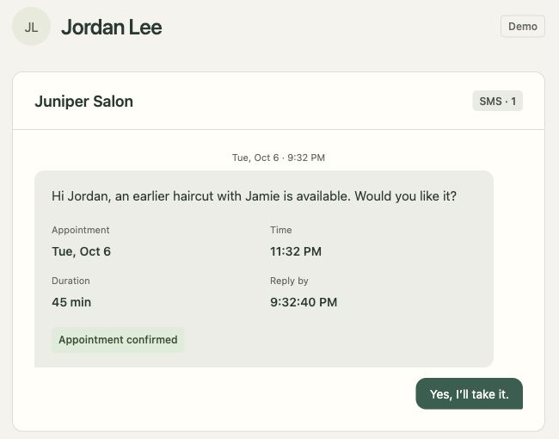
One offer at a time
Staff queue
Client confirmation
Client | Offer
Maya Patel | Declined
Alex Morgan | Expired
Jordan Lee | Confirmed
Sam Rivera | Not contacted
Earliest eligible client first
15 minutes to reply for same-day openings
Juniper Salon
02
Notes:
Sources: CUSTOMER_CHAT.md, public/app.js, src/matching.ts, src/workflows.ts and original slide 2. The staff table is an editable transcription of the source screenshot, in the same waitlist order. Eligibility matches service, time and required stylist. Same-day offers allow 15 minutes in the requested policy. A timely acceptance confirms immediately. The actual client screenshot shows the automated demonstration, which uses 10-second offers. Browser inbox simulates SMS. Maya declines, Alex times out and Jordan accepts in this scenario.

Slide 3
Only Alex gets the opening
Maya’s offer expires. Alex receives the next hold.
Maya replies late
Offer expired
Alex accepts in time
Booking confirmed
Juniper Salon
03
Notes:
Sources: src/workflows.ts and evidence/temporal-saturday-history.jpg. The two outcomes are editable transcriptions of the actual Temporal reply results in the source deck, redesigned for legibility. Event 35 returns accepted:false,code:expired; event 42 returns accepted:true,code:confirmed. Execution juniper-opening-228c11eb-f8d9-4e53-866f-1bca5484750e. Maya’s late response remains in history. This replay is separate from the queue scenario on slide 2.

Slide 4
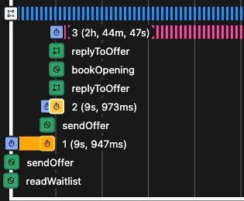
Temporal keeps the offer moving
Wait
The deadline survives closing the browser.
Resume
The workflow continues after a Worker restart.
Protect
Every reply checks the active offer and deadline.
10-second demo offers. Square, Sheets and SMS are simulated.
Juniper Salon
04
Notes:
Sources: README.md, src/workflows.ts, src/activities.ts, src/store.ts and evidence/temporal-saturday-timeline.jpg. The timeline crop enlarges the sequence of activities and timers without changing the recorded evidence. Its long final timer records late replies until appointment end; it is not an offer deadline. Temporal manages deadlines and recovery. After Worker downtime, advancement resumes when a Worker returns. No live Square, Sheets or SMS integration.

Slide 5
A pilot with Lena and Carla
Proposed scope
1 stylist for 1 week, starting with same-day openings.
Before launch
Rehearse late replies, timeouts and an exhausted waitlist.
Connect Square and recheck availability before booking.
Secure client links. Confirm SMS delivery and costs.
Agree on next-day timing and who handles failures.
Measure
Openings filled, time to fill, staff follow-ups
and booking conflicts.
No live integrations or measured results yet
Juniper Salon
05
Notes:
Sources: CUSTOMER_CHAT.md, README.md, src/activities.ts and src/api.ts. One stylist for one week is a proposed scope, not an agreed commitment. Confirm real SMS delivery as well as costs. Next-day response timing is unspecified. Independent Square bookings could conflict until a real availability/booking integration exists. Authentication, secure links, real SMS, production hosting and operating costs remain outside this local prototype. No business impact has been measured.

