Slide 1
JUNIPER SALON
01
Filling last-minute
openings
2
clients said yes
A waitlist prototype for Lena and Carla
1
Today: update Square, scan the sheet,
then text clients by hand.
Saturday opening
Goal: less follow-up and one clear confirmation.
Both arrived. One left angry.
Notes:
Source: CUSTOMER_CHAT.md. Lena described manual Square / Google Sheet / texting and the Saturday incident. She prioritizes openings within 48 hours. The numbers 2 and 1 describe that incident, not measured product outcomes.

Slide 2
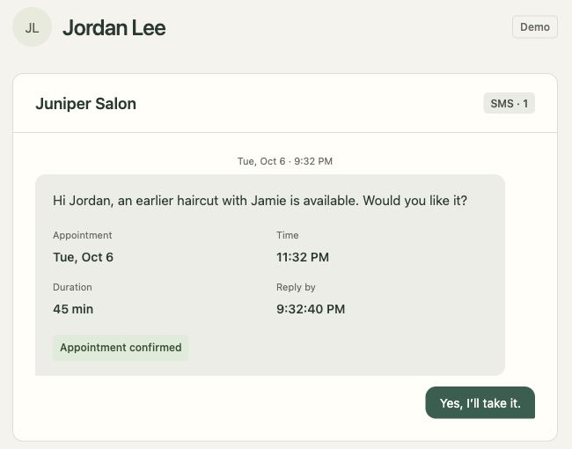
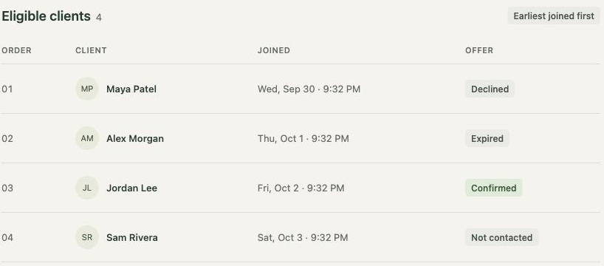
JUNIPER SALON
02
One offer at a time
Staff see the queue
Clients reply from their phone
Match service, time and required stylist.
Earliest eligible client goes first.
15 minutes for a same-day reply.
Timely acceptance confirms immediately.
Notes:
Sources: CUSTOMER_CHAT.md, public/app.js, src/matching.ts, src/workflows.ts, live localhost screenshots. Staff and client screenshots show the queue scenario: Maya declines, Alex times out, Jordan accepts. Browser inbox simulates SMS. Automated demo timer is 10 seconds. Manual mode offers 30 seconds or 15 minutes.

Slide 3
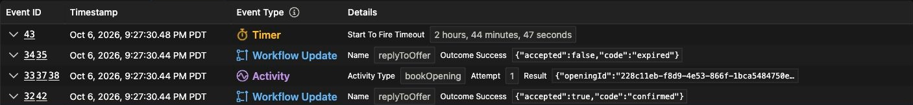
JUNIPER SALON
03
Saturday, resolved
01
1
Maya’s offer expires
02
Alex receives the exclusive hold
confirmed
booking
03
Maya replies late as Alex accepts
Maya’s late reply stays in history. Only Alex gets the opening.
Notes:
Sources: src/workflows.ts; evidence/temporal-saturday-history.jpg. Real Temporal execution juniper-opening-228c11eb-f8d9-4e53-866f-1bca5484750e. Update event 35 returns accepted:false,code:expired; event 42 returns accepted:true,code:confirmed. The evidence image is a crop of the unaltered Temporal Web UI screenshot.

Slide 4
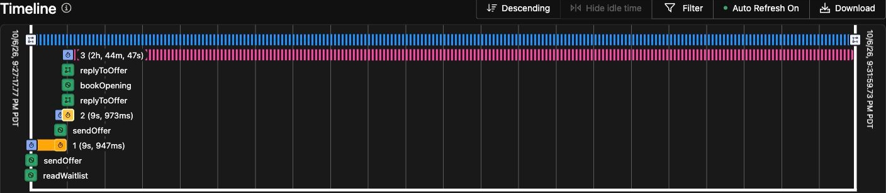
JUNIPER SALON
04
Temporal keeps the offer moving
Wait
Resume
Protect
The deadline survives
closing the browser.
After a Worker restart,
the process continues.
Every reply checks the
active offer and deadline.
10-second demo offers. Square, Sheets and SMS are simulated.
Notes:
Sources: src/workflows.ts, src/activities.ts, src/store.ts, README.md and evidence/temporal-saturday-timeline.jpg. Browser talks to Express, which starts Temporal Workflows and sends Updates. Stable opening IDs reject duplicate starts. Activities simulate waitlist reads, SMS and booking with local duplicate protection. Offers advance after a decline or expiry. When all clients are exhausted, the opening remains unfilled. The Workflow remains Running after booking until appointment end to record late replies. During Worker downtime, advancement resumes when a Worker returns. No live Square, Sheets or SMS integration.

Slide 5
JUNIPER SALON
05
A small pilot with Lena and Carla
Proposed scope
Before any live bookings
1 stylist
Rehearse late replies, timeouts and
an exhausted waitlist together.
1 week
Connect Square and recheck availability
before booking. Protect client links
and confirm SMS delivery and costs.
Same-day openings first
Agree on next-day response timing
and who handles failures.
Measure openings filled, time to fill,
staff follow-ups and booking conflicts.
No live integrations or measured results yet.
Notes:
Sources: CUSTOMER_CHAT.md, README.md, src/activities.ts and src/api.ts. Proposed pilot scope (one stylist / one week) is a suggestion, not an agreed commitment. Next-day response window remains unspecified. Independent bookings made in Square could conflict with workflow offers until a real availability/booking integration is built. Authentication, secure response links, real SMS delivery, production hosting and operating costs are excluded from this local prototype. No business impact has been measured.

