Slide 1
JOBBER

Slide 2
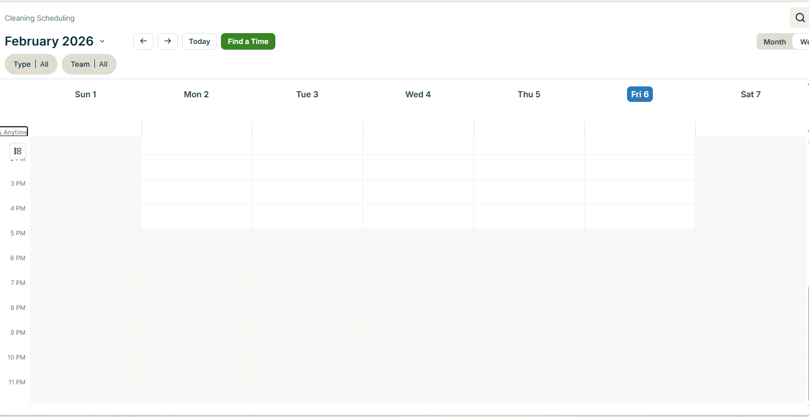

Slide 3
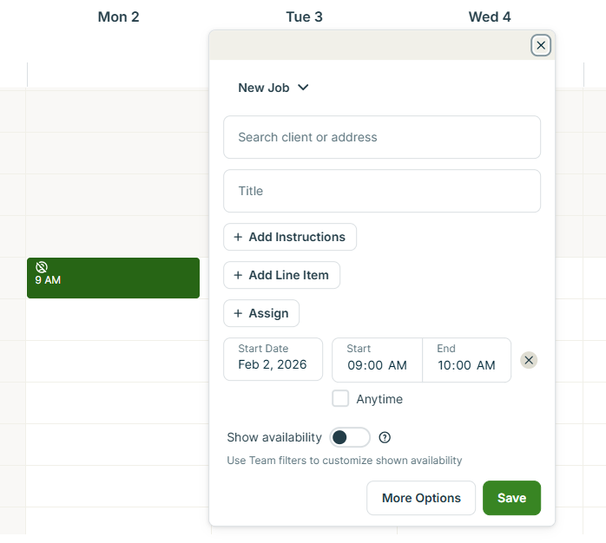
Instructions
WIFI Information
Photo

Slide 4
I want create a 24*7 calender in HTML, so I can later use with react, how would you guide me to do it. Let me show it part by part?
https://chatgpt.com/s/t_69862e8cc838819195f15e36960bdef5

Slide 5
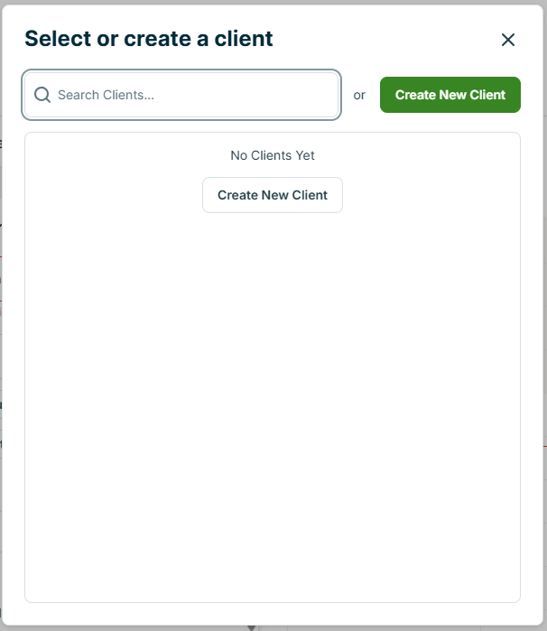
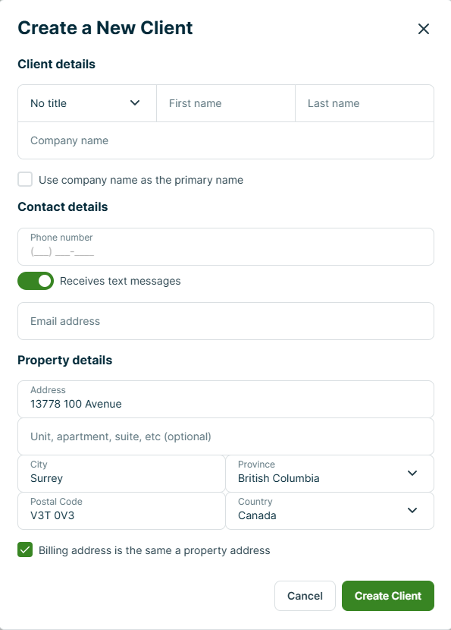

Slide 6
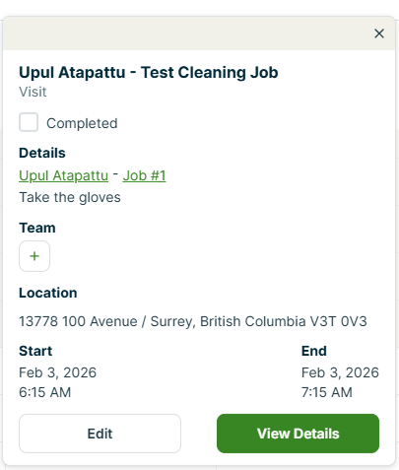
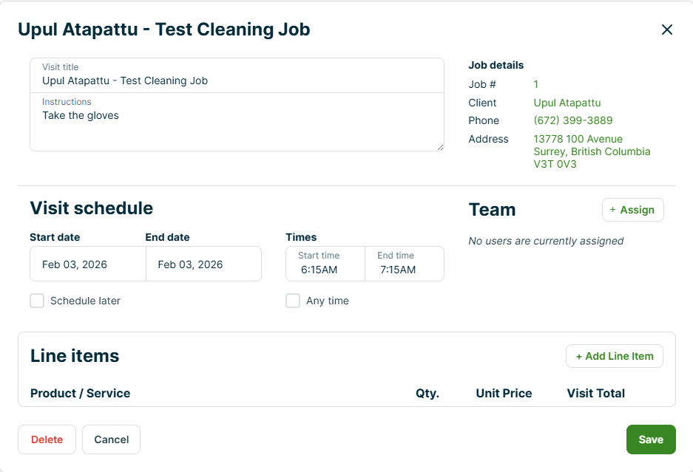
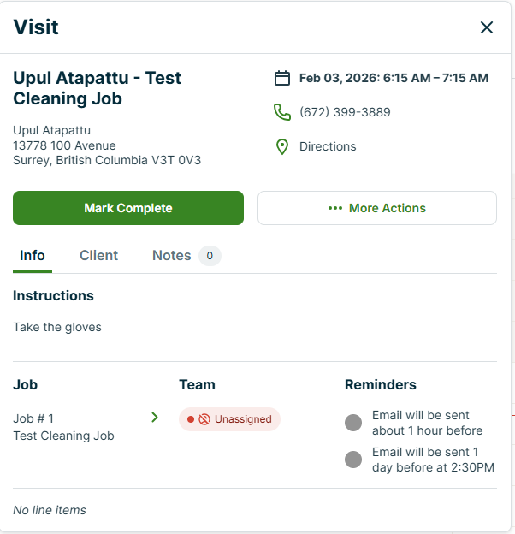
EDIT

Slide 7
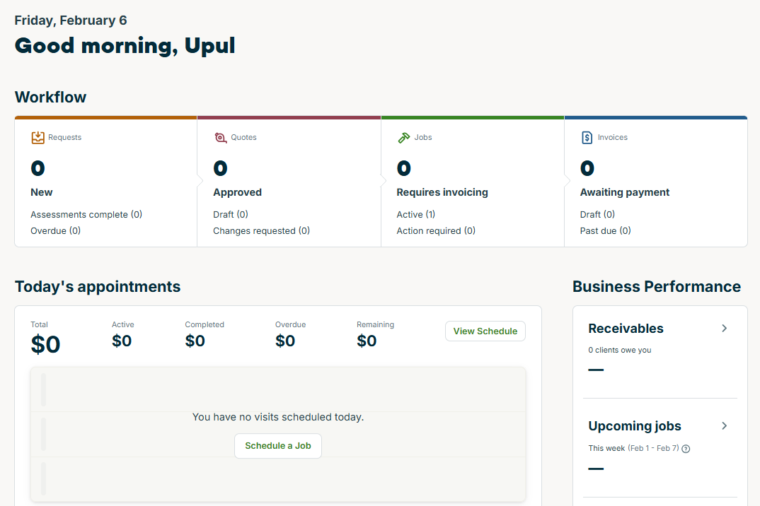
DASHBOARD

Slide 8
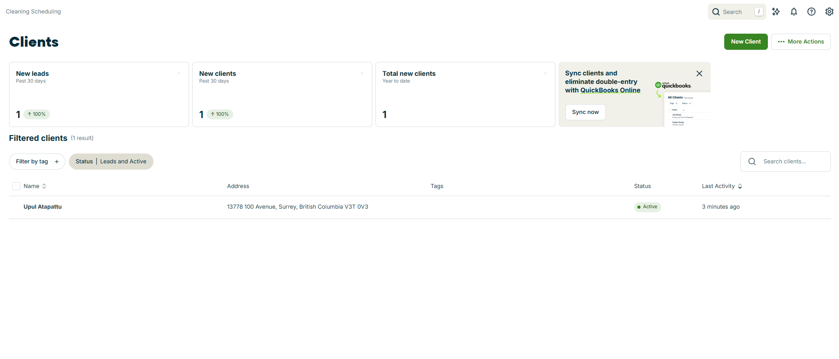
CLIENTS

Slide 9
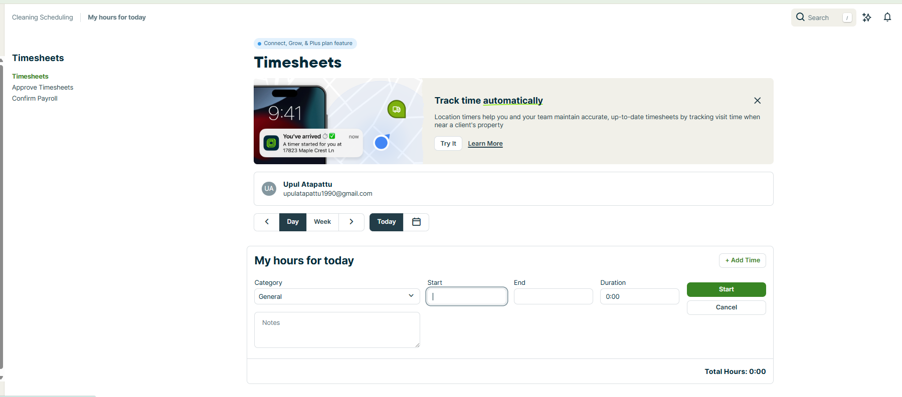
TIMESHEETS

Slide 10
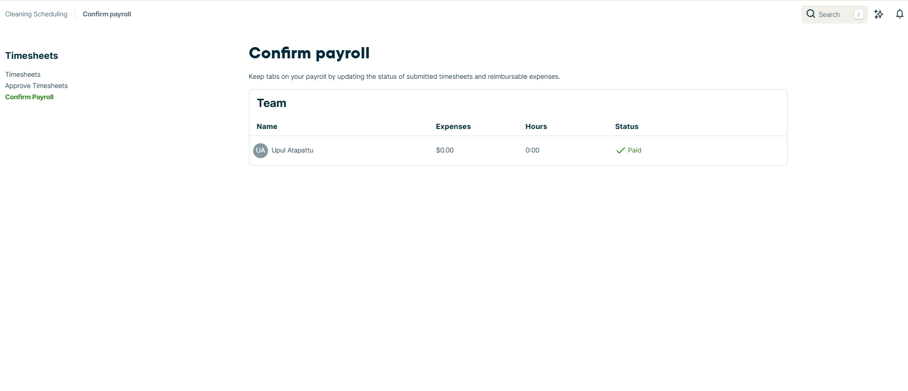

Slide 11
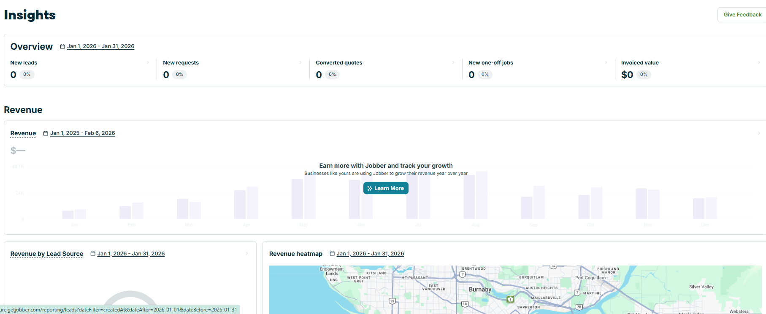

Slide 12
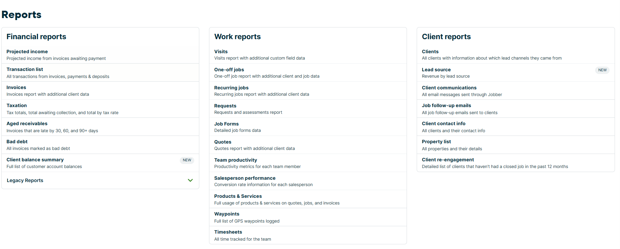

Slide 13
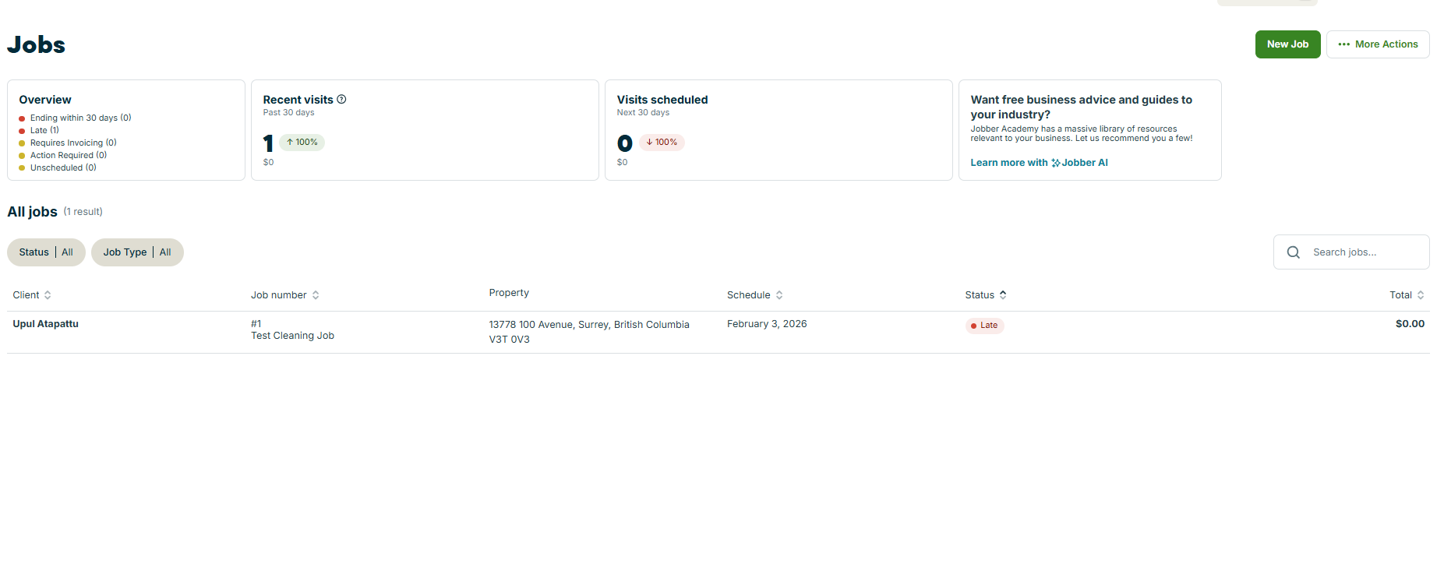

Slide 14
