Slide 1
HOCKEY: How to Observe Connectomes for gaining Knowledge and Estimating ‘Y’
Greg Kiar
March 7th, 2016

Slide 2
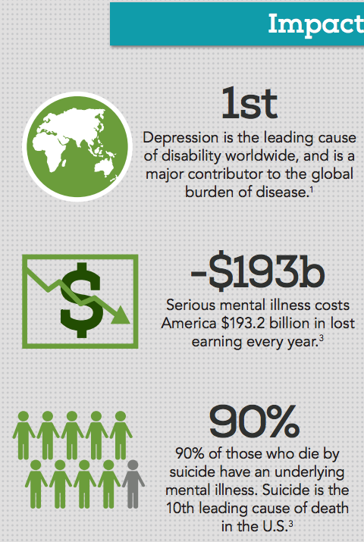
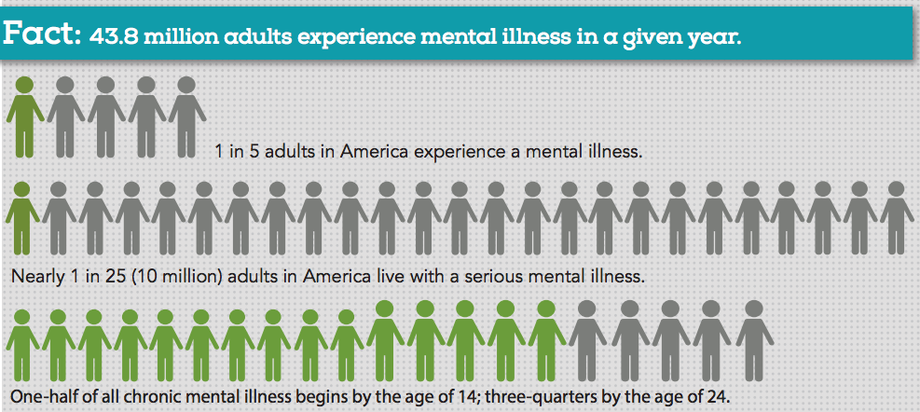
Significance
NAMI: https://www.nami.org/NAMI/media/NAMI-Media/Infographics/GeneralMHFacts.pdf

Slide 3
Gap
Currently, no brain imaging biomarkers exist that are clinically useful for any diagnostic category in psychiatry
Currently, no known open source sex (or other covariate) classifiers based on connectome analysis exist
APA 2012: Consensus Report of the APA Work Group on Neuroimaging Markers of Psychiatric Disorders RESOURCE DOCUMENT

Slide 4
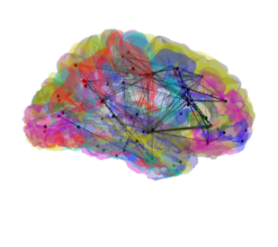
Challenge
Graph stats are hard:
Large number of dimensions (D)
Small number of samples (N)
Observations are noisy
Batch effects across studies

Slide 5

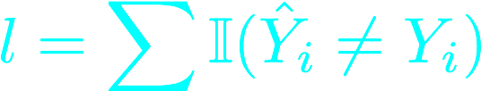
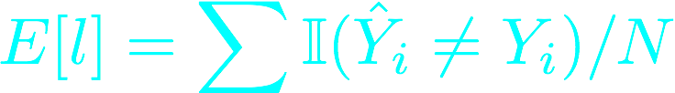
Formal Statement of Problem
Graphs and labels observed
Y is our binary label vector
CLASSIFY
We calculate loss based on
correct assignment
And get expected loss

Slide 6

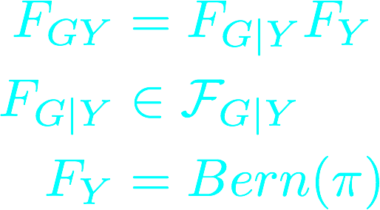
Model Assumptions
Graphs are i.i.d.
A class conditional
difference exists

Slide 7
Formal Statement of Algorithm
Algorithms used:
Linear Discriminant Analysis (LDA)
Quadratic Discriminant Analysis (QDA)
K-Nearest Neighbours (KNN)
Support Vector Machine (SVM)
Random Forrest (RF)
QDA:
Quadratic Score Function:
Becomes Decision Rule:

Slide 8
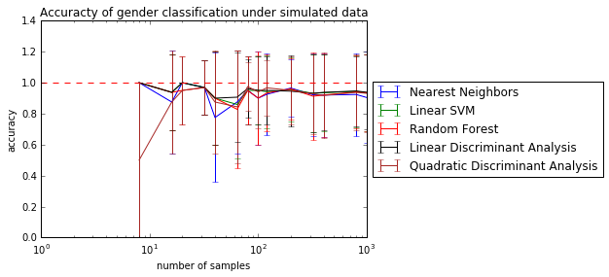
Results
B
A
Algorithm | Classification Accuracy
Nearest Neighbors | 0.48 (+/- 1.00)
Linear SVM | 0.55 (+/- 1.00)
Random Forest | 0.57 (+/- 0.99)
Linear Discriminant Analysis | 0.45 (+/- 1.00)
Quadratic Discriminant Analysis | 0.71 (+/- 0.90)
A. The performance of several classifiers on simulated data from our model, showing performance as the number of samples scaled. All algorithms scaled well with N and achieved near perfect accuracy in classification under these conditions. B. Performance of the same classifiers on the given dataset consisting of 42 graphs with 20 and 22 members of class 0 and 1, respectively, and each graph containing 70 nodes. The best classifier used here was the QDA method, which achieved just over 70% classification accuracy.

Slide 9
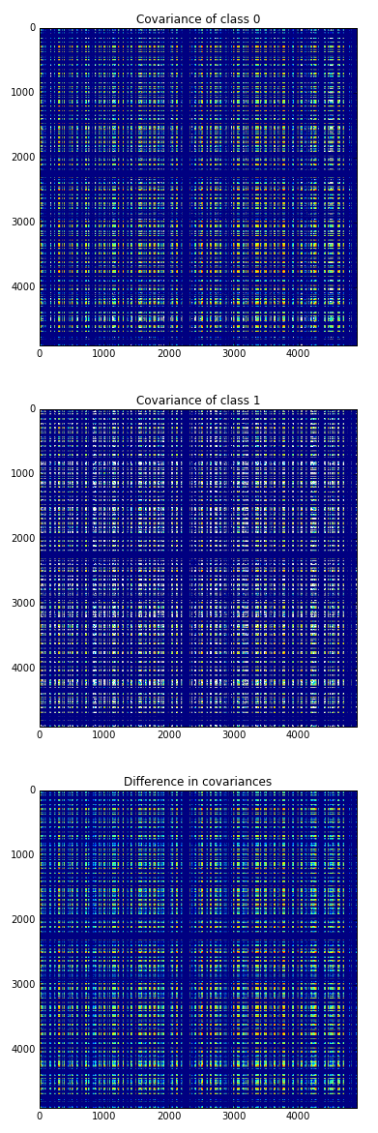
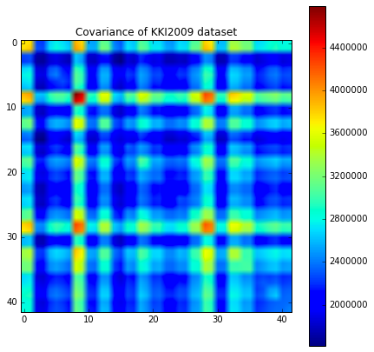
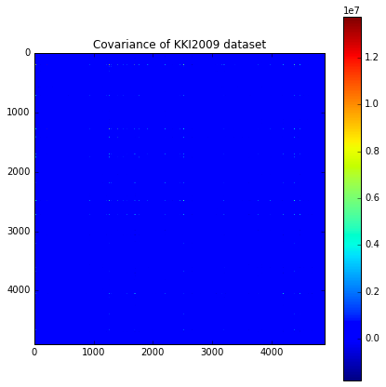
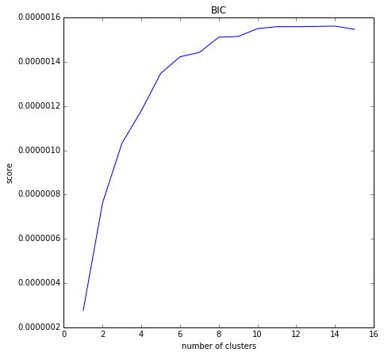
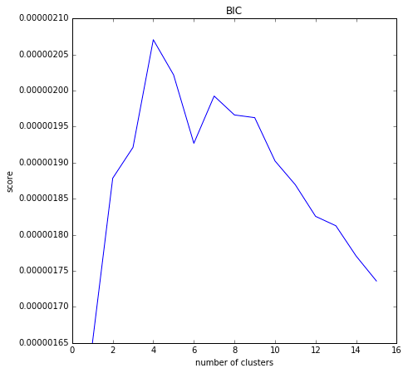
Model Checking
C
A
B
A. We show that the covariance across subjects is non zero and the ideal number of clusters is > 1, indicating both our graph i.i.d. assumptions were false. B. Like A, the same is true for the edge i.i.d. assumption. C. We compared the covariances across classes and found that the difference was very large, suggesting why QDA performed better for classification than LDA, for instance.

Slide 10
Resolution
The principled approach we took to this problem encourages us to believe the results we obtained
This is a building block for future studies which can leverage this domain knowledge to build better classifiers for more difficult covariates

