Slide 1
Synaptic Diversity
Kevin Huang, Edric Tam, Ivan Kuznetsov

Slide 2
Significance
Synaptic dysfunction can cause many different kinds of diseases such as fragile X and Rett Syndrome (affects 1,000,000s of people)
No previous attempt to classify synapses into sub-groups beyond excitatory/inhibitory and neurotransmitter type
In this study → well-validated markers and array tomography
Unprecedented scale and resolution for our data analysis
New insight into types of synapses

Slide 3
Dataset
Dimensions: 1119299x96.
Row corresponds to synapse
Features correspond to 24 immunostained markers with 4 columns for each describing:
Integrated intensity
Localized intensity
Center of mass of synapse
Moment of inertia of synapse

Slide 4
Goals
Explore properties of the dataset
Cluster the synapses

Slide 5
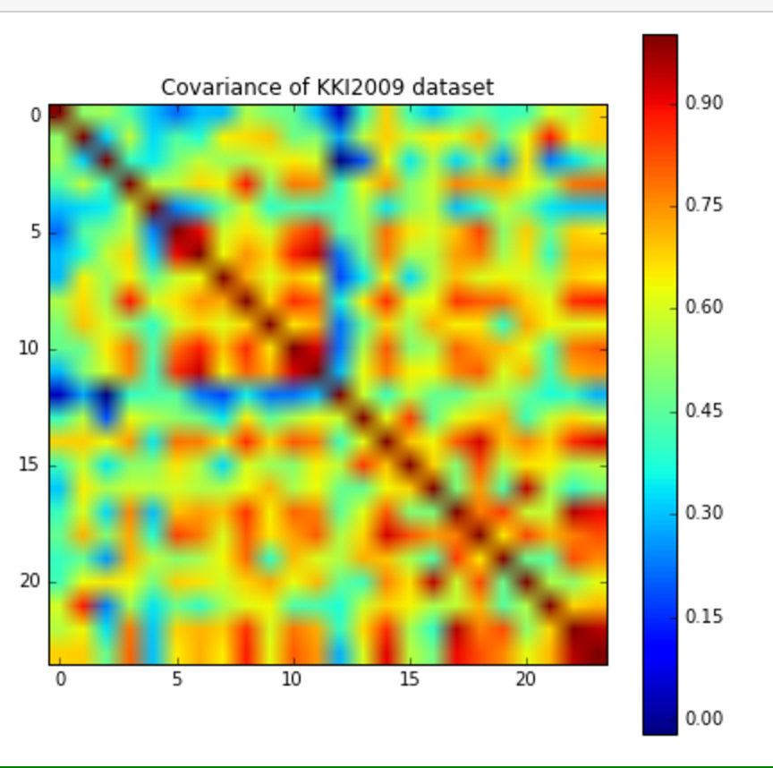
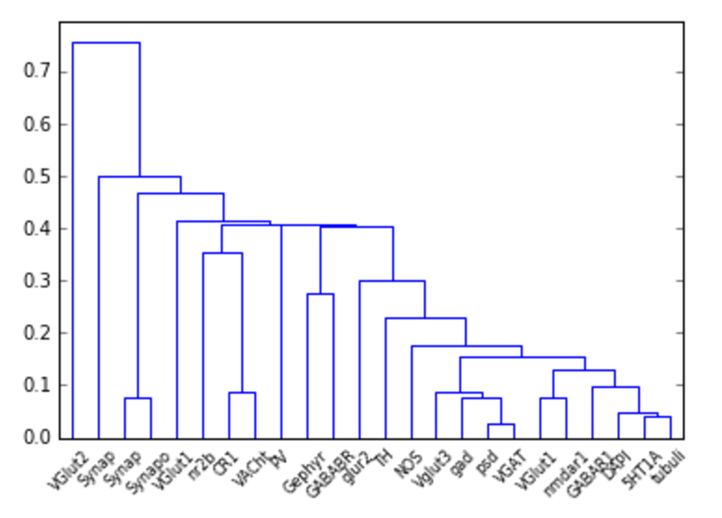
Exploration of Data (Cycle 1: Linear-Normalized)
Correlation Matrix for Integrated Brightness
Hierarchical Clustering on Matrix

Slide 6
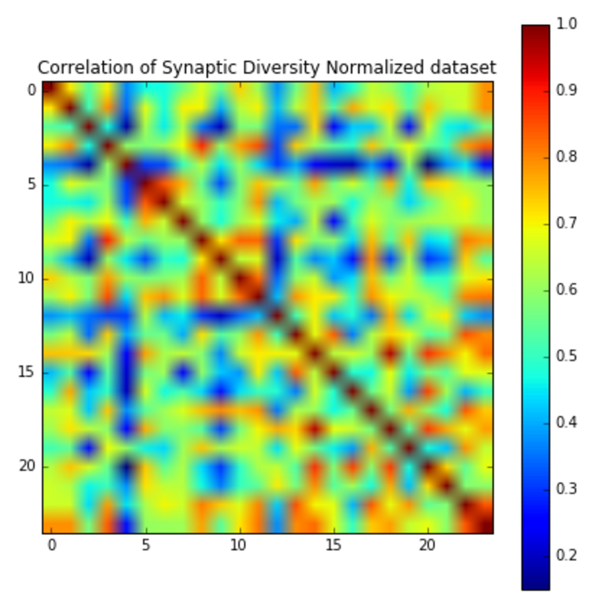
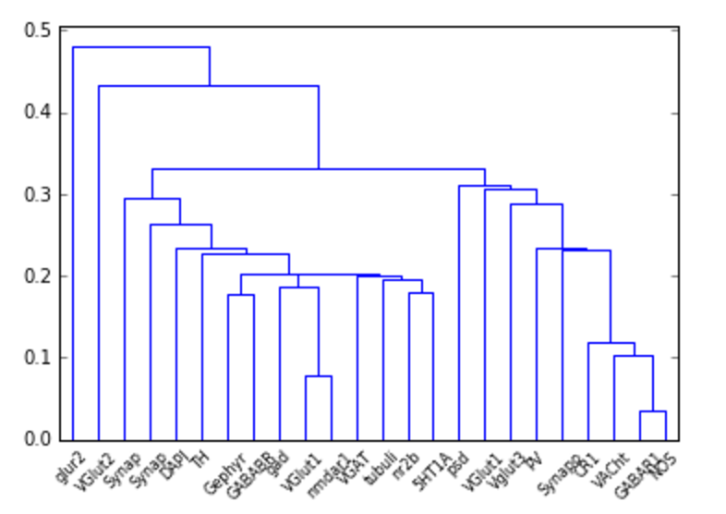
Exploration of Data (Cycle 2: Log-Normalized)
Hierarchical Clustering on Matrix

Slide 7
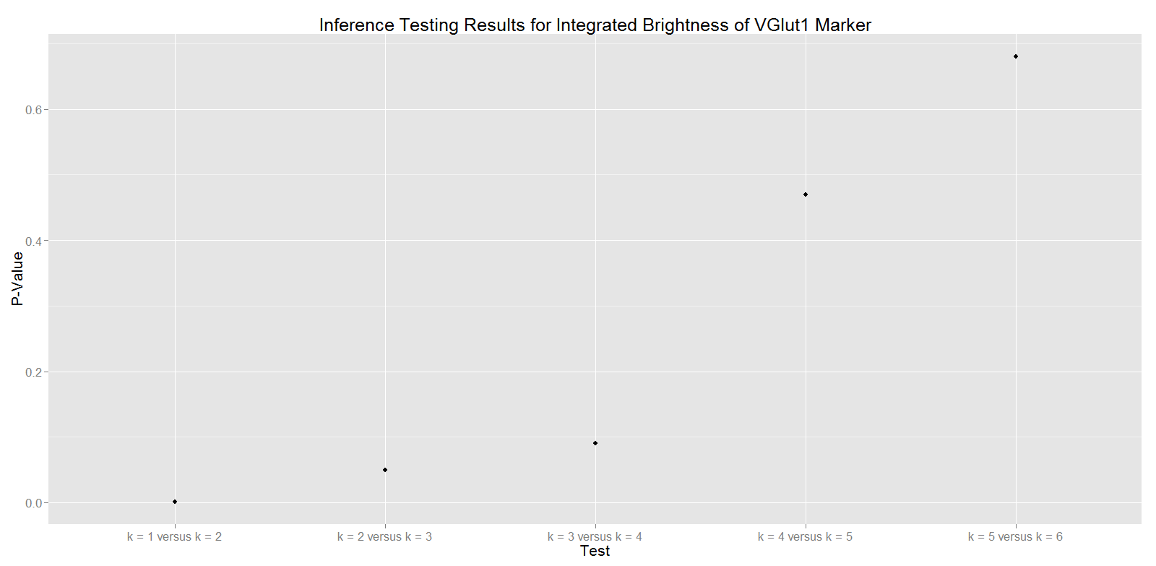

Inference Testing for Clusters
Suggests clusters within feature columns

Slide 8
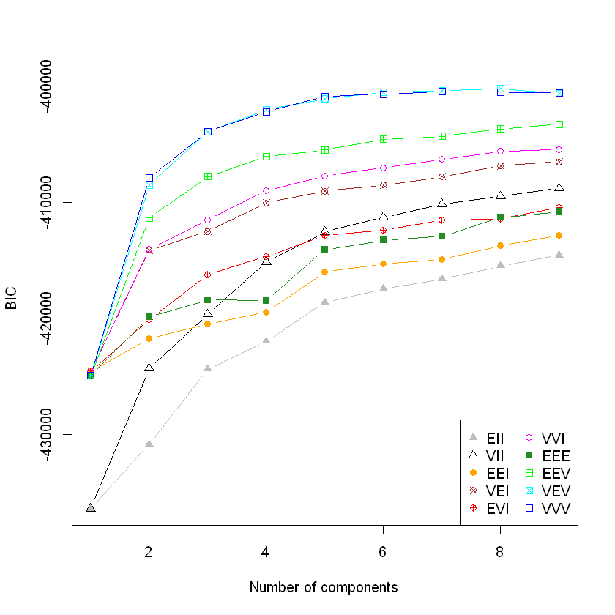
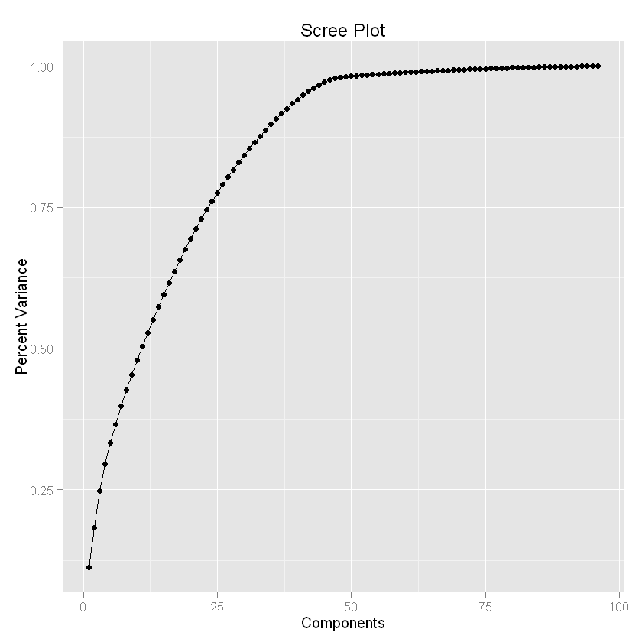
BIC Evidence for Clusters
BIC after PCA down to 10 dimensions
BIC suggests clusters across all features in the set

Slide 9
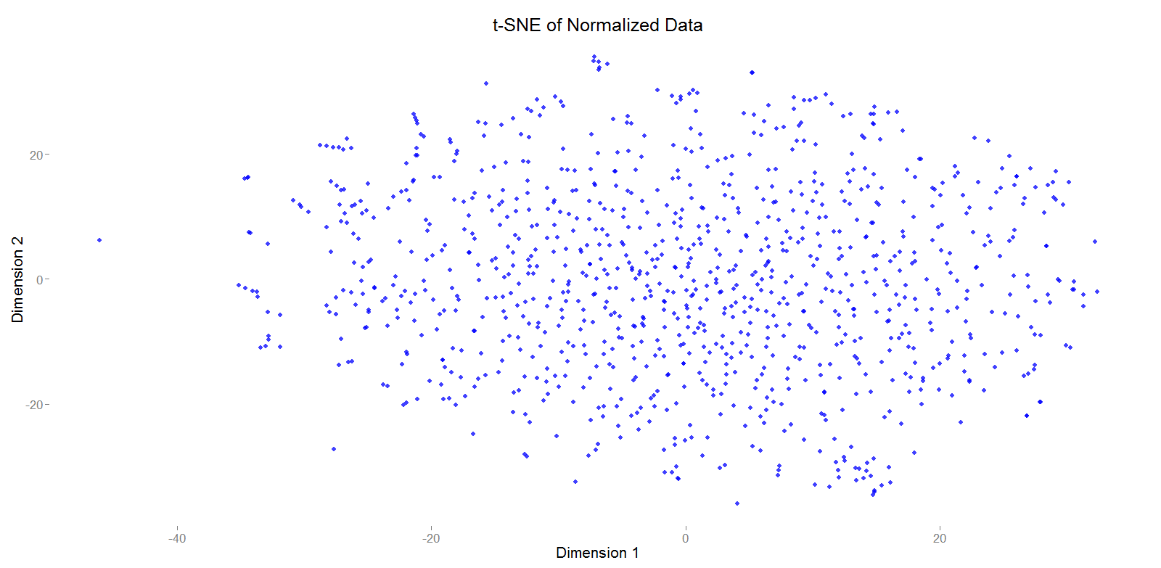
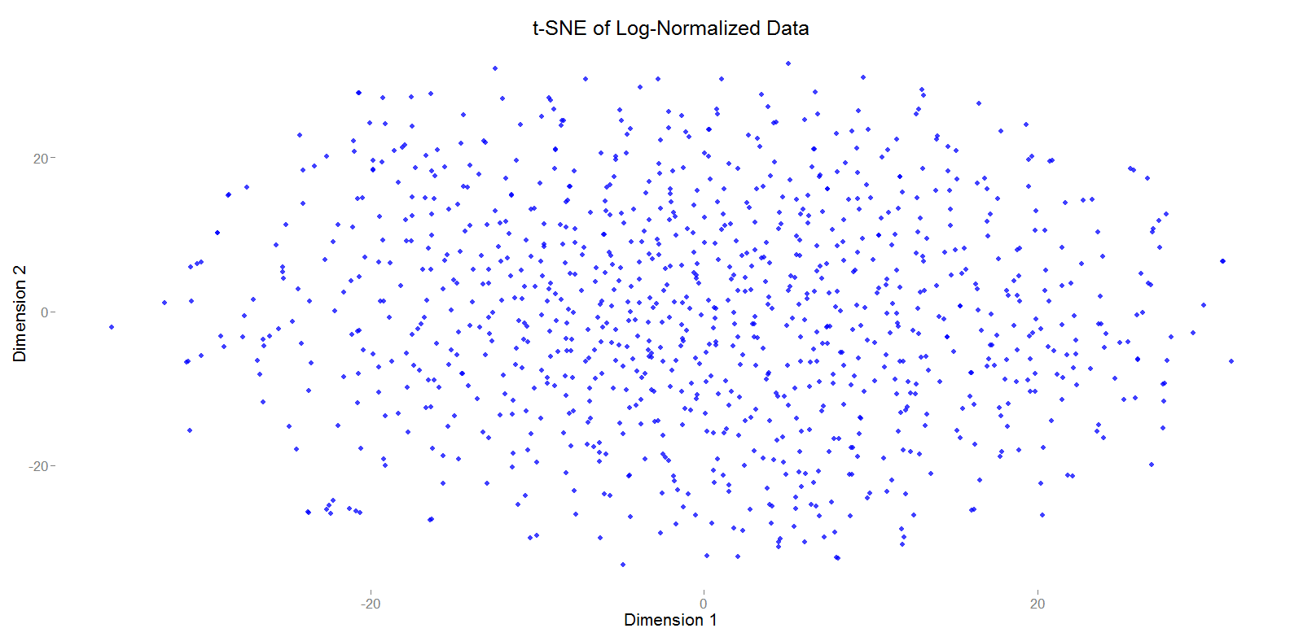
Actually visualizing clusters is difficult

Slide 10
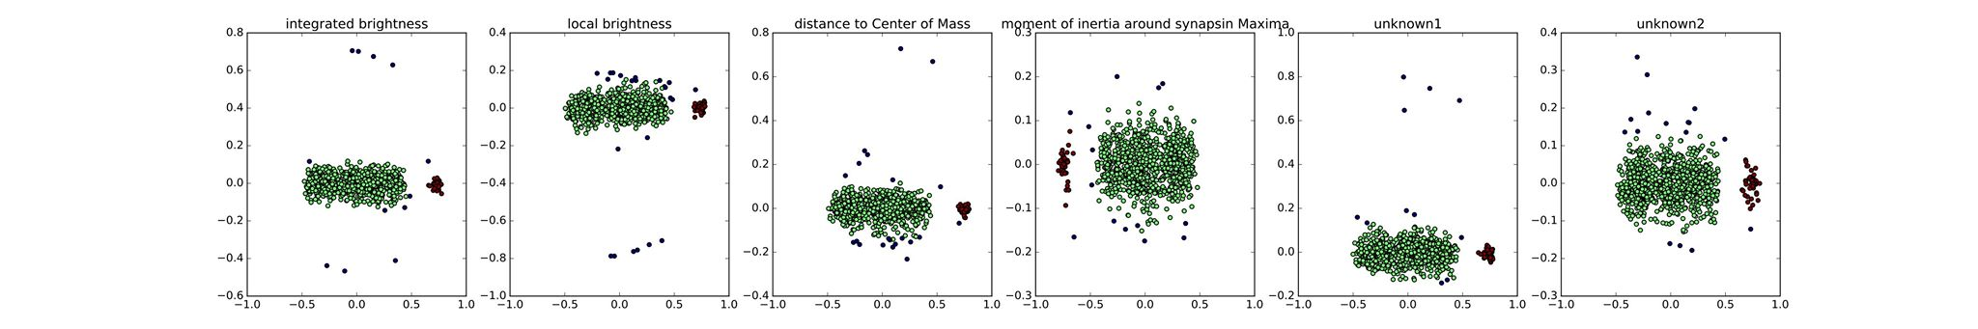
2D PCA embeddings of different marker columns always show an outlier set (black).
Are these really outliers?

Slide 11
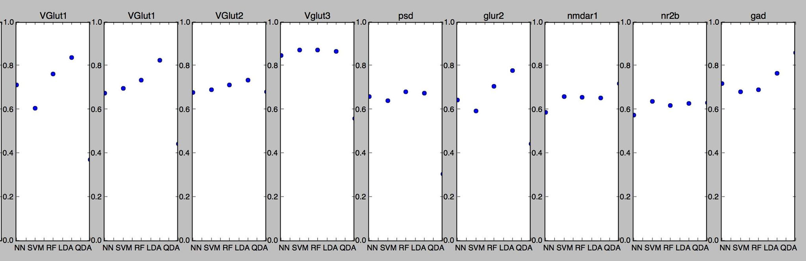
Can predict whether a marker’s intensity is above or below its median value using the other 23 markers.
Suggests protein co-expression → not independent

