Slide 1
Synaptic Diversity
Kevin Huang, Edric Tam, Ivan Kuznetsov

Slide 2
Significance
Synaptic dysfunction can cause many different kinds of diseases such as fragile X and Rett Syndrome (affects 1,000,000s of people)
No previous attempt to classify synapses into sub-groups beyond excitatory/inhibitory and neurotransmitter type
In this study → well-validated markers and array tomography
Unprecedented scale and resolution for our data analysis
New insight into types of synapses

Slide 3
Dataset
Dimensions: 1119299x96.
Row corresponds to synapse
Features correspond to 24 immunostained markers with 4 columns for each describing:
Integrated intensity
Localized intensity
Center of mass of synapse
Moment of inertia of synapse

Slide 4
Goals
Explore properties of the dataset
Cluster the synapses

Slide 5
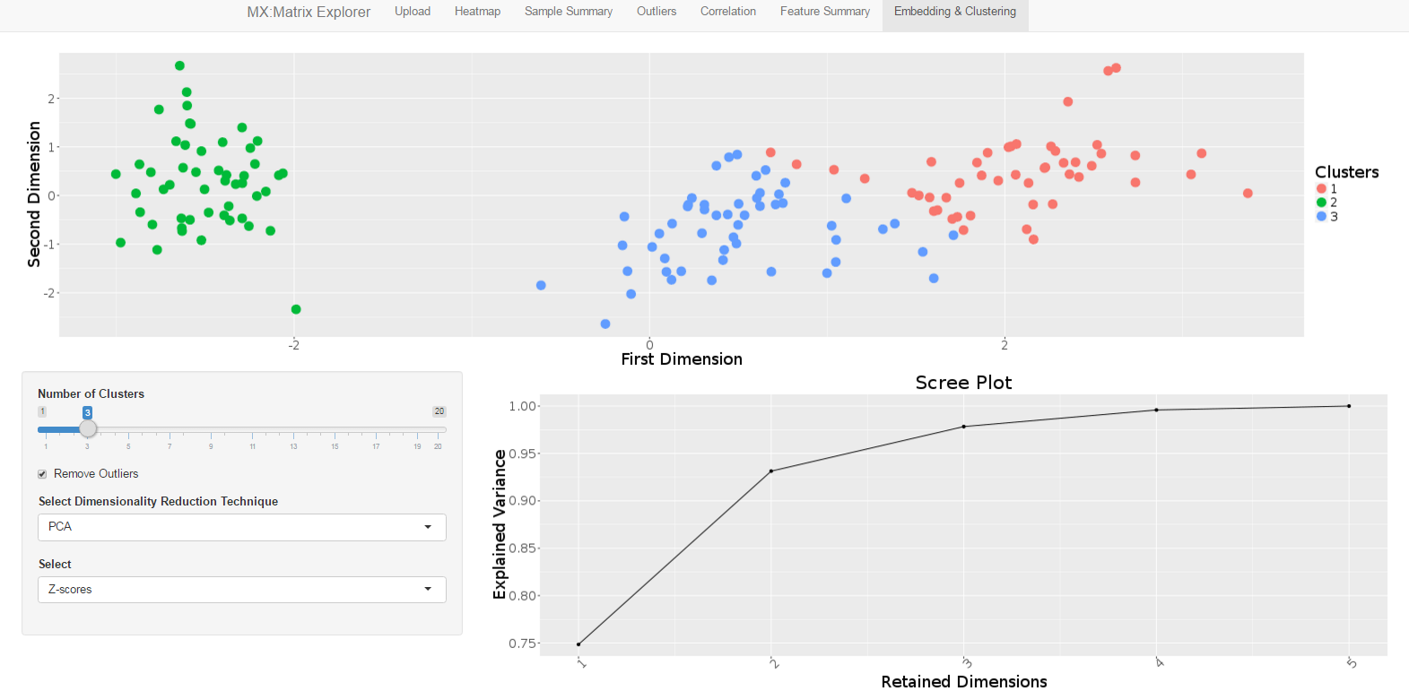

Slide 6
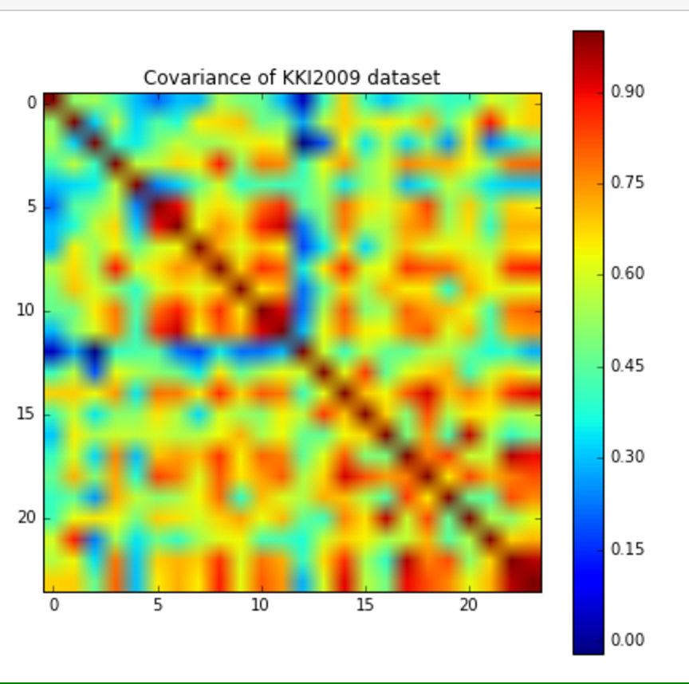
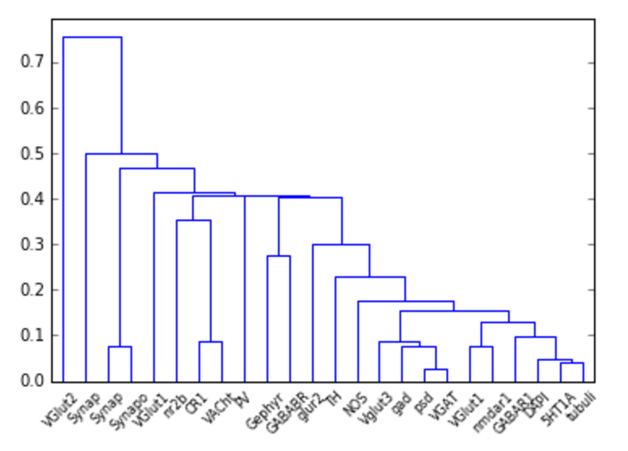
Exploration of Data (Cycle 1: Linear-Normalized)
Correlation Matrix for Integrated Brightness
Hierarchical Clustering on Matrix

Slide 7
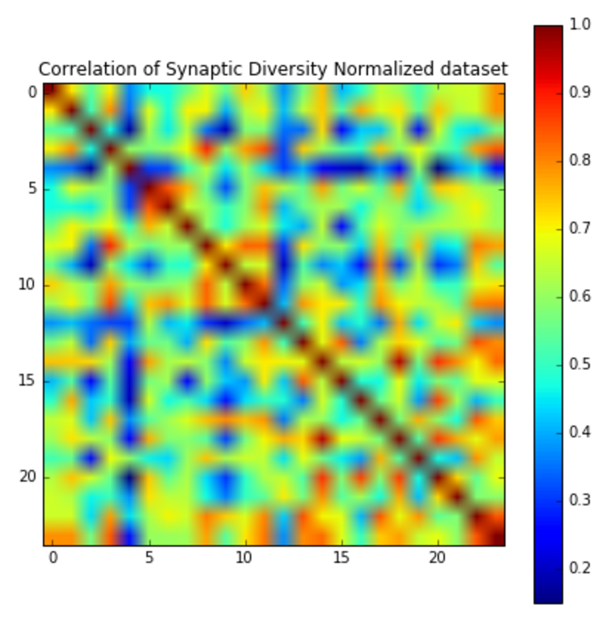
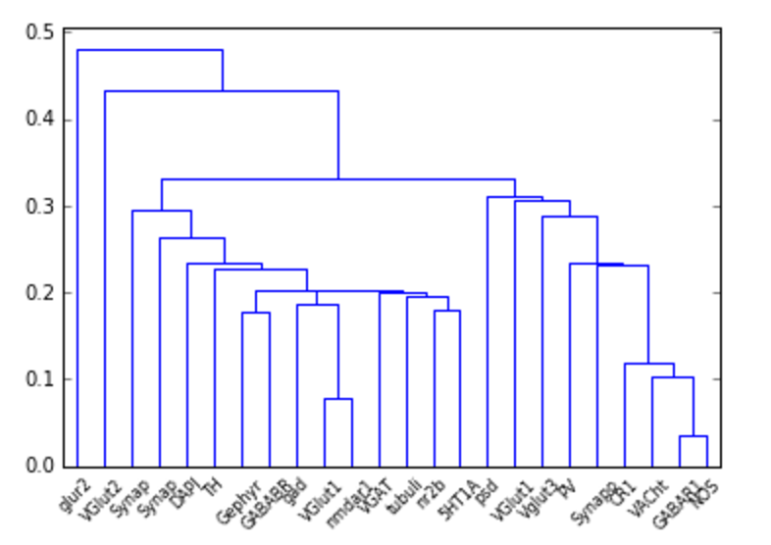
Exploration of Data (Cycle 2: Log-Normalized)
Hierarchical Clustering on Matrix

Slide 8
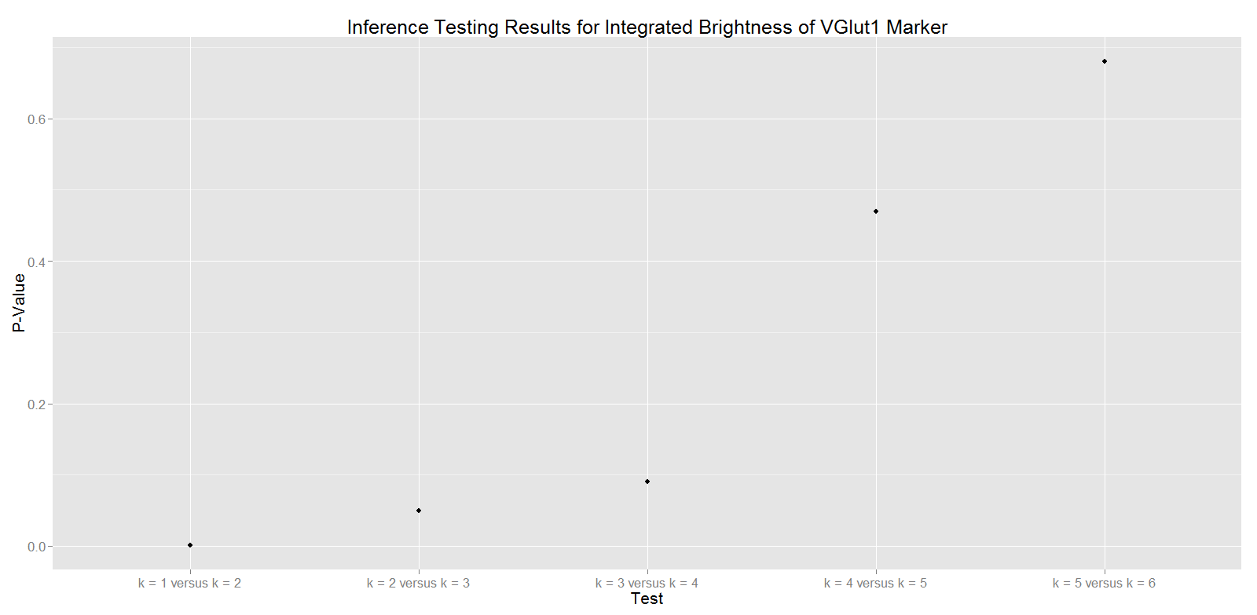

Inference Testing for Clusters
Suggests clusters within feature columns

Slide 9
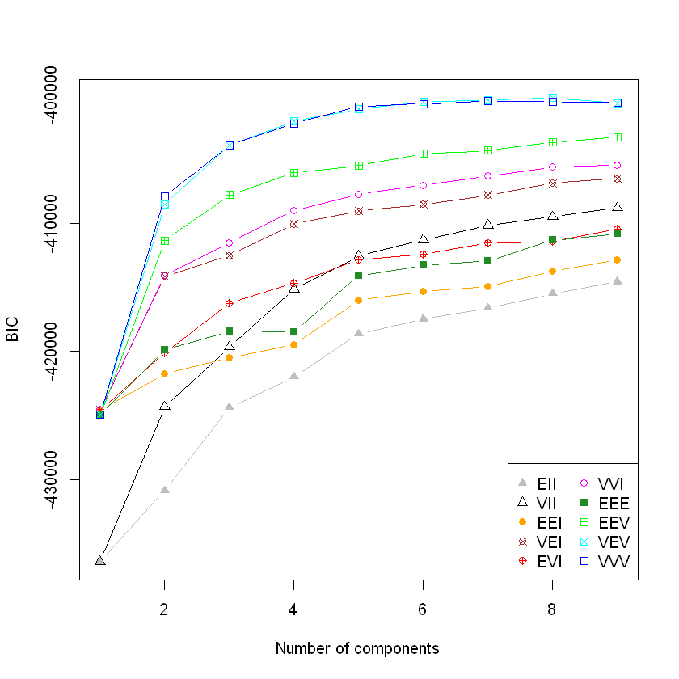
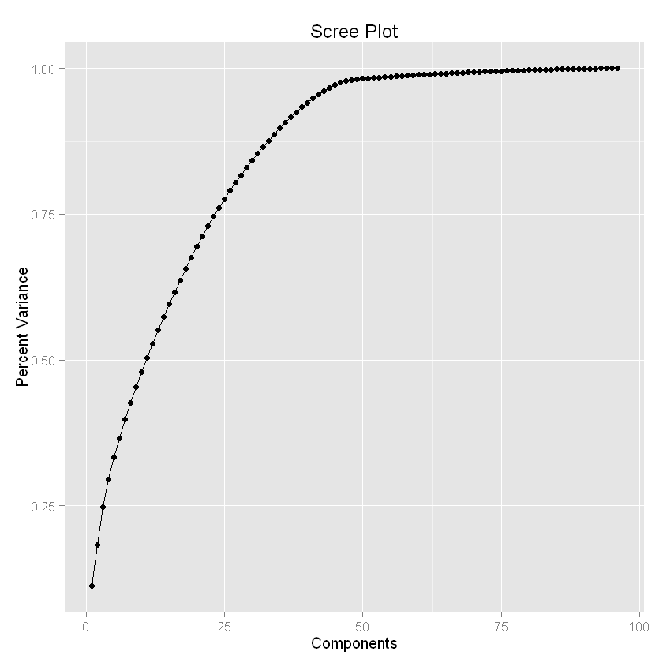
BIC Evidence for Clusters
BIC after PCA down to 10 dimensions
BIC suggests clusters across all features in the set

Slide 10
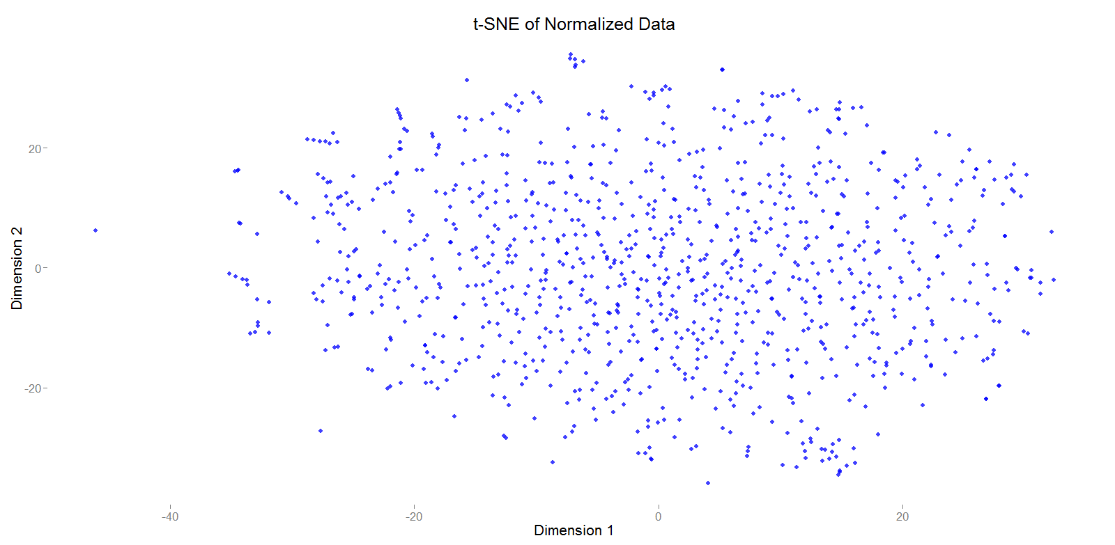
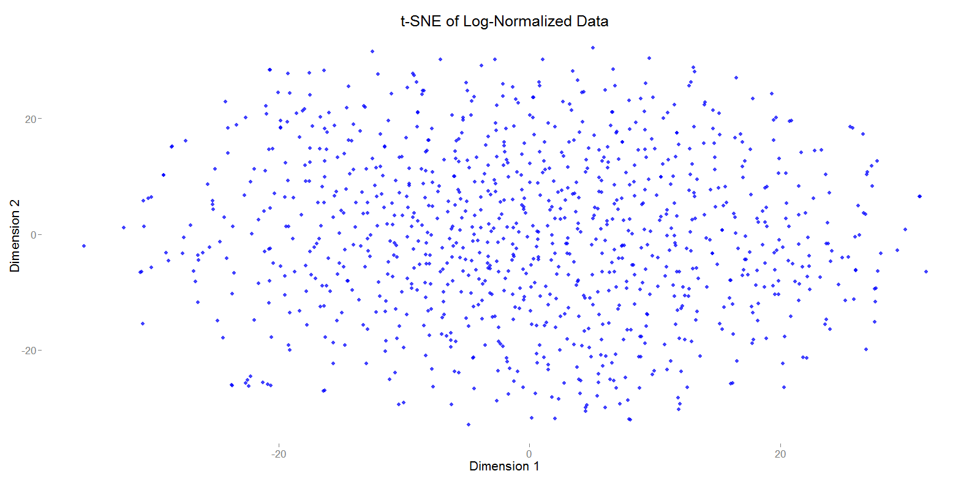
Actually visualizing clusters is difficult

Slide 11
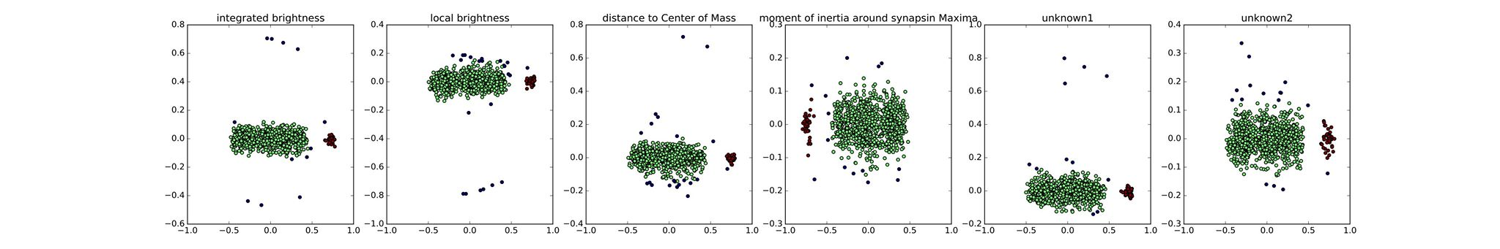
2D PCA embeddings of different marker columns always show an outlier set (black).
Are these really outliers?

Slide 12
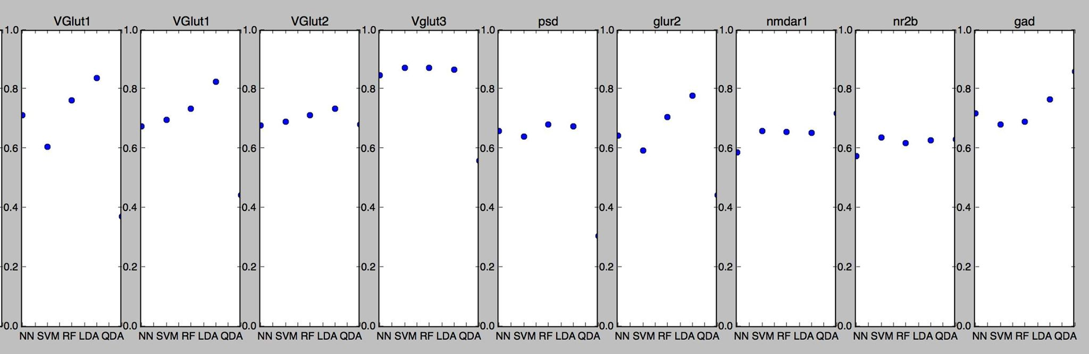
Can predict whether a marker’s intensity is above or below its median value using the other 23 markers.
Suggests protein co-expression → not independent

